Slide 1
Introduction to
OOAD and UML

Slide 2
Object Oriented Analysis and Design (OOA&D)
Object oriented Analysis and Design refers to the analysis and design of a system based on the concepts of object orientation.
UML is a diagrammatic approach to model the software to be developed.
OOAD with UML / Session 1 / <number> of 27

Slide 3
SDLC
Software Development Life Cycle (SDLC) is a sequence of activities carried out by analyst, designers, and users to develop and implement an information system.
Analyst – Studies requirements
Designer – Designs the system
User – An entity
OOAD with UML / Session 1 / <number> of 27

Slide 4
Object Oriented Analysis (OOA)
Phase of the project during which a precise and concise model of the problem in terms of real world objects and concepts as understood by the user is developed.
The analysis must also identify the relevant characteristics, interactions and relations between the entities.
This kind of real life mapping to computer analysis is the advantage offered by the Object Oriented Analysis.
OOAD with UML / Session 1 / <number> of 27

Slide 5
Object Oriented Design (OOD)
Programs are organized as co-operative collections of objects.
The purpose of Object Oriented Design is to adapt the results of OOA phase.
Designer defines the responsibilities, operations attributes and relationships of one or several classes.
Designer also designs the database and applies normalization techniques.
Diagrams can be classified into static or dynamic.
OOAD with UML / Session 1 / <number> of 27

Slide 6
Advantages of OOA&D over Traditional Analysis and Design
Close match between what is being implemented and the actual problem.
Promotes reuse of objects
Since reuse of objects is possible, it reduces errors and maintenance problems.
Reuse of objects also speeds up the process of design and development.
Propagates data encapsulation
Helps to handle the complexity of software development and aids generation of adaptable and resilient software systems.
OOAD with UML / Session 1 / <number> of 27

Slide 7
Modeling
A model is a simplification of reality
Provides the blueprints of a system
Models may encompass detailed plans
A good model includes those elements that have broad abstraction.
Helps to visualize a system as it is or according to the need.
Models permit to specify the structure or behavior of a system.
Models give a template that guides in constructing a system.
Models document the decisions that have been made
OOAD with UML / Session 1 / <number> of 27

Slide 8
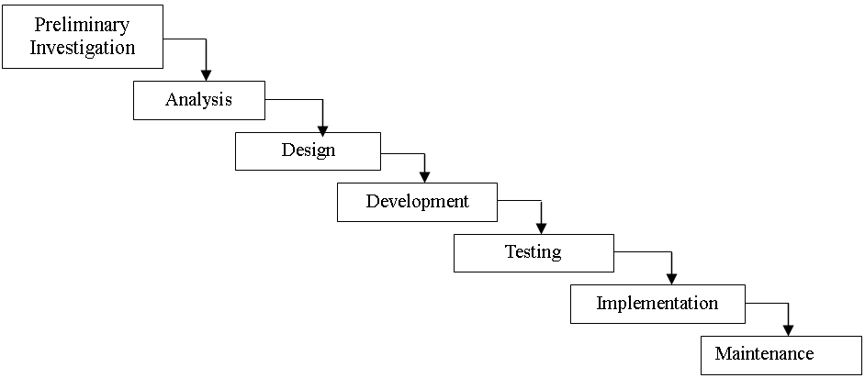
SDLC Phases
OOAD with UML / Session 1 / <number> of 27

Slide 9
SDLC Phases
Preliminary Investigation (Feasibility Study)
  An important outcome of the preliminary investigation is
determining whether the system to be developed is feasible
or not.
Requirement Analysis (Analysis)
  Involves study of the current business system in detail and to
find out how it works and where the improvements have to
be made.
OOAD with UML / Session 1 / <number> of 27

Slide 10
SDLC Phases
Design of the System
  The design phase states how a system will meet the requirements identified during the systems analysis phase as mentioned in the Requirements Specifications.
  Identification of data entry forms, data elements, reports, outputs the new system should produce, data elements and tables for database.
  Sketch the form or display as expected to appear at the end of completion of the system.
  Computation procedures explaining the process of deriving the output from given input.
OOAD with UML / Session 1 / <number> of 27

Slide 11
SDLC Phases
Software Construction
  Actual construction (coding) of the programs
System Testing
  After the programs are tested individually, the system as a whole needs to be tested.
  All the software modules are integrated and tested to ensure that they do not fail i.e. it will run according to specifications as mentioned in requirement specification document and in the way the users expected it to.
  Special test data is prepared as input for processing and the results are examined to find out any deviations from the desired results.
OOAD with UML / Session 1 / <number> of 27

Slide 12
SDLC Phases
System Implementation
  Developed system is deployed at the user’s site for use
  User personnel are trained
  The data files needed by the system are constructed
System Maintenance
  Due to environmental changes, the software may turn obsolete and it may call for modifications and enhancements for its effective use.
  The activity of system maintenance may vary depending on the scale of modifications and enhancements.
OOAD with UML / Session 1 / <number> of 27

Slide 13
What is UML?
Unified Modeling Language
  OMG Standard, Object Management Group
  Based on work from Booch, Rumbaugh, Jacobson
UML is a modeling language to express and design documents, software
  Particularly useful for OO design
  Independent of implementation language
OOAD with UML / Session 1 / <number> of 27

Slide 14
Why use UML
Open Standard, Graphical notation for
  Specifying, visualizing, constructing, and documenting software systems
Language can be used from general initial design to very specific detailed design across the entire software development lifecycle
Increase understanding/communication of product to customers and developers
Support for diverse application areas
Support for UML in many software packages today (e.g. Rational, plugins for popular IDE’s like NetBeans, Eclipse)
Based upon experience and needs of the user community

Slide 15
Brief History
Inundated with methodologies in early 90’s
  Booch, Jacobson, Yourden, Rumbaugh
Booch, Jacobson merged methods 1994
Rumbaugh joined 1995
1997 UML 1.1 from OMG includes input from others, e.g. Yourden
UML v2.0 current version

Slide 16
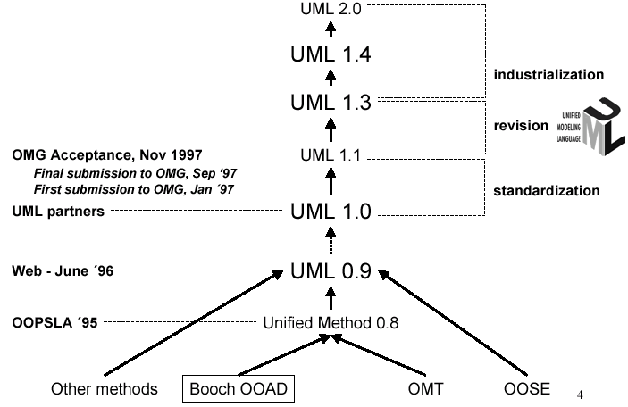
History of UML

Slide 17
UML Baseline
Use Case Diagrams
Class Diagrams
Interaction Diagrams
  Sequence
  Collaboration
Activity Diagrams
State Transition Diagrams

Slide 18
Use Case Diagrams
Used during requirements elicitation to represent external behavior
Actors represent roles, that is, a type of user of the system
Use cases represent a sequence of interaction for a type of functionality; summary of scenarios
The use case model is the set of all use cases. It is a complete description of the functionality of the system and its environment
Passenger
PurchaseTicket

Slide 19
Actors
An actor models an external entity which communicates with the system:
  User
  External system
  Physical environment
An actor has a unique name and an optional description.
Examples:
  Passenger: A person in the train
  GPS satellite: Provides the system with GPS coordinates
Passenger

Slide 20
Use Case
A use case represents a class of functionality provided by the system as an event flow.
A use case consists of:
Unique name
Participating actors
Entry conditions
Flow of events
Exit conditions
Special requirements
PurchaseTicket

Slide 21
Use Case Diagram: Example
Event flow:
1. Passenger selects the number of zones to be traveled.
2. Distributor displays the amount due.
3. Passenger inserts money, of at least the amount due.
4. Distributor returns change.
5. Distributor issues ticket.
Name: Purchase ticket
Participating actor: Passenger
Entry condition:
Passenger standing in front of ticket distributor.
Passenger has sufficient money to purchase ticket.
Exit condition:
Passenger has ticket.

Slide 22
Use Case Diagram: Example
Passenger
PurchaseTicket

Slide 23
Use Case Diagrams: Summary
Use case diagrams represent external behavior
Use case diagrams are useful as an index into the use cases
Use case descriptions provide meat of model, not the use case diagrams.
All use cases need to be described for the model to be useful.

Slide 24
Class Diagrams
Gives an overview of a system by showing its classes and the relationships among them.
Also shows attributes and operations of each class
Good way to describe the overall architecture of system components

Slide 25
Classes – Not Just for Code
Name
TariffSchedule
TariffSchedule
Attributes
Table zone2price
Enumeration getZones()
Price getPrice(Zone)
zone2price
getZones()
getPrice()
Operations
TariffSchedule
A class represent a concept
A class encapsulates state (attributes) and behavior (operations).
Each attribute has a type.
Each operation has a signature.
The class name is the only mandatory information.

Slide 26
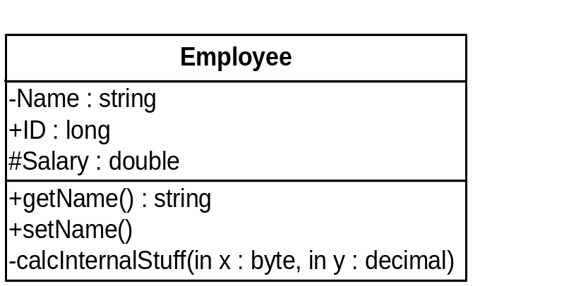
UML Class Notation
A class is a rectangle divided into three parts
  Class name
  Class attributes (i.e. data members, variables)
  Class operations (i.e. methods)
Modifiers
  Private: -
  Public: +
  Protected: #
  Static: Underlined (i.e. shared among all members of the class)
Abstract class: Name in italics

Slide 27
UML Class Notation
Lines or arrows between classes indicate relationships
  Association
    A relationship between instances of two classes, where one class must know about the other to do its work, e.g. client communicates to server
    indicated by a straight line or arrow
  Aggregation
    An association where one class belongs to a collection, e.g. instructor part of Faculty
    Indicated by an empty diamond on the side of the collection
  Composition
    Strong form of Aggregation
    Lifetime control; components cannot exist without the aggregate
    Indicated by a solid diamond on the side of the collection
  Inheritance
    An inheritance link indicating one class a superclass relationship, e.g. bird is part of mammal
    Indicated by triangle pointing to superclass

Slide 28

Binary Association
Binary Association: Both entities “Know About” each other
myB.service();
myA.doSomething();
Optionally, may create an Associate Class

Slide 29

Unary Association
A knows about B, but B knows nothing about A
myB.service();
Arrow points in direction
of the dependency

Slide 30

Aggregation
Aggregation is an association with a “collection-member” relationship
void doSomething()
aModule.service();
Hollow diamond on
the Collection side
No sole ownership implied

Slide 31
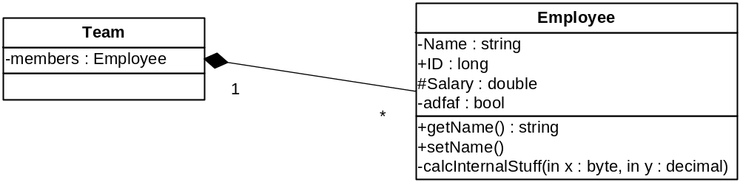
Composition
Composition is Aggregation with:
Lifetime Control (owner controls construction, destruction)
Part object may belong to only one whole object
members[0] =
new Employee();
…
delete members[0];
Filled diamond on side of the Collection

Slide 32
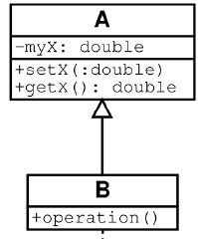
Inheritance
Standard concept of inheritance
Base Class
Derived Class
class B() extends A
…

Slide 33
UML Multiplicities
Links on associations to specify more details about the relationship
Multiplicities | Meaning
0..1 | zero or one instance. The notation n . . m indicates n to m instances.
0..* or * | no limit on the number of instances (including none).
1 | exactly one instance
1..* | at least one instance

Slide 34
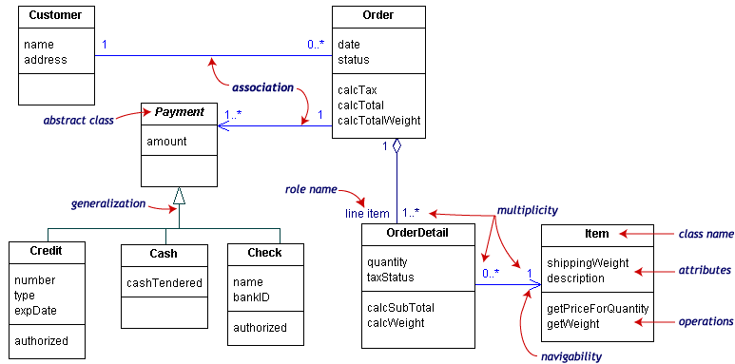
UML Class Example

Slide 35
Interaction Diagrams
Interaction diagrams are dynamic -- they describe how objects collaborate.
A Sequence Diagram:
  Indicates what messages are sent and when
  Time progresses from top to bottom
  Objects involved are listed left to right
  Messages are sent left to right between objects in sequence

Slide 36
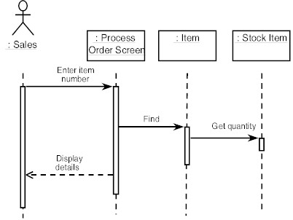
Sequence Diagram Format
Objects
Actor from
Use Case
1
Activation
2
3
4
Lifeline
Calls = Solid Lines
Returns = Dashed Lines

Slide 37
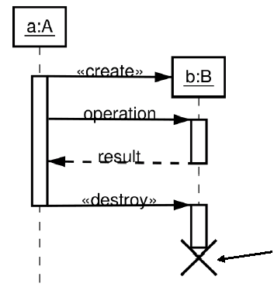
Sequence Diagram : Destruction
Shows Destruction of b
(and Construction)

Slide 38
Collaboration Diagram
Collaboration Diagrams show similar information to sequence diagrams, except that the vertical sequence is missing. In its place are:
  Object Links - solid lines between the objects that interact
  On the links are Messages - arrows with one or more message name that show the direction and names of the messages sent between objects
Emphasis on static links as opposed to sequence in the sequence diagram

Slide 39
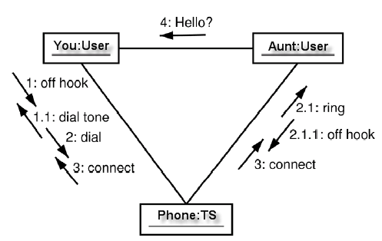
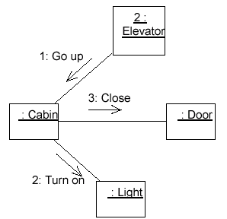
Collaboration Diagram

Slide 40


Activity Diagrams
Fancy flowchart
  Displays the flow of activities involved in a single process
  States
    Describe what is being processed
    Indicated by boxes with rounded corners
  Swim lanes
    Indicates which object is responsible for what activity
  Branch
    Transition that branch
    Indicated by a diamond
  Fork
    Transition forking into parallel activities
    Indicated by solid bars
  Start and End

Slide 41
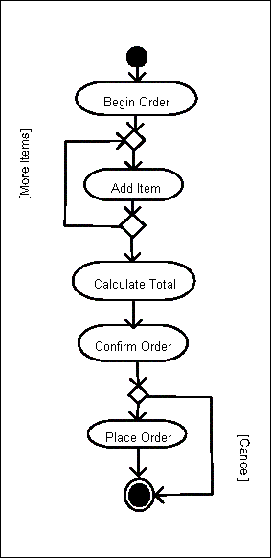
Sample Activity Diagram
Ordering System
May need multiple diagrams from other points of view

Slide 42

Activity Diagram Example

Slide 43
State Transition Diagrams
Fancy version of a DFA
Shows the possible states of the object and the transitions that cause a change in state
  i.e. how incoming calls change the state
Notation
  States are rounded rectangles
  Transitions are arrows from one state to another. Events or conditions that trigger transitions are written beside the arrows.
  Initial and Final States indicated by circles as in the Activity Diagram
    Final state terminates the action; may have multiple final states

Slide 44
State Representation
The set of properties and values describing the object in a well defined instant are characterized by
  Name
  Activities (executed inside the state)
    Do/ activity
  Actions (executed at state entry or exit)
    Entry/ action
    Exit/ action
  Actions executed due to an event
    Event [Condition] / Action ^Send Event

Slide 45
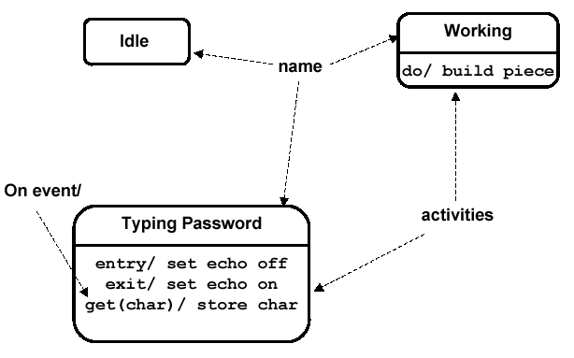
Notation for States

Slide 46
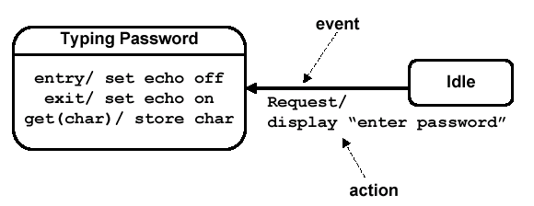
Simple Transition Example

Slide 47
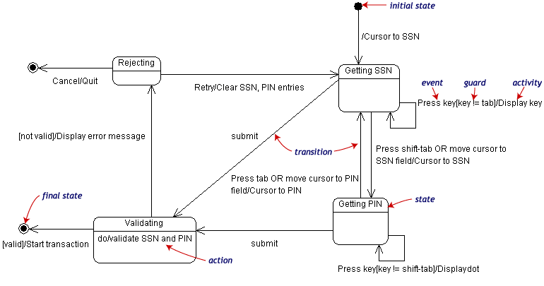
State Transition Example
Validating PIN/SSN

Slide 48
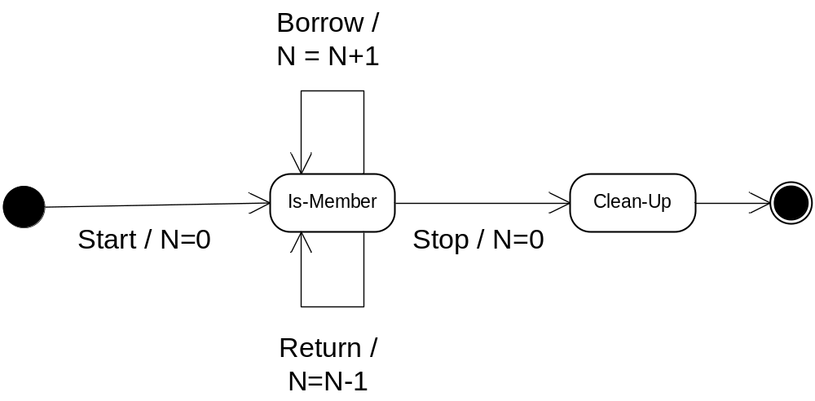
State Charts – Local Variables
State Diagrams can also store their own local variables, do processing on them
Library example counting books checked out and returned

