Slide 1


DDOS Detection Tool by Ashish Yadav abhishek NINGALA Under Guidance of: Dr. Carlos Mex-Perera
Notes:
The purpose of this presentation is to discuss about Distributed Denial of service (DDOS) attacks and look at a particular python-based tool which can detect any such DDoS attacks.

Slide 2

Introduction: Pcap file
The Pcap file extension is an abbreviation of packet capture. These files consist of network traffic (network data), which can be analyzed for different purposes.
The format of a pcap file is binary and it can provide timestamps with nano-second precision. The default format now is pcap Next Generation Capture file format (pcap-ng) which is also backward compatible with previous formats.
The most common uses of pcap are in detection of malicious DHCP servers, monitoring bandwidth, tracking the flow of malicious traffic to identify at which place the malware has breached the network, DNS resolution and incident response.
Notes:
The .pcap file extension is mainly associated with Wireshark; a program used for analyzing networks. These files are mainly used in analyzing the network characteristics of a certain data. These files also contribute to successfully controlling traffic of a certain network since they are being monitored by the program. The data and the results of the network analysis are saved using the .pcap file extension which is why they are called PCAP files. These files are used to determine network status, allowing analyzers to attend to problems that may have occurred on the network, and consequently allowing them to study data communications using network forensic tools.

Slide 3
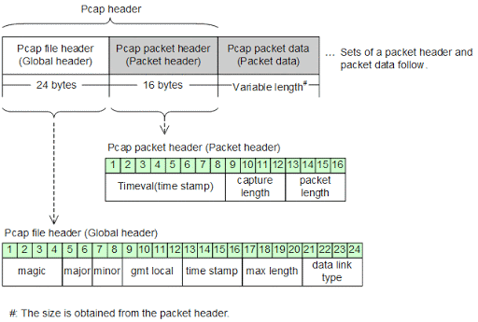
pcap file format and tools
Both commercial and open source are available for processing pcap data, but the most common tool is Wireshark. Other tools are:
WANDA
Tcptrace
dpkt (python packet creation/parsing library)
HttpSniffer
EtherApe
Snort (open source IDS/IPS)
Bro (Unix-based NIDS)
NetworkMiner (Windows based network forensic tool)
WinDump
Tcpdump
Packet Square – Capedit
Ethereal
Soundtap
Notepad
Pcap format
Notes:
The two main components of PCAP file are Global header and Packet header with sizes 24 bytes and 16 bytes respectively. This is the basic format and has not changed since 1998. There are many tools available for packet capture analysis as seen in this slide. The most famous tools are Wireshark, Tcpdump, and NetworkMiner

Slide 4
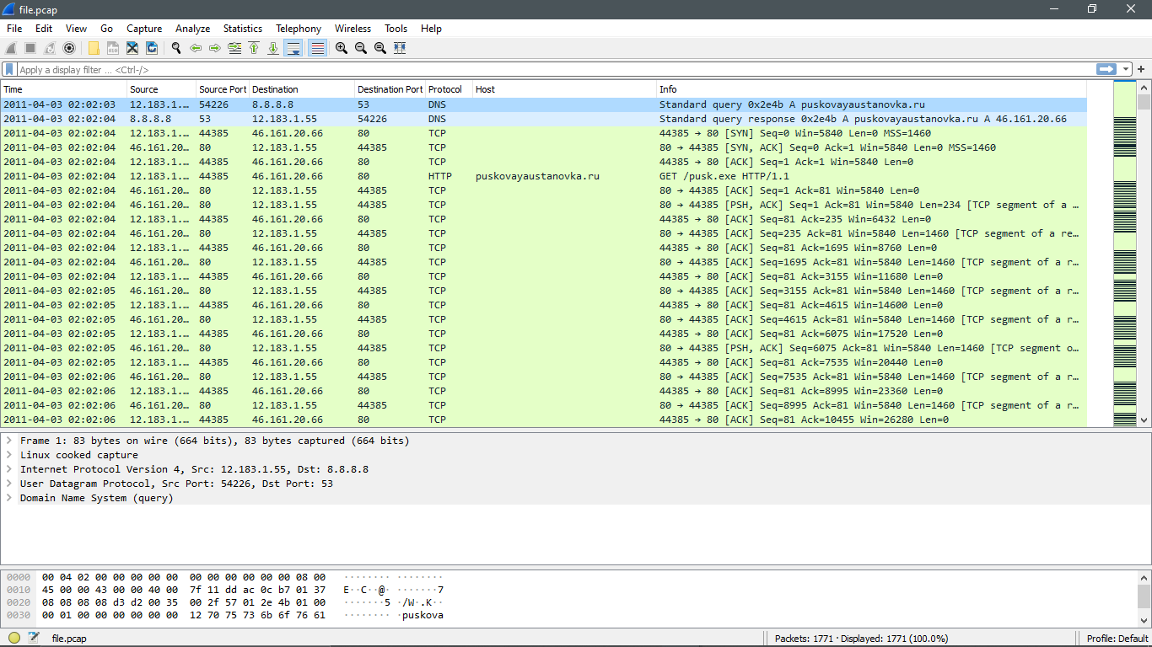
PCAP file example
Notes:
In this slide, we can see a pcap file is opened using Wireshark. The main goal of Wireshark to have a look at all the traffic on the network. There can be tons of information which can be inferred. We can see the time information regarding when a particular packet was sent or arrived on our interface. The source and destination IP address and port numbers can be viewed. Also, we can learn which protocol was being used and the actual length of the packet. Additional information regarding layers of the protocol stack can be found in the lower part of Wireshark.

Slide 5
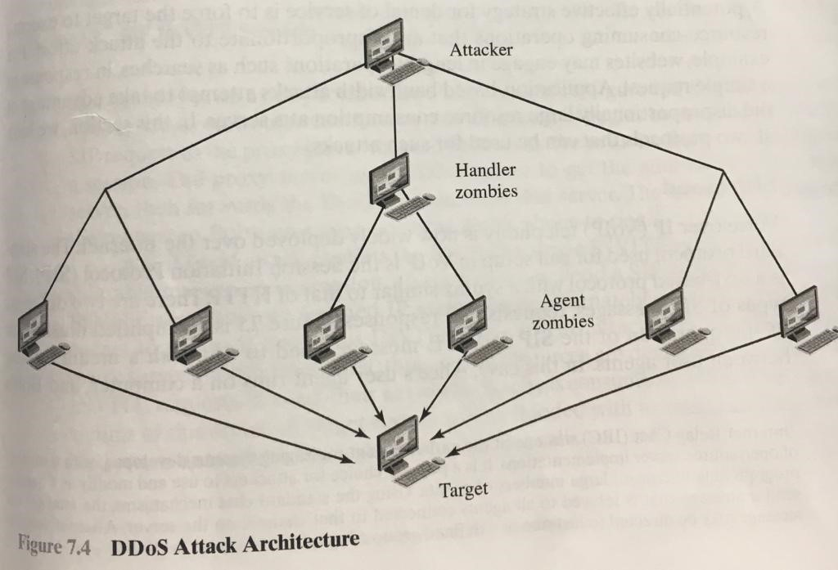
DDoS Attack
“A Denial-of-service (DOS) attack is an action that prevents or impairs the authorized use of network systems or applications by exhausting resources such as CPU, memory, bandwidth, and disk space.”
Notes:
When Denial of service attacks are carried by multiple systems as opposed to a single system it is known as a Distributed Denial of Service (DDOS) attack. Typically, these other systems are malware compromised systems which are under the control of an attacker. These systems are known as zombies and a large collection of these zombies are known a botnet. For better control, instead of individually controlling each of these systems, attacker makes a small number of systems as Handler zombies which in turn control the individual systems (zombies). The attacker now only needs to send a single command to the handler zombie to get the job done! Nowadays instead of handler programs, Internet Chat Relay (IRC), instant messenger server programs or Web-base HTTP servers can be used to communicate to the agents.

Slide 6

DDoS Attack Categories
From the definition we have seen in the previous slide, DOS attacks can be categorized based on the resources that could be attacked:
Network Bandwidth
System Resources
Application Resources
Notes:
Network Bandwidth: In these kinds of DOS attacks, unusual amounts of traffic is sent to the targeted networks. Due to such high loads of traffic, the target router will drop packets which it cannot handle. When such traffic is directed towards servers, legitimate users are denied access to these servers due to overwhelming amounts of traffic. Examples are TCP flood, UDP flood etc.
System Resources: In these kinds of DOS attacks, the main goal is to crash the network handling services. Rather than consuming network bandwidth, these attacks include sending of specially crafted packets which consume the limited amount of resources available on the system.
Application Resources: In these kinds of DOS attacks, specific applications are targeted such as which consists of some known vulnerability. For example: a buffer overflow vulnerability can be exploited by sending more data than a application expects thereby crashing the application. Examples are Slowloris, HTTP flood etc.

Slide 7
Common DDoS Attacks
Some of the most common DDoS attacks are flooding attacks which are as follows:
UDP Flood
ICMP (Ping ) Flood
SYN Flood
DNS Flood or Amplification
Notes:
UDP Flood: A UDP flood, by definition, is any DDoS attack that floods a target with User Datagram Protocol (UDP) packets. The goal of the attack is to flood random ports on a remote host. This causes the host to repeatedly check for the application listening at that port, and (when no application is found) reply with an ICMP ‘Destination Unreachable’ packet. This process saps host resources, which can ultimately lead to inaccessibility.
ICMP (Ping) Flood: Similar in principle to the UDP flood attack, an ICMP flood overwhelms the target resource with ICMP Echo Request (ping) packets, generally sending packets as fast as possible without waiting for replies. This type of attack can consume both outgoing and incoming bandwidth, since the victim’s servers will often attempt to respond with ICMP Echo Reply packets, resulting a significant overall system slowdown.
SYN Flood: A SYN flood DDoS attack exploits a known weakness in the TCP connection sequence (the “three-way handshake”), wherein a SYN request to initiate a TCP connection with a host must be answered by a SYN-ACK response from that host, and then confirmed by an ACK response from the requester. In a SYN flood scenario, the requester sends multiple SYN requests, but either does not respond to the host’s SYN-ACK response or sends the SYN requests from a spoofed IP address. Either way, the host system continues to wait for acknowledgement for each of the requests, binding resources until no new connections can be made, and ultimately resulting in denial of service.
DNS flood or amplification attack: This DDoS attack is a reflection-based volumetric distributed denial-of-service (DDoS) attack in which an attacker leverages the functionality of open DNS resolvers in order to overwhelm a target server or network with an amplified amount of traffic, rendering the server and its surrounding infrastructure inaccessible.

Slide 8
DDoS Attack defenses
The best defenses against participating in such kinds of DDOS attacks is to avoid being compromised by the attacker by ensuring our systems are patched and anti-virus software being UpToDate.
In a corporate environment, it is complicated to defend against these attacks, However, some of the measures as below can help:
Having a DDOS incident response and resilience plan ready
Early detection of DDOS network activity
Delegating the risk by hiring a DDOS mitigation provider
Hiring Cloud Scrubbing services for E-commerce sites
Maintain strong Network Architecture and secure your network infrastructure
Notes:
In this Slide, we look at some of the DDOS attack defenses at both personal level and in a Corporate Environment.

Slide 9
Motivation behind DDoS Attack
DDoS attacks are quickly becoming the most prevalent type of cyber threat, growing rapidly in the past year in both number and volume according to recent market research. The trend is towards shorter attack duration, but bigger packet-per-second attack volume. Attackers are primarily motivated by:
Ideology
Business feuds
Boredom
Extortion
Cyber warfare
Notes:
Ideology – So called “hacktivists” use DDoS attacks as a means of targeting websites they disagree with ideologically.
Business feuds – Businesses can use DDoS attacks to strategically take down competitor websites, e.g., to keep them from participating in a significant event, such as Cyber Monday.
Boredom – Cyber vandals, a.k.a., “script-kiddies” use prewritten scripts to launch DDoS attacks. The perpetrators of these attacks are typically bored, would-be hackers looking for an adrenaline rush.
Extortion – Perpetrators use DDoS attacks, or the threat of DDoS attacks as a means of extorting money from their targets.
Cyber warfare – Government authorized DDoS attacks can be used to both cripple opposition websites and an enemy country’s infrastructure.

Slide 10


Partial Objective 1: Opening Pcap File
First, the “argparse” module is used to get the pcap file name from the command line.
The argparse module defines what arguments it requires and will figure out how to parse those out of sys.argv.
Parse_args() inspects the command line, convert each argument to the appropriate type and then invoke the appropriate action.
File_name is given as args.pcap so that when pcap file is found within the given path, the file is processed successfully.
Notes:
Argparse automatically generates Help, and Usage information when users provide invalid arguments. Filling an ArgumentParser with information about program arguments is done by making calls to the add_argument() method.

Slide 11
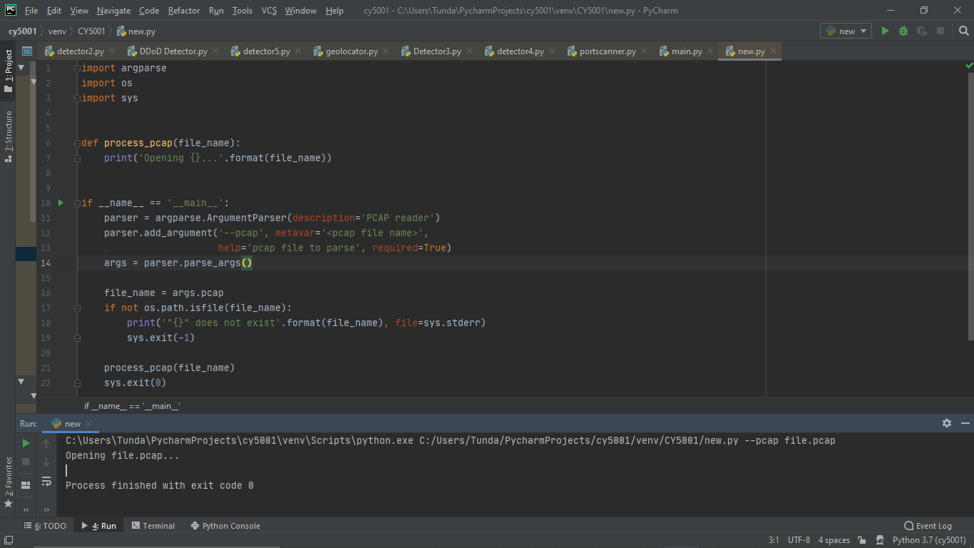
Partial Objective 1: Opening Pcap File
Notes:
In this slide, we imported argparse, os and sys modules so that we can successfully give the file name and ArgumentParser can successfully find the path and open the PCAP file.

Slide 12
Partial Objective 2: Printing packets of Pcap File
The RawPcapReader class is provided by the scapy module. This class is iterable, and in each iteration it yields the data (i.e., packet contents) and metadata (i.e., timestamp, packet number etc.) for every packet in the capture.
After counting the packets through this module, the pcap file was opened in Wireshark to verify if the packet count in our program is consistent with that reported by Wireshark.
Notes:
For this objective, we use raw RawPcapReader class which is provided by the scapy module. The benefit of this class is that it is iterable and it can provide data and metadata for every packet in the capture.

Slide 13
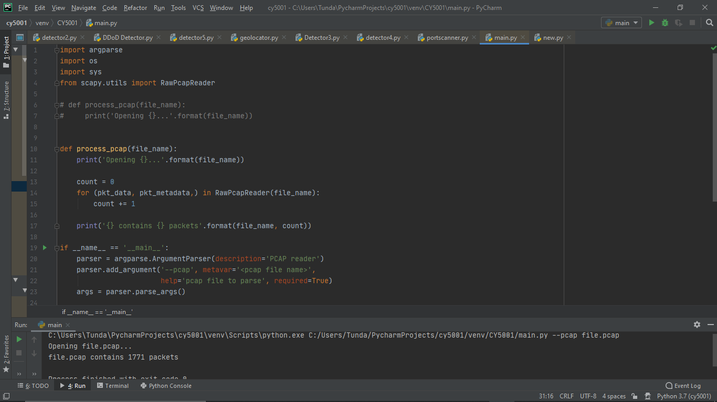
Printing packets of Pcap File
Notes:
Here, we can see that for printing packets of PCAP file we imported the module scapy.utils and that module gave us RawPcapReader for opening and counting packets of a particular PCAP file. In this PCAP file we have 1771 packets which was verified with Wireshark.

Slide 14
Partial Objective 3: Printing Geo-locations of IP addresses
Imported GeoLite2 City database module to get the Geo-location.
The Geo-location information includes country, city, postal code, subdivision of a city’s name, latitude and longitude information.
Notes:
In the partial objective 3, we have printed the geolocations of a particular IP address which we found in the given PCAP file. So, for completing this task we imported the GeoLite2 City database module so that we can get country, and city postal codes and geolocation information of the PCAP file.

Slide 15
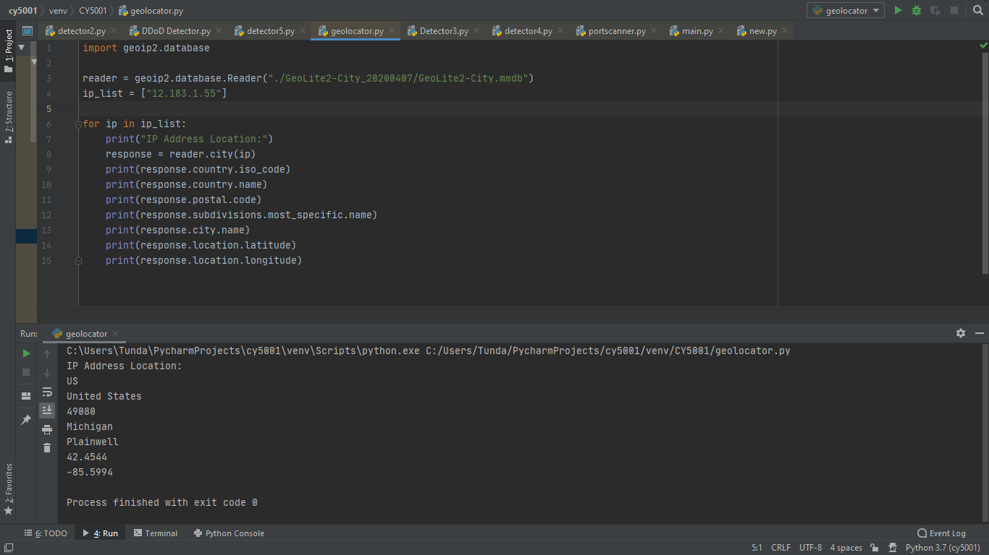
Printing Geo-locations of IP addresses
Notes:
As it is evident from this slide, we printed the geolocation information of a particular IP address which is 12.183.1.55. This IP address’s location was in US and city was Michigan. Also, we have successfully found the latitude and longitude of the IP address. We can also use argparse module and argparse arguments to give the IP address from the command line.

Slide 16
Final Script: Description of the criteria of DDoS Attack
In the final script, total count for each IP address is calculated to check which addresses tried to make numerous connections.
Secondly, the geo-location of each IP addresses is checked to decide duplicate or malicious IP addresses.
Thirdly, we check for TCP SYN flood attack, which is one of the common types of DDoS attack.
Notes:
As you can see in this slide while preparing the final script for making a networking tool which can successfully detect any DDOS attacks, the first step was to count the total IP addresses which were the hits in the pcap file. Next, the geolocation of each IP address was checked to decide whether it is duplicate or malicious IP address. Finally, we looked out for the TCP SYN flood attack which is one of the most common attacks.

Slide 17
Explanation of the final script
In the final script, first step is importing modules like scapy, argparse, os, sys, geoip2.database, json etc.
Secondly, the pcap file is opened using process_pcap and RawPcapReader is used to to read the pcap file for total packet count.
Thirdly, the IP count in the pcap file is initiated using Scapy and the data is put into a table and graph format using PrettyTable and Plotly.
Using geoip2.database, a Geo-locator class is defined to get location information such as city, country, longitude etc. of suspicious IP addresses. .
At the end, the script checks for a TCP-SYN flood attack as well as port scan based on TCP traffic in the PCAP file, and all the function were called at the end.
Notes:
In the final script the first step was to import all the related modules. Now , pcap file is opened using process_pcap and RawPcapReader which are the pcap readers to find the total packet count. Thirdly, the IP count in the pcap file is initiated using Scapy and we made table and graphs of that data using PrettyTable and Plotly. We can get geolocation by using Geo IP database of the suspicious IP addresses. Finally, the script is checked for TCP SYN attack as well as port scan so that all functions at end of the script were called and we looked into the data for particular DDOS attack.

Slide 18
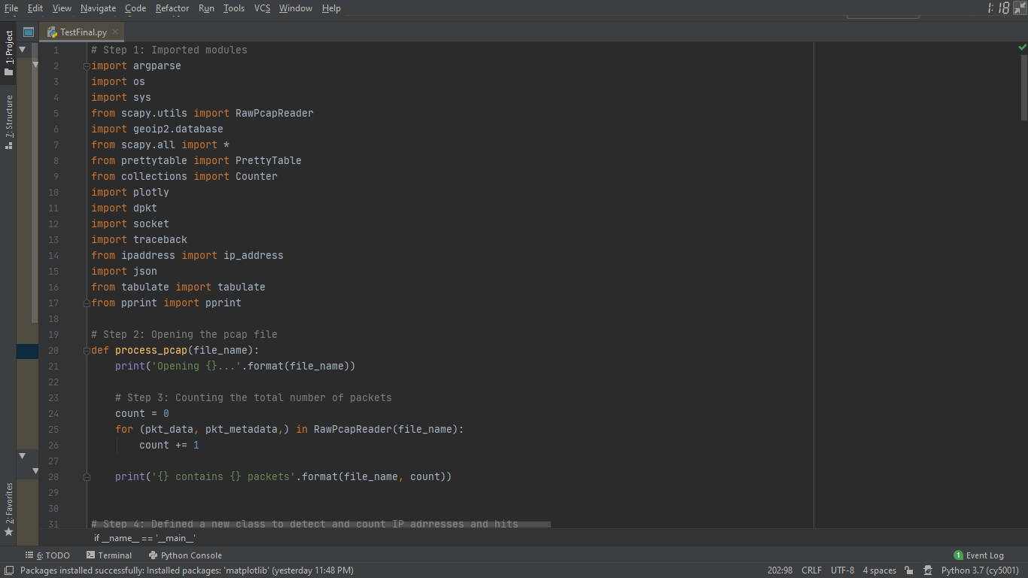
Demonstration of the final script
Notes:
From this slide, we can see we have imported a lot of modules which are required to successfully run the script. Here, we use scapy, geoip2.database, plotly, json and tabulate so that we can build graphs and table to show how IP address packet count and attacks on ports and hosts.

Slide 19
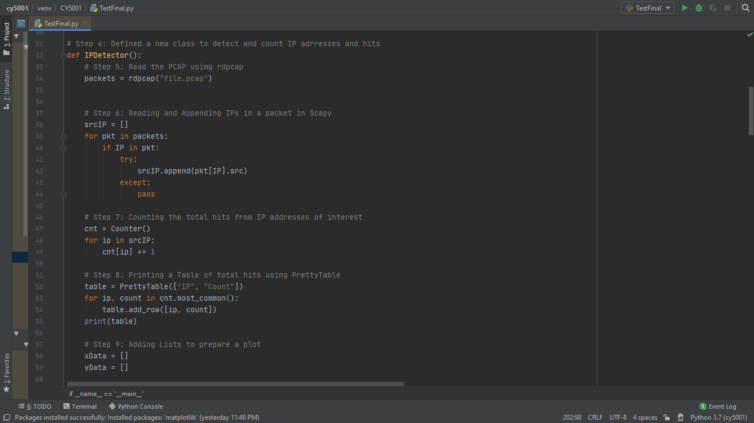
Demonstration of the final script
Notes:
Next, we made a class IPDetector, which reads the packets in the given PCAP. Step 6 involved reading and appending IPS and step 7 involved counting the total hits from IP addresses of interest.
Finally, a table and plot is printed.

Slide 20
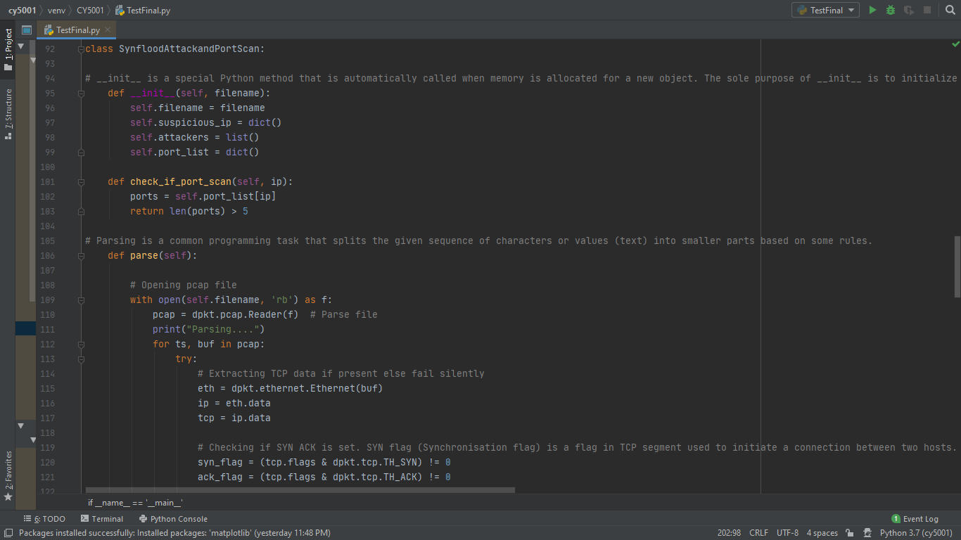
Demonstration of the final script
Notes:
In this part of the script, we made a class SynfloodAttackandPortScan, and called Init. Init is a special python method that is automatically called when memory is allocated for a new object. Then we use parsing which splits the given sequence of characters or values into smaller parts based on some rules. Here, we are checking for the TCP-SYN flood attack, and we will call the function at the end of the script.

Slide 21
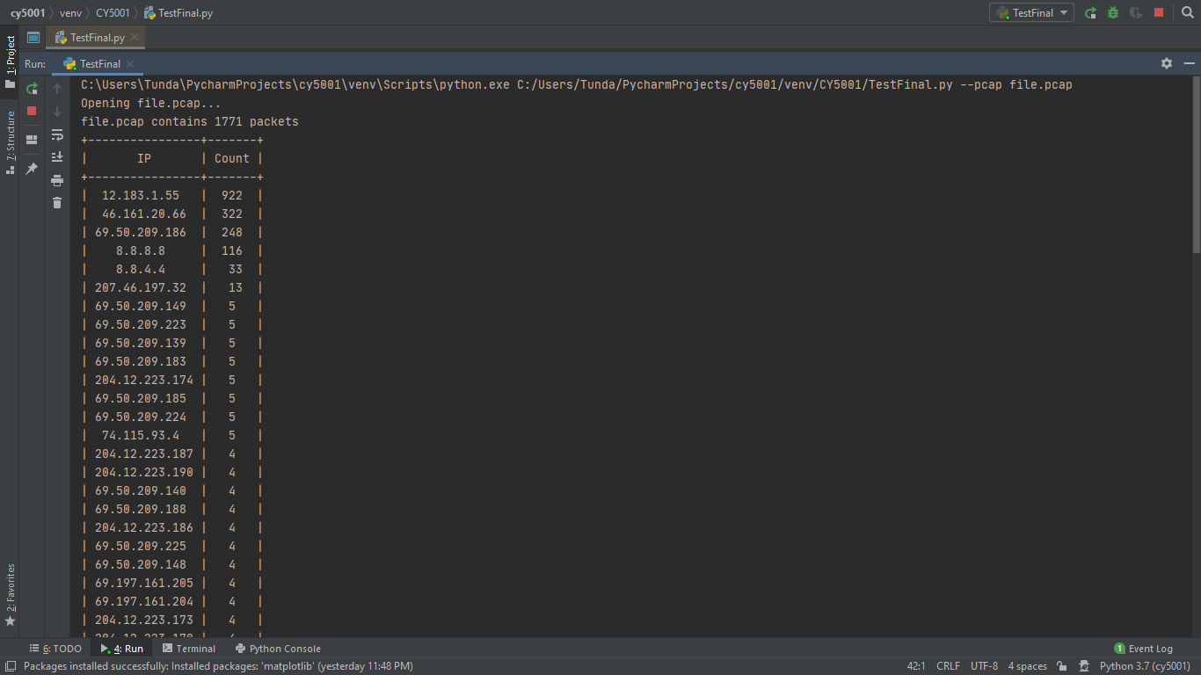
Output of the final script
Notes:
In this slide ,we can see that while running the script from the command line, we called for file.pcap and after opening the file, the script counted the total number of packets which were 1771 and gave out the count of every IP addresses involved. We can also see that most of the hits were from 4 IP addresses which are related and of particular interest in this project.

Slide 22
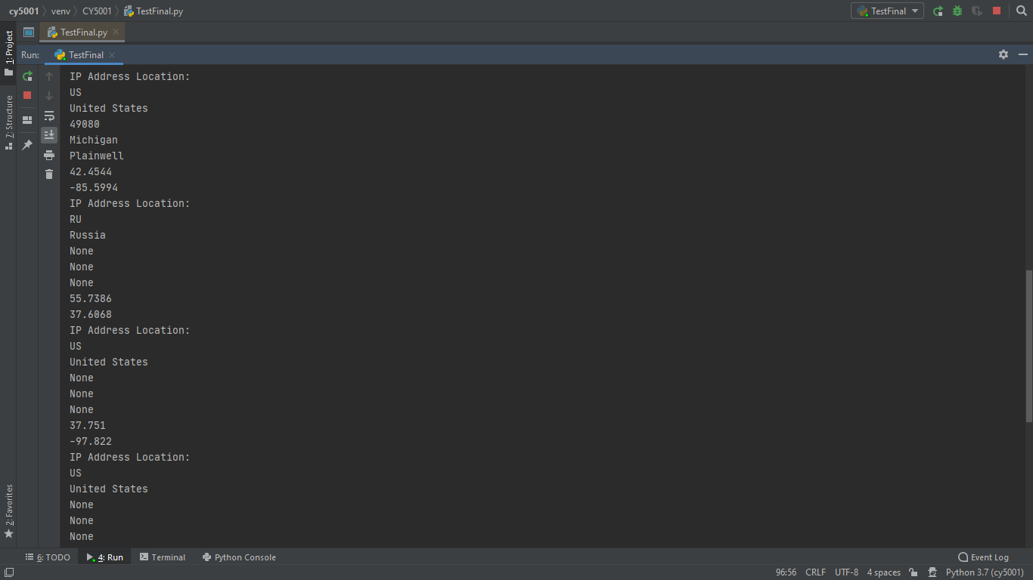
Output of the final script
Notes:
In this slide , we can see that after successfully running the script it gave the output of IP address locations of every IP addresses involved. We have hardcoded the IP address in this script, but we can also provide them as command line arguments by using argparse in the script.

Slide 23
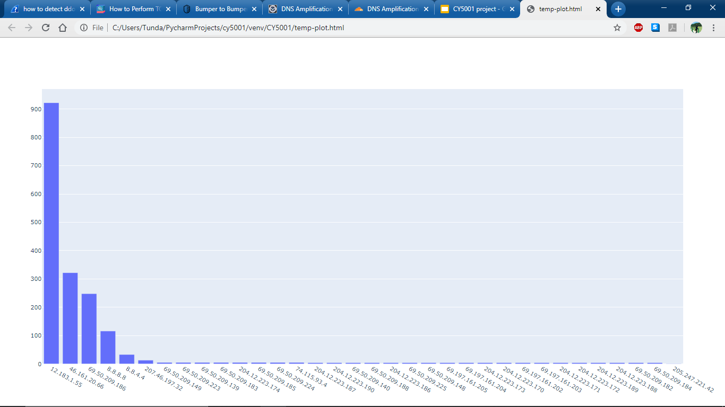
Output of the final script
Notes:
In this part of the final script, this script gave the output of the task it had in form of a plot which was a html file to better grasp the data of PCAP file. Here, we can see that the top 5 IP addresses were involved in most part of PCAP file.

Slide 24
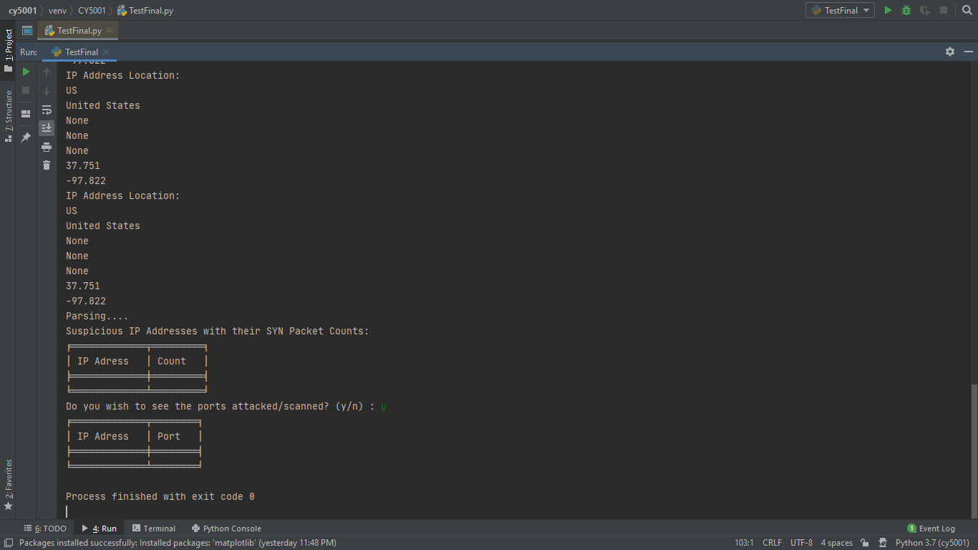
Output of the final script
Notes:
After successfully running the script, it can be seen that the IP Address locations were different and some of the IP addresses were not giving the details of the location as per the Geolite database. Some of them tried to spoof the IP addresses and we can see that SYN packet counts are not here as there is no TCP SYN attack and port scan in this particular PCAP file.

Slide 25
Conclusion
In conclusion, it can be said that after successfully running the script, there has been a lot of traffic in short amount of time as per the given PCAP file but not enough to call it a SYN flood attack.
Secondly, It is evident that there have been a DNS and ACK flood attack on or through 12.183.1.55 which can be seen via amount of traffic, IP location through script, Wireshark expert analyze as well as using filters in Wireshark like (tcp.flags.syn == 0/1 and tcp.flags.ack == 0/1) and (udp.srcport == 53 or udp.srcport == 123).
Our script is successfully able to recognize the victim and attackers here with location and found out that there is no SYN Flood attack in this particular PCAP file.
Notes:
In conclusion, it can be said that after successfully running the script there is a lot of traffic in short amount of time as per Pcap file, but traffic was not in the form of SYN Flood attack. It is evident that there was DNS as well as ACK flood attack which can be seen through amount of traffic, IP location through script. We have also used few of the Wireshark filters such as (tcp.flags.syn == 0/1 and tcp.flags.ack == 0/1) and (udp.srcport == 53 or udp.srcport == 123) for this analysis. Our script has successfully recognized the victim and attackers here with location and found out that there is no SYN attack which is the most common and dangerous attack.

Slide 26
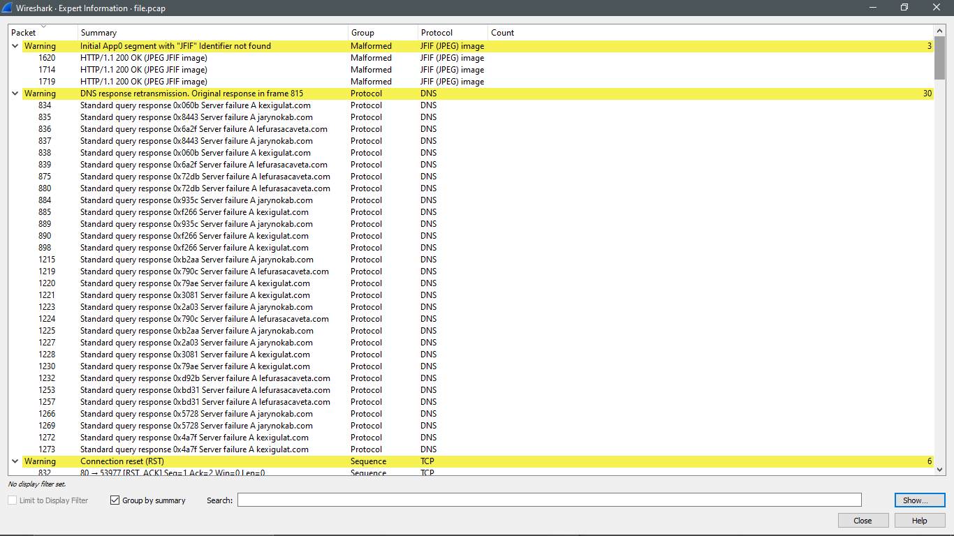
DNS Flood and Amplification Attack
Notes:
A DNS flood is a type of distributed denial-of-service attack (DDoS) where an attacker floods a domain’s DNS servers to disrupt DNS resolution for that domain. This DDoS attack is a reflection-based volumetric distributed denial-of-service (DDoS) attack in which an attacker leverages the functionality of open DNS resolvers in order to overwhelm a target server or network with an amplified amount of traffic, rendering the server and its surrounding infrastructure inaccessible.

Slide 27
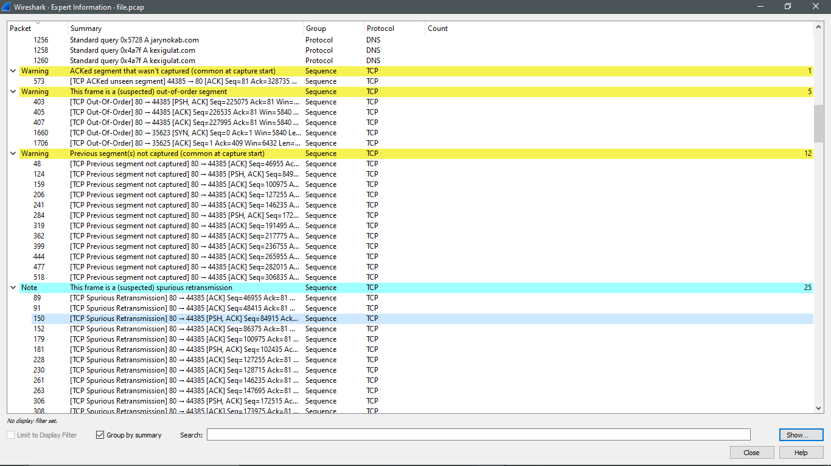
ACK Flood DDoS Attack
Notes:
An ACK flood attack is when an attacker attempts to overload a server with TCP ACK packets. Like other DDoS attacks, the goal of an ACK flood is to deny service to other users by slowing down or crashing the target using junk data. The targeted server has to process each ACK packet received, which uses so much computing power that it is unable to serve legitimate users.

Slide 28
References
Stallings, William, and Lawrie Brown. “Computer Security: Principles and Practice.” Amazon, Pearson, 2018, www.amazon.com/Computer-Security-Principles-Practice-4th/dp/0134794109
https://www.reviversoft.com/file-extensions/pcap
https://www.lesliesikos.com/pcap/
https://n0where.net/best-pcap-tools
http://itdoc.hitachi.co.jp/manuals/3020/30203V0200e/BV020176.HTM
https://us.norton.com/internetsecurity-emerging-threats-what-is-a-ddos-attack-30sectech-by-norton.html
https://www.imperva.com/learn/application-security/ddos-attacks/
www.github.com
www.stackoverflow.com
Notes:
Thank you !

