Slide 1
Forecasting ride demand in Addis Ababa
Team teamdev · Qiyas AI Hackathon
Hourly trips for 12 zones, 1–14 November 2025
Three tables feed one model: trip history (10 months, 12 zones, hourly) + hourly weather (observed, then forecast) + an events calendar (football, concerts, holidays, road closures).
Notes:
The ask: hourly trips for 12 Addis zones over the first fortnight of November. We have ten months of trip history, an hourly weather file, and an events calendar. All three are messy, and the whole game is joining them correctly.

Slide 2
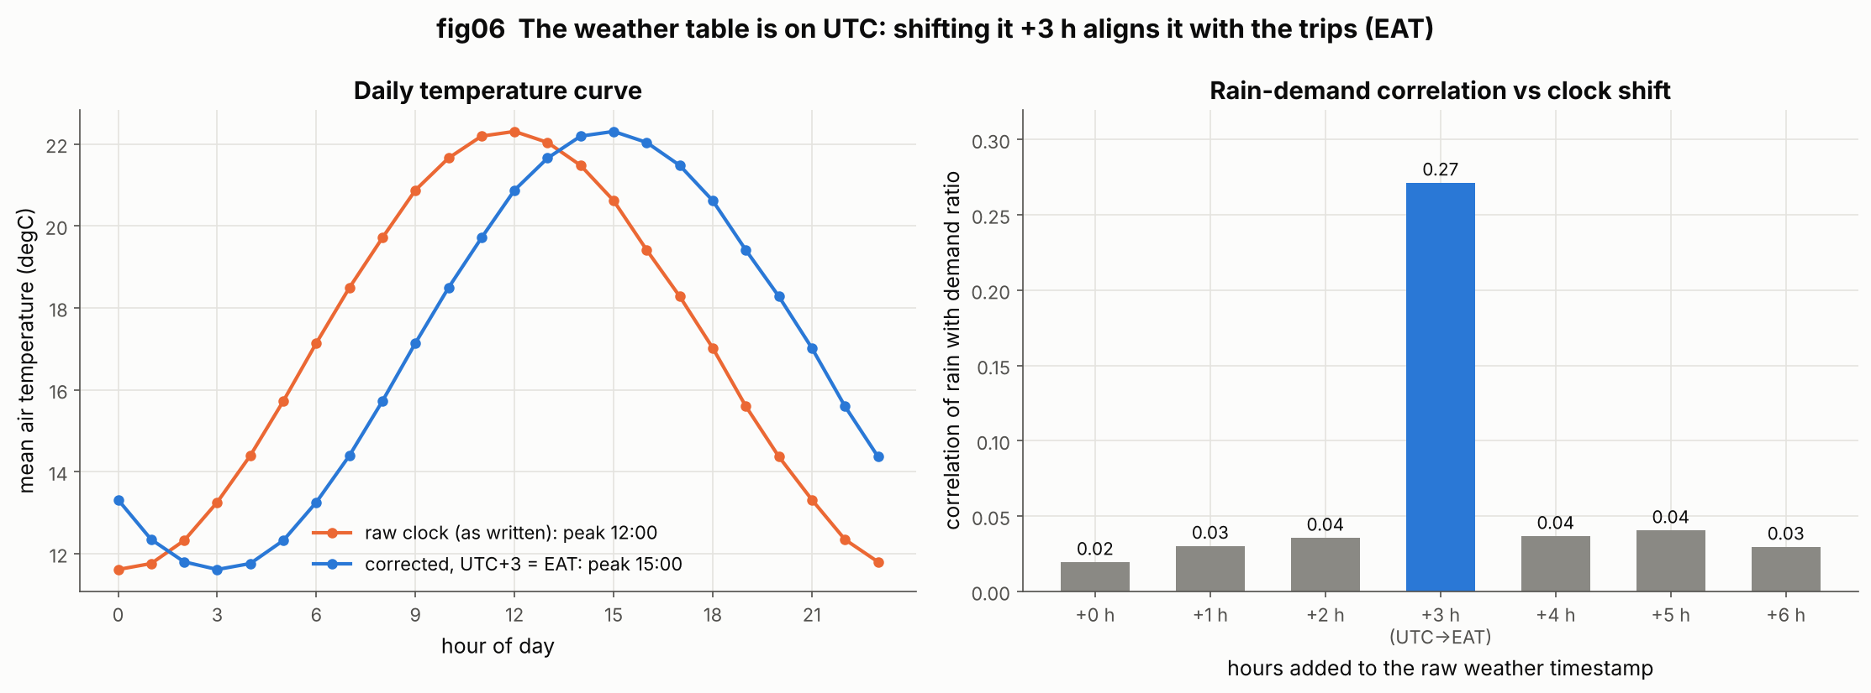
Cleaning and integration: the clock was the hard part
The weather file is on UTC, the trips are on Addis time
Fixed before joining
Forecast rows start 31 Oct 21:00 — that is 1 Nov 00:00 in Addis
Temperature peaks at 12:00 raw, which is 15:00 Addis time
Rain-to-demand correlation: 0.27 at +3 h, 0.02 unshifted
28 logged issues across the three files
A Fahrenheit block (10–24 Jul) and −9999 rain sentinels
125 export spikes where trips were multiplied by 8
A 42-hour outage (12–13 May) excluded, not imputed
87,552
100%
152 / 159
18 / 18
zone-hours in the
train grid
weather match rate
after de-duplicating
events matched to
a zone-hour
integrity checks
passing
Notes:
Everything hinges on the clock. The weather file looks local but is UTC: the first forecast row is stamped 21:00 on 31 October, which is midnight on 1 November in Addis. Shifting by three hours takes the rain-demand correlation from 0.02 to 0.27. We also fixed a Fahrenheit block, rain sentinels, 125 export spikes and a two-day outage, logging 28 issues in all, and 18 integrity checks pass on the joined table.

Slide 3
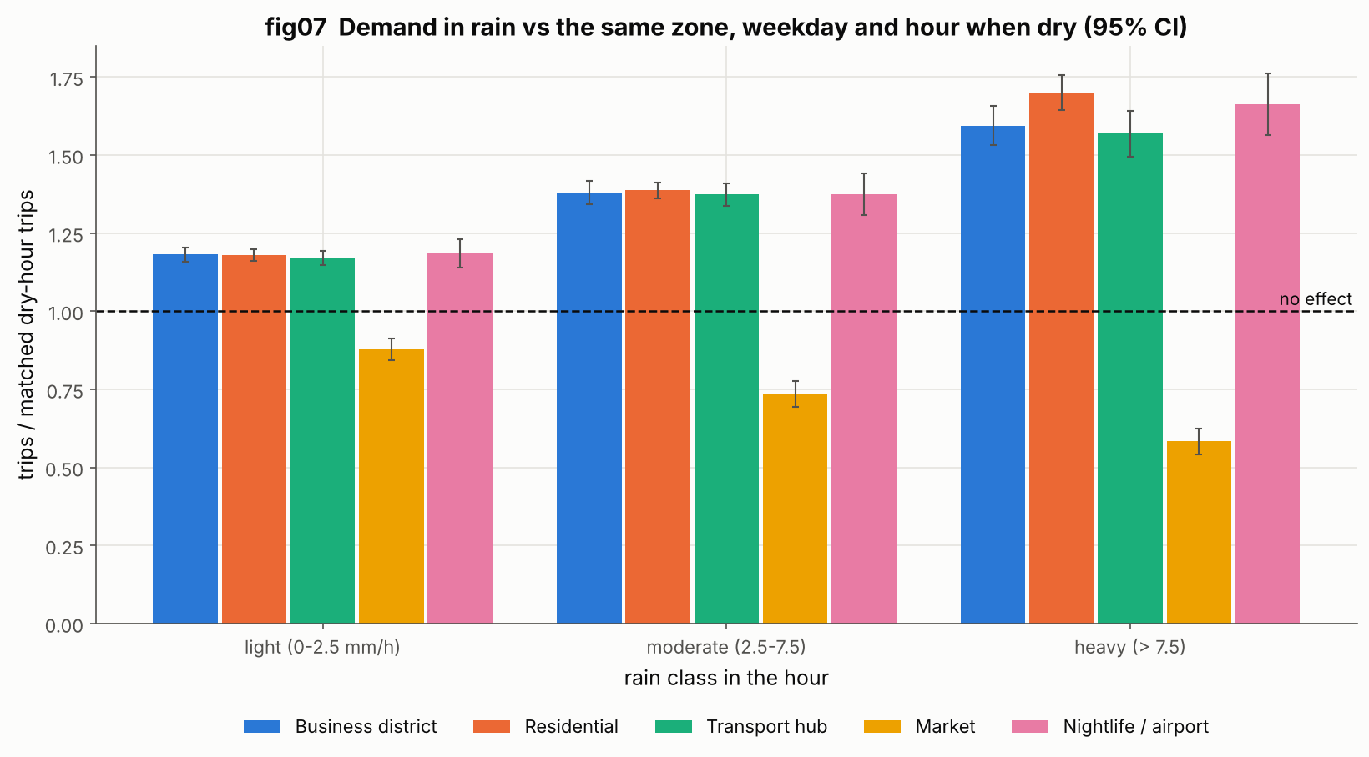
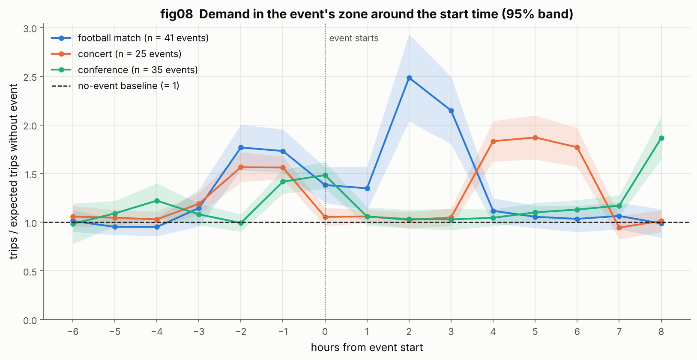
What the data says: rain lifts demand, events move it in waves
Rain lifts demand everywhere except the market.
Heavy rain: 1.63× a matched dry hour outside Merkato, but 0.58× inside it — the open-air market empties instead. Rain only helps the model with a zone-type interaction.
Events arrive and leave in distinct waves.
Football: 1.8× an hour before kick-off, 2.5× right after the final whistle. Concerts peak about 5 h in, as the crowd leaves. So events are features with before / during / after phases, not one flag.
Notes:
Two findings changed the model. First, rain lifts demand by up to 63 percent — except in Merkato, the open-air market, where it falls by 42 percent, so rain needs a zone-type interaction. Second, events move demand in waves: football peaks before kick-off for arrivals and again, harder, right after the whistle. That is why event features carry a before, during and after phase.

Slide 4
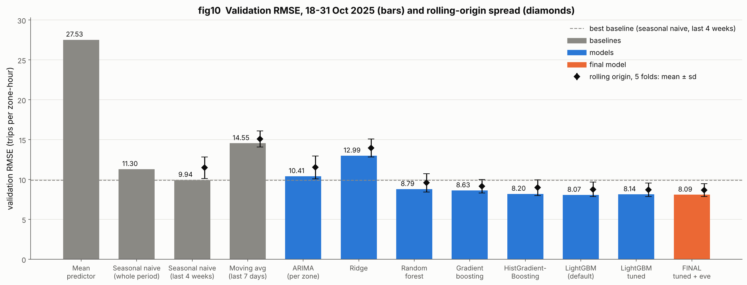
Modelling: six families, validated on five rolling fortnights
Final model
LightGBM, Poisson objective
36 forecast-time features
Chronological validation only
Nothing fitted on the test file
What each join is worth
Weather: −0.88 RMSE (−8.9%)
Events: −0.35 RMSE (−3.5%)
Both together: −1.16 (−11.7%)
8.09
9.94
19%
5
final RMSE
(trips per zone-hour)
best baseline
(seasonal naive)
better than
that baseline
rolling folds,
14 days each
Notes:
We compared six families against three baselines on the same chronological splits. Gradient boosting leads; ARIMA does no better than a seasonal naive because it cannot see rain or events. The final model is LightGBM with a Poisson objective on 36 forecast-time features: 8.09 RMSE, 19 percent better than the best baseline, and ahead in every one of the five rolling fortnights. The weather join is worth 0.88 RMSE and the events join 0.35.

Slide 5
Where it misses, what it scores, and the live demo
Error analysis
Final score
9 of the 10 largest misses are holiday eves — Meskel eve in Kazanchis, New Year eve in Merkato — crowds the calendar never lists
We answered with a holiday-eve feature: error on those hours fell from 16.9 to 16.1
Every large miss is an under-forecast, so the model plays safe on surges
8.09
8.68
RMSE on 18–31 Oct
(MAE 5.60)
rolling mean over
5 fortnights
In plain terms: about 5.6 trips off per zone-hour — roughly 4 drivers out of a typical 26.
What we would try next
Live demo
An Ethiopian religious-calendar feed, so eves are known in advance
A quantile model per zone instead of one pooled interval width
Weekly retraining, since demand grew 40% over the ten months
Runs locally: streamlit run app/app.py
Pick a zone and a day; the app looks up weather and events itself
Returns the 24-hour curve with an 80% range, the peak hour, drivers needed and gross fares
Pick any zone and date — we will run it now
Notes:
Where it misses: nine of the ten largest errors are the eve of a public holiday, which the calendar does not list. We added a holiday-eve feature and the error on those hours dropped. Final score: 8.09 RMSE on the held-out fortnight, 8.68 averaged over five. In plain terms, about four drivers out of a typical twenty-six. The demo runs locally with one command — pick a zone and a date and we will run it live.

