Slide 1

Bacchus Winery
Delta Group
Andrew Schaefer, Jennifer Thomas, Milo Blake, Shane Fox, Caleb Mastromonaco

Slide 2
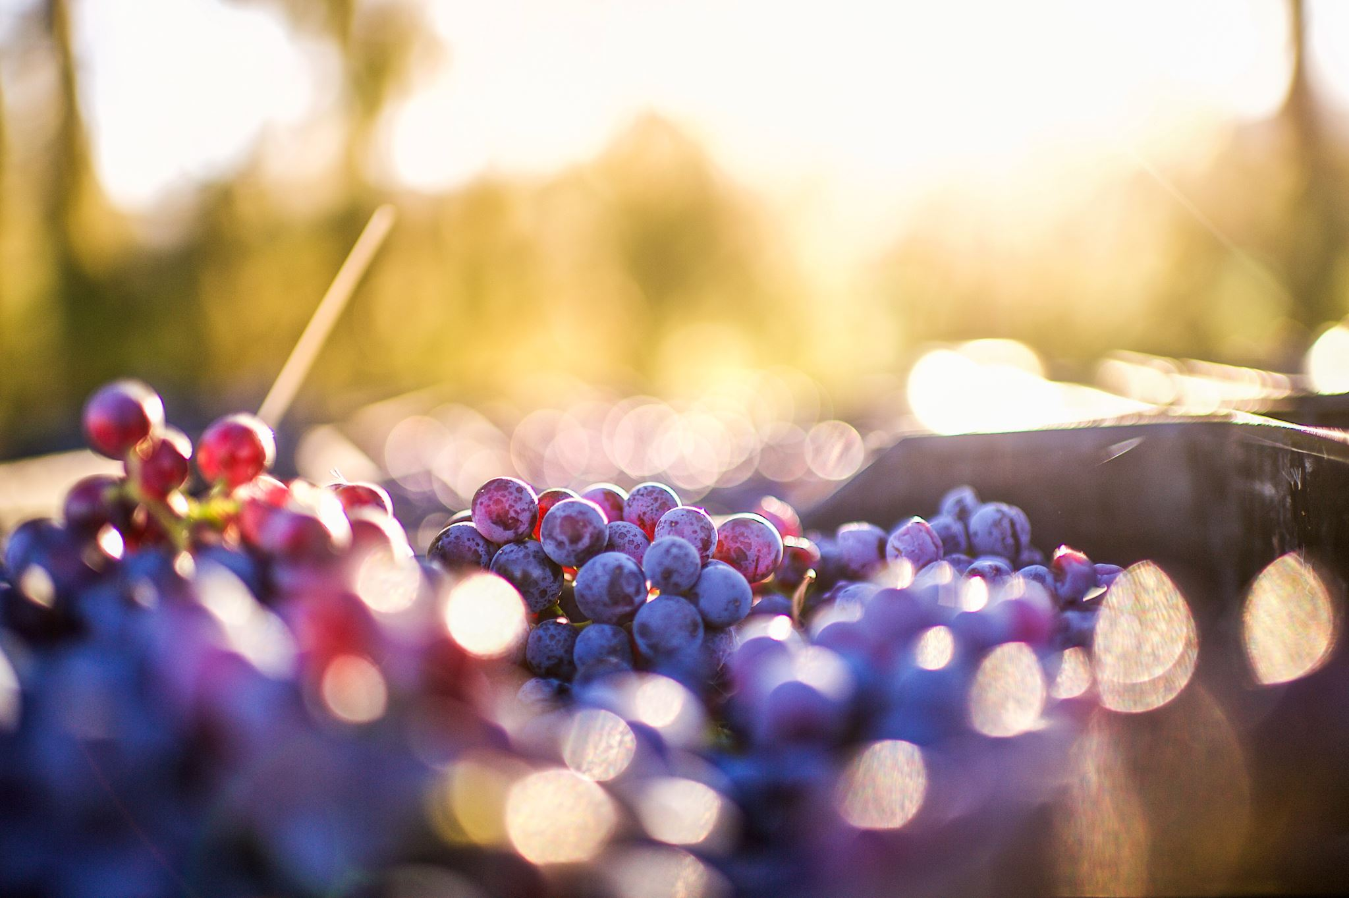
Delta Group Introduction
Our group is comprised of people from different backgrounds and different time zones so picking a time to work collectively was difficult.
We were able to work together by comparing and contrasting different aspects of the project until we produced a meaningful product that we could all be proud of.
It can be difficult to work in a group environment and even more difficult to do so in an online environment, but our team was able to make it work without any real complications.

Slide 3
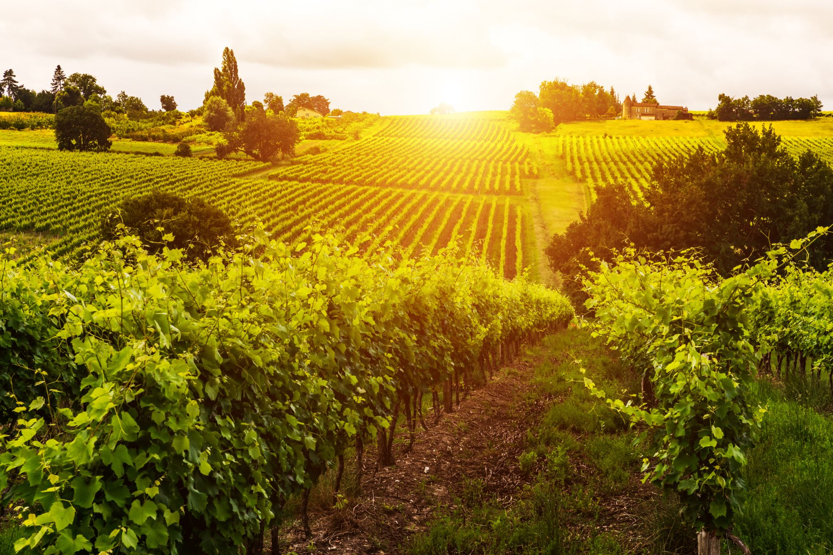
Bacchus Winery
Stan and Davis Bacchus have inherited a winery from their father and are looking to improve their products and customer service.
All twenty-five existing employees have remained on with Bacchus Winery during the transition. The winery grows all the grapes that are needed for the products: Merlot, Cabernet, Chablis, and Chardonnay. There are three suppliers that Bacchus Winery uses for their products.
The Bacchus brothers are searching for a way to improve keeping track of and ordering supplies. They need additional information to determine the state of the inventory, the distribution, and the employees for the yearly snapshot of the winery.

Slide 4

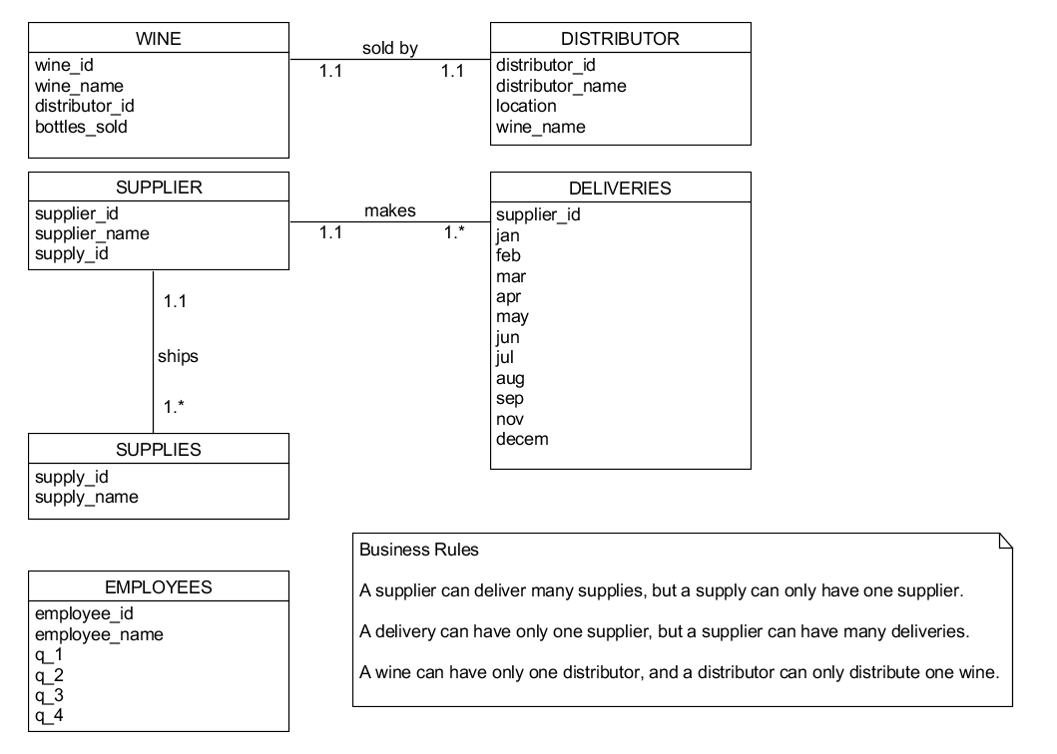
ORD

Slide 5
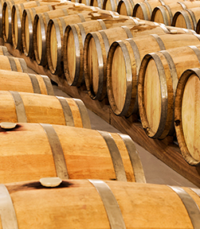
Report # 1 – Supplier Delivery Report
Like most businesses, Bacchus Winery needs to have reliable suppliers so they can have the equipment needed to help their winery flourish.
Therefore, keeping a month-by-month account of just how reliable Bacchus’ suppliers are is a must. The first report allows Bacchus Winery to do just that by analyzing the on-time performance of their suppliers.
This report includes a supply’s supplier ID, the corresponding supplier’s name, as well the expected and actual delivery times of each supply so Bacchus Winery can assess if there are any suppliers that might be falling behind the others.

Slide 6
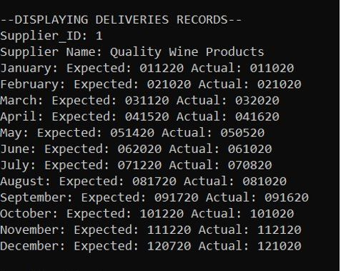
Report # 1 – Supplier Delivery Report Cont.
One Supplier Displayed

Slide 7

Report # 2 – Wine Sales Report
Among many other things, Bacchus Winery must keep an eye on their inventory to be sure all the products they offer are selling to their full potential.
This is where our second report comes in, which provides an easy-to-understand summary of a wine’s name and type, the number of bottles sold, as well as each wine’s distributor’s ID and name.
This report will help Bacchus Winery to keep real-time tabs on how well each wine is selling compared to the others which will provide information crucial for making business decisions.

Slide 8
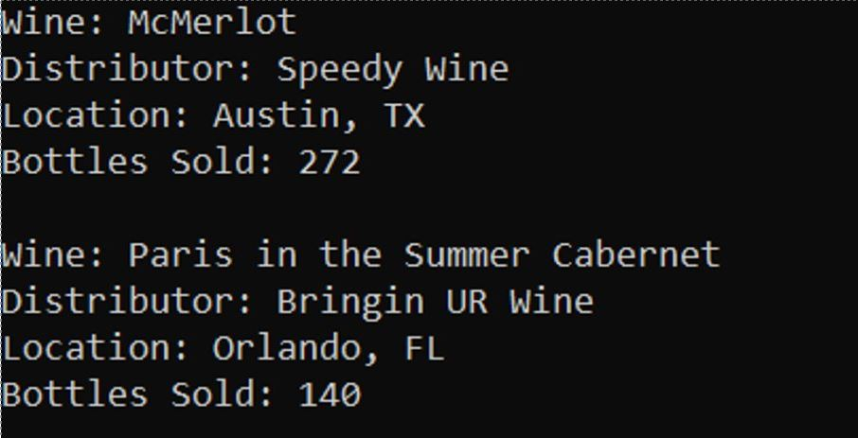
Report # 2 – Wine Sales Report Cont.
Displaying two sales reports

Slide 9
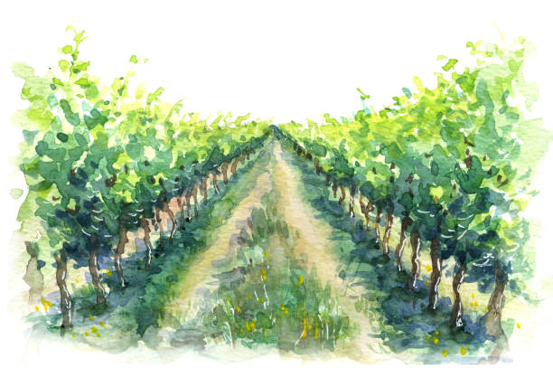
Report # 3 – Employee Time Report
Although an organization can get nowhere without its employees, they do represent a business cost that must be assessed to remain competitive.
Therefore, the third report focuses solely on Bacchus Winery’s many employees and the hours worked by each employee.
This report includes an employee’s ID, name, and the hours worked per yearly quarter, providing vital information to assist in determining the winery’s payroll costs.

Slide 10
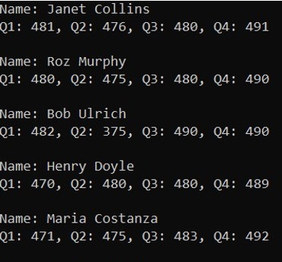
Report # 3 – Employee Time Report Cont.
Displaying five employee reports

