Slide 1

Shoggoth
AsmJit Based Polymorphic Encryptor
Furkan Goksel

Slide 2




#whoami
Furkan Goksel
Red Team Engineer @ Picus Security
Red Teaming
Vulnerability Research
Operating Systems
@R0h1rr1m
https://github.com/frkngksl
frkngksl.github.io

Slide 3
Agenda
What is Polymorphism?
AsmJit Project
Shoggoth Features
PE Loading
COFF Loading
Writing Shellcode in C
Garbage Code Generation
Stream Cipher: RC4
Block Cipher: Random Block Cipher
General Execution Flow
Demo
What’s Next?

Slide 4
What is Polymorphism?
“To exist in various forms of different types at different times”
“To create numerous encryption-decryption routines in order to disrupt the signature-derivation mechanism”
No constant algorithm or a single key
Controlled by Mutation Engines
Subroutine reordering, dead code insertion, register swapping...
Low level programming and assembly output
First seen in the Chameleon family (1260, V2P1, V2P2, and V2P6)

Slide 5

AsmJit Project
Lightweight open-source library for machine code generation
Led by Petr Kobalicek
X86, x86_64 support
Widely used by many projects like x64dbg, Blend2D, Cinder and many more…
Change operation codes, registers, operands, call labels …

Slide 6
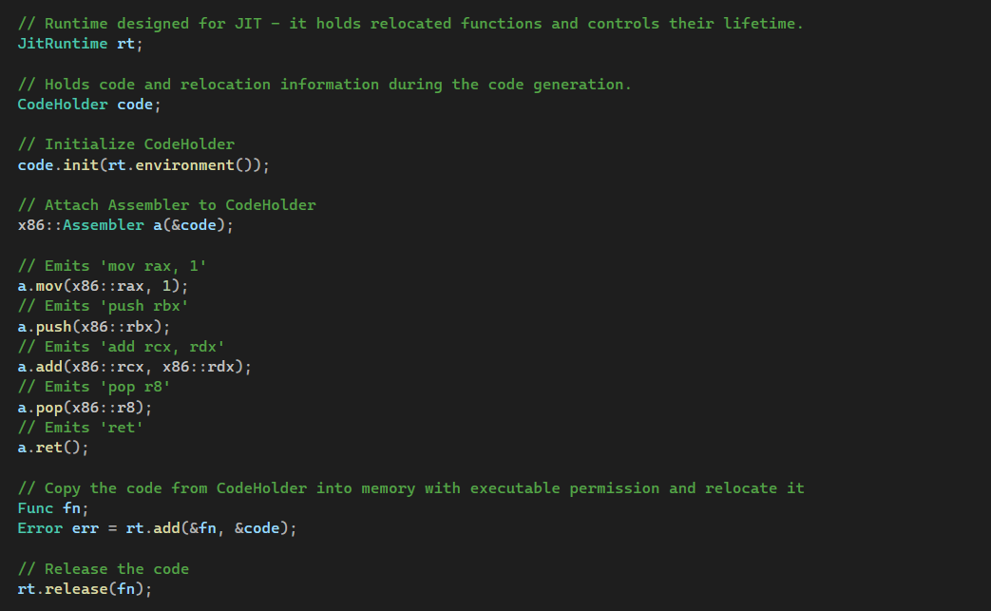
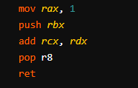
AsmJit Project

Slide 7


Slide 8

Shoggoth
Written in C++
AsmJit
x64 Inputs
Raw Mode
PE Mode
COFF Mode
Random Block Cipher
RC4 Cipher
Garbage Instructions
https://github.com/frkngksl/Shoggoth

Slide 9
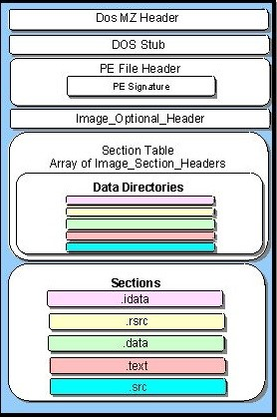
PE Loading
Allocate an executable region for the PE itself
Copy PE headers to the allocated region
Place PE sections to their RVAs
Parse Import Directory to resolve imports
If the allocated region is not the preferrable address, fix relocations
Execute instructions from the entry point

Slide 10
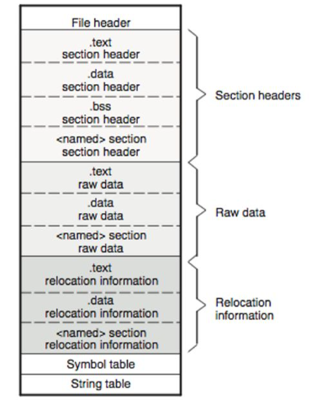
COFF Loading
Allocate a memory region for all COFF sections
Copy COFF sections to newly allocated area
Traverse relocation entries for each section
Find corresponding symbols and determines types
Apply relocations based on relocation types
Start the execution

Slide 11
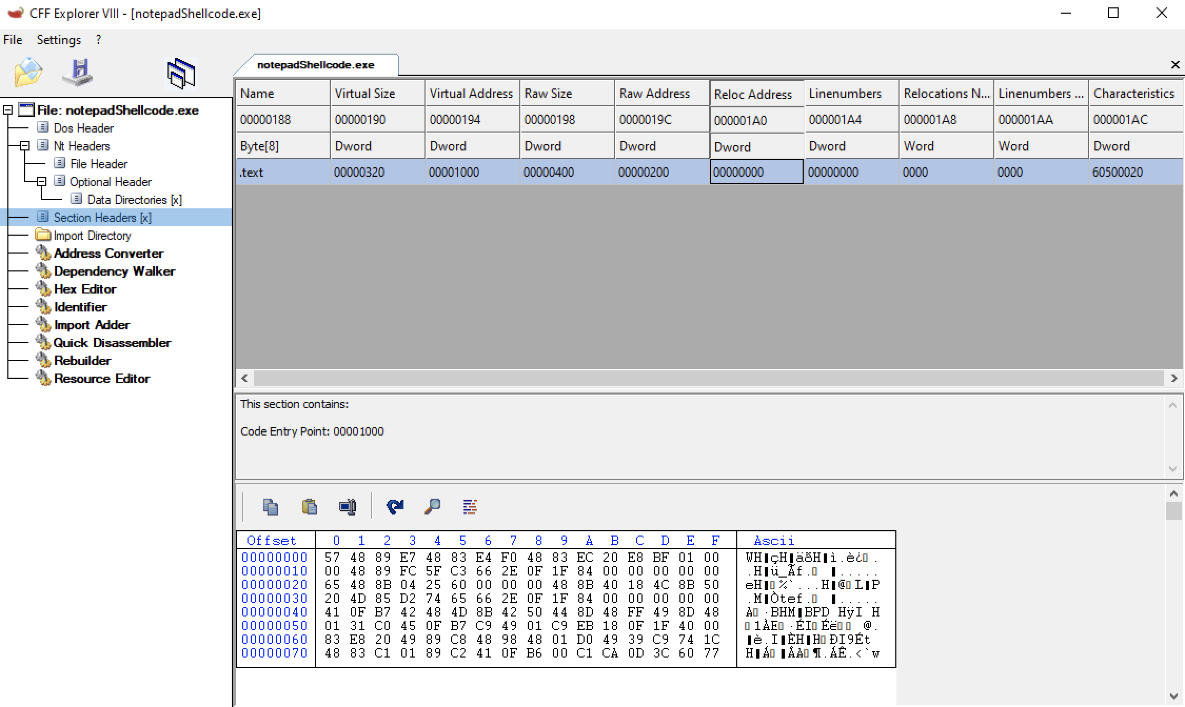
Writing Shellcode in C
C-To-Shellcode Technique
No Global Variable
No Static Variable
Use Stack String
Dynamic External WinAPI functions

Slide 12
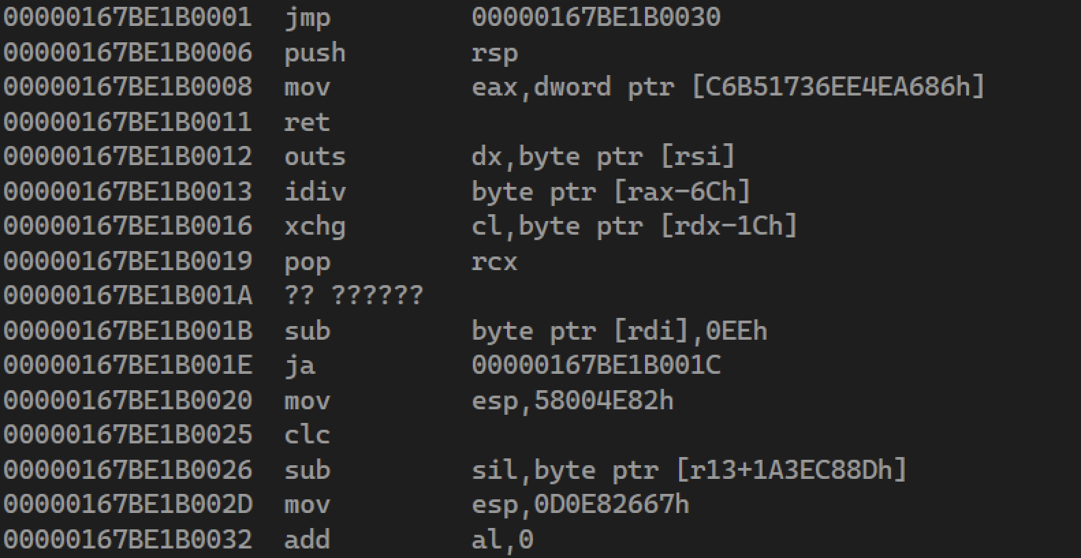
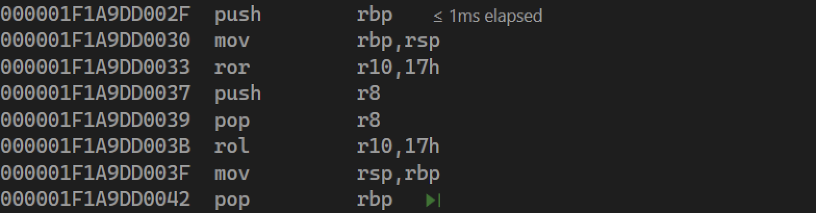
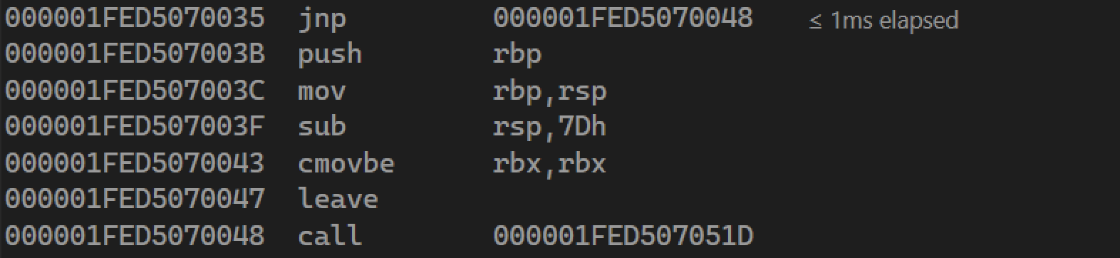
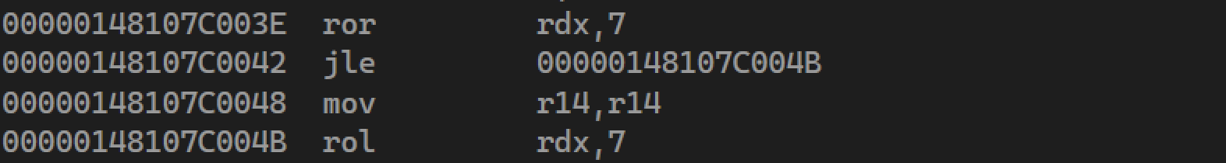
Garbage Code Generation
Jumping over random bytes
Fake functions with prologue and epilogue
Pair instructions for preserving the value
Jumping over valid instructions
Arithmetic operations for a register before restoring its value
Safe instructions with no effect

Slide 13
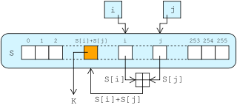
Stream Cipher: RC4
Random key generation
Random register selection for the decryptor
Merging the decryptor with the encrypted payload

Slide 14
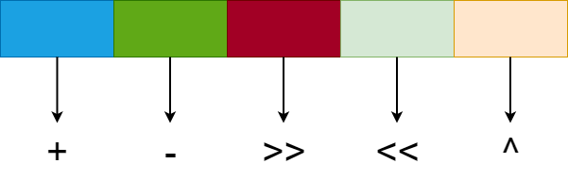
Block Cipher: Random Block Cipher
Dividing into equal blocks
Randomly selected operation and operand
Reverse the selected operation in the decryptor
No loop logic in the decryptor

Slide 15
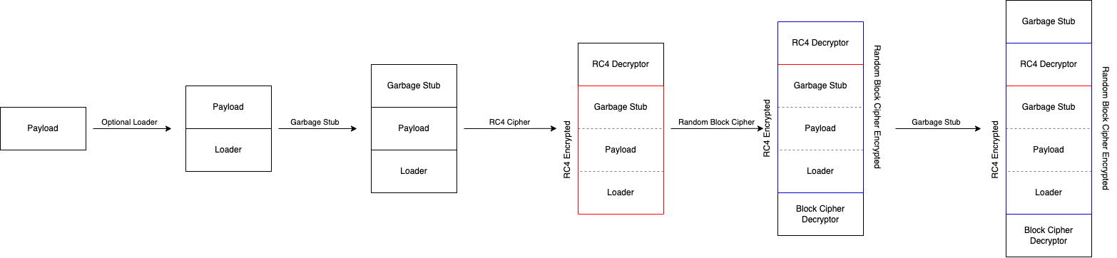
General Execution Flow

Slide 16
Demo Time

Slide 17
What’s Next?
Put more garbage instructions
Make encryption routines more polymorphic
Improve loaders and allow custom loaders
Byte blacklist for final payload
Pull requests!

Slide 18
https://github.com/frkngksl/Shoggoth

