Slide 1
Computer Networks
CSE 4511

Slide 2
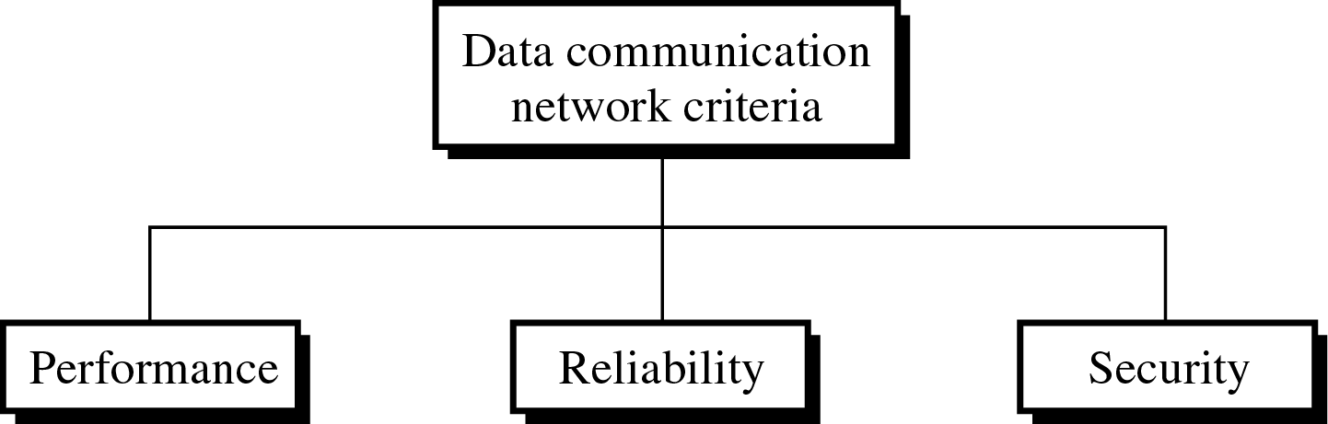
Network
Network: A set of devices (nodes) connected by communication links
Node: Computer, printer, or any device capable of sending and/or receiving data
To be considered effective and efficient, a network must meet a number of criteria

Slide 3
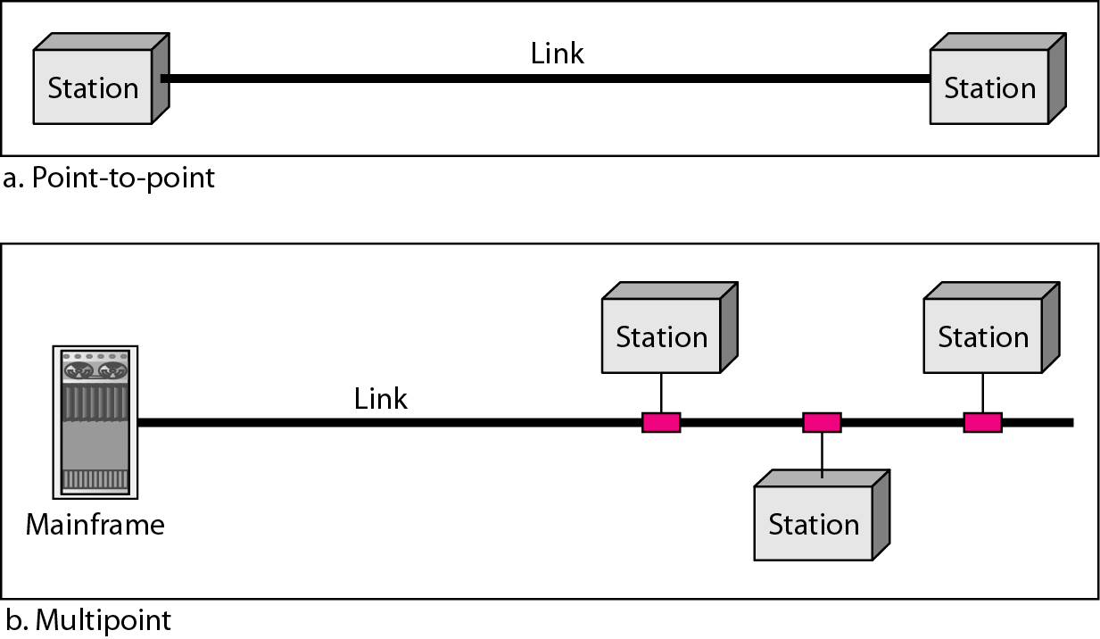
Type of Connection

Slide 4
Type of Connection
Point-to-point
Dedicated link between two devices
The entire capacity of the channel is reserved
Ex) Microwave link, TV remote control
Multipoint
More than two devices share a single link
Capacity of the channel is either
Spatially shared: Devices can use the link simultaneously
Timeshare: Users take turns

Slide 5
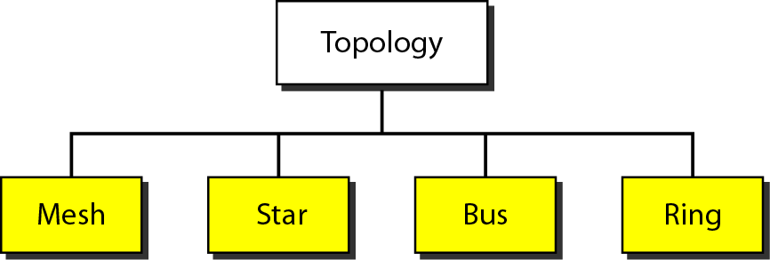
Physical Topology

Slide 6
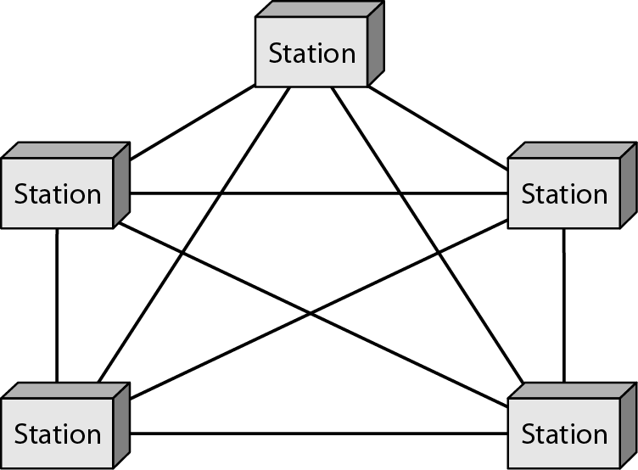
Mesh Topology
Dedicated point-to-point link to every other nodes
A mesh network with n nodes has n(n-1)/2 links. A node has n-1 I/O ports (links)
Advantages: No traffic problems, robust, security, easy fault identification & isolation
Disadvantages: Difficult installation/reconfiguration, space, cost

Slide 7
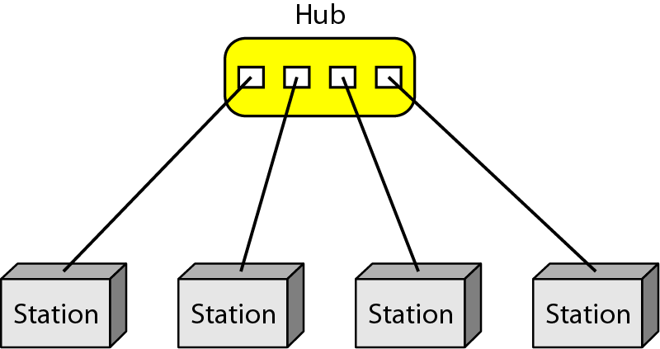
Star Topology
Dedicated point-to-point link only to a central controller, called a hub
Hub acts as an exchange: No direct traffic between devices
Advantages: Less expensive, robust
Disadvantages: dependency of the whole on one single point, the hub

Slide 8
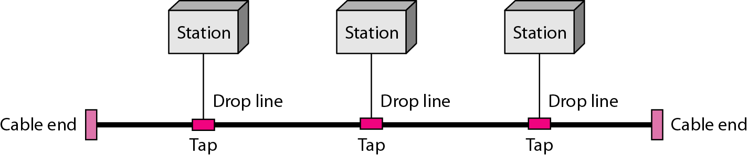
Bus Topology
One long cable that links all nodes
tap, drop line, cable end
limit on the # of devices, distance between nodes
Advantages: Easy installation, cheap
Disadvantages: Difficult reconfiguration, no fault isolation, a fault or break in the bus stops all transmission

Slide 9
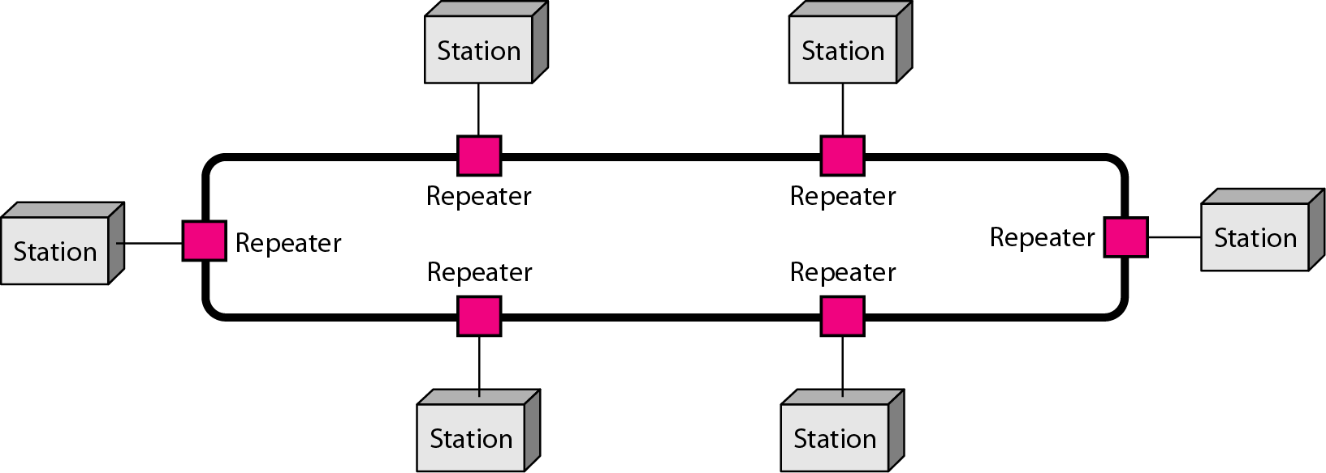
Ring Topology
Dedicated point-to-point link only with the two nodes on each sides
One direction, repeater
Advantages: Easy reconfiguration, fault isolation
Disadvantage: Unidirectional traffic, a break in the ring cab disable the entire network

Slide 10
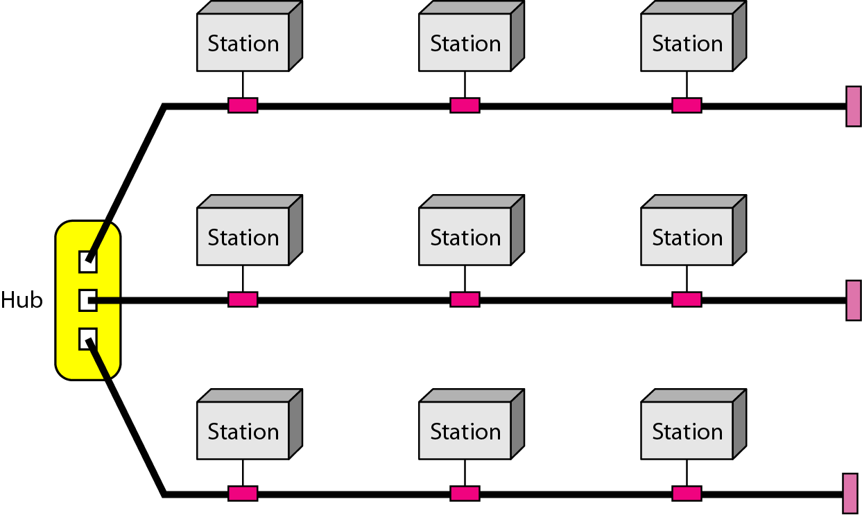
Hybrid Topology
Example: Main star topology with each branch connecting several stations in a bus topology
To share the advantages from various topologies

Slide 11
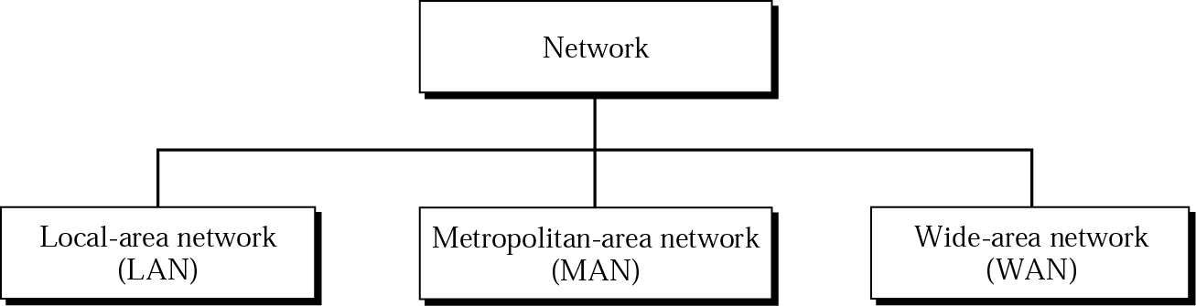
Categories of Networks

Slide 12
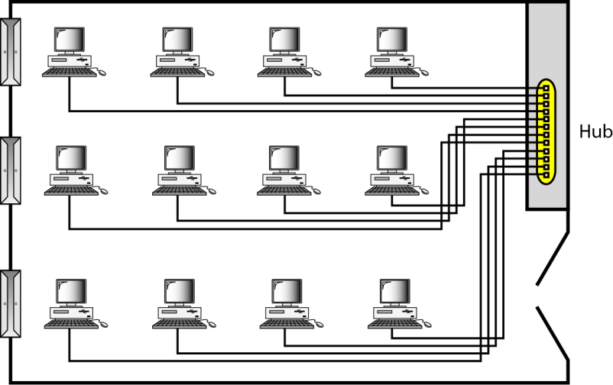
LAN
Usually privately owned
A network for a single office, building, or campus ≤ a few Km
Common LAN topologies: bus, ring, star
An isolated LAN connecting 12 computers to a hub in a closet

Slide 13
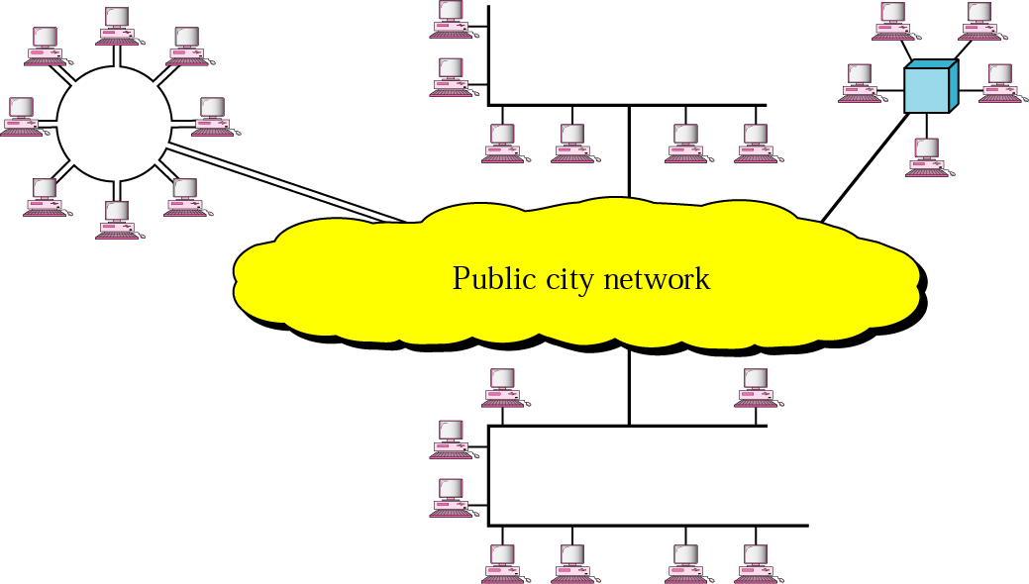
MAN
Designed to extend to an entire city
Cable TV network, a company’s connected LANs
Owned by a private or a public company

Slide 14
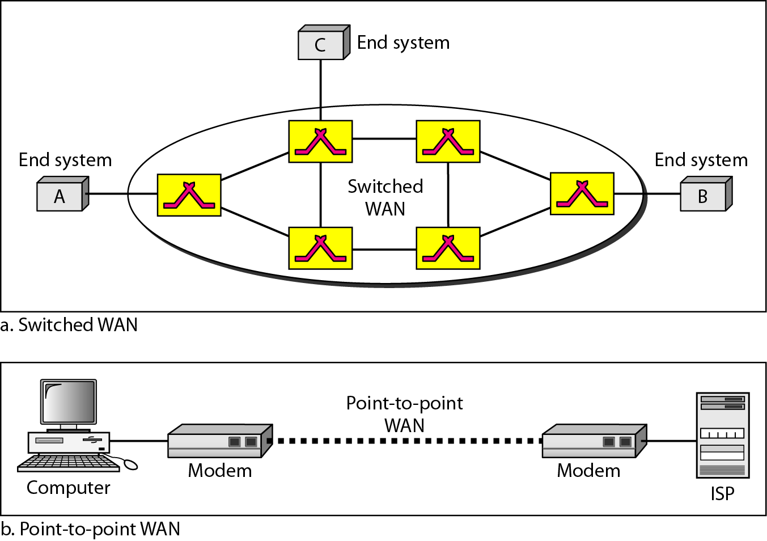
WAN
Long distance transmission, e.g., a country, a continent, the world
Enterprise network: A WAN that is owned and used by one company

Slide 15
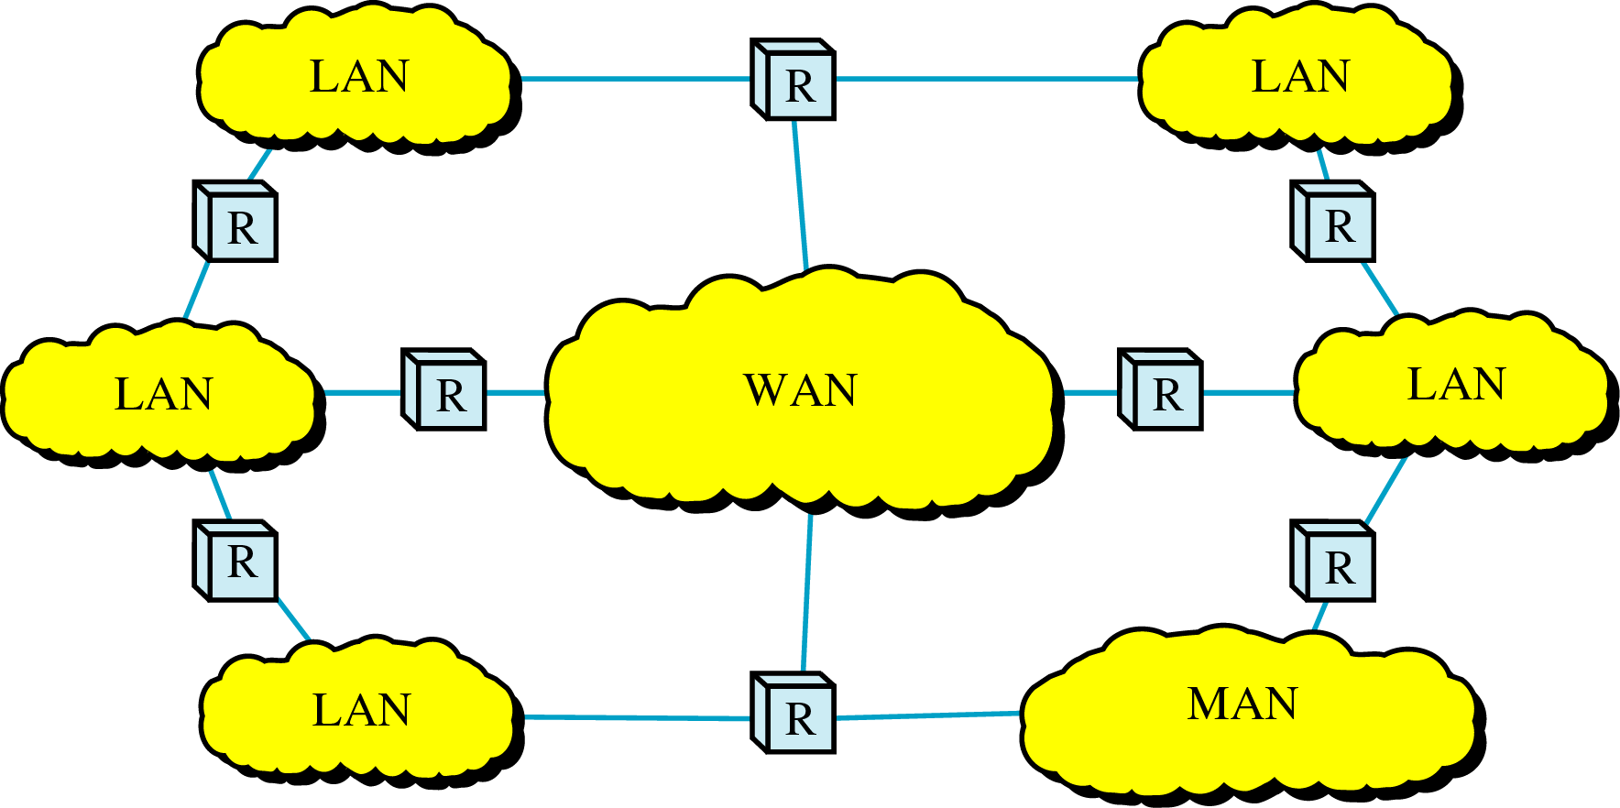
Internetwork
Internetwork (internet) : two or more networks are connected by internetworking devices
Internetworking devices: router, gateway, etc.
The Internet: a specific worldwide network

Slide 16
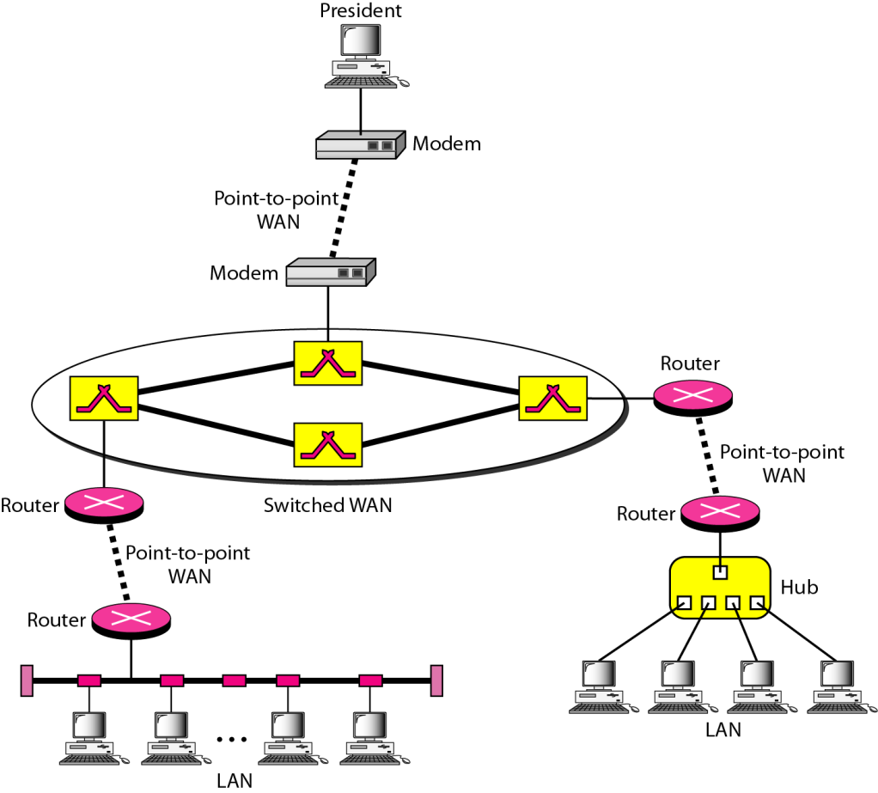
Internetwork Example
A heterogeneous network : four WANs and two LANs

Slide 17
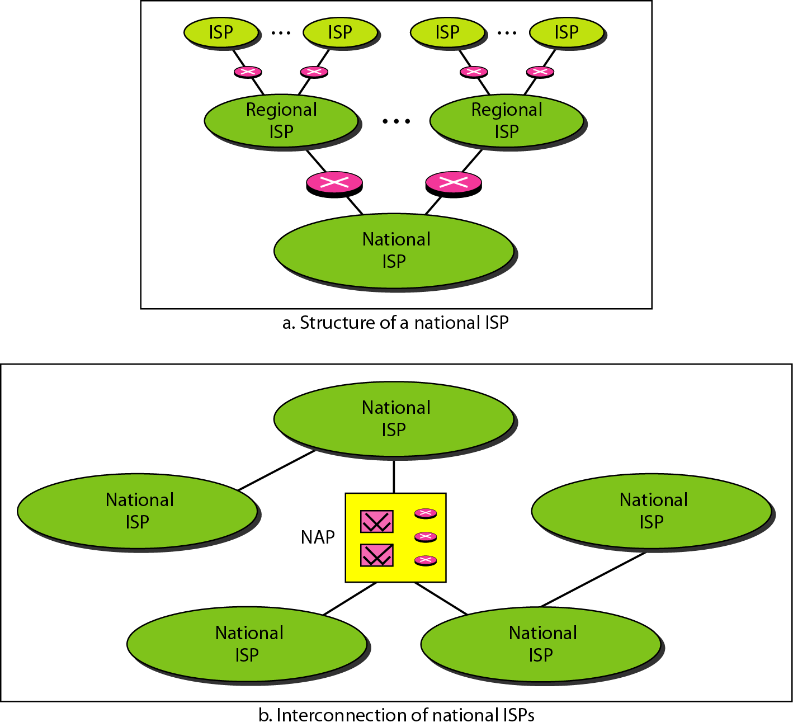
Internet Today
ISP (Internet service providers)
NISP (national ISP)
NAP (network access point)

Slide 18
Network Models
Layered Tasks
The OSI Model
Layers in the OSI Model
TCP/IP Protocol Suite
Addressing

Slide 19
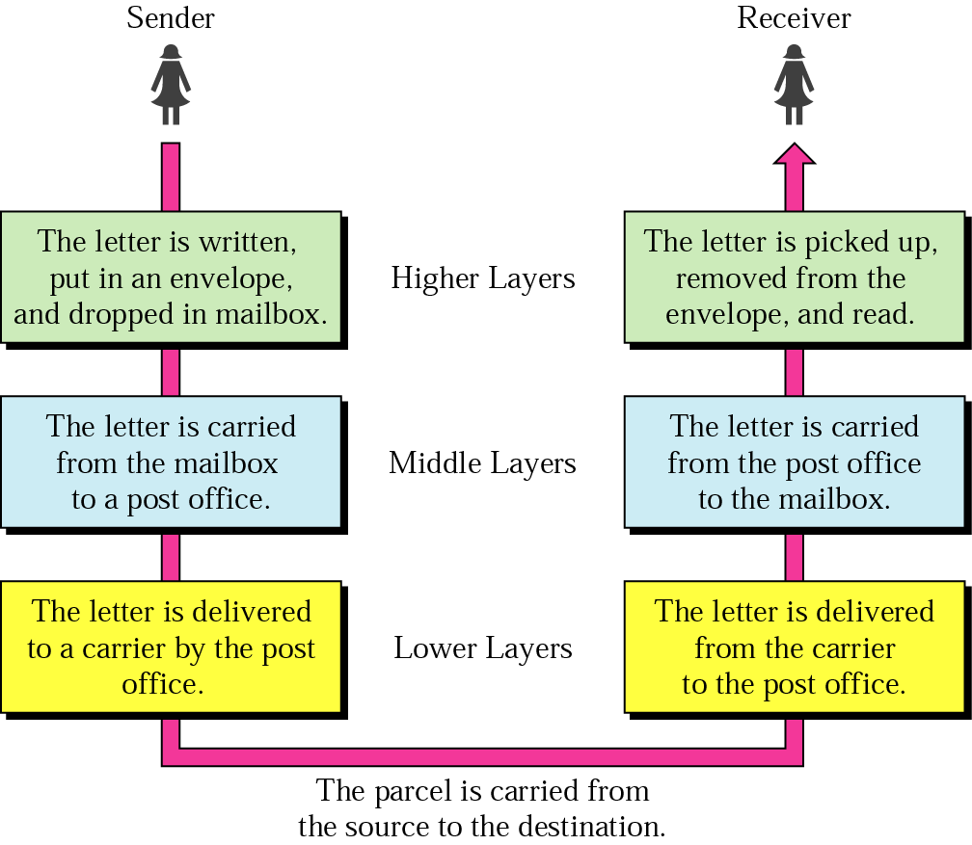
Layered Model: Sending a Letter

Slide 20
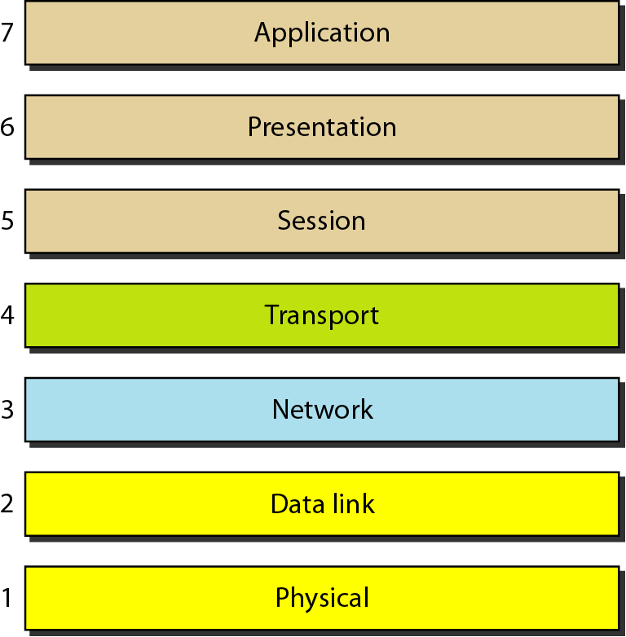
OSI Model
ISO is the organization. OSI is the model

Slide 21
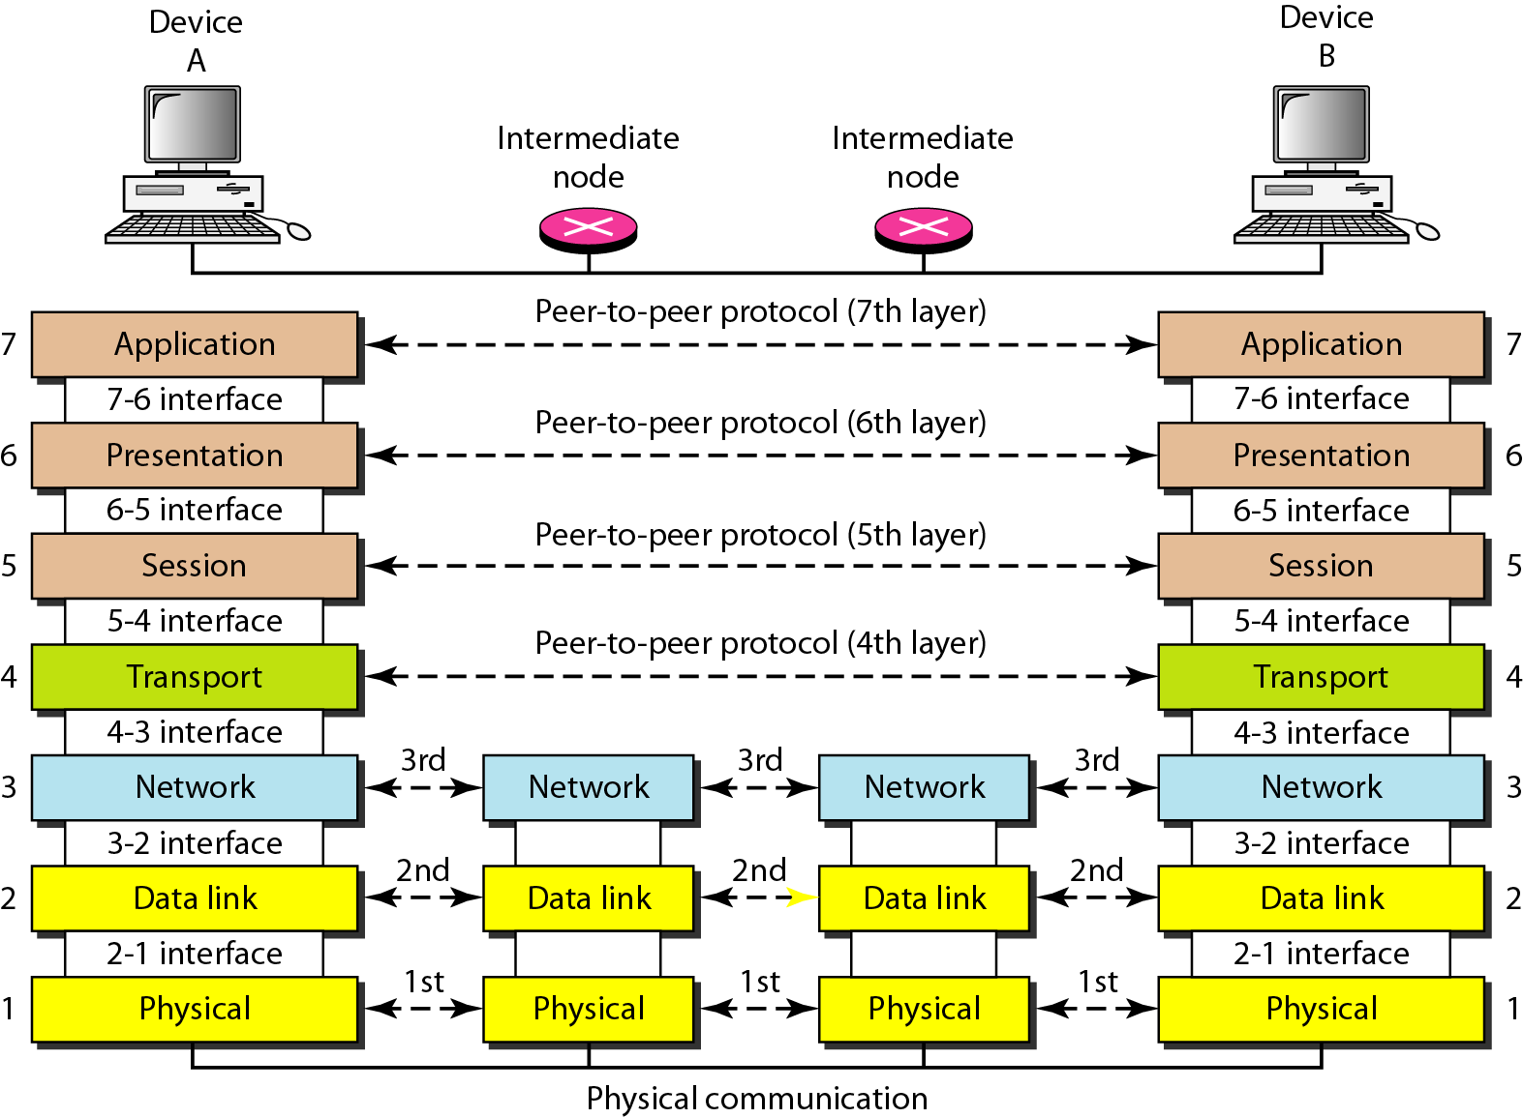
Interaction between layers in the OSI model
Layer and interface

Slide 22
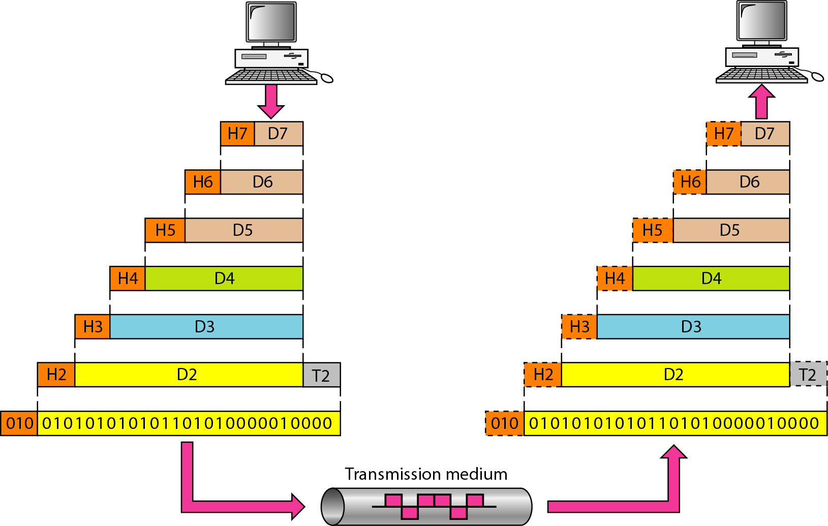
An exchange using the OSI model
Encapsulation with header and possibly trailer

Slide 23
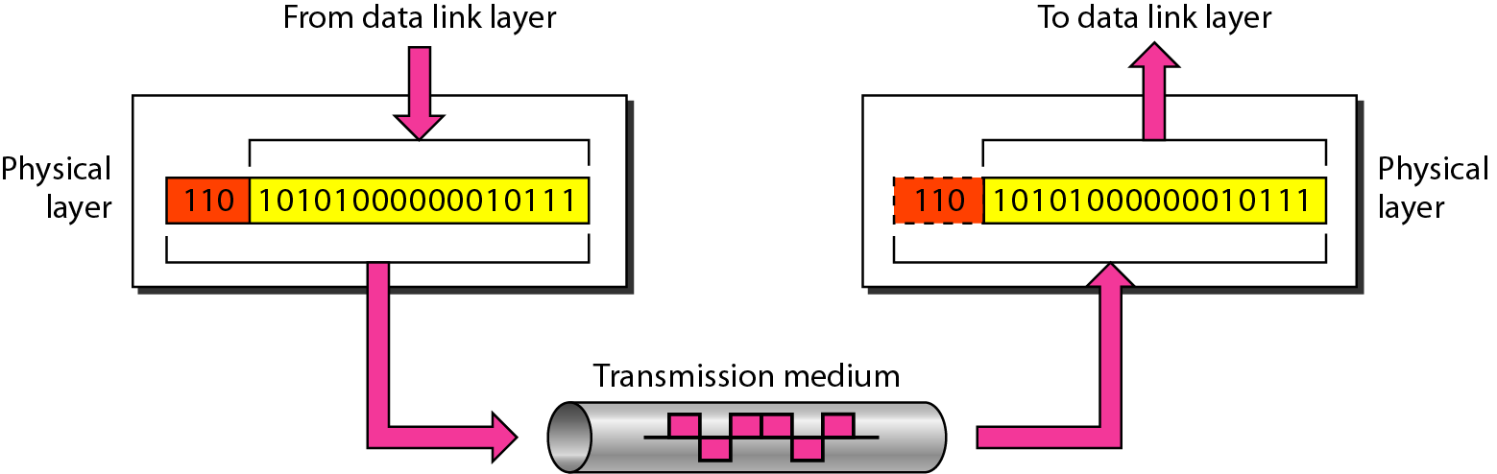
Physical Layer
The physical layer is responsible for movements of individual bits from one hop (node) to the next
Mechanical and electrical specification, the procedures and functions

Slide 24
Physical Layer: Responsibilities
Physical characteristics of interfaces and media
Representation of bits
Data rate
Synchronization of bits
Line configuration
Physical topology
Transmission mode

Slide 25
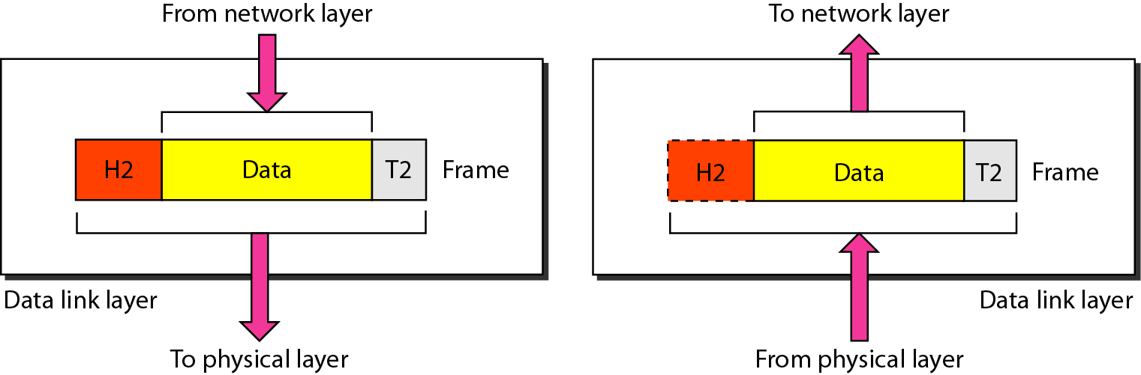
Data Link Layer
The data link layer is responsible for moving frames from one hop (node) to the next
Transform the physical layer to a reliable (error-free) link

Slide 26
Data Link Layer: Duties
Framing
Physical addressing
Flow control
Error control
Access control

Slide 27
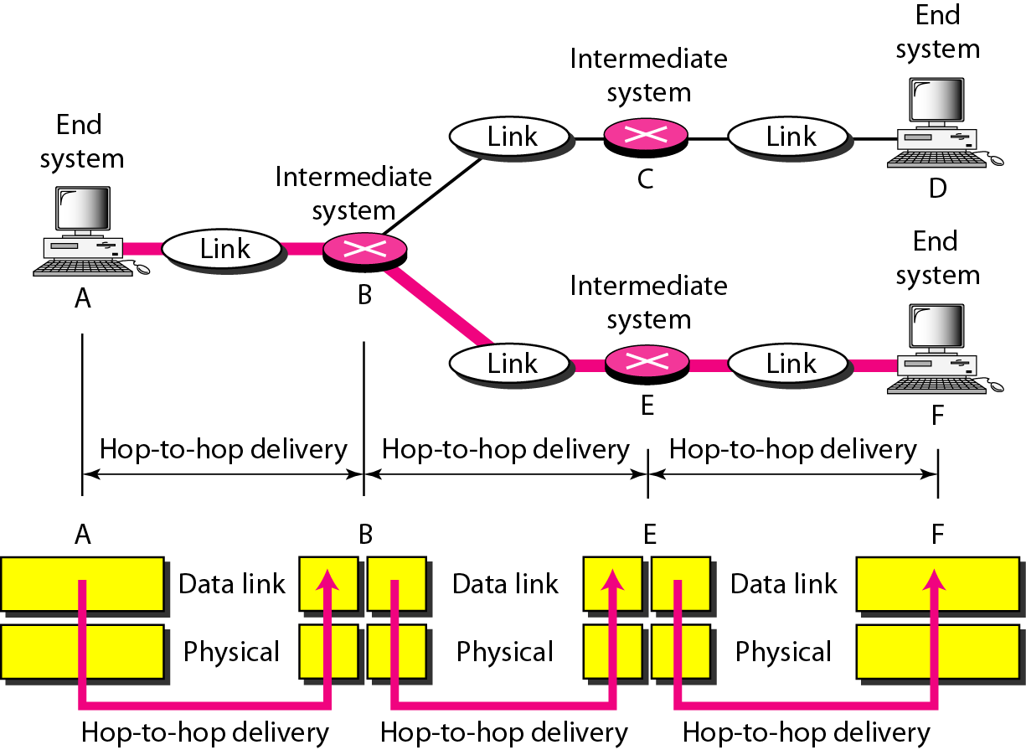
Hop-to-Hop Delivery

Slide 28
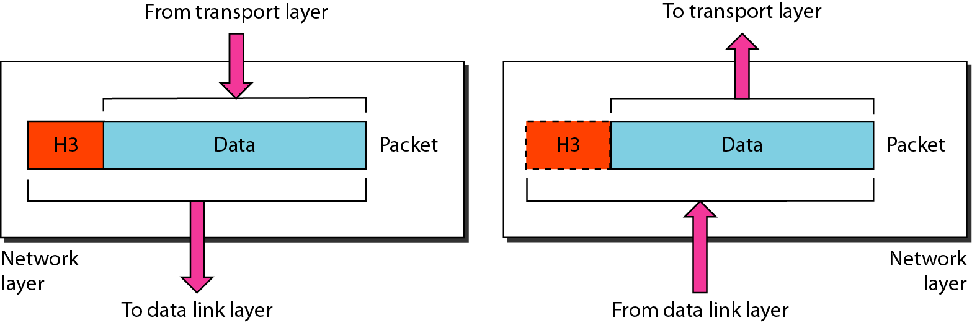
Network Layer
The network layer is responsible for the delivery of packets from the source host to the destination host

Slide 29
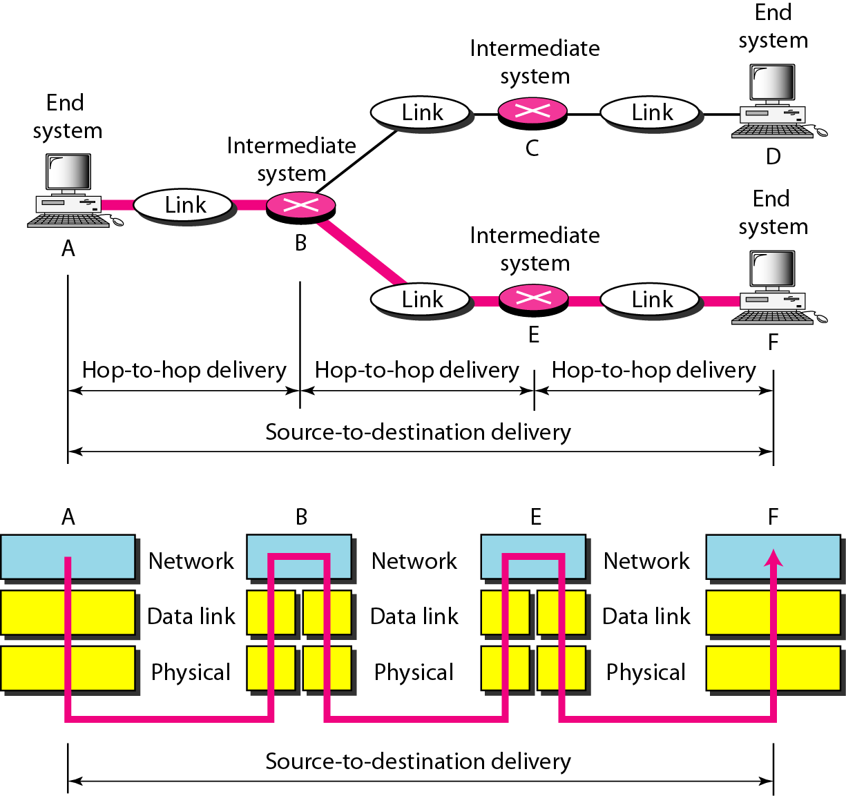
Network Layer: Duties
Logical addressing and routing

Slide 30
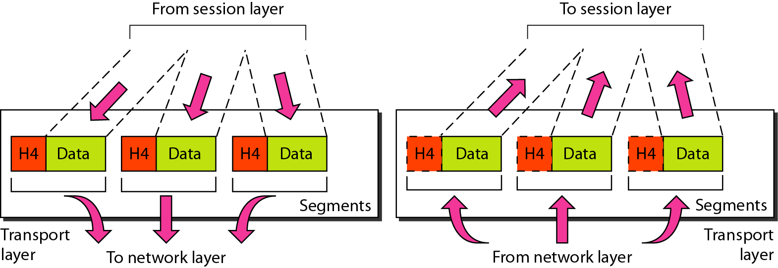
Transport Layer
The transport layer is responsible for delivery of a message from one process to another

Slide 31
Transport Layer: Duties
Service-point (port) addressing
Segmentation and reassembly
Connection control
Flow control
Error control

Slide 32
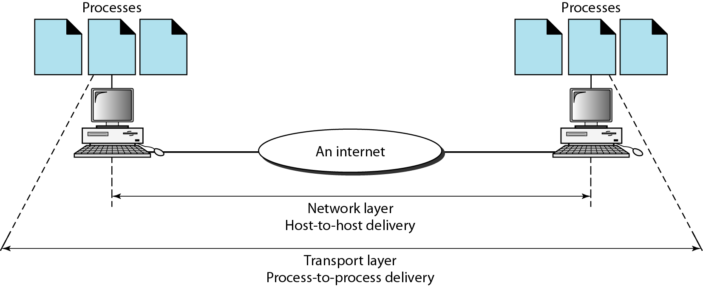
Reliable Process-to-Process Delivery of a Message

Slide 33
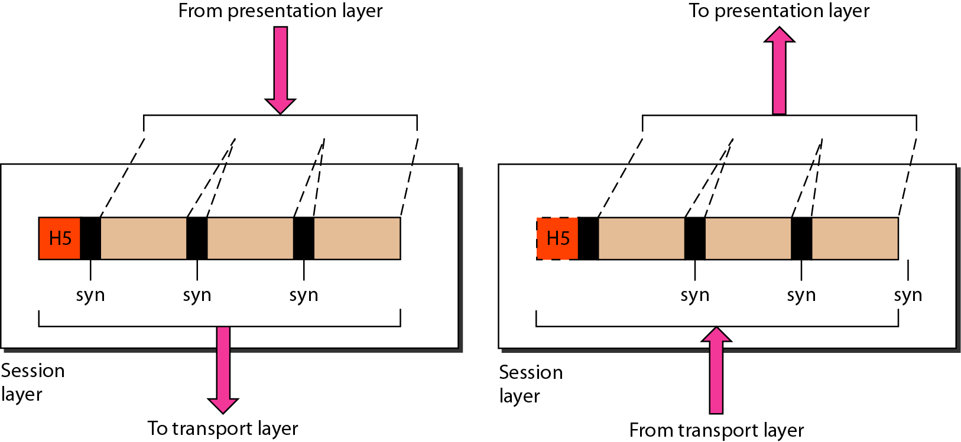
Session Layer
Session layer is responsible for dialog control and synchronization

Slide 34
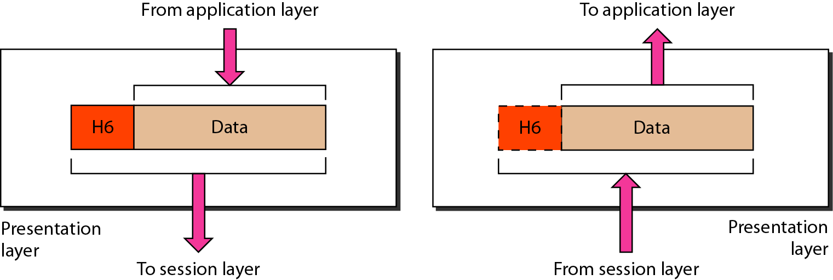
Presentation Layer
Presentation layer is responsible for translation, compression, and encryption

Slide 35
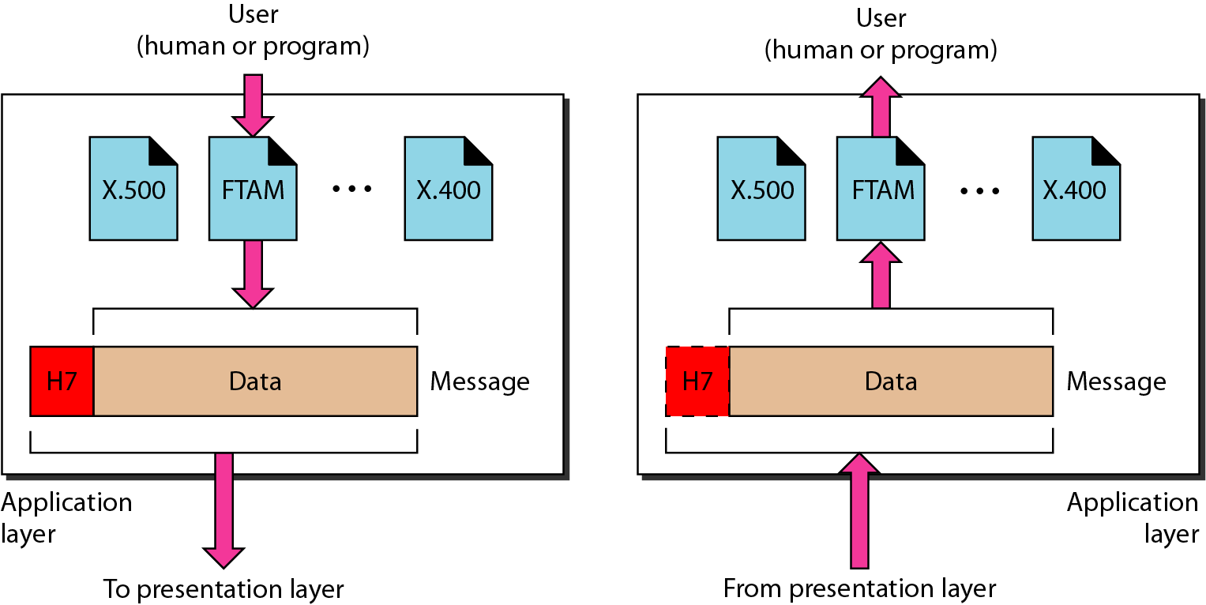
Application Layer
Application layer is responsible for providing services to the user

Slide 36
Application Layer: Services
Network virtual terminal
Mail services
File transfer, access, and management
Directory services

Slide 37
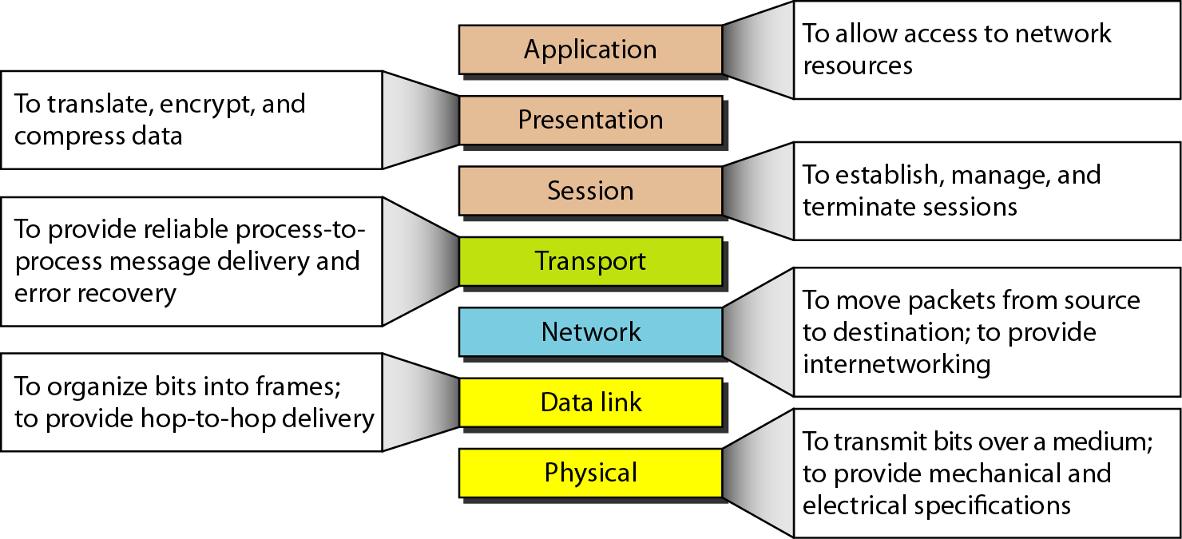
Summary of Layers

Slide 38
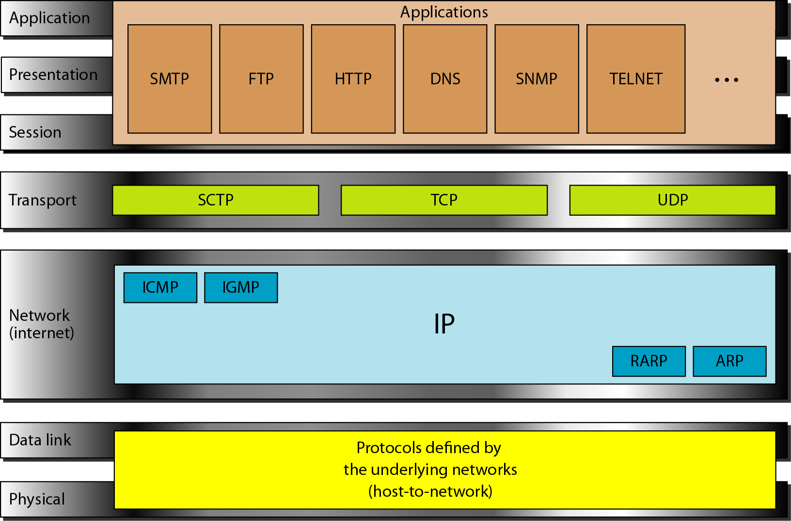
TCP/IP and OSI Model

Slide 39
TCP/IP Protocol Suite
Host-to-network : Physical and data link layer
No specific protocol
Network layer
IP(Internet Protocl), ARP(Address Resolution Protocol), RARP(Reverse ARP), ICMP(Internet Control Message Protocol), IGMP(Internet Group Message Protocol)
Transport layer
TCP(Transmission Control Protocol), UDP(User Datagram Protocl), SCTP(Stream Control Transmission Protocol),
Application Layer
Combined session, presentation, and application layers

Slide 40
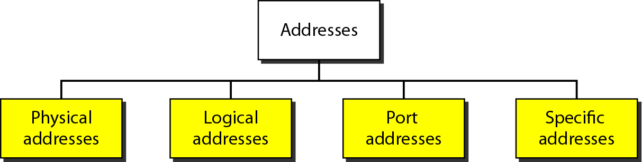
Addressing
Four levels of addresses in TCP/IP protocols
Physical (link), logical (IP, network), port, and specific addresses

Slide 41
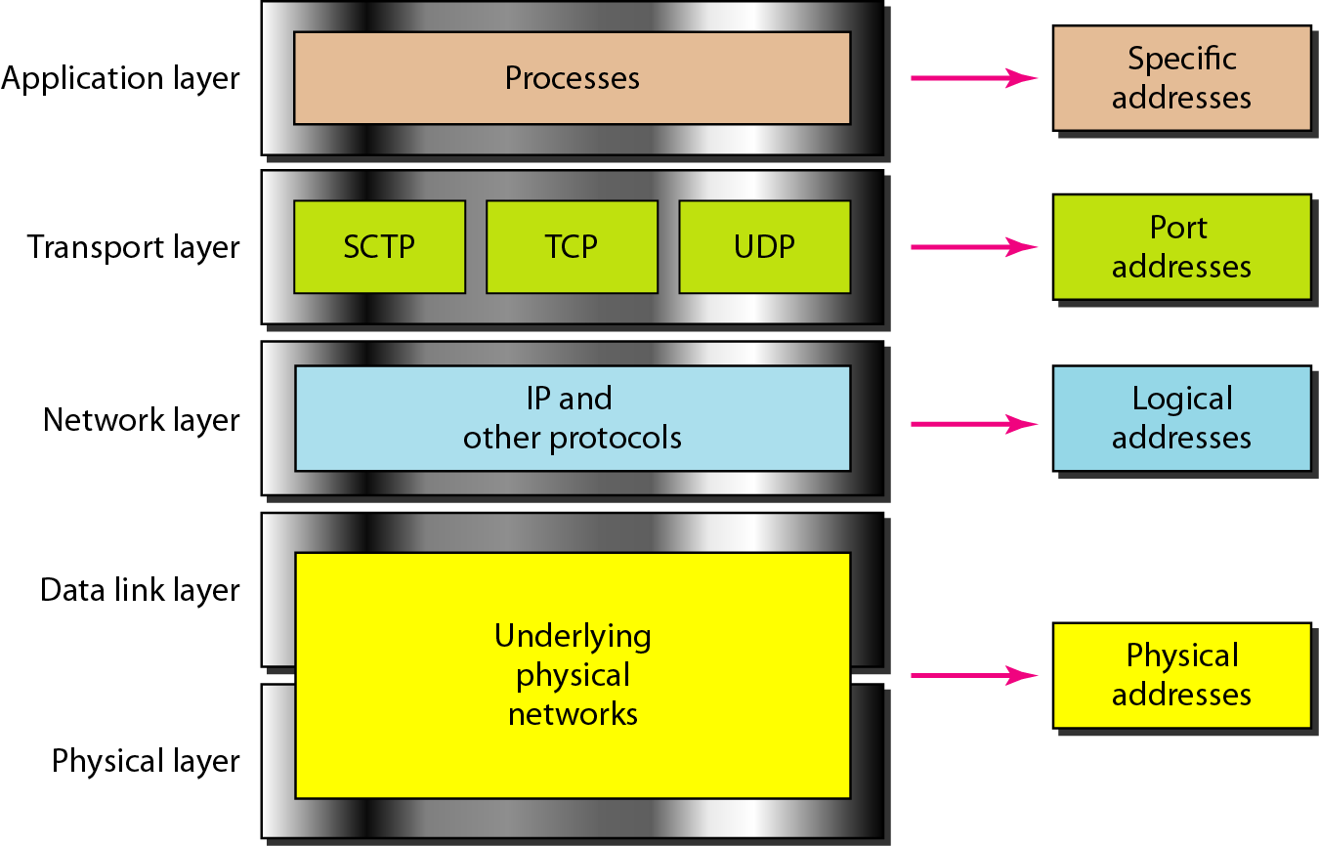
Relationship of Layers and Addresses

Slide 42
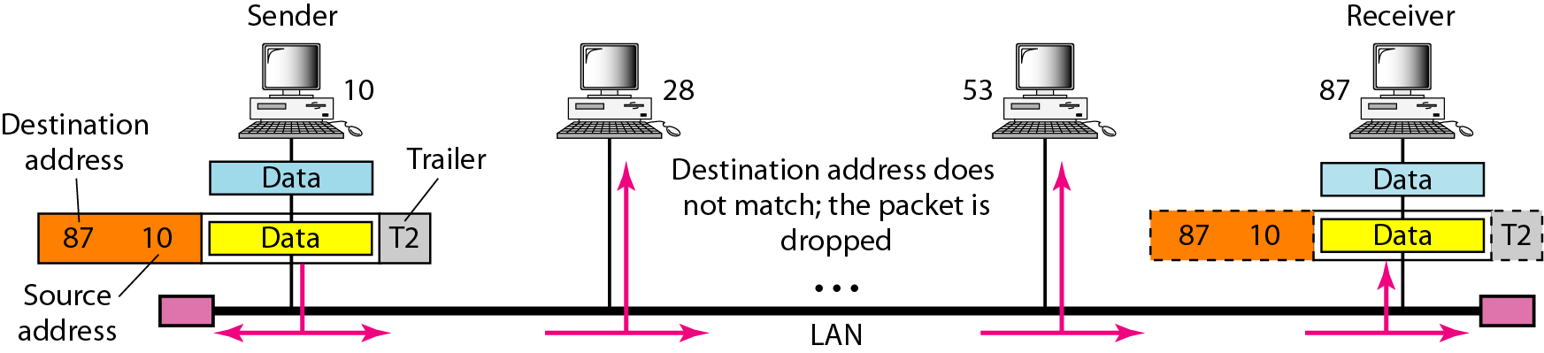
Physical Address
A node with physical address 10 sends a frame to a node with physical address 87. The two nodes are connected by a link (bus topology LAN). As the figure shows, the computer with physical address 10 is the sender, and the computer with physical address 87 is the receiver.
07:01:02:01:2C:4B A 6-byte (12 hexadecimal digits) physical address.

Slide 43
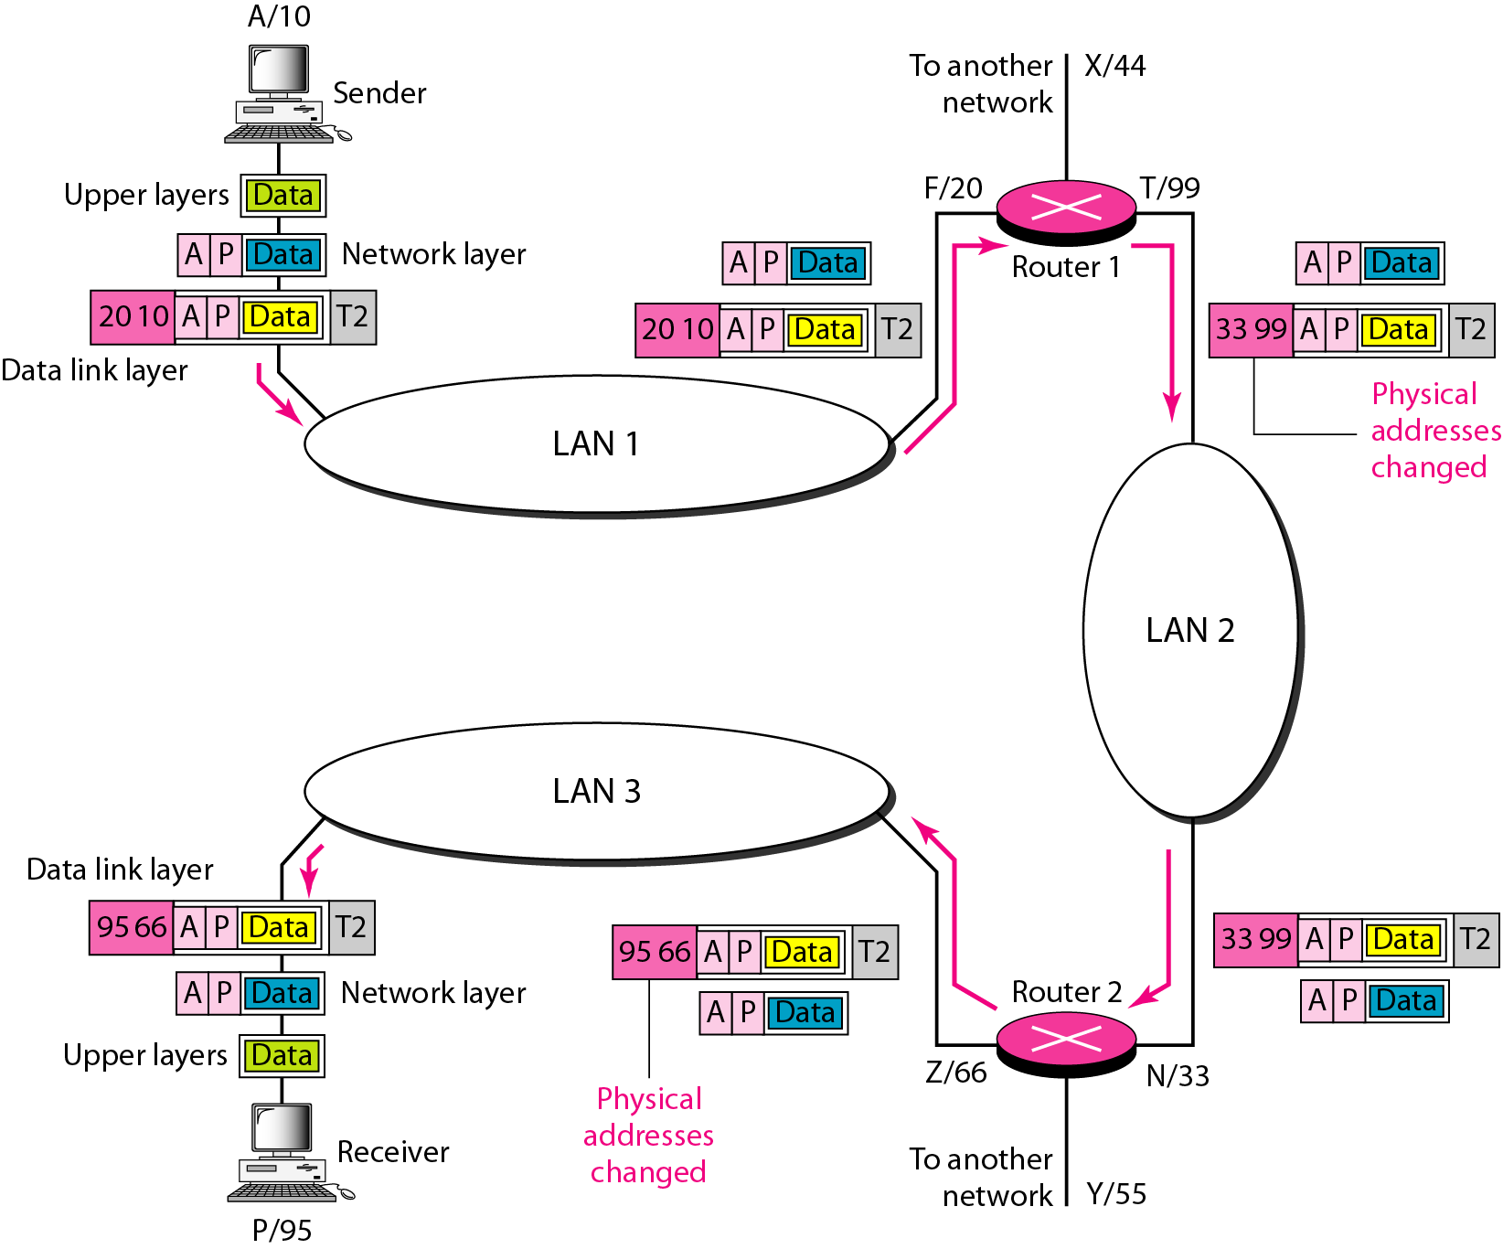
Logical (IP) Address
The physical addresses will change from hop to hop, but the logical addresses usually remain the same

Slide 44
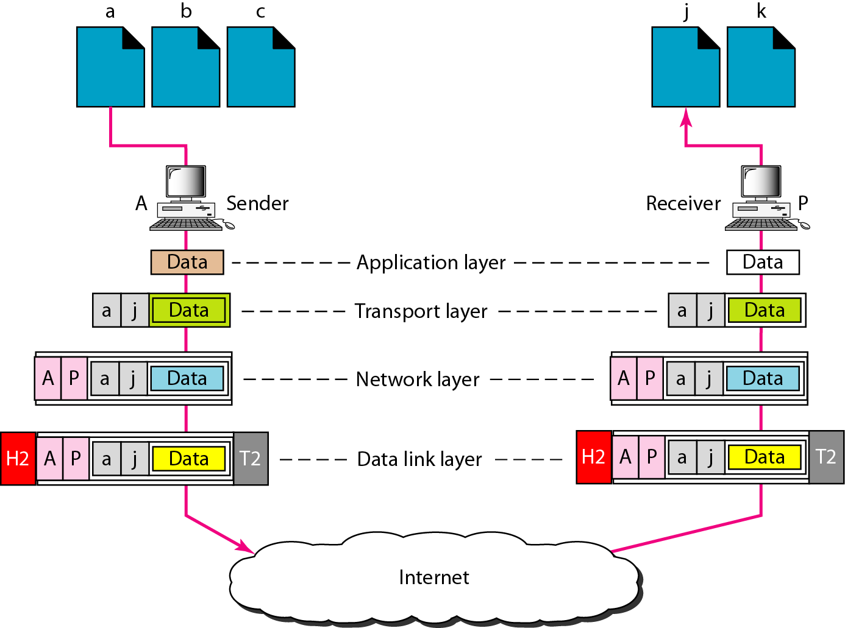
Port Address
The physical addresses change from hop to hop, but the logical and port addresses usually remain the same

Slide 45
Specific Address
Some application have user-friendly addresses that are designed for that specific address
Example 1: e-mail address: kchung@kw.ac.kr
Defines the recipient of an e-mail
Example 2: URL (Universal Resource Locator) : www.kbs.co.kr
Used to find a document on the WWW

