Slide 1
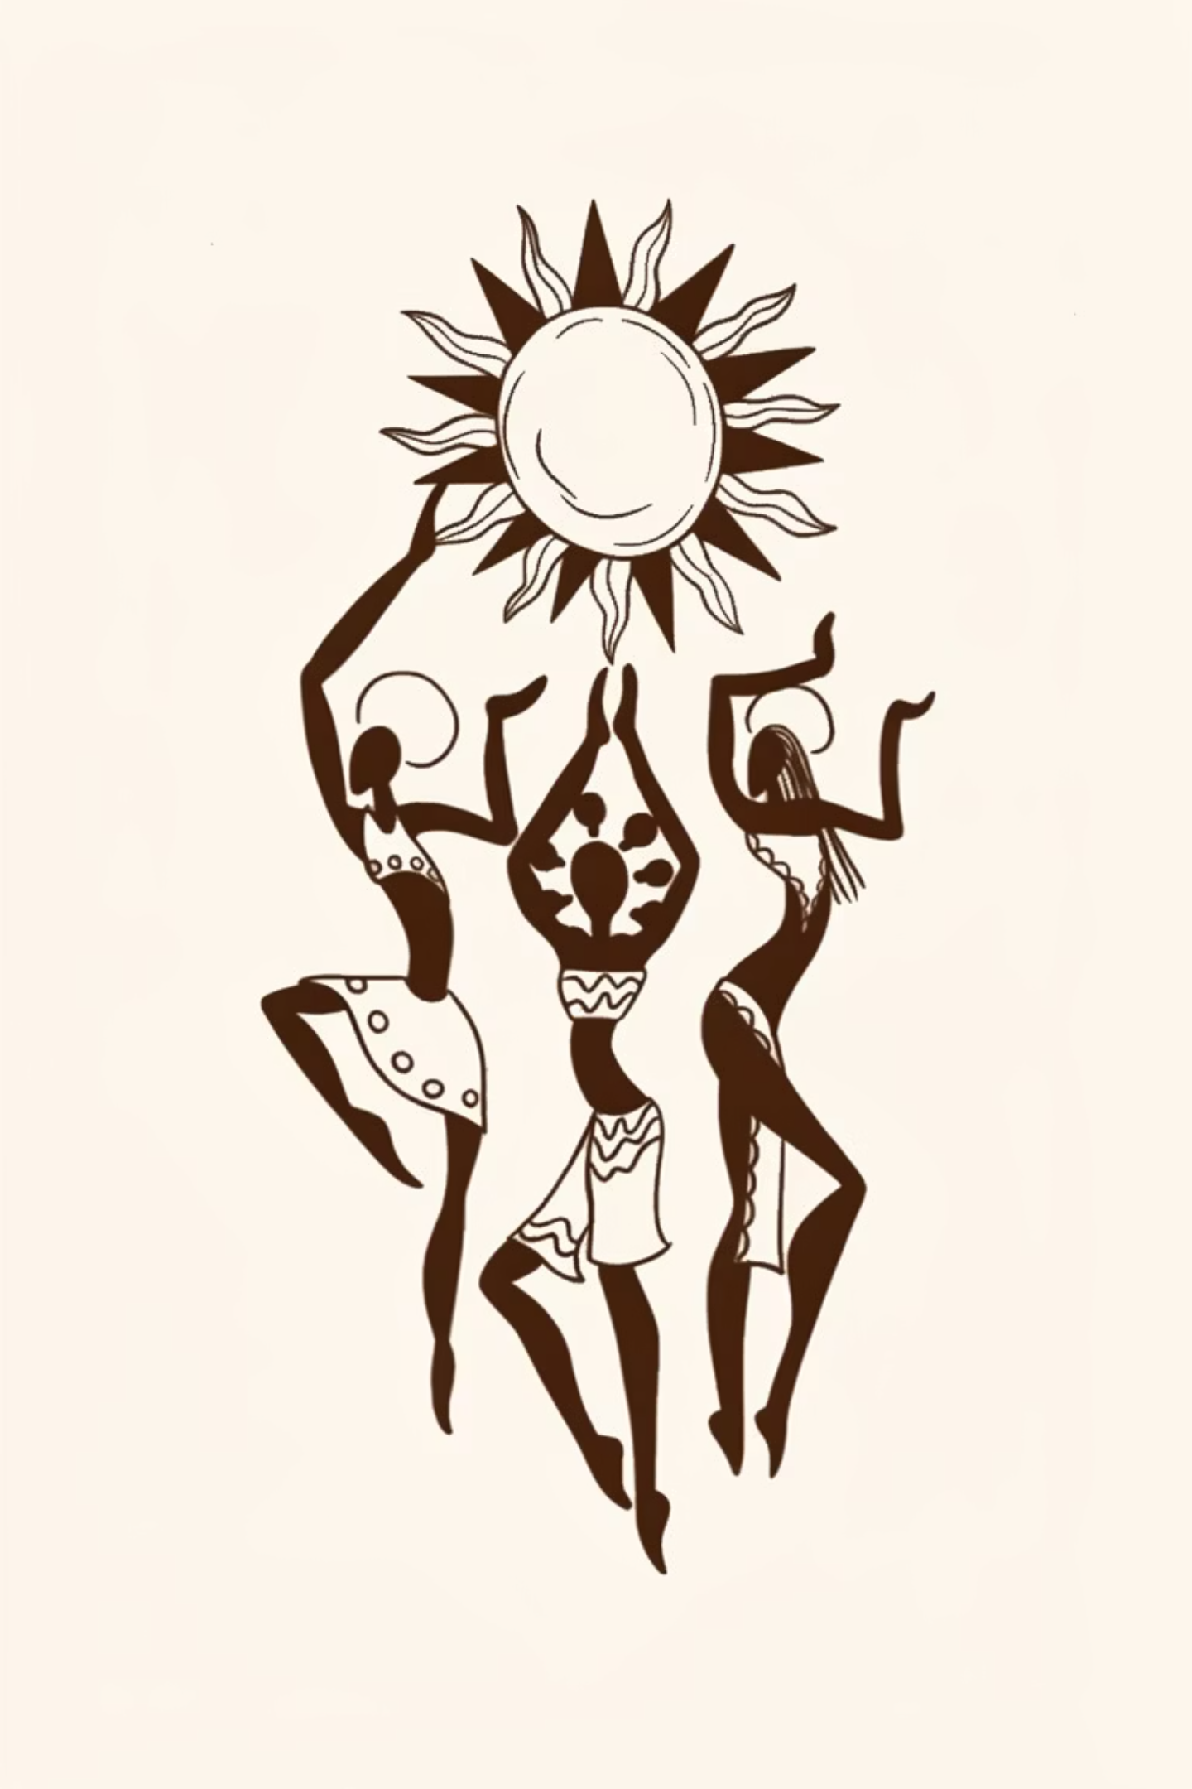
Problem statement: 09
Empowering Rural Women Artisans: Our Mission & Impact
Rangaayan: A women-first marketplace that pays fair prices, and connects handcrafted goods to global buyers.
Team: Bisleri

Slide 2

The Problem: Invisible Artisans, Lost Opportunities
Exploitative middlemen
No direct market
Digital exclusion
Unfair cuts, opaque pricing
Limited access to buyers and fair revenue
Complex onboarding and low tech literacy
Team: Bisleri

Slide 3
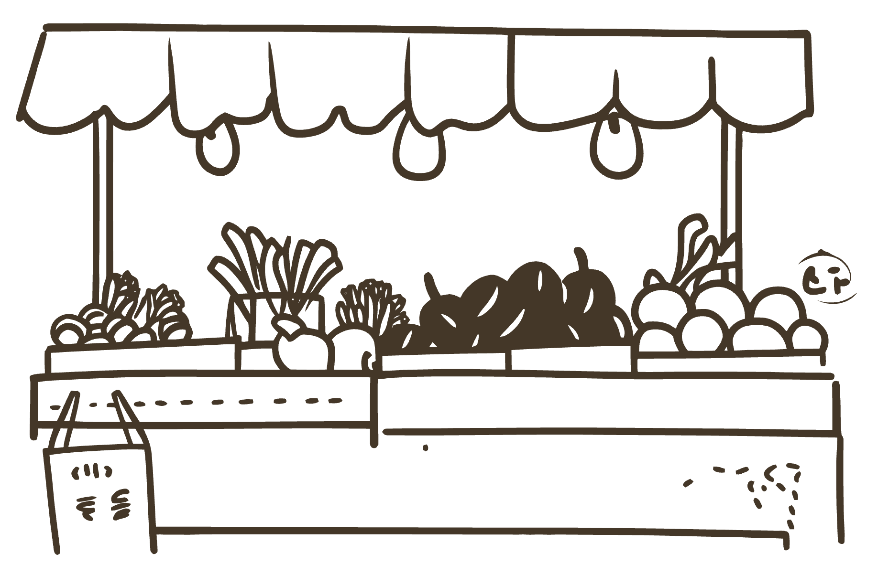

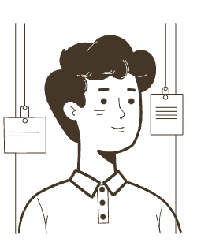
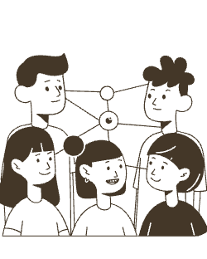
Rangaayan
A Women‑Centric Digital Marketplace
OTP‑Only Login
Zero-friction access for low-literacy users
Our Solution?
AI Pricing Engine
Data-driven fair prices for every artisan
SHG & NGO Integration
Trusted onboarding and last-mile reach
Team: Bisleri

Slide 4
What Differentiates Us
We serve organizations buying in bulk, not individual consumers. Our focus is on impact-driven B2B customers who value authentic, ethical products and measurable social outcomes.
1
2
3
Festival Gift Orders
Corporate Gifting
Colleges & Institutions
Bulk pricing advantage during peak seasons
For companies seeking authentic, ethical gifts
Meaningful gifts for students, alumni, and events
Direct artisan sourcing = authentic, handcrafted products
CSR value with rich character & impact storytelling
Flexible bulk quantities and customization options for events
Competitive bulk pricing and tiered discounts
Brand alignment with sustainability and women’s empowerment
Customization and white‑labeling available
Unique gift experiences with an educational, social‑impact story
Institutional bulk pricing and procurement-friendly ordering
Supports student entrepreneurship and cultural preservation
Key Differentiators: Direct artisan connection (no middlemen) • Authentic handcrafted quality • Bulk pricing advantages • CSR & impact storytelling • Customization capabilities • Fair-trade transparency
Team: Bisleri

Slide 5






Our SDG Impact: Building Equitable Growth
Rangaayan is deeply committed to the United Nations Sustainable Development Goals, driving positive change across multiple fronts for our artisan communities.
SDG 5: Gender Equality
SDG 8: Decent Work
Empowering rural women artisans by providing direct market access, fair pay, and ownership over their economic futures.
Ensuring fair wages and safe, dignified working conditions for artisans, free from exploitation by middlemen.
SDG 1: No Poverty
SDG 10: Reduced Inequalities
Increasing income and financial stability for marginalized artisan communities, lifting families out of poverty.
Bridging the gap between rural and urban economies, providing digital inclusion and equitable opportunities for disadvantaged groups.
SDG 12: Responsible Consumption
SDG 17: Partnerships
Promoting sustainable production and consumption of handcrafted goods, valuing traditional skills and ethical sourcing.
Fostering collaborations with Self-Help Groups (SHGs) and NGOs for community mobilization and last-mile support.
Team: Bisleri

Slide 6
Tech Stack we are using
Frontend: Next.js 16 (App Router), Tailwind CSS, shadcn/ui
AI Backend: FastAPI (Python) with Kimi K2.5 via OpenRouter
Database: PostgreSQL via Drizzle ORM
AI Detection: Kimi K2.5 vision (replaced YOLO — no torch/ultralytics dependency)
Team: Bisleri

Slide 7

Future Scope: Mobile App for Wider Access
01
Making a mobile app for easier access
To make it easier for rural women to access the interface
Team: Bisleri

Slide 8

THANK YOU!
Key Impact
How We Deliver
Call to Action
Empowering rural women artisans creates sustainable livelihoods, strengthens communities, and delivers measurable SDG outcomes across gender equality, decent work, and poverty reduction.
Traceable, ethical marketplaces plus mobile tools (offline catalog, chat, notifications) expand market access, boost retention, and connect buyers directly with makers.
Join as investors, CSR partners, NGOs, or community groups to scale impact, co-design solutions, and ensure benefits reach the last mile.
Team: Bisleri

