Slide 1
CAPSTONE PROJECT • 2026
MENTAL HEALTH TREATMENT PREDICTOR
Predicting Treatment-Seeking Behaviour in Tech Industry Workers
Dataset: OSMI Mental Health in Tech Survey 2014
Model: Random Forest Classifier
Abhin Ashok • Data Analytics • Zoople Technologies

Slide 2
THE PROBLEM
Mental Health conditions affect 1 in 5 tech workers globally – yet the majority never seek treatment.
Why? Stigma, lack of awareness, fear of workplace consequences, and no visibility into who needs help most.
THE QUESTION THIS PROJECT ANSWERS:
Can Machine Learning identify which individuals are likely to seek mental health treatment – based solely on their workplace and personal background.

Slide 3
DATA CLEANING
Age Column: Entries ranged from -1726 to 99,999,999,999 → kept only realistic working ages 18-75
Gender Column: 49 messy free-text entries → consolidated Male(974)/Female(240)/Other(37)
Missing Value: work_interfere blanks → filled with “Never”
Encoding: All text categories → converted to integer values using LabelEncoder
Final Clean Dataset: 1,251 rows • 26 features • 0 missing values

Slide 4
THE DATASET
OSMI Mental Health in Tech Survey – 2014
The largest mental health survey in the tech industry conducted.
Target Variable Balance
1,257
27
Treatment Sought: 637 (50.6%)
Did Not Seek: 622 (49.4%)
survey respondents globally
features recorded per respondent
A perfectly balanced dataset
No class imbalance issues
Model results are reliable
26
1
predictor features
target variable – treatment (Yes/No)

Slide 5
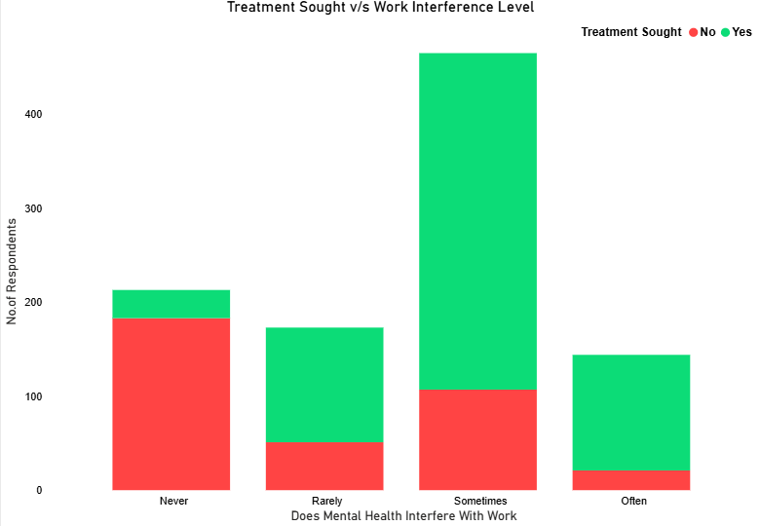
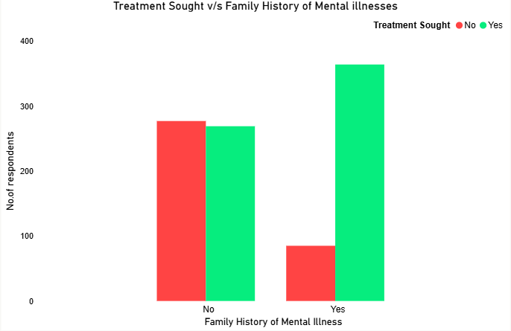
KEY FINDINGS FROM EXPLORATORY ANALYSIS
As work interference increases from Never to Often, the proportion seeking treatment rises sharply – suggesting it as a strong predictor.
Individuals with a family history of mental illness are significantly more likely to seek treatment, indicating a strong hereditary awareness factor.

Slide 6
THE MODEL – RANDOM FOREST CLASSIFIER
Why Random Forest Classifier?
A Random Forest builds 100 individual Decision Trees, each trained on a random subset of the data.
Every tree casts a vote. The majority vote wins.
Model Configuration:
Algorithm : Random Forest Classifier
Trees : 100
Max Depth : 10
Training Set : 1,000 rows
Test Set : 251 rows
Random State : 42
This Approach:
Corrects for individual tree errors.
Handles the encoded categorical features well.
Works optimally on balanced datasets.
Resists overfitting through ensemble voting.

Slide 7
MODEL ACCURACY
81.27%
204 of 251 unseen cases correctly predicted
+31 points above random guessing
Tested on balanced dataset

Slide 8
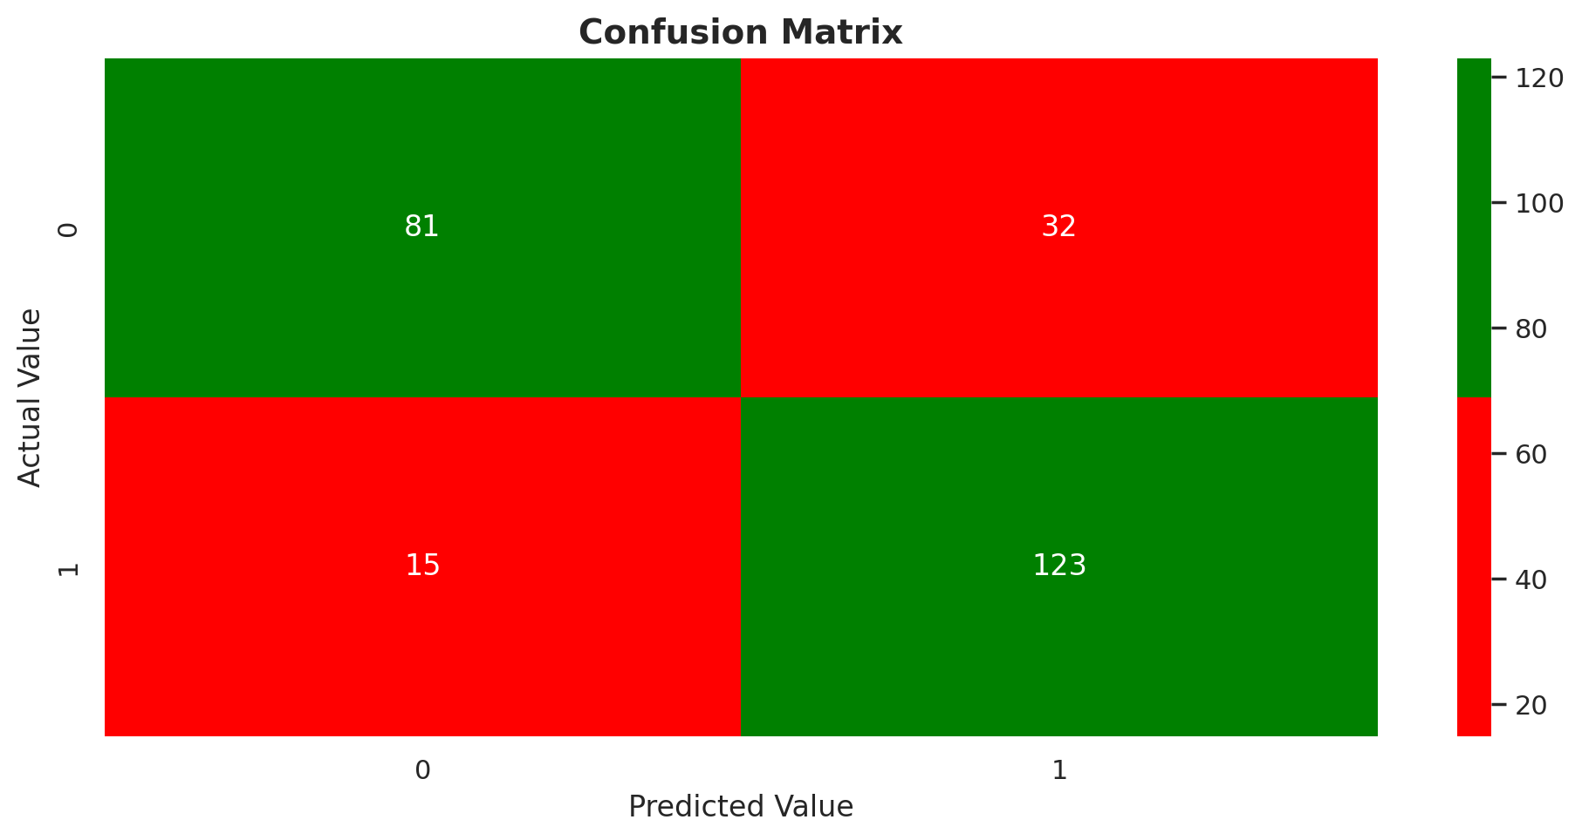
CONFUSION MATRIX RESULT
CORRECT PREDICTIONS
204/251
WRONG PREDICTIONS
47/251

Slide 9
CLASSIFICATION REPORT – WHAT THE METRICS MEAN
No Treatment Predicted
Precision: 0.84 • Recall: 0.72 • F1-Score: 0.78
Treatment Predicted
Precision: 0.79 • Recall: 0.89 • F1-Score: 0.84
KEY INSIGHT:
The model is stronger at identifying people who DO seek treatment (F1-Score=0.84) than those who don’t.
The model catches 89% of all actual treatment-seekers
Recall for class 1=0.89 – the most important metric for this use case

Slide 10
LIVE DEMONSTRATION
Predicting treatment-seeking in real time
Input: 22 workplace survey responses
Output: Likely/Unlikely to seek treatment
Switching to Google Colab →

Slide 11
CONCLUSIONS
Limitations
Survey data is self-reported – subject to bias.
2014 data – workplace mental health culture has evolved.
Model should support human decisions, not replace them.
A Random Forest Model can predict mental health treatment-seeking with 81.27% accuracy using only workplace survey data.
The dataset required significant cleaning – particularly Age & Gender – before modelling.
The model is more sensitive to true cases (89% Recall), making it appropriate for supportive, not punitive use.
Future Scope
Test on more recent OSMI survey years.
Incorporate additional workplace policy features.
Deploy as a HR support screening tool.

Slide 12
THANK YOU
Presented By: ABHIN ASHOK

