Slide 1
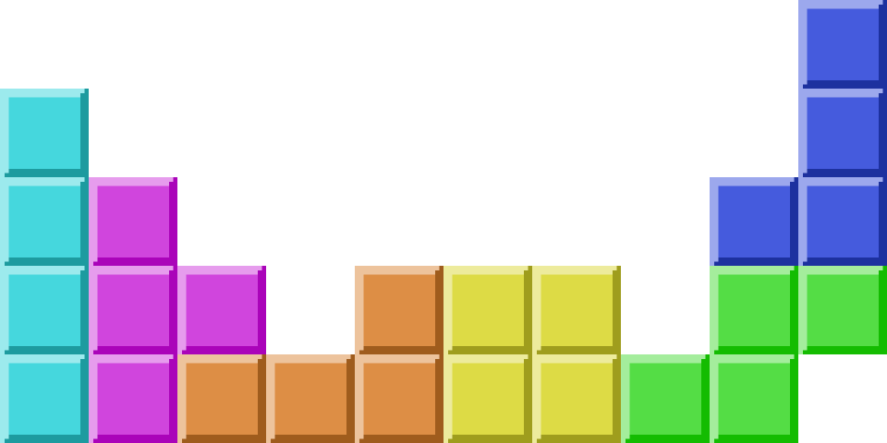
Experiential Learning
(DA1001) Project
Tetris clone

Slide 2
Introduction
Tetris is a retro classic video game created in 1984 by Russian software designer Alexey Pajitnov.
It is 2nd in the list of highest grossing games.
It is a simple game covering most important aspects of game development.
Modular and flexible; allows implementation of unique new ideas without compromising the original base ideas and gameplay.

Slide 3
Progress
Created and rendered
textures
Game logic
using SFML
Implementing an
Object-Oriented
approach

Slide 4
Game Mechanics
A random tetrominos of the 7 defined shapes is selected and rendered.
It falls down at a constant rate.
The player is allowed to move around and rotate the tetromino as it falls down till it rests on the base or other tetrominos.
After this tetromino comes to a standby, another is generated and the cycle continues.
The goal of the player is to complete an entire row to score points.
When this happens, the entire row is deleted and more space is generated.
The player loses if the board is filled and no more tetrominos can be placed.

Slide 5
Structure
Movement and rotation of blocks (tetrominos).
Random generation of defined tetrominos.
Collision detection system.
Score tracker.
When a row is entirely filled, it vanishes and points are increased.

Slide 6
Features
Non-linear scoring system.
Visual and sound effects.
Levels with increasing difficulty. Faster falling blocks.
Preview of upcoming block.
Texture packs.

Slide 7
Libraries
SFML (Simple and Fast Multimedia Library) provides an application programming interface (API) for rendering windows.
It has been used to create a window, load textures and 2D shapes.
Updates and displays content regulary.
Repository: www.github.com/SFML/SFML

Slide 8
References and Resources
https://www.stroustrup.com/programming.html
https://www.sfml-dev.org/tutorials/2.5/
https://www.youtube.com/playlist?list=PL6xSOsbVA1eb_QqMTTcql_3PdOiE928up
Background: https://i.redd.it/vwr7xn47pvk51.jpg
Border: https://www.dlf.pt/ddetail/TTwTJi_glowing-neon-square-png-transparent-png/

Slide 9
Thank you.
-Made by Abhishek Pagadala under the
guidance and mentorship of Dr. Kusum Lata Jain

