Slide 1

INTRODUCTION TO OUR PROJECT
WAD
Project
(Genz-gadgets)
Presented by:
Muhammad Hussain Abdulrehman
Muhammad Abu Bakar
Aitzaz-ul-Hassan

Slide 2
Introduction to Our Website's Purpose and Features
Gen Z Gadgets: Your one-stop shop for affordable, cutting-edge tech. From earbuds to drones — we bring the latest gadgets that fit your style and budget.
.

Slide 3
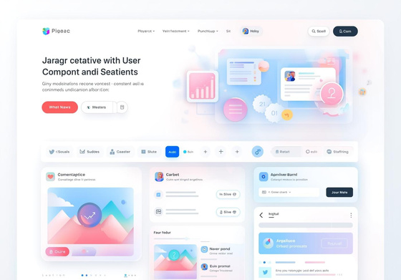
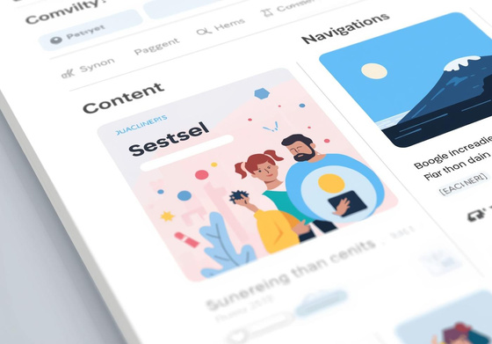
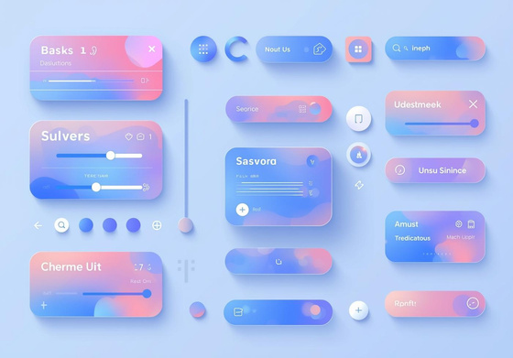
Figma Design Overview
Layout
Color Pallete
Interactivity
The layout promotes user engagement and accessibility.
The sound combination of black blue and white coior
Interactive elements increase engagement and usability.

Slide 4
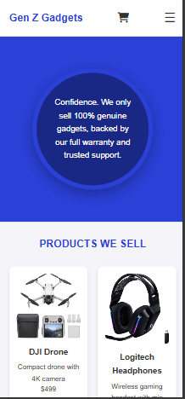
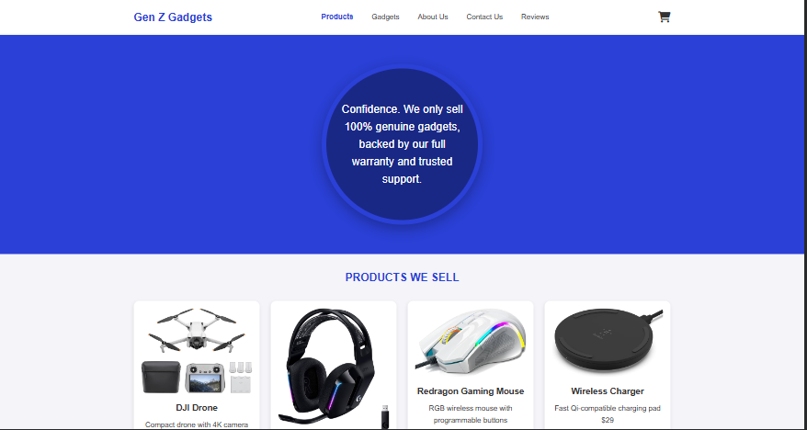
First Figma Design
Created By Aitzaz ul Hassan

Slide 5
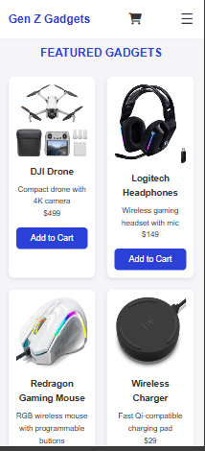
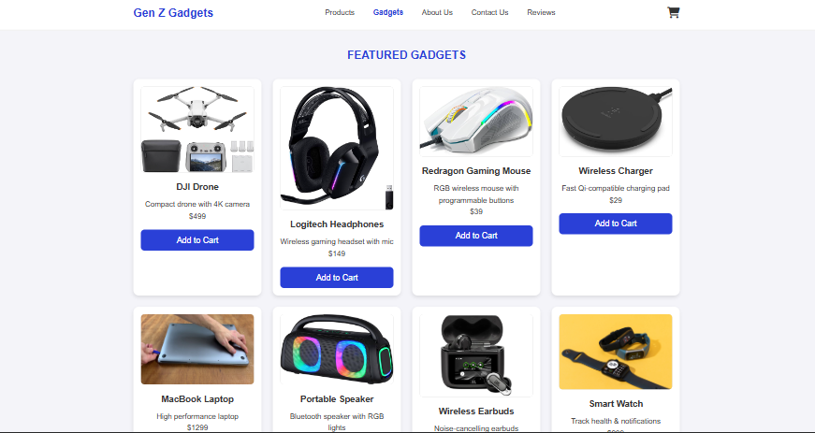
Second Figma Design
Created By Muhammad Abu Bakar

Slide 6
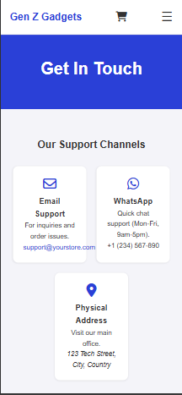
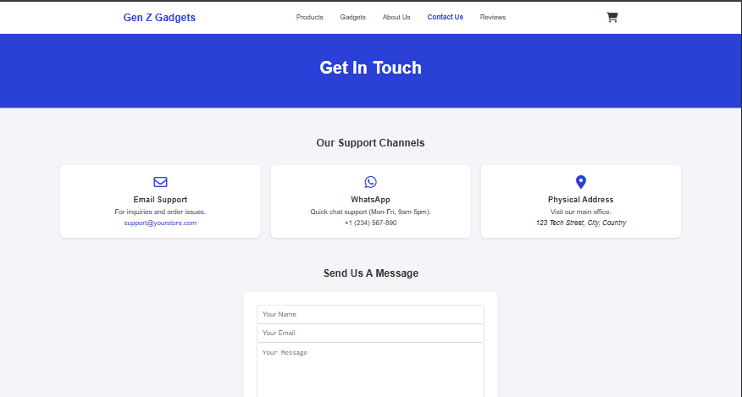
Third Figma Design
Created By Abd’al’Rehman

Slide 7
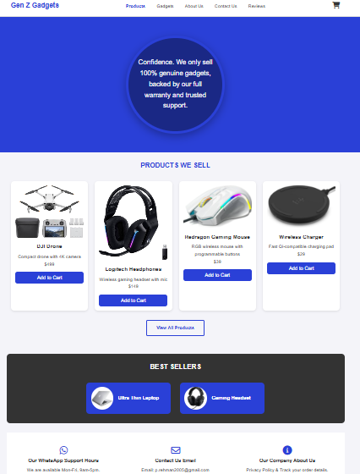
Implementation of Design 1
Home Page
Responsive layout with intuitive navigation features.

Slide 8
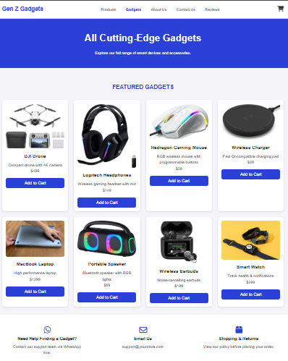
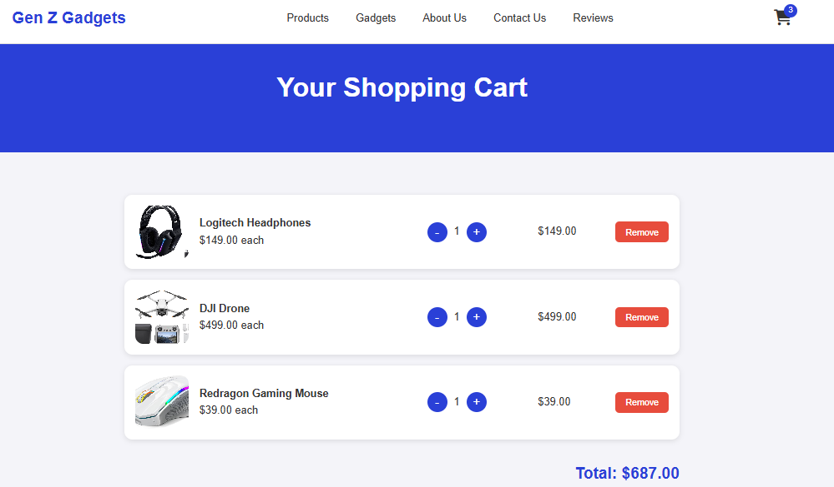
Implementation of Designs
Gadgets & Cart Page
Showcasing the elegant layout and functionality

Slide 9
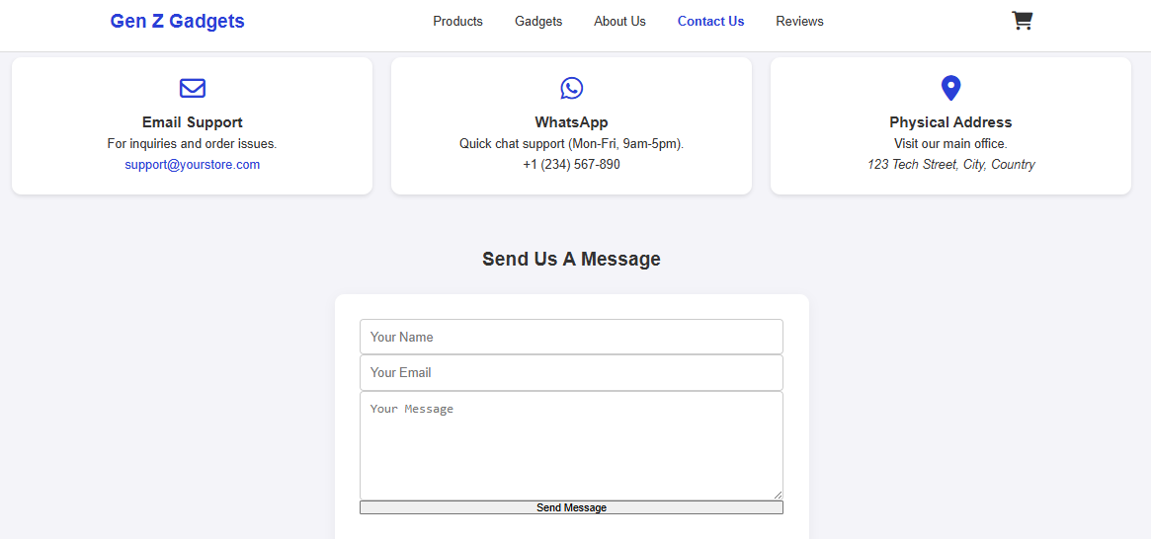
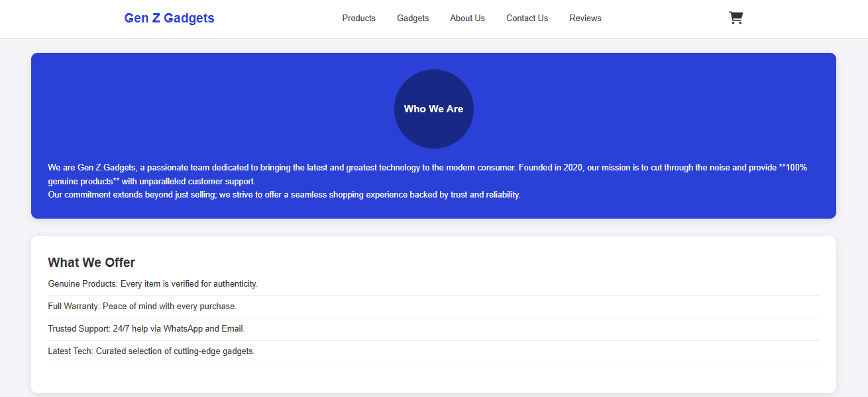
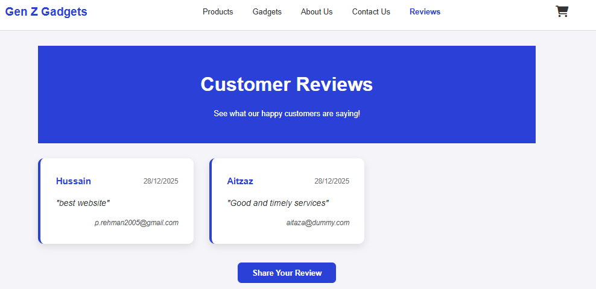
Implementation of Design 3
Contact , Review
About pages
Reflects all features and user interface choices

Slide 10
Understanding Our Node.js Script Functionality
The Node.js script serves as the backbone, handling server requests and managing database interactions for our website.

Slide 11
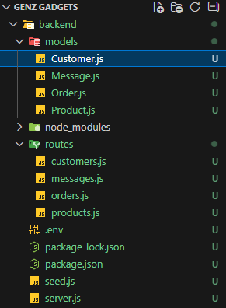
Quick guide
This is the complete structure of the backend folder structure in our project .

Slide 12
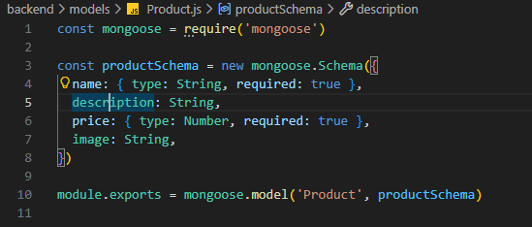
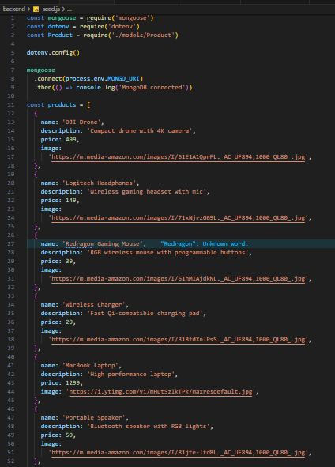
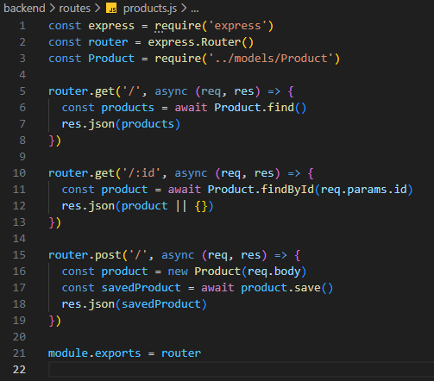
All but Just about products
Here we are presenting the complete structure of a PRODUCT (the Model, the Route and the Mongo Insertion). The same we’ve implemented for CUSTOMERS, ORDERS and Messages

Slide 13
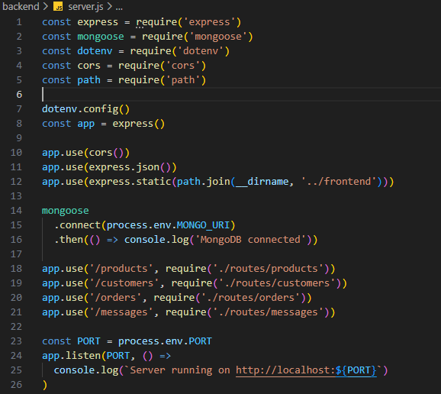
The Core :
The Server
This part consists of the complete implementation of the server with all actors discussed above

Slide 14
Client-Side JavaScript Implementation Journey
Embarked on a vanilla JavaScript journey to build an interactive e-commerce frontend from scratch. Mastered DOM manipulation, fetch API, and local Storage to create dynamic product grids and a persistent cart.

Slide 15
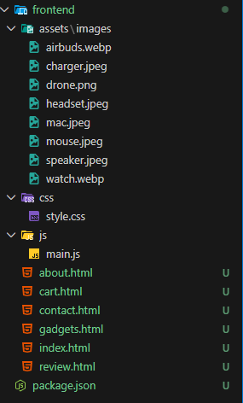
Quick guide
This is the complete structure of the frontend folder structure in our project .

Slide 16
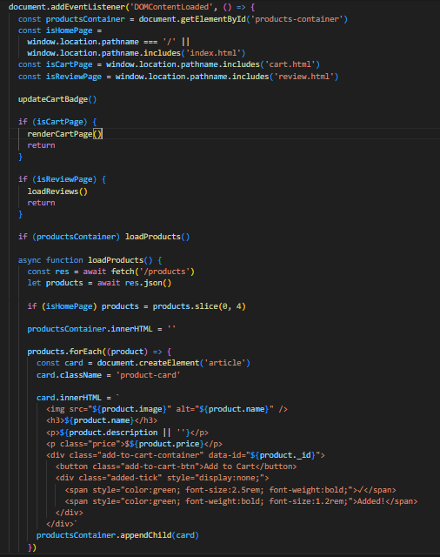
DOM Manipulation
Complete DOM structure explanation .

Slide 17
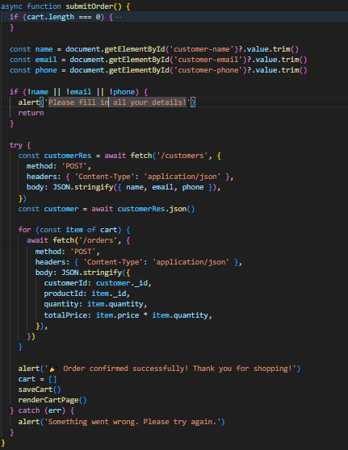
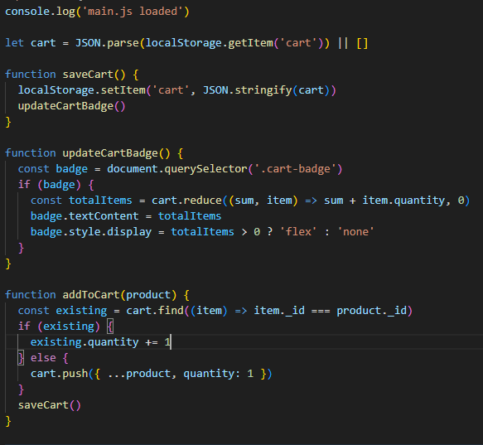
Functionalities
This is the complete structure of the frontend folder structure in our project .

Slide 18

Thank You!
Any Questions ?
We appreciate your attention and inquiries
EMAIL
genzGadgets@gmail.com
PHONE
0318x-xxxxxxxx
SOCIAL MEDIA
@genz_gadgets

