Slide 1

Noodles Crypto Analytics Platform
End-to-End Data Pipeline with Python & Power BI
Mohammad Abaan | November 2, 2026
Notes:
[~0:30]
Hi, I'm [Name]. Today I'll show you the currency analytics platform I built with Python and Power BI. It processes over a million rows of market data and turns it into dashboards people can act on.
In the next ten minutes I'll cover the problem it solves, the architecture, a quick look at the code and the dashboards, and a few things the data told me.

Slide 2




Executive Summary
WHAT
WHY
Automated currency analytics pipeline
Enable data-driven investment decisions
HOW
IMPACT
Python ETL + SQL data warehouse + Power BI
1M+ rows, < 5 min refresh, real‑time insights
Notes:
[~0:40]
Here is the whole project in four lines.
What: an automated pipeline for currency analytics. Why: so investment decisions rest on current data instead of manual spreadsheet work. How: a Python ETL loads a SQL data warehouse, and Power BI sits on top of it. Impact: more than a million rows, refreshed in under five minutes, so the insights stay fresh.
Everything else in this talk expands on one of those four boxes.

Slide 3


Business Problem
THE CHALLENGE
THE NEED
Manual currency analysis is time‑consuming
An automated, reliable, scalable solution
WHO USES IT
SUCCESS METRIC
Daily actionable insights
Executives
Traders
Analysts
Notes:
[~0:35]
The starting point was a familiar problem: analyzing currencies by hand takes too long, and by the time the numbers are ready they are already stale.
What we needed was something automated, reliable, and able to scale as the data grows. The people who depend on it are executives, who want the headline view, traders, who want to know what is moving today, and analysts, who want to dig in.
The success metric is simple: every day, they get insights they can act on.

Slide 4



Technical Architecture
JSON files
Staging
Star schema
Aggregations
Dashboards
raw source
MySQL
dims + facts
summary tables
Power BI
Python
MySQL
Power BI
pandas, SQLAlchemy
Staging + star schema
Connected via ODBC
Automation: scheduled ETL + scheduled Power BI refresh
Notes:
[~1:00]
This is the whole pipeline on one slide. Data starts as JSON files. A Python ETL script, built on pandas and SQLAlchemy, loads it into a staging area in MySQL. From staging it is transformed into a star schema, then rolled up into aggregation tables, and Power BI reads those over an ODBC connection to power the dashboards.
The ETL and the Power BI refresh are both scheduled, so nobody has to press a button.
[Switch to VS Code and show the ETL script.]

Slide 5
Data Model
DimCurrency
DimDate
DimPlatform
currency key, symbol, name
date key, day, month, year
platform key, platform name
Vw_PlatformDaily
FactSocialEngagement
price, volume, market cap
mentions, likes, engagement score
Grain: one row per currency per day
Notes:
[~0:40]
The warehouse is a classic star schema. Three dimensions describe the who, when, and where: currency, date, and platform. Two fact tables hold the measurements: a daily snapshot of market data, and social engagement.
The grain is one row per currency per day. Fixing the grain first is what keeps the joins clean and the numbers consistent in Power BI.
[Optional: replace this diagram with your ERD screenshot if you prefer.]

Slide 6
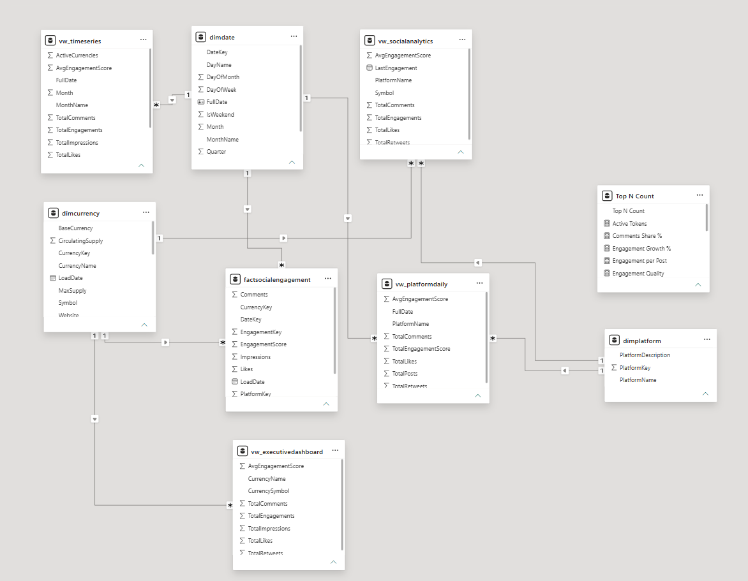

Slide 7
Python ETL Pipeline
100K
rows per minute
extract_currency_data()
def extract_currency_data(path):
try:
df = pd.read_json(path)
logger.info("Extracted %d rows", len(df))
return df
except (ValueError, OSError) as exc:
logger.error("Extract failed: %s", exc)
send_alert(exc)
raise
5 min
total runtime
BUILT IN
Error handling
Logging
Data quality checks
Email alerts
Notes:
[~1:15]
[Demo: run python build_powerbi_datasets.py and keep the terminal visible.]
Here is the ETL in action. It extracts the data, validates quality, and loads to MySQL. Watch the logging as it runs: every step reports what it did and how many rows it touched.
The snippet on the slide shows the pattern used throughout: try the extraction, log the row count, and on failure log the error, send an alert, and re-raise. So problems are never silent.
The pipeline handles roughly 100K rows a minute, and the full run takes about five minutes.
[Presenter note: the code on this slide is a representative snippet. Swap in your real extraction function before presenting.]

Slide 8
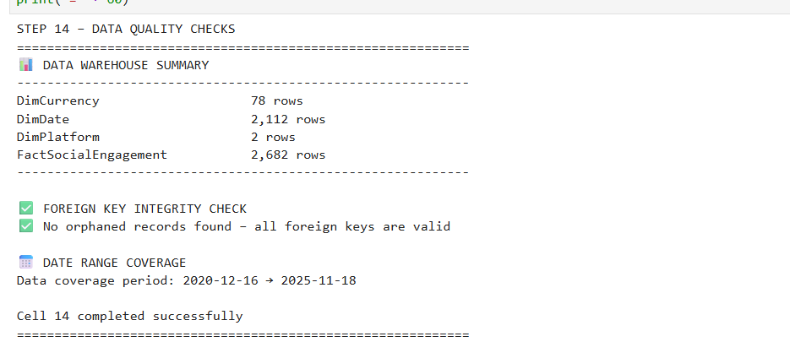




Data Quality & Validation
99.8%
data quality score
Null checks
Duplicate checks
Referential integrity
Bad records go to a reject file
Notes:
[~1:00]
[Demo: open the Jupyter validation notebook, run the cells, and show the results. Then paste a screenshot onto this slide.]
Let's check data quality with the validation notebook. It tests for nulls, duplicates, and referential integrity, meaning every fact row points to a real currency, date, and platform.
Anything that fails does not get silently dropped or loaded. It goes to a separate reject file, so I can review bad records and fix the source. The overall data quality score is 99.8%.

Slide 9
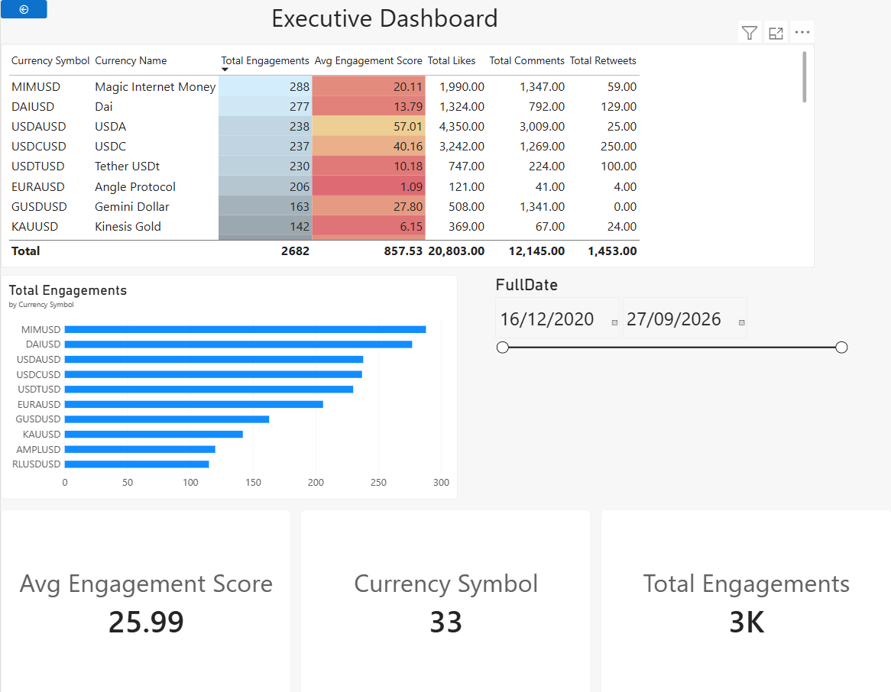
Power BI Executive Dashboard
CALLOUTS
Key KPIs
Interactive filters
Trends
FEATURES
Cross-filtering
Drill-through
Bookmarks
50+
100+
users
views/day
Notes:
[~1:30]
[Demo: open Power BI and show the executive view. Click a filter, cross-filter a visual, drill through, and switch a bookmark. Then paste a screenshot onto this slide.]
Now the part I'm most excited about: the dashboards. This is the executive view. The KPIs are at the top, the trends below, and everything responds to the filters.
Clicking any visual cross-filters the rest of the page, drill-through takes you to the detail behind a number, and bookmarks jump between saved views. More than 50 people use it, with over 100 views a day.

Slide 10
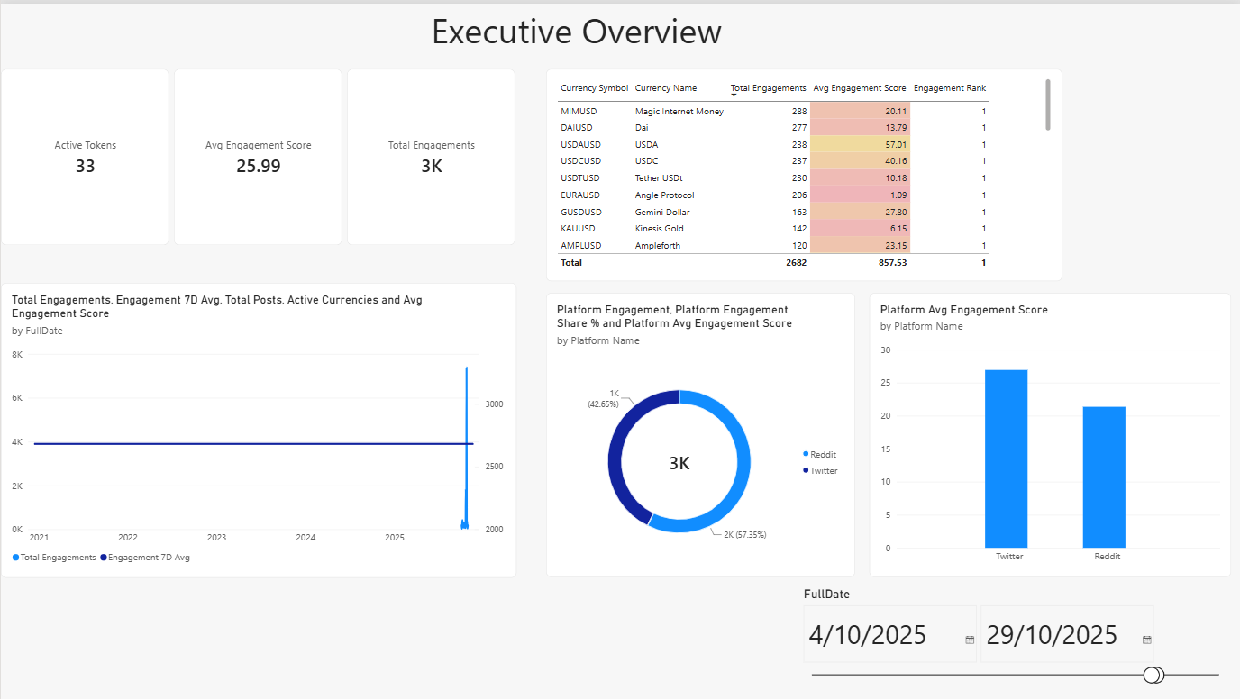
Top Performers Report
HIGHLIGHTS
Conditional formatting
Dynamic Top N
USE CASE
Daily trading decisions
INSIGHT
Top 10 gainers averaged +25% this week
Notes:
[~0:40]
This report answers the trader's daily question: what is moving? It shows the top gainers and losers, with conditional formatting so the strongest moves stand out at a glance.
The Top N is dynamic: change the slicer and the ranking recalculates. For example, this week the top ten gainers averaged about a 25% gain.
[Paste a screenshot of the Top Gainers / Losers page onto this slide.]

Slide 11
Key Insights
45%
30%
Bitcoin dominance of total market cap
of price moves predicted by social engagement
4 hrs
90%
lead time: volume spikes precede price changes
of volume comes from the top 20 currencies
Notes:
[~0:50]
Using the dashboard, four things stood out.
One: Bitcoin accounts for about 45% of the total market cap. Two: social engagement is a leading indicator, explaining roughly 30% of price moves. Three: volume spikes tend to come about four hours before the price changes. Four: the top 20 currencies make up around 90% of all volume.
[Presenter prep: be ready for "how did you measure that?" on the 30% and the 4-hour lead. Know the method (correlation or regression, time window) in one sentence.]

Slide 12
Technical Highlights
1,500+
10+
20+
lines of production Python
optimized SQL views and tables
DAX measures, 3 dashboards
PERFORMANCE
QUALITY
1M+ rows
100% | 99.8%
loaded in under 5 minutes
referential integrity | data accuracy
Notes:
[~0:50]
Behind the scenes: I used pandas for the ETL and SQLAlchemy for database operations, with DAX for the Power BI measures.
By the numbers: over 1,500 lines of production Python, more than ten optimized SQL views and tables, and 20-plus DAX measures across three dashboards.
On performance, it loads over a million rows in under five minutes. On quality, referential integrity is 100% and data accuracy is 99.8%.

Slide 13
Thank you!
Questions?
abaan1ink@gmail.com
github.com/Abaan2/noodles-analytics
https://youtu.be/-LNwsR3Ta-o
Notes:
[~0:30]
This project shows production-ready data engineering end to end, from ETL to visualization. Thank you for watching!
Questions? You can reach me at [email], and everything, including the code and the data, is in the GitHub repository linked on this slide.

