Slide 1

PostgreSQL High-Availability Cluster
Sistemi za upravljanje bazama podataka
Student: Andrija Petrović 1387
Mentor: Doc. dr Aleksandar Stanimirović

Slide 2


Sadržaj
Šta predstavlja High-Availability?
PostgreSQL High-Availability klaster
Instanciranje PostgreSQL High-Availability klastera
PostgreSQL izvorna replikacija
Repmgr i Pgpool-II
Kubernetes

Slide 3
Šta predstavlja High-Availability
Dostupnost % | Downtime po godini
90% ("one nine") | 36.53 dana
99% ("two nines") | 3.65 dana
99.9% ("three nines") | 8.77 sati
99.99% ("four nines") | 52.60 minuta
99.999% ("five nines") | 5.26 minuta
Downtime uzroci
Murphy’s law
Planirani Software upgrade
Datacenter failure
Server failure
I/O Disk failure
Data corruption

Slide 4
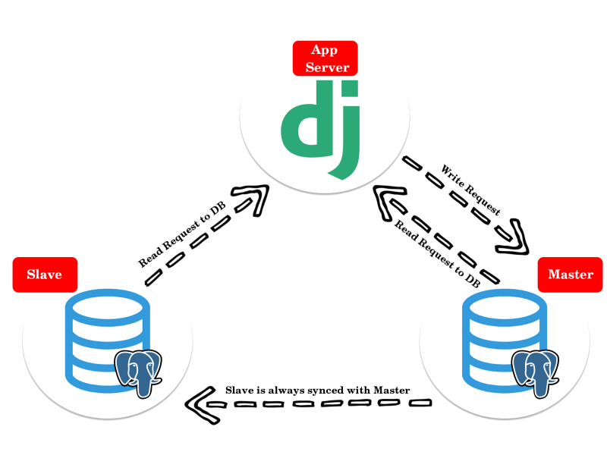
PostgreSQL High-Availability klaster
Replikacija
PostgreSQL izvorna replikacija
Master-Slave arhitektura
Multi-Master arhitektura
Balansiranje opterećenja
Više načina oporavka
Warm standby
Async hot standby
Sync hot standby
Failover

Slide 5
Instanciranje PostgreSQL High-Availability klastera
PostgreSQL izvorna replikacija
docker network create bridge-docker docker-compose up --build
version: "3" services: pg_master_1: build: ./master ports: - "5445:5432" volumes: - mdata:/var/lib/postgresql/data environment: - POSTGRES_USER=admin - POSTGRES_PASSWORD=root - POSTGRES_DB=postgres - PG_REP_USER=rep - PG_REP_PASSWORD=root networks: - bridge-docker restart: always
pgadmin: container_name: pgadmin4_container image: dpage/pgadmin4 restart: always environment: PGADMIN_DEFAULT_EMAIL: admin@admin.com PGADMIN_DEFAULT_PASSWORD: root ports: - "5050:80"

Slide 6
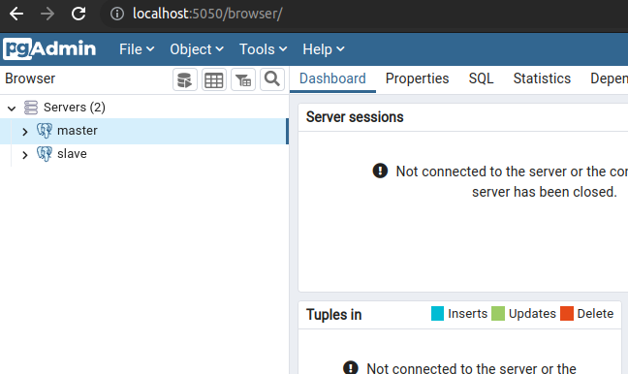
Instanciranje PostgreSQL High-Availability klastera
PostgreSQL izvorna replikacija
CREATE TABLE users ( id SERIAL PRIMARY KEY, username VARCHAR(255) NOT NULL, name VARCHAR(255) NOT NULL, description VARCHAR (255), last_update DATE ); INSERT INTO users (username, name, description) VALUES('User1', 'Milica', 'student');

Slide 7
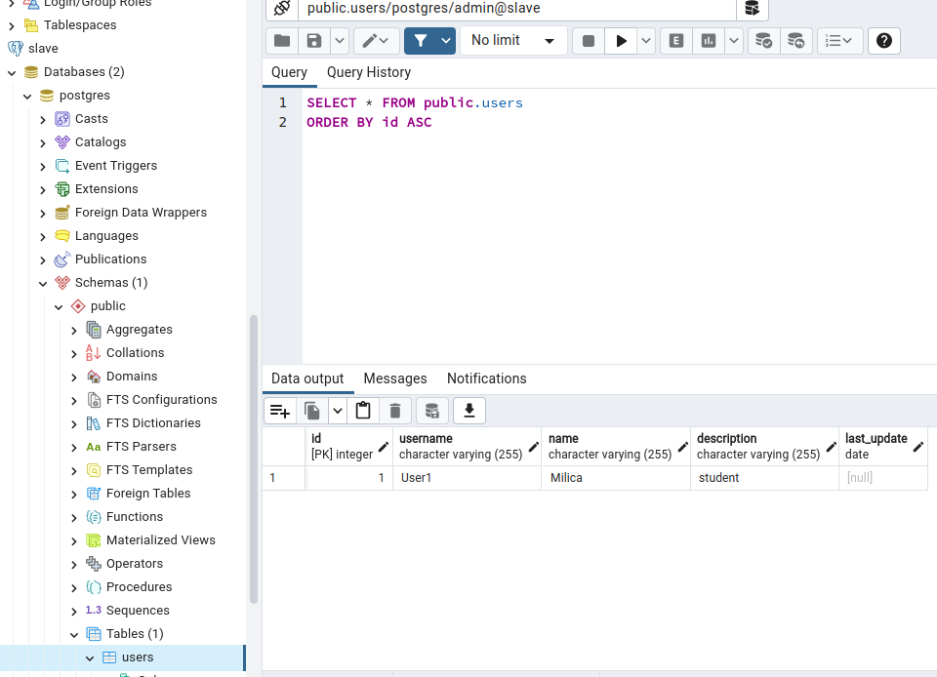
Instanciranje PostgreSQL High-Availability klastera
PostgreSQL izvorna replikacija

Slide 8
Instanciranje PostgreSQL High-Availability klastera
Repmgr i Pgpool-II
services: pg-0: image: bitnami/postgresql-repmgr:latest ports: - 5432 volumes: - pg_0_data:/bitnami/postgresql environment: - POSTGRESQL_POSTGRES_PASSWORD=root - POSTGRESQL_USERNAME=admin - POSTGRESQL_PASSWORD=root - POSTGRESQL_DATABASE=postgres - REPMGR_PASSWORD=root - REPMGR_PRIMARY_HOST=pg-0 - REPMGR_PARTNER_NODES=pg-0,pg-1,pg-2 - REPMGR_NODE_NAME=pg-0 - REPMGR_NODE_NETWORK_NAME=pg-0 networks: - bridge-docker

Slide 9
pgpool: restart: 'always' image: bitnami/pgpool:latest ports: - 5432:5432 volumes: - /home/aback/docker-pg-cluster/pgpool.conf:/config/pgpool.conf environment: - PGPOOL_USER_CONF_FILE=/config/pgpool.conf - PGPOOL_BACKEND_APPLICATION_NAMES=0,1,2 - PGPOOL_BACKEND_NODES=0:pg-0:5432,1:pg-1:5432,2:pg-2:5432 - PGPOOL_SR_CHECK_USER=admin - PGPOOL_SR_CHECK_PASSWORD=root - PGPOOL_ENABLE_LDAP=no - PGPOOL_POSTGRES_USERNAME=admin - PGPOOL_POSTGRES_PASSWORD=root - PGPOOL_ADMIN_USERNAME=admin - PGPOOL_ADMIN_PASSWORD=root - PGPOOL_AUTO_FAILBACK=yes - PGPOOL_CLIENT_IDLE_LIMIT=5 healthcheck: test: ["CMD", "/opt/bitnami/scripts/pgpool/healthcheck.sh"] interval: 10s timeout: 5s retries: 5

Slide 10
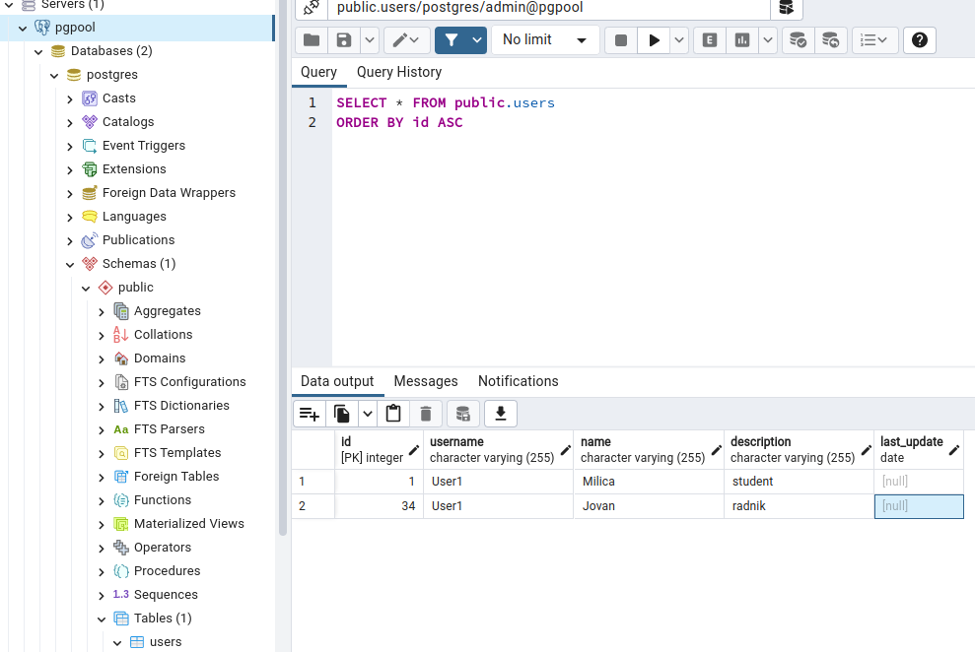
Instanciranje PostgreSQL High-Availability klastera
Repmgr i Pgpool-II
docker stop docker-pg-cluster_pg-0_1 docker ps

Slide 11
Instanciranje PostgreSQL High-Availability klastera
Kubernetes
$ kubectl get nodes NAME STATUS ROLES AGE VERSION pool-0uhg4nzs7-c5gvb Ready <none> 4m v1.22.8 pool-0uhg4nzs7-c5gvj Ready <none> 4m v1.22.8 pool-0uhg4nzs7-c5gvr Ready <none> 4m v1.22.8
apiVersion: v1 kind: Secret metadata: name: mypostgres-secret namespace: default type: Opaque stringData: superUserPassword: root replicationUserPassword: root
kubectl apply -f https://raw.githubusercontent.com/reactive-tech/kubegres/v1.15/kubegres.yaml
$ kubectl get sc NAME PROVISIONER do-block-storage (default) dobs.csi.digitalocean.com

Slide 12
Instanciranje PostgreSQL High-Availability klastera
apiVersion: kubegres.reactive-tech.io/v1 kind: Kubegres metadata: name: mypostgres namespace: default spec: replicas: 3 image: postgres: 14.4 database: size: 1Gi env: - name: POSTGRES_PASSWORD valueFrom: secretKeyRef: name: mypostgres-secret key: superUserPassword - name: POSTGRES_REPLICATION_PASSWORD valueFrom: secretKeyRef: name: mypostgres-secret key: replicationUserPassword
Kubernetes
$ kubectl get pods -o wide -w $ kubectl get pod,statefulset,svc,configmap,pv,pvc -o wide

Slide 13
Instanciranje PostgreSQL High-Availability klastera
Kubernetes
$ kubectl get pods --selector replicationRole=primary NAME READY STATUS RESTARTS AGE mypostgres-1-0 1/1 Running 0 12m51s
$ kubectl get pods --selector replicationRole=primary NAME READY STATUS RESTARTS AGE mypostgres-2-0 1/1 Running 0 24s
$ kubectl get pods --selector replicationRole=replica NAME READY STATUS RESTARTS AGE mypostgres-2-0 1/1 Running 0 13m14s mypostgres-3-0 1/1 Running 0 13m14s
$ kubectl get pods --selector replicationRole=replica NAME READY STATUS RESTARTS AGE mypostgres-3-0 1/1 Running 0 15m42s mypostgres-4-0 1/1 Running 0 44s
kubectl delete pod mypostgres-1-0

Slide 14

Hvala na pažnji!

