Slide 1
(sta)R(tistics)
Class 2: R Basics part 2

Slide 2
Questions?
Do you have any questions on the topics we covered in the last class?
Do you have any questions about the exercise you worked on at the end of last class?
If you missed the last class, you can ask a TA for help with installation

Slide 3
Today we will learn...
Data wrangling:
How to subset data
How to merge and modify data
Repetitive tasks
How to write loops
How to use apply
Alternatives for tibbles
How to write functions
How to do more with R

Slide 4
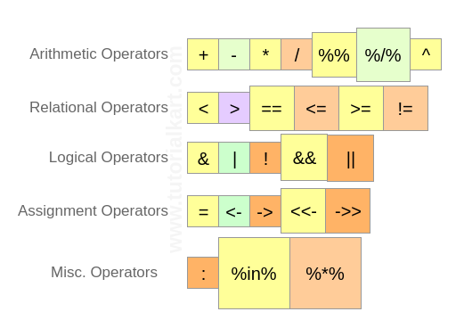
(Recap) R Functions and Operators
R has number of binary operators - kind of like functions with two input and one output
https://www.tutorialkart.com/r-tutorial/r-operators/

Slide 5
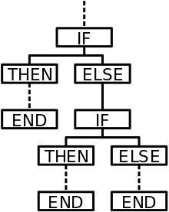
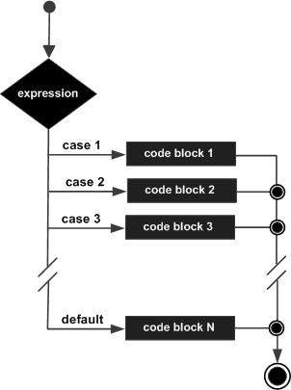
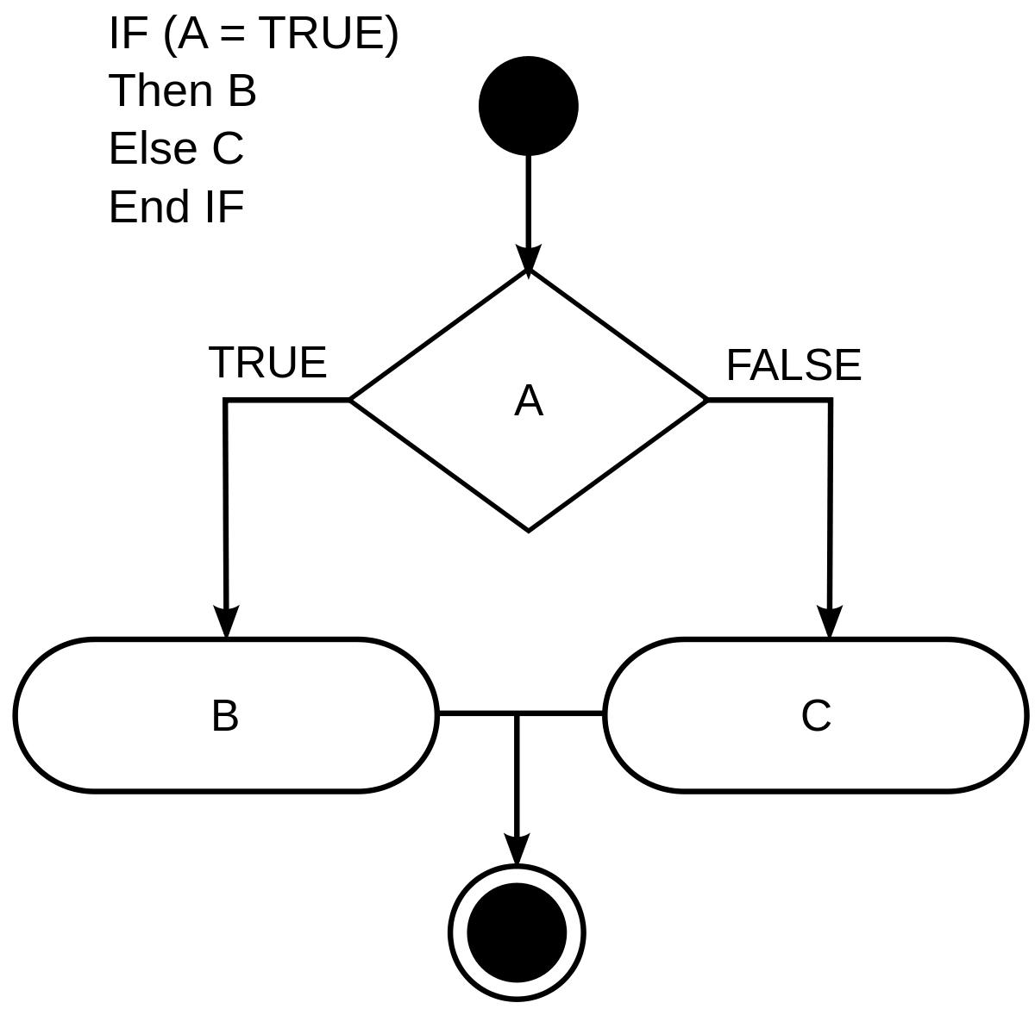
(Recap) R Conditionals
Operators can be combined with conditional programming with if-then-else statements, switch-case statements, and other approaches
https://www.tutorialspoint.com/r/r_switch_statement.htm

Slide 6

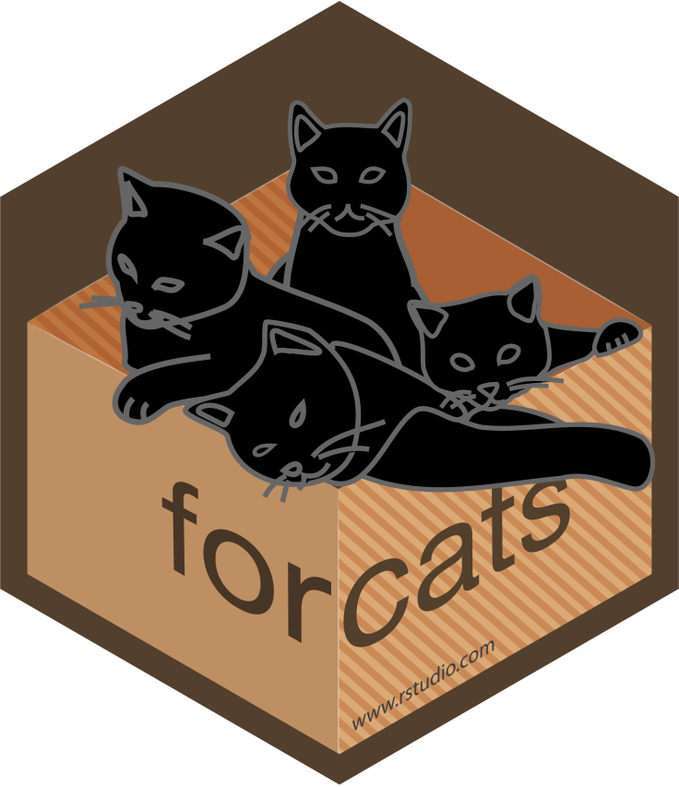

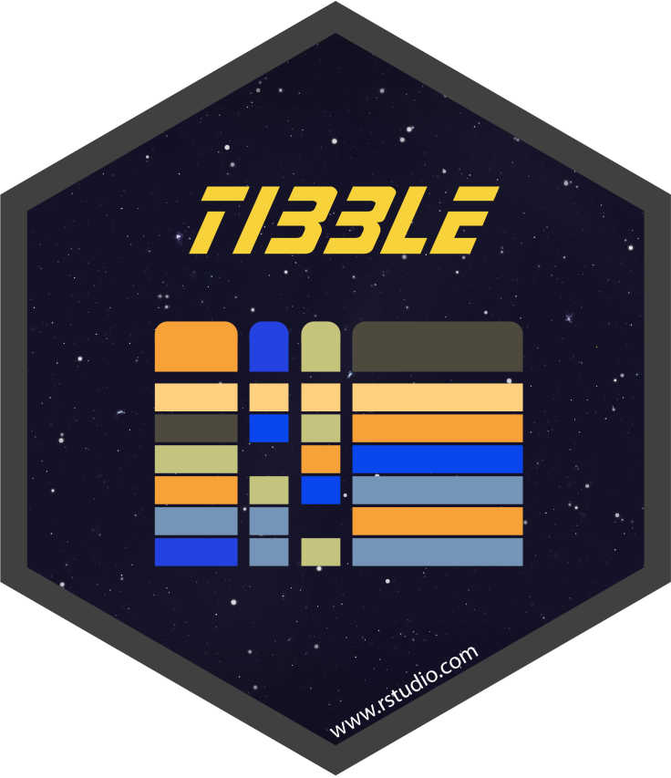

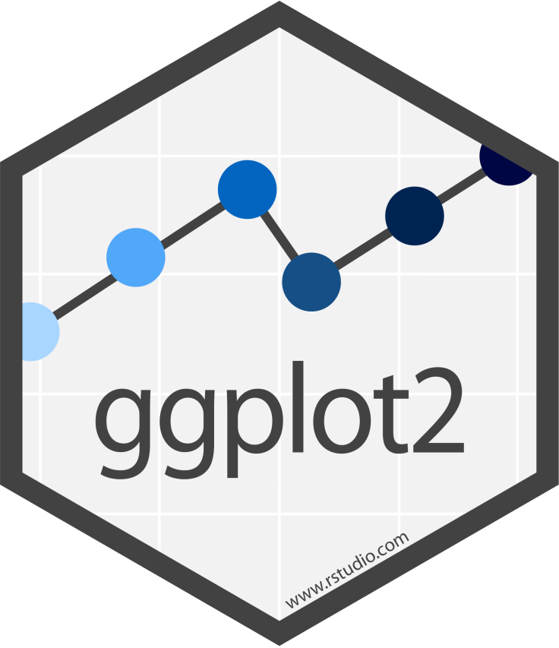


You have now entered - the tidyverse
You have already met the tidyverse!
- collection of packages in R that help keep data "tidy"
- useful for data wrangling, an essential step before statistics or plotting
- we will mostly be working with dplyr and tibble (automatically installed with core "tidyverse").

Slide 7
Data wrangling - motivation
Suppose you have some real data you want to work with in R....imagine a giant table with many different measurements for a variety of experimental groups
How can you easily look at the data for different experimental groups or time points?
How can you quickly calculate new metrics from the raw numbers?
How can you quickly and cleanly combine data from different related experiments?
And, how can you do it all without 20 Excel tabs worth of copying, pasting, transposing, reformatting and so on?

Slide 8
Filter
How do you look at the part of your data you are interested in?
We will learn the "tidy" way of doing this in R with tibbles and dplyr
The filter function allows you to subset your data by rows based on the values of some variables

Slide 9
Select
The select function allows you to subset your data by columns
Remember that in “tidy” data, each row is an observation (subject, sample, etc.) and each column is a variable
By using piping (the weird %>% symbol) we can chain together filtering, selecting, and many other manipulations of the data

Slide 10
Group and Summarize
What if you want to calculate some descriptive statistics for groups within your data?
This is a very common task that can get very messy with Excel or even something like SPSS or Graph Pad

Slide 11

Mutate and Map
What if you want to add more columns to your data – for example, a column of normalized values next to the raw values?
Using the mutate function you can add or remove columns from tibbles
Mutate combined with the “map” family of functions can cleanly replace a lot of dragging around formulas in Excel

Slide 12
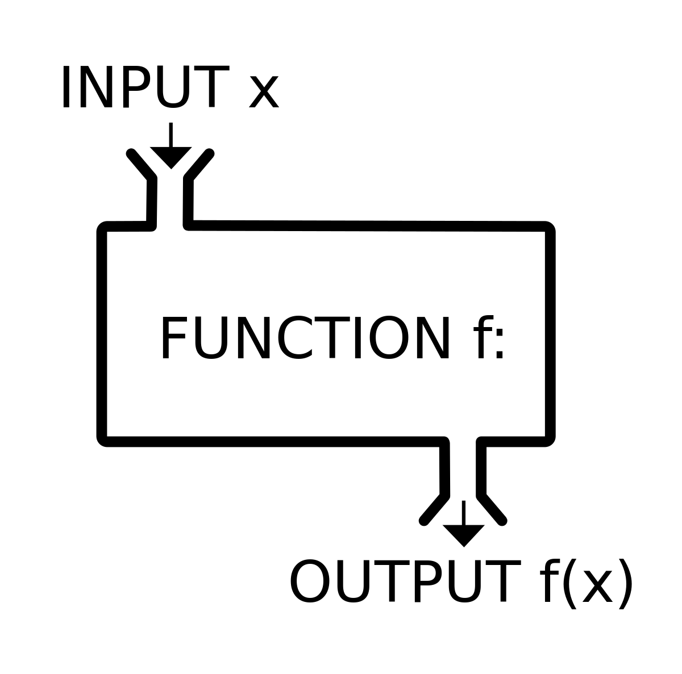
Your first R function
A custom function is another approach for reusing code
A function may have inputs and provide outputs (but it doesn’t need to)
An R function can be saved as an R script that can be run from

Slide 13

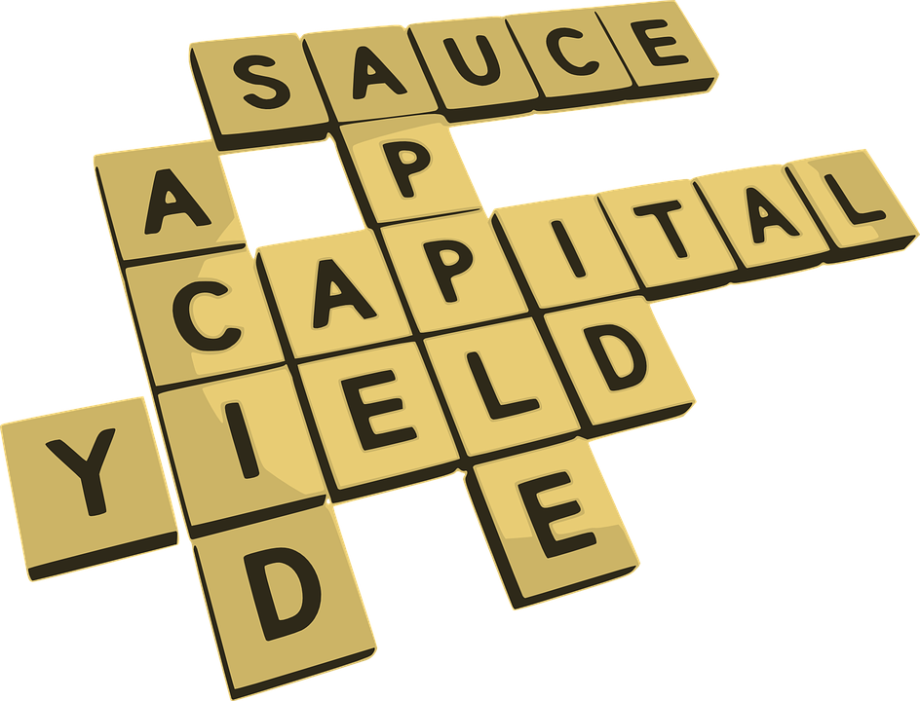
Stringr
Stirngr is a really useful package for working with strings
It has functions for splitting and joining strings, searching for substrings, replacing specific characters with other characters
It gives you a lot of the functionality of “find” and “replace” in Word/Excel but within R
Notes:
Replacing “KO_Gene1_female_A17” with “Group1” or replacing “KO” in the same phrase with “homozygous”

Slide 14




Recode and Mapvalues
In-built functions that can efficiently replace or rename values in a vector (or factor)
Fruit | Flower | Fruit | Fruit | Flower | Flower | Fruit | Flower | Fruit | Flower

Slide 15
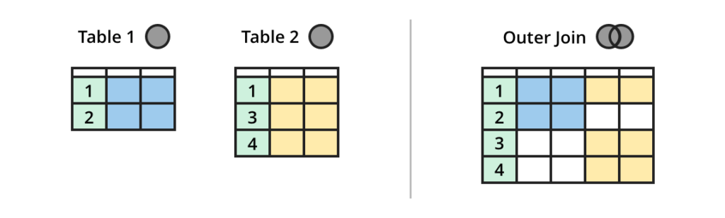
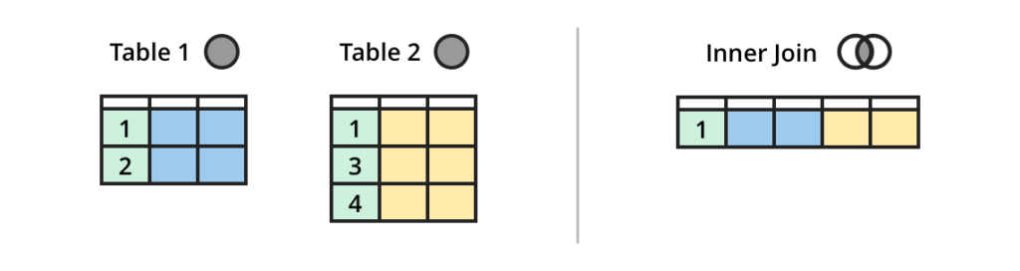
Join
What if you have information in two (or many) different files and tables and want combine the information without mixing up the data?
This is another common task which can get messy with other software!
“Outer” joins let you keep data unique to each table while “inner” joins let you keep data common to all tables (useful if you don’t have all the same subjects for each of the measurements you made)
https://dataschool.com/how-to-teach-people-sql/sql-join-types-explained-visually/

Slide 16
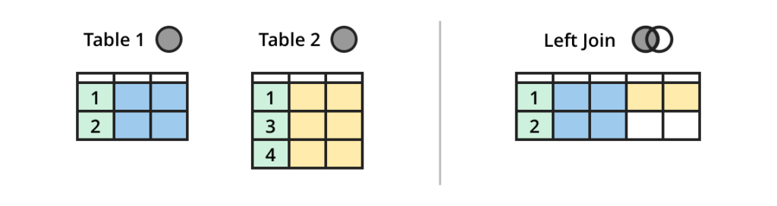
Join
“Left” (or “right”) joins let you prioritize data from one table or another
While joins let you merged tables by columns, bind_rows can be used to merge them by rows
https://dataschool.com/how-to-teach-people-sql/sql-join-types-explained-visually/

Slide 17
What did people do before the tidyverse???
Go look at the additional script provided which solves some of the in-class problem without tidyverse functions (using only base R)

Slide 18
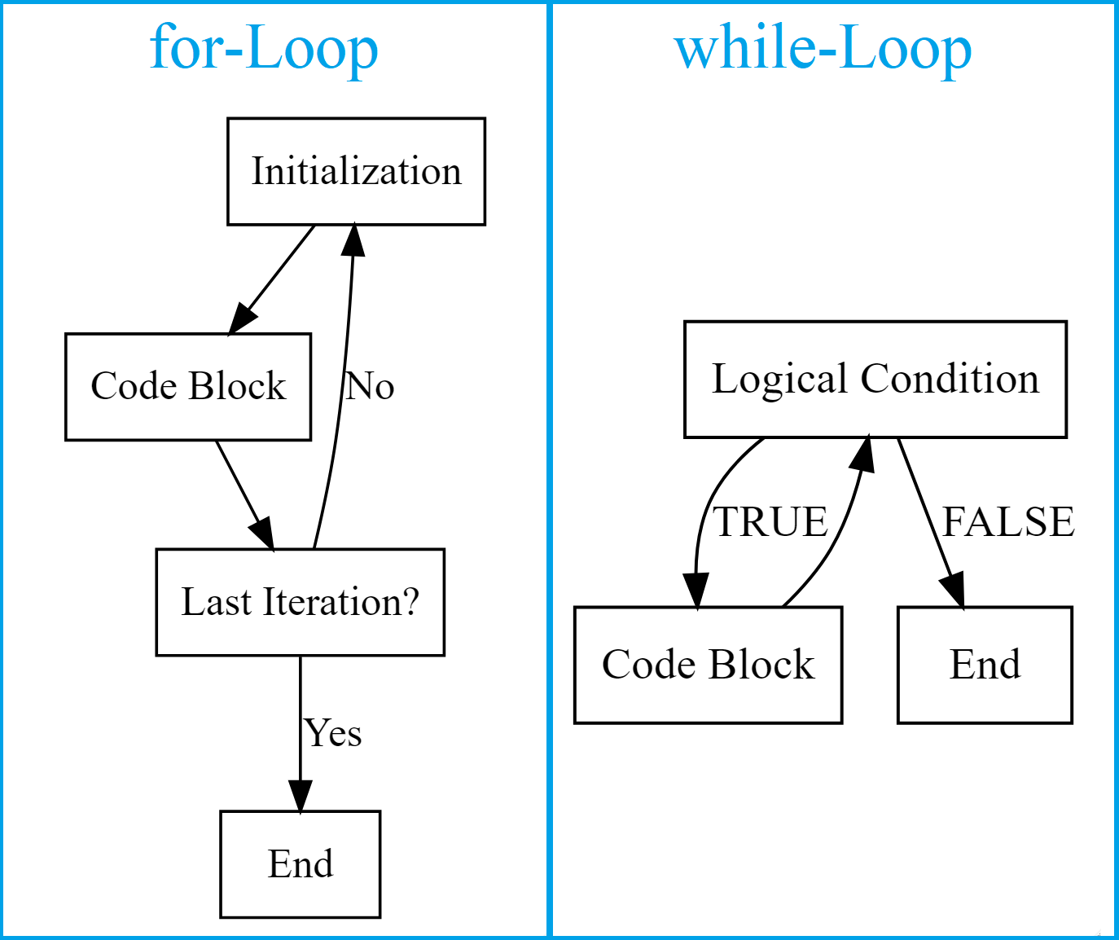
Repetitive tasks: For (mostly) & while loops
For loops let you repeat a task a specified number of times and while loops let you repeat a task an unspecified number of times
https://statisticsglobe.com/loops-in-r/

Slide 19
Repetitive tasks: apply!
The apply family of functions is a quicker alternative to for/while loops in R
Apply can be used on vectors, lists, matrices

Slide 20
Repetitive tasks for tibbles
Using combinations of functions we have met before, and some new ones, repetitive tasks can be streamlined for tibbles

Slide 21
How to do more with R
R Studio and tidyverse cheat sheets
Package repositories:
Bioconductor
Github
Training:
Bioinformatics.ca
MiCM
Compute Canada
Go look at the list of resources for links!

Slide 22
Exercise (in class, take home)
Wrangle the top songs dataset, which you will be working with more in the future classes

