Slide 1
(sta)R(tistics)
Class 1: R Basics part 1

Slide 2
Today we will learn....
What is R
What interfaces we can use with R
How to get started
How to get help
What are variables and data types
How to work with your data
How to load data into R
How to save your work done in R

Slide 3

What is R?
Most of us use R to do stats and make plots
Free and open source
Good for statistics
Used by biologists, psychologists, neuroscientists…
Can be used on Windows, Mac, and Linux computers
Let's install R

Slide 4

What interfaces we can use with R?
RStudio is an integrated development environment for R
Free and intuitive
We can also use R from the command line

Slide 5

How to get started?
You write commands in the console
You can save your scripts
You can see the variables in your workspace
You can install packages you need

Slide 6
How to get started?
Packages are collections of pre-coded functionality
Packages can define new functions, data types
CRAN is a huge collection of free, useful, maintained R packages
Let's install RStudio

Slide 7

How to get help?
In RStudio you can use the help panel to look up documentation
You can also type ?<topic> to find info about a topic – this also works from the command line
Many R "packages" have:
detailed vignettes that walk you through how to use the package
active Github pages where many questions have been asked and answered

Slide 8
What are variables and data types?
A variable is a named value – the same name can take on different values throughout the script
In R you can have
numeric (integer and double)
boolean (TRUE or FALSE, 0 or 1)
character variables
You can check what type of variable you have with inbuilt functions

Slide 9
What are variables and data types?
Variables can be converted from one type to another
Characters to numbers
Numbers to characters
Doubles to integers
Numbers to Booleans, etc
Be careful with type casting variables as the results can sometimes be unexpected!

Slide 10
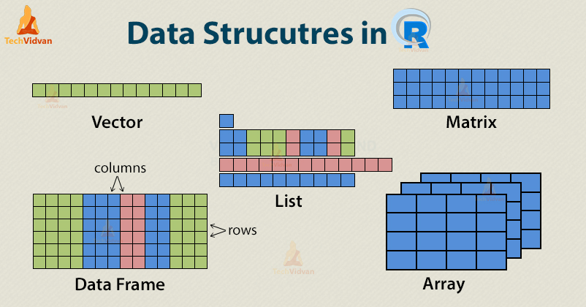
What are variables and data types?
https://techvidvan.com/tutorials/r-data-structures/

Slide 11
What are variables and data types?
R can have data structures such as
Vectors –
one dimensional, one data type
Can also be “factors” (more to be explained in the stats classes)
Matrices –
two or more dimensions, one data type
Both vectors and matrices can contain integers, doubles, or characters

Slide 12
What are variables and data types?
You can also have data structures such as
(*)Lists –
one dimensional, various data types combined
differing lengths allowed
(* next class)Data frames/ tibbles –
Two-dimensional, different data types in different columns
differing lengths of columns not allowed
Tibbles are the more “modern” version of dataframe (more info in the basics 2 class)

Slide 13
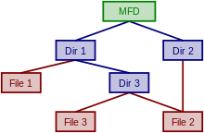
How to load your data in R?
Paths and working directories –
find out which folder you're working in with getwd()
Set which folder you are working in with setwd() (or the Rstudio interface)
Find the files in your directory list.files()

Slide 14
How to load your data in R?
CSV and TSV files
CSV files – comma "," separated values
TSV files – tab "\t" separated values
Each value may or may not be enclosed in quotation marks
Columns may or may not have names

Slide 15
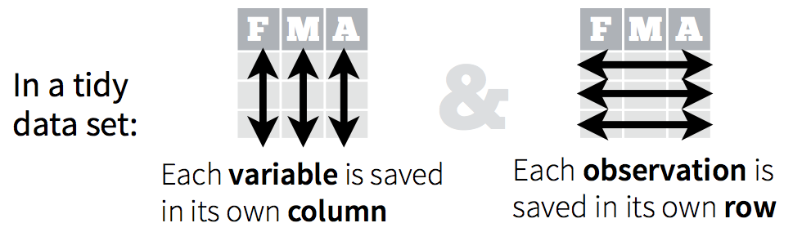
Exploring your data
What's tidy data and why should we care?
Every cell is a single value.
This is also called “long format” data in statistics
https://cran.r-project.org/web/packages/tidyr/vignettes/tidy-data.html
https://scienceparkstudygroup.github.io/r-lesson-based-on-ohi-data-training/05-tidyr/index.html

Slide 16
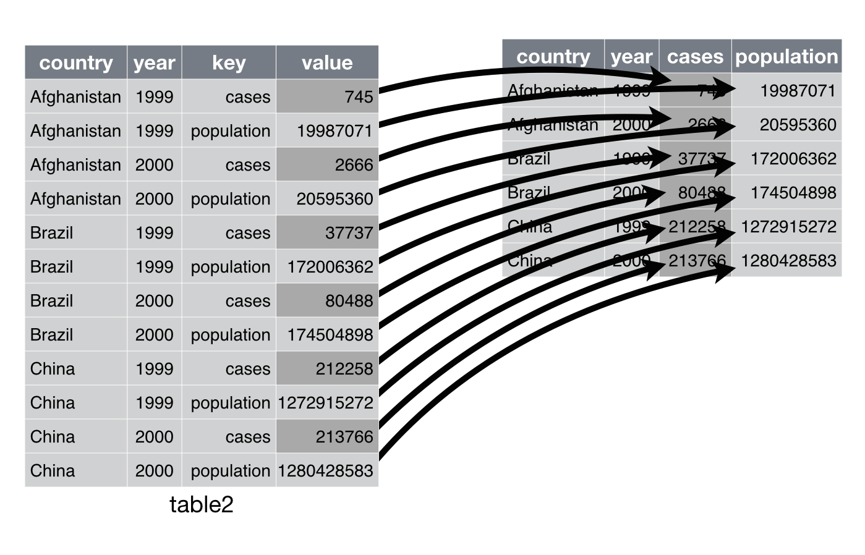
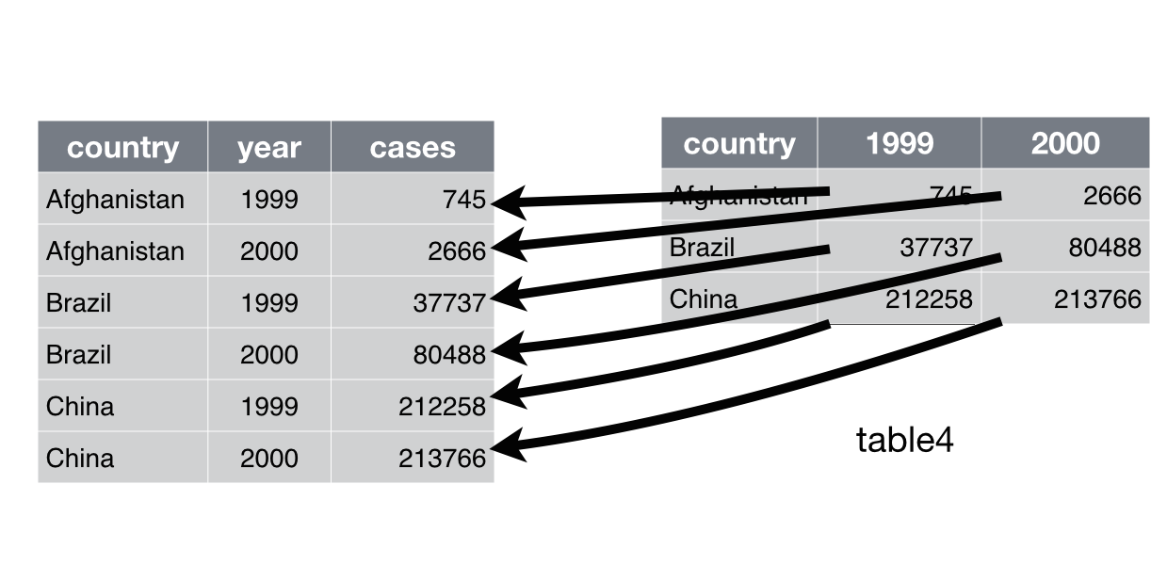
Exploring your data
What's tidy data and why should we care?
https://r4ds.had.co.nz/tidy-data.html#tidy-data

Slide 17
Exploring your data
How much data do you have?
What type of data do you have?
What about missing data?
Removing “NA”s
Other approaches to dealing with missing data (more info in the stats session)
Describing your data

Slide 18
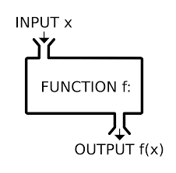
R Functions and Operators
There are thousands of functions in R, and anyone can write their own
You can list the functions in a package by typing <package>::
Go look at the lists of functions from some commonly used R packages (cheat sheets)

Slide 19

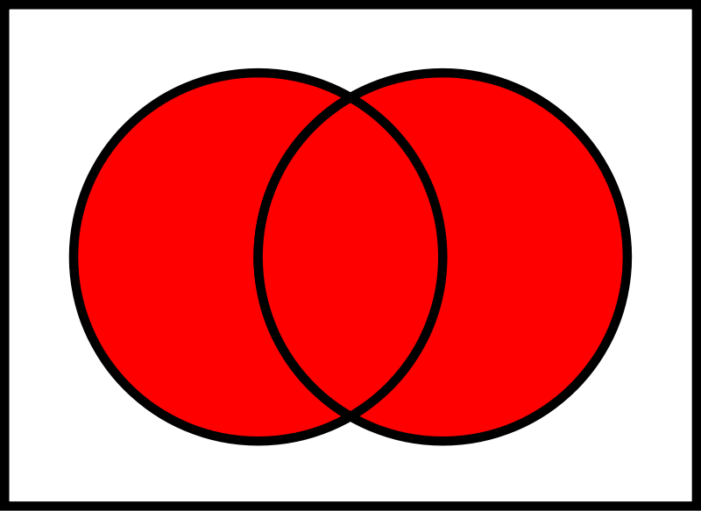
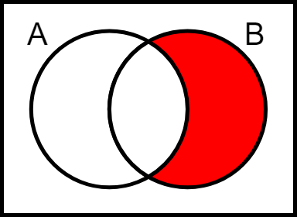
R Functions and Operators
We have already been using various functions, but let's meet a few functions from the sets package for practice!
intersect
union
setdiff B-A

Slide 20
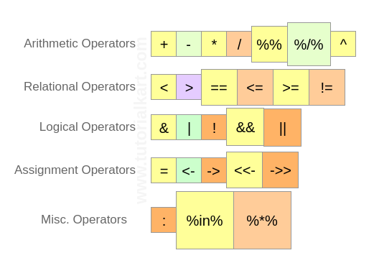
R Functions and Operators
R has number of binary operators - kind of like functions with two input and one output
https://www.tutorialkart.com/r-tutorial/r-operators/

Slide 21
R Functions and Operators
& (AND)
| (OR)
Value 1 | Value 2 | Results
T | T | T
T | F | T
F | T | T
F | F | F
Value 1 | Value 2 | Results
T | T | T
T | F | F
F | T | F
F | F | F

Slide 22
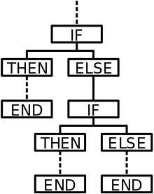
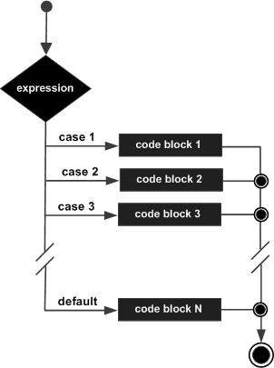
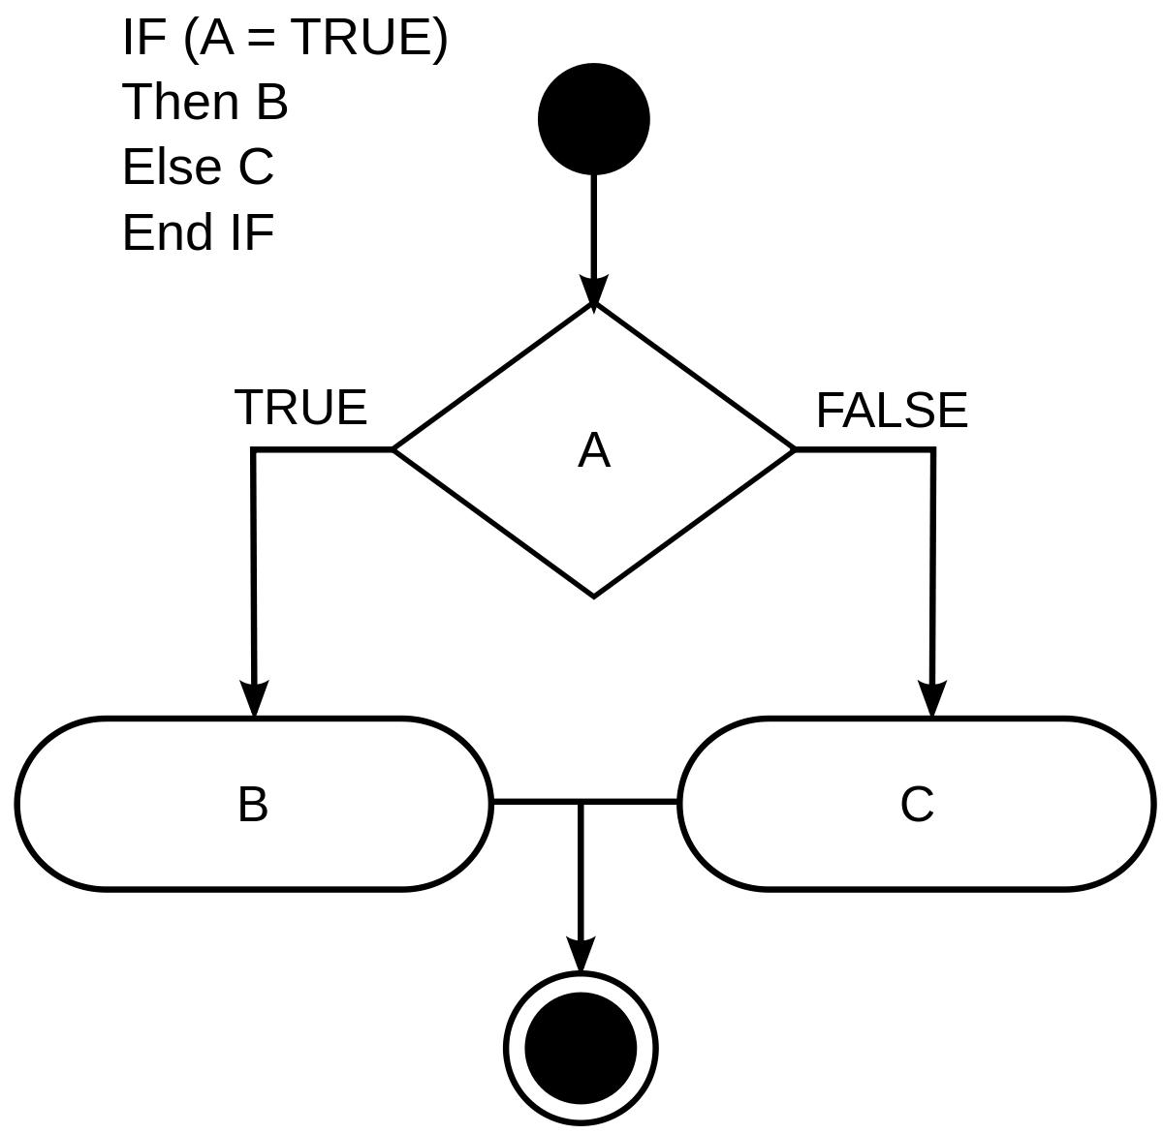
R Conditionals
Operators can be combined with conditional programming with if-then-else statements, switch-case statements, and other approaches
https://www.tutorialspoint.com/r/r_switch_statement.htm

Slide 23
How to save your work?
Removing things you don't need
Saving things to files (info about saving images in the visualization session)
Saving your steps
Saving your objects
Saving everything

Slide 24
Free Exercise (in class, take home)
Load and explore the practice dataset
<add more specific instructions>

