Slide 1
Lending Club Case Study Jahid Khan & Balaji Arumugam

Slide 2
Problem statement
the data provided contains the information about past loan applicants and whether they ‘defaulted’ or not. the aim is to identify patterns which indicate if a person is likely to default, which may be used for taking actions such as denying the loan, reducing the amount of loan, lending (to risky applicants) at a higher interest rate, etc.

Slide 3
Approach
Data Cleansing
Identification of variables and data types.
Creating derived metrics
Analyzing the basic correlations between various entities
Conclusion

Slide 4
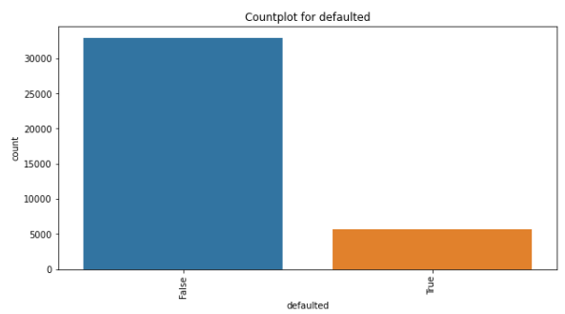
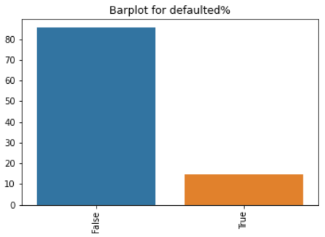
• Defaulted Loan Percent - 14.58%
• Non-Defaulted Loan Percent - 85.41%

Slide 5
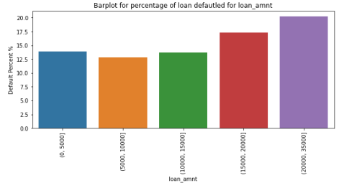
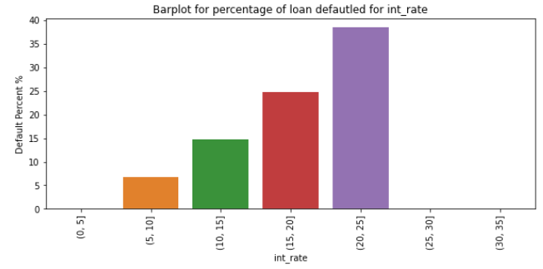
The loan default percent for loan amount 20k to 35k is higher than all other loan amount bins
The loan defaulted percent for 20-25% interest rate is highest

Slide 6
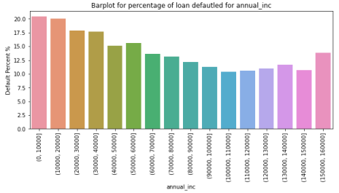
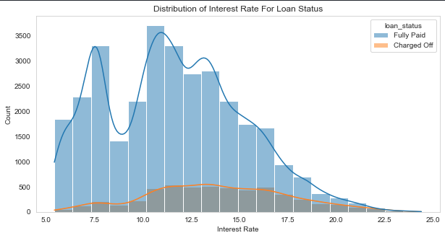
The loan defaulted percent for 0-40000 annual income is higher
The count of loan taken varies with interest rate showing peak around in 5-15 bracket and decreasing slowly where as the chance of defaulting increases with interest rate.

Slide 7
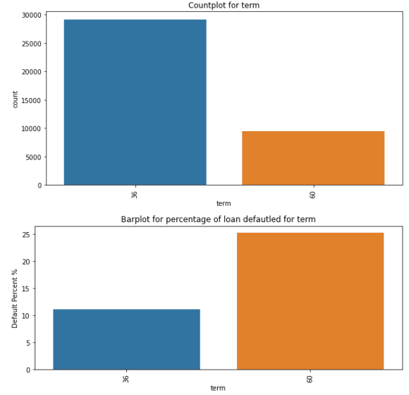
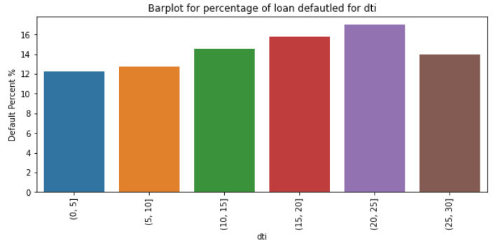
The loan defaulted percent for 15-25 DTI is higher than overall defaulted Loan Percent 14.58%
The borrowers have taken more loans for 36 months term verses 60 months
The loan defaulted percent for 60 months term is highest

Slide 8
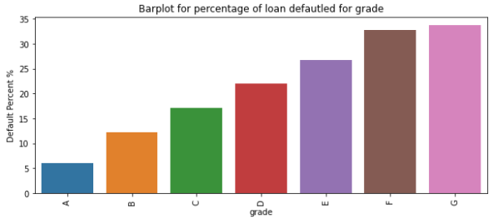
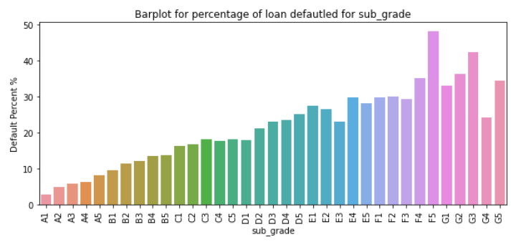
The grades A1 – C2 have highest number of loans.
The loan defaulted percent is highest at F5, followed by G3 & G2

Slide 9
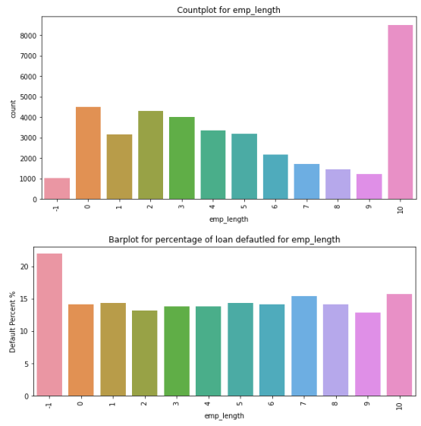
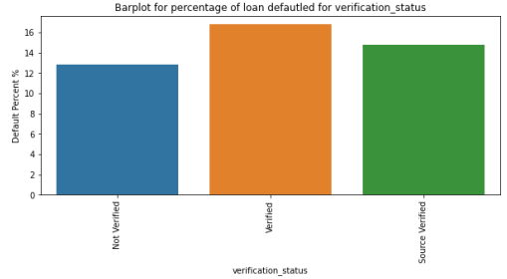
The loan defaulted percent for verified borrower is higher than overall
The 10+ years of employment have the most number of loans. The loan defaulted percent remains constant throughout the years.

Slide 10
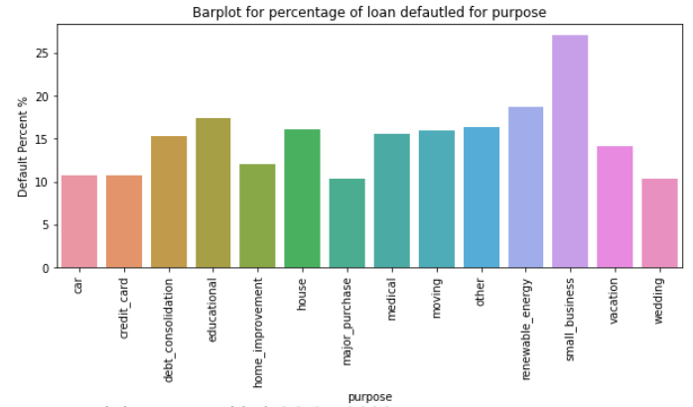
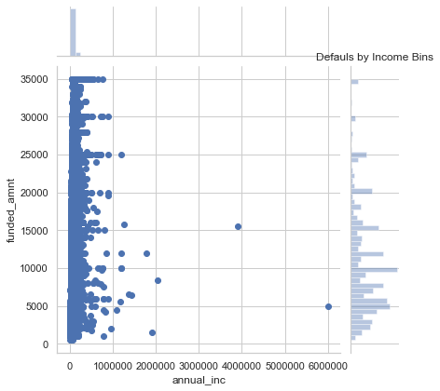
The loan defaulted percent for small business and renewable energy borrowers is higher

Slide 11
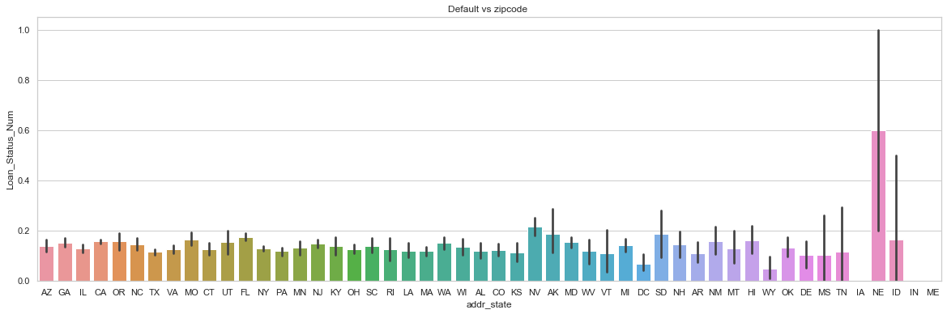
Percent of loan defaulted is very high for state NE

Slide 12
Observations
1. LOAN_AMOUNT : Loan amount greater than 15000 dollars have higher default rate
2. FUNDED_AMOUNT : Funded amount greater than 15000 dollars have higher default rate
3. FUNDED_AMOUNT_INVESTED : Funded amount invested greater than 15000 dollars have higher default rate
4. INTEREST_RATE : As Interest rate increases the default rate increases steeply
5. ANNUAL_INCOME : As the annual income increase the default rate decreases
6. DTI : As dti increase the default rate increases
7. MONTHS_SINCE_LAST_DELINQ : Crime committed between 90 to 110 days have higher default percent
8. TERM : 60 months term have a higher default rate than 36 months term
9. GRADE : As the Grade decreases (A B C D E F G) default rate increases
10. SUB_GRADE : As the Sub Grade decreases (A1 A2 B1 B2.....) default rate increases
11. VERIFICATION STATUS : Percent of loan defaulted is higher for verified borrowers
12. PURPOSE : Small business borrowers have high default rate
13. STATE : Percent of loan defaulted is very high for state NE and high for NV and SD

