Slide 1
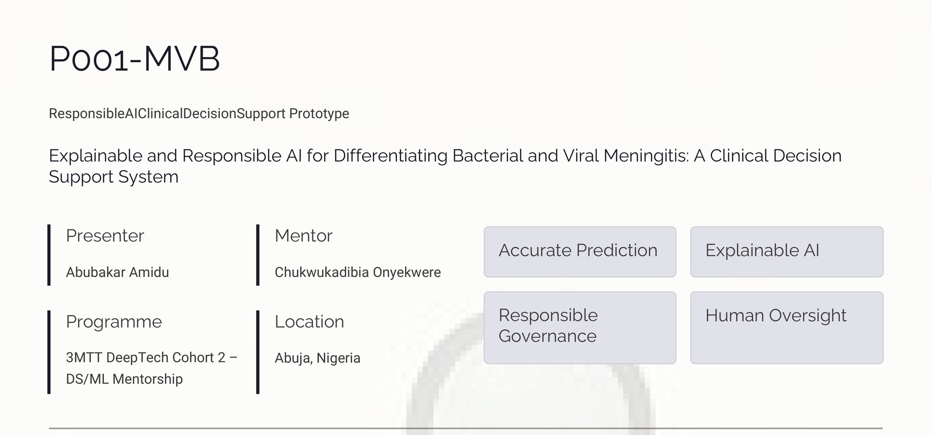
Responsible AI Clinical Decision Support Prototype

Slide 2
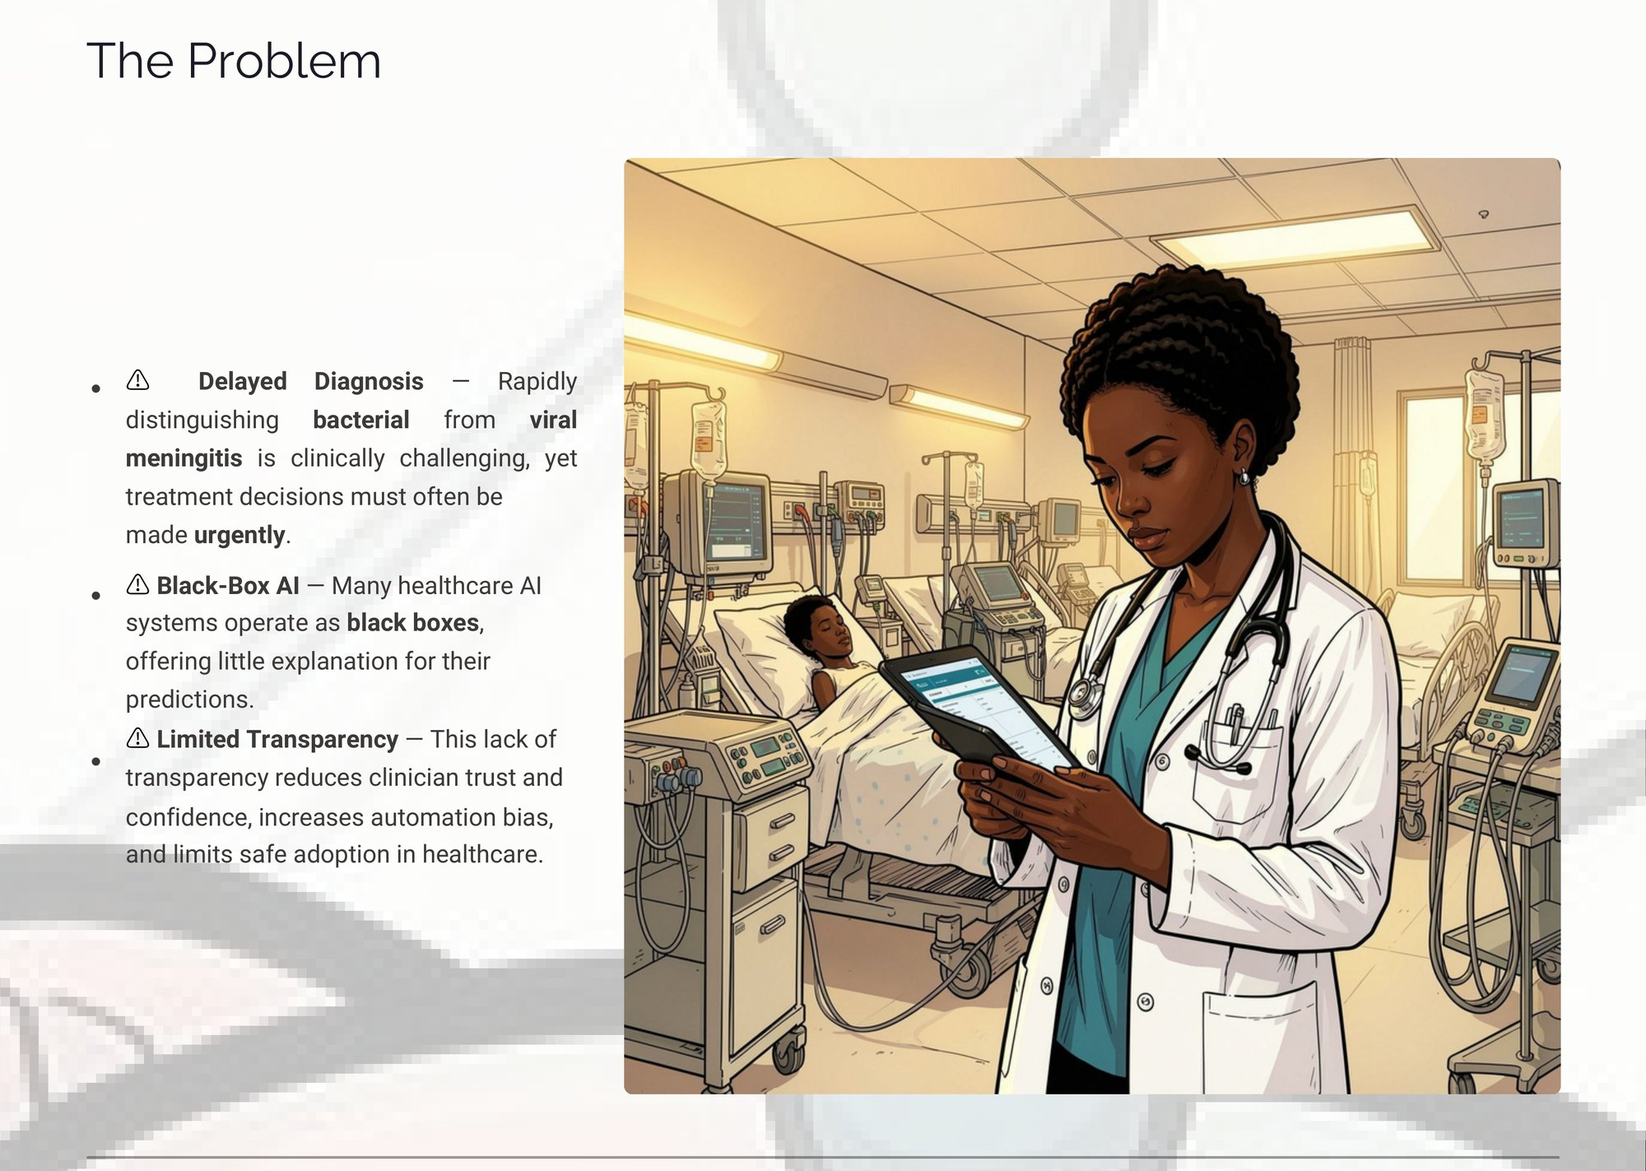

Slide 3
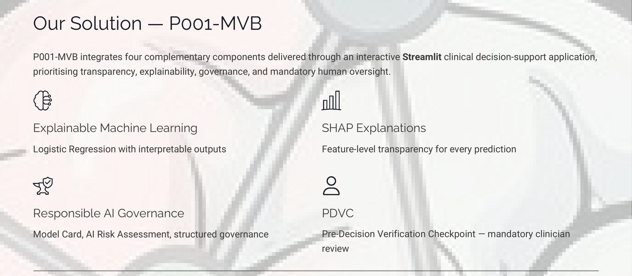

Slide 4
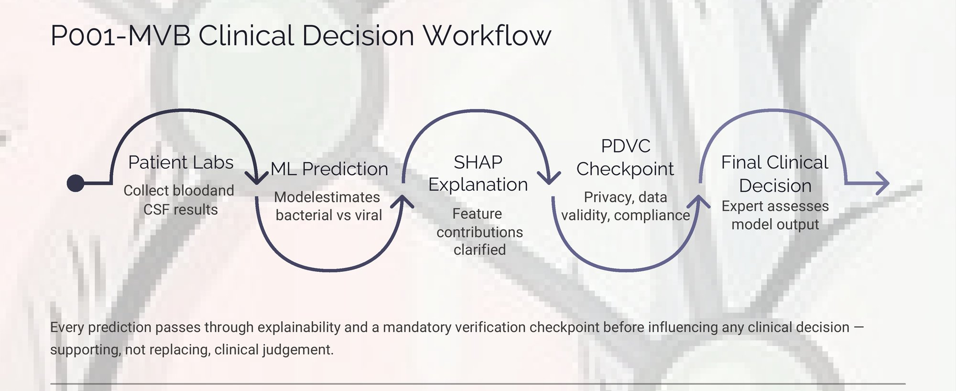

Slide 5


Slide 6
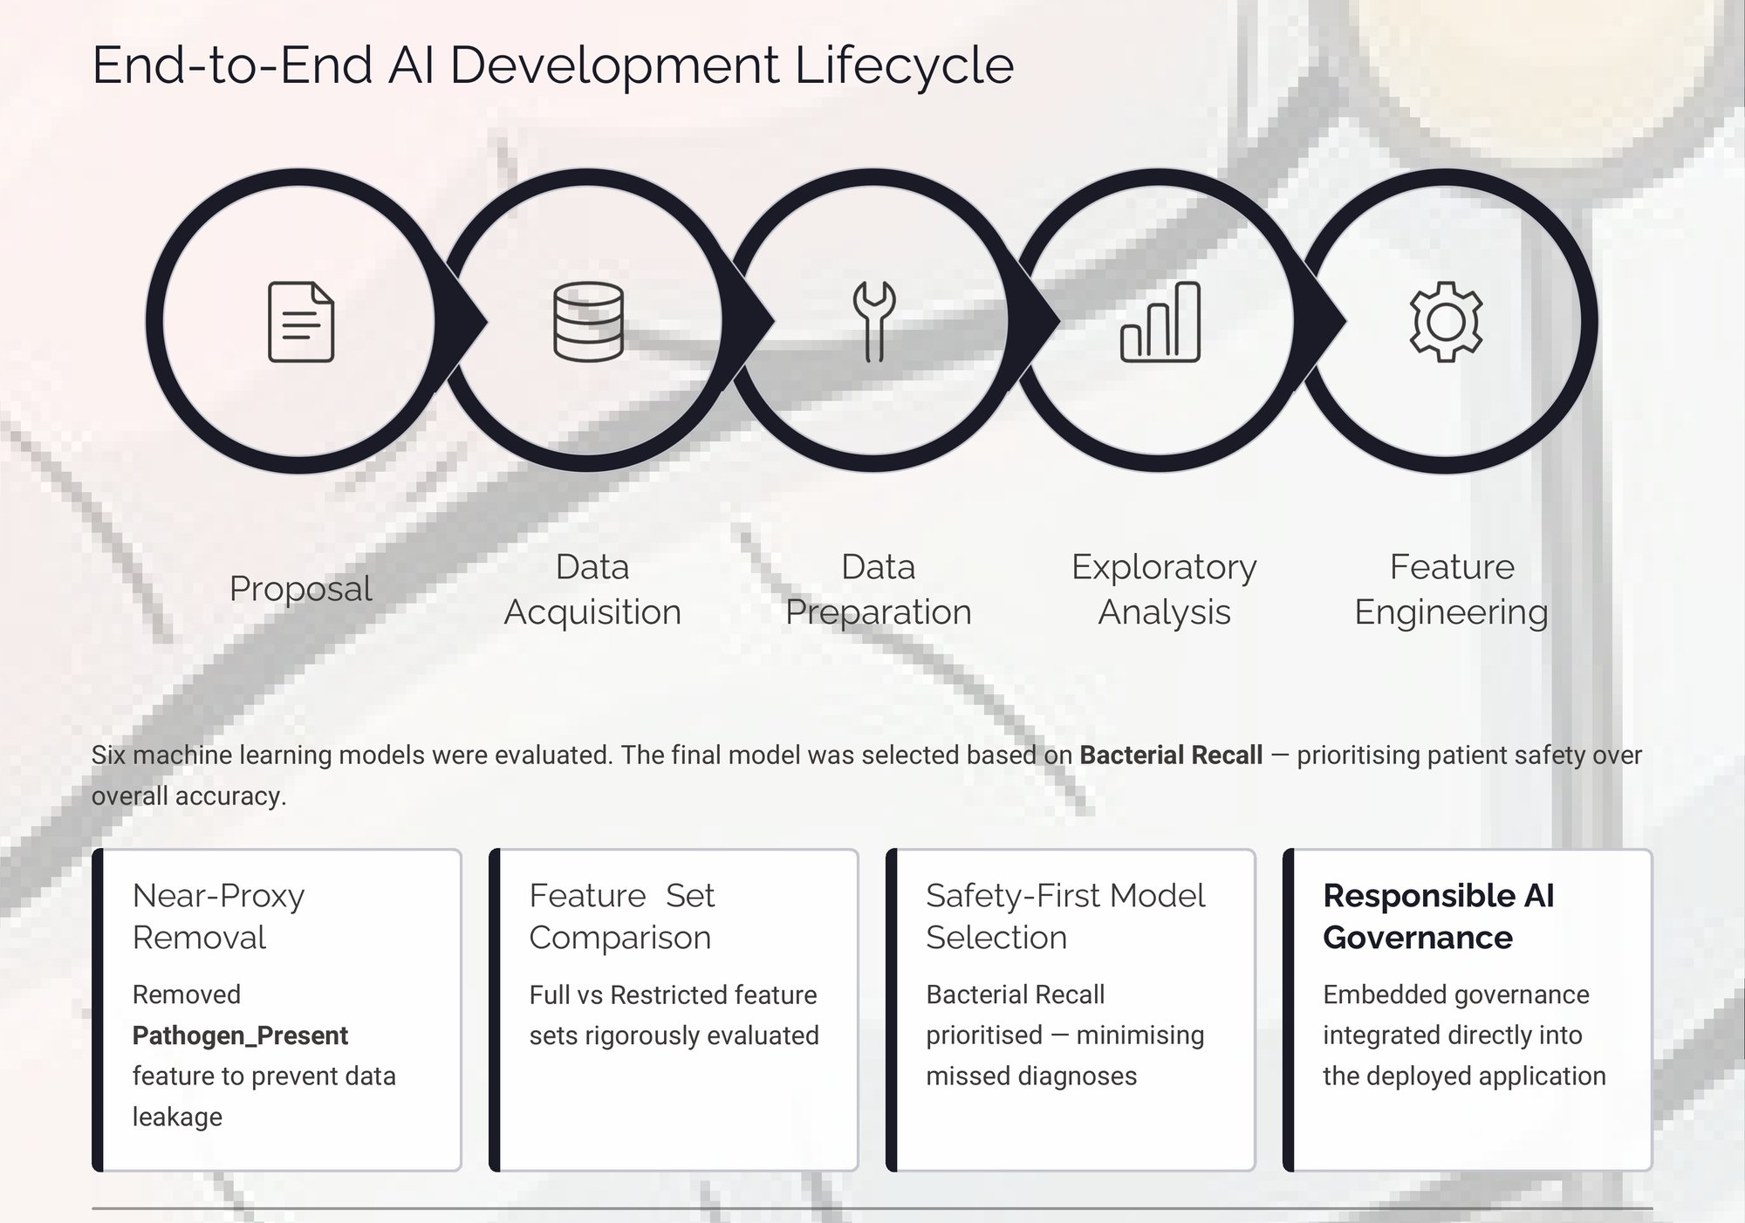

Slide 7
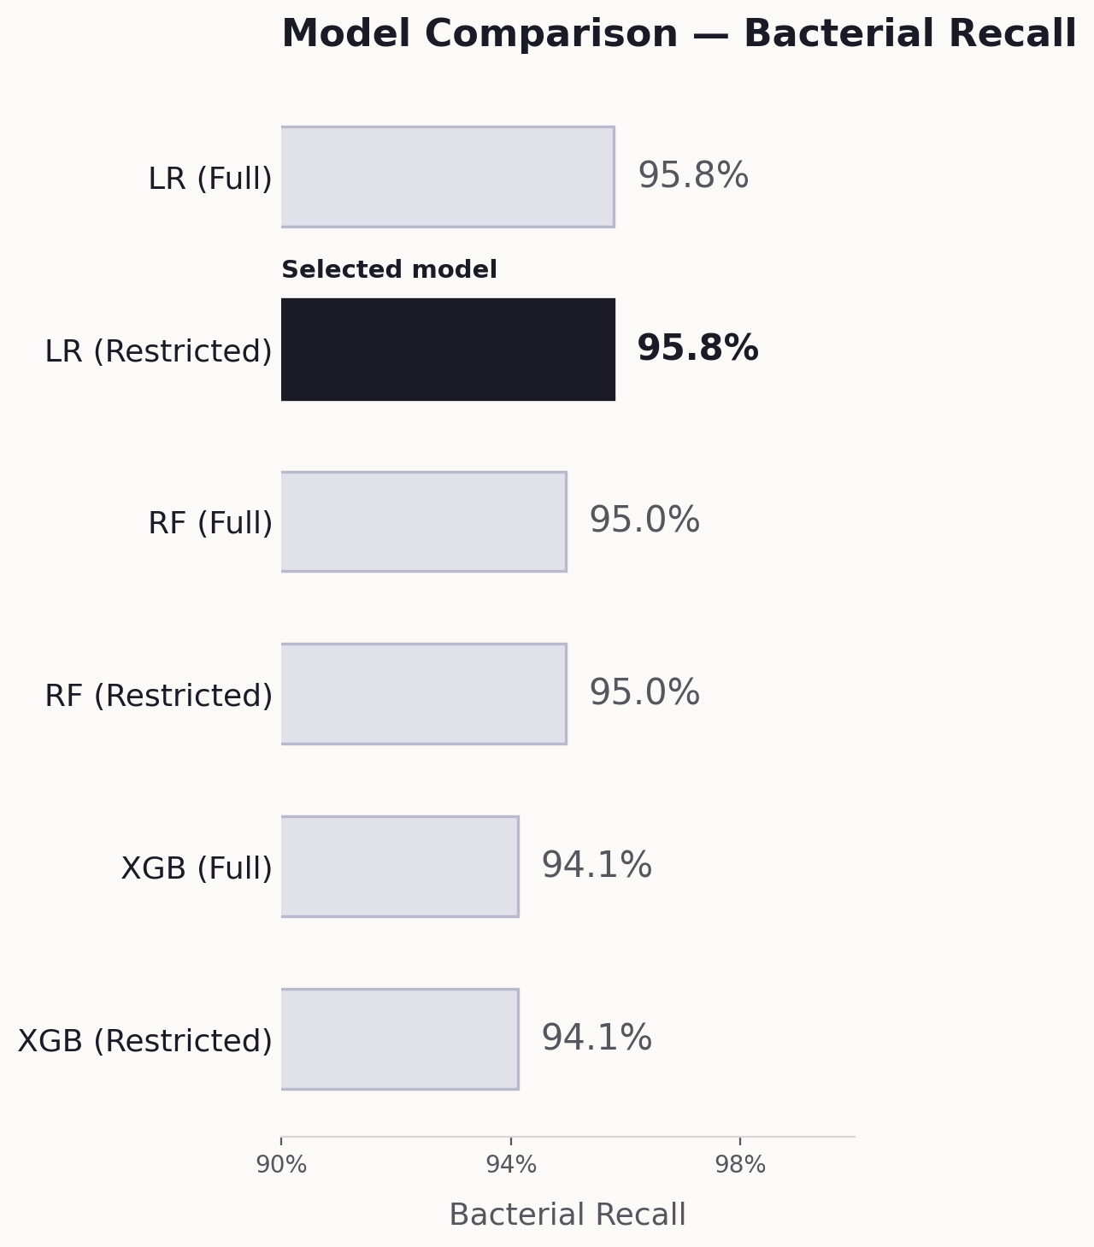
Model Development & Selection
Final Selected Model: Logistic Regression (Restricted Feature Set)
Dataset
Source: Kaggle – Meningitis Classification (ChanTest)
Original records: 1,200
Removed: 67 (“Unknown” diagnosis)
Final records: 1,133
Bacterial: 595 · Viral: 538
Models Evaluated
Logistic Regression — Full / Restricted
Random Forest — Full / Restricted
XGBoost — Full / Restricted
Selected: Logistic Regression (Restricted)
Best balance of bacterial recall, interpretability, transparency and Responsible AI deployment requirements.

Slide 8
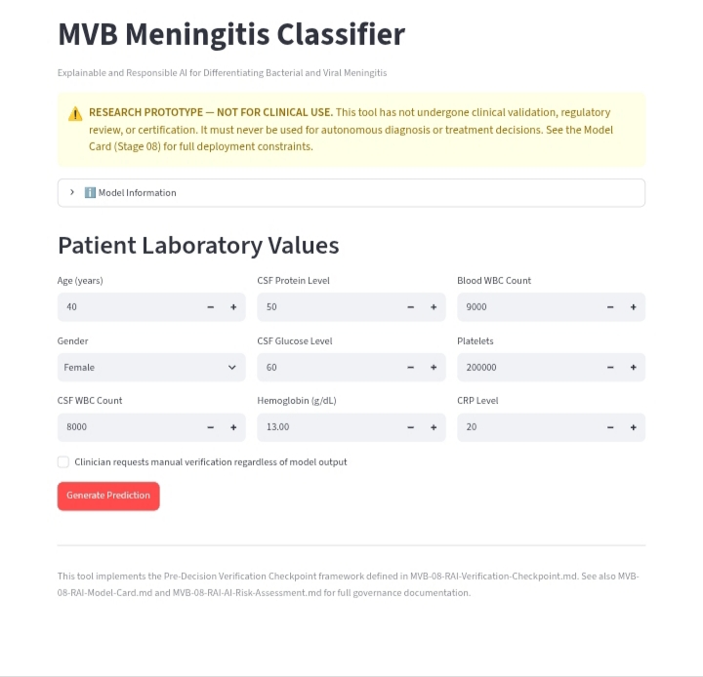
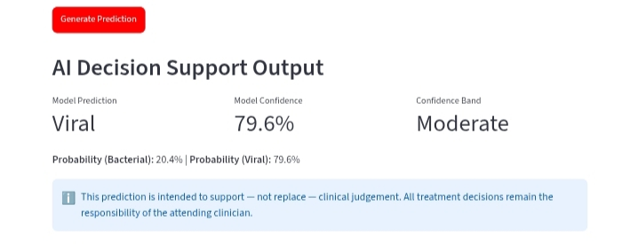
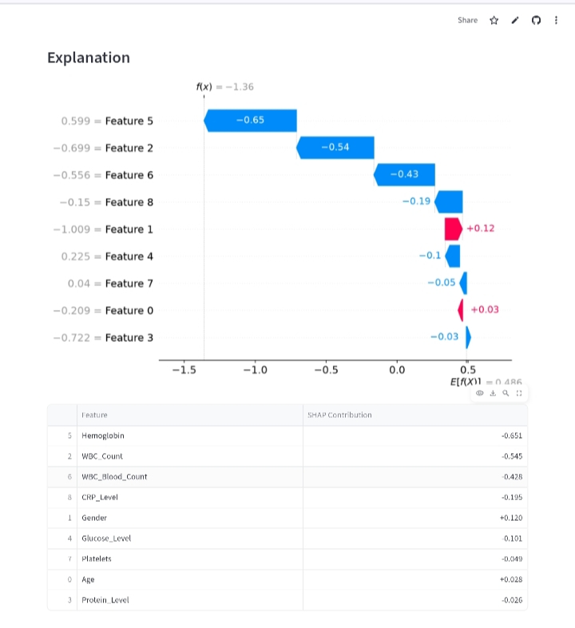
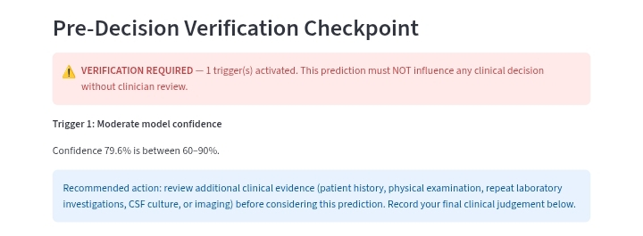
Live Application Demonstration
Final Selected Model: Logistic Regression (Restricted Feature Set)
Streamlit Home
Prediction Result
SHAP Waterfall
PDVC Verification

Slide 9
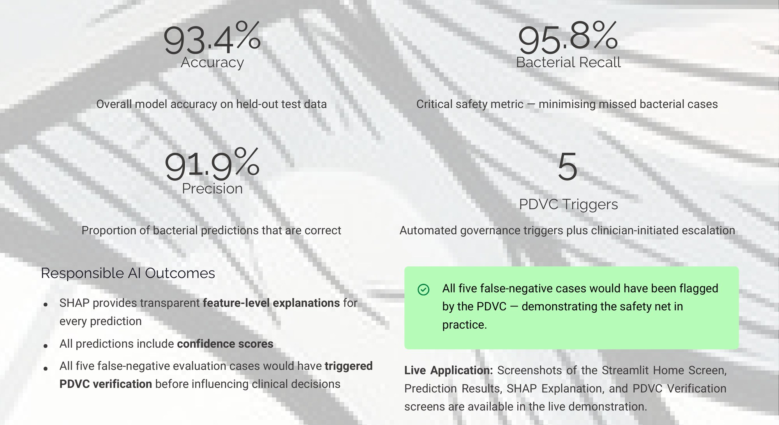
Results & Responsible AI Outcomes

Slide 10
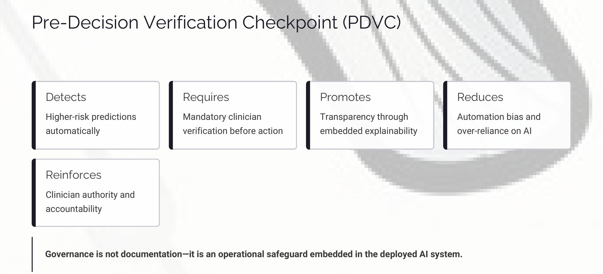
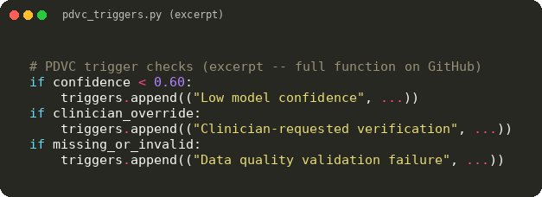
Many healthcare AI projects stop after producing an accurate prediction. P001-MVB goes further by integrating Responsible AI governance directly into the clinical decision-support workflow.

Slide 11
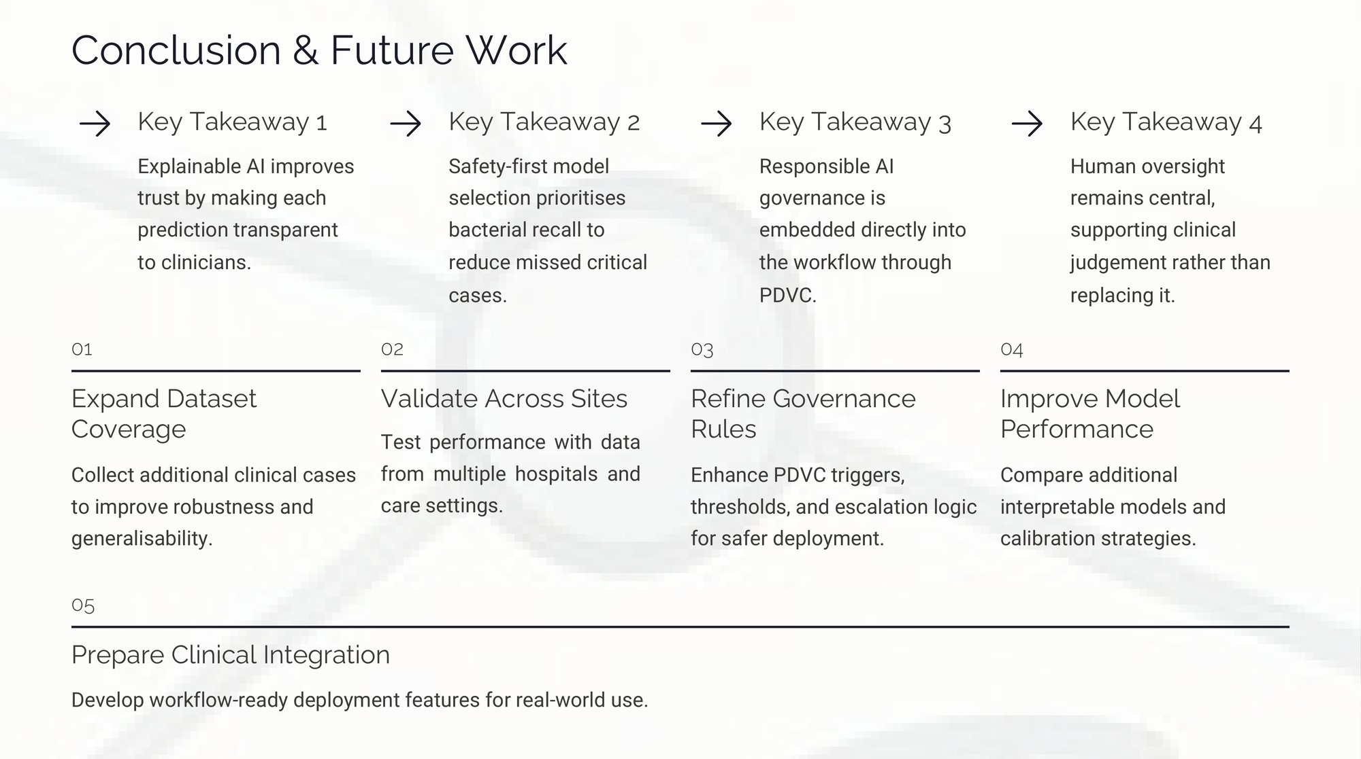

Slide 12

Limitations
Research prototype only — not intended for clinical use. · Dataset is clinically inspired rather than clinically validated.
No external validation has yet been performed. · Future work includes validation using representative clinical datasets.

Slide 13
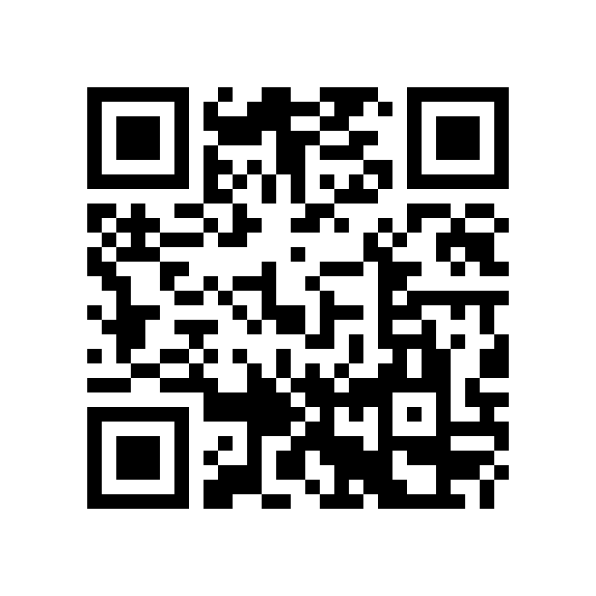
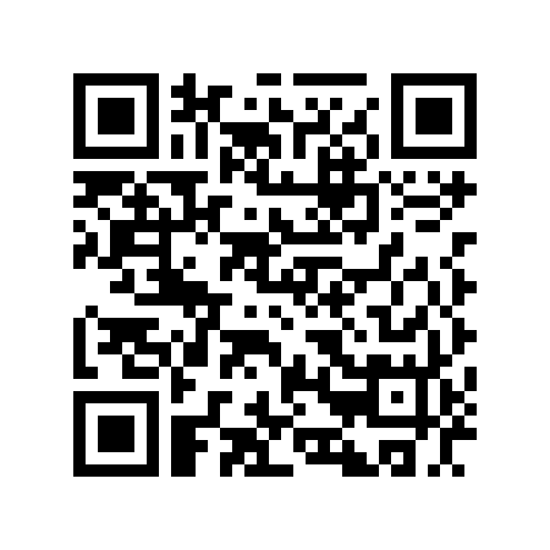
Live Resources
GitHub Repository
Live Streamlit Application
https://github.com/Abamid/P001-MVB
https://p001-mvb-iq6ziqmh6yr9tbdamggaqc.streamlit.app/
Scan the QR codes to explore the complete project.

