Slide 1
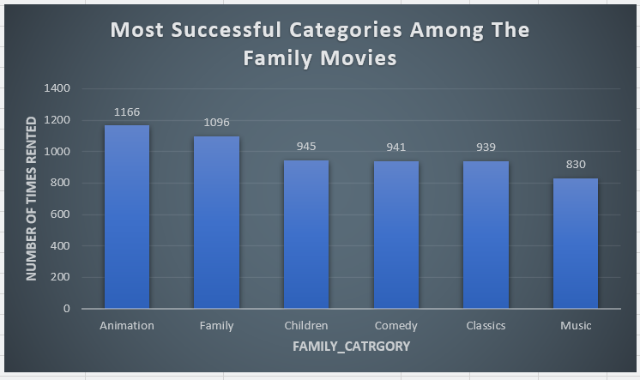
What are the most successful categories among the family movies ?
<visualization>
The Animation category is the most successful among the family movies, since it has been rented nearly 1200 times. The least popular is the category of Music that has been rented about 800 times.

Slide 2
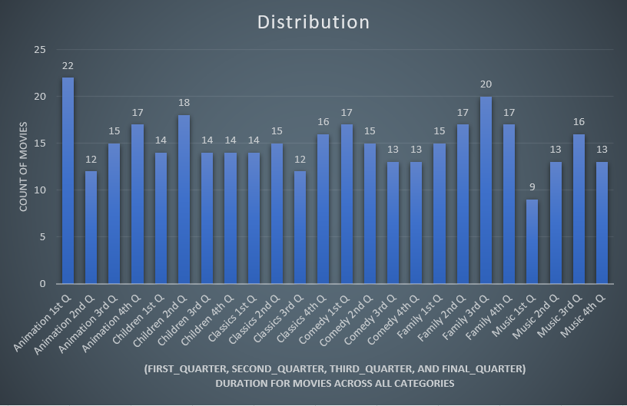
What is the distribution of family-friendly movies among the film categories and rental duration categories ?
<visualization>
A large number of animated films (22) are rented for a limited period of time (first quarter). However, for such a short time only a small portion of Music Films (9) are rented.

Slide 3
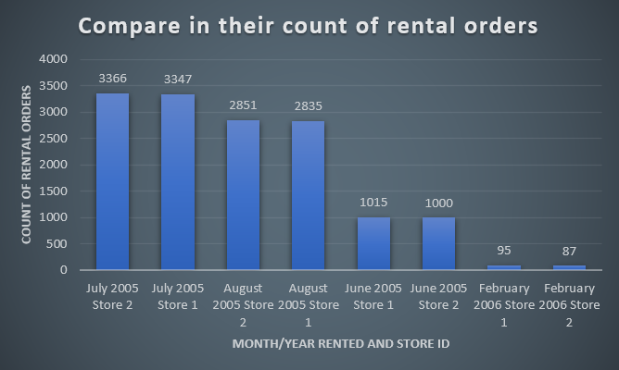
How does the two stores compare in their count of rental orders ?
<visualization>
We observe that the performance of the two stores is roughly the same for every month we have data for. This is the case for months with heavy rental orders such as July 2005 (3350 orders), and for months with small rental orders such as February 2006 (90 orders).

Slide 4
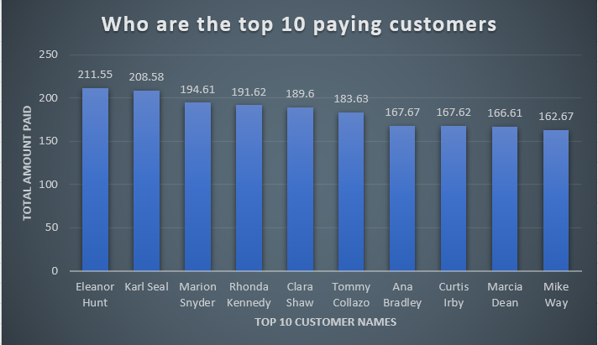
Who are the top 10 paying customers ? How many did each paid in total ?
<visualization>
Customer number 1 is Eleanor Hunt and she has paid a sum of approximately $210. The customer number 10 is Mike Way, and has paid about $160.

