Slide 1


Library Management System

Slide 2
Team Names
Omar mohamed
Fathy Ayman
Ahmed ibrahim
Ahmed Hani
Mahmoud Desoky
Abanob Emad

Slide 3
Introduction
The Library Management System with ASP.NET Core is designed to streamline the process of managing a library’s day-to-day operations. This system helps track book checkouts, returns, and penalties for late returns. It also provides a search feature for available books and manages member information, enabling users to easily borrow and return books. The platform leverages modern web technologies to deliver a user-friendly interface for both librarians and members. By implementing this system, libraries can enhance their operational efficiency and improve the user experience.

Slide 4
Key Features:
Book Management: Librarians can add, view, and manage book information such as title, author, genre, and availability status.
Member Management: The system allows for the registration and management of member information, including contact details and borrowing history.
Checkout and Return System: Librarians can record book checkouts by members, including due dates, and process returns while tracking overdue penalties.
Penalty Calculation: The system automatically calculates penalties for late returns based on the number of overdue days.
Book Search: Search and filtering functionalities help librarians and members find available books by title, author, or genre.
Member Portal: A member-specific portal allows users to view their borrowed books, due dates, and any outstanding penalties.
User Authentication: Secure login and role-based access control for librarians and members to ensure privacy and system integrity.

Slide 5
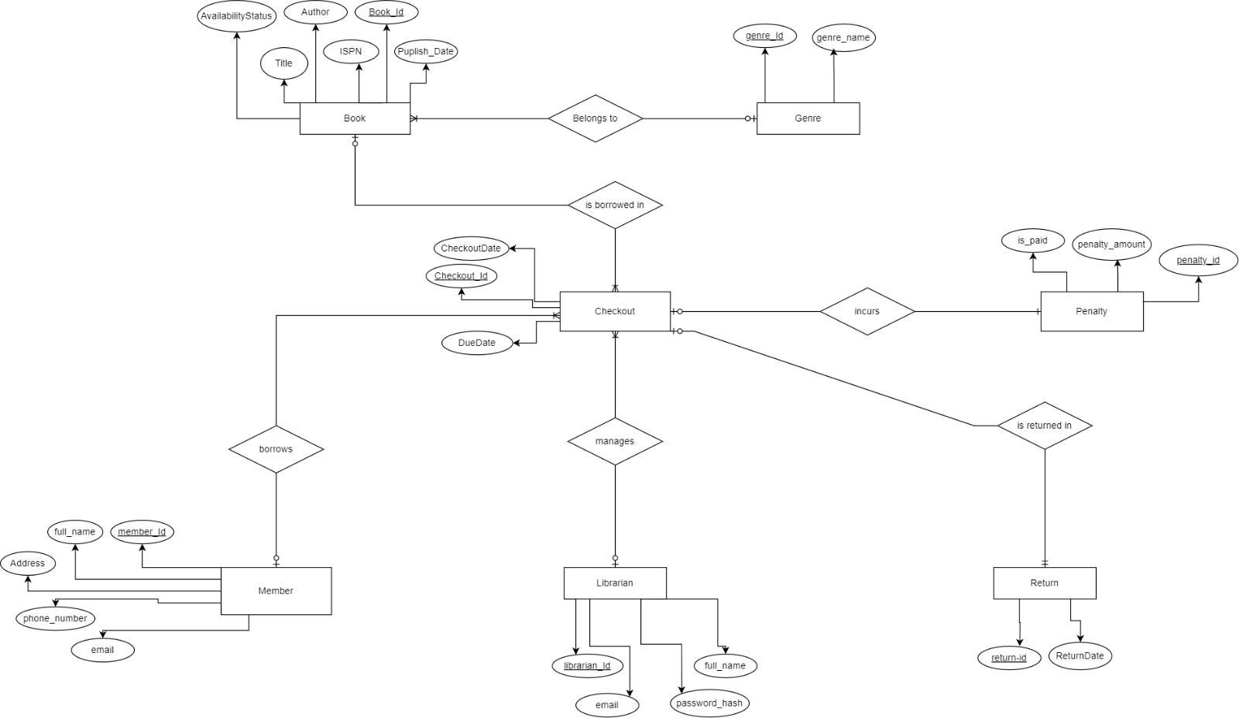
System Design : ERD

Slide 6

Technology Stack
ASP.NET Core: A powerful cross-platform framework for building web applications and APIs, serving as the backend for processing transactions.
Entity Framework: An Object-Relational Mapper (ORM) that simplifies database access by allowing developers to work with data using C# objects.
SQL Server: The relational database used to store book details, member information, and transaction data like checkouts and returns.
MVC (Model-View-Controller): A design pattern that separates the application into three interconnected components, allowing for better organization of code.
HTML/CSS/JavaScript: Used for designing the user interface and ensuring a responsive, user-friendly experience on the web.
User Authentication: ASP.NET Core Identity is utilized to manage authentication and authorization for both librarians and members.

Slide 7

Demo
Admin View

Slide 8

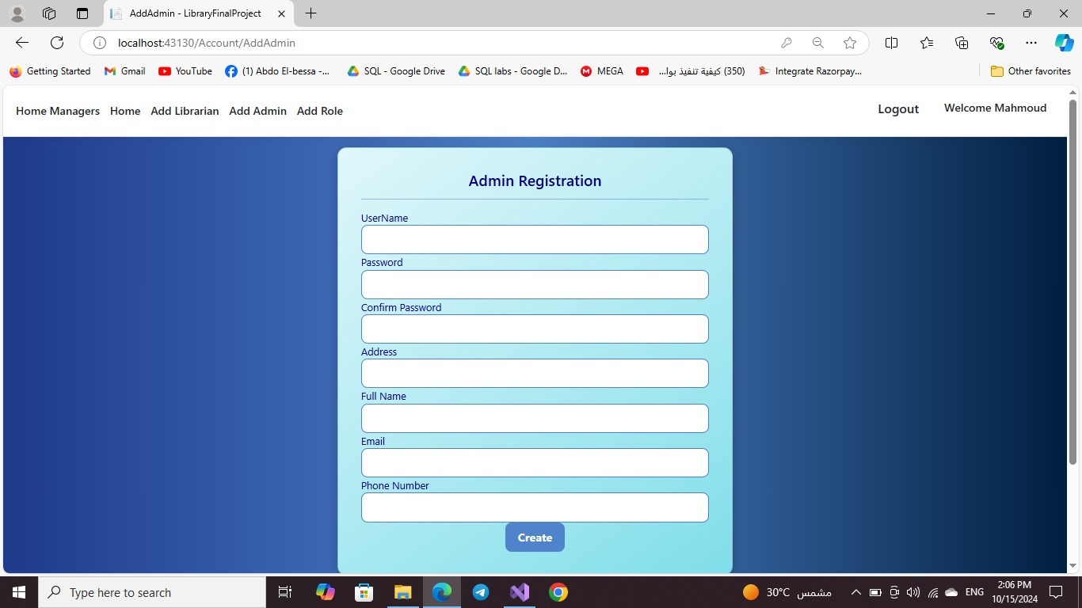



Slide 9
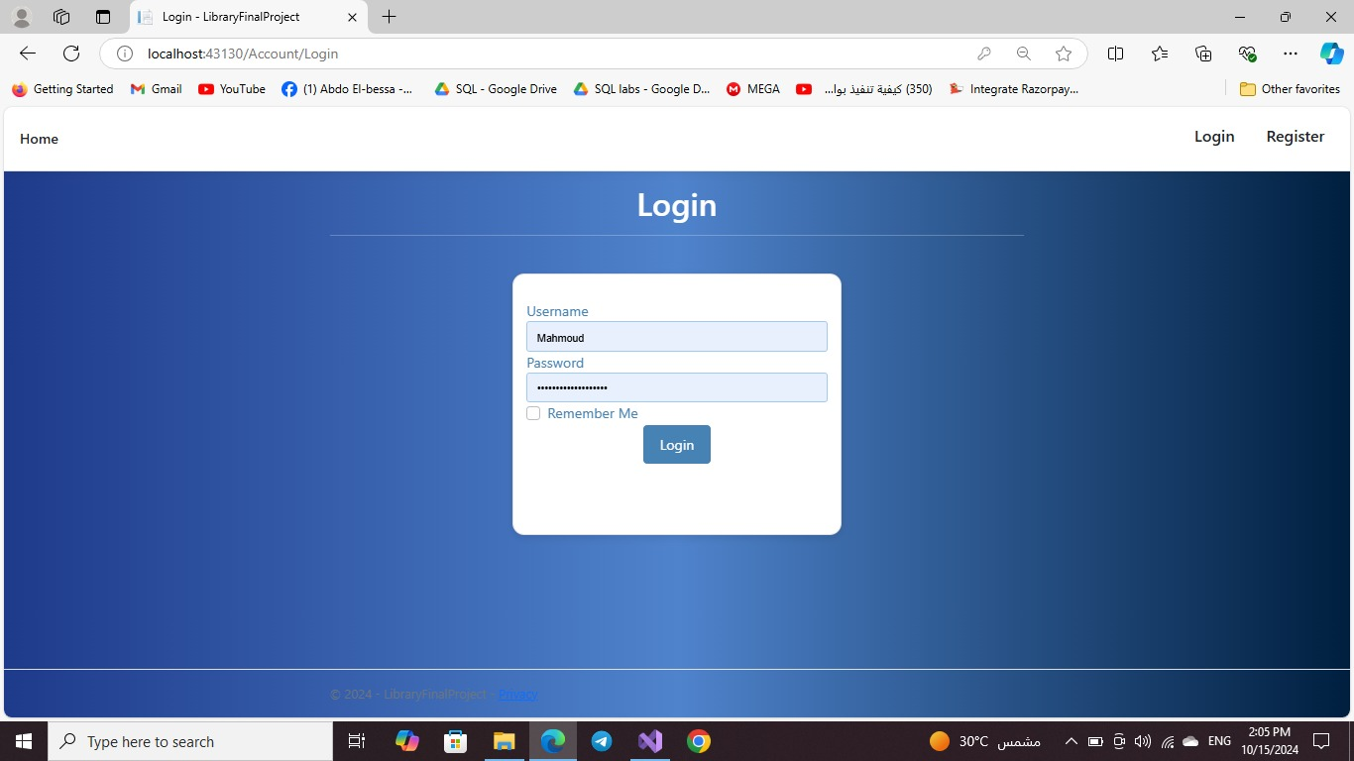

Slide 10
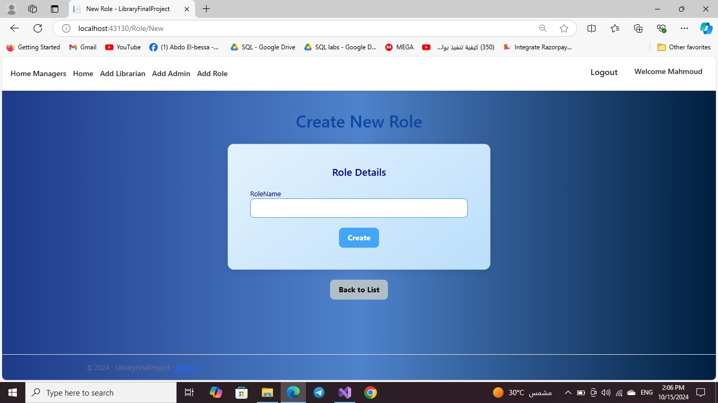

Slide 11
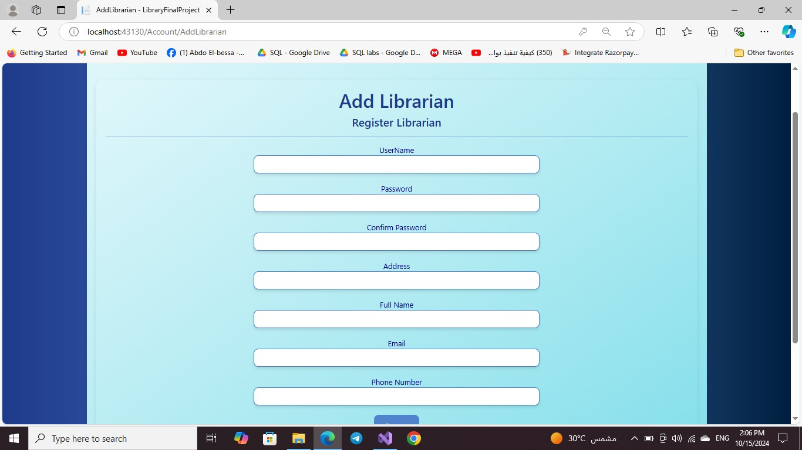

Slide 12
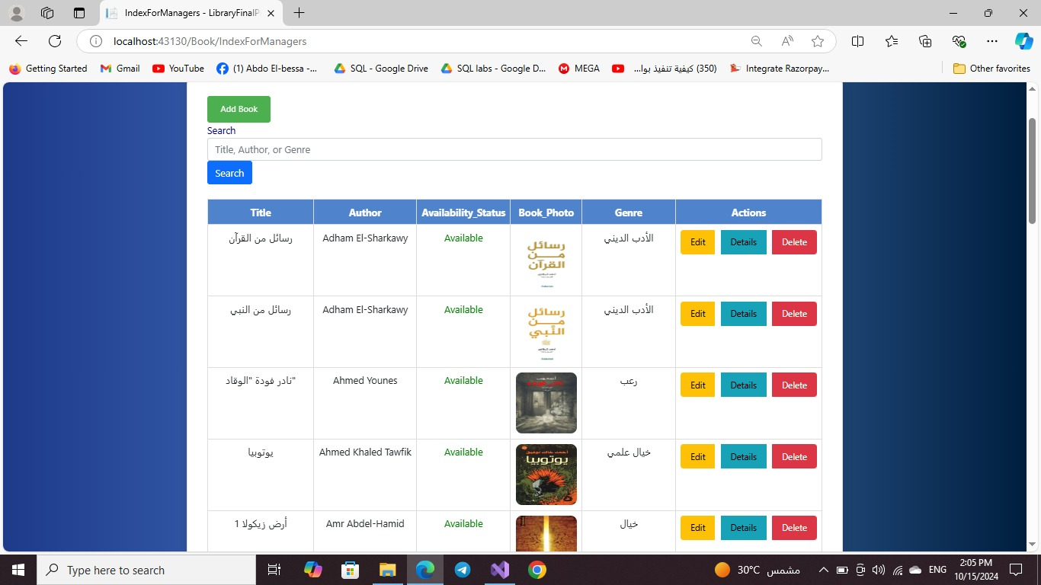

Slide 13


Slide 14
Demo
Librarian view

Slide 15
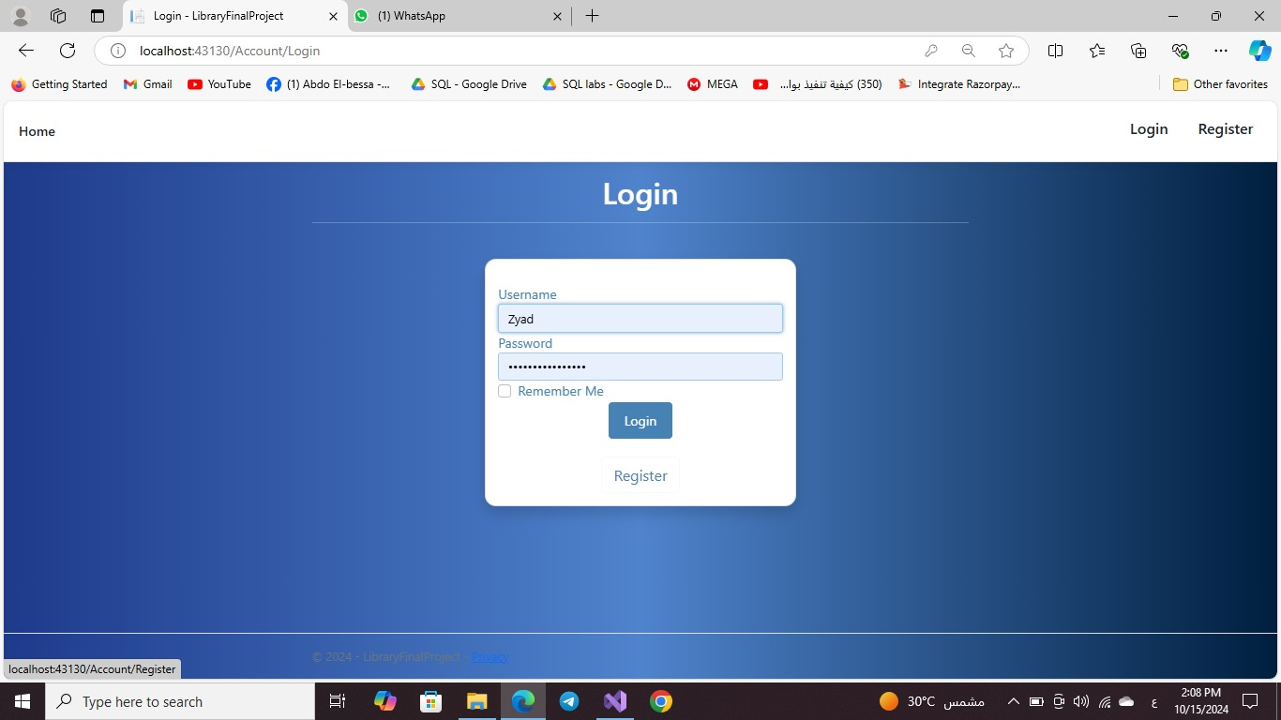

Slide 16


Slide 17
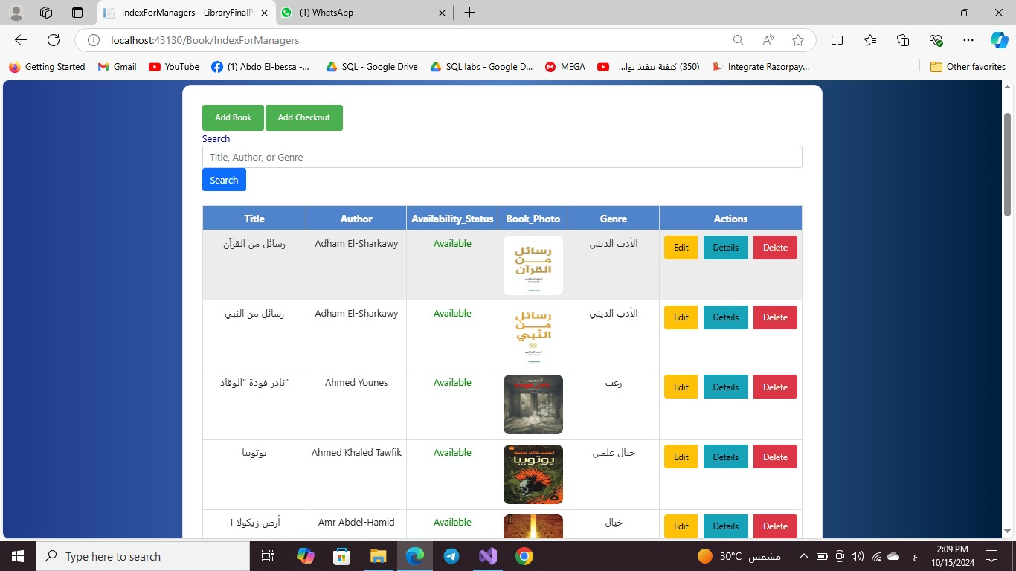

Slide 18
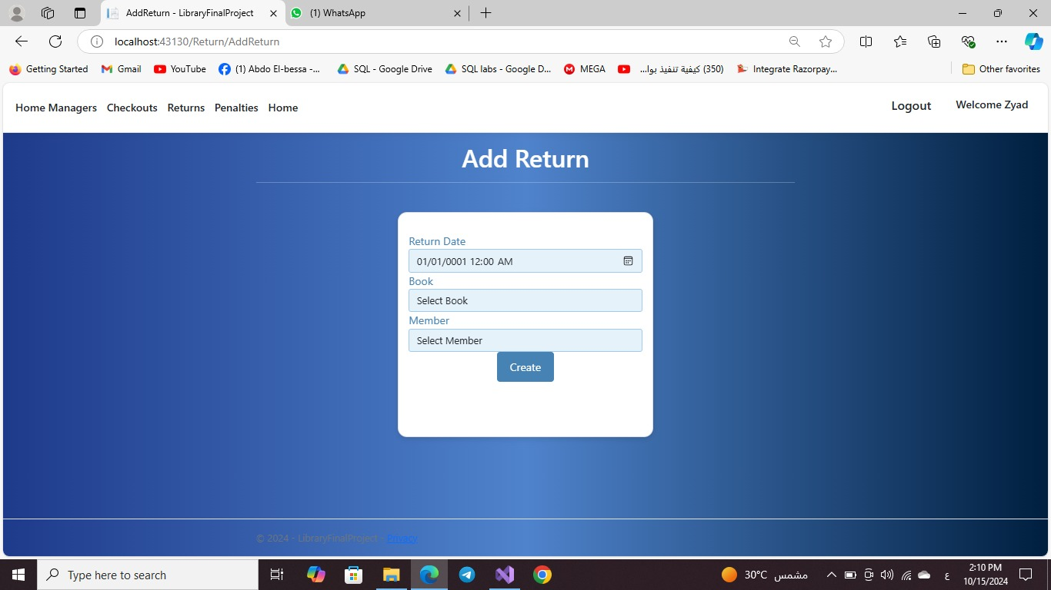

Slide 19
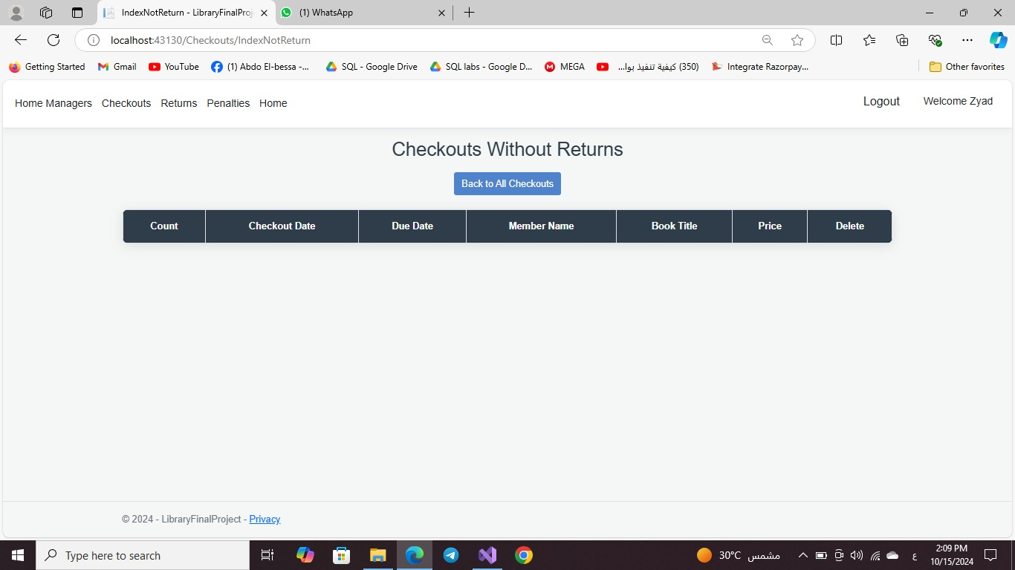

Slide 20
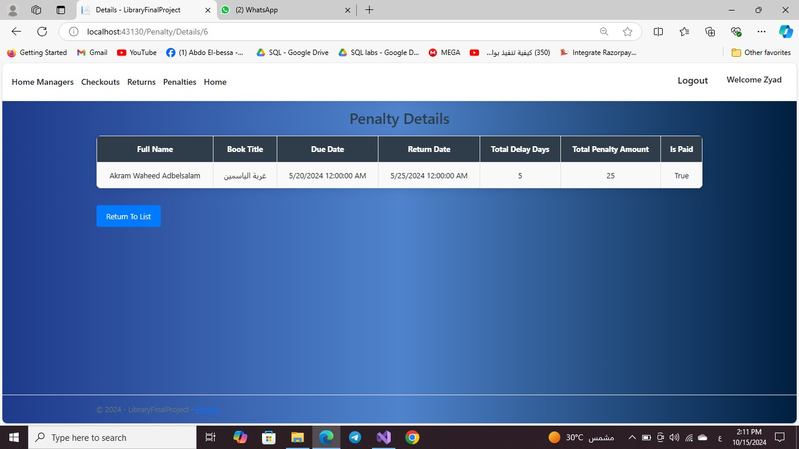

Slide 21
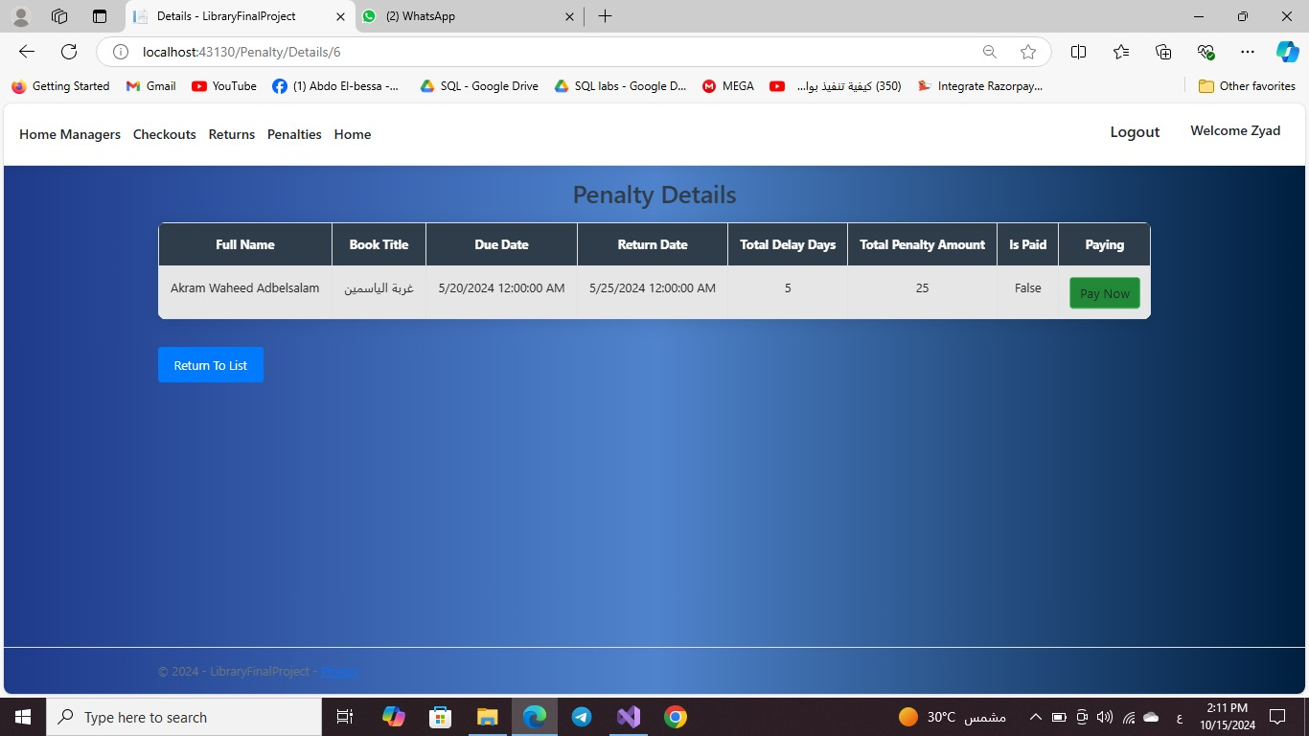

Slide 22
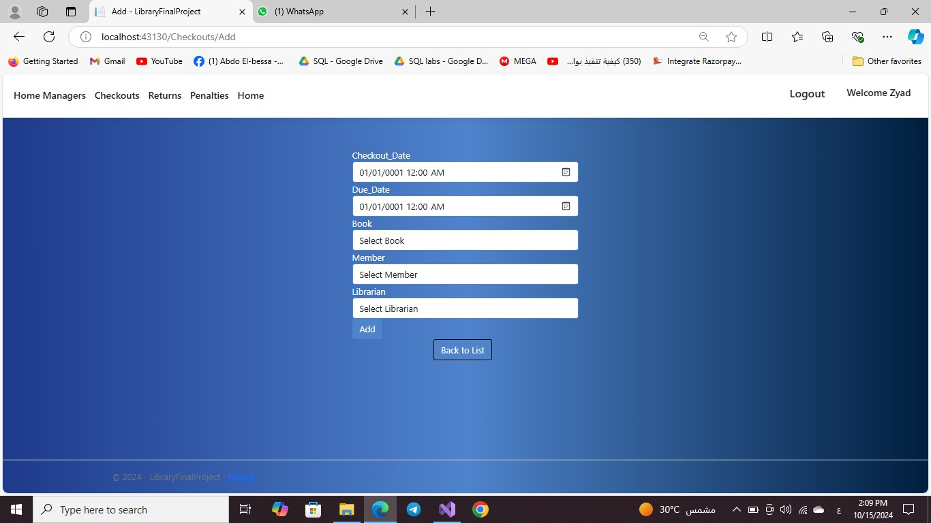

Slide 23
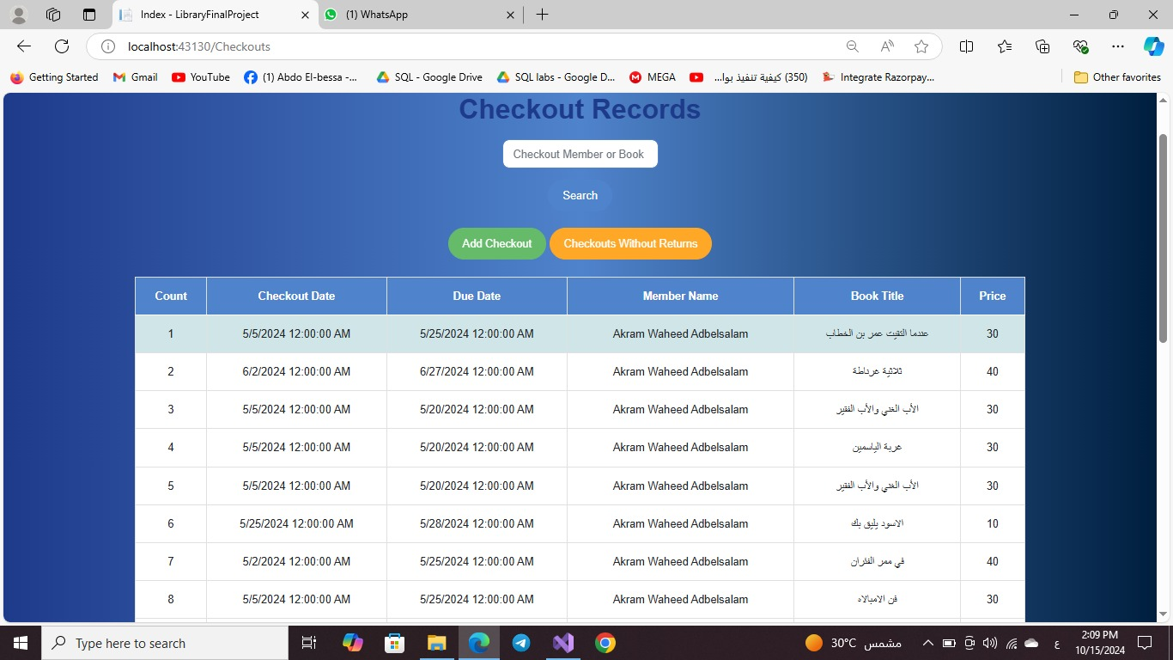

Slide 24
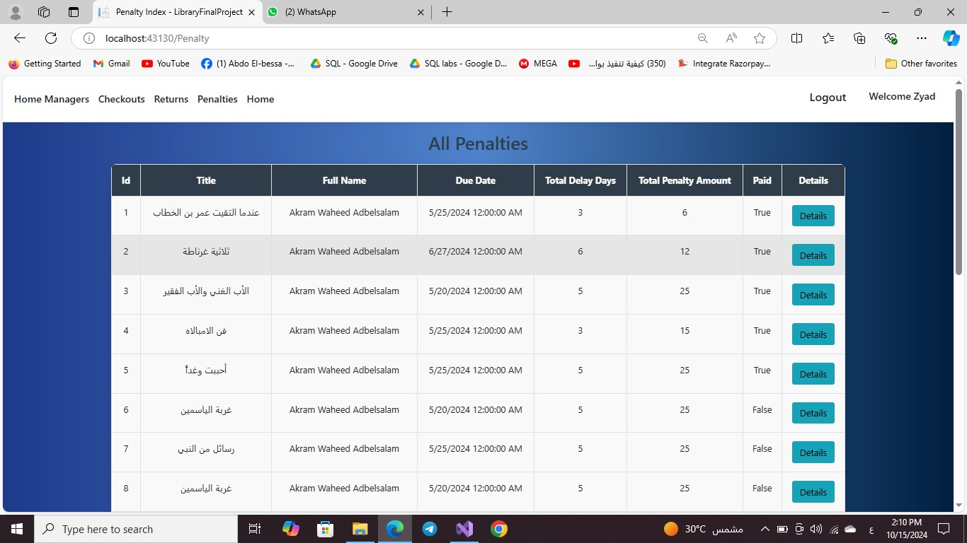

Slide 25
Demo
Member View

Slide 26
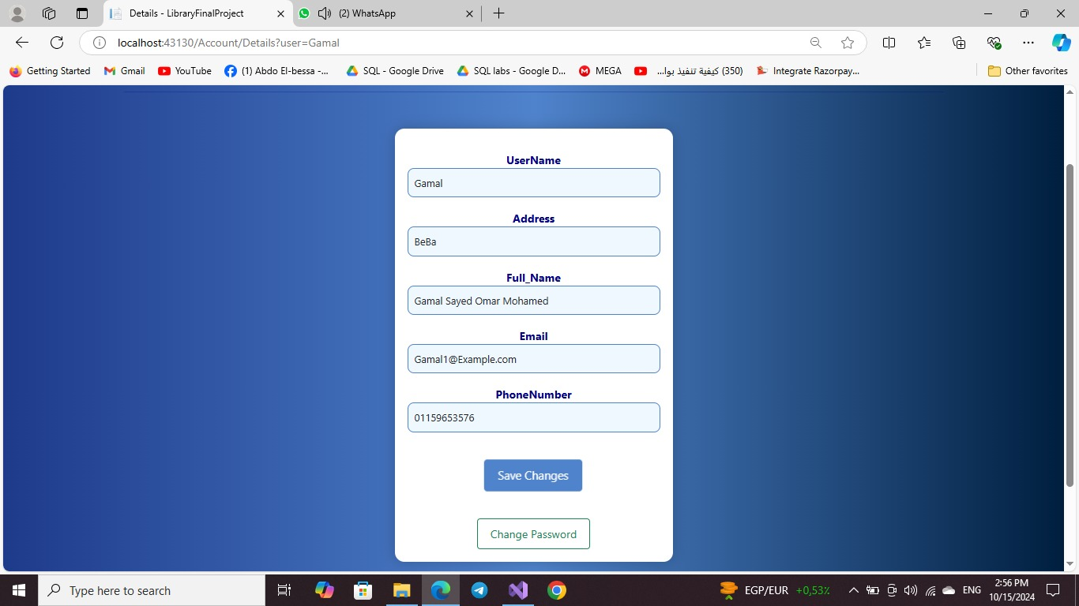

Slide 27
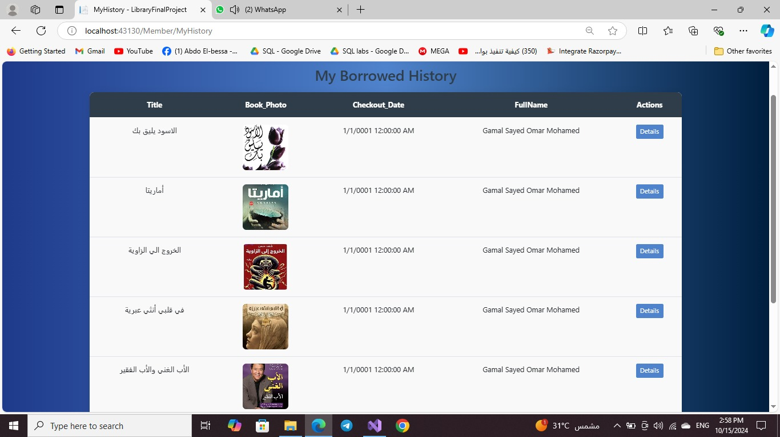

Slide 28
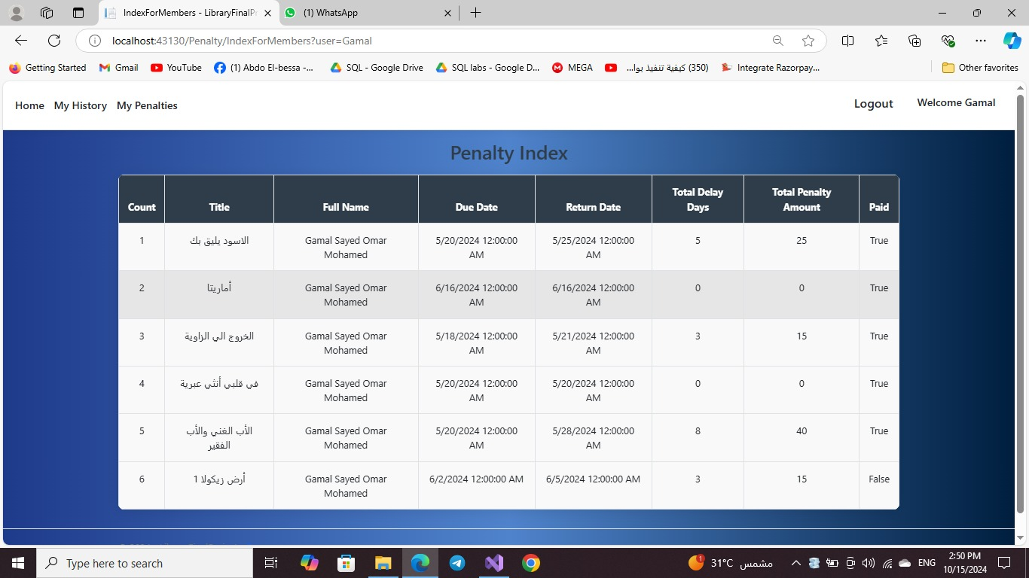

Slide 29
Conclusion
The Library Management System with ASP.NET Core successfully streamlines library operations by automating key processes like book checkouts, returns, and penalty calculation. The system provides a comprehensive platform for both librarians and members, enabling effective book management and efficient service delivery. Leveraging modern web technologies such as ASP.NET Core, SQL Server, and Entity Framework, the system ensures scalability, security, and a seamless user experience. With its easy-to-use interface and robust functionality, the system enhances library management, improving both efficiency and the user experience.

Slide 30
Thanks

