Slide 1



Slide 2


The Story
RGIII limps off the field after sustaining an injury and goes to the locker room for the Redskins trainer to examine his knee
The trainer lifts RGIII leg up and bends his knee, looking to see if it has “natural” full range of motion. The trainer clears him & RGIII returns to the field…

Slide 3
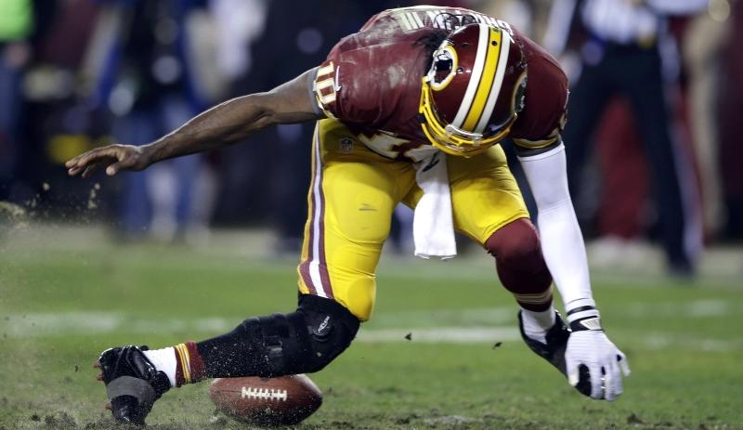
The Story

Slide 4
The Problem
The practice of medicine in many areas is still…practice.
Diagnosis of illnesses and recovery vitals are often based on estimates

Slide 5
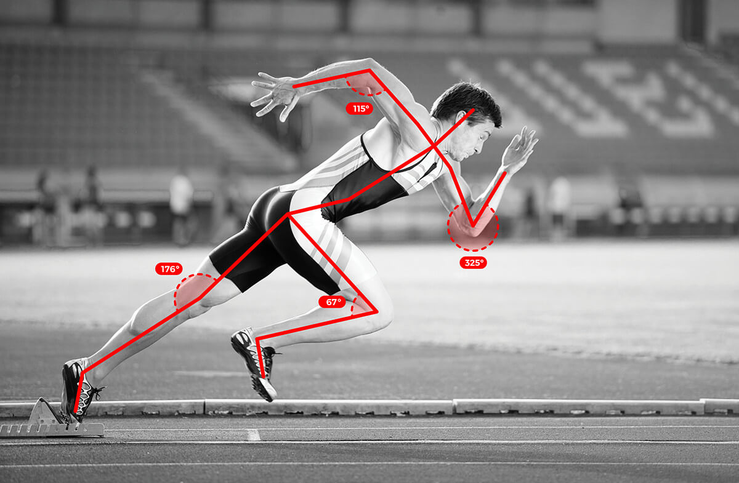
Our Solution
Vital Visuals
Providing primary care and physical therapy doctors scientific measurement and displaying those stats real time.

Slide 6
Commercial Applications
Exercise Science – Professional Sports
Physical Therapy
Prosthetics

Slide 7
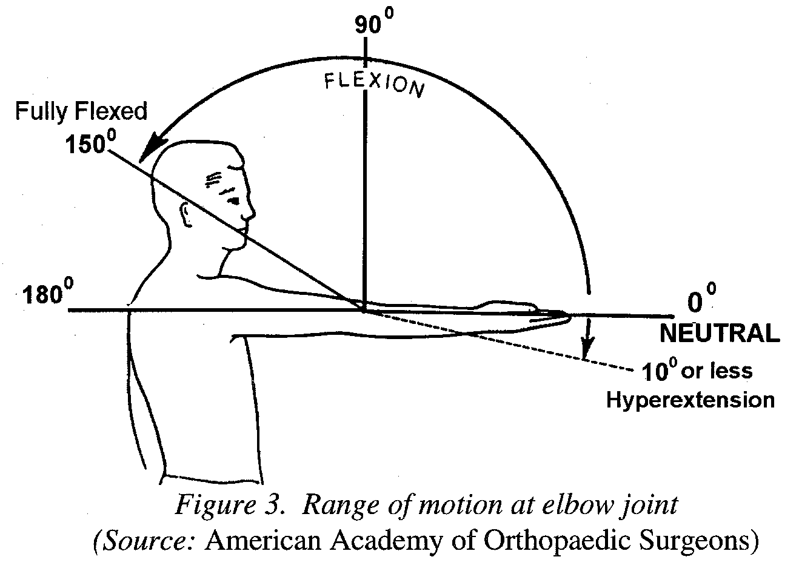
Key Features
Full Body Check of Patients Major Joints
Biometric Physiology Scan
Multi-device Coordination
Dynamic patient distance measuring

