Slide 1
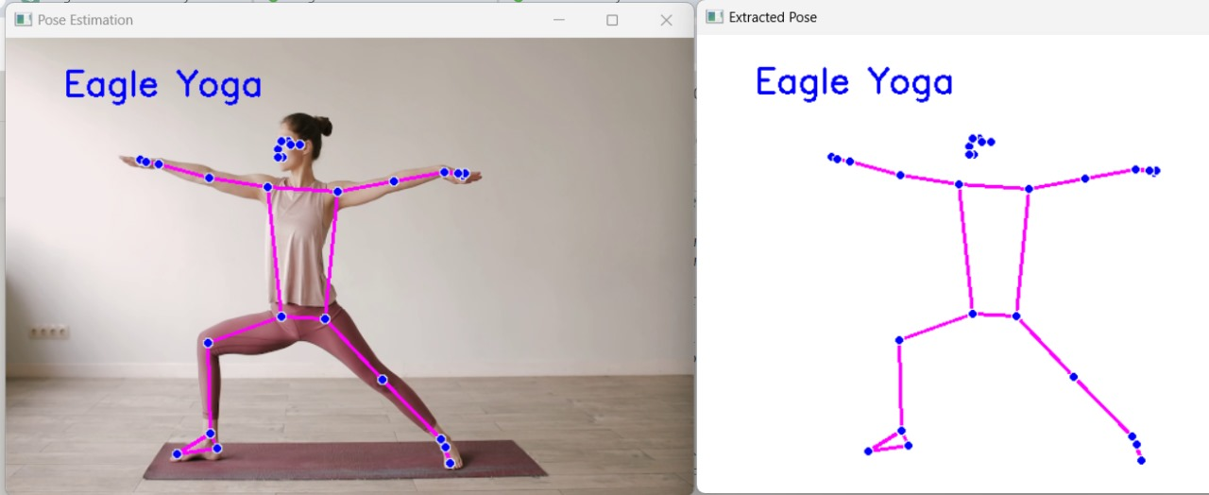
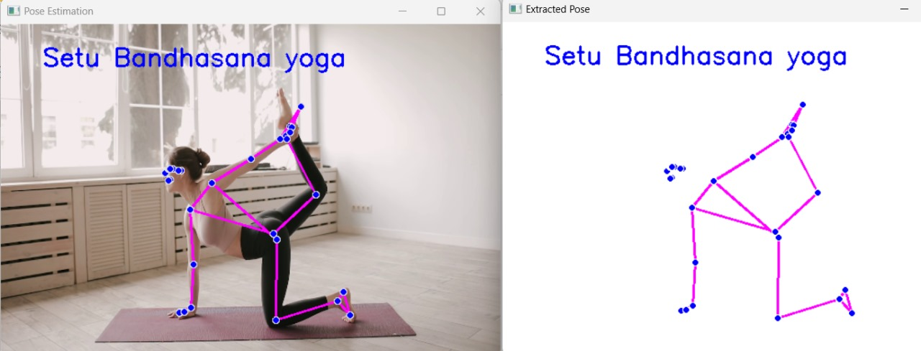
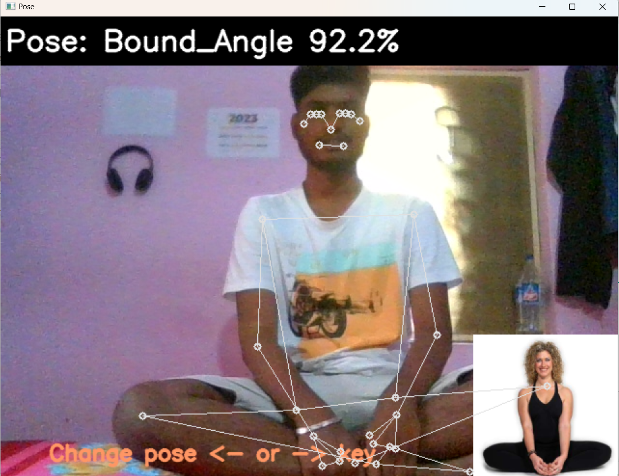
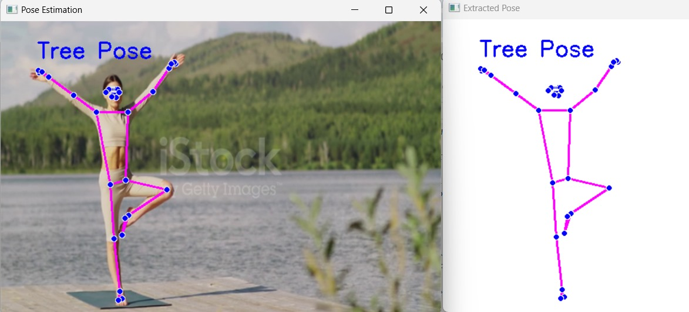
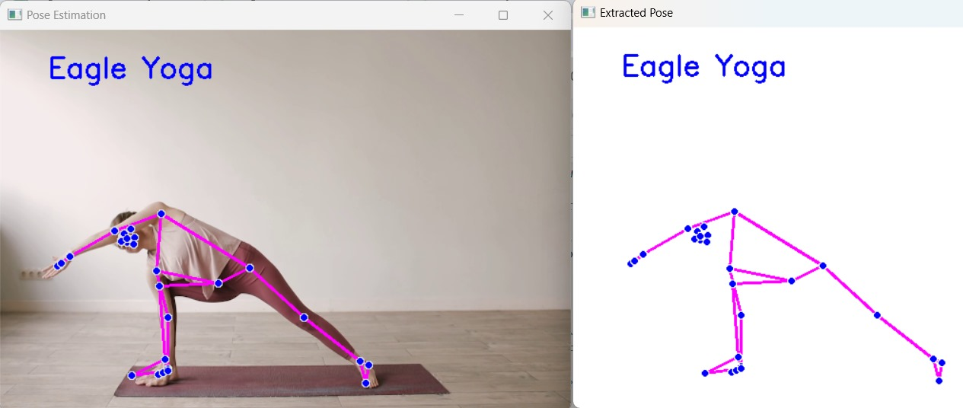
Models Used
Video File
Webcam Integration(Real-Time Feed)
YOLOV8
SSD
2D Pose Estimation
3D Pose Estimation
Data Preprocessing
Resizing
Renaming
Noise Removing
Classifiers Used
SVM
KNN
Naïve Bayes
Logistic Regression
Random Forest
Results
Yoga Pose Detection

