Slide 1
Credit Card Usage Segmentation
Presented by: Abantika Jena

Slide 2
Agenda
Project Overview
Dataset Description
Data Processing & Analysis
Cluster Analysis & Insights
Dashboard Visualization
Conclusion & Future Work

Slide 3
Project Overview
Goal: To analyze customer credit card data and segment them based on spending and payment behaviors.
Objectives:
Identify customer usage patterns.
Understand key behavioral segments.
Help businesses design personalized offers and manage risks.

Slide 4
Dataset Description
Dataset Source: Credit Card Customer Data
Total Records: 8,950 Total Features: 18
Each record represents a credit card customer.
Key columns include : BALANCE, PURCHASES, CASH_ADVANCE, PAYMENTS, CREDIT_LIMIT.
Target is not predefined — we perform unsupervised clustering to group similar customers.
Missing values were handled using mean imputation.

Slide 5
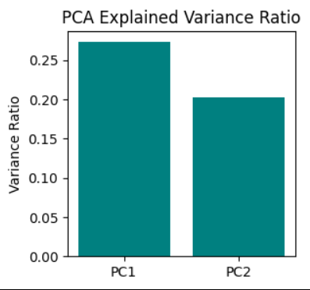
Data Preprocessing
Removed CUST_ID as it doesn’t help in analysis.
Filled missing values using mean.
Applied StandardScaler to bring all features to a similar scale.
Used PCA (2 components) to reduce dimensions and visualize data easily.
PCA also helps remove noise and highlight main patterns.

Slide 6
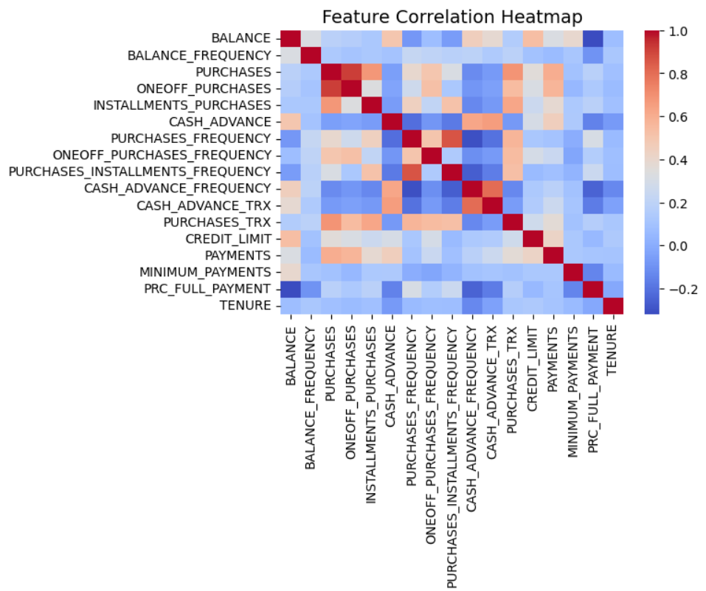
Exploratory Data Analysis (EDA)
Created heatmap to understand correlations between features.
Plotted distributions for BALANCE, PURCHASES, CASH_ADVANCE, and PAYMENTS.
Observed that:
High variation exists among spending habits.
Some customers use cards mostly for purchases, others for cash advances.
These visuals help identify patterns before clustering.

Slide 7
Clustering Models
Used two clustering algorithms:
K-Means (K=4)
DBSCAN
K-Means divides data into fixed clusters based on similarity.
DBSCAN identifies dense areas and detects noise points.
Evaluated using:
Silhouette Score
Davies–Bouldin Score
Calinski–Harabasz Score

Slide 8
Cluster Analysis
K-Means gave 4 main clusters.
Each cluster shows different spending and payment behavior.
For example:
Cluster 0: High balance, high purchases.
Cluster 1: Moderate spenders.
Cluster 2: Low activity customers.
Cluster 3: Frequent cash advance users.
Visualized using PCA scatter plots and pie charts.

Slide 9
Business Insights
High Spenders: Offer loyalty rewards and credit upgrades.
Moderate Users: Encourage higher engagement with offers.
Low Users: Target with awareness and usage campaigns.
Cash Advance Users: Monitor for credit risk and provide financial guidance.
Cluster insights saved for future business use.

Slide 10
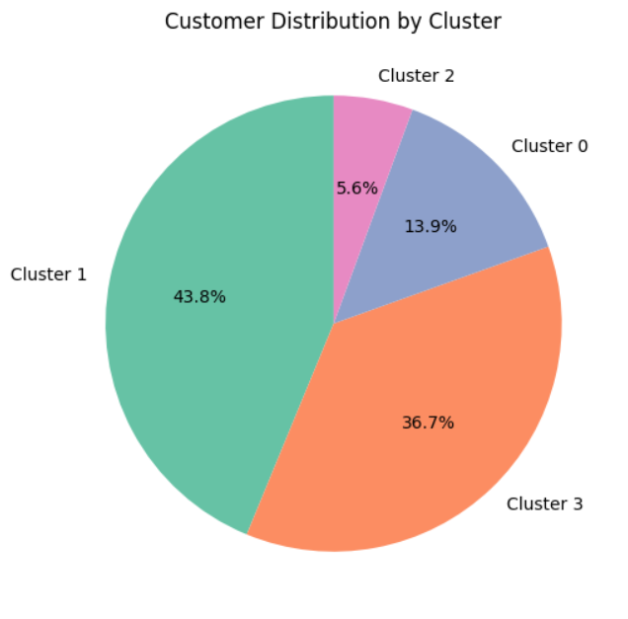
Cluster Analysis & Insights
Cluster | Behavior Summary | Key Traits
0 | Premium Customers | High balance, high payments
1 | Cash Advance Users | High cash withdrawal, low repayment
2 | Regular Users | Moderate purchases and payments
3 | Dormant Users | Low usage and small transactions

Slide 11
AI Model for Cluster Prediction
Used a Random Forest Classifier to predict customer cluster labels.
Trained model on the scaled dataset with 80–20 train-test split.
Model achieved 95% accuracy on the test data.
This allows automatic prediction of a new customer’s segment.

Slide 12
Dashboard
The dashboard shows overall customer spending behavior.
It highlights total customers, total balance, and total purchases.
The pie chart compares one-off and installment purchases.
Tenure analysis shows that long-term customers spend more.
Overall, it helps understand how customers use their credit cards.

Slide 13
Conclusion
This project successfully analyzed and segmented credit card customers based on their spending and payment behavior.
Using machine learning and visualization, we identified distinct customer groups such as high spenders, moderate users, low activity customers, and cash advance users.
The dashboard and AI model together provide clear insights that can help banks design personalized offers, improve customer retention, and manage credit risk effectively.
Overall, the project transforms raw data into meaningful business intelligence for smarter decision-making.

Slide 14
Thank You!

