Slide 1


MAM College of Engineering and Technology
Siruganur , Trichy 621105
IQ – based App
Register No | Names
1 | SABARIBALA P
2 | JAYAPRAKASH S

Slide 2
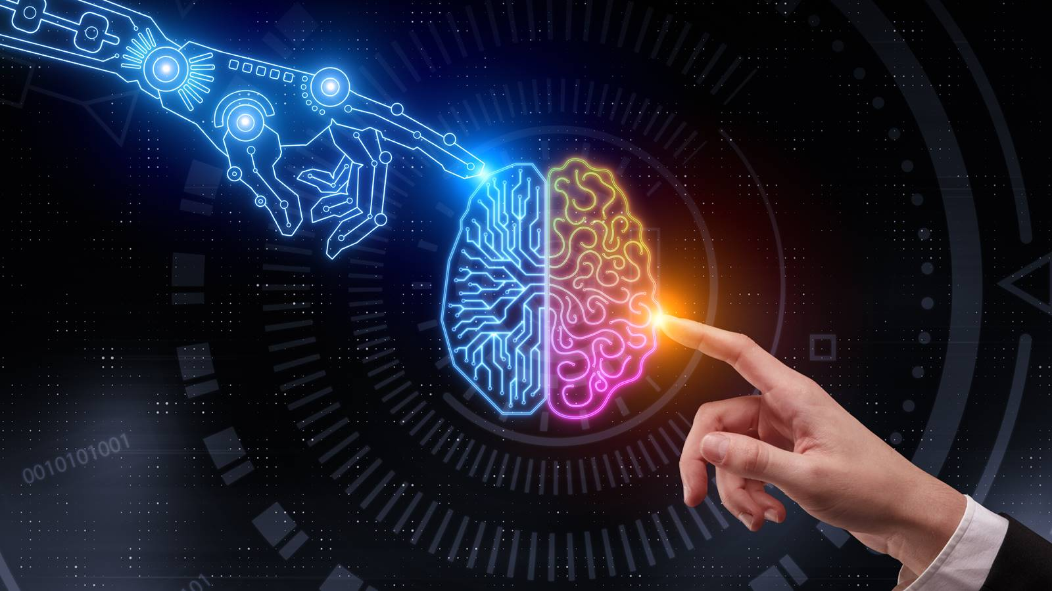
IQ - based App

Slide 3
IQ –( Intelligence Quotient )
Human IQ
IQ tests are made to have an average score of 100. Psychologists revise the test every few years in order to maintain 100 as the average. Most people (about 68 percent) have an IQ between 85 and 115. Only a small fraction of people have a very low IQ (below 70) or a very high IQ (above 130).
AI - IQ
At the maximum, these AI reached an IQ value of about 47, which corresponds approximately to a six-year-old child in first grade. An adult comes to about 100 on average.
Usually, a 6–year–old human has an IQ of 55.5, and as you can see, Google's is a little bit lower, but Siri's is twice as low – 23.9

Slide 4
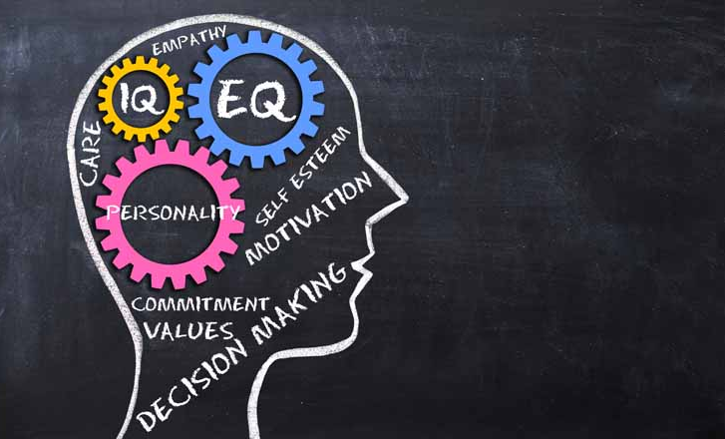
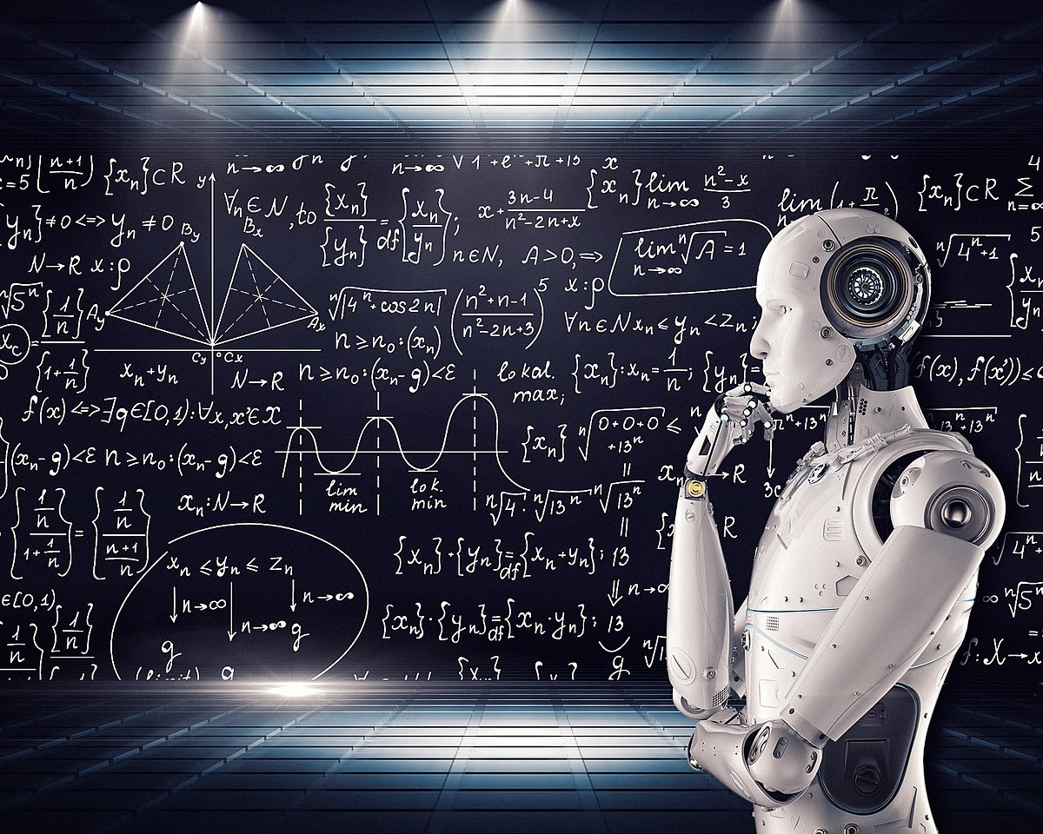
HUMAN IQ AI - IQ

Slide 5

Highest - IQ
William James Sidis – has the World's Highest IQ.
Anywhere from 250 to 300 is his IQ score,
almost twice the score of Albert Einstein.
At the age of eleven, William famously entered Harvard University,
becoming the youngest person to enter.
He also claimed to be conversant in 25 languages

Slide 6
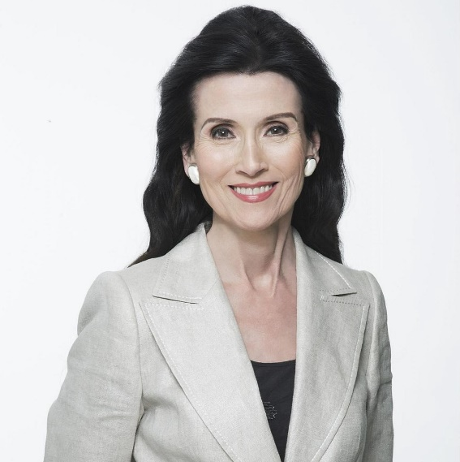
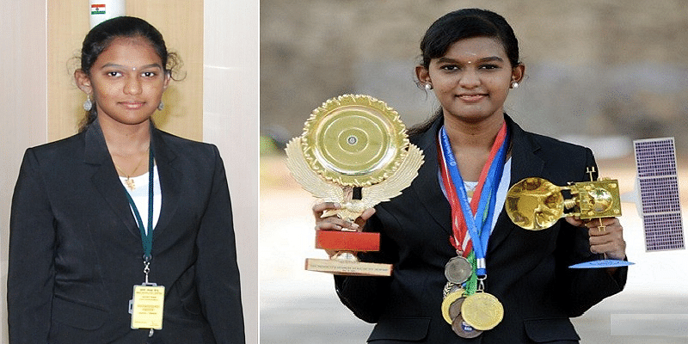
Marilyn Vos Savant - may well be the smartest person alive today.
With an IQ of 228 , she holds the highest IQ in the world by the
Guinness World Records since 1990 .
K. Visalini - is an Indian prodigy who is purported
to have an officially tested IQ of 225.
Visalini also holds several other records including the youngest person to receive CCNA certification and youngest person to receive EXIN cloud computing certification.

Slide 7
What is the average IQ in 2022?
Most people (about 68 percent) have an IQ between 85 and 115.
Only a small fraction of people have a very low IQ (below 70) or a very high IQ (above 130).
Chess player IQ level
Strong grandmasters with a rating of around and over 2600 are expected to have an IQ of 160 plus. The strongest grandmasters of the day with their ratings hovering around 2800 are expected to have IQs around 180.
When AI overtakes human
If superintelligent AI is possible , and if it is possible for a superintelligence's goals to conflict with basic human values , then AI poses a risk of human extinction.

Slide 8
ABSTRACT
Are people with higher IQ will gain better at solving problems?
Now a days , Many people are wasting there time by watching unusefull videos and playing games , etc…
For these purpose, we are introducing this app to develop people IQ level and there Knowledge .

Slide 9
Country wise IQ - Level
1st - Japan 106.48
2nd - Taiwan 106.47
3rd - Singapore 105.89
4th - Hong Kong 105.37
5th - China 104.1
Our India got 68th – place with the IQ – level of 81
United States - 74.88 (A+)
United Kingdom – 64.19 (A)
Germany - 64.18 (A)

Slide 10
INTRODUCTION
This is the app which helps the people to know there own IQ level and there known knowledge .
This app make people to learn more , quickly and interesting
People Improve there knowledge through their points they achieved.

Slide 11
HOW IT WORKS ?
Get the user data from users and store the data in database for fetching questions for there IQ level.
Now we are able to categories the users with there info they entered.
After login to the app some general questions are asked to check the user IQ and it helps to categories the user by there IQ level.
And now , we know the user IQ level with that data we ask some related questions to improve the user IQ and more and more user can gain knowledge

Slide 12
How users develop there IQ ?
There are many questions asked to the user if they unable to answer we give some tips to the user to find out answer .
If the user answered correctly then some points are added to user account
Points are used to participate in online Quiz tournament and user can convert the points into money.
If the user had win the online Quiz then the allotted points will be added to the user account and user will be awarded with certificate .
It is usefull to find out the people who are tallentted and have more skill in there domain

Slide 13
Quiz Tournament
There is a global tournament will be conducted once in year .
Global Tournament - is created to find out highlevel IQ person and the person will reward grand prize with certificate
National Tournament - is created for undergraduate students to find out there IQ level and to improve there knowledge for future
Local Tournament - is created for mainly schooling students to gain more advanvced knowledge and improve their skill .

Slide 14
Permissions
Storage
- helps to store the data in user device and they backup whenever the user reinstall it
Camera
- access to observe or monitor user face when he participating in tournament
- access to video while global conference
Mic
- access to conference and asking questions manually
Location
- it is easy to find questions within the user location like [like language , culture , etc….]
Recent activities
- to fetching questions easily

Slide 15

Benefits
Understanding Quickly
Improve IQ Level
Gain more and more knowledge
Gain Money
Interview Skill Improved
People will known there domain by answering

Slide 16
Motive
Make students to gain more advanced knowledge in all domain
Comman people to know about the basic of all domain
To find out the people who are better in their domain
It helps to move the human future to the next level
It helps to select the person without the interview
May be an Advanced AI can be made by the high IQ innovators.

Slide 17
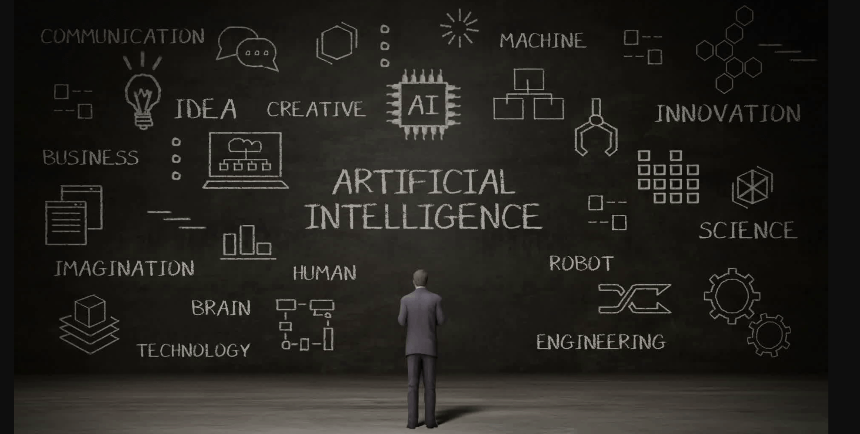
Soon with our innovators we could make advanced AI which may dominate the future of human and it controlled by advanced IQ - person

Slide 18


Slide 19

WE WILL BECAUSE WE CAN

