Slide 1

Lightweight Graph Neural Networks for Real-Time QoS-Aware Routing in Software-Defined Networks
K. Abaragithan
2021/SP/061
Under the supervision of Dr. K. Thabotharan
October 2025

Slide 2

Introduction & Background
Modern networks face challenges in maintaining QoS such as low latency, minimal packet loss and high throughput.
Impacted Applications:
The rise of real-time applications like IoT, autonomous systems, and video streaming demands networks that can dynamically adapt to ensure QoS
Traditional routing protocols lack adaptability to dynamic traffic conditions.

Slide 3
Introduction & Background
Existing Solutions:
SDN separates control and data planes, enabling centralized, programmable routing decisions.
DRL-based routing methods learn adaptive policies but require heavy computation and long training cycles.
GNN-based routing captures network structure efficiently but remains computationally expensive for real-time or edge-level deployment.

Slide 4
Problem Statement & Objectives
Problem Statement:
Existing DRL/GNN-based routing methods are too computationally heavy for edge-level SDN controllers.
They require faster, resource-efficient models for real-time deployment.
Research Objectives:
Design a lightweight GNN for real-time QoS-aware routing approach for SDNs.
Apply pruning, quantization, and knowledge distillation for optimization.
Evaluate the performance of the proposed system against existing algorithms.
Analyze the trade-offs between accuracy, latency, and resource use.

Slide 5
Literature Review
Authors | Methodology | Key Contribution | Limitation
Kim et al. | DRL (DDPG) M/M/1/K queue model ATVM for state | DRL-based SDN routing Balances delay & loss | Slow training for dynamic topologies
Song et al. | DRL (DDPG) Multi-QoS reward | QoS-aware routing Reduced delay, higher efficiency | Single-metric DRL → local optimum
He et al. | DRL (SAC) Causal Action Influence (CAI) CeGCN for node/link embedding | Combines causal inference + RL | Limited study on causal effects GNN may miss link details

Slide 6
Literature Review
Ampratwum & Nayak | Hybrid DRL + GNN WDM restoration | Real-time load balancing | Needs real-time response High training cost
Jiang et al. | Survey on GNN (SL & RL) | Overview of GNN in routing Highlights benefits over Dijkstra/OSPF | Scalability & explainability issues
Research Gap:
Existing GNN/DRL models perform well but are too heavy for real-time edge-level deployment.
Need lightweight GNN for efficient, real-time QoS routing.

Slide 7
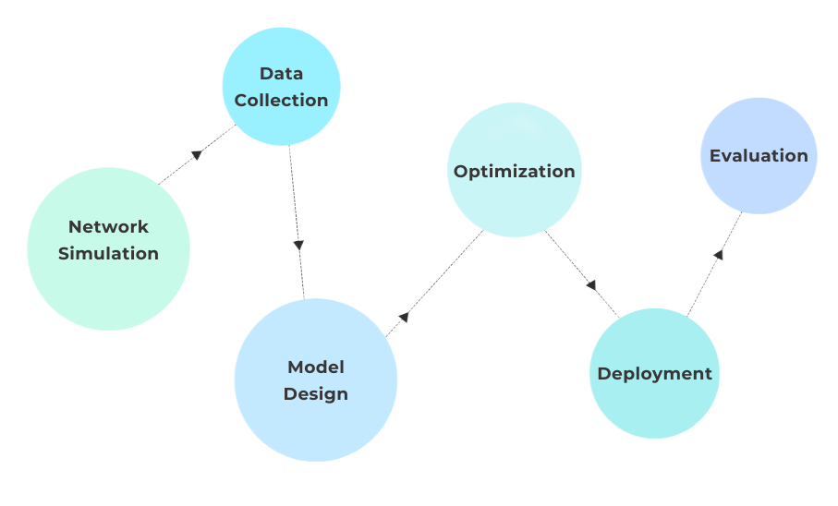
Proposed Methodology
Network Simulation: SDN setup using Mininet and RYU.
Data Collection: Capture dynamic traffic metrics.
Model Design: Implement lightweight GNN for routing prediction.
Optimization: Pruning, quantization, knowledge distillation.
Deployment: Evaluate on edge-level SDN for latency and efficiency.

Slide 8
Tools and Evaluation Metrics
Tools & Technologies:
Python, PyTorch, Mininet, RYU.
GEANT2 and Internet2 topologies.
Evaluation Metrics:
Network: Delay, packet loss, throughput.
Model: Latency, memory footprint, CPU usage.
Baselines: Shortest Path, DRL (DDPG/SAC), GNN (RouteNet, CeGCN).

Slide 9
References
[1] Y. Song, X. Qian, N. Zhang, W. Wang, and A. Xiong, “QoS routing optimization based on deep reinforcement learning in SDNs.,” Computers, Materials & Continua, vol. 79, no. 2, 2024.
[2] Ampratwum and A. Nayak, “Hybrid approach for WDM network restoration: Deep reinforcement learning and graph neural networks,” IEEE Open Journal of the Computer Society, 2025.
[3] W. Jiang, H. Han, Y. Zhang, J. Wang, M. He, W. Gu, J. Mu, and X. Cheng, “Graph neural networks for routing optimization: Challenges and opportunities,” Sustainability, vol. 16, no. 21, p. 9239, 2024.
[4] G. Kim, Y. Kim, and H. Lim, “Deep reinforcement learning-based routing on software-defined networks,” IEEE Access, vol. 10, pp. 18121–18133, 2022.
[5] Y. He, G. Xiao, J. Zhu, T. Zou, and Y. Liang, “Reinforcement learning-based SDN routing scheme empowered by causality detection and GNN,” Frontiers in Computational Neuroscience, vol. 18, p. 1393025, 2024.
[6] D. Kreutz, F. M. V. Ramos, P. Verıssimo, C. E. Rothenberg, S. Azodolmolky, and S. Uh-lig, “Software-defined networking: A comprehensive survey,” Proceedings of the IEEE, vol. 103, no. 1, pp. 14–76, 2015.

Slide 10
THANK YOU

