Slide 1


K.RAMAKRISHNAN COLLEGE OF ENGINEERING
(AUTONOMOUS)
DATA STRUCTURES USING C
<<< BUS TICKET BOOKING >>>
Presented by,
Name : ABARNA.D
Register No. : 8115U23AD002
Roll. No. : AD2302
Year & Section : I – AI&DS / E
Date of Review : 17.04.2024

Slide 2
PRESENTATION OVERVIEW
  Objective
  System Architecture (Flow Diagram)
  Module completion
  Data structure used
  Output
  Applications
  Conclusion
  Review

Slide 3
OBJECTIVE OF THE PROJECT
The program employs frameworks to organize data for buses, passengers, and users. It also has menus for both the main menu (login) and the user menu (booking, canceling, and checking status)

Slide 4
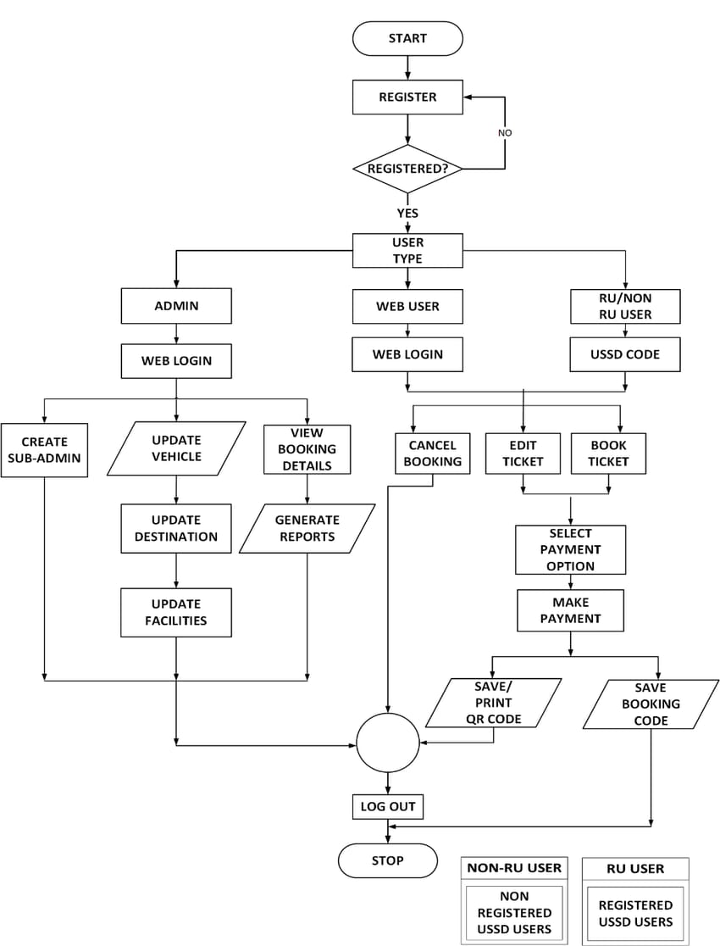
FLOW CHART

Slide 5
DATA STRUCTURES USED
Supporting Data Structures
Structures : Define custom data types for buses, tickets, and passengers.
Linked Lists : Maintain a dynamic list of buses, bookings, and passengers.
Arrays : Utilize for storing seats within each bus.
Files : For persistent storage of data across sessions.

Slide 6
MODULES INVOLVED
MODULE 1 : BUS MANAGEMENT MODULE
Responsible for all operations related to bus data management, including :
1. Adding new buses : Entering details like bus ID, route, timing.
2. Editing bus information : Updating details about existing buses.
3. Removing buses : Deleting bus records from the system.
4. Viewing bus lists : Displaying all or selected bus details based on criteria.

Slide 7
MODULES INVOLVED
MODULE 2 : BOOKING MANAGEMENT MODULE
Focuses on the ticket booking process, managing reservations and cancellations :
1. Booking a ticket : Allocating a seat for a passenger, updating bus seat
availability
2. Cancelling a ticket : Releasing a booked seat, updating the booking status.
3. Checking booking details : Retrieving and displaying details of specific bookings.

Slide 8
MODULES INVOLVED
MODULE 3 : PASSENGER MANAGEMENT MODULE
Manages details about the passengers using the service:
1. Adding passenger details : Input personal information linked to bookings.
2. Updating passenger information : Modify existing passenger details.
3. Deleting passenger records : Remove passenger data when no longer needed.

Slide 9
MODULES INVOLVED
MODULE 4 : DATA STORAGE MODULE
Handles data storage and retrieval operations, abstracting the specifics of data access.
1. Saving data : Writing bus, booking, and passenger data to files or other storage systems.
2. Loading data : Retrieving data from storage when the program starts or when needed.
3. Searching data : Providing mechanisms to search through stored data based on different
criteria.

Slide 10
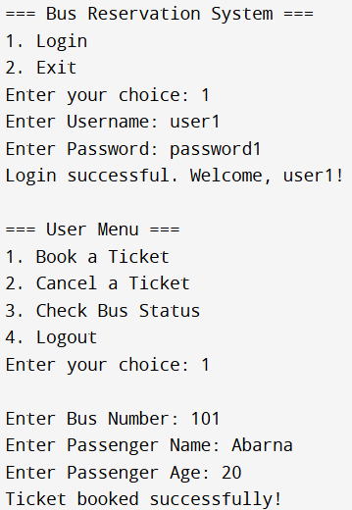
OUTPUT

Slide 11
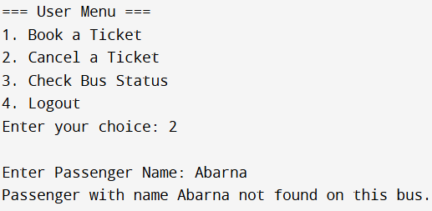
OUTPUT

Slide 12
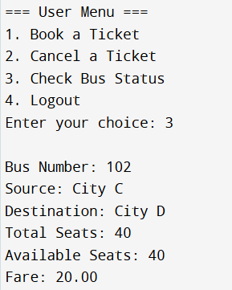
OUTPUT

Slide 13
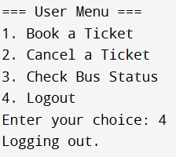
OUTPUT

Slide 14
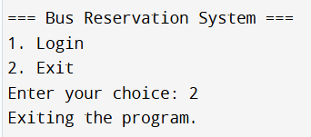
OUTPUT

Slide 15
applications
1.Bus Ticket Booking Management:
Purpose: To allow users to book bus tickets efficiently.
Functionality: Users can search for available buses based on source, destination, and date. They can book seats and receive booking confirmation. Admins can manage bus schedules and seat availability
Data Structures Used: Linked lists to store user data, bus details, and bookings.
2.Seat Allocation and Management:
Purpose: To manage and allocate seats dynamically as users book or cancel tickets.
Functionality: The system tracks available and booked seats in real-time. It ensures that seat allocation is fair and updates availability as transactions occur.
Data Structures Used: Arrays or linked lists to manage seats within each bus

Slide 16
applications
HOW EACH APPLICATION WORKS :
1.Bus Ticket Booking Management:
When a user searches for buses, the system traverses the linked list of buses to find matches.
Booking involves updating the bus’s seat availability and adding a booking record to the bookings linked list.
2.Seat Allocation and Management:
Each bus maintains an array or linked list representing seats.
When a booking is made, the system marks the corresponding seat as booked.

Slide 17
CONCLUSION
In conclusion, the bus ticket booking project using data structures in C demonstrates the practical application of various data structures to solve a real-world problem. The project effectively uses arrays, linked lists, and possibly other data structures to manage and organize data related to bus schedules, seat availability, customer bookings, and transactions.
Overall, the bus ticket booking project using data structures in C serves as a comprehensive example of how fundamental programming concepts can be applied to build functional and efficient software solutions. This project not only reinforces the importance of selecting the right data structures but also highlights the significance of algorithmic thinking in software development.

Slide 18
REVIEW
Each module works together, ensuring that the bus ticket booking system is robust, user-friendly, and efficient. The modular approach also helps in maintaining and upgrading the system over time.

Slide 19


