Slide 1
EMOJI PREDICTION USING GAN
Presentation By:-
Name: ABARNA DEVI .T
Dept.: CSE -6th SEM
Naan Mudhalvan username :au950021104001
ANNA UNIVERSITY REGIONAL CAMPUS TIRUNELVELI

Slide 2
Problem Statement
Predicting emojis using a GAN (Generative Adversarial Network) would involve training a model to generate emoji images based on input descriptions or labels. The generated emojis should be diverse, visually appealing, and semantically relevant to the input descriptions. Deep Learning Project Idea – In this deep learning emoji prediction project, we predict the emoji from the text.
Predict the emoji from the given text. This means we build a text classifier that returns an emoji that suits the given text.

Slide 3
Project Overview
-Emojis are widely used in digital communication to express emotions, sentiments, and reactions. In this project, we aim to develop a Generative Adversarial Network (GAN) model that can predict emojis based on textual input. The model will learn to generate emoji images that correspond to the given text description, enabling users to enhance their messages with appropriate emojis automatically.

Slide 4
AGENDA (OBJECTIVES)
Architecture of GAN
Your solution
Training Process
System Approach
Proposed solutions
Results
Summary
Conclusion
Reference

Slide 5
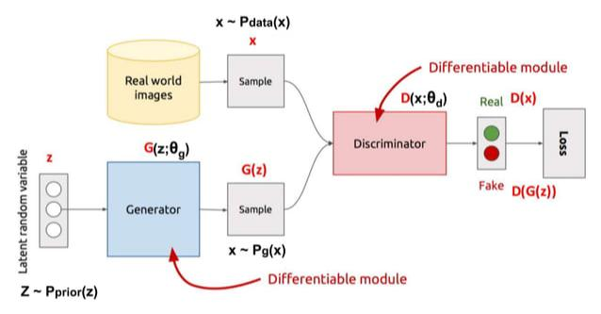
Architecture of GAN

Slide 6
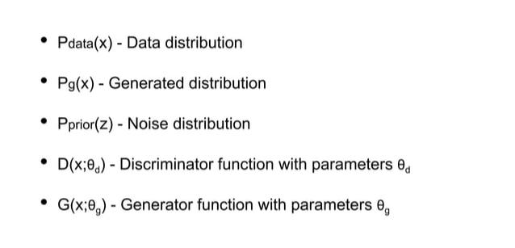
Some Terminology

Slide 7
Your Solution
Fine-tuning the model architecture and training parameters to improve emoji prediction accuracy and image quality. Exploring techniques for handling multi-label emoji prediction for text descriptions that correspond to multiple emotions or sentiments. Deploying the trained model as a web service or API for real-time emoji prediction in various applications.

Slide 8
Training Process
Preprocessing: Text descriptions may be tokenized, and emoji images may be resized and normalized before training. Adversarial Training: The generator and discriminator networks are trained adversarially, where the generator tries to fool the discriminator into believing that its generated emoji images are real, while the discriminator aims to distinguish between real and fake emoji images accurately. Loss Functions: The generator and discriminator are trained using appropriate loss functions such as binary cross-entropy loss or Wasserstein loss.

Slide 9
Training Process
Evaluation: The trained model is evaluated based on its ability to generate emoji images that accurately reflect the intended meaning of the input text descriptions. Evaluation metrics may include accuracy, precision, recall, and F1-score.
Embedding Layer: Optionally, an embedding layer may be used to convert text descriptions into continuous vector representations before feeding them into the generator network.

Slide 10
System Approach
Software Requirements: Python: The project is implemented using Python programming language. TensorFlow/Keras: TensorFlow and its high-level API, Keras, are used for building and training the GAN architecture. Google Colab: These platforms can be used for interactive development, experimentation, and documentation. NumPy: NumPy is used for numerical computations and array manipulation. Matplotlib: Matplotlib is used for data visualization, including plotting loss curves and displaying generated images.

Slide 11
Proposed solutions
GAN Architecture Design:
*Design a GAN architecture consisting of a generator and a discriminator network using TensorFlow/Keras.
Generator: The generator network takes text descriptions as input and generates corresponding emoji images. It may utilize recurrent neural networks (RNNs), convolutional neural networks (CNNs), or a combination of both to learn the mapping from text to image. Discriminator:
The discriminator network distinguishes between real emoji images and fake emoji images generated by the generator. It helps train the generator to produce realistic-looking emoji images.

Slide 12
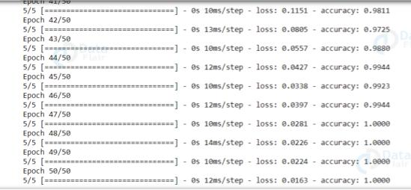
Results
We got 100% accuracy on our emoji prediction training set!

Slide 13

Results
Using the emoji module, see how these emojis turn out!

Slide 14
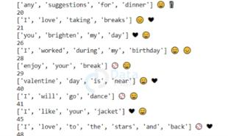
Results
Predicted emoji by our text classifier

Slide 15
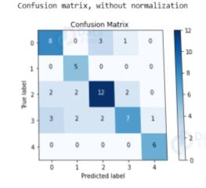
Results
Confusion matrix for emoji prediction

Slide 16
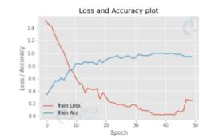
Results
Plot the loss and accuracies of our model on the dataset.

Slide 17
Summary
In this deep learning project, we built a text classifier that predicts an emoji that suits the given text.
We achieve good accuracy in the implementation, although based on requirements we can train it with larger datasets.
To predict emojis, we used LSTM as LSTM networks work well with time-series data.

Slide 18
Conclusion
The trained emoji prediction model can be integrated into messaging apps, social media platforms, or chatbots to automatically suggest emojis based on the text input provided by users. This can enhance the user experience by making communication more expressive and engaging.

Slide 19
References
https://www.kaggle.com/datasets/watts2/glove6b50dtxt
-use the 6B 50D GloVe vector to build the embedding matrix for the text in our dataset. The file can be downloaded from above link .
-The remaining test and train datasets are uploaded in GitHub.

Slide 20
Thank You

