Slide 1
BHOPAL GAS TRAGEDY

Slide 2
INTRODUCTION
BHOPAL GAS TRAGEDY ,A DIASTER THAT HAPPENED BY A GAS LEAK IS CONSIDERED AS ONE OF THE WORLDS WORST INDUSTRIAL CATASTROPHES THAT OCCURRED ON THE NIGHT OF DECEMBER 2-3,1984 AT THE UNION CARBIDE INDIAL LIMITED(UCIL) PESTICIDE PLANT IN BHOPAL,MADHYA PRADESH,INDIA.

Slide 3
UNION CARBIDE CORPORATION
The UCIL factory was built in 1969 to produce the pesticide Sevin (UCC's brand name for carbaryl using methyl isocyanate (MIC) as an intermediate.
An MIC production plant was added to the UCIL site in 1979.
The chemical process employed in the Bhopal plant had methylamine reacting with phosgene to form MIC, which was then reacted with 1-naphthol to form the final product, carbaryl.
Another manufacturer, Bayer, also used this MIC-intermediate process at the chemical plant once owned by UCC at Institute, West Virginia, in the United States.

Slide 4
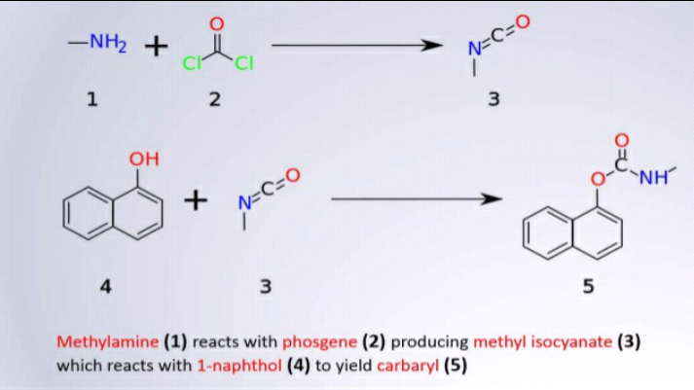
PRODUCTION

Slide 5
PREVIOUS EFFECTS
In 1981, a worker was accidentally splashed with phosgene as he was carrying out a maintenance job of the plant's pipes. In a panic, he removed his gas mask and inhaled a large amount of toxic phosgene gas, leading to his death just 72 hours later.
In January 1982, a phosgene leak exposed 24 workers, all of whom were admitted to a hospital. None of the workers had been ordered to wear protective masks.
One month later, in February 1982, an MIC leak affected 18 workers. In August 1982, a chemical engineer came into contact with liquid MIC, resulting in burns over 30 percent of his body.
Later that same year, in October 1982, there was another MIC leak. In attempting to stop the leak, the MIC supervisor suffered severe chemical burns and two other workers were severely exposed to the gases.
During 1983 and 1984, there were leaks of MIC, chlorine, monomethylamine, phosgene, and carbon tetrachloride, sometimes in combination.

Slide 6
HOW DID IT START?
The Bhopal UCIL facility housed three underground 68,000 liters liquid MIC storage tanks: E610, E611, and E619. UCC safety regulations specified that no one tank should be filled more than 50% with liquid MIC. Each tank was pressurized with inert nitrogen gas.
In late October 1984, tank E610 lost the ability to contain most of its nitrogen gas pressure. At the time of this failure, tank E610 contained 42 tons of liquid MIC.
Shortly after this failure, MIC production was halted at the Bhopal facility, and parts of the plant were shut down for maintenance.
An attempt to re-establish pressure in tank E610 on 1 December failed, so the 42 tons of liquid MIC contained within still could not be pumped out of it.
During the late evening hours of 2 December 1984, water was believed to have entered a side pipe and into Tank E610
Temperatures in the tank were off the scale, maxed out beyond 25 °C (77 °F), and the pressure in the tank was indicated at 40 psi (275.8 kPa).

Slide 7
FACTORS LEAD TO GAS LEAK
STORING MIC IN LARGE TANKS AND FILLING BEYOND RECOMMENED LEVELS.
THE FLARE TOWER AND SEVERAL VENT GAS SCRUBBERS HAD BEEN OUT OF SERVICE FOR FIVE MONTHS BEFORE DISASTER.
FAILURE OF SEVERAL SAFETY SYSTEMS.
ALSO SOME SAFETY SYSTEMS BEING SWITCHED OFF TO SAVE MONEY,INCLUDING A MIC TANK REFRIGERATION THE MIC WAS KEPT AT 20 DEGREES CELUSIS ,NOT THE 4.5 CELSIUS ADVISED BY THE MANUAL.
LACK OF SKILLED OPERATION-NO PROPER TRAINING WAS GIVEN TO THEM.

Slide 8
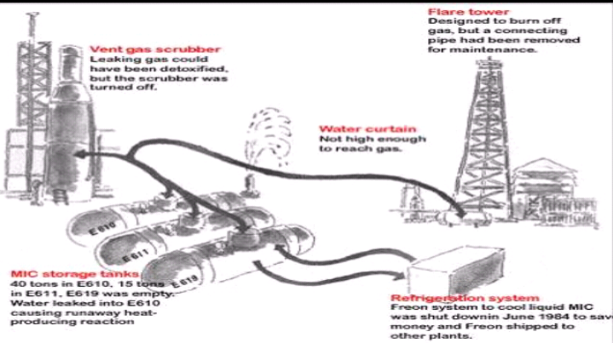

Slide 9
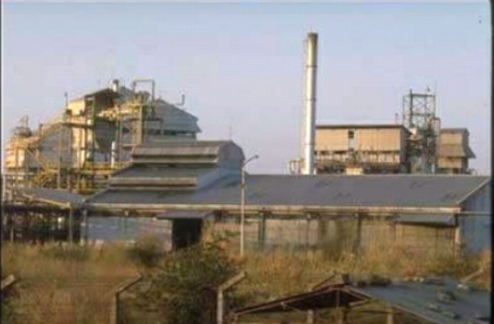
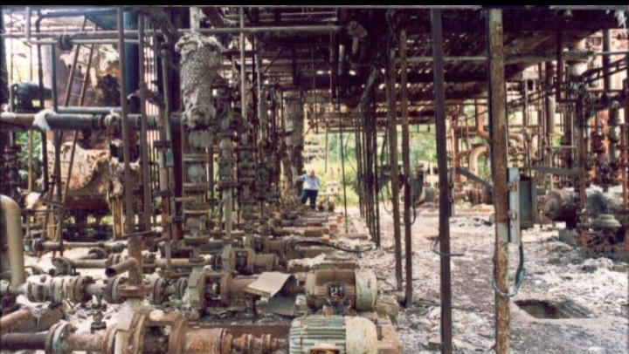
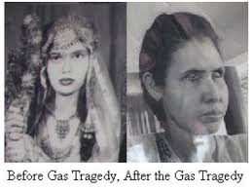
EFFECTS OF TRAGEDY

Slide 10
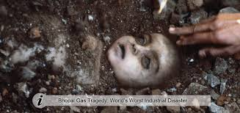
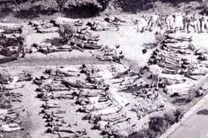
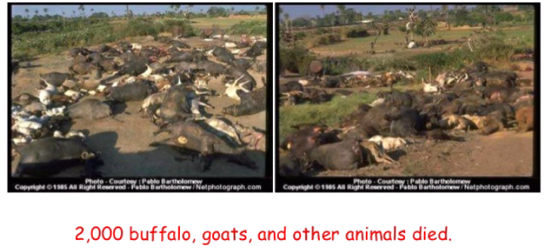
EFFECTS

Slide 11
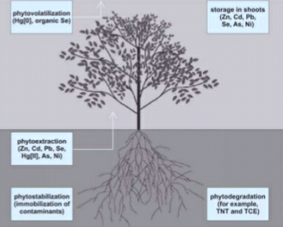
TOXIC MATERIALS IN SOIL AND WATER
LEAD,NICKEL,COPPER,CHROMIUM,HEXOCHLOROCYCLOHEXANE AND CHLOROBENZENES WERE FOUND IN SOIL SAMPLES.
MERCURY WAS FOUND TO BE BETWEEN 20000 TO 6000000 TIMES
THE STANDARD
LEVEL IN SOIL.

Slide 12
WHAT COULD HAD TO BEEN DONE TO AVOID THE DISASTER
SUPERVISOR COULD HAVE BEEN PLACED ON NIGHT SHIFTS AND THE READINGS AND FEEDBACK OF THE EQUIPMENTCOULDD HAVE BEEEN TAKEN FOR EVERY ONE HOUR.
THERE SHOULD HAVE BEEN 4-STAGE BACK UP SYSTEM INSTEAD OF A ONE MANUAL BACK UP SYSTEM.
AT REGULAR INTERVALS PROPER MAINTENANCE AND SERVICING OF FLARE TOWERS ,PRESSURE VALVES,GAS SCRUBBERS MUST HAVE BE MADE.
STRICT REGULATIONS AND METHODS MUST HAVE BEEN IMPLEMENTED.
PROPER PRESSUE GAUGES SHOULD HAVE BEEN USED.

Slide 13
PREVIEW
OCCURRENCE: 3rd DECEMBER 1984
PLACE OF OCCURRENCE:BHOPAL,MADHYA PRADESH,INDIA.
COMPANY:UNION CARBIDE CORPORATION
CHEMICAL:METHYL ISOCYANATE(40 TONS)
PEOPLE AFFECTED:>500,000
PEOPLE DIED:~40,000

Slide 14
THANKING YOU

