Slide 1
Dashboard Requirements Document (DRD)
Project: Improving Customer Onboarding Controls and KYC Efficiency in Digital Banking

Slide 2
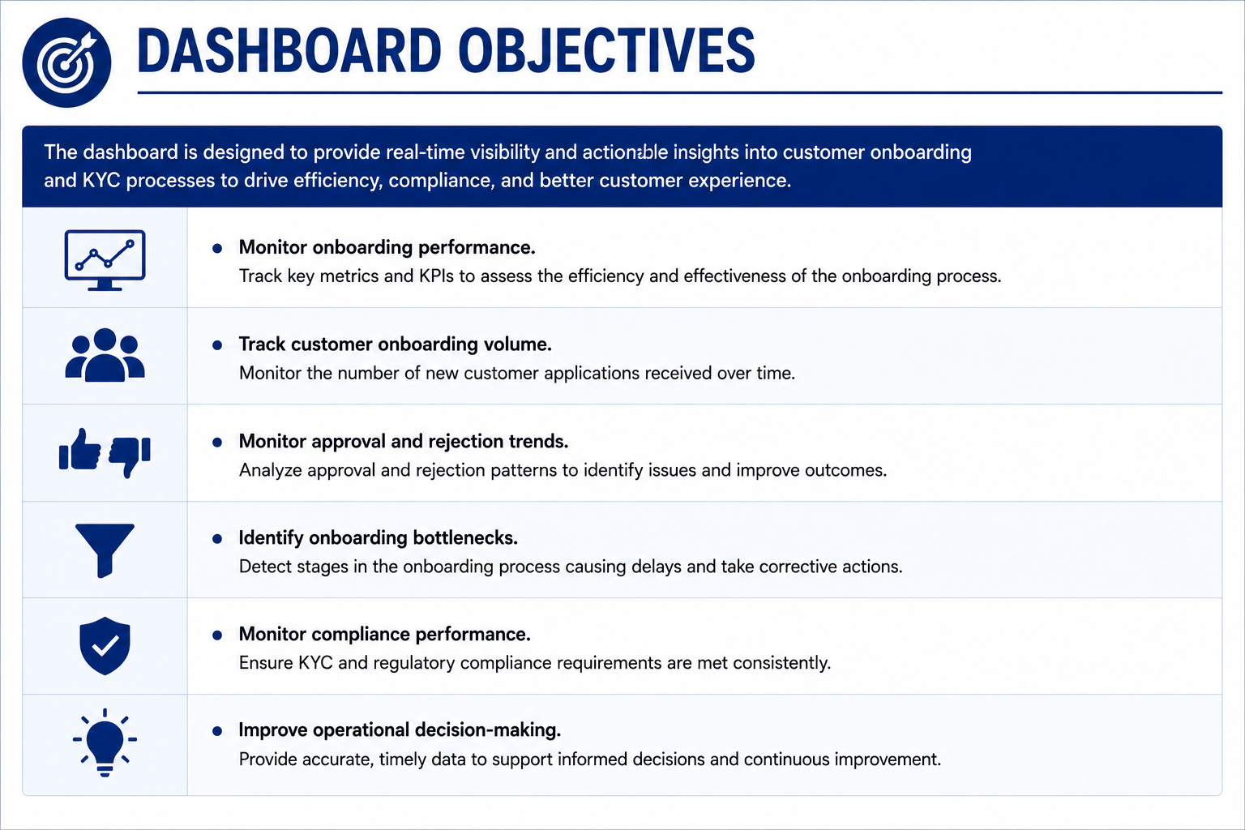

Slide 3
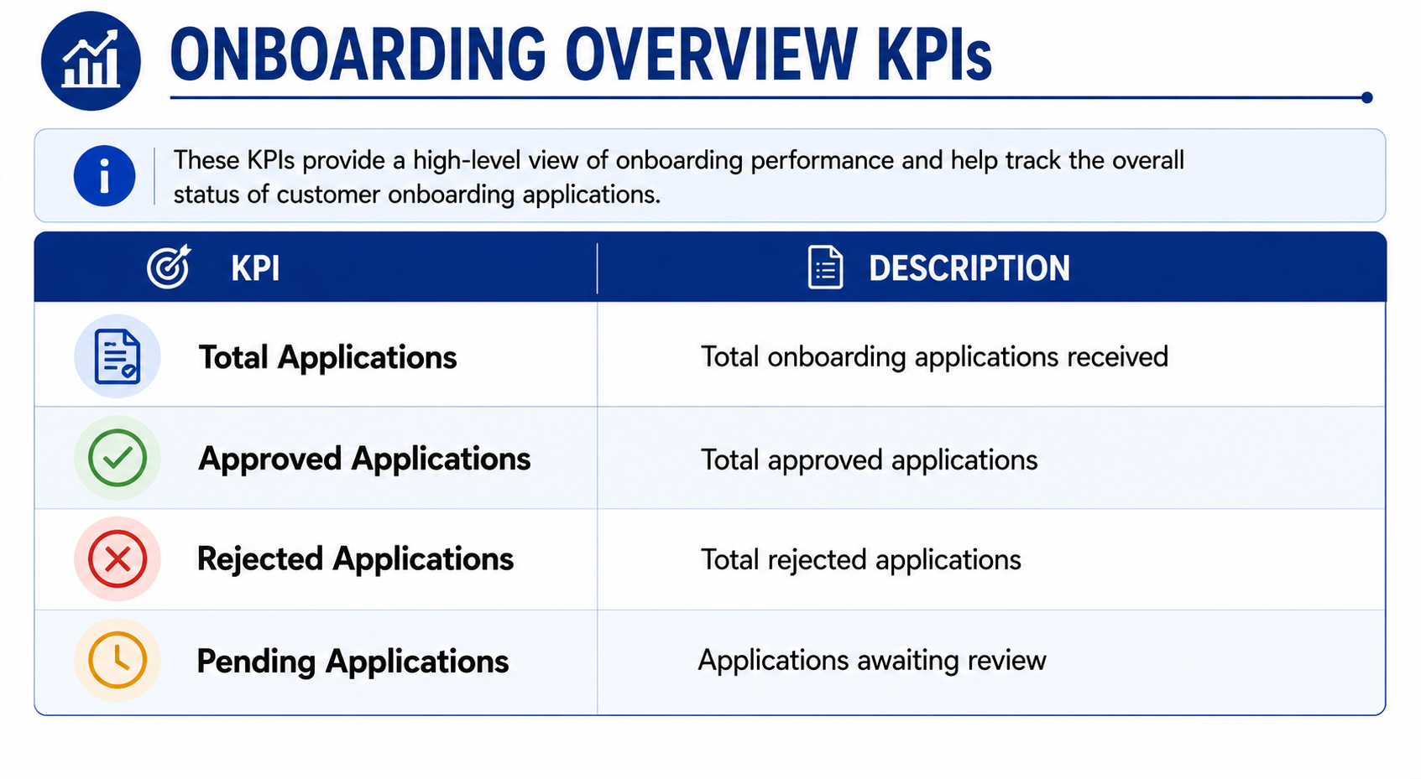

Slide 4
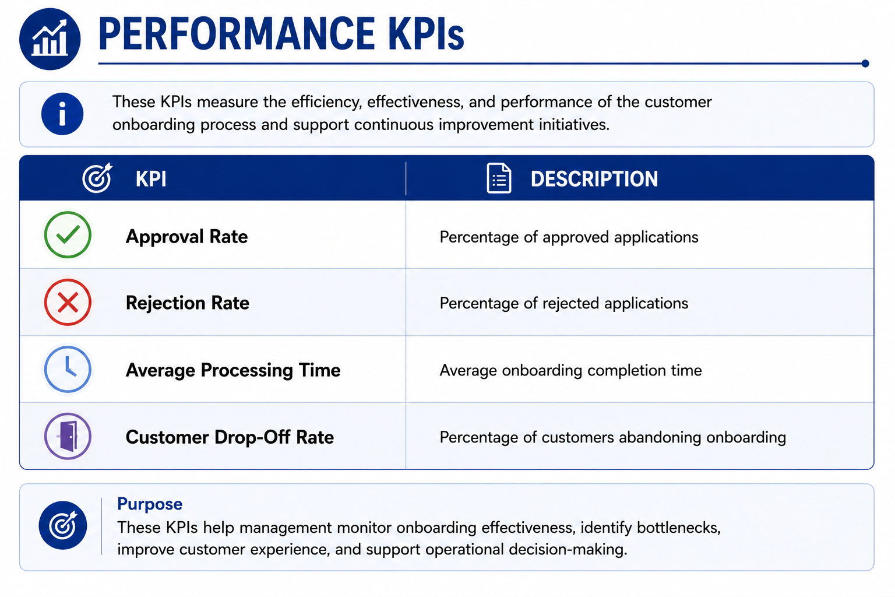

Slide 5
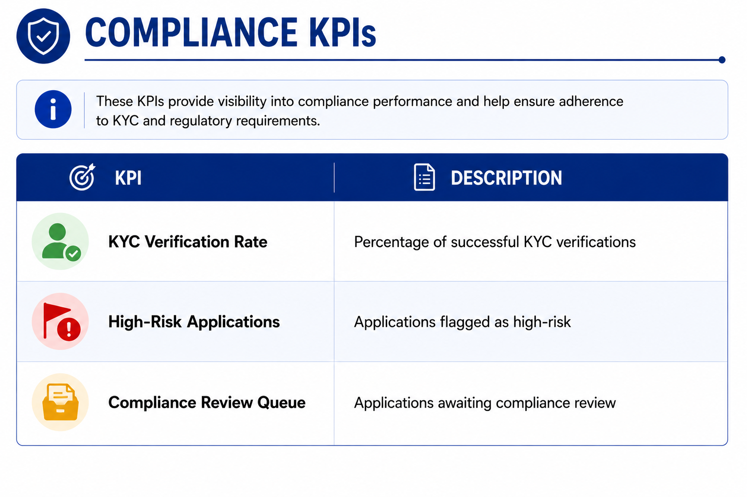

Slide 6
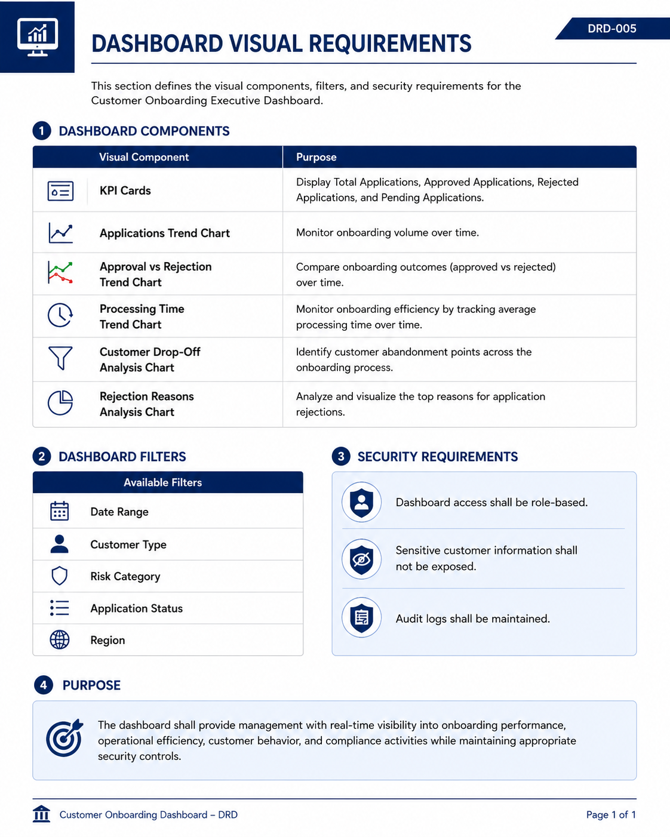

Slide 7
