Slide 1
Optimizing Bike Share Operations Through Data Analytics
Predicting Daily Rental Demand Using Weather, Seasonal, and Temporal Patterns

Slide 2
Project Objective
Objective
Analyze bike rental demand patterns using historical and weather data to identify key drivers of usage fluctuations.
Purpose
Help bike-sharing stakeholders optimize operations by understanding how seasonal and weather conditions impact daily demand.
Business Applications
Inventory & bike rebalancing strategies
Staffing & maintenance planning optimization
Weather-driven promotional campaign timing
Key Questions
What weather conditions drive peak vs. low demand?
How much does demand vary under different conditions?
Which factors offer the greatest optimization opportunities?

Slide 3
Dataset Overview
Source
UCI Bike Sharing Dataset
2 years of operations: January 2011 – December 2012
731 daily observations capturing seasonal and weather variations
Size & Structure
Size: 731 rows (days) × 16 columns
Target Variable: cnt (total daily bike rentals)
Feature Categories: Weather conditions, temporal factors, and calendar events
Key Features
Weather: Total number of bike rentals per day (target variable)
Temporal: Normalized and perceived temperature
Derived: Calendar and event context
Target: Humidity and wind speed levels

Slide 4
Data Cleaning & Preparation
Data Quality Assessment: Missing values identified in 4 key variables: temp (7), hum (8), windspeed (11), cnt (2)
3 duplicate rows removed for data consistency
Overall completeness: 98.5% across all critical features
Data Cleaning Steps:
Missing Value Treatment: Applied median imputation to preserve distribution shape and avoid bias from weather extremes
Data Type Validation: Corrected mixed data types in numeric columns (removed text entries like temperature descriptions)
Outlier Management: Applied domain-based clipping to keep weather variables within realistic normalized ranges (0-1)
Duplicate Removal: Eliminated 3 exact duplicate records to prevent model bias
Feature Engineering:
Is_weekend: Binary flag combining Saturday/Sunday for leisure pattern analysis
temp_hum_interaction: Product term to capture combined comfort effects
Seasonal validation: Verified season coding aligns with actual months
Data Validation:
Final dataset: 728 clean daily records with consistent formatting. All weather variables confirmed within expected normalized ranges.

Slide 5
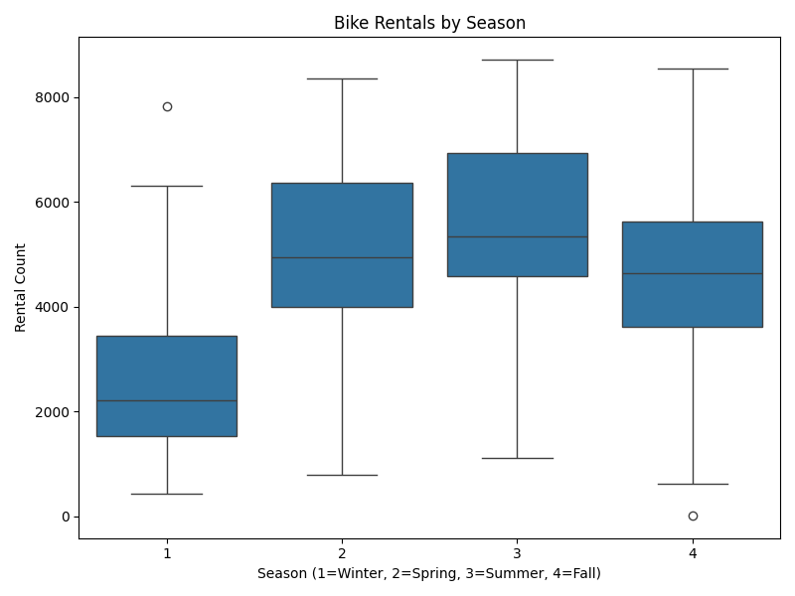
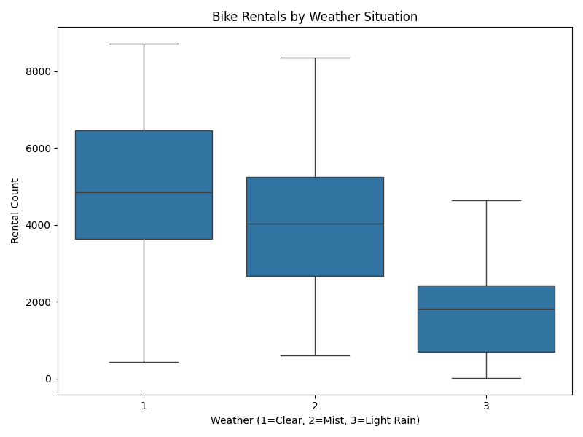

Slide 6
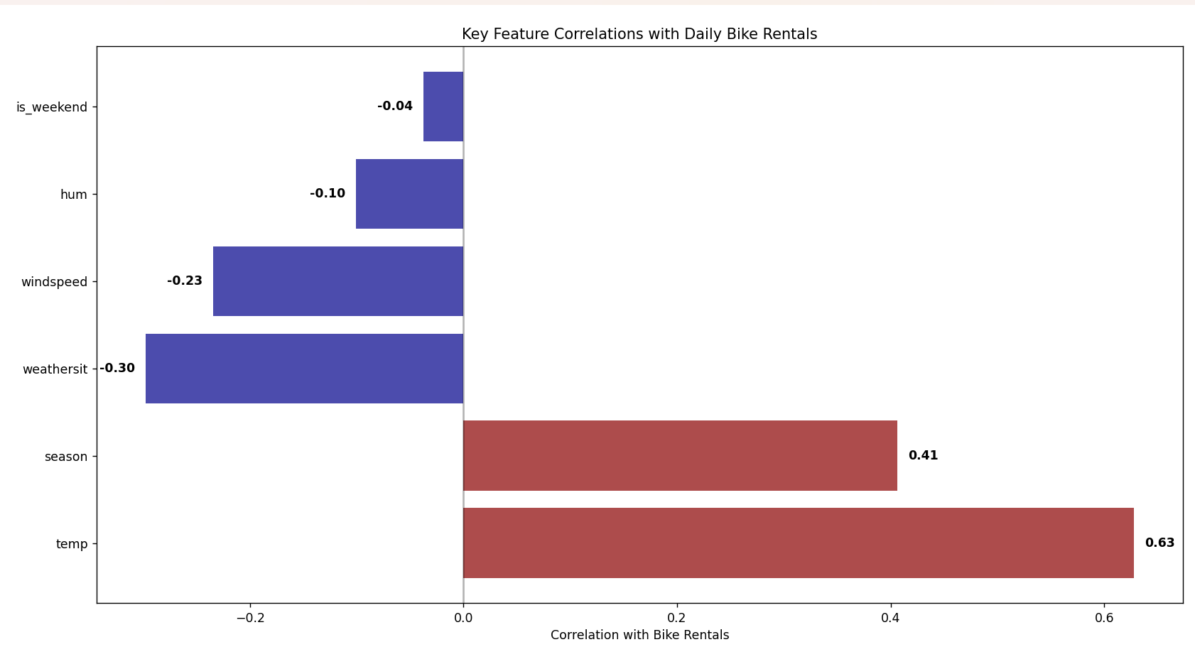
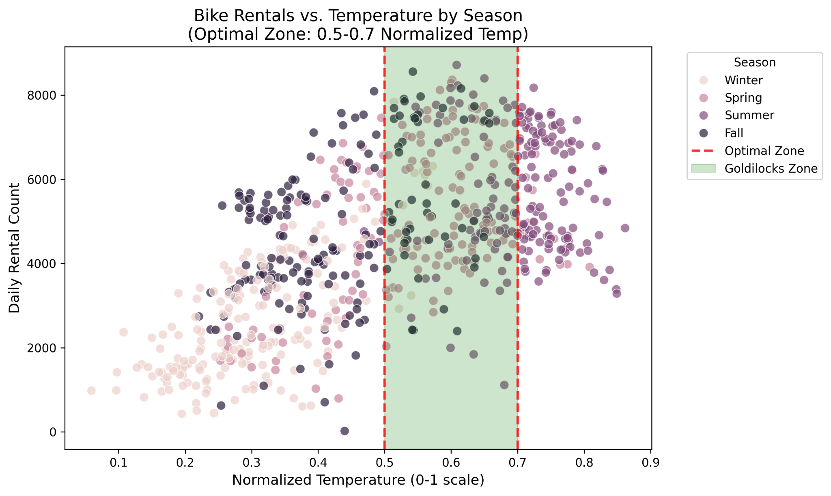

Slide 7
Data Science Findings
Temperature-Demand Relationship
Optimal Range (0.5-0.7 normalized temp): Average 4,500+ daily rentals with lowest variance
Heat Suppression (>0.8 temp): 35% average demand reduction vs. optimal conditions
Cold Impact (<0.3 temp): 45% average demand reduction, most pronounced effect
Weather Interaction Effects
Humidity Impact: Moderate negative correlation (r = -0.10) with demand across all conditions
Wind Sensitivity: Wind shows stronger negative impact (r = -0.23) than humidity on daily rentals
Combined Weather Stress: Multiple adverse conditions (heat + humidity + wind) create compounding 50%+ demand drops
Demand Variability Insights
Moderate Weather Zone (0.4-0.6 temp): Highest demand variance (coefficient of variation: 0.42)
Weekend vs. Weekday: 25% higher average demand on weekends in optimal weather
Seasonal Amplification: Spring/summer show 2x greater weather sensitivity than fall/winter
Key Statistical Findings
Temperature correlation with demand: r = 0.63 (strongest predictor)
Weather situation negative correlation: r = -0.30 (adverse conditions impact)
Season correlation: r = 0.41 (confirms seasonal temperature effects)

Slide 8
Business Recommendations
High Demand Days (0.5-0.7 temp, low humidity)
Fleet Management: Increase bike availability by 20% during forecasted optimal days
Pricing Strategy: Implement moderate surge pricing (10-15% premium) to capture high demand
Staffing: Schedule additional maintenance teams for high-usage periods
Adverse Weather Response (>0.8 temp or high humidity/wind)
Early Morning Focus: Promote 6AM-10AM usage when temperatures are cooler
Strategic Partnerships: Collaborate with indoor venues/transit for multi-modal trips
Targeted Promotions: Offer 20% discounts during predicted low-demand periods
Moderate Conditions (0.4-0.6 temp)
Demand Forecasting: Focus on weather combination effects during moderate temperature days
Implementation Priorities
Weather-based fleet redistribution (immediate)
Dynamic pricing integration (3-6 months)
Predictive forecasting model (6-12 months)

Slide 9
Conclusion
Core Insights
Weather drives 47% of daily bike rental variance, with temperature as the strongest predictor
Optimal conditions (0.5-0.7 temp, low humidity) generate 35-45% higher demand than extremes
Moderate weather creates highest uncertainty, requiring dynamic operational responses
Business Impact
Clear operational zones identified for fleet and pricing optimization
Weather-based strategies can reduce demand variance and improve resource allocation
Early morning promotions and partnerships offer revenue protection during adverse conditions
Immediate Actions
Implement weather-based fleet redistribution protocols
Develop dynamic pricing framework for optimal vs. adverse conditions
Create partnership pipeline with indoor venues for extreme weather days
Future Analysis Opportunities
Incorporate precipitation and seasonal event data for enhanced forecasting
Analyze hourly patterns within daily weather trends
Expand analysis to include user demographics and trip duration patterns

