Slide 1
MOD-02 Introduction to Mobile Robots
MOBILE ROBOTS
By Dr. Ahmad Abbadi

Slide 2
Learning Objectives
Locomotion meaning and types
Distinguish holonomic from non-holonomic robots; apply morphology selection criteria
Define DOF; apply Grübler's formula; distinguish total DOF from controllable DOF
Classify sensors as proprioceptive/exteroceptive and active/passive; select sensors for a mission
ROS architecture

Slide 3
Locomotion
Focus:
Motion capability
Engineering trade-offs
Design decision making
What Locomotion means?

Slide 4
Locomotion
Locomotion is
Physical interaction between a body and its environment, and
the interaction forces, including
the mechanisms and actuators that generate them.
kinematics means describing
robot’s motion geometrically
The relation between the robot variables and the robot state (position, speed, heading,…)
What are the Locomotion types?

Slide 5
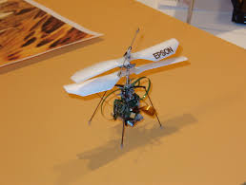
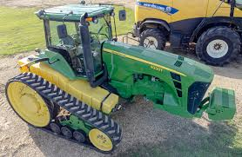
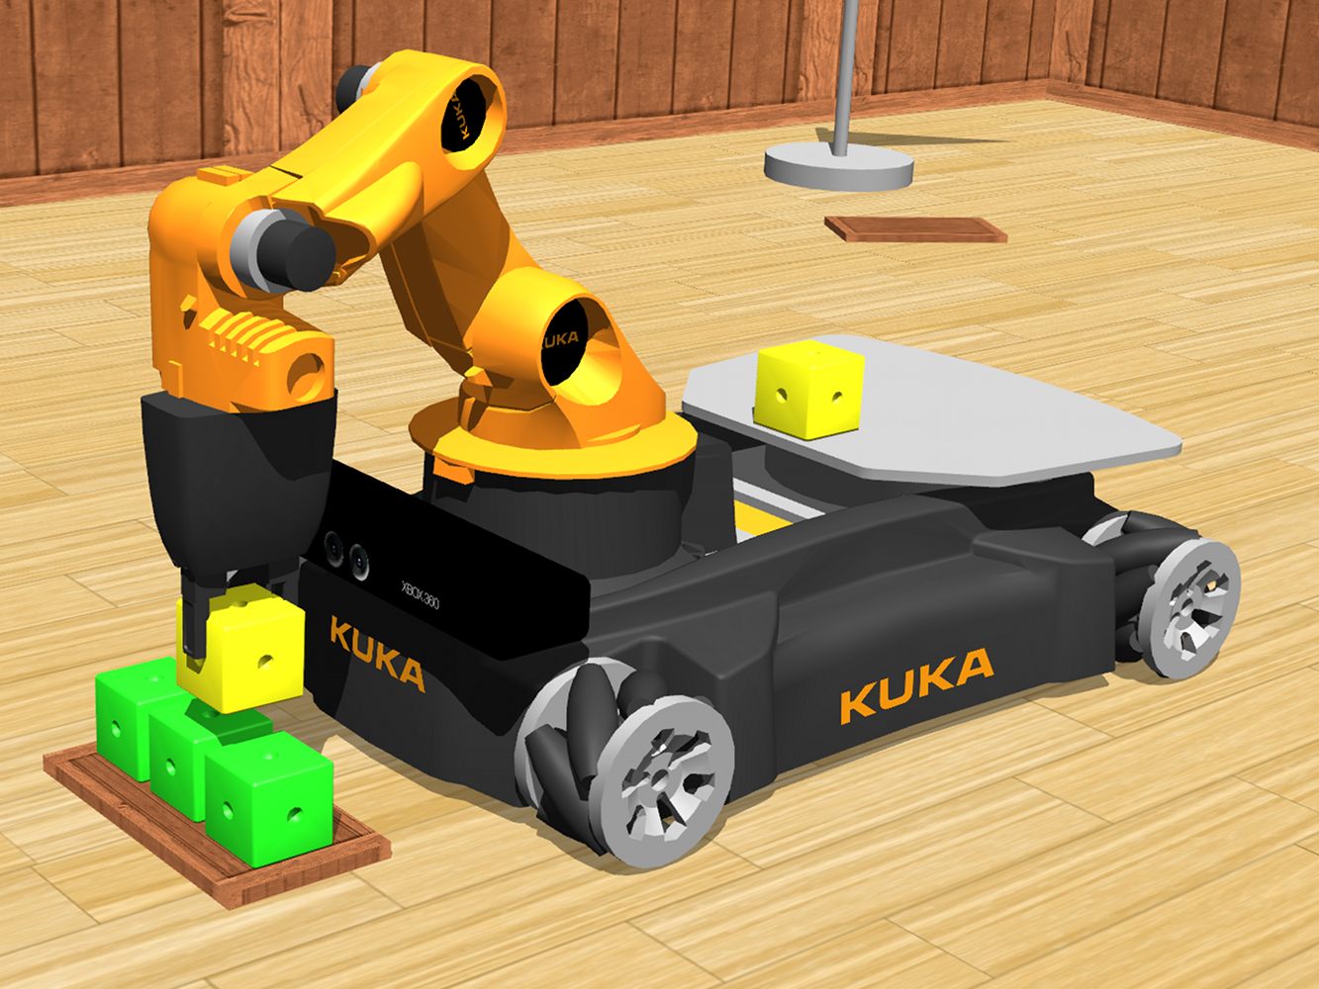
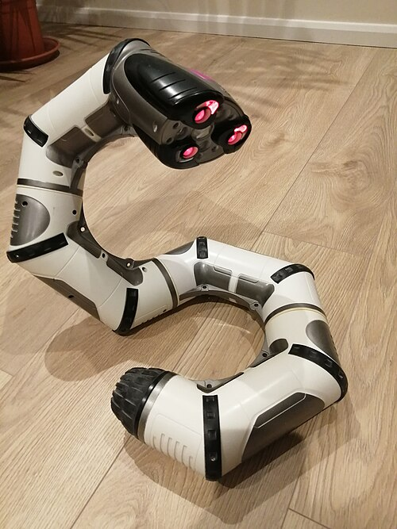
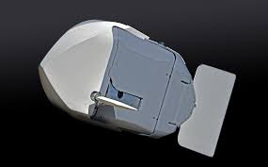

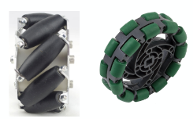
Locomotion types
Flying
Differential Drive
Ackermann Steering
Omnidirectional
Wheel
Tracked
Locomotion types
Slide
Swimming
Legged
Hybrid
Combine different model

Slide 6
Locomotion – Design Problem
Design a hospital delivery robot that must:
Navigate narrow corridors (≈ 1.2 m)
Approach beds from the side
Carry payload
Operate efficiently on battery
Question:
Which locomotion system should we choose?
Siegwart et al., Intro to Autonomous Mobile Robots

Slide 7
Locomotion – Design Problem
Is you solution
Can it move sideways?
Can it align without rotation?
Is turning space always available?
How complex it is to control the movement?
We need to make engineering decisions based on analysis
Siegwart et al., Intro to Autonomous Mobile Robots

Slide 8
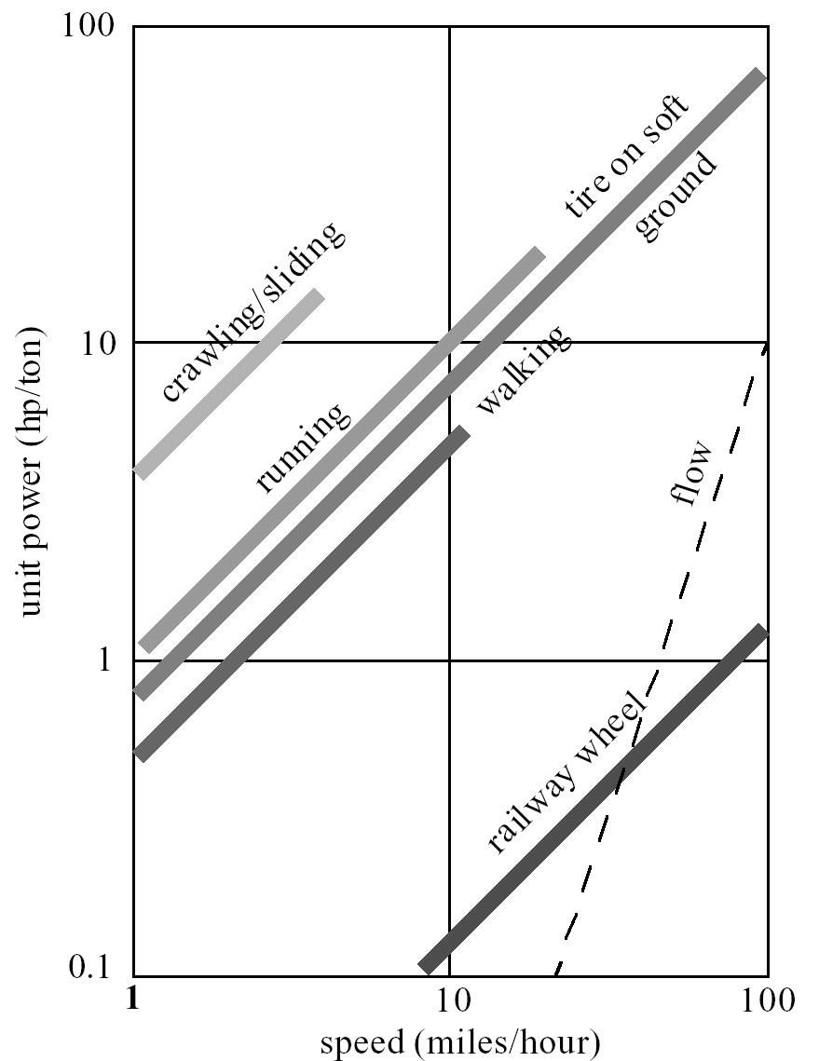
Locomotion
Locomotion determines:
Mechanical complexity
Control difficulty
Degrees of freedom of motion
Maneuverability
Terrain capability
Energy consumption
robot weight and complexity
Siegwart et al., Intro to Autonomous Mobile Robots

Slide 9
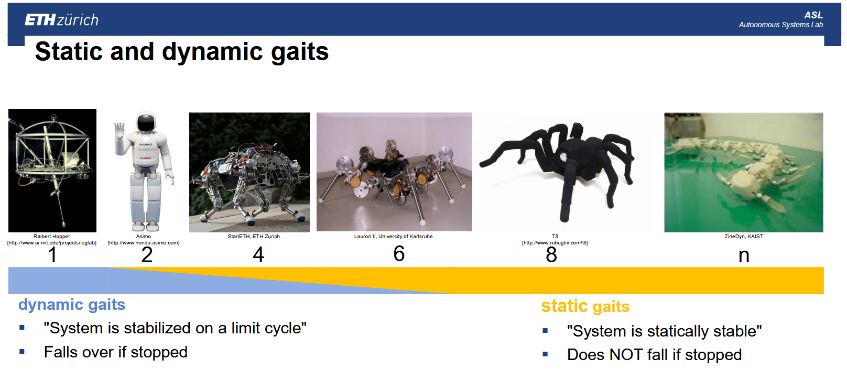
Locomotion
Insects can gait directly, Mammals need few hours, Humans need one year
https://learning.edx.org/course/course-v1:ETHx+AMRx+2T2020/home

Slide 10
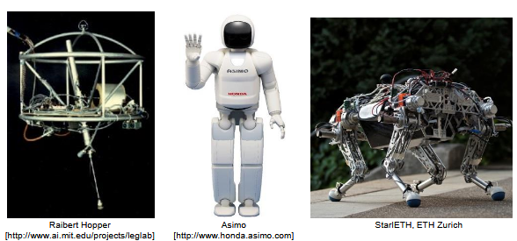
Locomotion – Legged Robot
Characteristics:
Complex mechanics
Complex control
Energy can be intensive
Advantage
Capable to move on Stairs/rubble/slopes
https://learning.edx.org/course/course-v1:ETHx+AMRx+2T2020/home

Slide 11
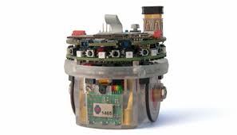
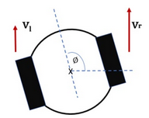
Locomotion - Differential Drive Robot
Characteristics:
Simple mechanics
Can rotate in place
Cannot move sideways
Motion constrained to circular arcs
Applications:
Indoor service robots
Educational robots
Cleaning robots

Slide 12
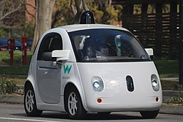
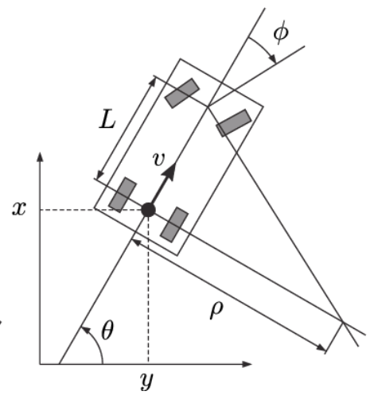
Locomotion - Car-Like (Ackermann Steering) Robot
Characteristics:
Front wheel steering
Stable at high speed
Efficient energy use
Large turning radius
Applications:
Autonomous cars
Outdoor delivery robots

Slide 13
Locomotion – Tracked Robot
Characteristics:
Large contact area
High traction
Good for rough terrain
High energy consumption
Slow turning
Kinematics similar to differential drive
Difference is in physics (traction, friction).

Slide 14
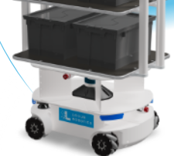
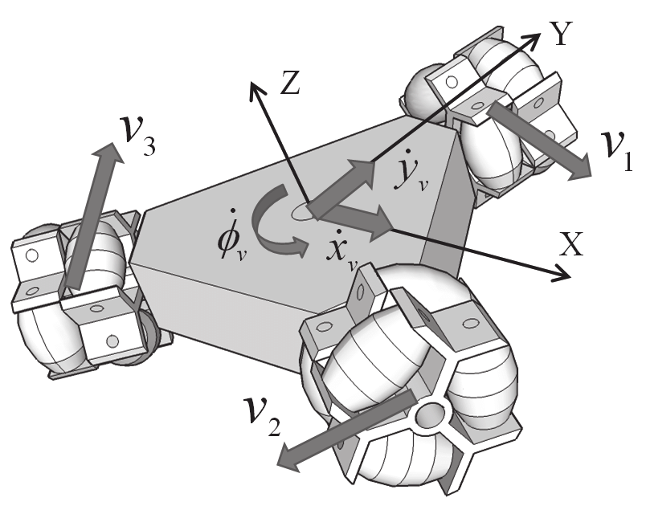
Locomotion - Omnidirectional (Mecanum / Omni Wheels) Robot
Characteristics:
Forward/backward motion
Sideways motion
Rotation simultaneously
Full planar mobility
Advantages:
Maximum maneuverability
Precise positioning
Disadvantages:
Higher energy consumption
More complex control
Lower traction efficiency
locusrobotics.com https://www.researchgate.net/figure/Omnidirectional-robot-with-three-omni-wheels_fig1_279244619

Slide 15
Locomotion off course -> Motion Constraints and Holonomy
Some robots can move in any direction instantly. Others must follow constrained paths.
This difference is called holonomy.
Car
cannot move sideways without turning first.
It must follow a curved path.
It is not Nonholonomic Robots
Holonomic Robots
A robot that can move forward,
sideways, and
rotate simultaneously.
https://www.researchgate.net/figure/Omnidirectional-robot-with-three-omni-wheels_fig1_279244619

Slide 16
Locomotion off course -> Motion Constraints and Holonomy
Holonomic robots:
✅ Maximum maneuverability ❌ Higher complexity and energy cost
Golden Rule
More freedom of motion always comes with higher cost and complexity.
can a car reach any position even though it is nonholonomic?
It can still reach any position by combining motions. Forward/ + turn + forward
Nonholonomic does NOT mean incapable. It means constrained instantaneous motion
Nonholonomic robots:
✅ Simpler and more efficient ❌ Limited motion flexibility
https://www.researchgate.net/figure/Omnidirectional-robot-with-three-omni-wheels_fig1_279244619
Notes:
Is a human walking holonomic or nonholonomic?

Slide 17
Locomotion - Engineering Comparison Summary
Which Locomotion system is the best for hospital delivery robot?
Type | Maneuverability | Energy | Complexity | Terrain
Differential | Medium | Low | Low | Low
Car-like | Low (tight spaces) | Low | Medium | Medium
Omni | Very high | High | High | Low
Tracked | Medium | High | Medium | Very high
No system is universally best.

Slide 18
Locomotion - Engineering Comparison Summary
Which Locomotion system is the best for hospital delivery robot?
Golden rule:
Choose the simplest locomotion system that satisfies mission requirements.
Engineering = trade-offs between:
Performance
Cost
Energy
Complexity
Reliability
Criterion | Importance | Score | No Go
Performance | 1–5
Cost | 1–5
Energy efficiency | 1–5
Complexity | 1–5
Terrain capability | 1–5

Slide 19
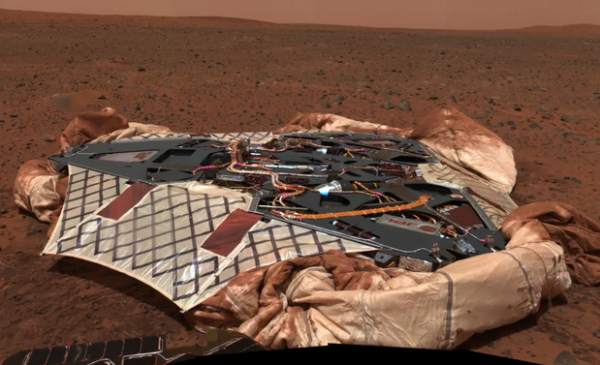
Locomotion - Advanced Thinking Questions
What locomotion is best for Mars exploration?
NASA

Slide 20
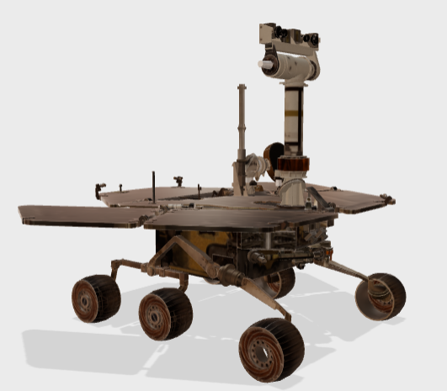
Locomotion - Advanced Thinking Questions
What locomotion is best for Mars exploration?
https://science.nasa.gov/mission/mars-exploration-rovers-spirit-and-opportunity/

Slide 21
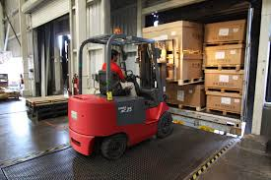
Locomotion - Advanced Thinking Questions
Why do forklifts use rear-wheel steering?
Notes:
Forklifts must:
Turn in very narrow aisles
Precisely position loads
Approach shelves head-on
Carry heavy weight in the front
Rear-Wheel Steering (Forklifts)
Rotation center moves closer to the load.
Vehicle pivots around the front axle.
Much smaller turning radius.
This allows forklifts to:
✅ Turn inside narrow aisles ✅ Align precisely with shelves ✅ Rotate almost around their own footprint
This leads to a key design requirement:
Minimize turning radius while maintaining stability under load.
Rear steering disadvantages:
Less stable at high speed
Harder for human drivers to control
Oversteer risk
Not safe for highways
Forklifts operate at low speed, so this is acceptable.

Slide 22
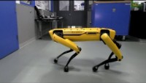
Locomotion - Advanced Thinking Questions
Watch Boston Dynamics Robots, and think if the leg robots is the best option for opening the door (in house, outdoor)
https://www.youtube.com/watch?v=fUyU3lKzoio

Slide 23
Degrees of Freedom and Controllability in Mobile Robot
What is DOF?
Grübler's formula
Distinguish between total DOF and controllable DOF

Slide 24
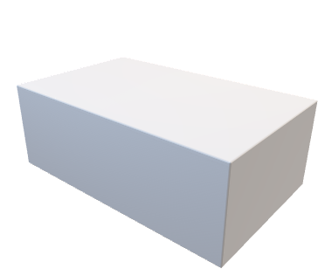
Degrees of Freedom
Assuming an object on the floor.
How many motions possibility can it has?

Slide 25
Degrees of Freedom
Assuming an object on the floor.
How many motions can it has?
A rigid body in a plane can:
Move in x direction
Move in y direction
Rotate
Therefore:
DOF in plane = 3
How many motions can you control?

Slide 26

Degrees of Freedom
Why a rigid object can move sideways but cars cannot?
Does a car has 3 DOF?
We should predict the object motion capability before using it for movement.
We need a tool to answer:
How many independent motions does this system have?

Slide 27
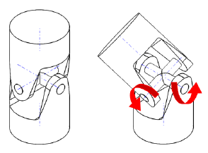

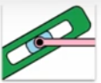
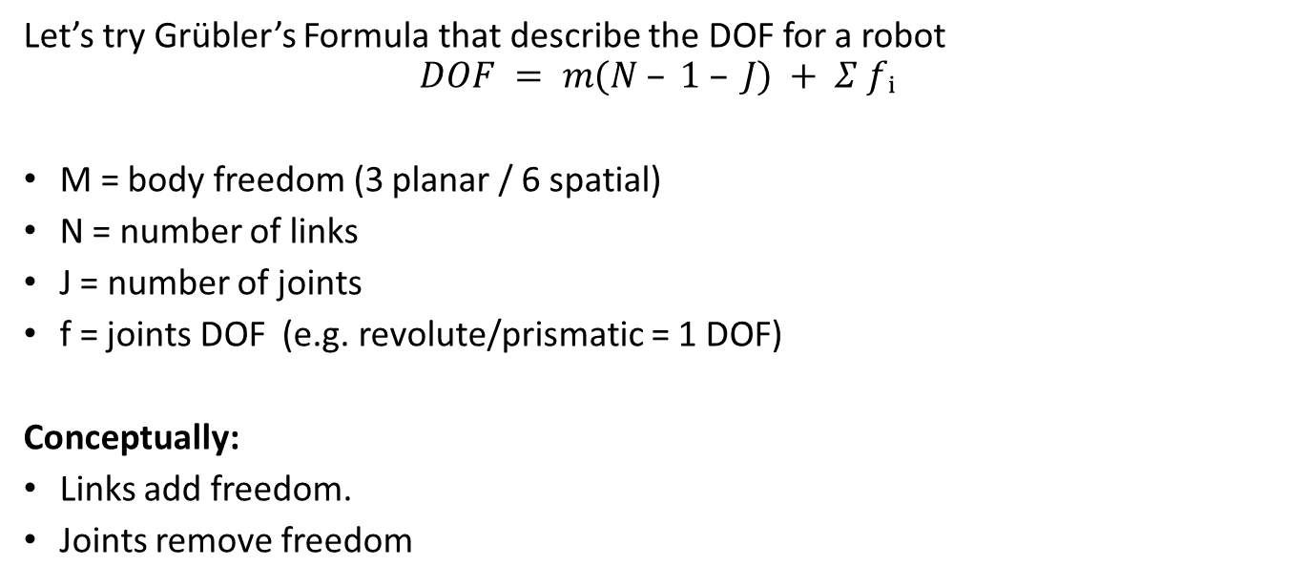
Degrees of Freedom - Grübler’s Formula
Let’s try Grübler’s Formula that describe the DOF for a robot
$$DOF = m(N – 1 – J) + Σ fᵢ$$
M = body freedom (3 planar / 6 spatial)
N = number of links
J = number of joints
f = joints DOF (e.g. revolute/prismatic = 1 DOF)
Conceptually:
Links add freedom.
Joints remove freedom
2 DOF
1 DOF
Notes:
https://www.researchgate.net/figure/DOFs-universal-joint_fig4_281621219

Slide 28
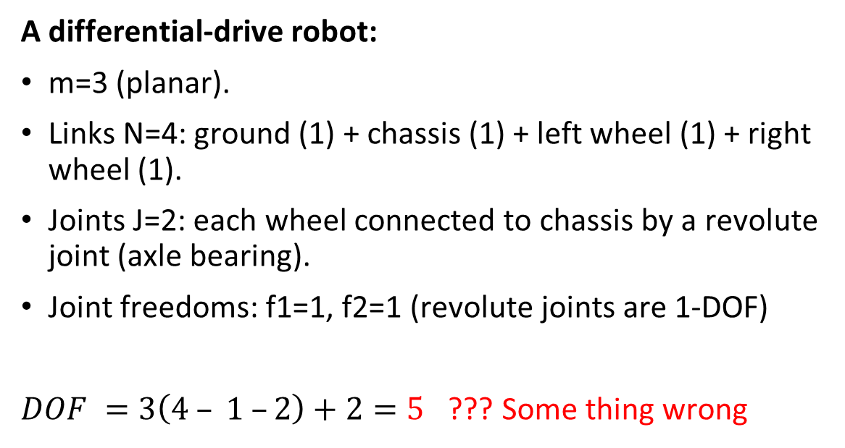
Degrees of Freedom - Grübler’s Formula
A differential-drive robot:
m=3 (planar).​
Links N=4: ground (1) + chassis (1) + left wheel (1) + right wheel (1).
Joints J=2: each wheel connected to chassis by a revolute joint (axle bearing).​
Joint freedoms: f1=1, f2=1 (revolute joints are 1-DOF)
$DOF =3\left(4 – 1 –2\right)+2=5$ ??? Some thing wrong

Slide 29
Degrees of Freedom - Grübler’s Formula
A differential-drive robot:
The connection between the ground and the platform is not representable by Grübler’s Formula.
Classical Grübler assumes:
Rigid links
Ideal joints
No rolling constraints
Mobile robots violate this assumption.
So we use an extended interpretation:
Mobility = Body DOF − Nonholonomic Constraints

Slide 30
Degrees of Freedom
How to apply the general equation:
Identify how many DOF the rigid body has
Identify touch points of the mobile robot body with the ground.
Identify where you can change the velocity on each DOF components.
The other consider as non-holomnomic constrains.
Degrees of Freedom: is the number of independent parameters required to uniquely define the configuration (position and orientation) of a mechanical system.
Controlled DOF are the movements you can directly change using motors or actuators.
In simple words:
DOF = all possible independent movements
Controlled DOF = the movements you can actively command

Slide 31
Degrees of Freedom - Grübler’s Formula – Differential drive robot
Differential drive robot body has:
DOF: X,Y, Heading on plain
2 driven wheels
Controllable DOF = 2 (forward and Angular velocities)

Slide 32
Degrees of Freedom - insights
More controllable DOF:
Higher maneuverability − Higher complexity − Higher energy consumption
Fewer controllable DOF:
Simpler
Efficient − Limited motion capability

Slide 33
Degrees of Freedom - Takeaways
Key Takeaways
DOF describes motion possibilities.
Grübler’s formula computes mechanism DOF.
Controllable DOF determines locomotion capability.
Engineering design depends on controllable DOF

Slide 34
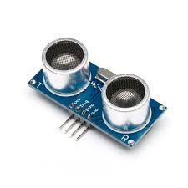
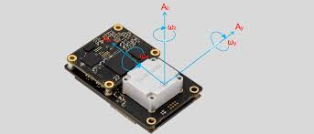
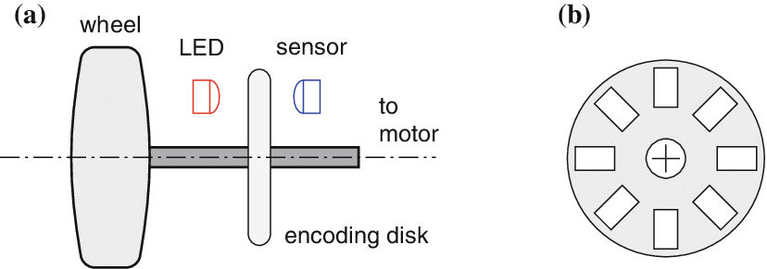
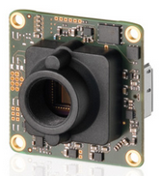
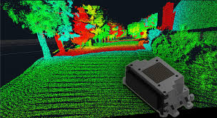
Sensors
A small differential-drive exploration robot moves in a completely dark straight corridor. The Robot has:
Two wheels (radius r)
Wheel encoders
An IMU (gyro)
Ultrasonic sensor
LiDAR
Camera
Mission:
Move 5 meters forward and stop exactly before hitting a wall.
Which sensor type is necessary for which decision?

Slide 35
Sensors
Which sensor type is necessary for which decision?
What information is inside the robot?
What information is about the environment?
What information requires emitting energy?
What information is just sensed passively?

Slide 36
Sensors
Proprioceptive + Active
Exteroceptive + Active
Encoder (optical disc, internal pulse count)
LIDAR, Sonar, Time-of-flight
Measures wheel rotation internally — no external energy
Emits laser/sound, measures return time → range
Proprioceptive + Passive
Exteroceptive + Passive
IMU (gyroscope, accelerometer)
Camera, thermopile
Measures internal inertial forces — no energy emitted
Detects ambient light/heat — no energy emitted

Slide 37
Sensors
Let’s think about autonomous vehicle.
Do we need all sensors?
Why there are many?

Slide 38
Development environment
ROS architecture
Gazebo / Webpot

Slide 39
ROS architecture – Robot SW design
Imagine we are building a warehouse mobile robot. It has:
Lidar
Camera
Obstacle avoidance algorithm
Localization algorithm
Path planner
Motor controller
Battery monitor
All running as separate software modules.”
If one module needs information from another, how should they communicate?

Slide 40
ROS architecture – Robot SW design
What happens if we add a new module?
What if two modules want the same data?
What if the lidar updates 10 times per second?
What if one module crashes?

Slide 41
ROS architecture – Robot SW design
Too many connections
Tight coupling
Hard to scale
No clear data flow
⚠️ Conclusion: We need structured communication

Slide 42
ROS architecture – Communication Types
Type A: Continuous Information
Example:
Lidar continuously publishes scans.
Battery continuously reports level.
Does the obstacle avoidance module need to ask every time for lidar data?

Slide 43
ROS architecture – Communication Types
Type B: On-Demand Request
Example:
“Reset odometry”
“Give me current robot pose”
“Compute path to goal”
Should this run continuously? Or only when requested?

Slide 44
ROS Architecture: Nodes, Topics, Messages
NODE (عقدة)
Independent process — one responsibility (e.g., /lidar_driver, /navigation_node)
TOPIC (موضوع)
Named async channel — /scan, /odom, /cmd_vel, /path
MESSAGE (رسالة)
Typed data struct — sensor_msgs/LaserScan, geometry_msgs/Twist
SERVICE (خدمة)
Synchronous request-response — emergency stop, mode change
TF Library
Manages coordinate frame transforms — robot body → world → map
/lidar_driver → /scan → /navigation_node → /cmd_vel → /turtlebot3_core
docs.ros.org/

Slide 45
ROS Architecture: Robot SW design
One node publishes.
Multiple nodes can subscribe.
Messages are sent whenever available.
Publisher does NOT know who receives.
Can multiple nodes publish to the same topic?
Can multiple nodes subscribe?
Does the publisher wait for a response?
Topics are:
Asynchronous
Decoupled
Good for continuous data
Mapping
LIDAR
/scan
Localization

Slide 46
ROS Architecture: Topics
Topic can receive messages from multiple nodes. And forward it to multiple node
docs.ros.org/

Slide 47
ROS Architecture: Robot SW design
The controller want to reset the odometer, values.
How to do that?
?
/reset_odo
controller
Localization
3/8/2026
47

Slide 48
ROS Architecture: Service
services only provide data when they are specifically called by a client
docs.ros.org/

Slide 49
ROS Architecture: Robot SW design
Client sends request.
Server processes.
Server returns response.
Communication ends.
There must be only ONE service server for a specific service. Why only one?
only one server because
If two servers respond, which one is correct?
Client expects exactly one answer.
Deterministic behavior required.
service
/reset_odo
Client
request
controller
Localization
server
response
3/8/2026
49

Slide 50
ROS Architecture: Service
docs.ros.org/

Slide 51
ROS Architecture
Scenario: Robot Avoiding Obstacle
Continuous sensing
Lidar publishes /scan at 10 Hz.
Obstacle Avoidance subscribes.
Is this Topic or Service?
Answer: ?
Topic
LIDAR
Obstacle Avoidance
/scan

Slide 52
ROS Architecture
Scenario: Robot Avoiding Obstacle
Continuous sensing
Lidar publishes /scan at 10 Hz.
Obstacle Avoidance subscribes.
Is this Topic or Service?
Answer: Topic
Because
Continuous.
No request.
Many subscribers possible.
Topic
LIDAR
Obstacle Avoidance
/scan

Slide 53
ROS Architecture
Scenario: Go to Shelf
Operator presses “Go to Shelf A”
Path Planner needs robot pose.
Should pose be continuously streamed OR requested once?
Localization
Topic
LIDAR
?
/scan
Path planner
/pos
Obstacle Avoidance

Slide 54
ROS Architecture
Scenario: Go to Shelf
Operator presses “Go to Shelf A”
Path Planner needs robot pose.
Should pose be continuously streamed OR requested once?
If pose is continuously used → Topic.
If we just want it once → Service.
If we design:
Localization publishes /pose → Topic
Planner subscribes → continuously updated.
But if we design:
Planner calls "get_current_pose()" → Service
Then pose is returned once.
Which is better for navigation?
Localization
Topic
LIDAR
Topic
/scan
Path planner
/pos
Obstacle Avoidance

Slide 55
ROS Architecture
Scenario: Go to Shelf
Motor controller
Topic
/cmd_vel
Localization
Topic
LIDAR
Topic
/scan
Path planner
/pos
Obstacle Avoidance

Slide 56
Development and testing
Can we develop the solution now on a real Robot?

Slide 57
Testing
🤖 Real Hardware Testing (HIL: Hardware in the loop)
🖥 Gazebo Simulation (SIL: Software in the loop)
Iteration time: 10–30 min per cycle
• Deploy → crash → fix → rebuild
• Real damage: robot, environment, people
• Cannot run 100 scenarios — not scalable
Iteration time: 30 seconds per cycle
• Fix → restart Gazebo → retest instantly
• Zero damage risk — purely virtual
• 100+ test scenarios per hour feasible
• Waymo runs 1000× simulated miles per real mile

Slide 58
Learning Objectives
Locomotion
Holonomic from non-holonomic robots
Define DOF; apply Grübler's formula; distinguish total DOF from controllable DOF
Classify sensors; select sensors for a mission
ROS architecture

Slide 59
?

