Slide 1
MOBILE ROBOTS
MOD-04
Sensor Modeling,
Measurement & Fusion
By Dr. Ahmad Abbadi

Slide 2
The MediBot Challenge
MediBot is a hospital delivery robot. Its mission:
Mission
Challenges
Pharmacy → Ward B (Floor 3) → Lab
Navigate hallways, glass doors, elevator
ZERO collisions — patient safety first
Polished floors → wheel slip
Glass doors → invisible to some sensors
People, carts, wheelchairs move unpredictably
Elevator → vibration, tilt, no references
Every sensor lies differently. We model the lies, quantify uncertainty, and combine sensors.
1
→
2
→
3
→
4
→
5
→
6
→
7
Encoders
Ultrasonic
LiDAR
IMU
Camera
Radar
GPS
Indoor (MediBot) → 1-6 | Outdoor (StreetBot) → 7 (GPS)
2

Slide 3
BLOCK 1
Wheel Encoders
Count wheel rotations → estimate position

Slide 4
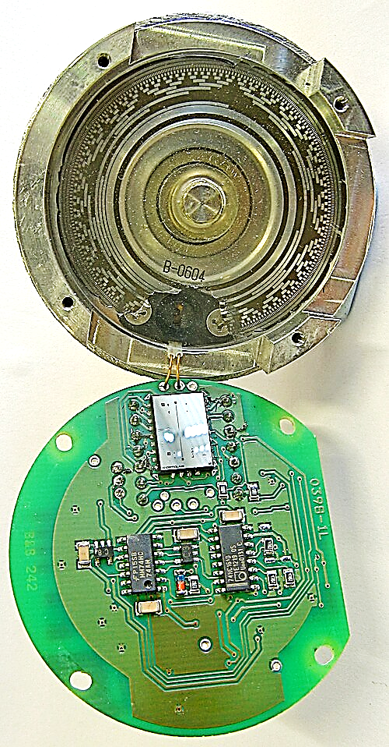
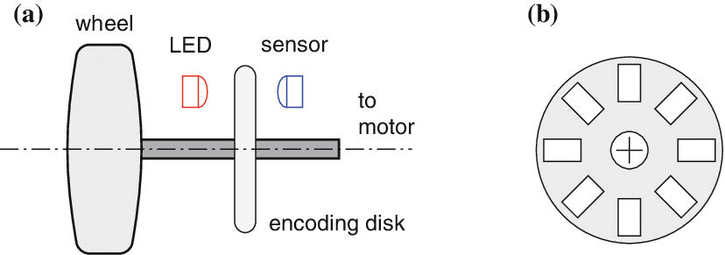
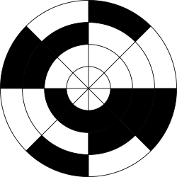
How Encoders Work
N ticks
per rev
A Gray code absolute rotary
Ticks + Movement Direction
Wikipedia
Parameter | Value | Meaning
N (ticks/rev) | 500–4096 | Encoder resolution
R (wheel radius) |  | Converts ticks to distance
L (wheelbase) |  | Distance between wheels
Rate | 1–10 kHz | Very fast updates
4

Slide 5


How Encoders Work
$$Δs =\frac{\left(Δs_{R}+ Δs_{L}\right)}{2} Δθ =\frac{\left(Δs_{R}− Δs_{L}\right)}{L}$$
Δs = distance robot center moved | Δθ = heading change
Δs_R, Δs_L = distance each wheel traveled | L = wheelbase
N ticks
per rev
$$x^{′}= x + Δs·\cos\left(θ\right)$$
$$y^{′}= y + Δs·\sin\left(θ\right)$$
$$θ′ = θ + Δθ$$
Update robot position (x,y) and heading (θ) each time step
Intuition:
Count steps → know distance.
Difference between wheels → know turning.
4

Slide 6
Feature Extraction: What Encoders Gives Us
Sensor → Raw Data → Features → Landmarks for Fusion
Velocity Estimate
Distance Traveled
Motion Detection
Δs / Δt = linear velocity
Δθ / Δt = angular velocity
High rate → smooth velocity signal
Cumulative sum of Δs over time
Used for trip odometry
Resets at each localization fix
Is the robot moving or stopped?
Zero-velocity updates (ZUPT)
Useful for IMU bias correction
As Landmarks: Encoders provide the PREDICTION step in fusion — they tell the system how the robot MOVED. But they drift, so external sensors must CORRECT.
5

Slide 7
Encoders: Operate & Failure
✅ Use for
❌ Fails when
Short-term dead reckoning (< 10m)
Velocity estimation for motion model
KF prediction step (fast, continuous)
Smooth/wet floors (slip → tick counts lie)
Long distances (drift grows unbounded)
Tight turns (differential errors amplified)
Bumps (wheel bounces = phantom ticks)
💥 FAILURE: MediBot traveled 80m. Odometry says "arrived at elevator." Reality: 3m PAST elevator. Polished floor → micro-slip → heading error accumulated. The uncertainty only grows — nothing corrects it.
→ Need an EXTERNAL sensor to measure the environment. Simplest: ultrasonic (cheap, detects walls and glass).
6

Slide 8
BLOCK 2
Ultrasonic Sensors
Ping walls with sound → measure distance

Slide 9
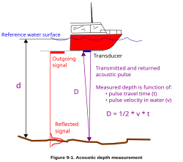
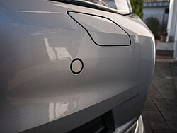
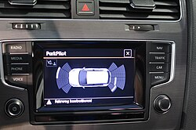
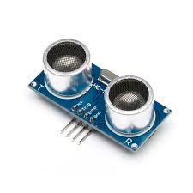
Ultrasonic: Time-of-Flight
distance = (speed of sound × time) / 2
Speed of sound on air ≈ 343 m/s at 22°C
Divide by 2: sound goes TO wall and BACK
Beam cone: 15–30° wide → returns NEAREST object in cone
TX/RX
WALL
c(T) = 331.3 + 0.606 × T
Speed changes with temperature!
Cold room (15°C): 340 m/s
Hot room (37°C): 354 m/s → This is BIAS error if we concede only one speed
★ Key advantage: Ultrasonic DETECTS GLASS! Sound reflects off glass (acoustic impedance mismatch). LiDAR laser (some types) passes through glass. Ultrasonic fills LiDAR's glass blind spot.
8
Wikipedia

Slide 10
Feature Extraction: What Ultrasonic Gives Us
Sensor → Raw Data → Features → Landmarks for Fusion
Range to Nearest Surface
Glass/Transparent Detection
Occupancy Confirmation
Single distance value per ping
Good for: wall distance, proximity
Not directional (wide beam cone)
Sound reflects off glass, plastic
Used to flag transparent obstacles
"Is there something within 2m?"
Binary: occupied / free
Used for close-range safety zones
As Landmarks: Ultrasonic features are SIMPLE (one range value)
9

Slide 11
Ultrasonic: Operate & Failure
✅ Use for
❌ Fails when
Close-range obstacles (< 4m)
Glass door/wall detection
Wall following, elevator proximity
Simple binary safety zone checks
Oblique angles > 5° (specular reflection)
Sound-absorbing materials (foam, cotton)
Multiple sensors fire at once (cross-talk)
Range > 4m, open spaces
💥 FAILURE: Hospital lobby (15×20m). Ultrasonic max range = 4m → "no reading." Marble columns at angles → specular reflection. Multiple sensors → cross-talk phantoms.
→ Need: 360° sweep, hundreds of points, fine angular resolution, long range.
→ Next: Block 3 — LiDAR (spinning laser scanner)
10

Slide 12
BLOCK 3
LiDAR (2D / 3D)
Spinning laser → hundreds of range-bearing points

Slide 13
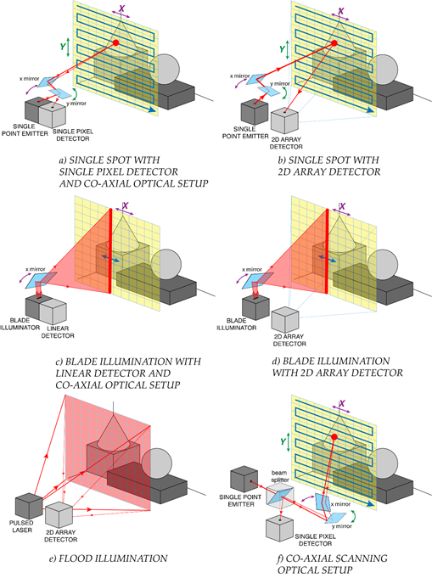
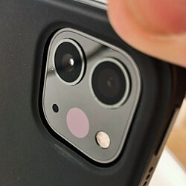
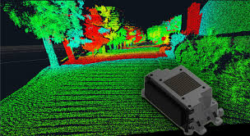
LiDAR: Each Beam Returns (range, angle)
Wikipedia
https://encyclopedia.pub/entry/11122
12

Slide 14
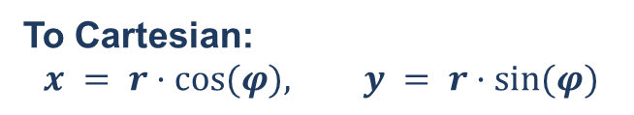
LiDAR: Each Beam Returns (range, angle)
Each beam → (r, φ)
To Cartesian:
$$x = r·cos⁡(φ), y = r·sin⁡(φ)$$
r = distance to surface | φ = angle of beam
360 beams per scan = full circle around robot
Convert polar to x,y coordinates
Result: a 2D point cloud of the environment
Spec | 2D LiDAR | 3D LiDAR
Range | 0.1–30 m | 0.1–200 m
Beams/scan | 360–1800 | 16,000–300,000+
Rate | 10–40 Hz | 10–20 Hz
Range noise σ_r | 1–3 cm | 1–5 cm
Angular noise σ_φ | 0.1–0.5° | 0.1–0.3°
2D limitation: scans ONE horizontal plane. Misses table edges above, fallen objects below.
12

Slide 15




LiDAR Beam Model: 4 Types of Readings
$$p(z) = 0.85 × p_{hit} + 0.05 × p_{short} + 0.05 × p_{max}⁡+ 0.05 × p_{rand}$$
$p_{hit}$(85%)
$p_{short}$(5%)
$p_{max}⁡$(5%)
$p_{rand}$(5%)
NORMAL reading
Laser hits wall → correct
distance + small noise
Bell curve shape
This is what we WANT
UNEXPECTED CLOSE
Person's leg, cart wheel
between sensor and wall
Returns shorter range
Exponential shape
MISSED (max range)
Glass → laser passes
through! Black surface
→ laser absorbed
Returns z_max
RANDOM PHANTOM
Dust, electrical noise
stray reflections
Could be ANY value
Uniform distribution
Most beams are good (85%). But 1 in 7 beams will be wrong in some way — the fusion system must handle this!
Practical alternative — Likelihood Field Model: Precompute a "distance to nearest wall" map. For each LiDAR endpoint, look up how close it is to the nearest expected wall. Close = good match, far = bad match. Much faster than ray-casting. Used by AMCL in ROS.
13

Slide 16
Feature Extraction: What LiDAR Gives Us
Sensor → Raw Data → Features → Landmarks for Fusion
Line Segments
Corner Points
Plane Segments (3D)
Walls appear as straight lines
Extract using Hough transform
or split-and-merge algorithm
Where two walls meet = corner
Very stable, repeatable features
Great for localization landmarks
Floors, walls, tables as planes
Normal vector + distance
Used in 3D SLAM systems
As Landmarks: LiDAR corners and lines are the PRIMARY landmarks for scan matching and localization. They are stable across visits — same corner = same landmark = position correction.
14

Slide 17
LiDAR: Operate & Failure
✅ Use for
❌ Fails when
Hallway mapping & SLAM
Localization
Obstacle avoidance in structured environments
Works in any lighting condition
Glass walls/doors (some laser type passes through!)
Mirrors (beam bounces to wrong place)
Black surfaces (absorb laser)
2D: misses above/below scan plane
💥 FAILURE: MediBot enters elevator. Vibrates and tilts. LiDAR scan shifts — but LiDAR has NO knowledge of MediBot’s drift. Doors open Floor 3 → heading off by 3° → after 20m: 1 meter lateral offset.
→ LiDAR sees the WORLD but not ITSELF. Need a sensor that FEELS motion directly.
→ Next: Block 4 — IMU (accelerometer + gyroscope)
15

Slide 18
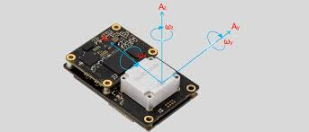
BLOCK 4
IMU (Inertial Measurement Unit)
Feel acceleration and rotation — 200 Hz, no external reference

Slide 19
IMU: Two Sensors in One Chip
Gyroscope (measures rotation)
Accelerometer (measures acceleration)
Output: angular velocity ω (rad/s)
ω_meas = ω_true + bias + noise
Bias drifts slowly over time (random walk)
Integrate ω → get heading angle θ
Heading error: grows linearly
Output: specific force f (m/s²)
f_meas = (accel − gravity) + bias + noise
Must subtract gravity → need orientation!
1° tilt error → 0.17 m/s² false acceleration
Position error: grows as QUADRATIC
18m
IMU Error Growth Over Time — Why It Gets Terrible
0.55m
2.2m
0.005m
0.12m
1s
5s
15s
30s
60s
Position error from accelerometer alone
17

Slide 20
Feature Extraction: What IMU Gives Us
Sensor → Raw Data → Features → Landmarks for Fusion
Gravity Vector
Zero-Velocity Detection
Vibration Signature
Accelerometer senses gravity direction
→ Tells roll and pitch angles
Only works when not accelerating
When robot stops: accel ≈ gravity only
Used to reset velocity drift
Key trick for correcting IMU bias
Different floors = different vibrations
Elevator vs. ramp vs. smooth floor
Can detect surface type changes
As Landmarks: IMU features are INDIRECT — not landmarks on a map, but constraints on MOTION. Zero Update Position and Timing (ZUPT) is especially powerful: when stopped, velocity must be zero → corrects accumulated drift.
18

Slide 21
IMU: Operate & Failure
✅ Use for
❌ Fails when
Short-term orientation (< 30 seconds)
Elevator/ramp detection
Bridging gaps between LiDAR scans
ZUPT (zero-velocity updates when stopped)
Standalone > 10 seconds (drift explodes)
No external correction available
Strong vibration (saturates accelerometer)
Position from accel: error ∝ T²
💥 FAILURE: 45 seconds without correction → gyro bias drifts 2.25° → 1.5m off.
All corridors look geometrically identical.
MediBot needs to READ the "Ward B" sign and RECOGNIZE a wheelchair vs. a cart.
→ LiDAR = geometry. IMU = motion. Neither = MEANING.
→ Next: Block 5 — Camera (color, texture, text, object recognition)
19

Slide 22
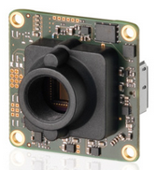
BLOCK 5
Camera (RGB + Depth)
See color, texture, text — and measure depth

Slide 23
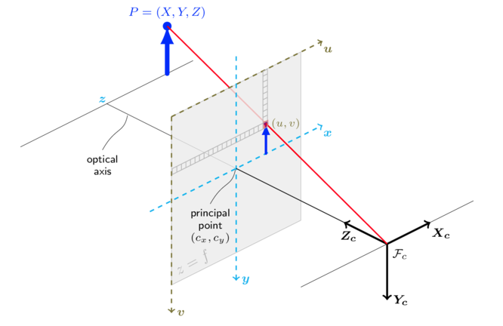


Camera: The Pinhole Model
$$u = f_{x} × (X / Z) + c_{x}$$
$$v = f_{y} × (Y / Z) + c_{y}$$
Key Insight:
Projection LOSES depth! A pixel (u,v) could be any point along a ray. Need separate depth sensor (stereo, IR, ToF).
(u,v) = pixel position | (X,Y,Z) = 3D point in camera frame
$f_{x}, f_{y}$= focal length (pixels) | ($c_{x}, c_{y}$) = image center
https://stackoverflow.com/questions/68249598/how-to-calculate-the-ray-of-a-camera-with-the-help-of-the-camera-matrix
21

Slide 24
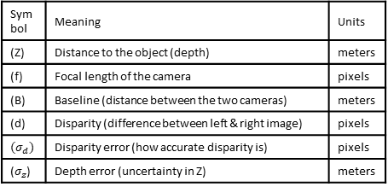
Camera: Stereo
Stereo Depth Uncertainty — Grows as Z² (quadratic!)
At 1 meter: ±1 cm
At 3 meters: ±9 cm
At 5 meters: ±25 cm!
Very precise!
Trust this measurement a lot
Good for obstacle avoidance
Getting noisy...
OK for sign detection
Unreliable for obstacles
25× worse than 1m!
Unreliable for navigation
Camera is "near-sighted"
$$σ_{Z} = \left(\frac{Z^{2}}{f·B}\right)× σ_{d}$$
Symbol | Meaning | Units
(Z) | Distance to the object (depth) | meters
(f) | Focal length of the camera | pixels
(B) | Baseline (distance between the two cameras) | meters
(d) | Disparity (difference between left & right image) | pixels
$$(σ_{d})$$ | Disparity error (how accurate disparity is) | pixels
($σ_{z}$) | Depth error (uncertainty in Z) | meters
If my stereo camera makes a small error in disparity, how big will the error be in the measured distance Z?
Noise depends on distance itself Z, Error grows with distance squared
→ HETEROSCEDASTIC:
close = reliable,
far = noisy.
Fusion must weight close readings MORE.
21

Slide 25
Feature Extraction: What Camera Gives Us
Sensor → Raw Data → Features → Landmarks for Fusion
Corner Features
Edge / Line Features
Semantic Labels (AI)
Distinctive pixel patterns
Repeatable across viewpoints
Used for visual odometry & SLAM
Door frames, corridor edges
Pair with LiDAR lines for cross-check
Hough transform or LSD detector
"Ward B — Cardiology" (OCR)
Person, wheelchair, cart (detection)
Room type classification
Dense Depth Map
Depth at every pixel (from stereo/IR)
Dense 3D reconstruction (< 4m)
Complements sparse LiDAR points
As Landmarks: Camera features are the RICHEST — from low-level corners (for visual odometry) to high-level semantics (sign reading). They provide MEANING that geometry alone cannot.
22

Slide 26
Camera: Operate & Failure
✅ Use for
❌ Fails when
Sign/label reading (OCR)
Person/object detection
Close-range dense 3D (< 4m)
Visual odometry, semantic mapping
Sunlight saturates IR depth sensor
Textureless white walls (no stereo match)
Dark corridors (no light = no image)
Glass (IR passes through, like LiDAR)
Limited FoV (~70°) — can't see behind
💥 FAILURE:
Sunlight through window → IR depth saturated.
Can't measure speed (differentiation amplifies noise).
→ Need: all-weather, wide coverage, DIRECT velocity measurement.
→ Next: Block 6 — Radar (radio waves, Doppler velocity)
23

Slide 27
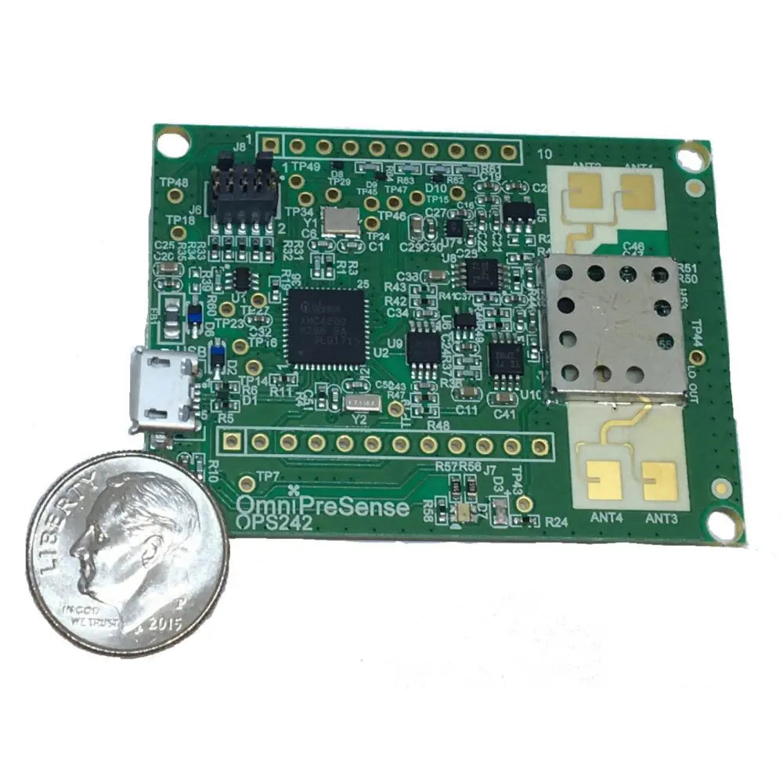
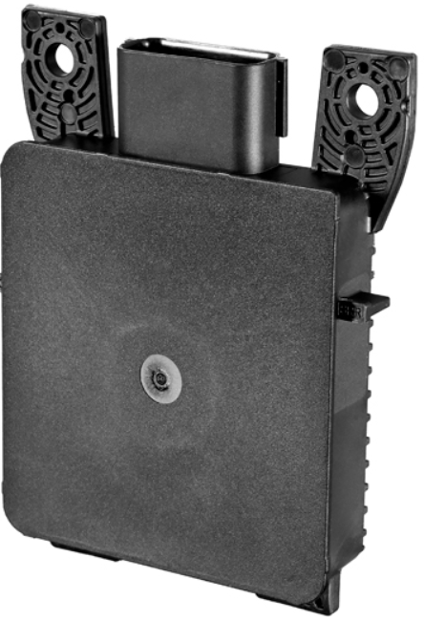
BLOCK 6
Radar (mmWave)
Radio waves → range + angle + VELOCITY for free
https://omnipresense.com/product/ops242-short-range-radar-sensor/
https://www.hella.com

Slide 28
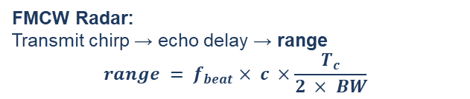
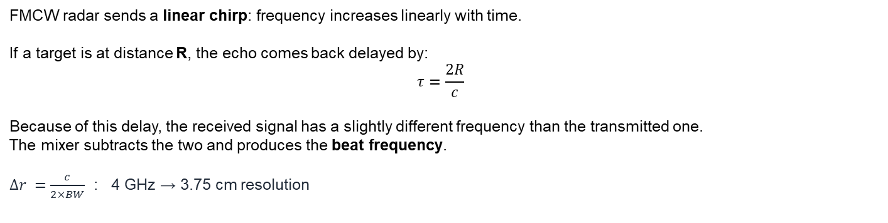
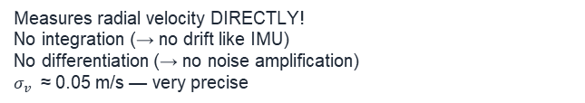

Radar: How FMCW Works + Doppler
FMCW Radar:
Transmit chirp → echo delay → range
$$range = f_{beat}× c ×\frac{T_{c}}{2 × BW}$$
Doppler Velocity:
$$v_{r} = λ × f_{Doppler} / 2$$
Measures radial velocity DIRECTLY!
No integration (→ no drift like IMU)
No differentiation (→ no noise amplification)
$σ_{v}$ ≈ 0.05 m/s — very precise
Chirp = frequency ramp. Echo has time delay.
F_Beat = frequency difference after mixing Tx & Rx.
BW = Bandwidth of chirp; how much frequency changes during chirp.
C = Speed of light.
T_c = Chirp duration
FMCW radar sends a linear chirp: frequency increases linearly with time.
If a target is at distance R, the echo comes back delayed by:
$$τ=\frac{2R}{c}​$$
Because of this delay, the received signal has a slightly different frequency than the transmitted one. The mixer subtracts the two and produces the beat frequency.
$Δr =\frac{c}{2×BW}$ : 4 GHz → 3.75 cm resolution
25

Slide 29
Radar: Velocity
Method | How | Problem
Encoders → velocity | Differentiate position | Amplifies noise
IMU → velocity | Integrate acceleration | Accumulates bias (drift)
Radar → velocity | Doppler: DIRECT | No drift, no amplification!
Trade-off: angular resolution ~5° (10–50× worse than LiDAR). Two people side-by-side = one blob.
Works through: glass, dust, fog, smoke, rain, any lighting. Does NOT care about visibility.
25

Slide 30
Feature Extraction: What Radar Gives Us
Sensor → Raw Data → Features → Landmarks for Fusion
Radial Velocity per Target
Moving Object Classification
Through-Material Detection
Each detection has speed attached
Positive = moving away, negative = approaching
Direct, no computation from position
Static vs. dynamic targets via Doppler
Moving person vs. stationary wall
Crucial for dynamic obstacle avoidance
Sees through glass, plastic, drywall
Detects objects behind partitions
Complementary to LiDAR/camera
As Landmarks: Radar features are SPARSE but carry VELOCITY - information no other sensor provides directly.
In fusion, radar constrains object MOTION, while LiDAR/camera constrain object POSITION.
26

Slide 31
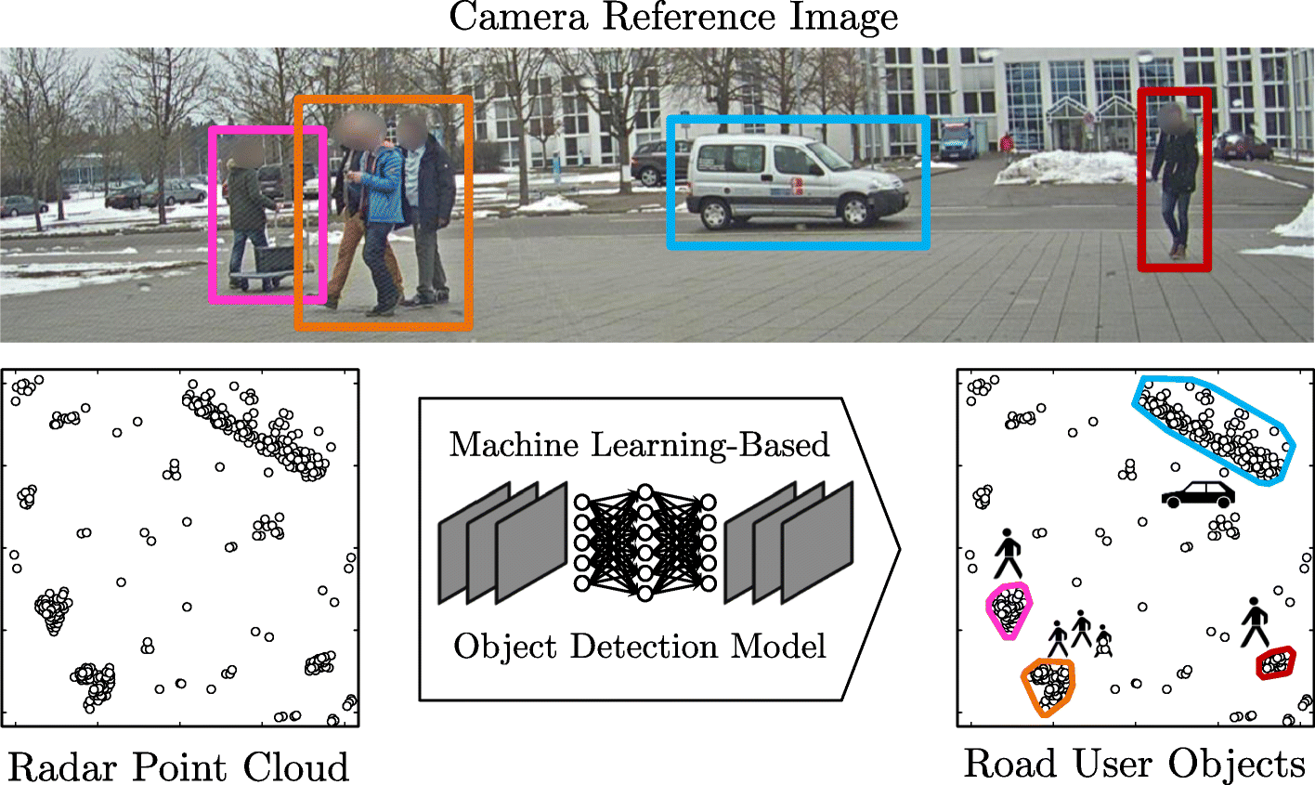
Feature Extraction: What Radar Gives Us
https://link.springer.com/article/10.1186/s42467-021-00012-z/figures/1
26

Slide 32
Radar: Operate & Failure → Need Absolute Outdoor Reference
✅ Use for
❌ Fails when
Moving object detection + velocity
All-weather sensing (rain, fog, night)
Rear collision avoidance
Seeing through glass/dust/partitions
Dense metal environments (multipath clutter)
Very small targets (low radar cross-section)
Need fine-grained shape recognition
Angular resolution too poor for sole navigation
💥 REALIZATION: We have 6 sensors. Indoors, this is enough — LiDAR provides absolute position reference. But what about OUTDOORS? MediBot's sister robot, StreetBot, navigates city sidewalks. No walls to scan. Open sky. Need a GLOBAL position reference.
→ For outdoor: we add a 7th sensor — GPS. Provides absolute position anywhere on Earth.
→ Next: Block 7 — GPS (switching from MediBot to StreetBot)
27

Slide 33
BLOCK 7
GPS / GNSS
Absolute position anywhere on Earth — but noisy and slow

Slide 34

GPS: How It Works (StreetBot Scenario)
StreetBot: a last-mile delivery robot navigating city sidewalks, crossings, building lobbies.
Position from satellite timing:
$$d = c × Δt$$
d: distance to satellite
c: speed of light
$\text{Δ}\text{t}$: signal travel time
4+ satellites → triangulate (x, y, z) + clock bias
GPS Error Sources
Atmospheric delay (ionosphere, troposphere)
Multipath: signal bounces off buildings
Urban canyon: buildings block satellites
Slow update rate: only 1–10 Hz
NO signal indoors — completely blind
Each satellite broadcasts its position + time.
Receiver measures signal travel time Δt.
With 4+ satellites: solve for position.
Accuracy: 2–5m (open sky), 10–50m (urban canyon)
Parameter | Standard GPS | RTK-GPS
Accuracy | 2–5 m (open sky) | 1–2 cm (with base station)
Update rate | 1–10 Hz | 10–20 Hz
Urban canyon | 10–50 m error | Degraded, needs fallback
Indoors | NO SIGNAL | NO SIGNAL
Cost | $10–$50 | $500–$5,000+
29

Slide 35
Feature Extraction: What GPS Gives Us
Sensor → Raw Data → Features → Landmarks for Fusion
Absolute Position (lat, lon)
Velocity (from Doppler)
Time Synchronization
Global reference frame
Does NOT drift over time
But noisy: ±2–5m per reading
GPS Doppler: velocity ±0.1 m/s
More accurate than position!
Useful for heading estimation
GPS provides precise UTC time
Used to timestamp all sensors
Critical for multi-sensor fusion
As Landmarks: GPS provides the ABSOLUTE REFERENCE that prevents long-term drift.
It's slow and noisy, but it bounds the error.
Combined with IMU+encoders (fast, drifting) = the classic complementary fusion pair.
30

Slide 36
Measurement Theory
The math behind sensor uncertainty

Slide 37
The Gaussian (Bell Curve) — Language of Uncertainty
Two numbers describe everything:
μ (mean) = where the peak is (best guess)
σ (std dev) = how wide the bell is (uncertainty)
68% within μ ± 1σ 95% within μ ± 2σ 99.7% within μ ± 3σ
Small σ → narrow bell → confident sensor
Large σ → wide bell → unreliable sensor
μ
← less likely MOST LIKELY less likely →
32

Slide 38
The Universal Sensor Equation
z = h(x) + b + v
Every sensor measurement in robotics follows this form.
z (measurement)
h(x) (truth)
b (bias)
v ~ N(0, σ²) (noise)
What the sensor REPORTS
The number you actually read
Contains truth + errors
What sensor SHOULD report
If world state is x, the
ideal reading would be h(x)
SYSTEMATIC error
Same direction each time
Fixable by calibration
Example: wrong temperature
RANDOM error
Different each time
Cannot remove, only reduce
Described by bell curve
This equation applies to EVERY sensor: encoders, ultrasonic, LiDAR, IMU, camera, radar, GPS. The values of b and σ are different for each.
33

Slide 39
The Uncertainty Ellipse — Where the Robot MIGHT Be
Start
10m
30m
80m (LOST!)
Each ellipse = region where robot PROBABLY is
Small ellipse = confident. Large ellipse = lost.
With encoders/IMU alone: ellipse ONLY GROWS.
External sensors (LiDAR, GPS) SHRINK the ellipse.
This grow/shrink cycle is the heart of sensor fusion.
34

Slide 40



Mahalanobis Distance — Is This Reading Trustworthy?
Before accepting any measurement, ask: "How surprising is this reading?"
$d_{M}$ < 2 → GREEN
$d_{M}$= 2–3 → YELLOW
$d_{M}$> 3 → RED
Reading matches prediction well
ACCEPT — use in fusion
Sensor is healthy
Most readings should be here
Reading is a bit surprising
Accept with caution
Maybe increase uncertainty
Monitor if it continues
Reading is almost certainly wrong
REJECT — do not use
Sensor may have failed
Flag for health monitoring
$$d_{M}= \sqrt{ innovationᵀ × S^{−1}× innovation }$$
innovation = (actual measurement) − (predicted measurement) → the "surprise"
S = combined uncertainty of prediction + measurement
The Mahalanobis distance accounts for HOW UNCERTAIN we are — a 10cm surprise is fine if σ=20cm, but alarming if σ=1cm.
35

Slide 41

Heteroscedastic Noise — Not All Measurements Are Equal
Some sensors have noise that DEPENDS ON the measurement itself.
Homoscedastic (constant noise)
Heteroscedastic (varying noise)
Noise σ is the same everywhere
Example: ultrasonic σ ≈ 5mm at any range
Simple to handle in fusion
Just set uncertainty R = σ² = constant
Noise σ depends on distance!
Camera depth: $σ_{Z}∝ Z^{2}$
At 1m: σ=1cm, at 5m: σ=25cm
Must update R for each measurement
Why this matters for fusion:
If you tell the fusion filter that camera depth has constant σ = 5cm, it will OVER-TRUST far readings (which are actually ±25cm) and UNDER-TRUST close readings (which are actually ±1cm). The filter will make bad decisions.
Fix: compute σ_Z = Z²/(f·B) × σ_d for each pixel and set R accordingly.
36

Slide 42
Feature Matching
From raw sensor data → landmarks for localization

Slide 43
What is a Landmark? Types of Landmarks
Point Landmarks
Line/Plane Landmarks
Semantic Landmarks
LiDAR/camera corners
Distinctive, repeatable
2D or 3D coordinates
Example: wall corner at (3.2, 5.1)
LiDAR wall segments
Parametric: (ρ, α) or (n, d)
Structured environments
Example: corridor wall
Camera-detected signs, doors
Named: "Ward B entrance"
Rich but harder to extract
Example: room label via OCR
Why landmarks matter:
1. Robot sees landmark A at position p_A in its sensor frame
2. Robot KNOWS landmark A is at position P_A on the map (from a previous visit or a pre-built map)
3. The DIFFERENCE between expected and observed position = position correction
This is exactly the UPDATE step in sensor fusion! Landmarks make uncertainty SHRINK.
38

Slide 44
Feature Matching: How to Recognize Landmarks Again
Nearest Neighbor Matching
RANSAC (Robust Matching)
For each feature in current scan:
Find the closest feature in the map
"Closest" in feature descriptor space
Accept if distance < threshold
Fast but sensitive to noise and clutter
RANdom SAmple Consensus
1. Pick random feature pairs
2. Compute transformation (rotation+translation)
3. Count how many other features agree
4. Keep the best. Rejects outliers automatically!
Matching Pipeline (for any sensor):
Raw Data
→
Extract Features
→
Describe Features
→
Match to Map
→
Reject Outliers
→
Position Correction
This pipeline runs for LiDAR (scan matching), camera (visual odometry), and even radar (Doppler-based tracking).
39

Slide 45
Sensor → Feature → Landmark Summary
Sensor | Features | Landmark Type | Matching Method
Encoders | Velocity, distance | — (motion, not landmarks) | Prediction only
Ultrasonic | Range, glass flag | Simple range constraints | Gating / threshold
LiDAR | Corners, lines, planes | Point/line landmarks | ICP, scan matching
IMU | Gravity, ZUPT | — (constraints, not landmarks) | Prediction + ZUPT
Camera | ORB/SIFT, edges, text | Visual landmarks, semantic | NN + RANSAC
Radar | Doppler velocity, RCS | Moving object tracks | Track association
GPS | Lat/lon, velocity | Absolute position fix | Direct measurement
Proprioceptive sensors (encoders, IMU) provide PREDICTION. Exteroceptive sensors (LiDAR, camera, radar, GPS, ultrasonic) provide CORRECTION.
40

Slide 46
Sensor Fusion
Combine imperfect sensors → better than any one alone

Slide 47
Three Types of Fusion
Complementary
Redundant
Competitive
Sensors give DIFFERENT info
that fills each other's gaps
IMU: fast but drifts
LiDAR: slow but absolute
Together: fast AND accurate
Most common and most powerful
Sensors measure the SAME thing
→ increased reliability
LiDAR + Ultrasonic both measure
wall distance. If LiDAR fails on
glass, ultrasonic still works.
Provides fault tolerance
Choose the BEST sensor for
current conditions
Bright sunlight: use radar
(camera depth fails)
Dark corridor: use LiDAR+camera
Context-dependent selection
Real systems use all three types simultaneously. The fusion filter handles it automatically via uncertainty weighting.
42

Slide 48
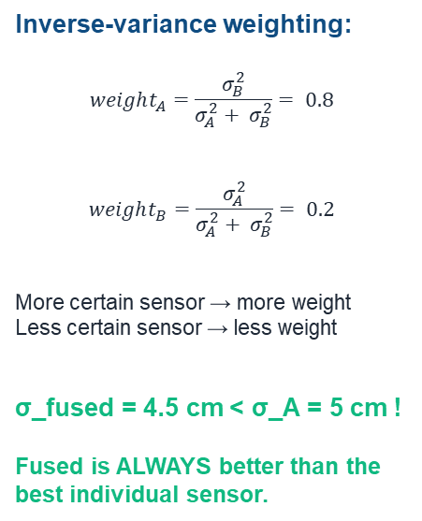
The Magic: Fused Result < Any Individual Sensor
Inverse-variance weighting:
$$weight_{A}=\frac{σ_{B}^{2}}{σ_{A}^{2}+ σ_{B}^{2}}= 0.8$$
$weight_{B}=\frac{σ_{A}^{2}}{σ_{A}^{2}+ σ_{B}^{2}}= 0.2$
More certain sensor → more weight Less certain sensor → less weight
σ_fused = 4.5 cm < σ_A = 5 cm !
Fused is ALWAYS better than the
best individual sensor.
Sensor A
σ = 5 cm
→
FUSED
σ = 4.5 cm!
Sensor B
σ = 10 cm
43

Slide 49
Predict-Update Cycle (Concept Only — Math in MOD-05)
This is how fusion works in practice. The math (Kalman Filter) is in MOD-05.
PREDICT
Source: Encoders + IMU
"Based on how my wheels turned and what my IMU felt, I think I moved 0.5m forward and turned 2° left."
Uncertainty GROWS ↑
(because motion adds noise)
UPDATE (CORRECT)
Source: LiDAR / Camera / Radar / GPS
"LiDAR says the wall is at 2.3m. I predicted 2.5m. I was 0.2m off. Correct my position by blending prediction and measurement."
Uncertainty SHRINKS ↓
(measurement corrects drift)
→
↻ This cycle repeats at the SENSOR RATE (10–200 Hz). Predict-Update-Predict-Update-...
Proprioceptive sensors (encoders, IMU) → FAST predictions that DRIFT
Exteroceptive sensors (LiDAR, camera, radar, GPS) → SLOW corrections that BOUND the drift
44

Slide 50
Example: IMU + Odometry + GPS Fusion
The classic outdoor fusion :
Odometry (1000 Hz)
IMU (200 Hz)
GPS (1–10 Hz)
Fast, continuous
Smooth but DRIFTS
Provides: Δx, Δy, Δθ
Role: PREDICTION
fast, feels rotation
Orientation + acceleration
Drifts in seconds (bias)
Role: PREDICTION (orientation)
Slow, noisy (±2–5m)
But ABSOLUTE — no drift!
Position + velocity
Role: CORRECTION
↓ ↓ ↓
EKF FUSION → Fused State Estimate
Smooth (from IMU/odom) + Bounded (from GPS) + Oriented (from IMU)
Best of all three sensors combined.
Uncertainty stays small and bounded.
Between GPS updates (100ms gaps): IMU+odom predict.
When GPS arrives: corrects drift. Continuous + accurate.
45

Slide 51
Fusion Architecture: Centralized vs. Federated
Centralized Fusion
Federated (Decentralized)
All sensors → ONE filter
Single state vector: [x,y,θ,v,bias,...]
✅ Theoretically optimal
❌ Complex, single point of failure
❌ Hard to debug which sensor is wrong
Each sensor → own local filter
Local estimates → merged by master
✅ One sensor can fail safely
✅ Easier to test subsystems
❌ Slightly suboptimal (correlations lost)
For safety-critical robots (hospital, delivery): Federated is preferred.
If camera dies → its local filter stops → master continues with remaining sensors.
Multi-rate handling: timestamp everything. When a late measurement arrives, rewind → apply → fast-forward.
Update rate examples (may vary depend on the application):
Encoders: 1kHz | IMU: 200Hz | Camera: 30Hz | Radar: 15Hz | LiDAR: 10Hz | GPS: 1Hz — all at different rates!
46

Slide 52
Sensor Health Monitoring — Graceful Degradation
What happens when a sensor FAILS mid-mission?
1. Detect
Mahalanobis distance $d_{M}$ spikes above threshold (d_M > 3)
2. Degrade
Increase sensor's uncertainty (σ → 10×σ). Filter trusts it less.
3. Disable
If persistent: set weight to zero. Continue with remaining sensors.
4. Recover
When $d_{M}$ returns to normal: re-enable sensor. Weight restored.
Example: Camera depth fails near sunlit window → $d_{M}$ spikes → auto-disabled → Robot continues with LiDAR+ultrasonic+radar → enters shade → camera recovers → auto-re-enabled.
47

Slide 53
Which Sensor Leads When?
Time | Event | Lead Sensor(s)
0–30s | MediBot: corridor travel | LiDAR corrects, Encoders+IMU predict
30s | Glass door approach | ULTRASONIC (glass!) + Camera (sign)
35–50s | Elevator ride (enclosed) | IMU ONLY — drift accumulates
50s | Doors open Floor 3 | LiDAR CORRECTS → uncertainty collapses!
85s | Cart from behind | RADAR (velocity + through glass)
— | StreetBot: open sidewalk | GPS provides absolute correction
— | StreetBot: urban canyon | GPS degrades → LiDAR+IMU take over
— | StreetBot: enters building | GPS = NO SIGNAL → full indoor suite
The fusion system seamlessly hands off between sensors based on availability and reliability. No sensor is "always best."
48

Slide 54
Key Takeaways
1
Every sensor lies
2
Quantify uncertainty
3
Errors accumulate
Model it: z = h(x) + b + v
Gaussian: μ (best guess), σ (confidence)
Only grows!
4
Extract features
5
Fuse wisely
6
Monitor health
Sensor data → landmarks → map anchors
Weight ∝ 1/σ² → better than any single sensor
Mahalanobis gating → graceful degradation
57

Slide 55
References
1. Thrun, Burgard & Fox (2005). Probabilistic Robotics. MIT Press. Ch. 5–7.
2. Siegwart, Nourbakhsh & Scaramuzza (2011). Intro to Autonomous Mobile Robots. MIT Press.
3. robot_localization ROS package. github.com/cra-ros-pkg/robot_localization
Next: MOD-05 — Probabilistic Robotics & State Estimation (Kalman Filter derivation)
58

Slide 56
?

Slide 57
DEEP DIVE — Appendix

Slide 58
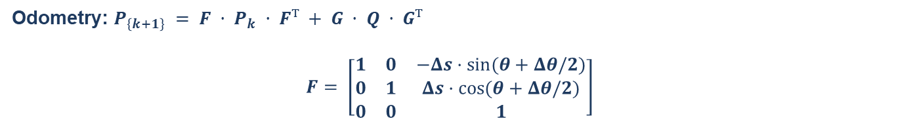
DEEP DIVE: Error Propagation via Jacobians
If y = f(x) and x ~ N(μ, P), then $P_{y} ≈ J · P_{x} · Jᵀ$
J = Jacobian matrix: $J_{ij} = \frac{∂f_{i}}{∂x_{j}}$
This is the FIRST-ORDER approximation — linearize f at the current estimate, then propagate the covariance through the linear approximation.
Odometry: $P_{\left\{k+1\right\}} = F · P_{k} · Fᵀ + G · Q · Gᵀ$
$$F= \left[\begin{matrix}1 & 0 & −Δs·sin⁡(θ+Δθ/2) \\ 0 & 1 & Δs·cos⁡(θ+Δθ/2) \\ 0 & 0 & 1\end{matrix}\right]$$
F = Jacobian w.r.t. state (how current uncertainty propagates)
G = Jacobian w.r.t. control input (how motion noise enters)
Q = control noise covariance: diag(σ²_Δs, σ²_Δθ)
F·P_k·Fᵀ = old uncertainty stretched through motion | G·Q·Gᵀ = new uncertainty added
This is why the covariance ellipse grows and rotates: the Jacobian F stretches it in the direction of motion, and Q adds new uncertainty.
50

Slide 59



DEEP DIVE: LiDAR Beam Model Equations
$$p(z|x,m) = α_{hit}·p_{hit} + α_{short}·p_{short} + α_{max}·p_{max}{+}α_{rand}·p_{rand}$$
Mixture model: each reading is generated by ONE of 4 mechanisms. Mixing weights sum to 1.
$p_{hit} = N(z; r_{true}, σ_{r}^{2})$ for $0 ≤ z ≤ z_{max}⁡$
$p_{short} = λ·exp⁡(−λz)$for $0 ≤ z ≤ r_{true}$
Gaussian centered on true range. σ_r ≈ 1–3 cm.
Exponential: unexpected close object. λ controls steepness.
$$p_{max}⁡= δ(z − z_{max})$$
$$p_{rand} =\frac{1}{z_{\max\left(uniform\right)}}$$
Point mass at max range. Glass, black surface, open door.
Random: equally likely anywhere. Dust, electrical noise.
Log-likelihood for full scan: ℓ = Σ log p(z_i | x, m) — sum instead of multiply to avoid numerical underflow.
51

Slide 60
DEEP DIVE: Stereo Depth Uncertainty Derivation
Stereo depth:
$$Z = f · \frac{B}{d}$$
f = focal length (pixels), B = baseline (meters), d = disparity (pixels)
Larger disparity → closer object. Zero disparity → infinitely far.
Differentiate:
$$dZ/dd = −f·B / d² = −Z² / (f·B)$$
→ $σ_{Z} = |Z² / (f·B)| × σ_{d}$
Key: σ_Z grows as Z² — QUADRATIC! This is why camera depth is great at 1m but terrible at 5m.
σ_d ≈ 0.5–2 pixels (sub-pixel stereo matching accuracy).
Noise covariance for fusion: $R(Z) = (Z²/(f·B))² × σ_{d}^{2}$
This R must be RECOMPUTED for each measurement! It's a function of Z, not a constant.
Setting R = constant would over-trust far readings and under-trust close ones.
52

Slide 61
DEEP DIVE: Allan Variance for IMU Characterization
$$σ_{Allan\left(τ\right)}^{2} = ½ × ⟨({\bar{ω}}_{\left\{k+1\right\}} − {\bar{ω}}_{k})²⟩$$
Record IMU while STATIONARY. Divide into clusters of length τ.
Compute variance of cluster-to-cluster differences. Plot σ(τ) vs τ on log-log.
Slope on log-log | Noise Type | Physical Meaning
−1/2 | White noise (ARW) | Electronic noise, quantization — always present
0 (flat) | Bias instability | Minimum of curve — best the gyro can ever do
+1/2 | Rate random walk | Slow environmental drift — temperature, aging
Read ARW from the −1/2 slope line at τ = 1s. Read bias instability from the minimum of the curve. These parameters go directly into your EKF noise configuration (MOD-05).
53

Slide 62
DEEP DIVE: GPS Error Model
Position:
$$p_GPS = p_{true} + b_{atm} + n_{multipath} + n_{receiver}$$
b_atm = atmospheric delay (ionosphere + troposphere) — partially correctable
n_multipath = building reflections — worst in urban canyons
n_receiver = internal noise ≈ 0.3–1 m
Error Source | Magnitude | Can Be Corrected?
Ionospheric delay | 2–5 m | Yes (dual-frequency GPS)
Tropospheric delay | 0.2–0.5 m | Partially (models)
Multipath | 1–50 m (urban) | Difficult (antenna design, algorithms)
Satellite geometry (DOP) | 1× – 5× multiplier | Choose better satellite constellation
Receiver noise | 0.3–1 m | No — fundamental limit
RTK-GPS uses a nearby base station to cancel most errors → achieves 1–2 cm accuracy. But requires base station infrastructure and clear sky.
54

Slide 63
DEEP DIVE: Polar → Cartesian Uncertainty (LiDAR)
$$J = \left[\begin{matrix}cos⁡(φ) & −r·sin⁡(φ) \\ sin⁡(φ) & r·cos⁡(φ)\end{matrix}\right]$$
Jacobian of the transformation (r,φ) → (x,y). Used to propagate polar noise into Cartesian noise.
$$P_{xy} = J · diag(σ_{r}^{2}, σ_{φ}^{2}) · Jᵀ$$
Result: at long range, the term $r²·σ_{φ}^{2}$dominates → uncertainty ellipse elongates TANGENTIALLY.
At r=4m: angular contribution small. At r=20m: angular contribution 25× larger → accuracy drops at distance.
This is why LiDAR-based SLAM degrades in large open spaces with long-range readings.
55

Slide 64
Final Challenge: StreetBot Design Problem
Apply everything to a NEW robot in a HARDER environment:
StreetBot Challenges (vs. MediBot)
Your Deliverables
Rain/snow/fog → camera+LiDAR degrade
Sunlight → camera depth saturated
Uneven terrain → more wheel slip
Moving traffic → need long-range velocity
Glass storefronts everywhere
1. Sensor suite: which 7, where, why (20%)
2. Sensor models + noise for each (20%)
3. Feature extraction + landmarks (15%)
4. Fusion architecture + data flow (20%)
5. Top 5 failure scenarios + mitigation (15%)
6. MediBot → StreetBot: what changes? (10%)
Key question: Which sensors change when moving from hospital to sidewalk? What NEW failure modes appear?
56

