Slide 1
MOBILE ROBOTS
MOD-05
Probabilistic Robotics
& State Estimation
By Dr. Ahmad Abbadi

Slide 2
BLOCK A
Why Probabilistic?
From MOD-04's uncertainty to a mathematical framework

Slide 3
The Fundamental Question: Where Is the Robot?
Deterministic (Wrong!)
Probabilistic (Correct!)
"The robot is at (3.2, 5.1)"
Pretends we know exactly
Ignores all sensor noise
ONE wrong reading → total failure
"The robot is PROBABLY at (3.2, 5.1) ± 0.3m"
Represents what we actually know
Accounts for sensor noise
Robust to individual bad readings
× Single point = fragile
Ellipse = honest & robust
MOD-05 builds the mathematical machine that turns noisy sensor data → probability distributions → state estimates.
3

Slide 4
The Pipeline We Are Building
Motion
(encoders, IMU)
PREDICT
bel⁻(x')
Sensor
(LiDAR, camera...)
UPDATE
bel(x')
Belief
(where am I?)
→
→
→
→
MOD-03/04
Grows uncertainty
MOD-04
Shrinks uncertainty
THE ANSWER
This module teaches the MATH behind each arrow:
Block B: Probability foundations
Block C: Linear algebra for covariance
Block D: Motion model as p(x'|x,u)
Block E: Sensor model as p(z|x)
Block F: Bayes filter (general algorithm)
Block G: Kalman Filter (exact solution!)
4

Slide 5
BLOCK B
Probability Foundations
The language we use to describe uncertainty

Slide 6
Random Variables & Probability Density
A random variable X is a quantity whose value is uncertain.
Discrete (countable values)
Continuous (infinite values)
Example: coin flip → heads or tails
P(X = heads) = 0.5
Probabilities must sum to 1
Described by: P(X = x) for each x
Example: LiDAR range → 2.31472... m
p(x) = probability DENSITY (not probability!)
Probability = area under curve: P(a<X<b) = ∫p(x)dx
Total area must equal 1
Area under curve = probability of being in that range
For robotics: almost everything is continuous (positions, angles, distances)
Probability density function p(x)
6

Slide 7
Mean & Variance — Two Numbers That Describe Everything
Mean: μ = E[X] = ∫ x · p(x) dx
Variance: σ² = E[(X−μ)²]
The "center of mass" of the distribution.
Our BEST GUESS of the true value.
Example: average of 100 LiDAR readings.
How SPREAD OUT the values are.
Small σ² → values cluster near μ (confident).
Large σ² → values spread far (uncertain).
Small σ → narrow → confident
Large σ → wide → uncertain
In robotics: μ = estimated position, σ = how much we trust it.
The entire MOD-05 is about computing μ and σ correctly.
7

Slide 8
Joint Probability: Two Variables Together
What if we have TWO uncertain quantities? (e.g., robot's x AND y position)
Joint probability: P(A and B) = P(A, B)
The probability that BOTH A and B occur simultaneously. For robot: P(x=3.2 AND y=5.1) — the 2D position belief.
If A and B are INDEPENDENT:
If A and B are DEPENDENT:
P(A, B) = P(A) × P(B)
Knowing A tells nothing about B
Example: two separate LiDAR beams
Simple — just multiply!
P(A, B) ≠ P(A) × P(B)
Knowing A changes belief about B
Example: x and y of robot ARE correlated
Need conditional probability → next slide
In robotics, positions are almost always dependent — errors in x affect errors in y (through heading uncertainty).
8

Slide 9
Conditional Probability: P(A | B)
The probability of A, GIVEN that we know “B is true"
P(A | B) = $\frac{P\left(A, B\right)}{P\left(B\right)}$
Read as: "probability of A given B." The vertical bar | means "given" or "knowing that."
Example: P(wall at 2m | LiDAR reads 2.1m) — "given this reading, where IS the wall?"
Robot Example:
Robot is near “a door” or “in a hallway” (two possible locations). Camera sensor reads "dark" (low light).
P(dark | at door) = 0.7 (The probability of dark given the robot near the door is 0.7. Doors are often in dim areas) P(dark | in hallway) = 0.2 (hallways are usually bright)
The sensor reading "dark" makes "at door" MORE likely.
This is exactly what P(A|B) captures — how evidence changes belief.
9

Slide 10
Bayes Theorem — The Most Important Equation in Robotics
$$P(x | z) =\frac{P(z \left| x\right)P\left(x\right)}{P\left(z\right)}$$
posterior = likelihood × prior / evidence
P(x | z) — Posterior
P(z | x) — Likelihood
P(x) — Prior
P(z) — Evidence
What we WANT
"Where is the robot,
GIVEN the sensor data?"
The updated belief
From MOD-04 sensors!
"If robot is at x, how
likely is reading z?"
= sensor model p(z|x)
What we believed BEFORE
the measurement
"I think I'm near (3,5)"
= previous belief
Normalizing constant
Makes probabilities sum to 1
Often written as η (eta)
Don't need to compute it
Bayes theorem tells us: multiply what you BELIEVED (prior) by what you OBSERVED (likelihood) → get what you SHOULD BELIEVE (posterior).
10

Slide 11
Bayes Theorem — Worked Example
Robot near a door (D) or hallway (H). Sensor reads "dark."
Step | Door (D) | Hallway (H) | Meaning
Prior P(x) | 0.5 | 0.5 | Equal chance — no idea which
Likelihood P(dark|x) | 0.7 | 0.2 | Doors are darker than hallways
Prior × Likelihood | 0.5 × 0.7 = 0.35 | 0.5 × 0.2 = 0.10 | Unnormalized posterior
Normalize (÷ 0.45) | 0.35/0.45 = 0.78 | 0.10/0.45 = 0.22 | Posterior: updated belief!
Result: After seeing "dark," belief shifted from 50/50 → 78% door, 22% hallway.
The sensor reading didn't TELL us we're at the door — it made it MORE LIKELY.
This is exactly how sensor fusion works: each measurement shifts our belief proportionally.
11

Slide 12
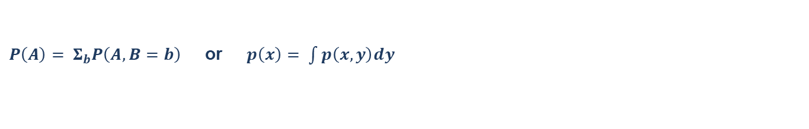
Marginalization: Summing Out Variables
$P\left(A\right)= Σ_{b}P\left(A, B=b\right)$ or $p\left(x\right)= \int{p\left(x, y\right)dy}$
To find the probability of A alone, SUM (or integrate) over all possible values of B.
This "removes" B from the joint distribution — we don't care about B, only A.
Why we need this:
In the PREDICTION step of the Bayes filter:
bel⁻(x') = ∫ p(x' | x, u) × bel(x) dx
We integrate over ALL possible previous positions x to get the predicted new position x'.
This is marginalization! We "sum out" the previous state to get the new belief.
Total Probability: P(A) = Σ P(A|B=b) × P(B=b) — same idea, using conditional probability.
12

Slide 13
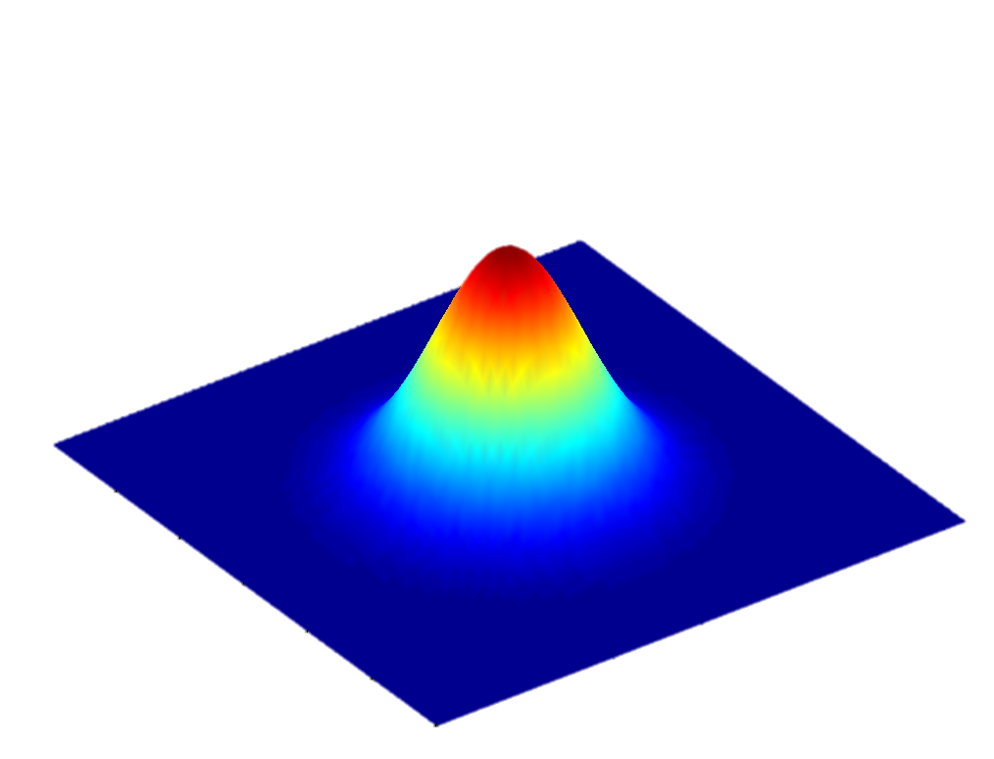
Multivariate Gaussian — The 2D Bell Curve
$p(x) = N(x; μ, Σ)$where $μ = [μ_{x}, μ_{y}]ᵀ$and Σ = 2×2 covariance matrix
A 2D Gaussian is a "hill" in x-y space. The peak is at μ. The shape of the hill is determined by Σ.
3σ
2σ
Contour lines = iso-probability curves
Inner ellipse (1σ): 68% chance robot is here
Middle ellipse (2σ): 95% chance
Outer ellipse (3σ): 99.7% chance
Ellipse SHAPE = covariance matrix Σ
Σ diagonal → circular (independent x,y)
Σ off-diagonal → tilted (correlated x,y)
1σ
μ
13

Slide 14
BLOCK C
Linear Algebra for Robotics
The matrix tools behind covariance and Kalman Filter

Slide 15


Matrix Multiplication — Quick Visual Recap
A matrix transforms one vector into another.
In robotics, matrices appear everywhere:
A = state transition matrix (how state evolves)
H = observation matrix (what sensor measures)
P = covariance matrix (uncertainty shape)
K = Kalman gain (how much to trust sensor)
$$y = A · x$$
$$\left[\begin{matrix}y^{1} \\ y^{2}\end{matrix}\right]= \left[\begin{aligned}\begin{matrix}a_{11} & a_{12}\end{matrix} \\ \begin{matrix}a_{21} & a_{22}\end{matrix}\end{aligned}\right]\left[\begin{matrix}x^{1} \\ x^{2}\end{matrix}\right]$$
Each output is dot product of A's row with x.
$$y₁ = a₁₁·x₁ + a₁₂·x₂$$
If you can multiply matrices and vectors, you can implement the Kalman Filter.
15

Slide 16
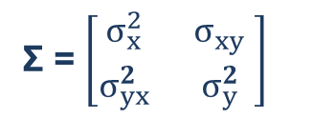
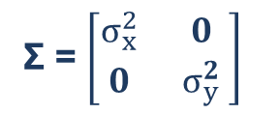
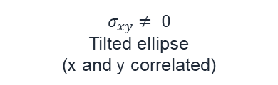
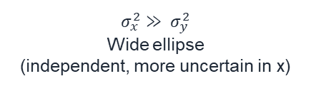
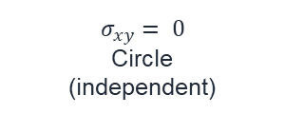
Covariance Matrix — What Each Element Means
Σ = $\left[\begin{matrix}σ_{x}^{2} & σ_{xy}^{2} \\ σ_{yx}^{2} & σ_{y}^{2} \end{matrix}\right]$ = variances (how spread in x, y)
$σ_{xy}$= covariance (are x,y linked?)
Diagonal = individual uncertainties. Off-diagonal = correlation between variables.
$$σ_{xy}= 0$$
Circle
(independent)
$$σ_{x}^{2}≫ σ_{y}^{2}$$
Wide ellipse
(independent, more uncertain in x)
$$σ_{xy}≠ 0$$
Tilted ellipse
(x and y correlated)
Σ = $\left[\begin{matrix}σ_{x}^{2} & σ_{xy} \\ σ_{yx}^{2} & σ_{y}^{2} \end{matrix}\right]$
Σ = $\left[\begin{matrix}σ_{x}^{2} & 0 \\ 0 & σ_{y}^{2} \end{matrix}\right]$
16

Slide 17
Eigenvalues & Eigenvectors — Ellipse Shape
The covariance matrix Σ has eigenvalues and eigenvectors. These define the ellipse:
Eigenvectors = ellipse DIRECTIONS
Eigenvalues = ellipse LENGTHS
The axes of the uncertainty ellipse
Point along the directions of max/min uncertainty
For a 2D covariance: 2 eigenvectors
They are always perpendicular (orthogonal)
λ₁ = length of major axis (biggest uncertainty)
λ₂ = length of minor axis (smallest uncertainty)
Large eigenvalue = lots of uncertainty in that direction
Both must be > 0 (positive-definite)
Positive-definite: All eigenvalues > 0. Means the ellipse is a REAL shape (not collapsed). If your covariance matrix has a zero or negative eigenvalue, your filter is BROKEN.
You don't need to COMPUTE eigenvalues — just understand what they MEAN. The Kalman Filter handles the math automatically.
17

Slide 18
Matrix Inverse & Transpose — Tools for KF
Matrix Inverse: A⁻¹
Matrix Transpose: Aᵀ
A⁻¹·A = I
Like dividing: if y = Ax, then x = A⁻¹y
Only exists for square, non-singular matrices
In KF: used to compute the Kalman gain
Flip rows ↔ columns
Key property: (AB)ᵀ = BᵀAᵀ (reverse order!)
For symmetric matrices: Σ = Σᵀ
Covariance matrices are ALWAYS symmetric
Quadratic form: xᵀ Σ⁻¹ x = Mahalanobis distance²
This is the Mahalanobis distance from MOD-04! The "distance" that accounts for uncertainty shape.
Small value → point is close to the center of the ellipse. Large value → point is far away (unlikely).
These operations are the building blocks of every KF equation. You'll see Aᵀ, A⁻¹, and xᵀΣ⁻¹x in Blocks F and G.
18

Slide 19
BLOCK D
Probabilistic Motion Model
Wrapping MOD-03/04 kinematics in probability

Slide 20
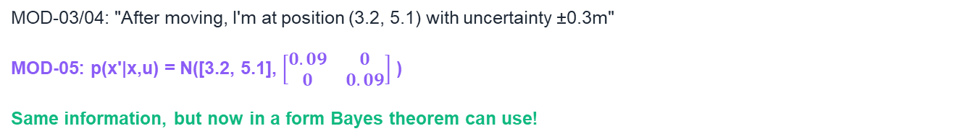
From MOD-03/04 to Probability: p(x' | x, u)
You already know the pieces. Now we wrap them in probability:
MOD-03: x' = f(x, u)
MOD-04: x' = f(x, u) + noise
MOD-05: p(x' | x, u) = N(x’; f(x,u), Q)
Kinematics: given state x and control u,
new state is f(x,u).
Noise: Gaussian w ~ N(0, Q)
The probability of ending up at x',
given you were at x and applied control u,
is a Gaussian centered on f(x,u) with spread Q.
This is the same thing, just written differently:
MOD-03/04: "After moving, I'm at position (3.2, 5.1) with uncertainty ±0.3m"
MOD-05: p(x'|x,u) = N([3.2, 5.1], $\left[\begin{matrix}0.09 & 0 \\ 0 & 0.09\end{matrix}\right]$ )
Same information, but now in a form Bayes theorem can use!
20

Slide 21
Prediction = Belief Propagation Through Motion
bel⁻(x') = ∫ p(x' | x, u) × bel(x) dx
For each possible current position x: multiply "where I might be” by “where I'd end up" → integrate → new belief.
The predicted belief bel⁻(x') is WIDER
than the previous belief bel(x).
Prediction ALWAYS increases uncertainty.
Motion adds noise Q → ellipse grows.
For Linear-Gaussian:
bel⁻(x') = N(A·μ + B·u, A·Σ·Aᵀ + Q)
This is KF Equations 1 & 2 (Block G)!
bel(x)
(before)
→ motion →
bel⁻(x')
(after predict)
21

Slide 22
BLOCK E
Probabilistic Observation Model
Connecting MOD-04 sensor models to Bayes theorem

Slide 23
From z = h(x) + v to p(z | x)
MOD-04 taught sensor models as equations. Now we rewrite them as probabilities:
MOD-04:
z = h(x) + v
v ~ N(0, R)
MOD-05:
p(z | x) = N(z; h(x), R)
The probability of observing z,
given the robot is at state x,
is Gaussian centered on h(x) with spread R.
The measurement z equals the true value h(x)
plus Gaussian noise v with covariance R.
Same information, different notation. But now p(z|x) can plug into Bayes theorem!
This p(z|x) is the LIKELIHOOD FUNCTION — for each possible position x, how well does the sensor reading z match?
Likelihood p(z=2.3 | x) for different robot positions x:
Peak at x where h(x) = 2.3 "most likely position"
23

Slide 24
The Update Step: Prior × Likelihood → Posterior
This is the CORE of how sensor readings improve our estimate:
Prior bel⁻(x)
(wide = uncertain)
×
Likelihood p(z|x)
(from sensor)
=
Posterior bel(x)
(narrower = more certain!)
The posterior is ALWAYS narrower than the prior.
Every measurement REDUCES uncertainty.
The posterior sits BETWEEN the prior and the likelihood:
closer to whichever has SMALLER uncertainty.
For Linear-Gaussian: this gives KF Equations 3, 4, 5 (Block G)!
24

Slide 25
BLOCK F
The Bayes Filter
The general algorithm that ALL state estimation is based on

Slide 26
The Recursive Bayes Filter Algorithm
For each time step k:
1. PREDICT:
bel⁻(x') = ∫ p(x'|x,u) · bel(x) dx
2. UPDATE:
bel(x') = η · p(z|x') · bel⁻(x')
Use motion model to predict.
Uncertainty GROWS.
Use sensor model to correct.
Uncertainty SHRINKS.
This is THE fundamental algorithm of probabilistic robotics.
It repeats: predict → update → predict → update → ...
Motion makes you MORE uncertain (predict step grows the ellipse).
Sensors make you LESS uncertain (update step shrinks the ellipse).
Together: uncertainty stays bounded — not perfect, but not lost.
26

Slide 27
1D Example: Robot on a Line (Step 1 — Start)
Robot is on a 10-meter line.
One landmark at position 7m.
Landmark
0
1
2
3
4
5
6
7
8
9
10
Initial belief: very uncertain — robot could be almost anywhere
State: x = position on the line (1D)
Control: u = "move 0.5m right" (but noisy!)
Sensor: measures distance to landmark (noisy, σ = 0.5m)
Let's step through predict → update → predict → update...
27

Slide 28
1D Example: Predict → Update → Predict → Update
Step 1: PREDICT (move right 0.5m)
Step 2: UPDATE (sensor reads d=1.8m to landmark)
Belief shifts right by 0.5m
Uncertainty GROWS (motion noise Q)
μ: 5.0 → 5.5, σ: 2.0 → 2.1
Landmark 7m, reads 1.8m → robot ≈ 5.2m
Uncertainty SHRINKS (sensor corrects)
μ: 5.5 → 5.25, σ: 2.1 → 0.45
Step 3: PREDICT again (move 0.5m)
Step 4: UPDATE again (reads d=1.1m)
μ: 5.25 → 5.75, σ: 0.45 → 0.48
Slightly wider but still tight!
μ: 5.75 → 5.88, σ: 0.48 → 0.33
Even tighter! Converging on truth.
Each predict grows uncertainty, each update shrinks it. Over time, belief converges to the true position!
28

Slide 29
Why the General Bayes Filter Is Intractable
The integral $∫ p(x′|x,u) × bel(x) dx$has NO closed-form solution in general.
We need APPROXIMATIONS. Three families:
Gaussian Approximation
Histogram Approximation
Sample Approximation
Assume belief is ALWAYS Gaussian
→ Kalman Filter
Integral becomes matrix algebra!
Exact for linear + Gaussian
THIS MODULE (Block G)
Divide space into grid cells
Compute probability per cell
Works for any distribution shape!
But: exponential in dimensions
MOD-06 (Histogram Filter)
Represent belief with N particles
Each particle = one possible position
Works for any shape!
Scales better than histograms
MOD-06 (Particle Filter / MCL)
The Gaussian assumption is the KEY that makes Kalman Filter possible — and it's remarkably powerful for most robotics applications.
29

Slide 30
BLOCK G
The Kalman Filter
The exact solution to Bayes filtering under linear-Gaussian assumptions

Slide 31
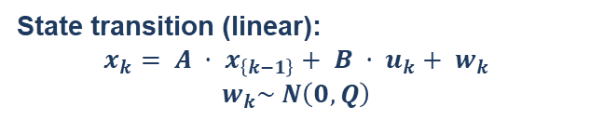
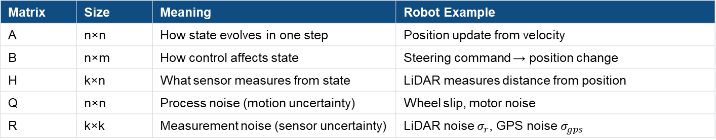
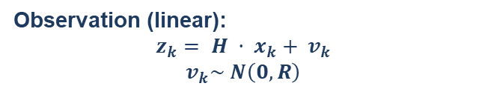
Linear-Gaussian Assumptions
State transition (linear):
$$x_{k}= A · x_{\left\{k−1\right\}}+ B · u_{k}+ w_{k}$$
$$w_{k}\sim N\left(0, Q\right)$$
Observation (linear):
$$z_{k}= H · x_{k}+ v_{k}$$
$$v_{k}\sim N\left(0, R\right)$$
A = state transition matrix
B = control input matrix
Q = process noise covariance
H = observation matrix
R = measurement noise covariance
v = sensor noise
Under these assumptions, the Bayes filter has an EXACT closed-form solution: the Kalman Filter.
Matrix | Size | Meaning | Robot Example
A | n×n | How state evolves in one step | Position update from velocity
B | n×m | How control affects state | Steering command → position change
H | k×n | What sensor measures from state | LiDAR measures distance from position
Q | n×n | Process noise (motion uncertainty) | Wheel slip, motor noise
R | k×k | Measurement noise (sensor uncertainty) | LiDAR noise $σ_{r}$, GPS noise $σ_{gps}$
31

Slide 32

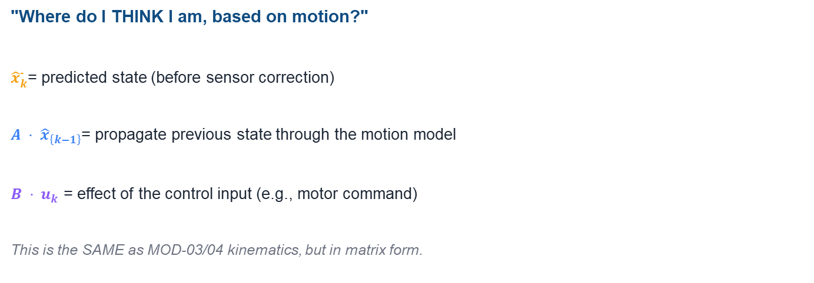
KF Equation 1: State Prediction
$${\hat{x}}_{k}^{−}= A · {\hat{x}}_{\left\{k−1\right\}}+ B · u_{k}$$
"Where do I THINK I am, based on motion?"
${\hat{x}}_{k}^{−}$= predicted state (before sensor correction)
$A · {\hat{x}}_{\left\{k−1\right\}}$= propagate previous state through the motion model
$B · u_{k}$ = effect of the control input (e.g., motor command)
This is the SAME as MOD-03/04 kinematics, but in matrix form.
32

Slide 33

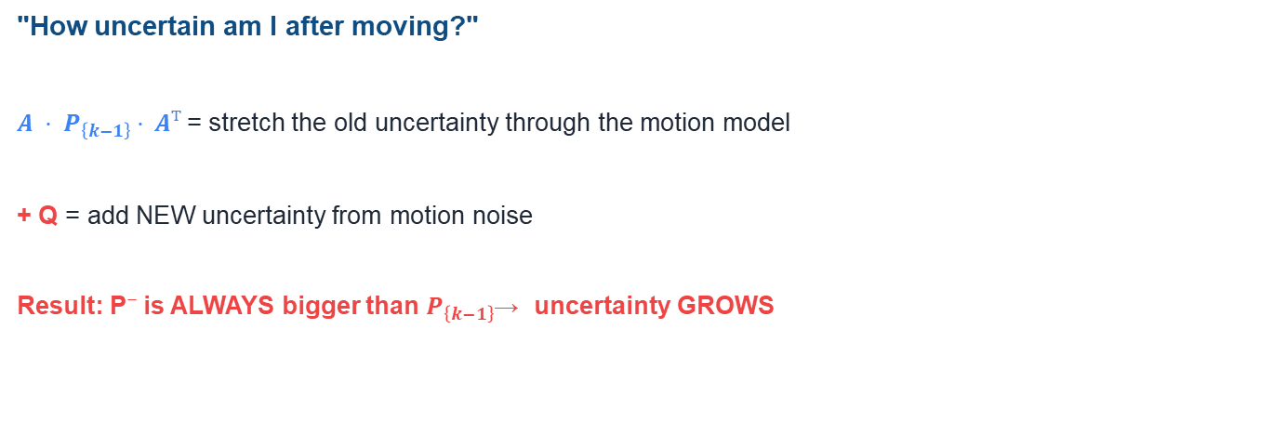
KF Equation 2: Covariance Prediction
$$P_{k}^{−}= A · P_{\left\{k−1\right\}}· Aᵀ + Q$$
"How uncertain am I after moving?"
$A · P_{\left\{k−1\right\}}· Aᵀ$= stretch the old uncertainty through the motion model
+ Q = add NEW uncertainty from motion noise
Result: P⁻ is ALWAYS bigger than $P_{\left\{k−1\right\}}$→ uncertainty GROWS
33

Slide 34
KF Equation 3: The Kalman Gain (Most Important!)
$$K_{k}= P_{k}^{−}· Hᵀ · {\left(H · P_{k}^{−}· Hᵀ + R\right)}^{−1}$$
"How much should I trust the measurement vs. my prediction?"
Trust PREDICTION more
Trust SENSOR more
When R is small (sensor is precise):
When P⁻ is small (prediction is confident):
K → large (closer to 1)
Trust the sensor more
Correction is large
Sensor pulls estimate toward its reading
K → small (closer to 0)
Trust the prediction more
Correction is small
Ignore the sensor, keep prediction
34

Slide 35
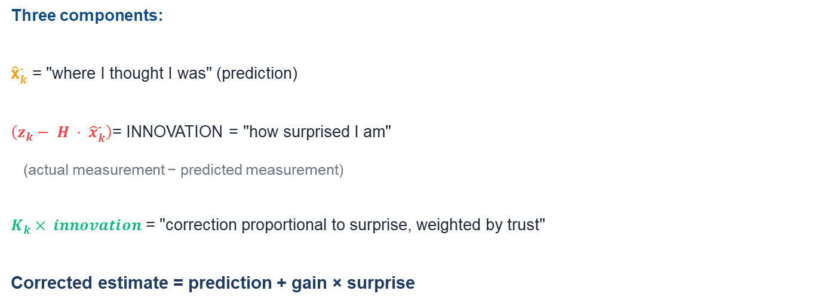
KF Equation 4: State Update (Correction)
$${\hat{x}}_{k}= {\hat{x}}_{k}^{−}+ K_{k}· \left(z_{k}− H · {\hat{x}}_{k}^{−}\right)$$
Three components:
${\hat{\text{x}}}_{k}^{−}$ = "where I thought I was" (prediction)
$\left(z_{k}− H · {\hat{x}}_{k}^{−}\right)$= INNOVATION = "how surprised I am"
(actual measurement − predicted measurement)
$K_{k}× innovation$= "correction proportional to surprise, weighted by trust"
Corrected estimate = prediction + gain × surprise
35

Slide 36

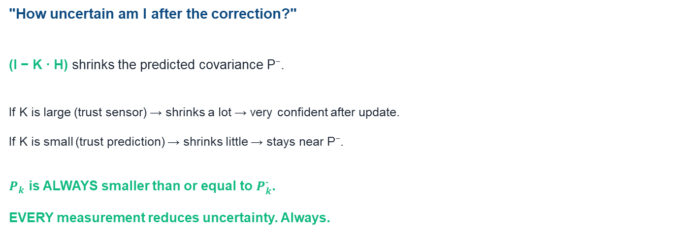
KF Equation 5: Covariance Update
$$P_{k}= \left(I − K_{k}· H\right)· P_{k}^{−}$$
"How uncertain am I after the correction?"
(I − K · H) shrinks the predicted covariance P⁻.
If K is large (trust sensor) → shrinks a lot → very confident after update.
If K is small (trust prediction) → shrinks little → stays near P⁻.
$P_{k}$ is ALWAYS smaller than or equal to $P_{k}^{−}$.
EVERY measurement reduces uncertainty. Always.
36

Slide 37
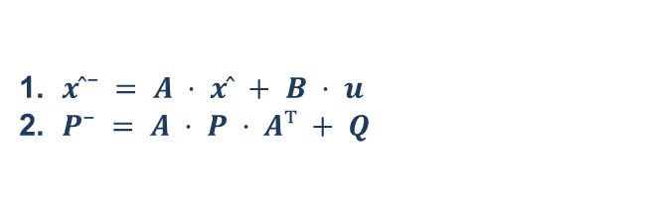
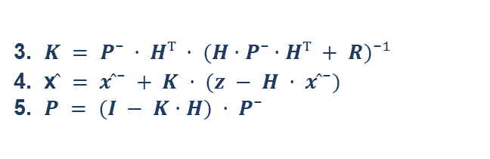
The Complete Kalman Filter — All 5 Equations
PREDICT
UPDATE
1. $x ̂⁻ = A · x ̂ + B · u$
2. $P⁻ = A · P · Aᵀ + Q$
3. $K = P⁻ · Hᵀ · (H·P⁻·Hᵀ + R)⁻¹$
4. x$̂ = x ̂⁻ + K · (z − H · x ̂⁻)$
5. $P = (I − K·H) · P⁻$
These 5 equations are the ENTIRE Kalman Filter. Repeat predict → update at each timestep.
37

Slide 38
Tuning Q and R — What Happens When You Get It Wrong?
Q too large
Q just right
R too large
R too small
"I don't trust my motion"
Prediction ignored
Estimate jumps with each sensor
reading → JERKY motion
Filter is too REACTIVE
Smooth predictions
Sensor corrections are gradual
Estimate follows truth
smoothly and accurately
THE GOAL
"I don't trust my sensors"
Corrections are tiny
Estimate follows prediction
→ DRIFTS like pure odometry
Filter is too SLUGGISH
"I fully trust my sensors"
Corrections are huge
Estimate copies raw sensor data
→ NOISY estimate
Filter is too TRUSTING
The art of Kalman filtering: set Q and R to MATCH the actual noise levels of your robot and sensors (from MOD-04!).
MOD-04's sensor datasheets give you the numbers for R. Motion experiments give you Q.
38

Slide 39
KF Assumptions & Limitations
When KF works perfectly vs. when it breaks:
✅ Linear motion model (x' = Ax + Bu + w) — works if motion is approximately linear over one timestep
✅ Linear observation model (z = Hx + v) — works for range sensors measuring distance directly
✅ Gaussian noise — works for most well-calibrated sensors
❌ Nonlinear models (e.g., differential drive kinematics: sin/cos) → need EKF (MOD-06)
❌ Multi-modal beliefs ("I might be in room A OR room B") → need particle filter (MOD-06)
What comes next in MOD-06:
EKF: linearize nonlinear models using Jacobians → apply KF to real robots
Particle Filter (MCL): handle multi-modal beliefs using random samples
Histogram Filter: discretize space into grid cells for exact (but expensive) solutions
39

Slide 40
BLOCK H
The Localization Problem
Defining what MOD-06 will solve

Slide 41
Three Flavors of Localization
Position Tracking
Global Localization
Kidnapped Robot
"I roughly know where I started"
Track how I move over time
Single Gaussian belief works!
→ KF / EKF can handle this
Example: MediBot starts at the
pharmacy — track from there.
"I have NO idea where I am"
Must figure it out from scratch
Belief is multi-modal (many peaks!)
→ KF CANNOT handle this
→ Need particle filter or histogram
Example: robot powered on
in unknown location.
"I THOUGHT I knew, but I'm wrong"
Was tracking correctly, then teleported
Must detect failure AND re-localize
→ Hardest problem
→ Need MCL with random particles
Example: someone picks up
and moves the robot.
MOD-05 gave you the tools. MOD-06 applies them to solve each flavor of localization.
41

Slide 42
Bridge to MOD-06: What You Now Have vs. What Comes Next
✅ MOD-05 gave you (TOOLS):
➡ MOD-06 will give you (ALGORITHMS):
Probability: P(A|B), Bayes theorem
Linear algebra: covariance, eigenvalues
Motion model as p(x'|x,u)
Sensor model as p(z|x)
Bayes filter: predict-update algorithm
Kalman Filter: 5 equations, tuning Q/R
Localization problem: 3 types defined
EKF: linearize with Jacobians → apply to
real nonlinear robot models
Histogram Filter: discrete grid approach
Particle Filter / MCL: sample-based
approach for global localization
AMCL: adaptive MCL (used in ROS Nav2)
Compare: which algorithm for which problem?
MOD-05 = mathematical foundations. MOD-06 = practical algorithms. Together = complete localization toolkit.
42

Slide 43
Key Takeaways
1
Think probabilistically
2
Bayes is the key
3
Predict grows uncertainty
State = distribution, not point. μ ± σ, not just μ.
posterior = likelihood × prior / evidence
Motion adds noise Q → ellipse expands
4
Update shrinks uncertainty
5
KF = 5 equations
6
Tuning matters
Sensor corrects → ellipse contracts
Linear + Gaussian → exact solution
Q, R must match real noise. Wrong = bad filter.
43

Slide 44
References
1. Thrun, Burgard & Fox (2005). Probabilistic Robotics. MIT Press. Ch. 2–3, 7.
2. Siegwart, Nourbakhsh & Scaramuzza (2011). Intro Autonomous Mobile Robots. Ch. 5.
44

Slide 45
?

