Slide 1
MOD-001 Robotics Trends & Industry Landscape
MOBILE ROBOTS
Dr. Ahmad Abbadi

Slide 2
Introduction

Slide 3
Robot’s Domains
What is MOBILE ROBOT

Slide 4
Robot’s Domains
What is MOBILE ROBOT
Humanoid
Autonomous vehicles
Assistant robots
Agricultural Robots
Consumer robots
Warehouse & Logistics

Slide 5
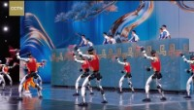
Robot’s Domains - Humanoid
28 Best Humanoid Robots [2026 Ranked] | Robozaps https://youtu.be/eQpyvR-B7hc?si=Ra_4N8UgPYgEdjnB

Slide 6
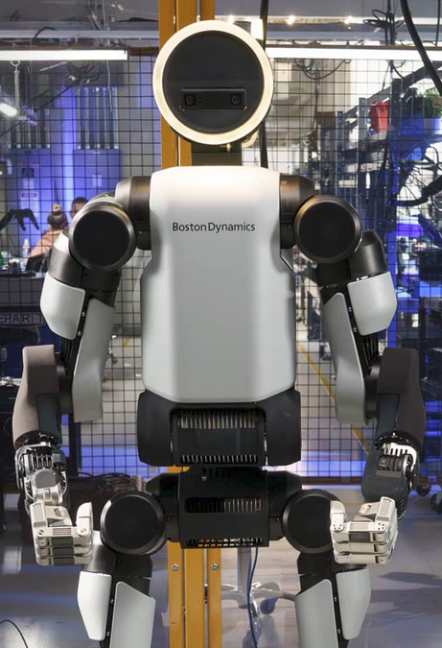
Problem Solved:
Labor shortage in manufacturing
replacing dangerous,
repetitive physical tasks (parts sorting, assembly) that humans find hazardous or tedious.

Slide 7
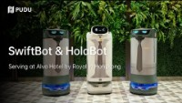
Robot’s Domains –Service Robots
https://www.youtube.com/watch?v=o2fBnMtlE7Y

Slide 8
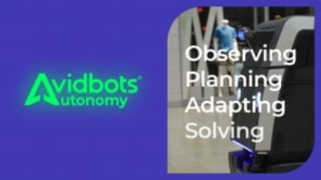
Robot’s Domains – Cleaning Robots
Tech Spec

Slide 9
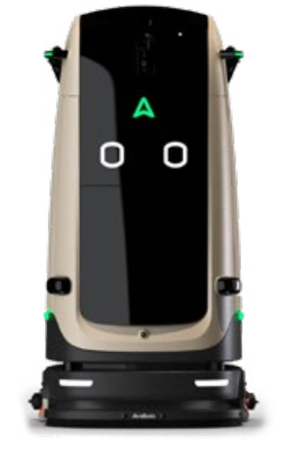
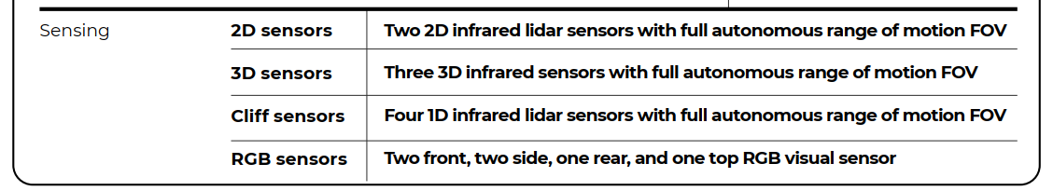
Robot’s Domains – Cleaning Robots
Tech Spec

Slide 10
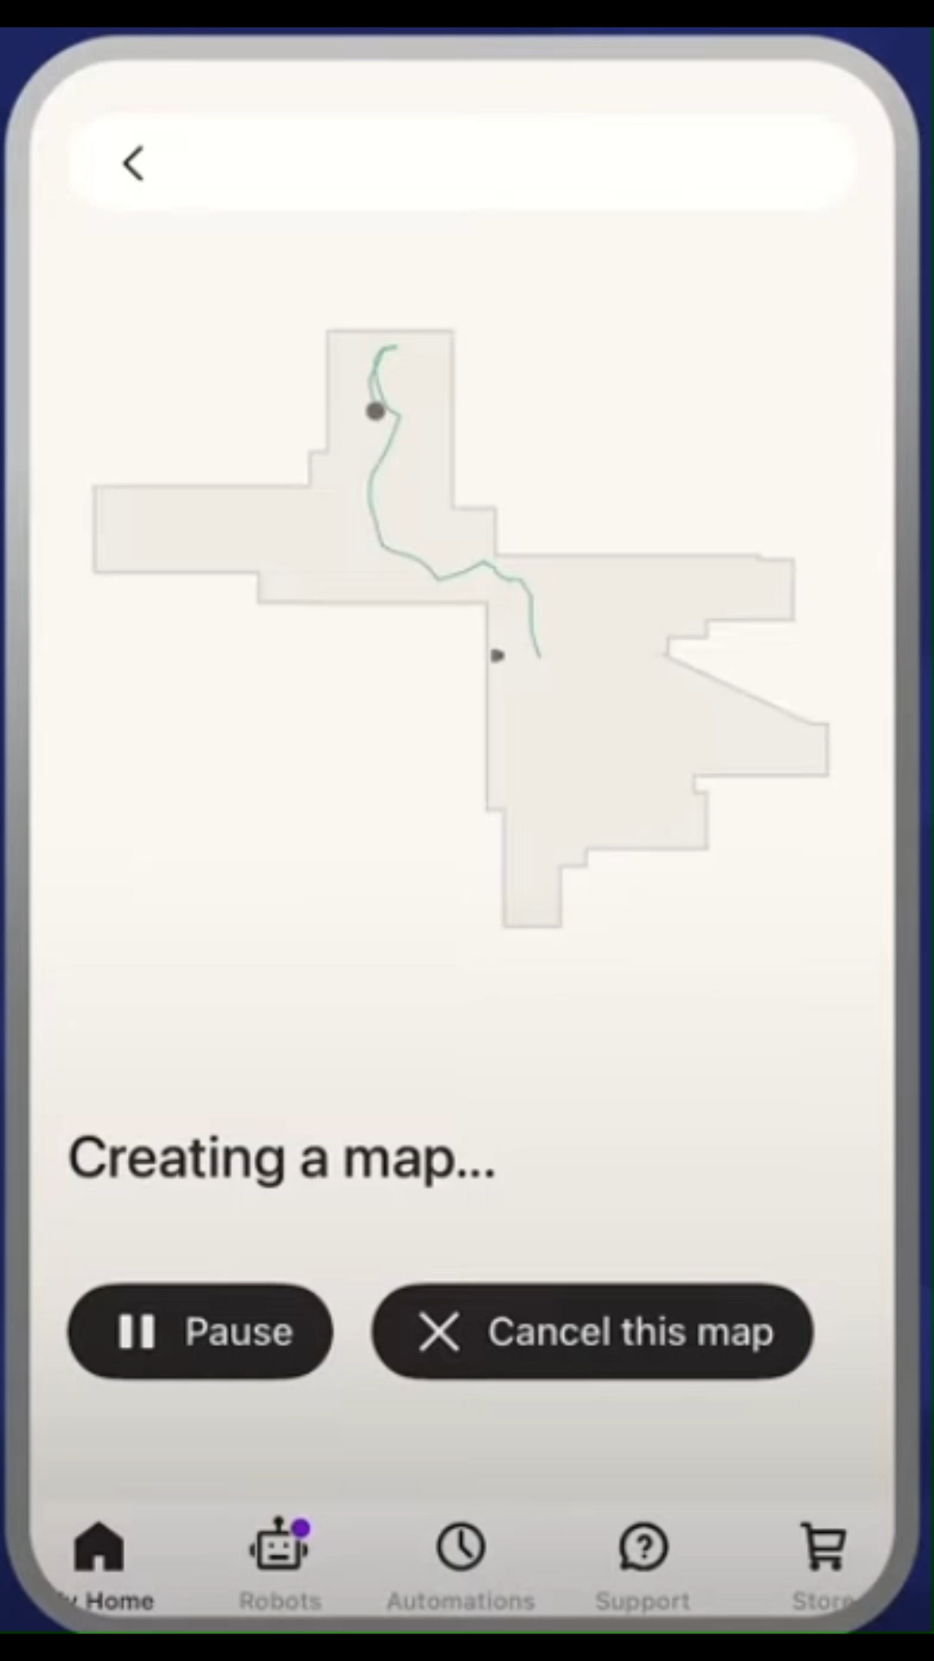
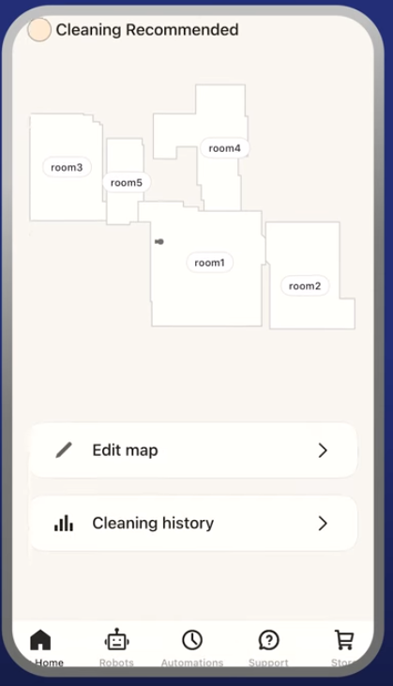
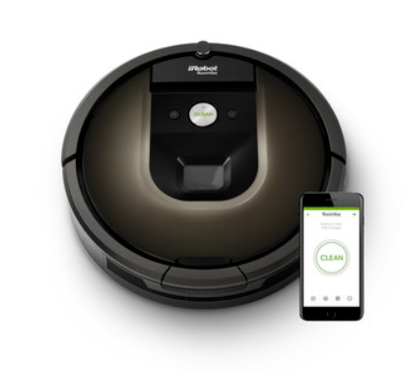
Robot’s Domains – Consumer Robot
Problem Solved: Fully autonomous home floor cleaning without human intervention — recognizing and avoiding obstacles (pet waste, cords, socks), self-emptying, and adapting cleaning priority room-by-room.
SOURCE iRobot Corp

Slide 11
Robot’s Domains – Consumer Robot
Stack Layer | Autonomy Component
Sensing | Front-facing RGB camera + cliff sensors + IR proximity sensors + wheel encoders
Perception | PrecisionVision Navigation — real-time object classification
State Estimation | Wheel odometry + IMU for dead-reckoning
Localization | Imprint® Smart Mapping — visual SLAM, room-level
Planning | Dirt Detective reactive coverage planner — prioritizes dirtiest rooms, adjusts suction
Control | Differential drive actuator + 3-stage cleaning motor interface
SOURCE iRobot Corp

Slide 12
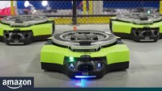
Robot’s Domains –Warehouse & Logistics — Amazon Proteus AMR
Problem Solved: 24/7 autonomous goods movement in fulfillment centers, eliminating the need for workers to manually push heavy GoCarts, while safely operating alongside humans
Stack Layer | Autonomy Component
Sensing | High-precision LiDAR + RGB cameras
Perception | Person detection + GoCart recognition
State Estimation | Wheel encoder odometry + IMU
Localization | Feature-based LiDAR SLAM (cm-level) + floor fiducial cross-reference
Planning | Fleet-coordinated path
Control | Differential drive + hydraulic lift mechanism
https://www.youtube.com/watch?v=AmmEbYkYfHY

Slide 13
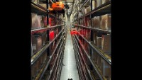
BionicHIVE 2023 - https://www.youtube.com/watch?v=ePkReRlyiRk

Slide 14

Problem Solved: Agricultural labor shortage and precision farming at scale — enabling 24/7 driverless tillage, planting, and field work with inch-level accuracy.
Stack Layer | Autonomy Component
Sensing | 6× stereo camera pairs (360° coverage) + GPS + IMU; LiDAR
Perception | Deep neural network pixel classifier, obstacle detection at 3 frames/sec (processed by 2× NVIDIA GPUs)
State Estimation | RTK-GNSS + fusion
Localization | RTK GPS — <2.5 cm accuracy + geofence boundary enforcement
Planning | AB-Line / AutoPath adaptive field coverage planner + remote monitoring via Operations Center Mobile
Control | Hydraulic auto-steer
https://www.youtube.com/watch?v=0tyuk7cWiOQ

Slide 15
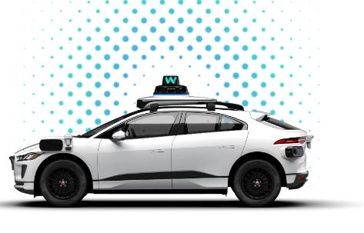
Robot’s Domains –Autonomous Vehicle (Car like robot)
Self-Driving Car Technology for a Reliable Ride - Waymo Driver
https://www.youtube.com/watch?v=B8R148hFxPw

Slide 16
Robot’s Domains –Autonomous Vehicle (Car like robot)
Stack Layer | Waymo Component
Sensing | Camera / LiDAR / Radar
Perception | Sensor Fusion Encoder
State Estimation | GPS/IMU + HD Map
Localization | HD Map localization (cm)
Planning | Driving VLM (ML-based)
Control | Actuator interfaces
Self-Driving Car Technology for a Reliable Ride - Waymo Driver

Slide 17
Robot’s Domains
What is MOBILE ROBOT
Humanoid
Autonomous vehicles
Healthcare and assistant robots
Inspection & Security
Ships and Airplanes
Consumer robots
Agricultural Robots
Mining and tunneling
Warehouse & Logistics
Trains
Last-Mile Delivery
Tracks & Public transport
Space
Underwater
Drones and flying robots
… and many other

Slide 18
Pattern Recognition
What Do All those Robots Share?

Slide 19
Pattern Recognition: What Do All those Robots Share?
WHAT is around me?
→ Sensing & Perception
WHERE am I?
→ State Estimation & Localization
WHAT does the world look like?
→ Mapping
WHERE should I go, and HOW do I get there?
→ Planning & Navigation & control

Slide 20
Autonomy stack
Position on the map
Localization and mapping
Planning
Environment model & surrounding map
Trajectory
Autonomy Stack
Perception
Motion control
Sensing raw data
Real World
Movement & interactions

Slide 21
Sensing
SENSING: Converting physical phenomena (light, distance, acceleration) into digital signals
→ Camera: 2D pixel array (RGB, depth, stereo) — 30–90 Hz, low cost
→ LiDAR: Time-of-flight laser → 3D point cloud — 10–30 Hz, high accuracy
→ Radar: Doppler velocity + range, all-weather capability — penetrates fog/rain
→ IMU: Acceleration + angular velocity (6-DOF inertial) — 100–1000 Hz
→ GPS: Global position (meter-level)
Proprioceptive (internal state): Encoders, IMU, battery voltage
Exteroceptive (external world): LiDAR, cameras (RGB, depth, stereo), ultrasonic, GPS, force/torque
Notes:
RTK variant (centimeter-level)
Real-Time Kinematic

Slide 22
Perception
PERCEPTION: Extracting meaningful information from raw sensor data
→ Object Detection: Identify and locate objects in sensor data
→ Scene Classification: Understand environment type and context
→ Sensor Fusion: Combine multiple sensor modalities for robust understanding
perception pipeline:
raw data → preprocessing → feature extraction → classification → output
Notes:
RTK variant (centimeter-level)
Real-Time Kinematic

Slide 23
State Estimation & Localization
STATE ESTIMATION: Combining motion model + sensor data to track robot pose over time
→ Output: Robot state vector [x, y, θ] with uncertainty covariance P
→ Kalman Filter (KF): Optimal estimator for linear Gaussian systems
→ Extended Kalman Filter (EKF): Linearized for nonlinear systems — used in most real robots
LOCALIZATION: Matching state estimate to a known map
→ Particle Filter / Monte Carlo Localization (MCL): Probabilistic set of pose hypotheses
→ AMCL: Adaptive MCL — standard in ROS navigation stack
→ Challenge: Kidnapped robot problem — what if the robot is moved without warning?
Notes:
RTK variant (centimeter-level)
Real-Time Kinematic

Slide 24
Mapping, Planning & Control
MAPPING: Representing the environment in computational form
→ Occupancy Grid: 2D/3D grid, each cell = occupied / free / unknown (most common)
→ SLAM: Simultaneous Localization And Mapping — build map + localize simultaneously
→ Topological Maps: Graph of nodes (places) + edges (paths) — memory-efficient
PLANNING: Finding a path from current pose to goal
→ A* Algorithm: Heuristic search on grid — optimal, complete
→ RRT / RRT*: Sampling-based planner for high-DOF, nonconvex spaces
→ Dynamic Window Approach (DWA): Real-time local planner in ROS
CONTROL: Executing motion commands on actuators
→ PID Controller: Simple, robust, widely used for velocity/heading control
→ Model Predictive Control (MPC): Predictive horizon, constraint handling

Slide 25
Course Roadmap
MOD-001
MOD-002 / MOD-003
MOD-002
MOD-004
MOD-005
Industry Landscape
Locomotion Kinematics
Holonomy
Degrees of Freedom
ROS2 & Dev Environment
Sensors & Modeling
Probabilistic Robots
Bayes’ Rule
Kalman filter
Overview
Introduction and basics
Framework
Sensing
State Est.
MOD-006
MOD-007
MOD-008
MOD-009
Localization
Markov Localization
Particle Filters
Perception
introduction
SLAM
Path Planning
Localization
Perception
Localization and Mapping
Planning

Slide 26
Autonomy Levels
← More Human Control | More Robot Autonomy →
Teleoperated
(Remote Control)
Supervised
Autonomy
Supervised
Autonomy
Conditional
Autonomy
Full
Autonomy
Human decides + executes.
Robot = dumb actuator.
Human supervises.
Robot handles tasks.
Robot autonomous.
Human fallback ready.
Robot decides + executes.
No human needed.
REAL-WORLD EXAMPLES
Unmanned Ground Vehicle
(operator-driven)
Tesla Autopilot
(driver monitor)
Waymo (geo-fenced)
SAE Level 4
Vacuum cleaner Robots
Standard: IEEE 1872 — Ontologies for Robotics and Automation (ORA) | SAE J3016 for Automated Driving levels

Slide 27
Career Roles in the Robotics Industry
Robotics Software Engineer
Motion Planning Engineer
Skills: ROS, C++/Python, perception & planning
Skills: Path planning, trajectory optimization, real-time
Companies: Waymo, Boston Dynamics, Cruise
Companies: Nuro, Argo AI, NVIDIA
Perception Engineer
Controls Engineer
Skills: Computer vision, LiDAR processing, sensor fusion
Companies: Waymo, Motional, Aurora
Skills: Low-level robot control, actuator interfaces, PID/MPC
Companies: ABB, FANUC, Amazon Robotics
Localization & Mapping Engineer
Skills: SLAM, EKF, factor graphs, optimization
…..
Companies: Apple Maps, HERE, Zoox

Slide 28
Learning Objectives
① Robot’s Domains
② The autonomy stack
③ Mapping systems to stack
④ Career roles + roadmap

Slide 29
?

Slide 30
Robot’s Domains – Underwater Robot
Problem Solved: Inspection of submerged infrastructure (pipelines, ship hulls, dams, fish farms) without exposing human divers to hazardous, zero-visibility conditions.
Stack Layer | Autonomy Component
Sensing | HD stereo camera + multibeam imaging sonar + Doppler Velocity Log + depth/pressure sensor + IMU + magnetometer
Perception | Acoustic object detection + visual close-range inspection pipeline
State Estimation | DVL velocity fusion + (attitude/heading) + depth sensor
Localization | Acoustic USBL/LBL positioning + sonar-DVL-IMU SLAM (ArduSub stack)
Planning | Waypoint + reactive mission
Control | 6-DOF thruster allocation matrix

