Slide 1
MOBILE ROBOTS
MOD-07
Robot Perception
By Dr. Ahmad Abbadi

Slide 2
BLOCK A
Why Perception?
From raw pixels and point clouds to understanding the world

Slide 3
The Gap: Sensor Data ≠ Understanding
SCENARIO: MediBot's camera captures 640×480 = 307,200 pixels at 30 Hz. Its LiDAR returns 1,800 range values per scan (some car LIDAR output 12M/s). But MediBot needs to answer: "Is that a wheelchair or a cart? Is the door open or closed? Can I pass?" Raw numbers don't answer these questions.
What sensors give (MOD-04):
What the robot NEEDS:
Camera: array of RGB pixel values
LiDAR: array of (range, angle) pairs
Depth camera: array of distance values
Radar: sparse (range, angle, velocity) tuples
"Wheelchair at (3.2, 1.5), moving left at 0.5 m/s"
"Door is OPEN — I can pass through"
"Corridor wall corner at (5.0, 2.1) — landmark"
"Free space ahead for 8 meters"
Perception = the process of transforming raw sensor data into actionable understanding.
Without perception: localization has no landmarks, planning has no obstacles, SLAM has no features.
3

Slide 4
What Perception Must Deliver (Downstream Consumers)
→ MOD-06 Localization
→ MOD-08 SLAM
→ MOD-09 Planning
Detected landmarks (corners, lines)
Feature descriptors for matching
Landmark identity (which corner?)
Visual odometry estimates
Visual features for loop closure
Point cloud segments for registration
Distinctive places for re-recognition
Consistent features across visits
Obstacle positions and sizes
Free space map
Semantic labels (door, wall, person)
Dynamic vs. static classification
CDIO for this module:
C
CONCEIVE: Understand what raw sensor data lacks and what perception must add (this block)
D
DESIGN: Design a perception pipeline: which algorithms for which stage (Blocks B–I)
I
IMPLEMENT: Map the pipeline to ROS 2 nodes and topics (Block B)
4

Slide 5
BLOCK B
Perception Pipeline
Architecture
The assembly line from raw data to understanding

Slide 6
The Abstract Pipeline: 5 Stages
SENSE
PREPROCESS
DETECT
CLASSIFY
INTERPRET
→
→
→
→
Raw data from
camera, LiDAR
Filter noise,
enhance features
Find objects,
edges, features
What IS it?
chair, door, wall
What does it
MEAN for the robot?
Every perception system follows this pattern, regardless of sensor or robot.
Each stage reduces data volume and increases information value:
Camera: 921,600 bytes/frame → 50 features → 5 objects → 2 decisions
This module teaches the algorithms inside each arrow.
6

Slide 7
How the Pipeline Maps to ROS 2
The abstract pipeline becomes a graph of ROS 2 nodes connected by topics:
Camera Pipeline:
camera_driver
/image_raw
→
image_proc
/image_rect
→
feature_node
/features
→
detector_node
/detections
LiDAR Pipeline:
lidar_driver
/scan
→
pcl_filter
/cloud_filtered
→
ground_remove
/cloud_objects
→
clustering
/obstacles
Key ROS 2 tools for perception:
cv_bridge: converts ROS Image messages ↔ OpenCV matrices (numpy arrays)
image_transport: efficient image streaming (compressed, theora)
sensor_msgs/PointCloud2: standard message for 3D point clouds
vision_msgs/Detection2D: standard message for object detections (bounding box + class + confidence)
7

Slide 8
Pipeline Design Decisions
Decision | Option A | Option B | Trade-off
Process on robot vs. offboard | On-robot (low latency) | Cloud (more compute) | Latency vs. capability
Frame rate | Full 30 Hz | Skip frames (10 Hz) | Accuracy vs. CPU load
Resolution | Full 640×480 | Downscaled 320×240 | Detail vs. speed
Feature type | Classical | Deep learning | Interpretable vs. powerful
2D vs. 3D | 2D image detection | 3D point cloud | Simple vs. complete
D
DESIGN: Every perception system involves these trade-offs. The 'best' choice depends on your robot's compute, speed, and task.
O
OPERATE: MediBot (hospital): low speed, safety-critical → full resolution, 15 Hz, classical + DL backup.
8

Slide 9
BLOCK C
Image Preprocessing
Clean the data before trying to understand it

Slide 10
Fluorescent Flicker Ruins Everything
SCENARIO: MediBot's camera captures images under fluorescent lights. Every other frame has a color shift. JPEG compression adds block artifacts. Feature detection on raw images finds hundreds of phantom features on compression boundaries. We must CLEAN the image first.
Why Preprocess?
Key Operations:
Reduce noise (sensor, compression, lighting)
Enhance features (sharpen edges, normalize contrast)
Standardize input (consistent brightness, color)
Remove irrelevant info (background, known patterns)
Bad preprocessing = bad features = bad everything
Color conversion: RGB → Grayscale, HSV, Lab
(many algorithms work on grayscale only)
Gaussian blur: smooth out noise (kernel 3×3, 5×5)
Median filter: remove salt-and-pepper noise
Histogram equalization: normalize contrast
Undistortion: correct lens distortion
SENSE
→
PREPROCESS
→
DETECT
→
CLASSIFY
→
INTERPRET
Raw data from
camera, LiDAR
Filter noise,
enhance features
Find objects,
edges, features
What IS it?
chair, door, wall
What does it
MEAN for the robot?
10

Slide 11
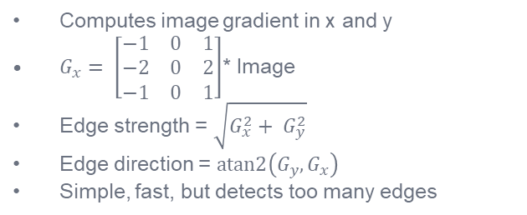
Edge Detection: Finding Boundaries
Edges = rapid changes in pixel intensity → boundaries of objects
Sobel Filter (gradient)
Canny Edge Detector (best practice)
Computes image gradient in x and y
$G_{x}= \left[\begin{matrix}−1 & 0 & 1 \\ −2 & 0 & 2 \\ −1 & 0 & 1\end{matrix}\right]$* Image
Edge strength = $\sqrt{G_{x}^{2}+ G_{y}^{2}}$
Edge direction = $atan2\left(G_{y}, G_{x}\right)$
Simple, fast, but detects too many edges
1. Gaussian blur (remove noise)
2. Sobel gradient (find edges)
3. Non-maximum suppression (thin edges)
4. Hysteresis thresholding (keep strong edges,
keep weak edges connected to strong ones)
Result: clean, 1-pixel-wide edges
Edges are the INPUT to many higher-level algorithms: line detection, corner detection, contour extraction.
In ROS: edges computed by OpenCV inside a perception node, NOT transmitted as a topic (too much data).
SENSE
→
PREPROCESS
→
DETECT
→
CLASSIFY
→
INTERPRET
Raw data from
camera, LiDAR
Filter noise,
enhance features
Find objects,
edges, features
What IS it?
chair, door, wall
What does it
MEAN for the robot?
11

Slide 12
BLOCK D
Feature Extraction
Finding distinctive, repeatable points in images and scans
https://rpg.ifi.uzh.ch/docs/teaching/2023/06_feature_detection_2.pdf

Slide 13
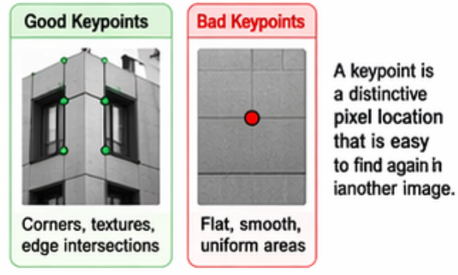
Re-Recognizing a Corridor Corner
SCENARIO: MediBot saw a corridor corner 10 seconds ago from 5m away. Now it sees it again from 3m away, at a different angle. How does it know it's the SAME corner? It needs to DESCRIBE the corner in a way that's the same regardless of viewpoint.
This requires two things:
1. Feature DETECTOR
2. Feature DESCRIPTOR
"WHERE in the image is something interesting?"
Finds distinctive points (corners, blobs)
Must be REPEATABLE: same point found again
Output: list of (x, y) pixel locations
"WHAT does this point look like?"
Compact summary of the patch around the point
Must be DISTINCTIVE: different points have different descriptors. Same point has similar descriptors.
Output: vector of numbers (32–128 values)
Detector = WHERE. Descriptor = WHAT. Together = you can find and re-recognize features.
SENSE
→
PREPROCESS
→
DETECT
→
CLASSIFY
→
INTERPRET
Raw data from
camera, LiDAR
Filter noise,
enhance features
Find objects,
edges, features
What IS it?
chair, door, wall
What does it
MEAN for the robot?
13

Slide 14
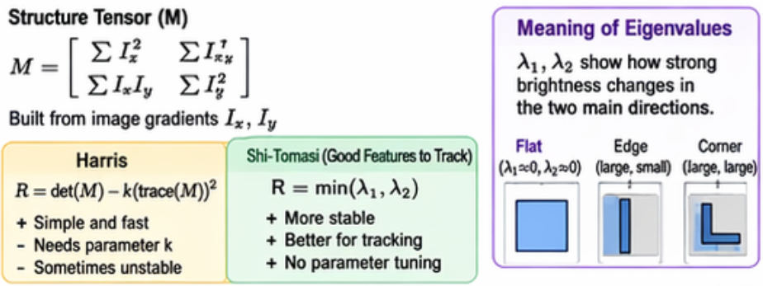
Corner Detection: Harris & Shi-Tomasi
A corner is where the image changes significantly in BOTH x and y directions.
Flat Region
Edge
Corner ✓
No change in any direction
Sliding a window → same everywhere
NOT a feature
Example: white wall
Change in ONE direction only
Sliding along edge → no change
Ambiguous — can't pinpoint location
Example: corridor wall line
Change in BOTH directions
Sliding window → changes everywhere
UNIQUE location — can pinpoint!
Example: door frame corner
Harris and Shi-Tomasi are classic corner detection algorithms used in computer vision to find “interest points” in an image (points where intensity changes strongly in two directions).
Harris detects corners; Shi-Tomasi is a refined version
that selects the best corners for tracking.
14

Slide 15
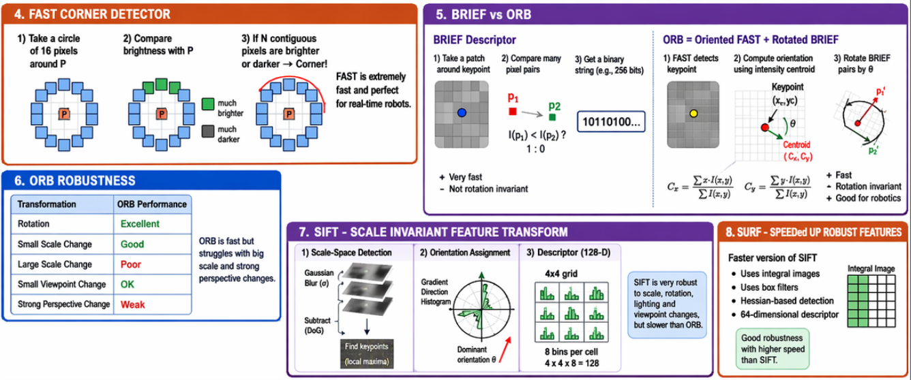
Feature Descriptors: ORB and BRIEF
15

Slide 16
Feature Descriptors: ORB and BRIEF
ORB (Oriented FAST and Rotated BRIEF)
SIFT (Scale-Invariant Feature Transform)
The go-to descriptor for real-time robotics
Detector: FAST corners (very fast!)
+ orientation from intensity centroid
Descriptor: rotated BRIEF (binary, 256 bits)
Matching: Hamming distance (XOR — super fast)
Free, open-source, no patents
Used in: ORB-SLAM, ROS feature matchers
Most robust descriptor (gold standard)
Scale-invariant: finds features at multiple sizes
Rotation-invariant: works from any angle
Descriptor: 128-float vector (gradient histogram)
Matching: L2 distance
Slower than ORB, more memory
Was patented until 2020, now free in OpenCV
For real-time robotics: use ORB (fast, free, good enough). For offline processing or when accuracy matters most: use SIFT.
15

Slide 17
From MOD-04 to MOD-07: Features Revisited
MOD-04 showed WHAT features each sensor extracts. MOD-07 shows HOW and WHY.
Sensor | MOD-04: What features | MOD-07: How to extract them | Used by
Camera | Corner points, edges | Harris/ORB detector + descriptor | VO, SLAM, localization
LiDAR | Lines, corners, planes | Hough transform, RANSAC plane fit | Scan matching, SLAM
Depth camera | Dense 3D points | Ground removal, clustering | Obstacle detection
Radar | Doppler velocity | CFAR detection, clustering | Moving object detection
MOD-04 = "sensors can extract features." MOD-07 = "here's the algorithm to actually do it."
16

Slide 18
BLOCK E
Feature Matching &
Geometric Verification
Finding the same feature again — and rejecting impostors

Slide 19
PBL: 200 Matches, 40 Are Wrong
PBL SCENARIO: MediBot matched 200 ORB features between the current image and the previous one. But the hospital floor has repetitive tiles — 40 matches are WRONG (they matched similar-looking but different tiles). If we use wrong matches, the position estimate will be garbage.
Step 1: Brute-Force Matching
Step 2: Lowe's Ratio Test
For each feature in image A:
Compute distance to ALL features in image B
Pick the closest one as the match
ORB: Hamming distance (count different bits)
SIFT: Euclidean distance
For each match, find the 2 closest descriptors
If best_distance / second_best < 0.75: KEEP
Otherwise: REJECT (ambiguous match)
Intuition: a good match should be MUCH closer
to the best than to the second-best
Removes ~50% of wrong matches
After ratio test: ~160 matches remain, but ~20 are STILL wrong. We need geometric verification.
18

Slide 20
RANSAC: Rejecting Outliers Geometrically
RANSAC = RANdom SAmple Consensus
1. SAMPLE
2. MODEL
3. COUNT
4. REPEAT
Pick random minimal set of matches (e.g., 4 for homography)
Compute the geometric transformation from these 4 matches (rotation + translation)
How many OTHER matches agree with this transformation?
These are INLIERS
Try many random sets
Keep the model with the MOST inliers
Outliers are rejected!
After RANSAC: ~140 inlier matches, ~20 outliers identified and REMOVED. Robust result!
19

Slide 21
BLOCK F
Visual Odometry
Estimating robot motion from camera images alone

Slide 22
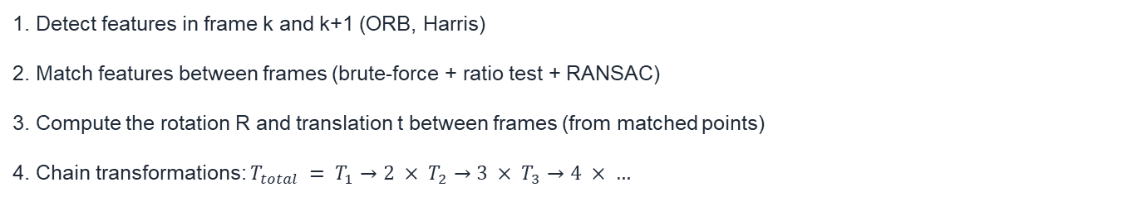
PBL: Elevator Doors Closed — Only Camera Works
PBL SCENARIO: MediBot is in the elevator. LiDAR is blocked (enclosed box). Encoders are slipping on the smooth floor. But the camera can see the elevator walls and buttons.
Can it estimate how MediBot is moving using ONLY image changes?
Visual Odometry (VO): estimate robot motion from sequences of images.
Detect
Features
Match Across
Frames
Estimate
Motion (R, t)
Integrate
Trajectory
→
→
→
1. Detect features in frame k and k+1 (ORB, Harris)
2. Match features between frames (brute-force + ratio test + RANSAC)
3. Compute the rotation R and translation t between frames (from matched points)
4. Chain transformations: $T_{total} = T_{1}→2 × T_{2}→3 × T_{3}→4 × …$
21

Slide 23
Monocular vs. Stereo Visual Odometry
Monocular VO (one camera)
Stereo VO (two cameras)
Uses one camera only
Can estimate rotation well
CANNOT estimate true scale!
(a 1m cube at 5m looks the same as
a 2m cube at 10m from one camera)
Needs external info for scale (IMU, known object)
Simpler hardware, harder math
Uses stereo baseline
Known baseline → known scale!
Can compute true metric motion
More robust (triangulation with 2 views)
More hardware, more computation
VO provides an independent motion estimate — complementary to encoders and IMU in sensor fusion (MOD-04).
22

Slide 24
VO: Where It Fits and When It Fails
✅ VO works well when:
❌ VO fails when:
Enough visual texture (features to track)
Camera moves slowly (features don't blur)
Good lighting (stable features)
Combined with IMU in VIO (Visual-Inertial)
Pure rotation (no translation → no triangulation)
Textureless surfaces (no features to match)
Fast motion → motion blur → features lost
Dark environments, direct sunlight
Drifts over time (like any odometry)
VO in the autonomy stack: Used as an ADDITIONAL odometry source in sensor fusion. Feeds into the EKF alongside encoders and IMU. When wheel odometry slips, VO provides an independent motion estimate.
O
OPERATE: In practice: VO alone drifts. VIO (Visual-Inertial Odometry) combines VO + IMU for robust indoor navigation. Standard on drones and AR headsets.
23

Slide 25
BLOCK G
Object Detection
Finding and identifying objects in the scene

Slide 26
PBL: Wheelchair in the Corridor — Obstacle or Passable?
PBL SCENARIO: MediBot sees an object in the corridor. Is it a wheelchair (obstacle — must avoid) or an open door (passable — can go through)? The shape in the LiDAR scan is ambiguous — both look like a rectangular void. The camera image can tell the difference.
Object detection: find WHERE objects are AND WHAT they are.
Detection outputs:
Classical approach:
Deep learning approach:
Bounding box: (x, y, w, h)
Class label: "wheelchair"
Confidence: 0.92 (92%)
One detection per object
Handcrafted features (HOG, Haar)
Sliding window + classifier
Template matching
Interpretable, no training data
Learned features (CNN)
End-to-end: image → detections
YOLO, SSD, Faster R-CNN
Powerful but needs training data
25

Slide 27
Classical: Hough Transform for Lines and Circles
Detect geometric shapes — essential for structured environments (corridors, doors, rails)
Hough Line Transform
Hough Circle Transform
1. Apply Canny edge detection
2. Each edge pixel votes for all lines that could
pass through it: r = x·cos(θ) + y·sin(θ)
3. Accumulate votes in (r, θ) space
4. Peaks in accumulator = detected lines
Used for: corridor walls, door frames, lane markings
Same idea but for circles: (x−a)² + (y−b)² = r²
Each edge pixel votes for all circles through it
3D accumulator: (a, b, r)
Peaks = detected circles
Used for: wheel detection, pipe detection,
button/dial recognition
Hough transforms are fast, robust to noise, and don't need training data. Perfect for structured environments.
26

Slide 28
Brief Intro: Deep Learning Detection (YOLO)
Modern object detection uses Convolutional Neural Networks (CNNs).
Image
640×480×3
→
CNN Backbone
(learned filters)
→
Feature Maps
(what CNN "sees")
→
Detection Head
(boxes + classes)
YOLO: You Only Look Once
When to use DL vs. Classical?
Divides image into grid (e.g., 13×13)
Each cell predicts: bounding boxes + confidence
+ class probabilities — ALL at once
Single forward pass → real-time (30+ FPS)
YOLOv26: state of the art for robots (2026)
DL: many object classes, complex shapes,
have training data, have GPU
Classical: geometric shapes (lines, circles),
no training data, interpretable,
limited compute (embedded systems)
Many robots use BOTH in parallel!
27

Slide 29
BLOCK H
Point Cloud Processing
From 100,000 dots to individual objects

Slide 30
PBL: 100,000 LiDAR Points — Where Are the Obstacles?
PBL SCENARIO: MediBot's 3D LiDAR returns 100,000 points per scan. Most points are the floor, walls, and ceiling — not obstacles. The planning module (MOD-09) needs a list of OBJECTS with bounding boxes, not a cloud of raw points.
The point cloud processing pipeline:
Raw Cloud
100K points
Downsample
(voxel grid)
Remove Ground
(RANSAC plane)
Cluster Objects
(Euclidean)
Bounding Boxes
(for planning)
→
→
→
→
Each step reduces data: 100K → 20K → 5K → 500 (3 clusters) → 3 bounding boxes. 33,000× data reduction!
29

Slide 31
Step by Step: What Each Operation Does
1. Voxel Grid Downsampling
2. Ground Plane Removal (RANSAC)
Divide space into small cubes (voxels) e.g. 5cm
Replace all points in each voxel with ONE point (centroid)
100K → 20K points. Same shape, less data.
Reduces computation for all following steps.
The largest plane in the cloud = the floor
RANSAC: pick 3 random points → fit plane → count inliers
Repeat → keep best plane → remove its points
20K → 5K points. Floor is GONE, only obstacles remain.
3. Euclidean Clustering
4. Bounding Box Fitting
Group nearby non-ground points into clusters
Points within distance d of each other = same object
Each cluster = one physical object
5K points → 3 clusters (wheelchair, cart, person)
For each cluster: fit the smallest box that contains it
Output: position (x,y,z), dimensions (w,h,d)
This is what the planner needs: obstacle position + size
3 clusters → 3 bounding boxes → 3 obstacles
30

Slide 32
Normal Estimation: Surface Orientation
Normals tell you which way a surface FACES — critical for SLAM and mapping.
For each point: fit a small plane to its k nearest neighbors → normal = plane's perpendicular vector
Floor normals point UP (0,0,1). Wall normals point SIDEWAYS (1,0,0 or 0,1,0).
A ramp normal is tilted. Normal estimation distinguishes floor from wall from obstacle automatically.
Why normals matter:
MOD-09 Planning: is this surface driveable? (normal ≈ up → yes)
MOD-08 SLAM: align two scans using normal consistency
Obstacle detection: vertical normal → wall, tilted → ramp
Semantic: flat+up → floor, flat+sideways → wall
In practice: PCL library (C++) or Open3D (Python)
In ROS: pcl_ros package processes PointCloud2 messages
31

Slide 33
BLOCK I
Semantic Understanding
Beyond geometry: WHAT does the robot see?

Slide 34
PBL: Closed Door vs. Open Door — Same Shape, Different Meaning
PBL SCENARIO: MediBot approaches Ward B. The LiDAR scan shows a rectangular gap in the wall. Is the door OPEN (can drive through) or CLOSED (must stop and wait)? Geometrically, both look similar. Only semantic understanding — knowing what a 'door' means — resolves this.
Semantic understanding = assigning MEANING to perceived objects.
Classification
Object Detection
Semantic Segmentation
"What IS this object?"
One label per image/region
"This is a wheelchair"
Simplest semantic task
Classification + WHERE
Bounding box + class label
E.g "Wheelchair at (3.2, 1.5)"
Every PIXEL gets a label
“e.g floor or wall"
Dense understanding of scene
Most complete but most expensive
33

Slide 35
How Semantics Help the Robot
Semantic information enables:
Connection to MOD-09 Planning:
"That's a DOOR → I can go through" (planning)
"That's a PERSON → yield and wait" (behavior)
"That's a SIGN → read the text" (localization)
"That's FLOOR → safe to drive" (costmap)
"That's GLASS → LiDAR can fail" (sensor selection)
Semantic costmap layers:
Floor → FREE (cost = 0)
Wall → OCCUPIED (cost = infinity)
Person → HIGH COST (avoid but possible)
Door (open) → FREE
Door (closed) → OCCUPIED
The planner uses these costs to find safe paths
Without semantics: robot treats everything as either 'obstacle' or 'free.' With semantics: nuanced decisions.
O
OPERATE: In practice: semantic segmentation runs on GPU. Classical robots use simpler classification. Choose based on compute budget.
34

Slide 36
BLOCK J
Perception in the
Autonomy Stack
How perception connects to everything else

Slide 37
Perception: The Central Bridge
Sensors
(MOD-04)
Localization
(MOD-06)
raw data →
→ landmarks
PERCEPTION
(MOD-07)
→ obstacles
SLAM
(MOD-08)
← features →
Planning
(MOD-09)
If perception fails, EVERYTHING downstream fails. Robustness is critical.
36

Slide 38
When Perception Fails — And How to Recover
Common perception failures:
Robustness strategies:
Feature detection fails: textureless surface → no features
→ VO fails, SLAM loses tracking
Object detection fails: unusual object (never seen before)
→ planner doesn't know it's an obstacle
Point cloud fails: glass, rain, fog, dust
→ obstacles invisible in 3D
Semantic fails: novel scene (construction zone)
→ wrong labels → wrong decisions
Multi-sensor perception: camera + LiDAR + radar
(from MOD-04 fusion — same principle!)
Fallback modes: if detection fails, treat as obstacle
(conservative = safe)
Confidence thresholds: only act on high-confidence
detections (>0.8 confidence)
Temporal consistency: object must be detected in
3+ consecutive frames to count (reduces false positives)
O
OPERATE: Perception is NOT 100% reliable. Design the system to degrade gracefully (based on sensor health monitoring).
37

Slide 39
Key Takeaways
1
Pipeline matters
2
Features = identity
3
VO = camera odometry
Sense → Preprocess → Detect → Classify → Interpret. Each stage adds value.
ORB/Harris detect, descriptors describe, RANSAC verifies.
Independent motion estimate from images. Drifts but complements IMU.
4
Detection = actionable
5
Point clouds → objects
6
Semantics = meaning
Classical (Hough) for geometry, DL (YOLO) for objects. Use both.
Downsample → ground remove → cluster → bounding boxes.
Door=passable, wall=blocked, person=yield. Enables smart planning.
38

Slide 40
Bridge to MOD-09: Planning & Navigation
What MOD-07 provides → What MOD-09 needs:
MOD-07 provides: obstacle bounding boxes, free space map, semantic labels, visual odometry.
MOD-09 needs: "Given this map of obstacles, plan a safe path from A to B and avoid collisions."
MOD-07 answers WHERE things are. MOD-09 answers HOW to get past them.
The obstacle map from point cloud processing feeds directly into the planning costmap.
The autonomy pipeline so far:
Sensors
(MOD-04)
→
Probability
(MOD-05)
→
Localization
(MOD-06)
→
Perception
(MOD-07)
SLAM
(MOD-08)
→
Planning
(MOD-09)
39

Slide 41
References
1. Szeliski, R. (2022). Computer Vision: Algorithms and Applications, 2nd ed. Springer.
2. Hartley & Zisserman (2004). Multiple View Geometry in Computer Vision. Cambridge.
3. Rublee et al. (2011). ORB: An Efficient Alternative to SIFT or SURF. ICCV.
4. Lowe, D.G. (2004). Distinctive Image Features from Scale-Invariant Keypoints. IJCV.
5. Redmon et al. (2016). You Only Look Once: Unified, Real-Time Object Detection. CVPR.
6. Fischler & Bolles (1981). Random Sample Consensus (RANSAC). Communications of the ACM.
7. Scaramuzza & Fraundorfer (2011). Visual Odometry Tutorial. IEEE RAM. Parts I and II.
8. Rusu & Cousins (2011). 3D is here: Point Cloud Library (PCL). ICRA.
Next: MOD-09 — Planning & Navigation (path planning, DWA, costmaps, Nav2)
40

Slide 42
?

