Slide 1
MOBILE ROBOTS
MOD-09
Planning &
Navigation
By Dr. Ahmad Abbadi

Slide 2
BLOCK A
The Planning Problem
Given obstacles and a goal — find a safe path

Slide 3
PBL: MediBot Knows Where It Is and What's Around It
PBL SCENARIO: MediBot is localized (MOD-06) at the pharmacy.
Perception (MOD-07) has detected: walls, 2 wheelchairs, 1 cart, and an open door to corridor B.
Goal: reach Ward B. The map is known.
How does MediBot plan a path that avoids all obstacles and reaches the goal?
This is the PLANNING problem: find a collision-free path from start to goal.
What the planner HAS:
What the planner must PRODUCE:
Robot position (from MOD-06 localization)
Obstacle map (from MOD-07 perception)
Goal position (Ward B entrance)
Robot kinematics (from MOD-03)
A sequence of waypoints from start to goal
That avoids ALL known obstacles
That the robot can physically follow (kinematic feasibility)
And adapt if new obstacles appear
3

Slide 4
Global vs. Local Planning — Why You Need BOTH
Global Planner
Local Planner
Plans the OVERALL route on the full map
A*, RRT, Dijkstra (this module)
Runs at 1-5 Hz (slow but complete)
Finds optimal or near-optimal path
Can see "around corners" on the map
Problem: can't react to sudden obstacles
Reacts to IMMEDIATE surroundings
DWA, TEB (this module)
Runs at 10-20 Hz (fast, reactive)
Avoids dynamic obstacles (people, carts)
Follows the global path approximately
Problem: can get stuck in dead ends
Running TOGETHER on the same robot:
Global path (A*): planned route across entire map
Person!
Local planner (DWA): deviates around person, returns to global path
4

Slide 5
CDIO Framework for This Module
Module structure:
C-Space
Pot. Fields
Dijkstra
A*
RRT Family
Kinematic
Feasibility
Costmaps
DWA
Splines
Collision
Nav2
Dynamic
Replan
5

Slide 6
BLOCK B
Configuration Space
Shrink the robot to a point by growing obstacles

Slide 7
PBL: Does MediBot Fit Through the Door?
PBL SCENARIO: MediBot is 0.4m wide. The doorway to corridor B is 0.9m wide.
On the map, the path looks clear — but will MediBot actually FIT with safety margin?
We need to account for the robot's physical size.
Idea: Grow every obstacle by the robot radius r. Then treat the robot as a POINT.
Original obstacle boundary + r in all directions = C-space obstacle.
If the POINT can pass through, the REAL robot can pass through. Planning becomes easier!
Workspace (real world):
C-Space (planning world):
Robot has physical size (0.4m diameter)
Obstacles have real boundaries
Must check robot footprint vs. obstacles
Complex: rotations, shapes, clearances
Robot is a dimensionless POINT
Obstacles grown by robot radius (0.2m)
Doorway: 0.9m → 0.9−0.4 = 0.5m in C-space
Simple: just check if point is in free space
All planning algorithms in this module operate in C-space, not workspace.
7

Slide 8
C-Space for Different Robot DOFs
Robot Type | DOFs | C-Space | Challenge
Point robot | 2 (x, y) | 2D plane | Easy — same as workspace
Circular mobile robot | 2 (x, y) | 2D (grow obstacles by r) | Standard — what we use
Non-circular robot | 3 (x, y, θ) | 3D (different shape at each θ) | Rotation matters!
Robot arm (6-DOF) | 6 (θ₁...θ₆) | 6D hypercube | Grid = 10¹⁸ cells → RRT needed!
For MediBot (circular): C-space = 2D.
For StreetBot (rectangular): C-space = 3D (orientation matters).
High-dimensional C-spaces (robot arms, multi-robot) → grids are impossible → sampling-based planners (RRT).
8

Slide 9
BLOCK C
Potential Fields
The naive approach — and why it fails

Slide 10
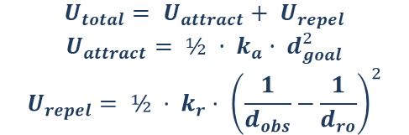
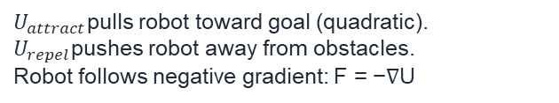
Idea: Attract to Goal, Repel from Obstacles
$U_{attract}$pulls robot toward goal (quadratic).
$U_{repel}$pushes robot away from obstacles.
Robot follows negative gradient: F = −∇U
Advantages:
$$U_{total}= U_{attract}+ U_{repel}$$
$$U_{attract}= ½ · k_{a}· d_{goal}^{2}$$
$$U_{repel}= ½ · k_{r}· {\left(\frac{1}{d_{obs}}−\frac{1}{d_{ro}}\right)}^{2}$$
Simple, intuitive, real-time
Smooth trajectories
No graph/tree construction needed
Robot velocity: v = −α · ∇U(x) → "roll downhill" on the potential surface
At each step: compute gradient of total potential → move in opposite direction. Like a ball rolling downhill toward the goal.
FATAL FLAW: Local Minima!
U-shaped obstacle: attractive force pulls toward goal, repulsive force pushes away from walls.
Forces CANCEL in the concavity → robot gets STUCK forever.
No local information can tell the robot to go AROUND the obstacle.
→ We need GLOBAL planning: algorithms that consider the ENTIRE map, not just local gradients.
→ Next: Dijkstra and A* (graph search on the full map).
10

Slide 11
BLOCK D
Dijkstra's Algorithm
Find the shortest path — guaranteed optimal

Slide 12
Dijkstra: Expand in All Directions Until You Reach the Goal
Algorithm (simplified):
1. Create a priority queue. Add start node with cost = 0.
2. Pop the node with LOWEST cost from the queue.
3. If it's the goal → DONE! Trace back the path.
4. Otherwise: for each neighbor, compute cost. If cheaper than known, update and add to queue.
5. Repeat from step 2.
Key properties:
✅ OPTIMAL: always finds the shortest path
✅ COMPLETE: if a path exists, it will find it
❌ SLOW: explores in ALL directions (doesn't know where goal is)
Complexity: O(V log V) with binary heap, where V = number of grid cells
12

Slide 13
Dijkstra Pseudocode
function DIJKSTRA(start, goal, grid):
cost[start] = 0
parent[start] = None
openSet = PriorityQueue()
openSet.push(start, priority=0)
while openSet is not empty:
current = openSet.pop() // lowest cost
if current == goal:
return RECONSTRUCT_PATH(parent, goal)
for each neighbor of current:
if neighbor is obstacle: continue
newCost = cost[current] + edgeCost(current, neighbor)
if newCost < cost[neighbor]:
cost[neighbor] = newCost
parent[neighbor] = current
openSet.push(neighbor, priority=newCost)
return FAILURE // no path exists
This same structure becomes A* with ONE change: the priority function.
13

Slide 14
BLOCK E
A* Algorithm
Dijkstra + a smart heuristic = much faster

Slide 15
A*: The Key Idea — Use a Heuristic to Guide Search
f(n) = g(n) + h(n)
g(n) = actual cost from start to n (same as Dijkstra)
h(n) = ESTIMATED cost from n to goal (the heuristic — NEW!)
f(n) = total estimated cost through n → prioritize nodes with low f
Dijkstra: priority = g(n) only
A*: priority = g(n) + h(n)
"How far have I come?"
Expands in ALL directions equally
Finds goal eventually but explores too much
Like flooding water — slow!
"How far have I come + how far to go?"
Prefers nodes that are CLOSER to the goal
Explores mostly TOWARD the goal
Like GPS navigation — efficient!
With a good heuristic, A* explores 5-50× fewer nodes than Dijkstra on typical robot maps.
15

Slide 16
Heuristics: What Makes a Good h(n)?
Admissible Heuristic (required for optimality)
Common heuristics for grid maps:
h(n) must NEVER overestimate true cost
h(n) ≤ actual_cost(n → goal) always
"Optimistic" estimate
If admissible: A* is OPTIMAL (finds shortest path)
If not: A* may find suboptimal paths
Euclidean: h = √((x−gx)²+(y−gy)²)
→ always admissible (straight line)
Manhattan: h = |x−gx| + |y−gy|
→ admissible for 4-connected grids
Diagonal: max(|Δx|,|Δy|) + (√2−1)·min(|Δx|,|Δy|)
→ admissible for 8-connected grids
Better heuristic = closer to true cost = fewer nodes explored = faster planning.
16

Slide 17
A* Pseudocode (One Change from Dijkstra)
function A_STAR(start, goal, grid):
g[start] = 0
f[start] = h(start, goal) // ← THE ONLY CHANGE
openSet = PriorityQueue()
openSet.push(start, priority=f[start])
while openSet is not empty:
current = openSet.pop() // lowest f = g + h
if current == goal:
return RECONSTRUCT_PATH(parent, goal)
for each neighbor of current:
if neighbor is obstacle: continue
newG = g[current] + edgeCost(current, neighbor)
if newG < g[neighbor]:
g[neighbor] = newG
f[neighbor] = newG + h(neighbor, goal) // ← ADD HEURISTIC
parent[neighbor] = current
openSet.push(neighbor, priority=f[neighbor])
Only TWO lines different from Dijkstra! The heuristic h() is the entire difference.
17

Slide 18
BLOCK F
RRT Family
Sampling-based planning for complex spaces

Slide 19
PBL: 6-DOF Robot Arm — Grid Is Impossible
PBL SCENARIO: A 6-DOF robot arm needs to reach into a shelf. C-space is 6-dimensional. A grid with 100 bins per DOF = 100⁶ = 10¹² cells! A* on a trillion-cell grid? Impossible. We need algorithms that DON'T discretize the space.
Sampling-based planners: explore C-space by taking RANDOM samples.
Grid-based (A*, Dijkstra):
Sampling-based (RRT, PRM):
Discretize space into cells
Exhaustive: check every cell
Optimal: finds shortest path
Fails in high dimensions (curse of dimensionality)
Good for: 2D mobile robots
Take random samples in C-space
Build a tree/graph incrementally
Probabilistically complete
Scales to high dimensions
Good for: arms, multi-robot, complex geometry
19

Slide 20
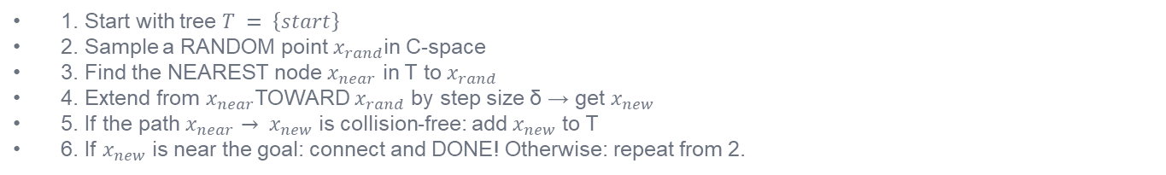
RRT: Rapidly-Exploring Random Tree
RRT Algorithm:
1. Start with tree $T = \left\{start\right\}$
2. Sample a RANDOM point $x_{rand}$in C-space
3. Find the NEAREST node $x_{near}$ in T to $x_{rand}$
4. Extend from $x_{near}$TOWARD $x_{rand}$ by step size δ → get $x_{new}$
5. If the path $x_{near}→ x_{new}$ is collision-free: add $x_{new}$ to T
6. If $x_{new}$ is near the goal: connect and DONE! Otherwise: repeat from 2.
$$x_{new}= x_{near}+ δ ·\frac{\left(x_{rand}− x_{near}\right)}{\left|x_{rand}− x_{near}\right|}$$
Move from nearest node TOWARD random sample by fixed step size δ. Check collision along the way.
Properties:
✅ Probabilistically complete: will find a path if one exists (given enough time)
❌ NOT optimal: path is random, often jagged and suboptimal
Exploration bias: random sampling naturally explores unexplored areas (Voronoi bias)
20

Slide 21

RRT*: Rewiring for Optimality
RRT* adds TWO operations to basic RRT: choose-parent and rewire.
Choose-Parent (before adding x_new):
Rewire (after adding x_new):
Don't just connect to NEAREST node
Check ALL nodes within radius r
Connect x_new to the one that gives
the LOWEST total cost from start
Better parent → shorter path
Check if nearby nodes would benefit from
routing THROUGH $x_{new}$instead of
their current parent
If yes: rewire their parent to $x_{new}$
Tree continuously improves over time!
Result: RRT* is asymptotically optimal — given enough samples, the path converges to the true shortest path. RRT does not.
21

Slide 22
RRT-Connect: Bidirectional Growth
Grow TWO trees: one from start, one from goal. Meet in the middle.
RRT-Connect Algorithm:
1. Grow tree A from start toward random sample
2. Grow tree B from goal toward the NEW node in tree A (greedily!)
3. If trees connect: path found!
4. Alternate: next iteration, swap roles (B random, A greedy toward B)
Much faster than single-tree RRT because BOTH ends explore toward each other.
Property | RRT | RRT* | RRT-Connect
Optimal? | NO | YES (asymptotic) | NO
Speed | Medium | Slower (rewiring) | FASTEST
Path quality | Poor (jagged) | Best (converges) | Medium
Use case | Quick feasibility | Quality matters | Fast solution needed
22

Slide 23
BLOCK F2
Kinematic Feasibility
Can the robot actually DRIVE the planned path?

Slide 24
PBL: A* Path Has 90° Turns — MediBot Can't Do That
PBL SCENARIO: A* produced a grid path with sharp 90° corners. But MediBot is a diff-drive robot — it can't teleport sideways! It must follow smooth curves respecting its minimum turning radius. The path is mathematically shortest but physically IMPOSSIBLE.
Holonomic Robot (omnidirectional)
Non-Holonomic Robot (diff-drive, car)
Can move in ANY direction instantly
No constraints on velocity direction
Omni-wheels, mecanum wheels
A* grid path IS feasible!
CANNOT move sideways!
Velocity constrained: v = f(x, u)
Must respect turning radius
A* grid path is NOT directly feasible
Most mobile robots are NON-HOLONOMIC. The planner must respect kinematic constraints.
24

Slide 25
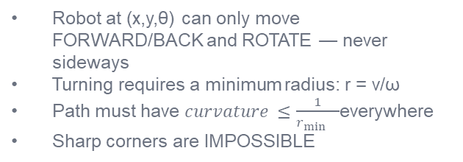
Non-Holonomic Constraints: The Pfaffian Form
Constraint: ẋ·sin(θ) − ẏ·cos(θ) = 0 (Pfaffian form: A(q)·q̇ = 0)
This says: the robot's velocity must be aligned with its heading θ. It CANNOT slide sideways.
This is NOT integrable → non-holonomic → reduces the space of reachable motions.
What this means for planning:
Robot at (x,y,θ) can only move FORWARD/BACK and ROTATE — never sideways
Turning requires a minimum radius: r = v/ω
Path must have $curvature ≤\frac{1}{r_{\min{}}}$everywhere
Sharp corners are IMPOSSIBLE
Diff-drive, bicycle, car: all non-holonomic. Omni-wheel, mecanum: holonomic.
25

Slide 26
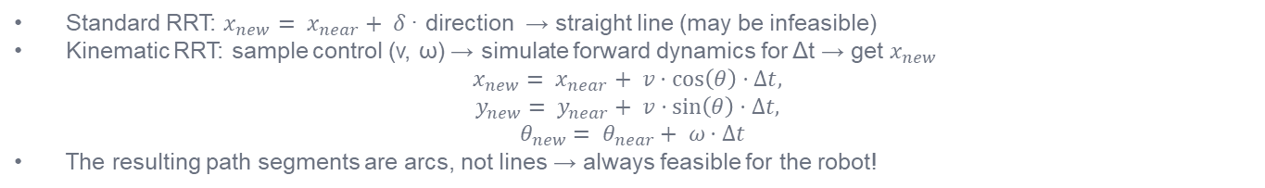
Kinematic RRT: Planning Feasible Paths
Standard RRT extends in straight lines → infeasible for non-holonomic robots.
Solution: Kinematic RRT samples CONTROL INPUTS instead of straight-line extensions.
Kinematic RRT — Modified Step:
Standard RRT: $x_{new}= x_{near}+ δ$· direction → straight line (may be infeasible)
Kinematic RRT: sample control (v, ω) → simulate forward dynamics for Δt → get $x_{new}$
$$x_{new}= x_{near}+ v·\cos\left(θ\right)·Δt,$$
$$y_{new}= y_{near}+ v·\sin\left(θ\right)·Δt,$$
$$θ_{new}= θ_{near}+ ω·Δt$$
The resulting path segments are arcs, not lines → always feasible for the robot!
Two approaches to feasible planning:
1. Plan with kinematics (Kinematic RRT): paths are feasible by construction.
2. Plan without kinematics (A*) + post-process (cubic splines, Dubins curves): faster but may fail in tight spaces.
Nav2 uses approach 2: A*/NavFn for global path + DWA/TEB controller respects kinematics locally.
26

Slide 27
BLOCK G
Costmaps
From binary free/occupied to continuous costs

Slide 28

PBL: Path Clips Wall by 2cm — Legal but Unsafe
PBL SCENARIO: A* found a path that passes 2cm from a wall corner. In the binary map (free/occupied), this is technically legal. But in reality, 2cm clearance is DANGEROUS — any localization error and MediBot hits the wall. We need GRADED costs: closer to obstacles = higher cost.
Costmap: every cell has a COST value, not just free/occupied.
Lethal (cost = 254)
Inscribed (cost = 253)
Inflation (cost = 1–252)
Inside an obstacle
Robot WILL collide
Planner MUST avoid
Source: static map + live sensors
Robot footprint touches obstacle
Collision certain for this robot size = C-space obstacle boundary
Radius = robot inscribed radius
Near obstacle but not colliding
Cost decreases with distance
Exponential decay:
$c = 253·e^{−k·d}$
Planner prefers to stay far away
Planner minimizes TOTAL path cost → naturally keeps distance from obstacles.
28

Slide 29
Three Costmap Layers
1. Static Layer
2. Obstacle Layer
3. Inflation Layer
From the pre-built map (SLAM output)
Walls, permanent obstacles
Loaded once, rarely changes
Source: map_server in Nav2
From LIVE sensors (LiDAR, camera)
Dynamic obstacles (people, carts)
Updates at sensor rate (10 Hz)
Source: MOD-07 perception output
Computed from lethal cells
Adds cost gradient around obstacles
Configurable: inflation_radius, cost_scaling
Makes planner prefer open space
Layers are STACKED: static + obstacle + inflation = combined costmap used by planners.
Two separate costmaps in Nav2: global_costmap (full map, for A*) and local_costmap (small window, for DWA).
29

Slide 30
BLOCK H
DWA — Dynamic Window
Approach
Local planning: react to immediate obstacles in real-time

Slide 31
PBL: Person Steps into the Corridor — React NOW!
PBL SCENARIO: MediBot is following the global A* path when a patient steps into the corridor 2m ahead. The global planner runs at 1 Hz — next replan is 0.8 seconds away. At 0.5 m/s, MediBot will travel 0.4m before replanning. We need a FAST local planner running at 20 Hz.
DWA: search the velocity space for the best (v, ω) to execute RIGHT NOW.
DWA Algorithm (simplified):
1. Generate candidate velocities (v, ω) within the DYNAMIC WINDOW (reachable given acceleration limits)
2. For each (v, ω): simulate forward trajectory for T seconds using robot kinematics (MOD-03)
3. Score each trajectory: heading_to_goal × clearance × speed
4. Select the (v, ω) with HIGHEST score → send to motors
5. Repeat at 20 Hz
31

Slide 32
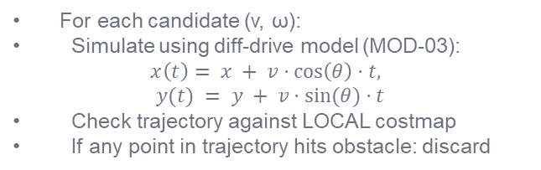
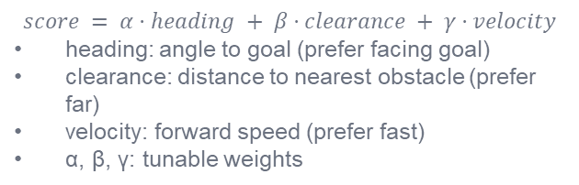
DWA: The Dynamic Window
Dynamic Window = reachable velocities in one timestep:
$$v ∈ \left[v_{cur}− a_{max}·Δt, v_{cur}+ a_{max}·Δt\right]$$
$$ω ∈ \left[ω_{cur}− {αn}_{max}·Δt, ω_{cur}+ {αn}_{max}·Δt\right]$$
Only velocities the robot can PHYSICALLY reach from its current velocity are considered.
$a_{max}=$max linear acceleration, ${αn}_{max}=\max{\text{angular} \text{acceleration}}$, Δt = control period.
This constrains the search to kinematically feasible motions — DWA naturally respects non-holonomic constraints!
Scoring function:
Trajectory simulation:
$$score = α·heading + β·clearance + γ·velocity$$
heading: angle to goal (prefer facing goal)
clearance: distance to nearest obstacle (prefer far)
velocity: forward speed (prefer fast)
α, β, γ: tunable weights
For each candidate (v, ω):
Simulate using diff-drive model (MOD-03):
$$x\left(t\right)= x + v·\cos\left(θ\right)·t,$$
$$y(t) = y + v·sin⁡(θ)·t$$
Check trajectory against LOCAL costmap
If any point in trajectory hits obstacle: discard
32

Slide 33
DWA: Strengths & Limitations
✅ DWA Strengths:
❌ DWA Limitations:
Fast: runs at 20 Hz (real-time)
Naturally respects kinematics (dynamic window)
Handles dynamic obstacles (re-evaluates each cycle)
Simple to implement and tune
Standard local planner in Nav2
Short horizon (only looks 1-2 seconds ahead)
Can get stuck in local minima (U-shapes)
→ needs global planner to guide it
Oscillation: may switch between (v,ω) rapidly
Tuning: α, β, γ require careful calibration
DWA is the LOCAL planner. A*/RRT is the GLOBAL planner. Together: global finds the route, local navigates safely.
33

Slide 34
BLOCK I
Path Smoothing
From jagged grid paths to smooth, feasible trajectories

Slide 35
Cubic Spline Smoothing
PBL SCENARIO: A* produces waypoints on a grid: sharp corners, straight segments. MediBot's diff-drive needs SMOOTH curves with bounded curvature. Cubic splines interpolate through waypoints with continuous first and second derivatives.
Cubic spline between waypoints: $S(t) = a + b·t + c·t² + d·t³$
4 coefficients per segment.
Boundary conditions: positions match at waypoints, first and second derivatives continuous.
Result: smooth C² curve (continuous position, velocity, and acceleration).
Before smoothing (A* output):
After smoothing (cubic spline):
Sharp 90° and 45° turns
Grid-aligned segments only
Infinite curvature at corners
Robot would need to STOP and rotate at each turn
Smooth curves through waypoints
Bounded curvature everywhere
Robot can follow at constant speed
Curvature ≤ 1/r_min enforced
Nav2: the Smac planner produces smooth paths directly. Alternatively: plan with A* then smooth post-process.
35

Slide 36
BLOCK J
Collision Detection
Is this path actually safe?

Slide 37
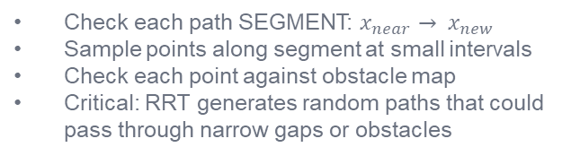
Why Collision Checking Matters
Every planner must verify: "Does this path/trajectory collide with any obstacle?"
For A* / Grid planners:
For RRT / Sampling planners:
Check each cell: is it in C-space obstacle?
Simple lookup: costmap(x,y) < threshold?
Very fast: O(1) per cell
Limited to grid resolution
Check each path SEGMENT: $x_{near}→ x_{new}$
Sample points along segment at small intervals
Check each point against obstacle map
Critical: RRT generates random paths that could pass through narrow gaps or obstacles
Key methods:
Point-in-polygon (is point inside obstacle?),
Line-segment intersection (does path cross obstacle boundary?),
Swept volume (does robot body sweep through obstacle along path?).
For costmaps: just check costmap cell value at each point.
37

Slide 38
BLOCK K
Nav2 Architecture
The standard ROS 2 navigation stack — wiring everything together

Slide 39
Nav2: The Full Picture
Nav2 is the standard navigation framework in ROS 2.
Behavior Tree
(BT Navigator)
Planner Server
(Global: A*, NavFn, Smac)
Controller Server
(Local: DWA, TEB, RPP)
Recovery Server
(Spin, BackUp, Wait)
Global Costmap
Local Costmap
Map Server
AMCL
The BT Navigator ORCHESTRATES everything. It decides: plan → follow → stuck? → recover → replan.
Each server is a lifecycle node: can be configured, activated, deactivated independently.
Smac: Search-based Motion Aware Control.
DWA: Dynamic Window Approach ;TEB: Timed Elastic Band; RPP: Regulated Pure Pursuit
39

Slide 40
Behavior Trees: The Brain of Nav2
A Behavior Tree (BT) decides WHAT to do at each moment. Like a flowchart but more flexible.
Sequence Node (→)
Fallback Node (?)
Action Nodes (leaves)
Execute children LEFT to RIGHT
If one FAILS: stop, report failure
If all SUCCEED: report success
Example: Plan → Follow → Done
If Plan fails: don't try to Follow
Try children LEFT to RIGHT
If one SUCCEEDS: stop, report success
If all FAIL: report failure
Example: Follow → Spin → BackUp
If Follow works: great. If not: try Spin.
ComputePathToPose → call planner
FollowPath → call controller
Spin → recovery: rotate in place
BackUp → recovery: drive backward
Wait → recovery: pause and retry
ClearCostmap → reset obstacle layer
Nav2's default BT: NavigateToPose → Sequence[ComputePath, FollowPath] with Fallback[Spin, BackUp, Wait] recovery.
40

Slide 41
Nav2 Planner & Controller Options
Component | Options in Nav2 | Algorithm | Best for
Global Planner | NavFn | A* / Dijkstra on costmap | Standard 2D navigation
 | SmacPlanner2D | A* with Smac optimizations | Large maps, faster
 | SmacPlannerHybrid | Hybrid A* (kinematic-aware) | Car-like robots
 | SmacPlannerLattice | Precomputed feasible movements (kinematic-aware) | autonomous cars
Local Controller | DWA | Dynamic Window Approach | Diff-drive robots
 | TEB | Timed Elastic Band | Smooth, time-optimal
 | RPP | Regulated Pure Pursuit | Simple, robust tracking
For MediBot (diff-drive, hospital): what is the best planner?
Choose planner+controller combination based on your robot type. Configure via Nav2 YAML parameters.
41

Slide 42
BLOCK L
Dynamic Environments
& Replanning
When the world changes — adapt or fail

Slide 43
PBL: Spill Blocks Corridor C — Original Path Is Dead
PBL SCENARIO: MediBot planned a path through corridor C. Halfway there, a cleaning crew blocks corridor C with a wet floor sign and mop bucket. The global path is now blocked. MediBot must DETECT the blockage, REPLAN through corridor D, and CONTINUE without human intervention.
This is REPLANNING: the ability to adapt when the environment changes.
What triggers replanning?
Nav2 handles this automatically:
DWA controller reports: path blocked (can't follow)
Costmap updated: new obstacle on global path
Planner fails: no local deviation possible
Recovery failed: spin/backup didn't help
Goal changed: new destination requested
BT detects FollowPath failure
Triggers recovery: Spin, BackUp, ClearCostmap
If recovery succeeds: re-attempt FollowPath
If recovery fails: BT requests NEW global plan
New plan computed on UPDATED costmap
43

Slide 44
The Sense-Plan-Act-Replan Cycle
SENSE
(perception updates
costmap)
PLAN
(global path
on costmap)
ACT
(DWA follows
path locally)
→
→
↺ REPLAN: if ACT fails (obstacle blocks path) → return to SENSE → update costmap → new PLAN → retry ACT
This cycle runs CONTINUOUSLY at different rates: SENSE: 10-30 Hz (sensor rate → costmap update rate)
PLAN: 1-5 Hz (global replanning rate, or on-demand when path blocked)
ACT: 10-20 Hz (DWA local controller rate)
Different rates → different response times. DWA avoids people instantly. Global replan avoids blocked corridors.
44

Slide 45
Temporal Costmap: Remembering and Forgetting Obstacles
How long should the costmap remember a dynamic obstacle after the sensor stops seeing it?
Never forget (infinite persistence):
Timed clearing (configured decay):
Obstacle stays in costmap forever
Problem: person walks away, but
costmap still shows them there!
Robot avoids empty space → inefficient
Map becomes cluttered with ghosts
Obstacle fades from costmap after T seconds
Nav2: observation_persistence parameter
Typical: 2-5 seconds for dynamic obstacles
Sensor re-observes → obstacle refreshed
Not seen again → obstacle disappears
Nav2 costmap parameters for dynamic environments:
observation_persistence: how long to keep obstacle after last observation (seconds)
raytrace_range: how far sensor can clear (mark free) behind detected obstacles
obstacle_range: how far sensor can mark new obstacles
These connect directly to MOD-04 sensor models: range, FoV, reliability determine costmap accuracy.
45

Slide 46
Key Takeaways
1
C-space simplifies
2
A* = gold standard
3
RRT for complex spaces
Grow obstacles by robot radius → robot becomes a point.
Dijkstra + heuristic = fast, optimal global planning.
Sampling-based: handles high-DOF, non-holonomic.
4
Costmaps add safety
5
DWA reacts locally
6
Nav2 wires it all
3 layers: static + obstacle + inflation. Graded costs.
Velocity space search at 20 Hz. Avoids dynamic obstacles.
BT + planner + controller + costmap + recovery.
46

Slide 47
References
1. LaValle, S. (2006). Planning Algorithms. Cambridge University Press. Ch. 5, 14.
2. Hart, Nilsson & Raphael (1968). A* algorithm. IEEE Trans. SSC.
3. LaValle & Kuffner (2001). Rapidly-Exploring Random Trees. IJRR.
4. Karaman & Frazzoli (2011). Sampling-based Optimal Motion Planning (RRT*). IJRR.
5. Fox, Burgard & Thrun (1997). The Dynamic Window Approach. IEEE RAM.
6. Khatib, O. (1986). Real-Time Obstacle Avoidance. IJRR.
7. Lu & Smart (2013). NavFn: A Global Planner for ROS. github.com/ros-navigation.
8. Nav2 documentation: docs.nav2.org
9. Macenski et al. (2023). Nav2: The ROS 2 Navigation Framework. JOSS.
Next: MOD-09 — Mapping & SLAM
48

Slide 48
?

