Slide 1
MOD-03 Robot Kinematics & Motion Models
MOBILE ROBOTS
By Dr. Ahmad Abbadi

Slide 2
The Problem
A company wants to build a warehouse delivery AMR (Autonomous Mobile Robot) that must:
move between shelves
carry packages
know its position without GPS
avoid slipping when carrying heavy loads
The robot should:
drive in narrow aisles
rotate at intersections
track its position accurately

Slide 3
The Problem
How should we mathematically describe the robot motion?
What motion is physically possible for wheeled robots?
How do we plan motion that respects these limits?
How can the robot estimate where it is using its motion knowledge?

Slide 4
we need a precise mathematical relationship between
what we control (the wheel motors) and
what we observe (the robot's position and orientation in the warehouse).
This relationship is called the kinematic model.
Without it,
every command we send would be a guess,
we could not predict the robot's path, plan collision-free trajectories,
or estimate the robot's position from sensor data.

Slide 5
Lets divide the problem into smaller ones and think systematically.
First: what is the robot references

Slide 6
The Frame Coordination
The Scene: A Warehouse AMR detects a shelf at [1.0,0.5] in its LIDAR frame. The robot is currently at [10.0,5.0,π/4] in the Global Map frame.
The Problem: which shelf it is on the warehouse map?
The Challenge:
How do we communicate "where things are" across multiple moving frames of reference (Robot, Sensor, Map) without losing accuracy?
{W} World Frame
Fixed to warehouse. Origin at corner. X = aisle direction. NEVER changes.
Base frame
{R} Robot Body Frame
Origin at robot center. Moves with robot. Forward = +X, Left = +Y.
Sensor
frame
1m
{S} Sensor Frame
Fixed to LIDAR mount. Static relative to {R}. Encoded in URDF.
Robot
frame

Slide 7
Introduction Homogeneous Transforms
Core Concept: Representing a pose as a single matrix that encodes both translation and rotation.
The Tool: The Special Euclidean Group SE(2) for planar motion.
Industry Standard: ROS TF2 (Transform Library) which automates the "Tree" of these matrices across time.

Slide 8




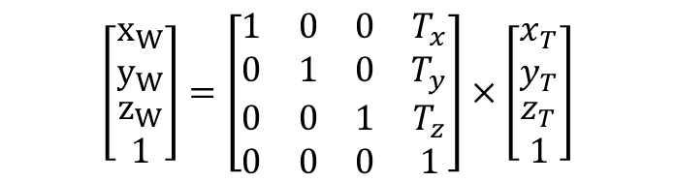
Homogeneous transformation matrix - Translation Matrix
$x_{W}= x_{T}+ T_{x}$
$y_{W}= y_{T}+ T_{y}$
$z_{W}= z_{T}+ T_{z}$
$$\left[\begin{matrix}x_{W} \\ y_{W} \\ \begin{aligned}z_{W} \\ 1\end{aligned}\end{matrix}\right]=\left[\begin{matrix}1 & 0 & 0 & T_{x} \\ 0 & 1 & 0 & T_{y} \\ 0 & 0 & 1 & T_{z} \\ 0 & 0 & 0 & 1\end{matrix}\right]×\left[\begin{matrix}x_{T} \\ y_{T} \\ \begin{aligned}z_{T} \\ 1\end{aligned}\end{matrix}\right]$$
$$W$$
$$P(x,y,z)$$
$$T$$
$x_{W} :$X on the World frame, $x_{T} :$X on the T frame

Slide 9

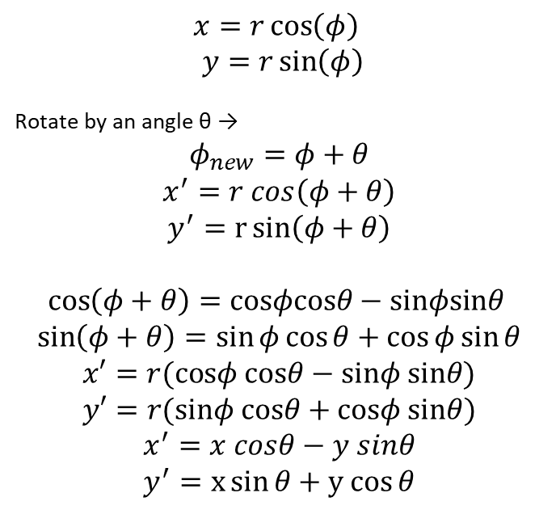


Homogeneous transformation matrix - Rotation Matrix
$$x=r\cos\left(φ\right)$$
$$y=r\sin\left(φ\right)$$
Rotate by an angle θ →
$$φ_{new}​=φ+θ$$
$$x^{′}=r cos\left(φ+θ\right)$$
$$y^{′}=r\sin\left(φ+θ\right)$$
$$\cos\left(φ+θ\right)=cosφcosθ−sinφsinθ$$
$$\sin\left(φ+θ\right)=\sin{φ\cos{θ}}+\cos{φ\sin{θ}}$$
$$x′=r(cosφ cosθ−sinφ sinθ)$$
$$y′=r(sinφ cosθ+cosφ sinθ)$$
$$x^{′}=x cosθ−y sinθ$$
$$y^{′}=x\sin{θ}+y cos⁡θ$$
r = distance from origin
ϕ = angle from x-axis
P` = R . P
$$θ$$
r
$$P(x,y,z)$$

Slide 10
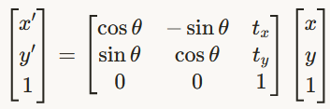
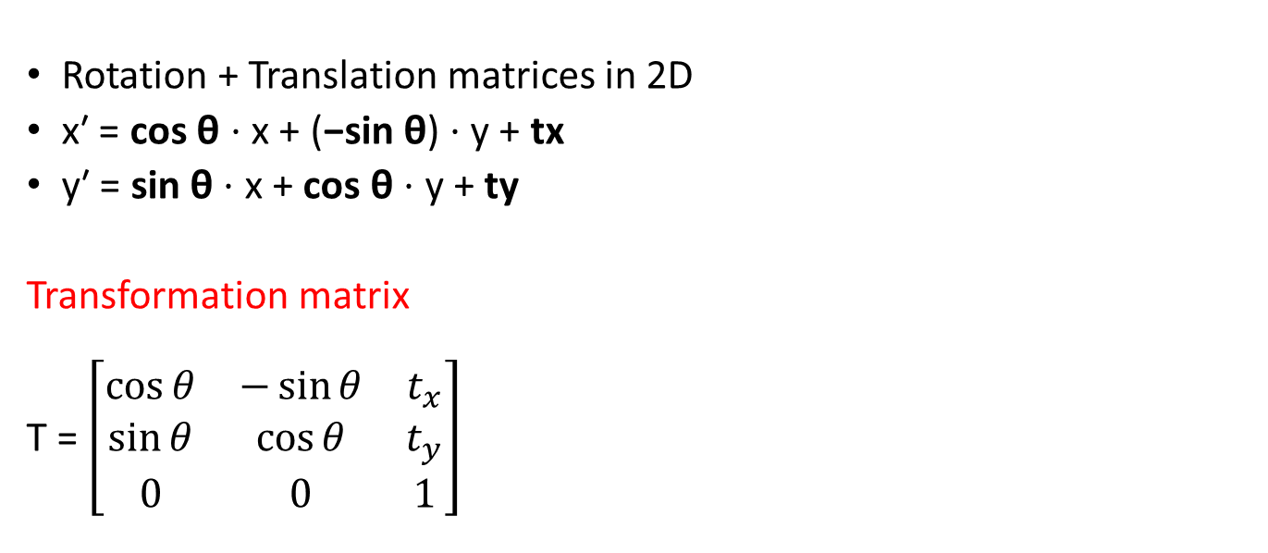
Homogeneous transformation matrix 2D
Rotation + Translation matrices in 2D
x′ = cos θ ⋅ x + (−sin θ) ⋅ y + tx
y′ = sin θ ⋅ x + cos θ ⋅ y + ty
Transformation matrix
T = $\left[\begin{matrix}\cos{θ} & −\sin{θ} & t_{x} \\ \sin{θ} & \cos{θ} & t_{y} \\ 0 & 0 & 1\end{matrix}\right]$

Slide 11
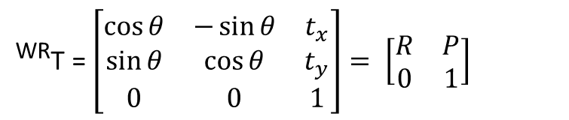
Homogeneous transformation matrix - Transformation Matrix
^{W}P = ^{WR} T​ ⋅ ^{RS}T​ ⋅ ^{S}P
Inversion: To go from World to Robot: ^{RW}T​=(^{WR}T​)⁻¹
^{WR}T = $\left[\begin{matrix}\cos{θ} & −\sin{θ} & t_{x} \\ \sin{θ} & \cos{θ} & t_{y} \\ 0 & 0 & 1\end{matrix}\right]= \left[\begin{matrix}R & P \\ 0 & 1\end{matrix}\right]$
Base frame
Sensor
frame
1m
Robot
frame

Slide 12
Homogeneous transformation matrix - Notes
In a 3D warehouse with ramps, can we simplify our math back to SE(2), or does the "Pitch" and "Roll" of the floor make SE(3) mandatory?
^{RW}T = (^{WR}T)⁻¹ = $\left[\begin{matrix}RT & −RT \text{p} \\ 0 & 1\end{matrix}\right]$ (Computationally efficient)
we never use inv() in real-time code; we use the geometric property of the rotation matrix.

Slide 13

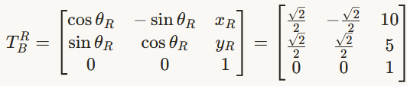
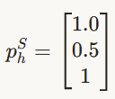


The Frame Coordination
The Scene: A Warehouse AMR detects a shelf at [1.0,0.5] in its LIDAR frame. The robot is currently at [10.0,5.0,π/4] in the Global Map frame.
The Problem: which shelf it is on the warehouse map?
where things are across multiple moving frames of reference (Robot, Sensor, Map)?
You want the shelf point from LIDAR frame → Robot base frame → Global Map frame
Shelf point in sensor: p^{S}=[1.0, 0.5]
we assumed a point in robot frame equals point in LIDAR frame
Transform R → B
Homogeneous point in S
Base frame
If the sensor not same as the robot frame then $P_{h}^{B}=T_{B}^{R} T_{R}^{S} P_{h}^{S}$
go back to sensor frame $P_{h}^{S}={{(T}_{R}^{S})}^{−1} {{(T}_{B}^{R})}^{−1}P_{h}^{B}$
Sensor
frame
1m
Robot
frame

Slide 14
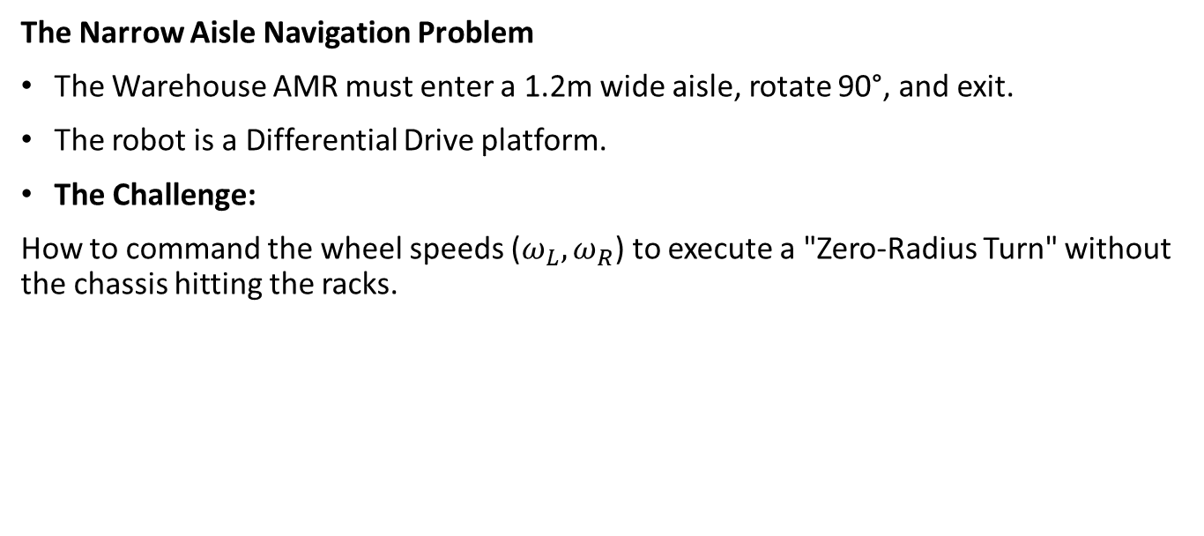
Kinematic Blueprints & Constraints
The Narrow Aisle Navigation Problem
The Warehouse AMR must enter a 1.2m wide aisle, rotate 90°, and exit.
The robot is a Differential Drive platform.
The Challenge:
How to command the wheel speeds ($ω_{L}​, ω_{R}$​) to execute a "Zero-Radius Turn" without the chassis hitting the racks.

Slide 15
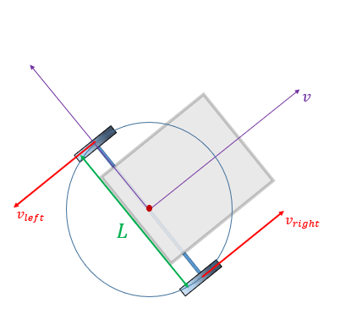
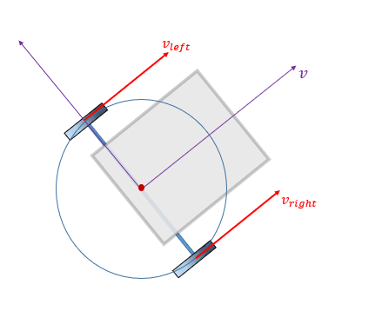
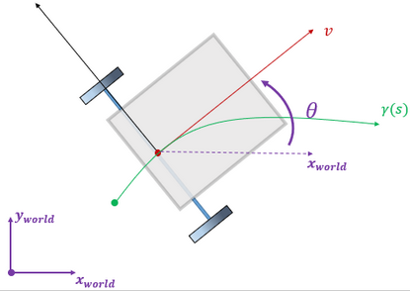
Kinematic Blueprints & Constraints
Why?
How to move the robot in a specific radius?
Rotate
Move forward
Move on curve
https://www.roboticsbook.org/S52_diffdrive_actions.html

Slide 16
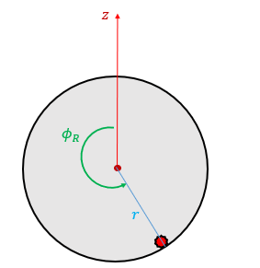

Kinematic Blueprints & Constraints
The forward speed of a wheel is
$$v=r\dot{∅}$$
Then the angular speed is
$$\dot{∅}=\frac{v}{r}$$
To move the robot forward
the angular speeds on the right and left wheels should be similar
$$\dot{∅_{L}=}\dot{∅_{R}=}\frac{v_{x}}{r}$$
https://www.roboticsbook.org/S52_diffdrive_actions.html

Slide 17
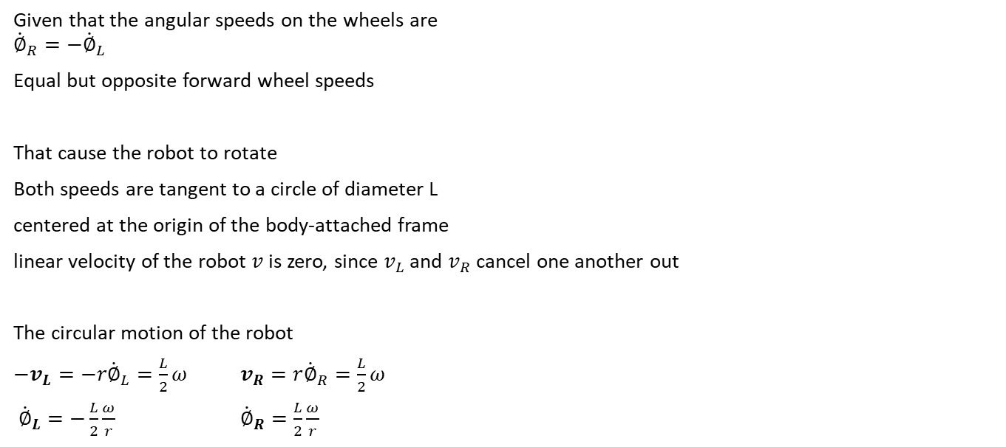
Kinematic Blueprints & Constraints - Rotating robot
Given that the angular speeds on the wheels are
$${\dot{∅}}_{R}=−{\dot{∅}}_{L}$$
Equal but opposite forward wheel speeds
That cause the robot to rotate
Both speeds are tangent to a circle of diameter L
centered at the origin of the body-attached frame
linear velocity of the robot $v$ is zero, since $v_{L}$ and $v_{R}$ cancel one another out
The circular motion of the robot
$−v_{L}=−r{\dot{∅}}_{L}=\frac{L}{2}ω$ $v_{R}=r{\dot{∅}}_{R}=\frac{L}{2}ω$
${\dot{∅}}_{L}=−\frac{L}{2}\frac{ω}{r}$ ${\dot{∅}}_{R}=\frac{L}{2}\frac{ω}{r}$
ω:Robot angular speed. L:wheels base. r:wheel radius. $\dot{∅}:$Wheel angular speed

Slide 18
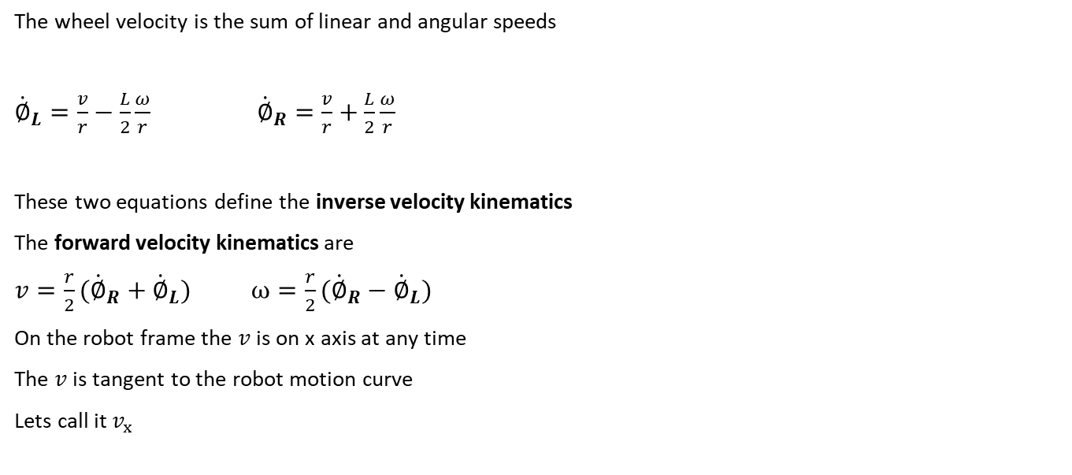
Kinematic Blueprints & Constraints
The wheel velocity is the sum of linear and angular speeds
${\dot{∅}}_{L}=\frac{v}{r}−\frac{L}{2}\frac{ω}{r}$ ${\dot{∅}}_{R}=\frac{v}{r}+\frac{L}{2}\frac{ω}{r}$
These two equations define the inverse velocity kinematics
The forward velocity kinematics are
$v=\frac{r}{2}({{\dot{∅}}_{R}+\dot{∅}}_{L})$ $ω=\frac{r}{2}({{\dot{∅}}_{R}−\dot{∅}}_{L})$
On the robot frame the $v$ is on x axis at any time
The $v$ is tangent to the robot motion curve
Lets call it $v_{x}$
https://www.roboticsbook.org/S52_diffdrive_actions.html

Slide 19



Kinematic Blueprints & Constraints
The velocity of the robot in its frame
$$v^{Body,linear}=\left[\begin{matrix}v_{x} \\ 0\end{matrix}\right]$$
The velocity in the world frame
$$v^{World,linear}=\left[\begin{matrix}v_{x}\cos{θ} \\ v_{x}\sin{θ}\end{matrix}\right]$$
Combine the angular velocity with the linear one
$v^{World}=\left[\begin{matrix}v_{x}\cos{θ} \\ \begin{aligned}v_{x}\sin{θ} \\ \dot{θ}\end{aligned}\end{matrix}\right]$
$v^{Body}=\left[\begin{matrix}v_{x} \\ 0 \\ \dot{θ}\end{matrix}\right]$
$v=\frac{r}{2}({{\dot{∅}}_{R}+\dot{∅}}_{L})$, $ω=\frac{r}{2}({{\dot{∅}}_{R}−\dot{∅}}_{L})$
$v^{World}=\left[\begin{matrix}\frac{r}{2}({{\dot{∅}}_{R}+\dot{∅}}_{L})\cos{θ} \\ \begin{aligned}\frac{r}{2}({{\dot{∅}}_{R}+\dot{∅}}_{L})\sin{θ} \\ \frac{r}{2}({{\dot{∅}}_{R}−\dot{∅}}_{L})\end{aligned}\end{matrix}\right]$
$$v^{Body}=\left[\begin{matrix}\frac{r}{2}({{\dot{∅}}_{R}+\dot{∅}}_{L}) \\ 0 \\ \frac{r}{2}({{\dot{∅}}_{R}−\dot{∅}}_{L})\end{matrix}\right]$$
https://www.roboticsbook.org/S52_diffdrive_actions.html

Slide 20
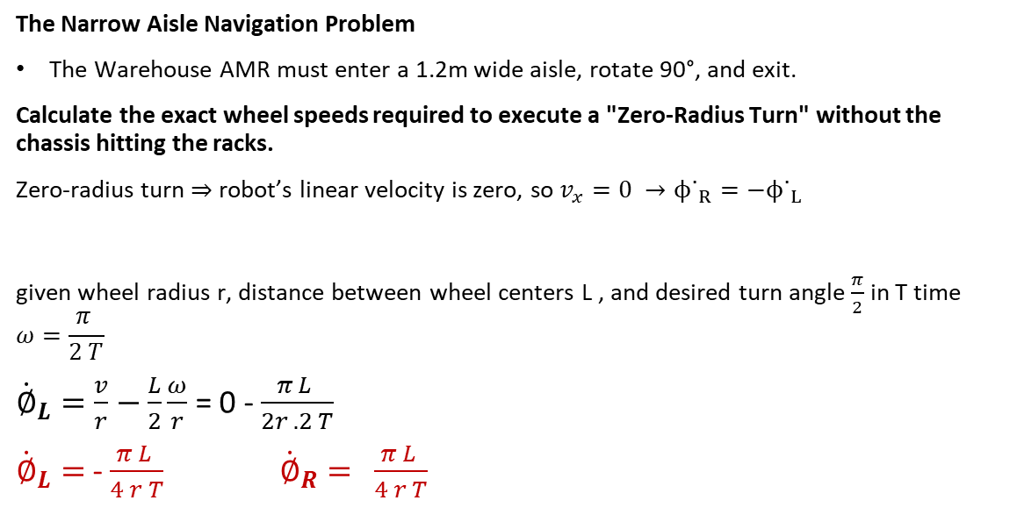

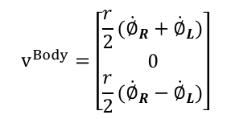
Kinematic Blueprints & Constraints
The Narrow Aisle Navigation Problem
The Warehouse AMR must enter a 1.2m wide aisle, rotate 90°, and exit.
Calculate the exact wheel speeds required to execute a "Zero-Radius Turn" without the chassis hitting the racks.
Zero-radius turn ⇒ robot’s linear velocity is zero, so $v_{x}=0 →ϕ˙_{R}=−ϕ˙_{L}$
given wheel radius r, distance between wheel centers L , and desired turn angle $\frac{π}{2}$ in T time
$$ω=\frac{π }{2 T}$$
${\dot{∅}}_{L}=\frac{v}{r}−\frac{L}{2}\frac{ω}{r}$ = 0 - $\frac{π L }{2r .2 T}$
${\dot{∅}}_{L}=$- $\frac{π L }{4 r T}$ ${\dot{∅}}_{R}= \frac{π L }{4 r T}$
$${\dot{∅}}_{L}=\frac{v}{r}−\frac{L}{2}\frac{ω}{r}$$
${\dot{∅}}_{R}=\frac{v}{r}+\frac{L}{2}\frac{ω}{r}$
$$v^{Body}=\left[\begin{matrix}\frac{r}{2}({{\dot{∅}}_{R}+\dot{∅}}_{L}) \\ 0 \\ \frac{r}{2}({{\dot{∅}}_{R}−\dot{∅}}_{L})\end{matrix}\right]$$

Slide 21
Kinematic Constraints
The Warehouse AMR is on position (0,0,0) and wants to go to the delivery position on (0,2,x)
How to go there?
If a planner output
Move left 2 meters.
What is your opinion?
😏

Slide 22
Kinematic Constraints
The Warehouse AMR is on position (0,0,0) and wants to go to the delivery position on (0,2,x)
How to go there?
If a planner output
Move left 2 meters.
The AMR can't simply move sideways
😏

Slide 23
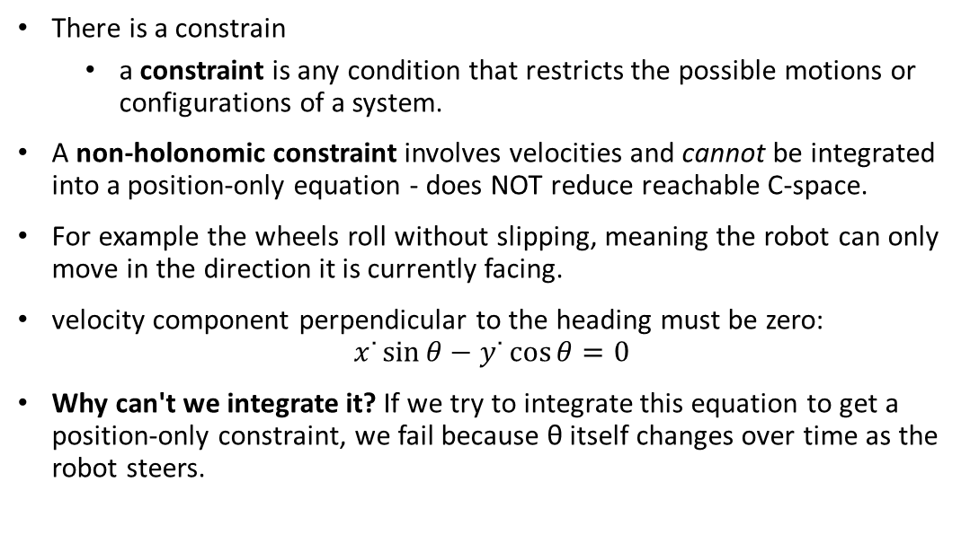
Kinematic Constraints - Holonomic vs Non-Holonomic Constraints
There is a constrain
a constraint is any condition that restricts the possible motions or configurations of a system.
A non-holonomic constraint involves velocities and cannot be integrated into a position-only equation - does NOT reduce reachable C-space.
For example the wheels roll without slipping, meaning the robot can only move in the direction it is currently facing.
velocity component perpendicular to the heading must be zero:
$$x˙\sin{θ}−y˙\cos{θ}=0$$
Why can't we integrate it? If we try to integrate this equation to get a position-only constraint, we fail because θ itself changes over time as the robot steers.
😏

Slide 24
Kinematic Constraints - Holonomic vs Non-Holonomic Constraints
What if the robot should move on specific rail?
Is that limiting the velocities?
Can we reach the goal?
😏

Slide 25
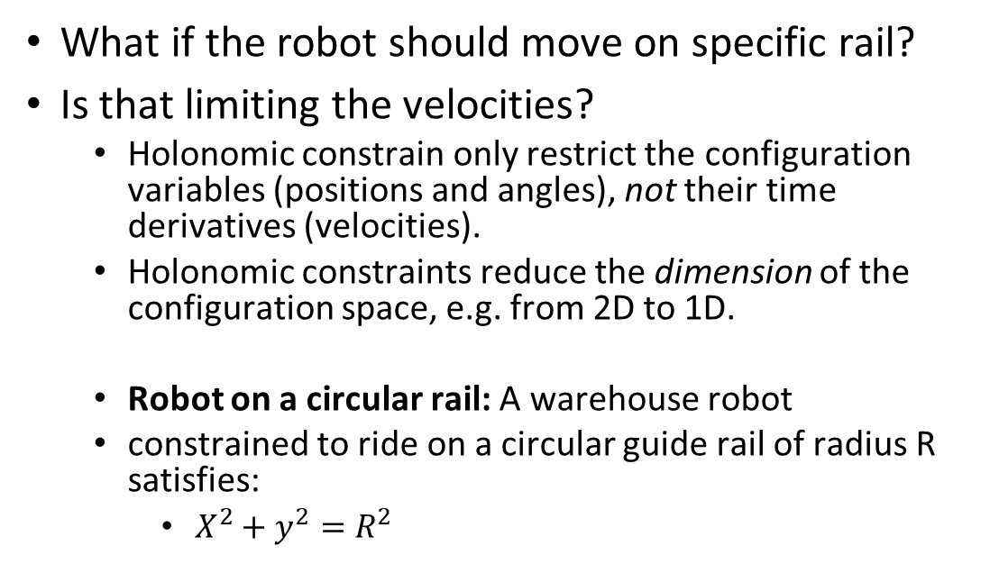
Kinematic Constraints - Holonomic vs Non-Holonomic Constraints
What if the robot should move on specific rail?
Is that limiting the velocities?
Holonomic constrain only restrict the configuration variables (positions and angles), not their time derivatives (velocities).
Holonomic constraints reduce the dimension of the configuration space, e.g. from 2D to 1D.
Robot on a circular rail: A warehouse robot
constrained to ride on a circular guide rail of radius R satisfies:
$X^{2}+y^{2}=R^{2}$
😏

Slide 26
Kinematic Constraints - Holonomic vs Non-Holonomic Constraints
Property | Holonomic constraints | Non-Holonomic constraints
Depends on | Position only | Velocities
Reduces configuration space dimension | Yes | No
Restricts reachable positions | Yes — some positions are forever forbidden | No — all positions remain reachable
Restricts instantaneous velocity | Not directly | Yes — certain velocities are forbidden at each instant

Slide 27
Kinematic Constraints - Holonomic vs Non-Holonomic Constraints
Why This Matters for Motion Planning
A planner that ignores non-holonomic constraints will
produce trajectories the robot cannot follow.
Valid plans must ensure the robot's velocity vector is always aligned with its heading (in differential robot case).
This is why car-like robots cannot change lanes instantaneously and why parallel parking requires a multi-step maneuver.
The non-holonomic constraint does not limit where the robot can go, but it limits how it can get there.

Slide 28
Heavy Duty Robot
The differential driving model assumes
perfect wheel contact with the floor,
no wheel slipping, and
exact motor control.
These assumptions hold well for small, lightweight warehouse robots on smooth concrete. But real vehicles behave differently.
We need a robots to move heavy pallets
To better represent steering vehicles we need different kinematics that is more accurate.
What can it Be?

Slide 29
Kinematic Blueprints & Constraints - Bicycle Model (Car-Like Robots)
These Robot have
a front steering axle (two wheels that turn together) and
a rear drive axle (two fixed wheels).
Unlike the differential-drive robot,
the driver steers by changing the angle of the front wheels
What can we control?

Slide 30
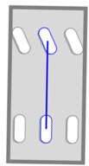
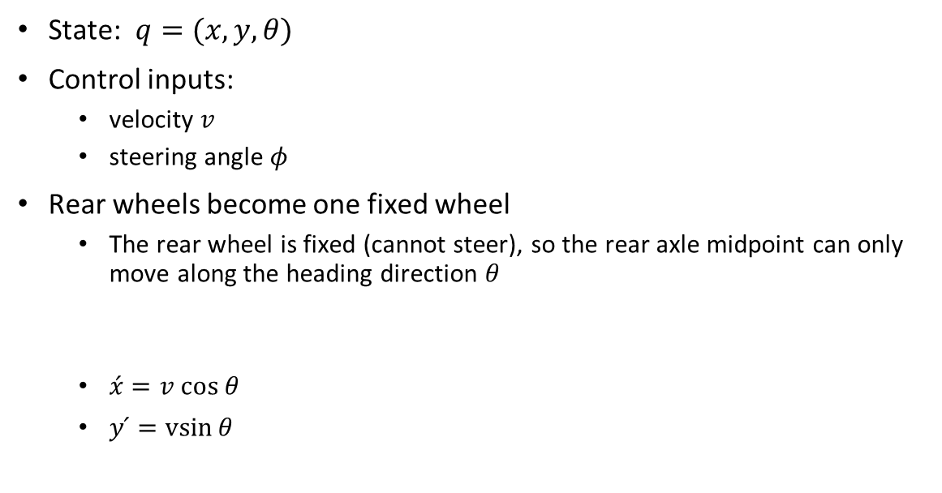
Kinematic Blueprints & Constraints - The Bicycle Approximation
State: $q=(x, y, θ)$
Control inputs:
velocity $v$
steering angle $φ$
Rear wheels become one fixed wheel
The rear wheel is fixed (cannot steer), so the rear axle midpoint can only move along the heading direction $θ$
$\acute{x}=v cos θ$
$y ́=vsin⁡θ$
These are identical to the differential-drive equations because the rear wheel obeys the same no-lateral-slip condition
https://thomasfermi.github.io/Algorithms-for-Automated-Driving/Control/BicycleModel.html

Slide 31
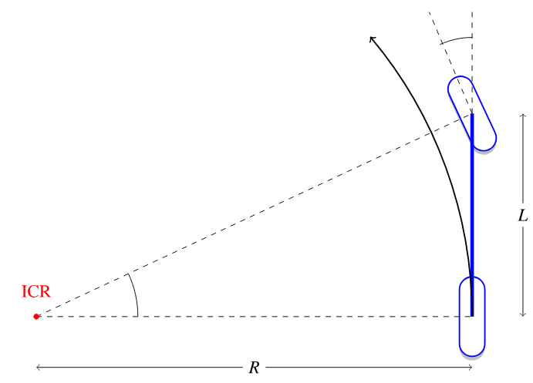
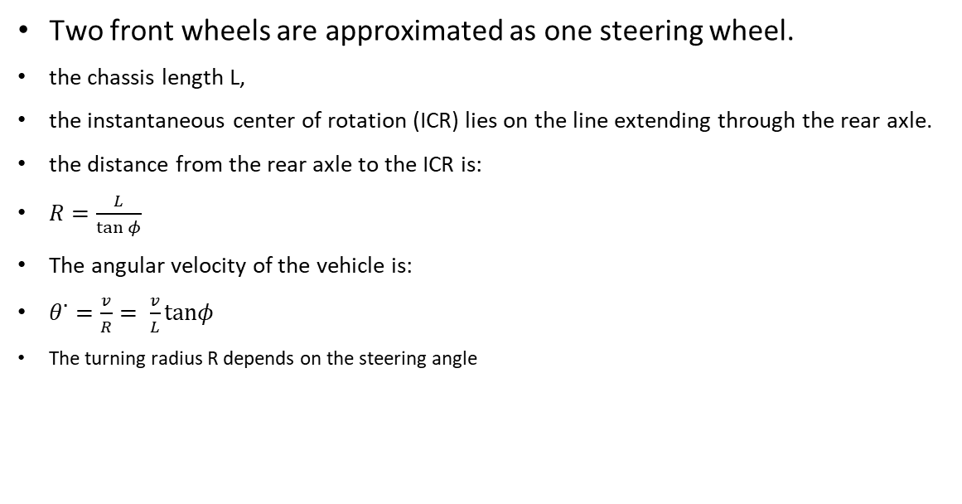
Kinematic Blueprints & Constraints - The Bicycle Approximation
Two front wheels are approximated as one steering wheel.
the chassis length L,
the instantaneous center of rotation (ICR) lies on the line extending through the rear axle.
the distance from the rear axle to the ICR is:
$R=\frac{L}{\tan{φ}}$
The angular velocity of the vehicle is:
$θ˙=\frac{v}{R}= \frac{v}{L}​tanφ$
The turning radius R depends on the steering angle
https://thomasfermi.github.io/Algorithms-for-Automated-Driving/Control/BicycleModel.html

Slide 32
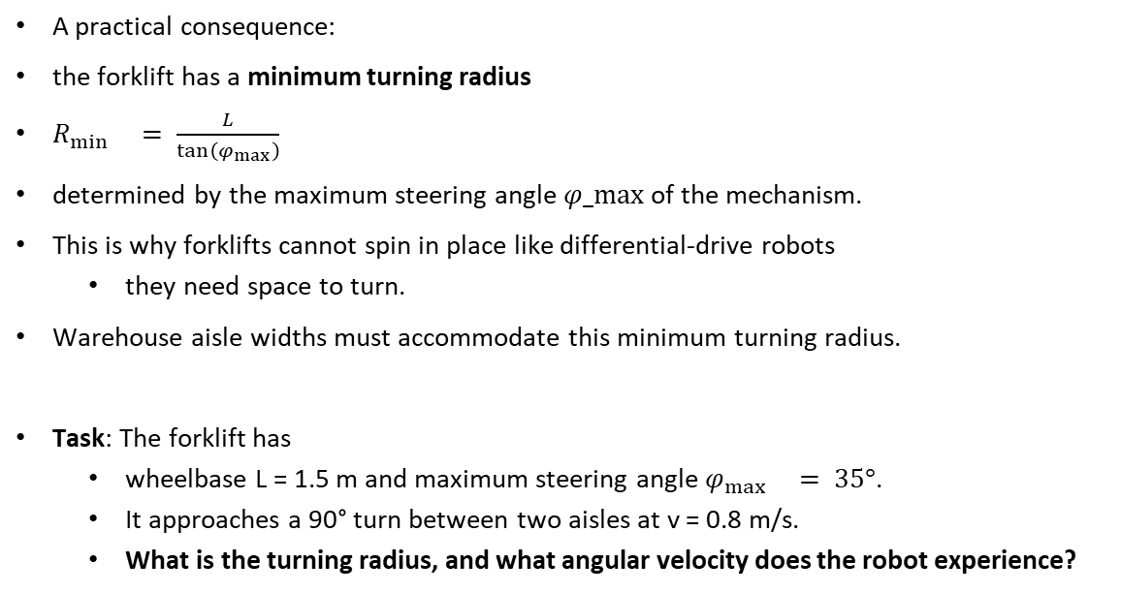
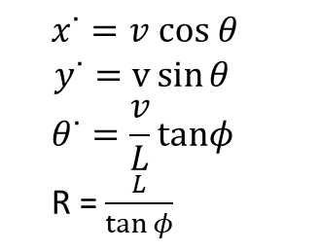
Kinematic Blueprints & Constraints - The Bicycle Approximation
A practical consequence:
the forklift has a minimum turning radius
$R_{\min{}}= \frac{L}{\tan\left(φ_{max}\right)}$
determined by the maximum steering angle $φ_max⁡$of the mechanism.
This is why forklifts cannot spin in place like differential-drive robots
they need space to turn.
Warehouse aisle widths must accommodate this minimum turning radius.
Task: The forklift has
wheelbase L = 1.5 m and maximum steering angle $φ_{\max{}}= 35°$.
It approaches a 90° turn between two aisles at v = 0.8 m/s.
What is the turning radius, and what angular velocity does the robot experience?
$$x˙=v cos θ$$
$$y˙=v\sin{θ}$$
$$θ˙=\frac{v}{L}​tanφ$$
R = $\frac{L}{\tan{φ​}}$
https://thomasfermi.github.io/Algorithms-for-Automated-Driving/Control/BicycleModel.html

Slide 33
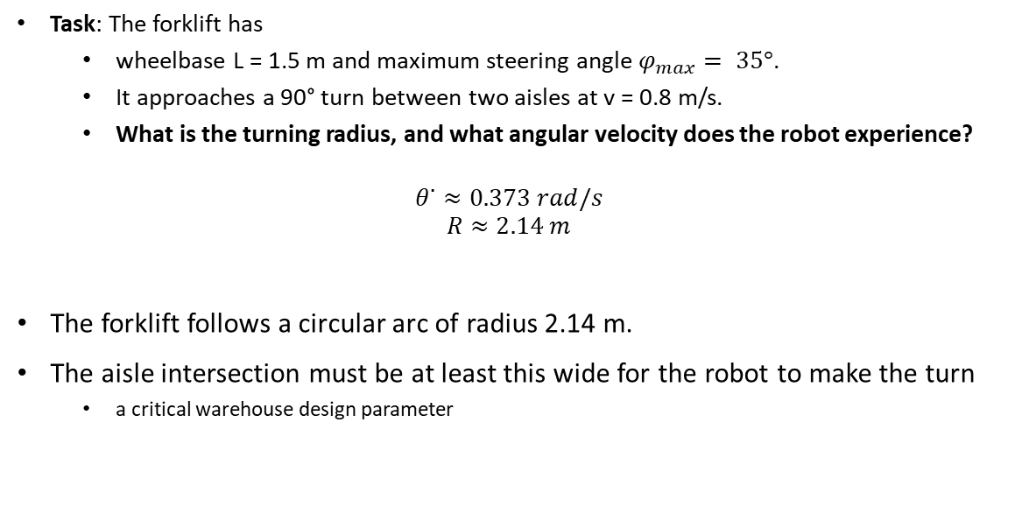
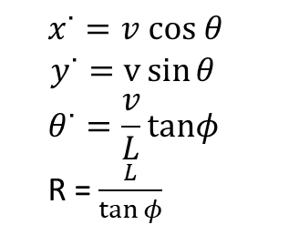
Kinematic Blueprints & Constraints - The Bicycle Approximation
Task: The forklift has
wheelbase L = 1.5 m and maximum steering angle $φ_{max}= 35°$.
It approaches a 90° turn between two aisles at v = 0.8 m/s.
What is the turning radius, and what angular velocity does the robot experience?
$$θ˙≈0.373 rad/s$$
$$R​≈2.14 m$$
The forklift follows a circular arc of radius 2.14 m.
The aisle intersection must be at least this wide for the robot to make the turn
a critical warehouse design parameter
$$x˙=v cos θ$$
$$y˙=v\sin{θ}$$
$$θ˙=\frac{v}{L}​tanφ$$
R = $\frac{L}{\tan{φ​}}$
https://thomasfermi.github.io/Algorithms-for-Automated-Driving/Control/BicycleModel.html

Slide 34
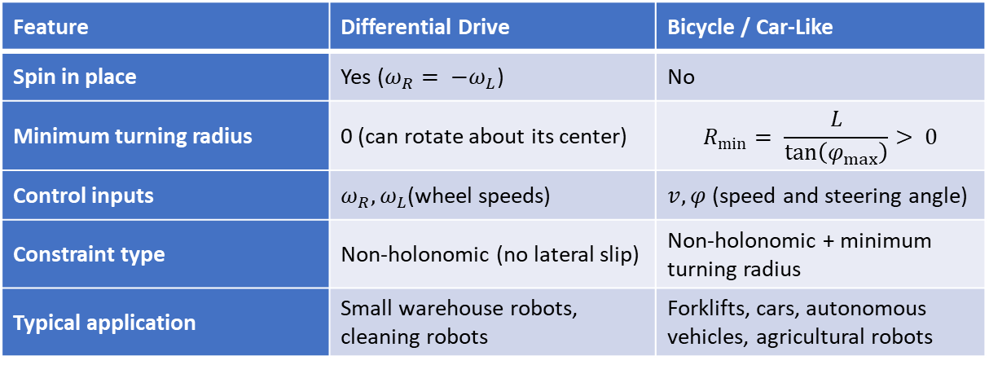
Kinematic Blueprints & Constraints - The Bicycle Approximation
Feature | Differential Drive | Bicycle / Car-Like
Spin in place | Yes ($ω_{R}= −ω_{L}$) | No
Minimum turning radius | 0 (can rotate about its center) | $$R_{min}= \frac{L}{\tan\left(φ_{max}\right)}> 0$$
Control inputs | $ω_{R}, ω_{L}$(wheel speeds) | $v, φ$(speed and steering angle)
Constraint type | Non-holonomic (no lateral slip) | Non-holonomic + minimum turning radius
Typical application | Small warehouse robots, cleaning robots | Forklifts, cars, autonomous vehicles, agricultural robots

Slide 35
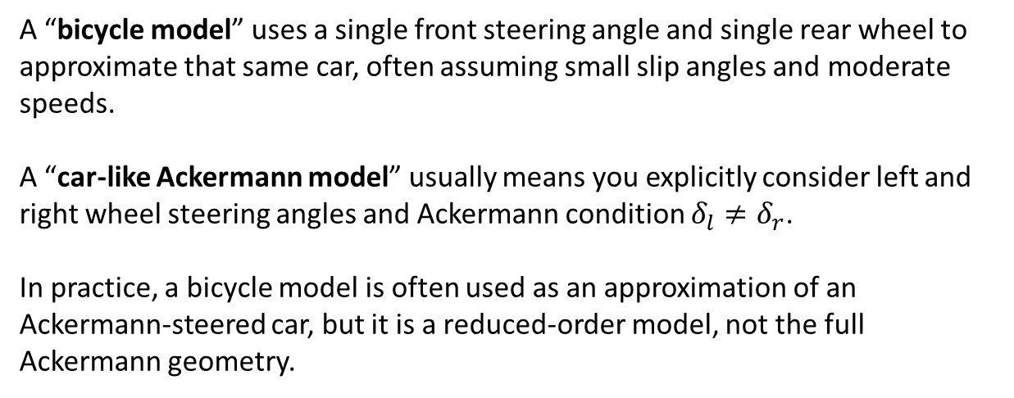
Kinematic Blueprints & Constraints - The Bicycle Approximation
A “bicycle model” uses a single front steering angle and single rear wheel to approximate that same car, often assuming small slip angles and moderate speeds.
A “car‑like Ackermann model” usually means you explicitly consider left and right wheel steering angles and Ackermann condition $δ_{l}≠δ_{r}$.
In practice, a bicycle model is often used as an approximation of an Ackermann‑steered car, but it is a reduced‑order model, not the full Ackermann geometry.

Slide 36
Kinematic Blueprints & Constraints
Your company is designing a new custom robot and needs to evaluate whether it will be able to navigate tight warehouse sections.
Instead of deriving the constraints from scratch for every new wheel configuration, the engineering team wants a general mathematical framework that works for any wheeled mobile robot
Is there a single mathematical framework that captures the constraints of any wheeled robot, so we can analyze new designs systematically?

Slide 37
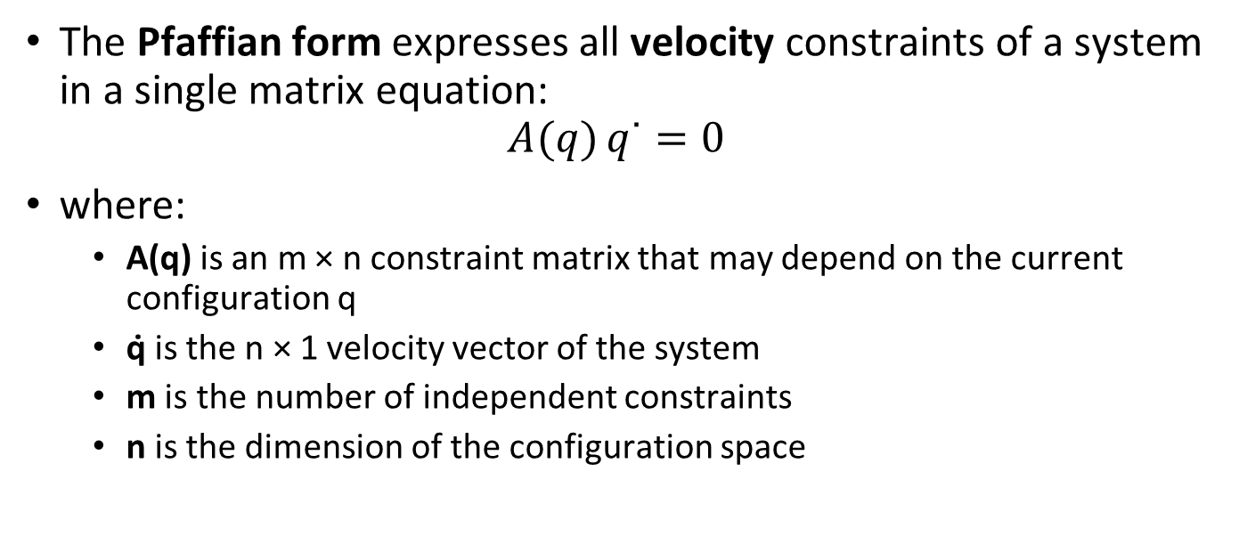
Kinematic Blueprints & Constraints
The Pfaffian form expresses all velocity constraints of a system in a single matrix equation:
$$A(q) q˙=0$$
where:
A(q) is an m × n constraint matrix that may depend on the current configuration q
q̇ is the n × 1 velocity vector of the system
m is the number of independent constraints
n is the dimension of the configuration space

Slide 38
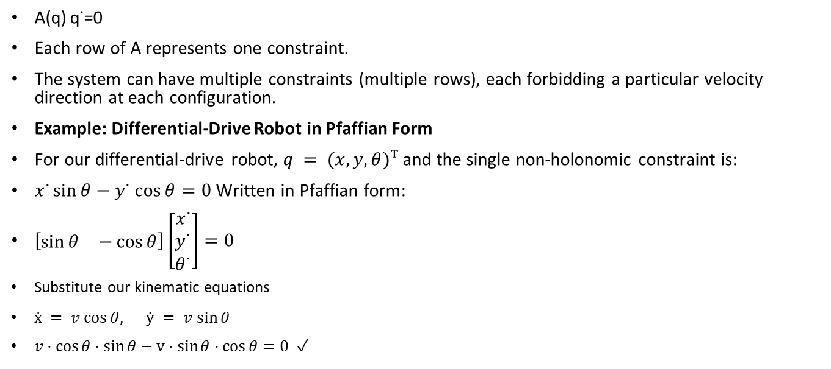
Kinematic Blueprints & Constraints - Pfaffian
A(q) q˙=0
Each row of A represents one constraint.
The system can have multiple constraints (multiple rows), each forbidding a particular velocity direction at each configuration.
Example: Differential-Drive Robot in Pfaffian Form
For our differential-drive robot, $q = (x, y, θ)ᵀ$and the single non-holonomic constraint is:
$x˙\sin{θ}−y˙ cos⁡θ=0$Written in Pfaffian form:
$\left[\begin{matrix}\sin{θ} & −\cos{θ}\end{matrix}\right]\left[\begin{matrix}x˙ \\ y˙ \\ θ˙\end{matrix}\right]=0$
Substitute our kinematic equations
$ẋ = v cos⁡θ, ẏ = v sin⁡θ$
$v⋅\cos{θ}⋅\sin{θ}−v⋅sin⁡θ⋅cos⁡θ=0$ ✓
The kinematic model automatically satisfies the Pfaffian constraint, as it should — the model was derived from the rolling constraint.

Slide 39
Kinematic Blueprints & Constraints - Pfaffian
Why Engineers Use Pfaffian Form
The Pfaffian form is powerful because it enables:
Systematic modeling — For any new robot, list the no-slip conditions for each wheel, express each as a row in A(q), and you have the complete constraint model.
Controllability analysis — From A(q), we can determine the null space (the set of allowed velocities) and analyze whether the system can reach all configurations (more on this in Section 7).
Motion planning — Planners can check proposed trajectories against A(q)q̇ = 0 to verify feasibility.
Control design — The allowed velocity directions (null space of A) define the input distribution, which is the starting point for nonlinear control law design.

Slide 40
Kinematic Blueprints & Constraints
Scenario
Diff-Drive
Bicycle / Ackermann
Mecanum
Legged
Warehouse tight aisles
(R < 1 m)
✅ R_min=0, zero turn
❌ R_min>0, too wide
⚠ Clean floor only
✅ R≈0 via steps
Road / outdoor travel
(speed > 2 m/s)
⚠ Slower, less stable
✅ Stable, fast
❌ High slip risk
❌ Too slow
Factory lateral precision
(sideways move)
❌ Multi-step maneuver
❌ Cannot go lateral
✅ Direct lateral
⚠ Slow steps
Mixed indoor/outdoor
(variable terrain)
⚠ Slower, less stable
⚠ Min R constraint
❌ Terrain sensitive
✅ Best adaptability

Slide 41
Odometry
The robot leaves its charging dock at a known position (0, 0, 0) begins driving toward a pick station.
The warehouse has no GPS coverage.
The robot must estimate its own position using only its internal sensors e.g. the wheel encoders that measure how much each wheel has turned.
how does the robot estimate its own position?

Slide 42
Odometry
The idea is straightforward:
if you know where you started, and you know
how fast and
in which direction you have been moving at each moment, you can
compute where you are now.
Dead reckoning is
the process of estimating the current position by starting from a known position and integrating velocity over time.
It is the simplest form of localization and requires no external sensors, only a kinematic model and internal measurements.

Slide 43

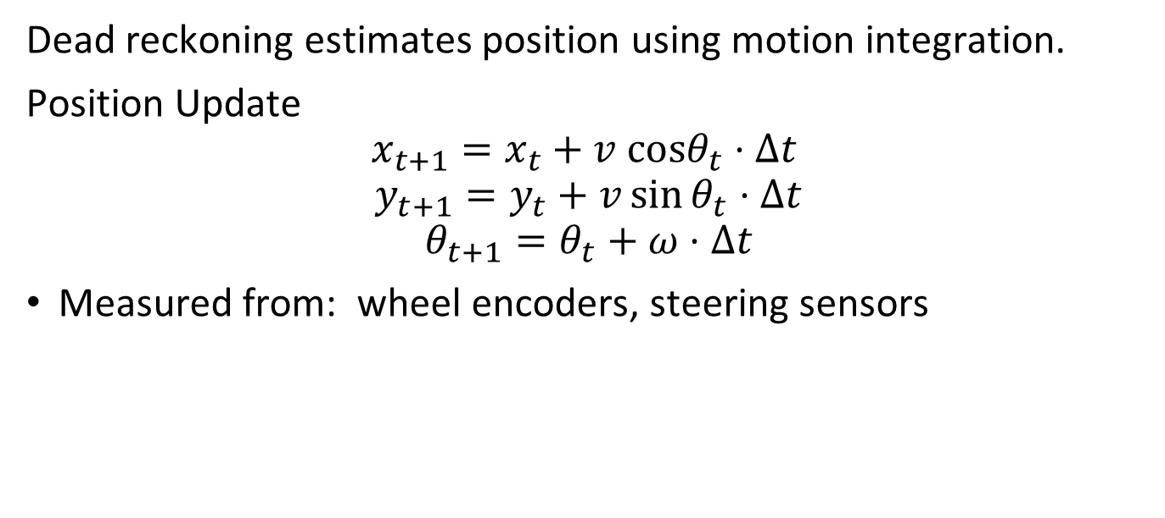
Odometry - Dead reckoning
Dead reckoning estimates position using motion integration.
Position Update
$$x_{t+1}​=x_{t​}+v cosθ_{t​}⋅Δt$$
$$y_{t+1}=y_{t}+v\sin{θ_{t}}⋅Δt$$
$$θ_{t+1​}=θ_{t}​+ω⋅Δt$$
Measured from: wheel encoders, steering sensors
$$v_{wheel}= r · ω_{wheel}$$

Slide 44
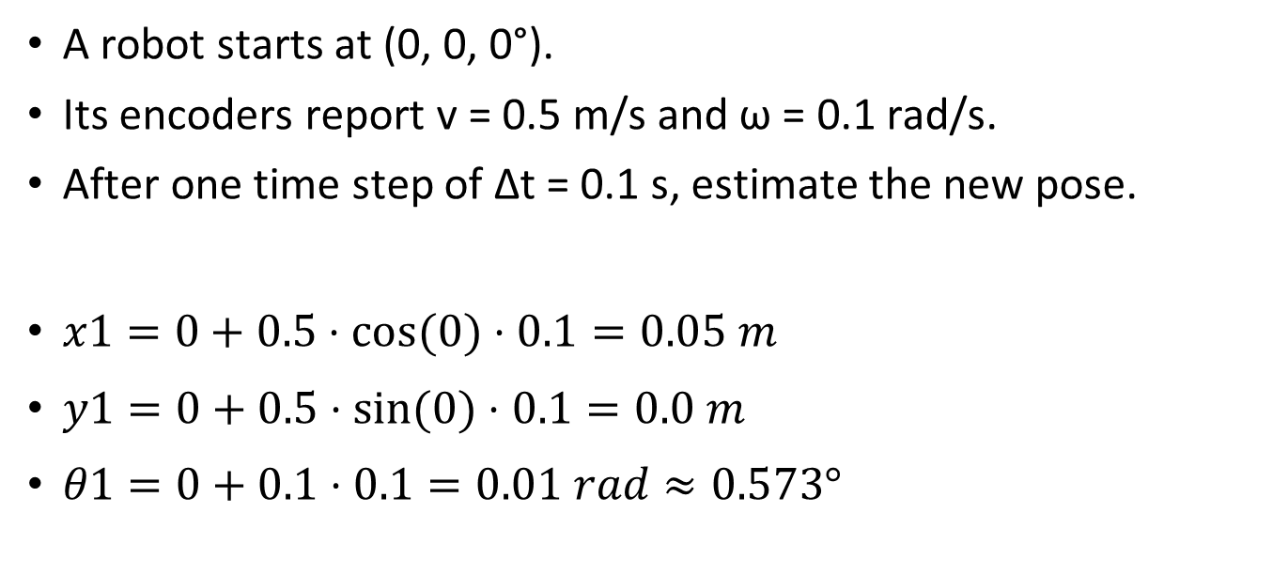
Odometry – Dead reckoning
A robot starts at (0, 0, 0°).
Its encoders report v = 0.5 m/s and ω = 0.1 rad/s.
After one time step of Δt = 0.1 s, estimate the new pose.
$x1​=0+0.5⋅cos⁡(0)⋅0.1=0.05 m$
$y1=0+0.5⋅sin⁡(0)⋅0.1=0.0 m$
$θ1​=0+0.1⋅0.1=0.01 rad≈0.573°$

Slide 45
Odometry - Dead reckoning
Dead reckoning suffers from unbounded error growth.
Every small measurement error — from wheel slip, uneven floors, or encoder quantization — is accumulated into the position estimate and never corrected.
After traveling 100 m, a 1% distance error means the position estimate is off by 1 m.
Worse, heading errors cause all subsequent position updates to be projected in the wrong direction

Slide 46
Odometry - Dead reckoning
This is why dead reckoning is almost never used alone.
It is combined with external corrections (landmarks, lidar, cameras) in algorithms like the Extended Kalman Filter or particle filters.
But dead reckoning remains the backbone of localization — it provides the continuous, high-rate position estimate between external corrections.

Slide 47
Traction control
A forklift robot picks up a 500 kg pallet
accelerates toward the shipping dock.
The heavy load increases the normal force on the drive wheels,
when the robot reaches a patch of oily concrete, the wheels spin freely.
The encoders report 2 m of forward travel, but the robot has only moved 0.5 m.
Dead reckoning is now wildly wrong, and the robot misses its target dock by 1.5 m.
What we should do about that, can we know when the robot is slipping?

Slide 48
Traction control
The kinematic models we derived assume pure rolling
the wheel's contact point has zero velocity relative to the ground.
In reality, wheels can slip.
When the drive torque exceeds the friction force the ground can provide, the wheel spins faster than the ground speed — this is longitudinal slip.
The opposite can also happen during braking: the wheel locks up and slides.

Slide 49
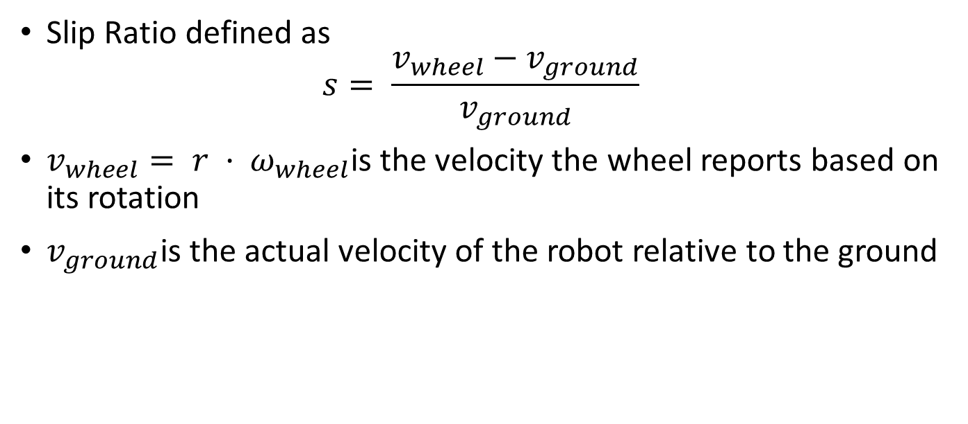
Traction control
Slip Ratio defined as
$$s= \frac{v_{wheel​}−v_{ground}}{v_{ground​​​}}$$
$v_{wheel}= r · ω_{wheel}$is the velocity the wheel reports based on its rotation
$v_{ground}$is the actual velocity of the robot relative to the ground

Slide 50

Traction control
Condition | Slip Ratio s | Meaning
Pure rolling | s = 0 | Encoder matches reality perfectly
Wheel spinning (acceleration slip) | s > 0 | Encoder over-reports distance
Wheel locked (braking slip) | s < 0 | Encoder under-reports distance
Any slip directly violates the Dead reckoning model's assumptions.
What we should do to limit the slipping?
$$s= \frac{v_{wheel​}−v_{ground}}{v_{ground​​​}}$$

Slide 51
Traction control
Traction Control Strategies
The goal is to keep the slip ratio as close to zero as possible:
Torque limiting: Reduce the motor torque when the wheel begins to spin. This is the simplest approach, analogous to traction control in cars.
Wheel speed comparison: Compare the speeds of the left and right wheels. A sudden difference suggests one wheel is slipping.
IMU-based correction: An inertial measurement unit (IMU) provides an independent acceleration estimate. If the IMU shows zero acceleration but the encoders report increasing speed, the wheel is slipping.
The robot can reduce torque and flag the dead reckoning estimate as unreliable.
Adaptive speed profiles: The planner reduces commanded velocities when the robot carries heavy loads or when approaching known low-traction zones (painted floor lines, metal grating, etc.).

Slide 52
Odometry errors
Odometry errors arise from multiple sources:
Encoder quantization: Finite tick resolution means small motions are rounded.
Wheel diameter uncertainty: Manufacturing tolerances, tire wear, and inflation pressure cause the actual wheel radius to differ from the nominal value.
Wheel slip: As discussed, any slip invalidates the pure-rolling assumption.
Uneven floors: Bumps and slopes cause the wheels to travel different distances than the flat-floor model predicts.

Slide 53
Traction control
How to use the traction information in robotics?
Real robots use traction monitoring as a critical safety and localization feature.
When slip is detected, the robot's localization module increases its uncertainty estimate,
prompting the system to rely more heavily on external sensors (lidar, cameras) for position correction.
Heavy-duty outdoor robots (agricultural, mining) use even more sophisticated slip estimation, often fusing encoder, IMU, and GPS data.

Slide 54
Your Task
Software team is implementing the localization module for differential drive robot.
They receive raw data from the wheel encoders: "right wheel rotated 150 ticks, left wheel rotated 143 ticks."
They must convert these tick counts into a pose update (Δx, Δy, Δθ).
Your task is to design a solution that convert the ticks into position.
What assumption you need, e.g. ticks resolution, … ?
What is your solution(s)? E.g. equations, algorithms,…
Make the implementation on paper first then in simulation e.g. using ROS and gazebo, or webbot, .
Note: explore the midpoint heading concept to improve the accuracy

Slide 55
MOD-003 DELIVERED (Motion Model)
MOD-004 WILL DELIVER (Sensor Model)
✅ SE(2) transforms + TF2
✅ Diff-drive FK and IK
✅ No-slip Pfaffian constraint
✅ Ackermann bicycle model
✅ Dead reckoning + covariance
✅ Slip ratio + traction control
→ PREDICT step of EKF complete
📡 LIDAR range model (beam model)
📡 Gaussian measurement noise N(0, σ²)
📡 Expected vs actual measurement h(q)
→ UPDATE step of EKF
MOD-005: EKF = PREDICT (MOD-003) + UPDATE (MOD-004)

Slide 56
?

Slide 57
Kinematic Blueprints & Constraints - Pfaffian
Null Space Interpretation
The velocities that the robot can execute are those in the null space of A(q). For the differential-drive robot, the null space of [sin θ, −cos θ, 0] is two-dimensional, spanned by:
​​ These are precisely the forward-motion vector and the rotation vector. Any velocity the robot can achieve is a linear combination v·g₁ + ω·g₂ — which is exactly the kinematic model we derived earlier.
The Pfaffian form thus provides an alternative, and often cleaner, route to the kinematic equations.
q˙=g1(q)v1+g2(q) ω

Slide 58
Kinematic Blueprints & Constraints - Chow's Theorem (Controllability)
A robot must parallel-park into a narrow loading dock. It cannot move sideways. Yet experienced human drivers parallel-park cars every day using only forward, reverse, and steering. The question is:
Can we mathematically prove that the robot can reach any pose despite the non-holonomic constraint?

Slide 59
Kinematic Blueprints & Constraints - Chow's Theorem (Controllability)
The Lie Bracket
The mathematical tool that captures this idea is the Lie bracket of two vector fields. Given our two control vector fields:
g_1​=​(cosθ,sinθ,0)​​(forward motion),g_2​=(​0,0,1)​​(rotation)
The Lie bracket is defined as:
[g_1,g_2]=(∂g_2/∂q)g_1−(∂g_1/∂q)g_2​
Practical Consequence
Chow's Theorem guarantees that a motion planner can always find a path connecting any two configurations, even for non-holonomic robots. The planner may need complex maneuvers (like the multi-step parallel parking sequence), but a solution always exists. This is a foundational result for warehouse robot deployment: no loading dock or shelf position is inherently unreachable, as long as there is sufficient free space for the robot to maneuver.

Slide 60
Reference card — photograph this slide
E01
SE(2) Transform
E02
Frame Chain
E03
FK — linear speed
T=[cosθ −sinθ x; sinθ cosθ y; 0 0 1]
T_WL = T_WR · T_RL
v = r(ω_R+ω_L)/2
E04
FK — pose dot
E05
IK — wheel speeds
E06
No-Slip Constraint
[ẋ ẏ θ̇]=[cosθ 0; sinθ 0; 0 1]·[v ω]
ω_R=(2v+ωl)/(2r), ω_L=(2v−ωl)/(2r)
ẋ sinθ − ẏ cosθ = 0
E07
Pfaffian Form
E08
Ackermann Model
E09
Ackermann R_min
A(q)·q̇=0, A=[sinθ, −cosθ, 0]
ẋ=v cosθ, ẏ=v sinθ, θ̇=(v/L)tanδ
R_min = L / tan(δ_max)
E10
Mecanum Jacobian
E11
Maneuverability
E12
Odometry Integration
[vx vy ω]ᵀ = (r/4)·J·[ω1 ω2 ω3 ω4]ᵀ
δ_M = δ_m + δ_s
q_{k+1} = q_k + f(q_k, u_k)·Δt
E13
Covariance Propagation
E14
Slip Ratio
E15
Traction Limit
Σ_{k+1} = F_k·Σ_k·F_kᵀ + Q_k
λ = (v_wheel−v_ground)/max(v_w, v_g)
F_traction ≤ μ_s · N

Slide 61
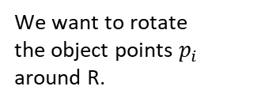




$$P_{1}$$
r
r
r
r
W
W
W
We want to rotate
the object points $p_{i}$
around R.
$$T\left(−r\right)P_{i}$$
$$R\left(θ\right)T\left(−r\right)P_{i}$$
r
W
$$T\left(r\right)R\left(θ\right)T\left(−r\right)P_{i}$$

