Slide 1
C E 4 0 1 1 · S T R U C T U R A L A N A L Y S I S P R O J E C T
2D Structural Analysis
& Timber Design Suite
A from-scratch direct-stiffness solver with multi-code timber member design.
Built with C# · .NET 10 · WPF
Presented by Sayed Ali Abbas Rasool

Slide 2
01
Program Overview
A from-scratch desktop application that analyzes plane frames and trusses by the linear-elastic direct-stiffness (matrix displacement) method, then designs timber members to three international codes.
Every layer — solver, loading engine, design engine and matrix library — is hand-built (only CSparse is external).
3
88
design codes
NDS · EC5 · TBDY
tests passing
automated regression suite
CAPABILITIES
▪ Loads — nodal, UDL, point, thermal & support settlement
100%
2
▪ Modeling — moment releases / internal hinges; frame & truss
▪ Results — reactions, displacements, N/V/M diagrams, deflected shapes
from scratch
solver · loads · design · matrix
element types
frame (6 DOF) · truss (4 DOF)
▪ Design — code load combinations & per-member D/C utilization

Slide 3
02
Layered Architecture
Strictly one-directional dependencies — each layer knows only the one beneath it.
FrameAnalysis.UI — WPF shell: XAML views, editable grids, live 2D canvas renderer
FrameAnalysis.UI.Core — WPF-free ViewModels, services & DTO mapping
FrameAnalysisProgram
Direct-stiffness solver
MemberDesigner
Timber design engine
StructuralLoads
Load types & natures
Matrix_Library
Sparse matrices + CSparse
Data-flow boundary: StructureInputData → StructureModelBuilder → StructureModel → FrameAnalyzer.Analyze → FrameAnalysisResult

Slide 4
02
Object-Oriented Design
Polymorphic elements
StructuralElement2D (abstract)
FrameElement2D (6 DOF) and TrussElement2D (4 DOF) override stiffness & rotation; the assembler treats both uniformly via GetDofAddresses().
Interface-driven loads
INodalLoad · IMemberLoad
UniformDistributedLoad, PointLoad and TemperatureLoad each implement AssembleIntoVector() — a new load type never touches the solver.
Swappable solvers (Strategy)
ILinearSolver
SparseLDLtSolver and CSparseCholeskySolver are fully interchangeable behind a single interface.
Generic design checks
ITimberDesignCheck<TInput,TData>
A dependency graph (parameters → checks) executed in topological levels by ATimberDesigner.CheckDesignAsync.
Single source of truth: the UI's ProjectDocument (observable VMs, object references) is mapped to the tabular solver DTO only at export — so reorder, insert and delete in the grids are always safe.

Slide 5
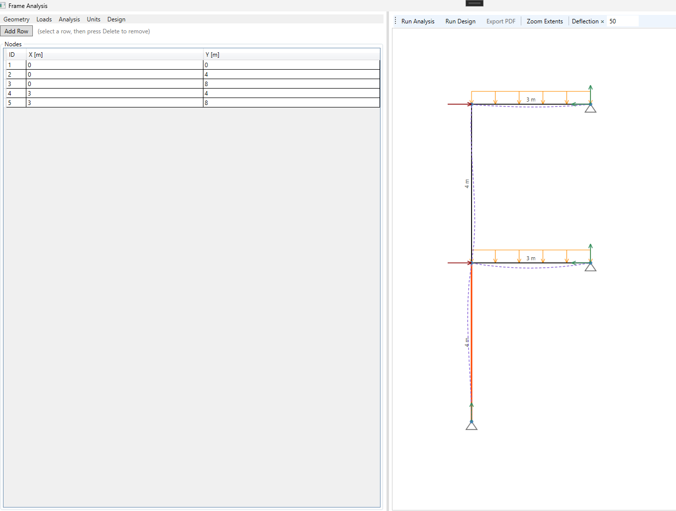
03
User Interface & Input
1
Nodes (X, Y) coordinates
2
Materials pick a timber grade — design values auto-fill (EN 338 / NDS)
3
Sections width × depth, moment of inertia I
4
Elements combo-box refs to node / material / section; frame or truss; moment release
Screenshot — application shell
Split window: editable grids (left) · live 2D canvas (right)
Supports restraints + prescribed settlements
5
6
Loads joint · distributed · point · thermal · settlement
7
Design ▸ Project Details code · service class / moisture · load duration
Live canvas on every edit · Object references (safe reorder / delete)

Slide 6
04
Live Analysis Demonstration
05
Post-Processing & Results

Slide 7
06
Verification
HOW IT IS VERIFIED
88
▪ Closed-form checks
cantilever, simply-supported UDL & point load (SectionForceRecoveryTests).
▪ Equilibrium residual
internal ||K·U − F|| check after every solve.
of 88 tests passing
Automated regression suite covering the solver, loading, recovery and design engines.
▪ Hand-calc

Slide 8
07
Limitations & Roadmap
Current limitations
Planned improvements
▪ 2D only — no minor-axis / out-of-plane / 3D
▸ Project persistence (JSON)
▸ Full design envelope across all load combinations in the analysis phase as well.
▪ Linear-elastic, small-displacement — no P-Δ, buckling lengths, or modal / dynamic
▸ 3D analysis via the swappable IStructuralRenderer
▸ More testing and validation.
▪ Timber design only, solid members
▪ No project save / load yet and not very well detailed calc-report export

Slide 9
Thank you
2D Structural Analysis & Timber Design Suite
Sayed Ali Abbas Rasool

