Slide 1
K-Nearest Neighbours (KNN) – Distance Metrics & Feature Scaling
A Machine Learning Tutorial
Syed Abbas Ali Safdar

Slide 2
What is KNN?
K-Nearest Neighbors is a simple yet powerful classification algorithm.
Finds the ‘k’ closest data points to a new sample.
Assigns the most common label among them.
Works similarly to taking a majority opinion from friends.

Slide 3
How KNN Works
KNN operates in three steps:
1. Compute the distance between the new point and all existing points.
2. Identify the k closest points based on the distance metric.
3. Assign the most common class label among neighbors.

Slide 4
IMDB Sample Dataset
Name | Rating | Duration | Genre
Movie 1 | 8.0 | 160 | Action
Movie 2 | 6.2 | 170 | Action
Movie 3 | 7.2 | 168 | Comedy
Movie 4 | 8.1 | 155
Predict the Genre of the movie 4

Slide 5

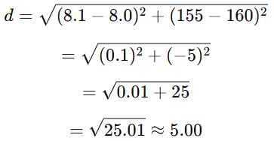
Calculating Euclidean Distance
Formula :
Movie 1 :

Slide 6
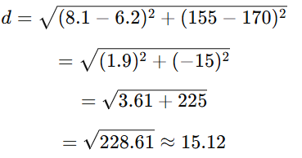
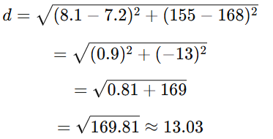
Movie 2 (Action) :
Movie 3 (Comedy) :
The smallest distance is 5.00 (closest to Movie 1, which is Action). Therefore , Movie 4 is most likely an Action movie.

Slide 7
The Role of Distance Metrics
KNN relies on measuring distances between points. Common metrics:
- Euclidean Distance (straight-line distance)
- Manhattan Distance (sum of absolute differences)
- Minkowski Distance (generalized form of both)

Slide 8
Why Feature Scaling Matters
Feature scaling ensures no feature dominates the classification.
- If features have different scales, KNN may focus on one over the other.
- Example: House prices (sq. footage vs. room count). Scaling balances importance.

Slide 9
Implementing KNN (Code Walkthrough)
1. Generate a dataset.
2. Apply KNN without scaling – observe accuracy.
3. Scale features and compare results.
4. Experiment with different k-values and distance metrics.

Slide 10
Key Findings
1. KNN performs better with feature scaling (accuracy improved).
2. Distance metric choice affects classification boundaries.
3. The best k-value depends on the dataset.

Slide 11
Conclusion
KNN is intuitive but requires proper preprocessing.
- Understanding distance metrics and scaling enhances performance.
- Experiment with k-values and scaling for better accuracy.

Slide 12
References
Scikit-learn documentation: https://scikit-learn.org/stable/modules/neighbors.html
Towards Data Science: Articles on KNN and distance metrics
Géron, A. (2019). Hands-On Machine Learning with Scikit-Learn, Keras, and TensorFlow

Slide 13
Github Link
https://github.com/Abbas12u/MachineleariningKNN

