Slide 1
Secure data hiding in images using steganography
CAPSTONE PROJECT
Presented By : Shaik Mahammad Abbas
Student Name : Shaik Mahammad Abbas
College Name & Department : Madhura Sai Institute of IT and Management

Slide 2
OUTLINE
Problem Statement
Technology used
Wow factor
End users
Result
Conclusion
Git-hub Link
Future scope

Slide 3
Problem Statement
In today’s digital world, data security and privacy are major concerns, as traditional encryption methods are easily detected. Steganography provides a covert way to transmit confidential information by embedding messages within images. This enhances data confidentiality while preventing detection. Our project focuses on using steganography to enable secure communication and protect privacy in a vulnerable digital landscape.

Slide 4
Technology used
Programming Language: Python
Libraries:
OpenCV for image processing.
NumPy for efficient array manipulation.
Platform: Cross-platform (Windows/Linux)
Tools: IDLE(python)

Slide 5
Wow factors
Utilizes LSB steganography to securely encode the passcode and message length within the image header.
Maintains hidden data integrity by leveraging a lossless PNG format.
Provides an intuitive, user-friendly interface for seamless encryption and decryption.
Integrates advanced image processing methods to enhance secure data transmission.

Slide 6
End users
Security professionals and cybersecurity enthusiasts.
Journalists, activists, and government agencies needing secure communication channels.
Students and researchers interested in data privacy and steganography.
General users looking for enhanced digital security.

Slide 7
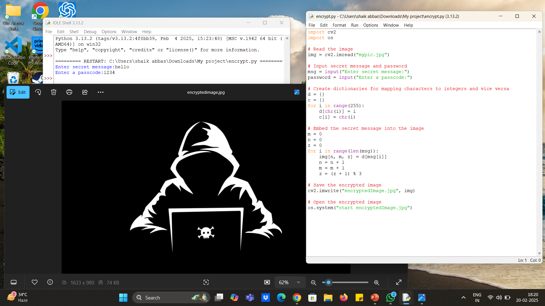
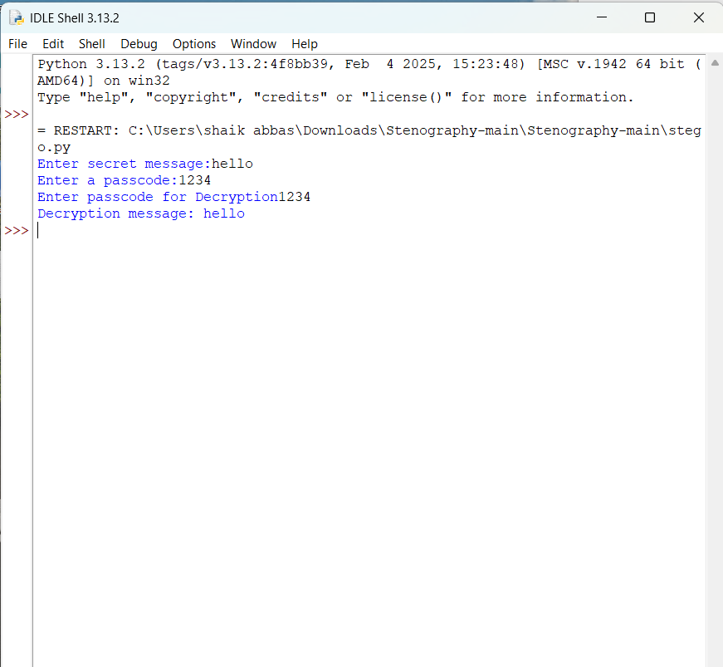
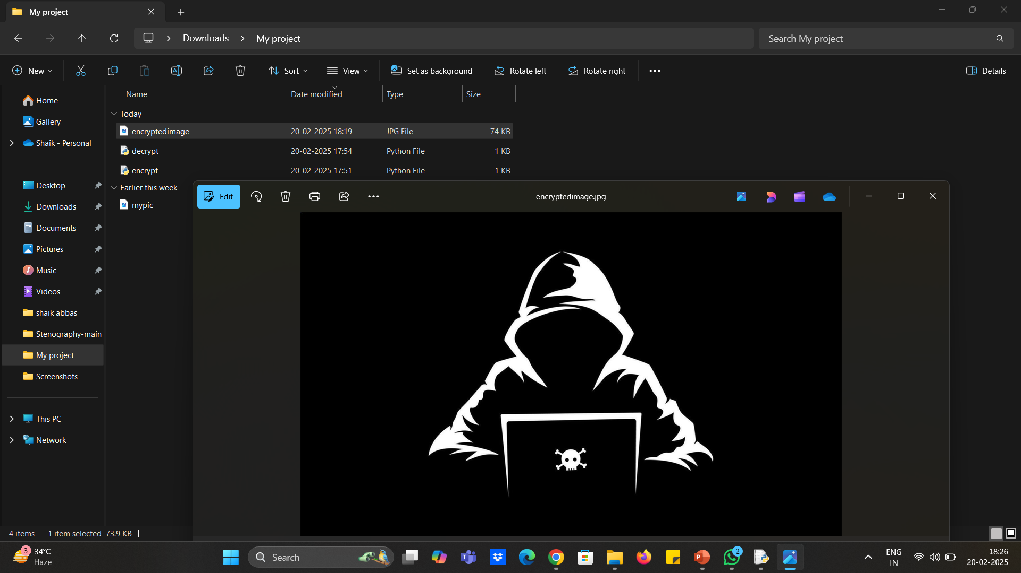
Results

Slide 8
Conclusion
My project introduces an innovative method for data security by concealing information within images using LSB steganography.
By embedding key details like passcodes and message lengths in the header, the technique remains both highly secure and virtually undetectable.
A user-friendly GUI ensures ease of use, making the encryption and decryption process accessible to all.
This work significantly advances digital privacy and strengthens secure data transmission practices.

Slide 9
GitHub Link
https://github.com/Abbas7777/secure-data-hiding-in-images-using-steganography.git

Slide 10
Future scope(optional)
Enable compatibility with various image formats and support higher-resolution images.
Expand the method to video steganography for dynamic and versatile data hiding.
Integrate advanced encryption techniques to enhance message security.
Create a web-based or mobile application to improve accessibility and usability.
Investigate automated tools for detecting and extracting steganographic content.

Slide 11
THANK YOU

