Slide 1
SAMS
Students' Auditorium
Management Software
Software Engineering Lab
Mohammad Abbas Mehdi · 24JE0656

Slide 2
PROBLEM
Replace the manual show management system
Show Manager
Show dates, timings, seats for sale, complimentary seats, prices, sales accounts, reports
Sales Person
Sells tickets with seat numbers; each sale records the sales person for commission
Spectator
Queries seat availability; books and cancels through a sales person
Accounts Clerk
Enters show expenditure, including payment to artists
REFUND ON CANCELLATION
− Rs 5
3+ clear days before the show
− Rs 10 / 15
3 to 1 days before (ordinary / balcony)
− 50%
last day of the show
Constraint low cost, free software: Linux · MySQL · Apache
02

Slide 3
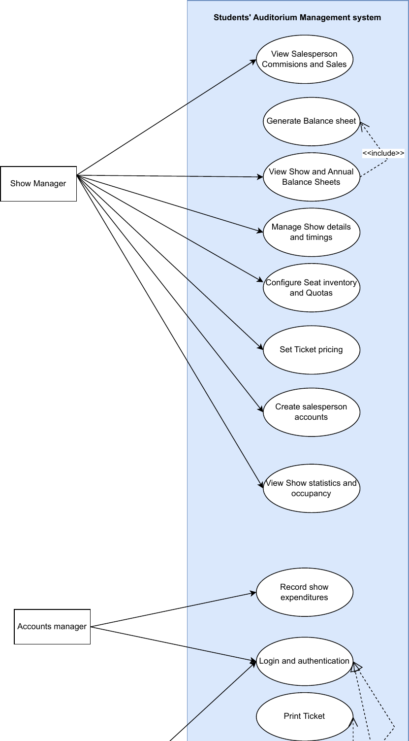
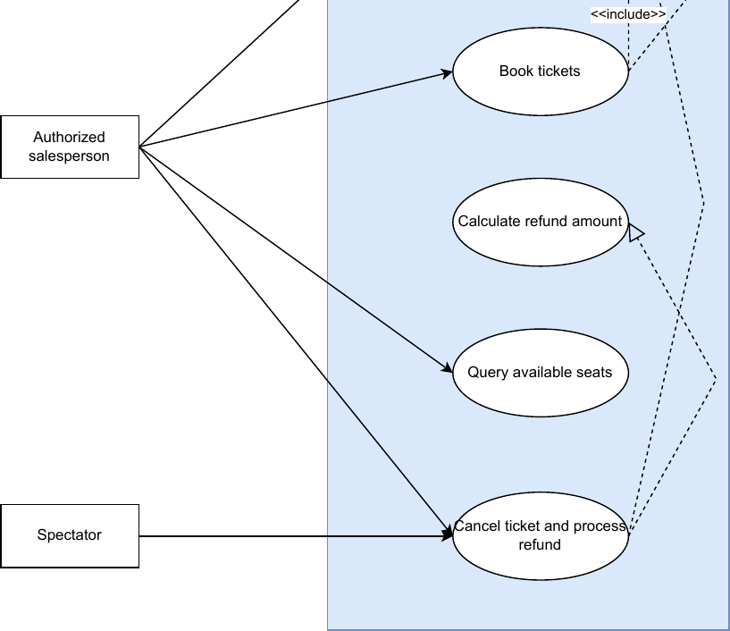
UML · USE CASE
Use case diagram (1)
03

Slide 4
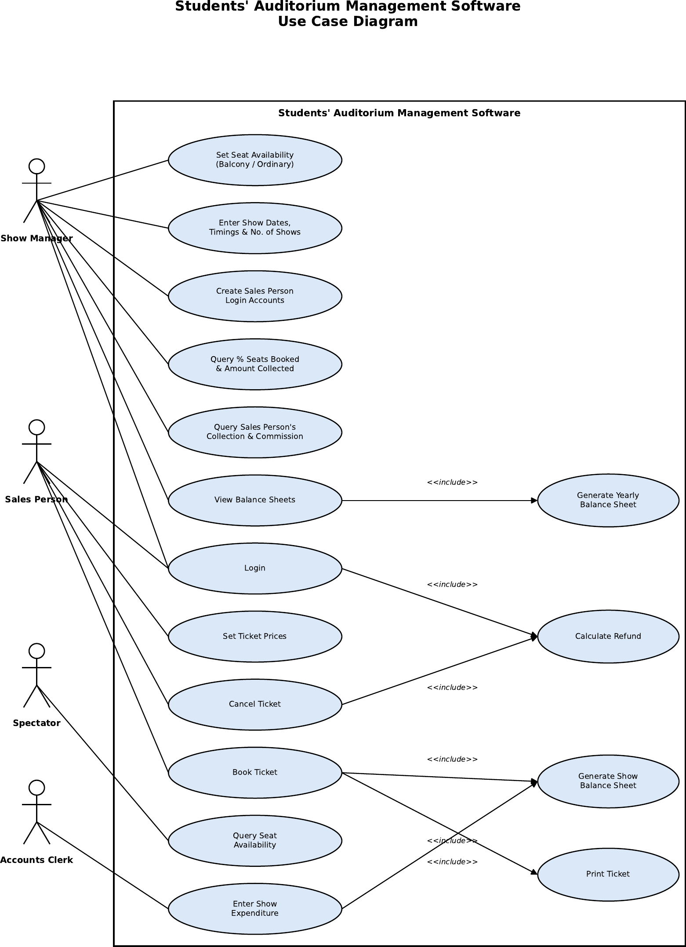
UML · USE CASE
Use case diagram (2)
04

Slide 5
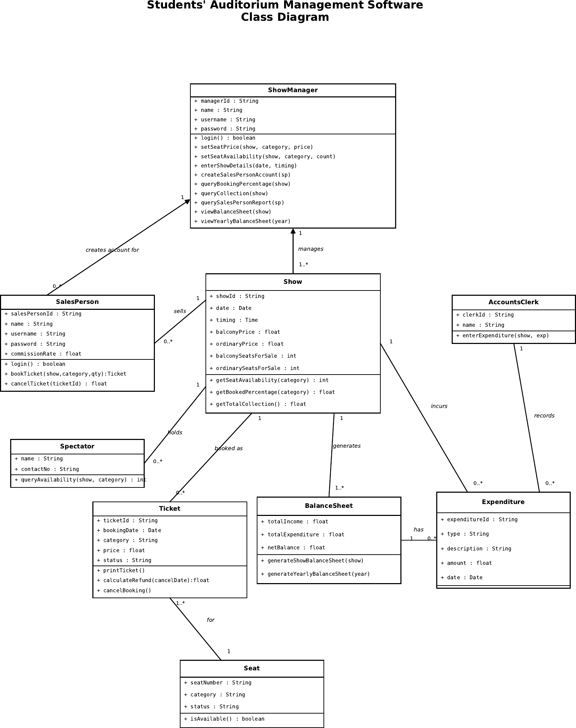
UML · CLASS
Class diagram
05

Slide 6
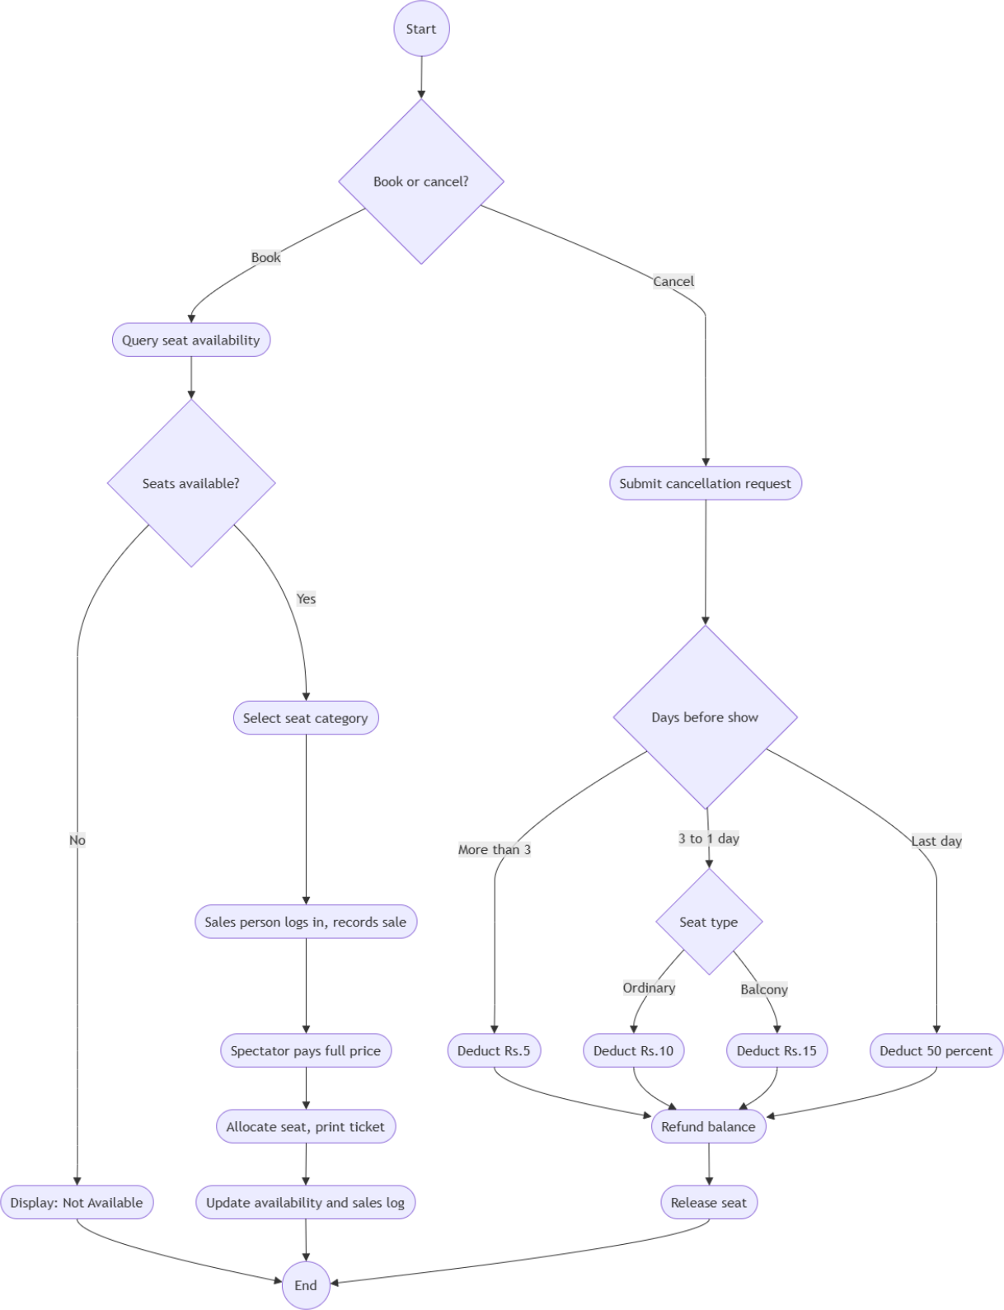
UML · ACTIVITY
Booking & cancellation
06

Slide 7
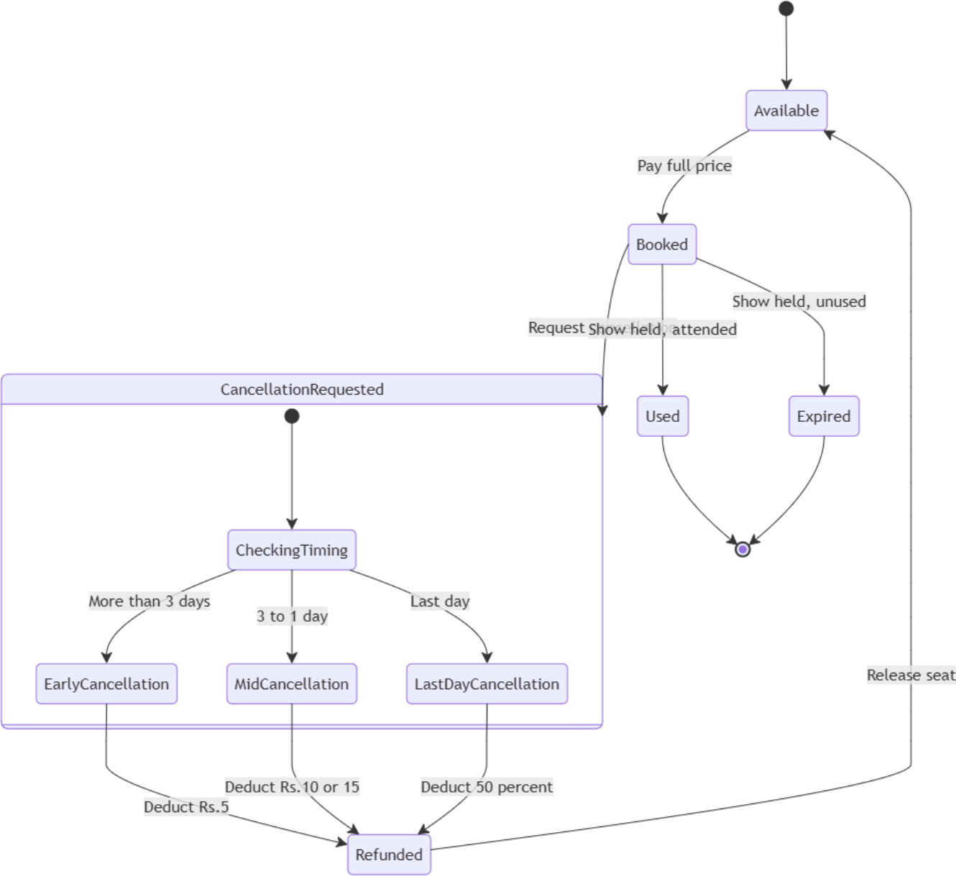
UML · STATE
Ticket life cycle
07

Slide 8
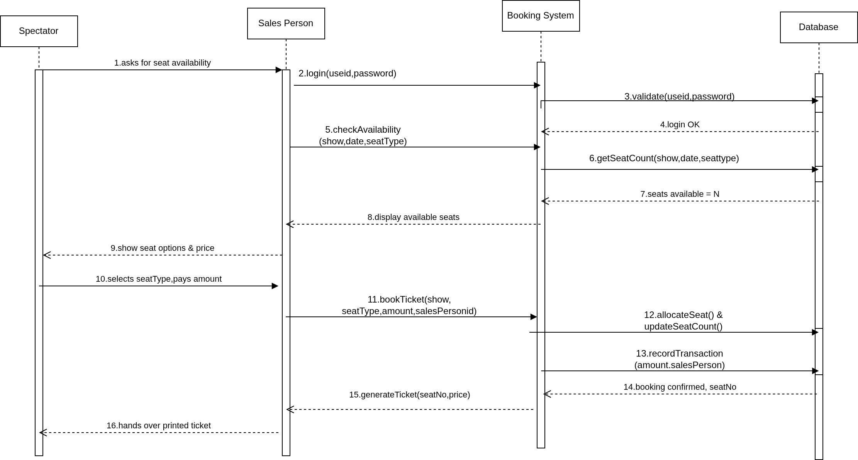
UML · SEQUENCE
Ticket booking
08

Slide 9
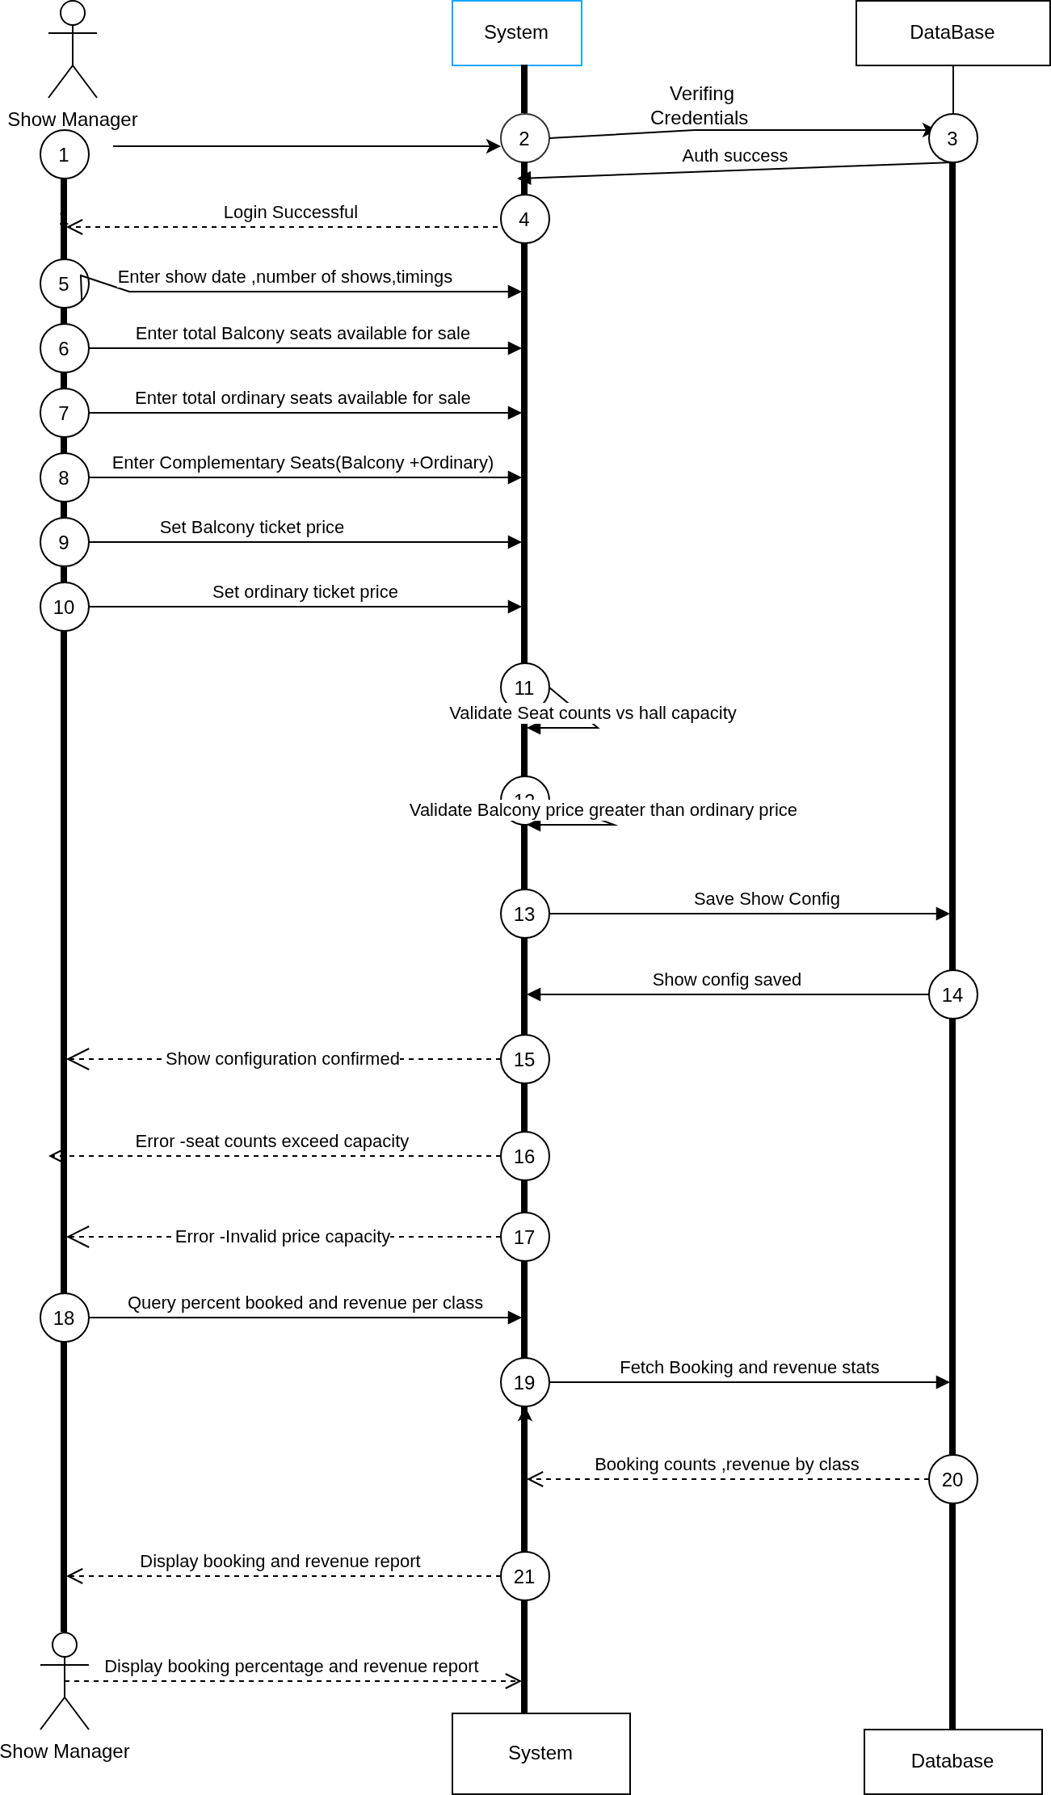
UML · SEQUENCE
Show configuration
09

Slide 10
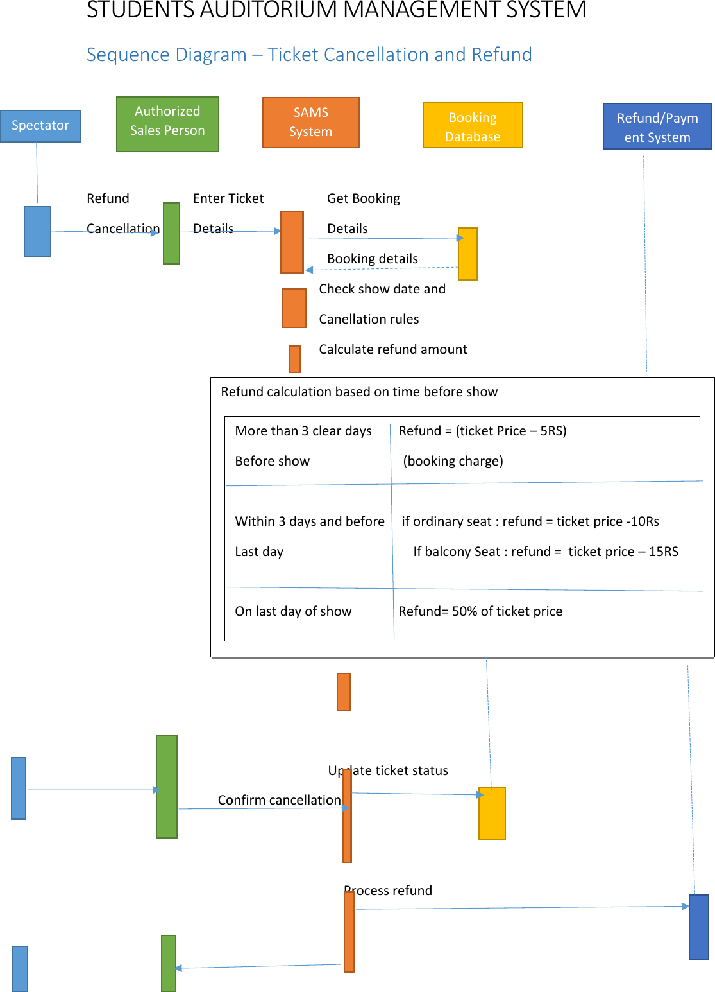
UML · SEQUENCE
Cancellation & refund
10

Slide 11
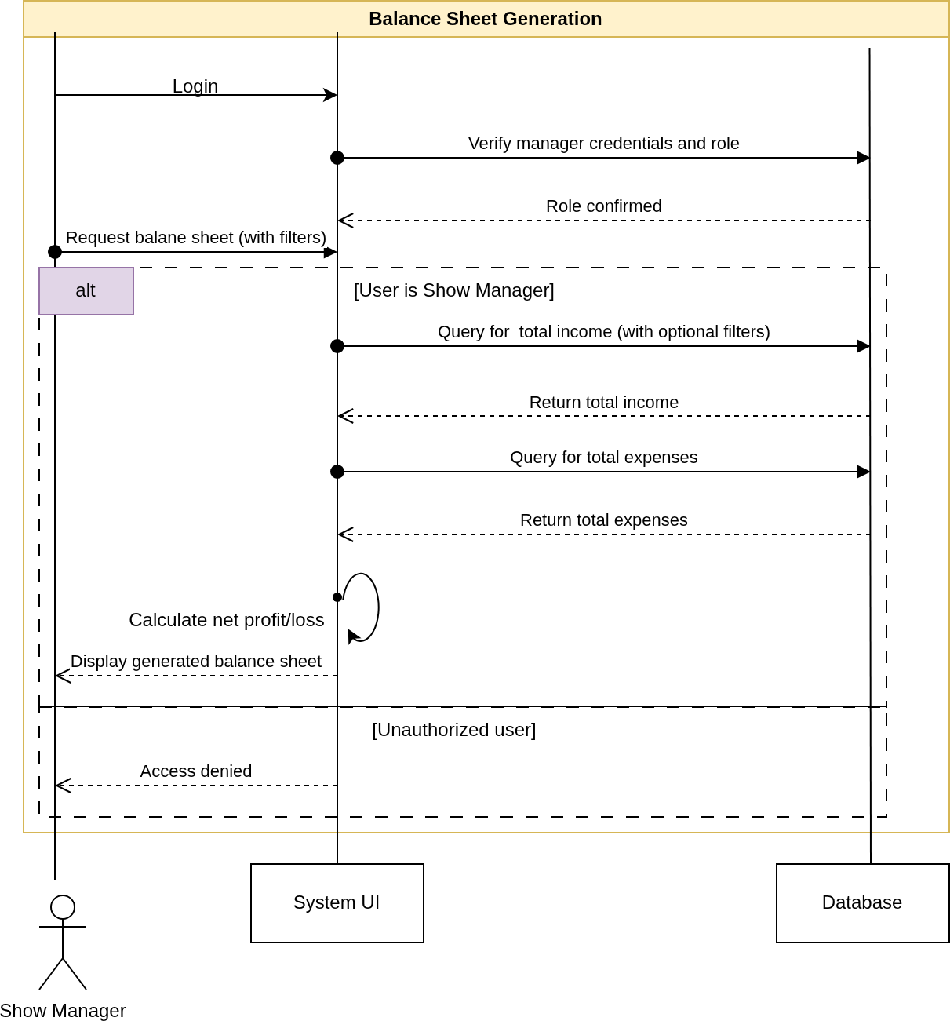
UML · SEQUENCE
Balance sheet generation
11

Slide 12
DESIGN
Architecture
Browser · HTML forms
Free software stack
Linux, MySQL, Apache, as the statement requires
APP CONTAINER
Layered
web server → routes → models → storage
Apache + mod_wsgi web server
Models = class diagram
no web or DB code inside, so unit-testable
app.py routes · role guard
One place per rule
refund in Ticket, validation in Show
models.py · db.py logic · storage
Role-based access
balance sheets for the manager only
Row locking
SELECT … FOR UPDATE stops double-selling a seat
DB CONTAINER
MySQL / MariaDB InnoDB
Docker Compose
app + database containers, nothing installed on host
12

Slide 13
DESIGN
Diagram → code
DIAGRAM
CODE
NOTES
Show
models.Show
availability, % booked, collection per class
Ticket
models.Ticket
calculate_refund(), cancel_booking()
SalesPerson
models.SalesPerson
collection(), commission()
BalanceSheet
models.BalanceSheet
per show and yearly
Expenditure
models.Expenditure
entered by the accounts clerk
Seat
Ticket.seat_no
allocated by Show.next_seat_no()
Actors
users table + role
/manager, /sales, /clerk routes
Login
role_required()
guards every page
Persistence
schema.sql
users, shows, tickets, expenditures
13

Slide 14
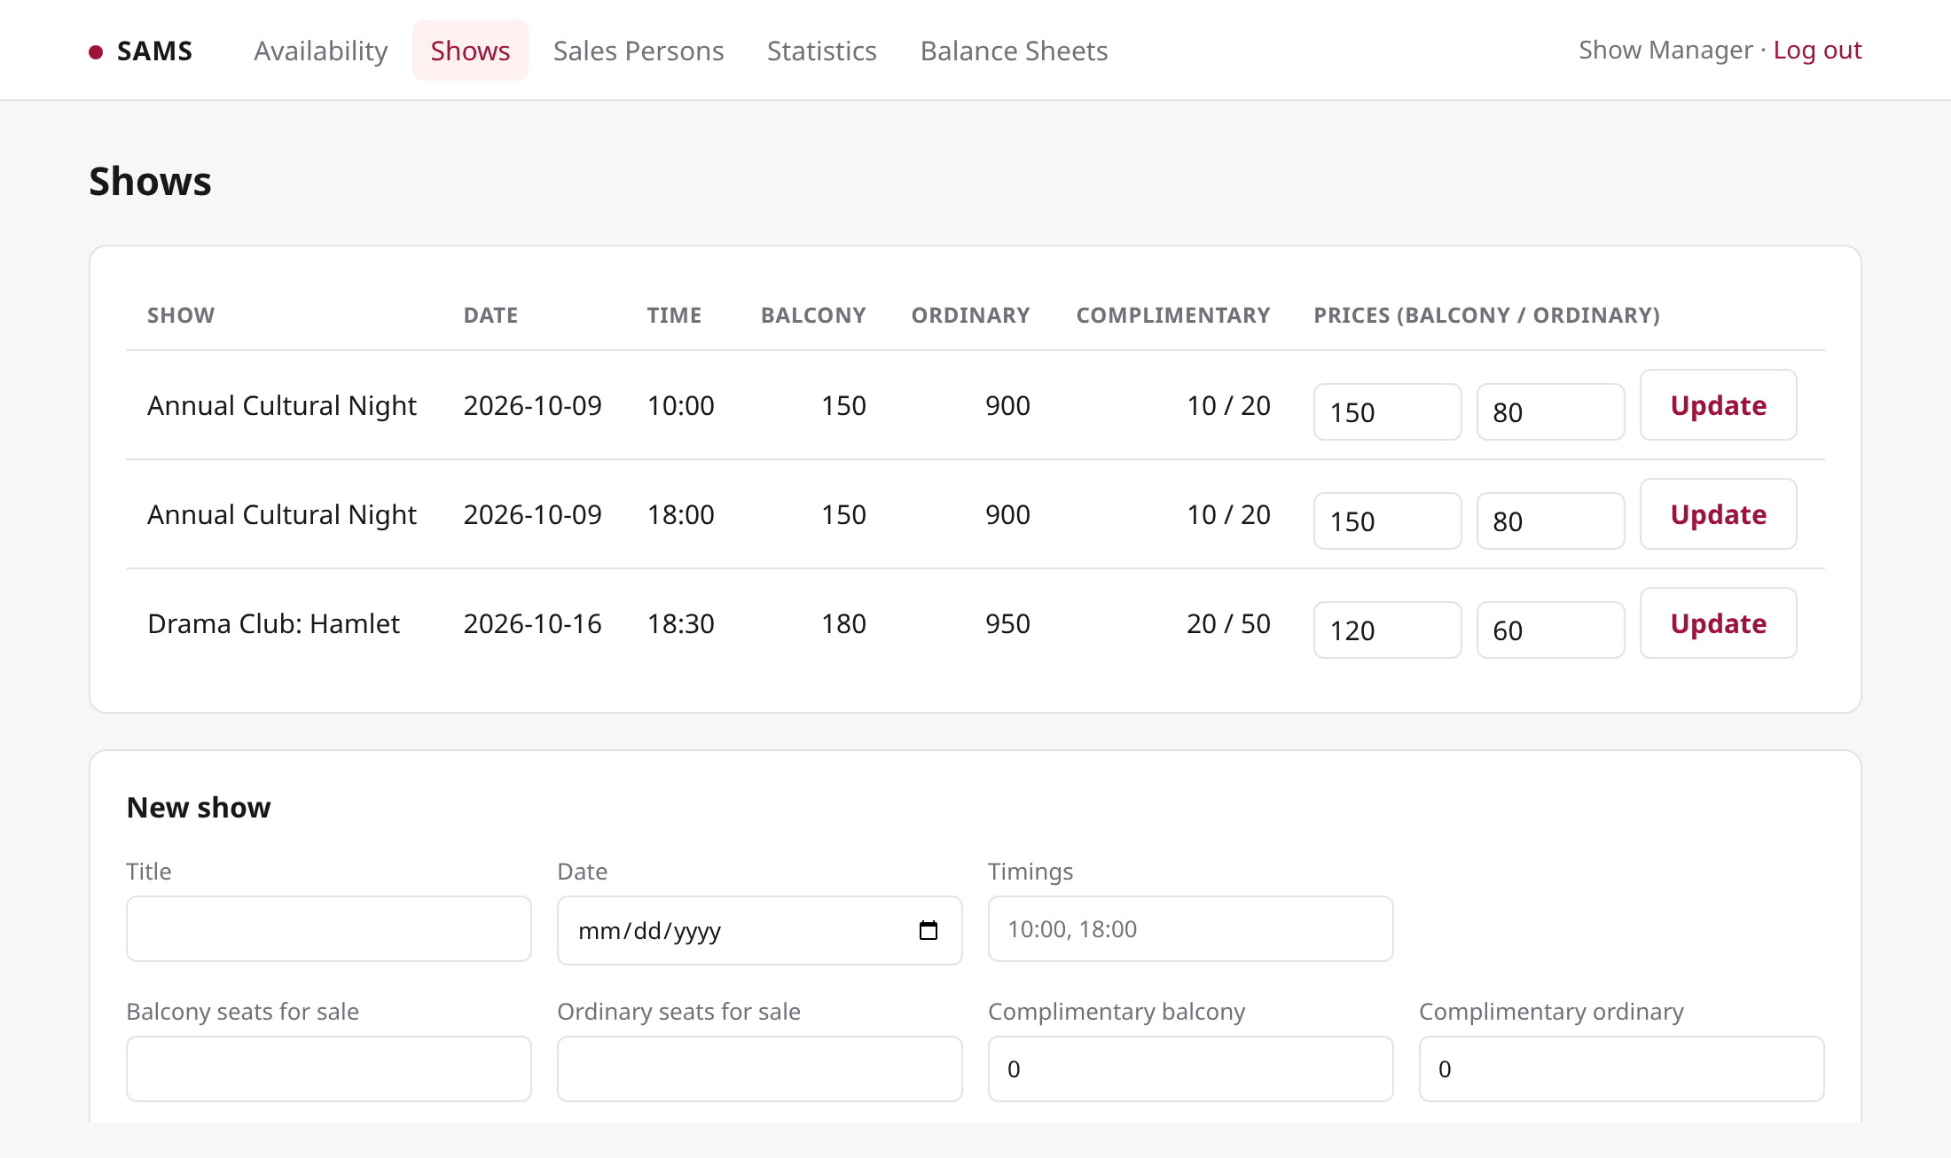
DEMO
Show manager
Shows: dates, several timings per date, seats for sale, complimentary seats, prices
14

Slide 15
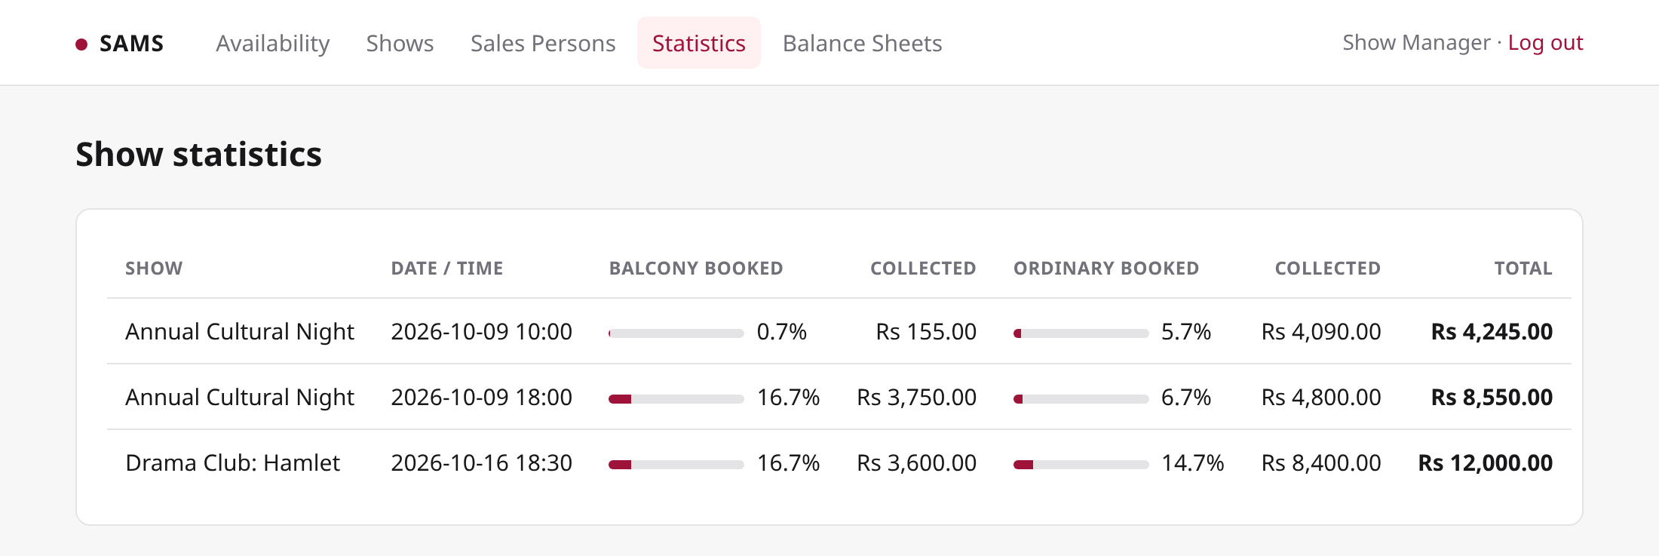
DEMO
Show manager
% of seats booked and amount collected, per seat class
15

Slide 16
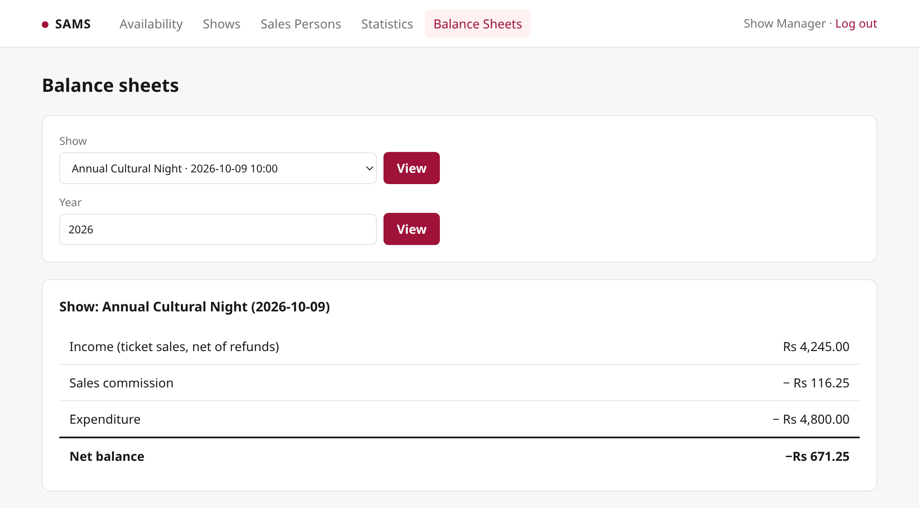
DEMO
Show manager
Balance sheet per show or year, manager only
16

Slide 17
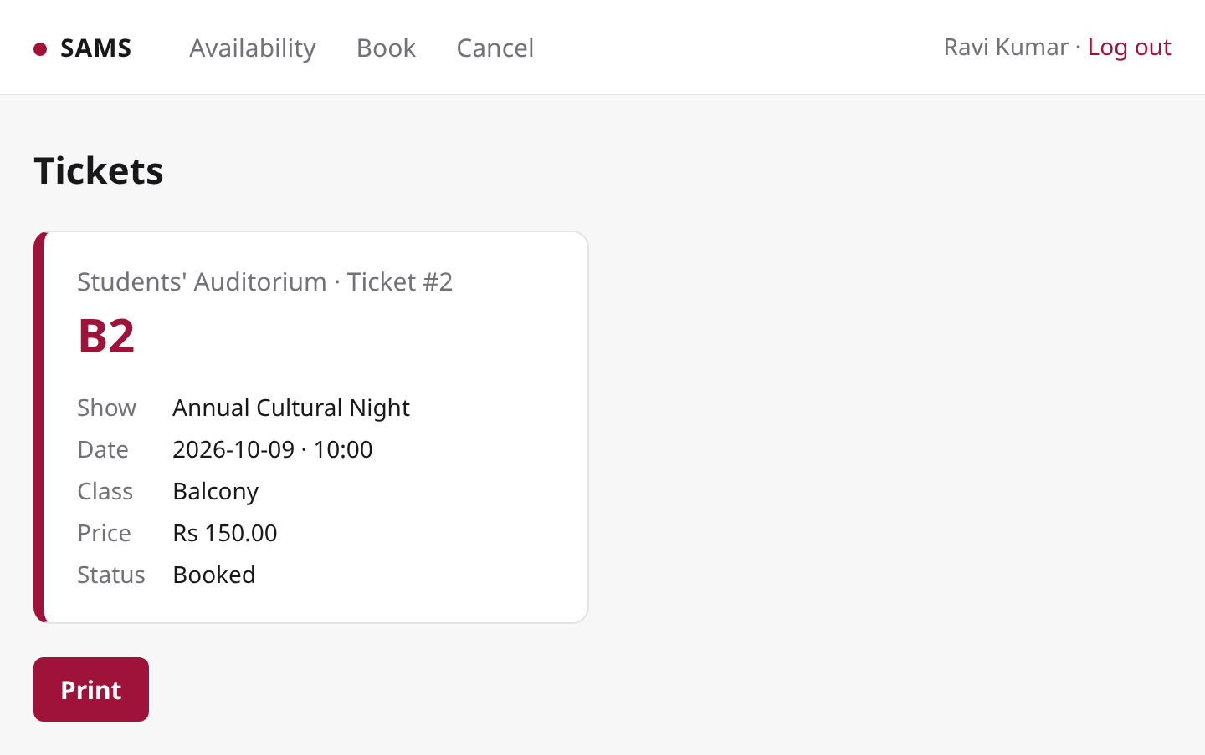
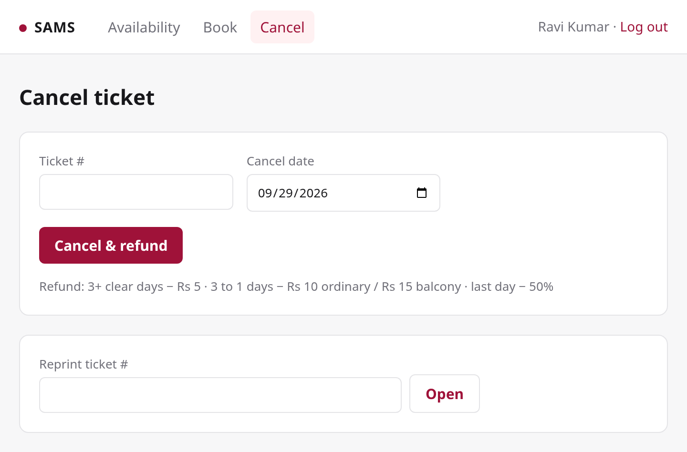
DEMO
Sales person
Printed tickets with seat numbers
Cancellation with refund
17

Slide 18
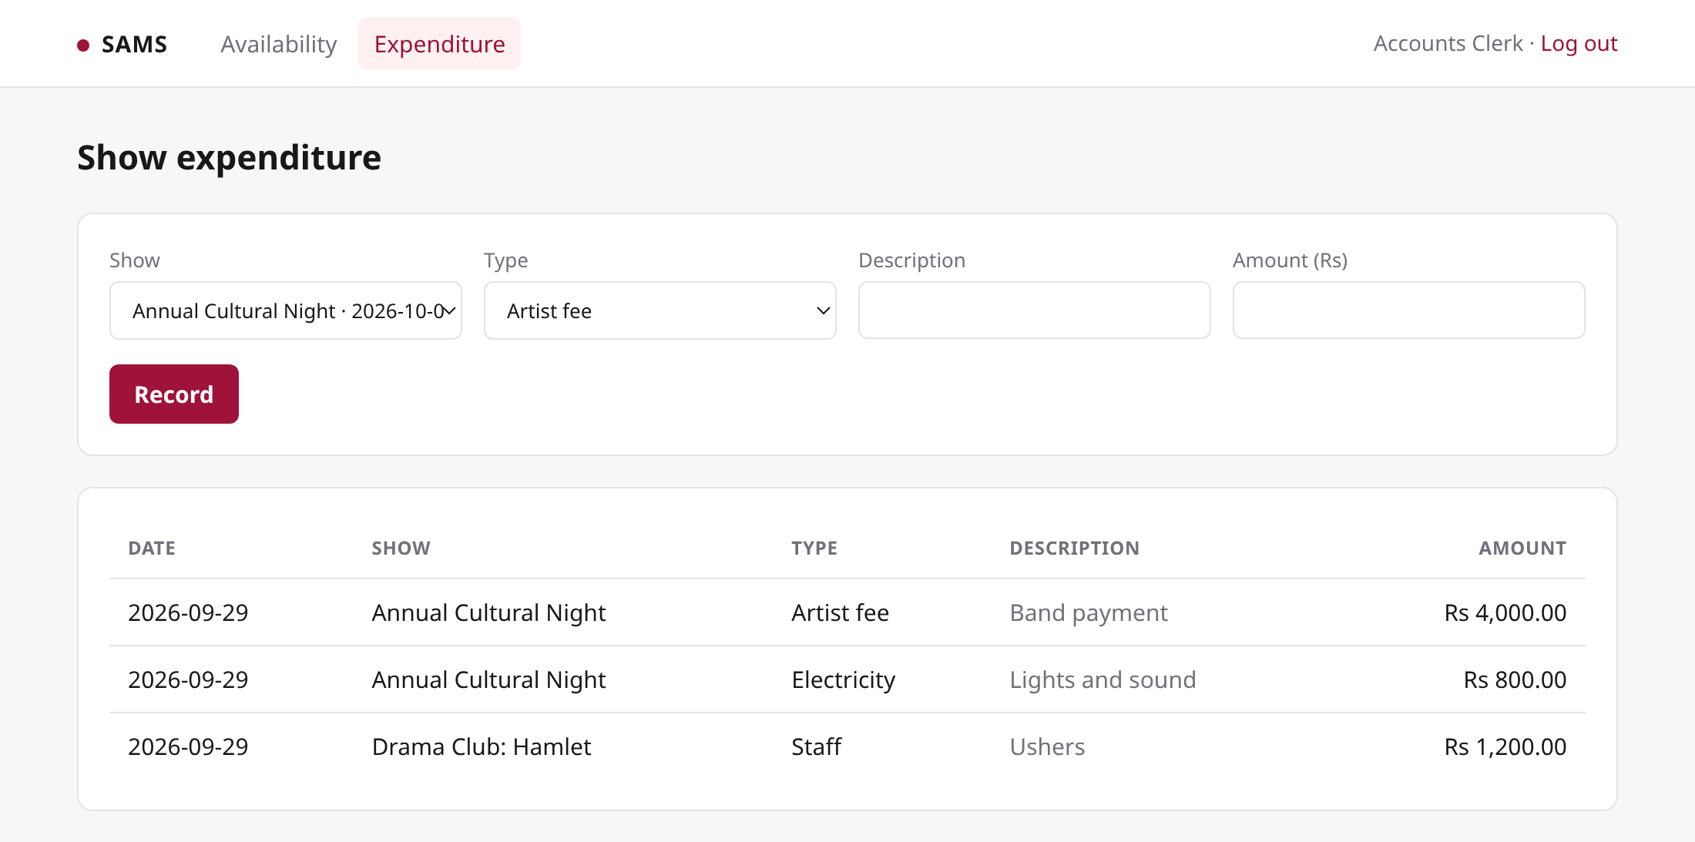
DEMO
Accounts clerk
Expenditure entry, including payment to artists
18

Slide 19
VERIFICATION
Testing
Refund rules
all four branches, after-show rejection, double cancel
11 / 11
unit tests pass
Validation
hall capacity, balcony price > ordinary price
Balance sheet
income net of refunds, commission, expenditure, yearly filter
End to end
manager → sales person → clerk → balance sheet, on Docker + MySQL
Access control
sales person and anonymous users denied manager pages
19

