Slide 1
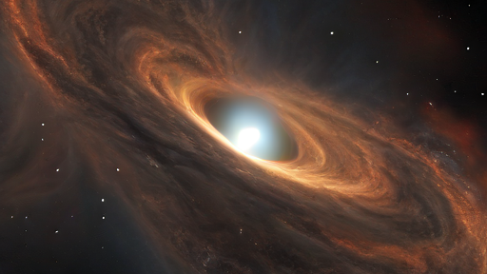
CINEMATIC AI:
A Text-to-Video Generator

