Slide 1

PDF Accessibility
How to make your documents ADA-compliant

Slide 2

PDF Basics
The Portable Document Format (PDF) is a file format developed by Adobe in 1993 to present documents, including text formatting and images, in a manner independent of application software, hardware, and operating systems. (Source: Wikipedia)
PDFs can be created from many applications (Microsoft Office, web browsers, all Adobe applications, etc.)

Slide 3
PDF Components
Text
Images
Graphics
Logical structuring elements (sections, headers, paragraphs, etc.)
Annotations
Form Fields
Rich Media (including video content)
Encryption and Digital Signatures
And more!

Slide 4
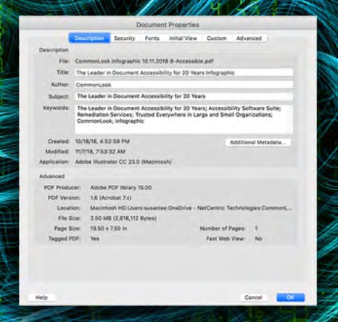
PDF Metadata
PDF metadata consists of information about the PDF document, which includes title of the PDF document, author, subject, keywords and copyright information. This information falls under searchable fields of a PDF document, which means that they can be accessed by search utilities. (Source: CommonLook)

Slide 5
PDF Metadata
Why is this important?
The title of a PDF, like the title of a webpage, appears in the browser title bar, and is the first thing search engines utilize.
The author, subject and keywords of a PDF make that PDF more visible to search engines (and thus search engine results).
Search engines and accessibility go hand in hand.
Having this information makes the PDF identifiable for other uses (document management systems).
How do I update this information?
Open any PDF in Adobe Acrobat and go to File > Properties.

Slide 6
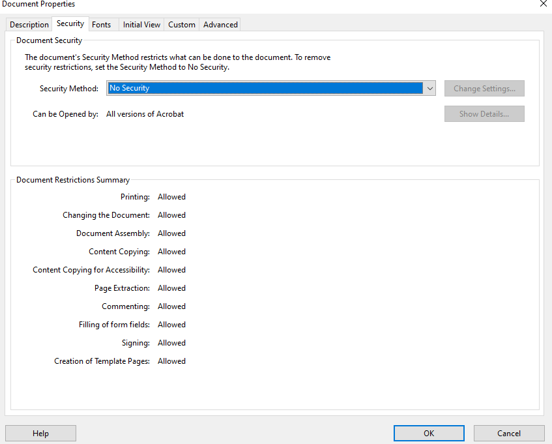
Protected and Locked PDFs
PDFs from external sources are sometimes locked to prevent tampering.
When this occurs, necessary changes to allow for accessibility cannot be saved.
The best way to work around this is to contact the creator of the PDF and work out how best to make the PDF accessible.
If that fails, online tools exist to unlock PDFs.

Slide 7
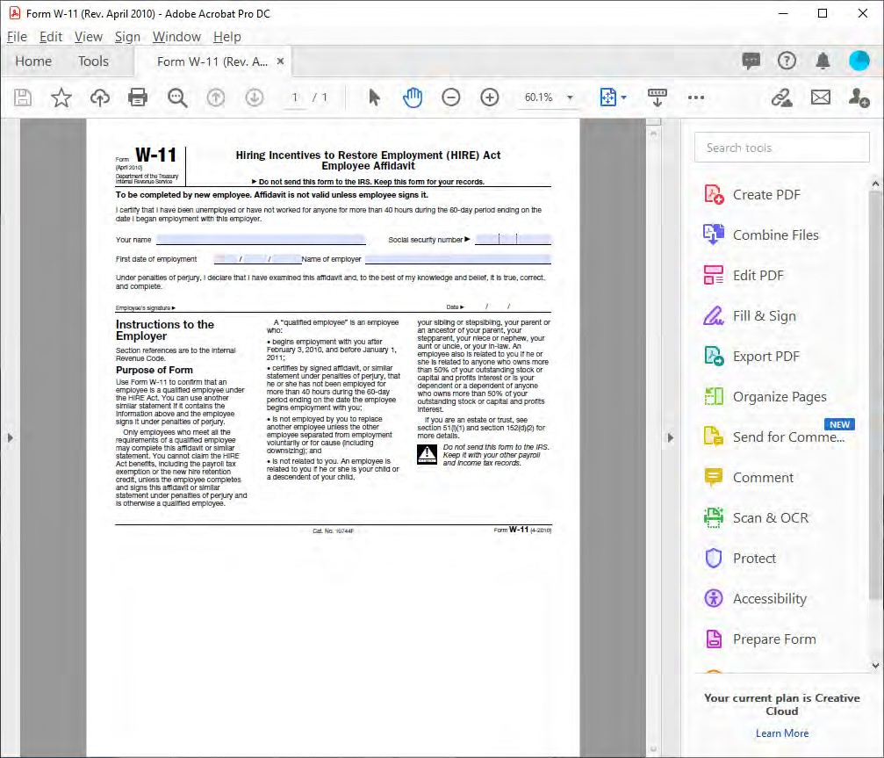
Getting Started with PDF Accessibility
Adobe Acrobat (NOT Adobe Acrobat Reader) can be used to make most PDFs accessible.
To get started, open Acrobat and make sure the “Accessibility” tool has been added to the list of tools.

Slide 8
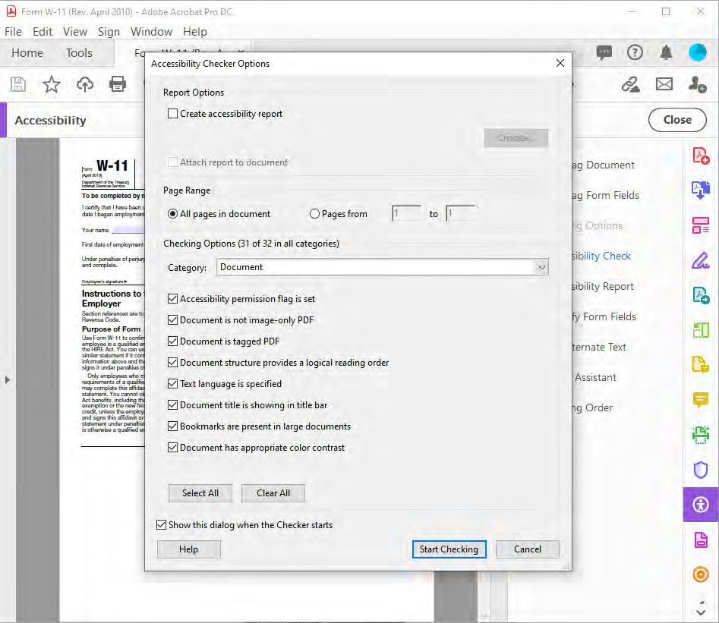
Checking for PDF Accessibility
To run an initial check on a PDF for accessibility, click the “Accessibility” tool.
On the menu that appears, click the “Accessibility Check” option.
Make sure all options are checked, then click the “Start Checking” button.

Slide 9
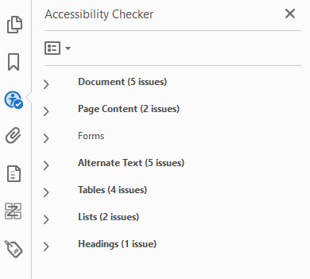
Checking for PDF Accessibility
The Accessibility Checker will return a list of issues that it finds.
Almost all these issues will need to be corrected before this PDF can be considered accessible.
NOTE: The Accessibility Checker is not perfect – sometimes it does miss some issues!
The issues it usually misses are related to tables and table headers.
To fix MOST issues, just right-click on the issue and choose “Fix.”

Slide 10
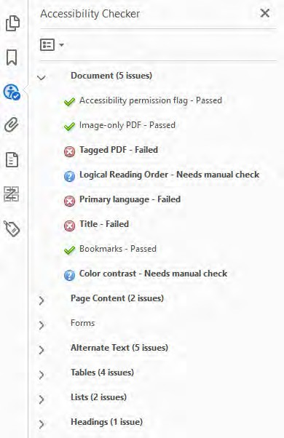
General PDF Document Accessibility
Image-only PDF – Usually applies to PDFs that were created from scans. When fixing, attempts to convert the images into a combination of readable text and images.
Tagged PDF – All PDFs have to be “tagged” in the same way web pages are so they can be read by screen readers. More details to come!
Primary language and Title – can be fixed in document properties.
Bookmarks – determine which tag(s) are used to define the bookmarks of a PDF.
Logical Reading Order and Color Contrast – no built-in tool, check these manually.

Slide 11
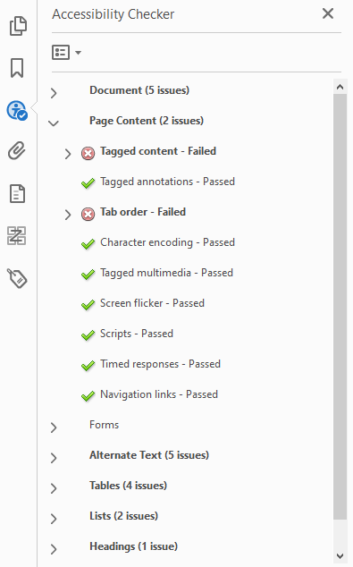
Page Content Accessibility
Tagged content – any content within the PDF that has not already been tagged. This is usually an issue when the PDF has not been tagged at all, but sometimes occurs when PDF has not been tagged correctly.
Tab order – allows for keyboard users to navigate through sections of the document.
The other items listed in this section should not cause any issues, though some may require a manual check, such as Navigation links.

Slide 12
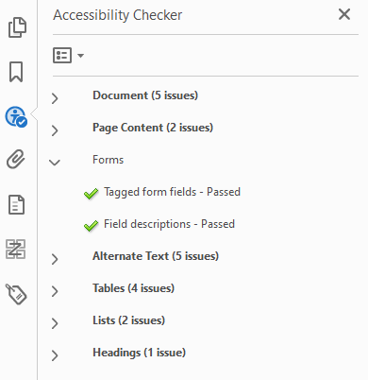
Forms Accessibility
Tagged form fields – any item that is part of the PDF that is a form field must be tagged as such.
Radio button and checkboxes must be grouped and named accordingly
Field descriptions – all form fields must have appropriate names and tooltips supplied. Generic names (e.g. “Text1”) will NOT suffice.

Slide 13
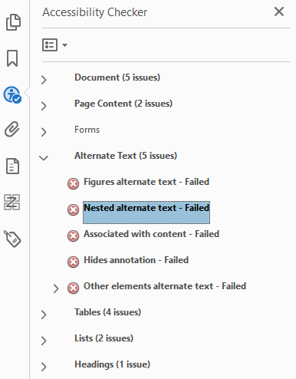
Alternate Text Accessibility
Alternate text – text that is supplied as an alternative for an image/graphic that a screen reader can read for someone with a visual impairment.
Figures alternate text is the only one that needs to be corrected.
Mark images as “decorative” if they serve no contextual purpose.
Otherwise, supply a short textual description for each image.
Examples: “Departmental logo”, “Student sitting under a tree”, etc.

Slide 14
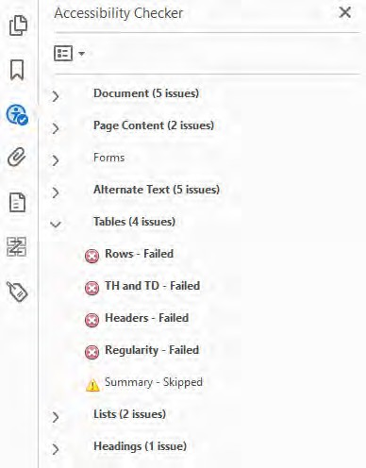
Table Accessibility
Rows – each row in a table must fall underneath the main table, the table header, the table body, or the table footer (not another row or a table cell). Not usually an issue.
TH and TD – each table header cell and table data cell must fall under a table row. Not usually an issue.
Headers – all tables must have a header. This is usually achieved by having at least table header cell in the first row of the table. Frequent issue.
Regularity – tables must have the same number of columns in each row and rows in each column. Sometimes an issue.

Slide 15
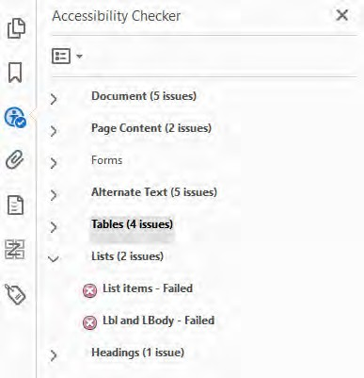
List Accessibility
List items – each list item (tagged as “LI”) must be a child of a list (tagged as “L”). This is commonly an issue when another tag (often “Sect”) is in between the “L” tag and the “LI” tag.
Lbl and Lbody – each list item can only contain label tags (“Lbl”) or list item body tags (“LBody”).

Slide 16
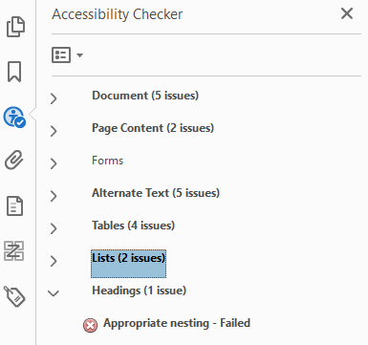
Headings Accessibility
Appropriate nesting – headers must be applied in order from a first-level heading down to a sixth-level heading (if applicable).
Think of this like an outline – heading levels should not be skipped.
The same issue occurs when checking for web page accessibility.
One issue that will not appear here – all PDFs must have a first-level heading.

Slide 17
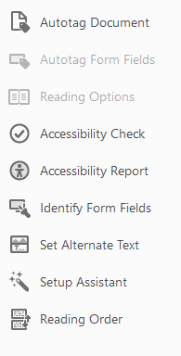
Tags
As with a web page, tags are used to identify parts of a PDF.
Tags allow screen readers and other assistive devices to “read” a PDF to a person needing assistance.
Tags are usually created when a PDF is created. A PDF that does not contain tags can be tagged within Acrobat by using the “Autotag Document” option.
In addition, a PDF can be tagged by “fixing” the “Tagged content” error after running an accessibility check.
Sometimes this doesn’t work, and “autotagging” the PDF is the best option.

Slide 18
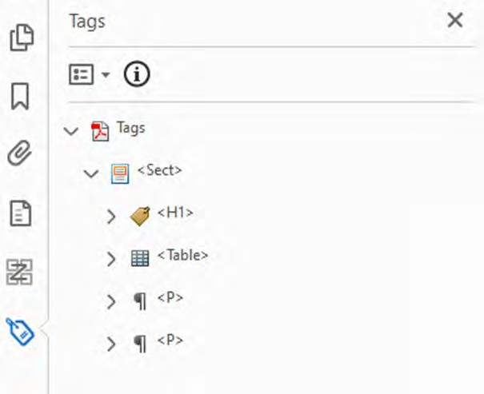
Tags
The Tags Panel in Acrobat shows how a PDF is currently tagged.
Tags can be added or modified within the Tags Panel without changing the visible PDF (the way it appears to everyone).
Working within the Tags Panel allows for multiple accessibility problems to be fixed:
Headers (additions and sequencing)
Tables (headers and regularity)
Lists (structure)

Slide 19
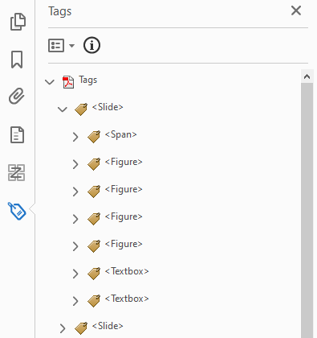
Tags
Unlike browsers and web pages, PDF tags can be named just about anything!
Programs that generate PDFs frequently “make up” their own tags.
The image to the right is from a PDF generated by PowerPoint.
Accessibility is not determined by the fully tagged structure of a PDF.
A PDF just has to pass all the accessibility checks in Acrobat regarding tags (headers, tables, lists).

Slide 20
Tags
The biggest obstacle to making a PDF accessible revolves around tagging older and/or larger PDFs.
The tagging process can take a long time for PDFs with complex charts/graphics or that have a large number of pages.
Tables frequently are mis-tagged, especially when split between pages. Table header tags often have to be added. Some tables may not be tagged as tables, and vice versa.
Some parts of a PDF may be marked as images because Acrobat has a difficult time evaluating them.
Acrobat will frequently evaluate bolded text that’s at a larger size as a header and guess as to which header level it is.

Slide 21
Making Tagging Easier!
If a PDF has a really messy tag structure after an initial accessibility check, re-tag the document using the “Autotag document” option.
Auto-generated tags in Acrobat are usually better than what other programs produce.
Manual intervention may still be necessary, especially with older/complex documents.
If any part of your document contains content that is not tagged, re-tag the document.
Insert your own tags only when absolutely necessary. This is usually needed for image-only PDFs that don’t have headers as well as fixing irregular tables (adding empty table cell tags).
Don’t be afraid to be creative, especially when dealing with an older PDF. PDFs can be really complex!

Slide 22
Tools and Resources
Common Accessibility Issues (Seattle, WA Public Schools)
Ten Common PDF Accessibility Errors with Solutions (University of Ottawa)
PDF Accessibility (University of Arizona)
Equidox – Cloud-based, UNC-licensed tool for making PDFs accessible through a web application. Works well for tagging PDFs on which Acrobat crashes.
Tools for unlocking PDFs – Smallpdf and iLovePDF.

Slide 23
Demonstration!
From the University of Arizona:
Yeats
A World of Love
Letter
From the Illinois Department of Human Services:
Newsletter
Order Form
Annual Report

Slide 24


