Slide 1
Text classification of Consumer Complaints
Jasia Alam, Michaela Hubweber, Kathrin Schumich, Florian Ye

Slide 2
Overview
Research question
State of the art
Data structure
EDA
Feature Engineering
Models
Results
Limitation
References

Slide 3
Research question
How to develop an automatic text classification model that assigns customer complaints to the correct product categories based on their content?

Slide 4
State of the Art / Related work
What has been researched so far?
Classifying customer complaints into predefined categories using advanced NLP techniques
Various machine learning and deep learning techniques
Word embeddings to capture semantic relationships in complaint texts
Studies show high accuracy in categorizing consumer complaints based on text
Some approaches also use dimensionality reduction for better data visualization and grouping
What are common approaches/models?
Traditional Methods: Naïve Bayes, Decision Trees, Support Vector Machines, Generalized Linear Model
More advanced approaches: LSTM, GRU, and CNN
Word Embeddings (Word2Vec, BERT)
Transformer Models (DistilBERT and FinBERT)
Sentiment analysis to identify trends

Slide 5
Data structure
Public dataset on Kaggle
162 400 consumer submissions
3 columns:
id, product, narrative
5 products:
credit_reporting, debt_collection, mortages_and_loans, credit_card, retail_banking
Time frame: March 2020 to March 2021
Nearly no missing values (total 10)
Text written lowercase

Slide 6
Explorative Data Analysis
Total count of complaints per product
Distribution of narrative length (post stopword removal)
Word cloud
Statistics summaries

Slide 7
Explorative Data Analysis
Total count of complaints per product
Distribution of narrative length (post stopword removal)
Word cloud
Statistics summaries
TF-IDF

Slide 8
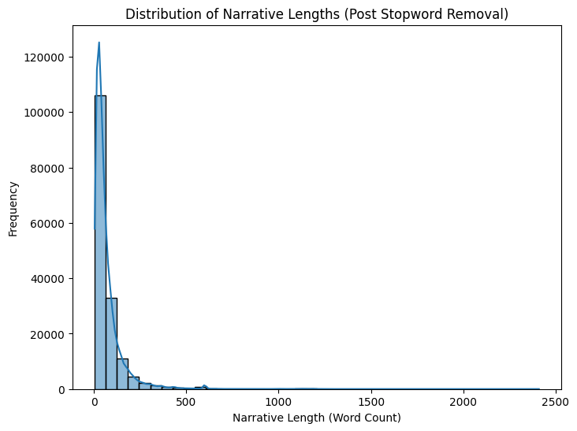
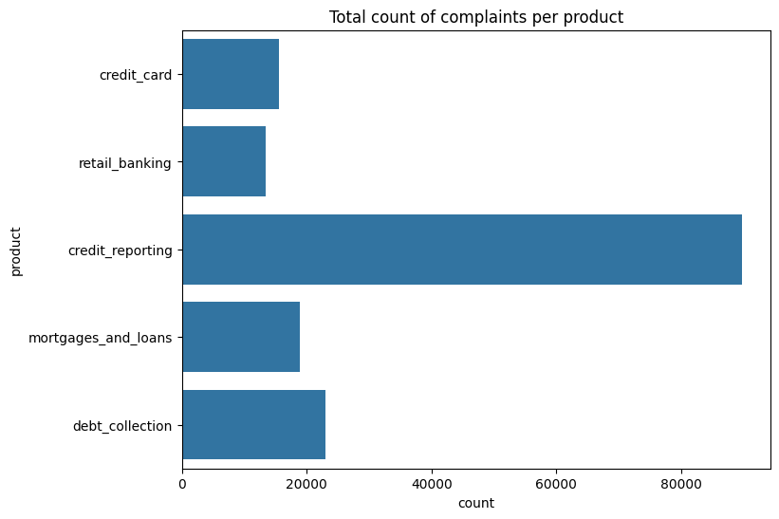
EDA of product, narrative

Slide 9
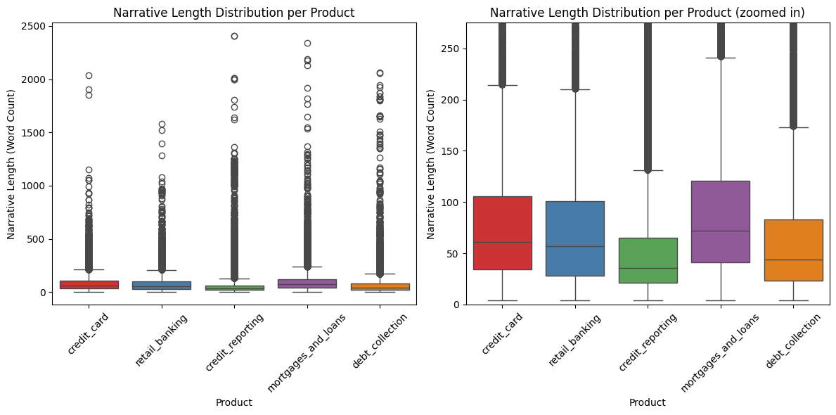
EDA of product, narrative

Slide 10
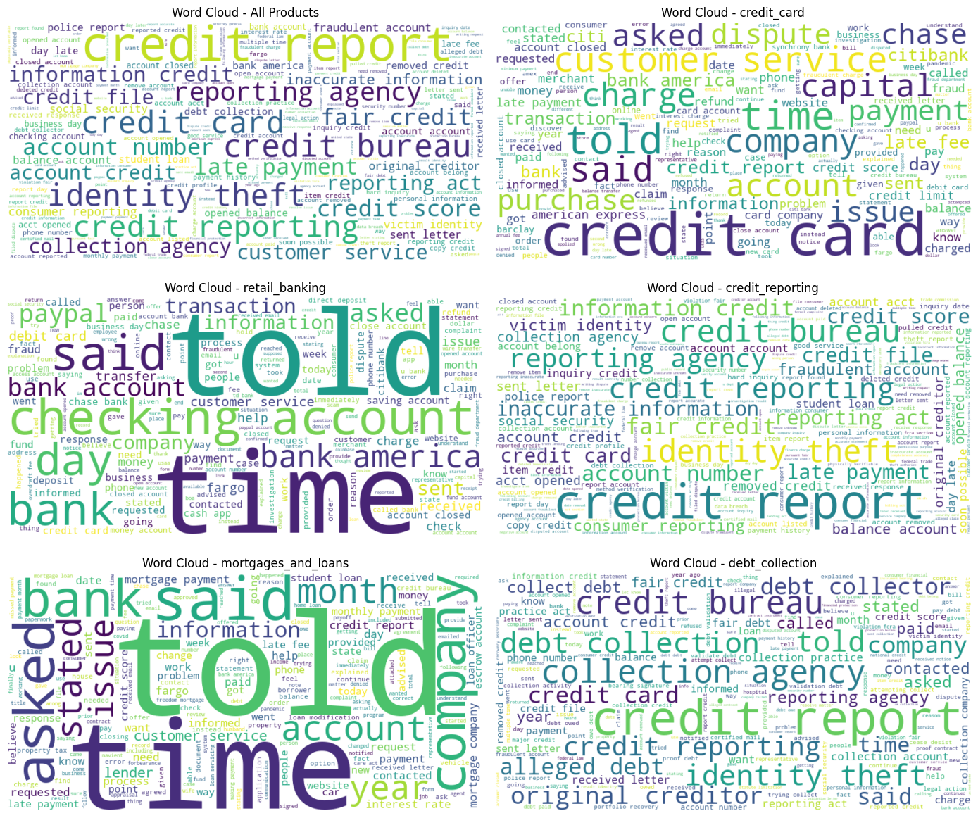
EDA of narrative

Slide 11
Feature Engineering
TFIDF
Word2vec

Slide 12
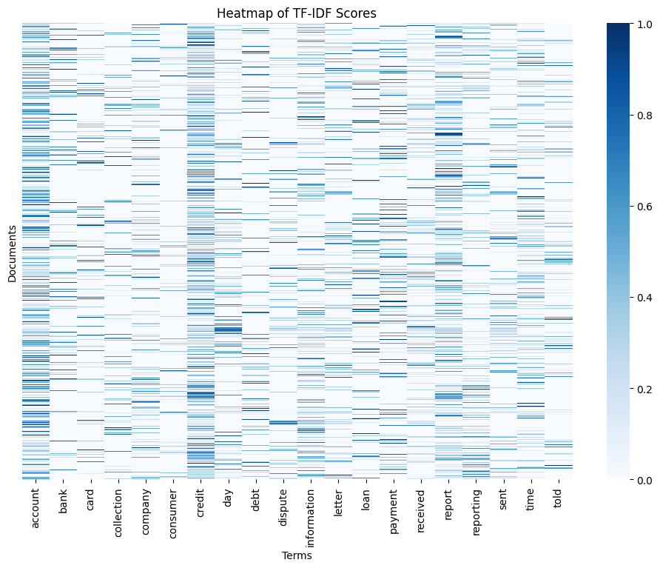
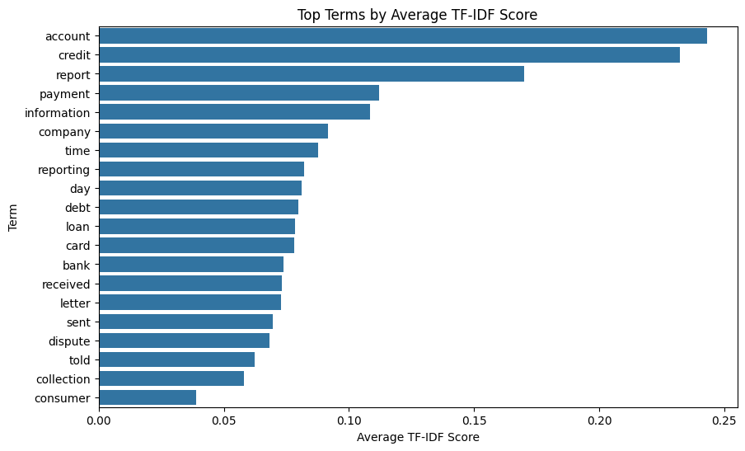
TF-IDF

Slide 13
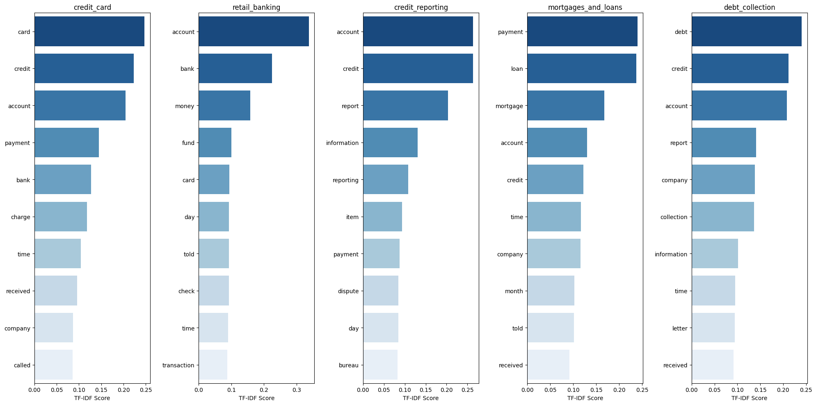
Top words by TF-IDF score by products

Slide 14
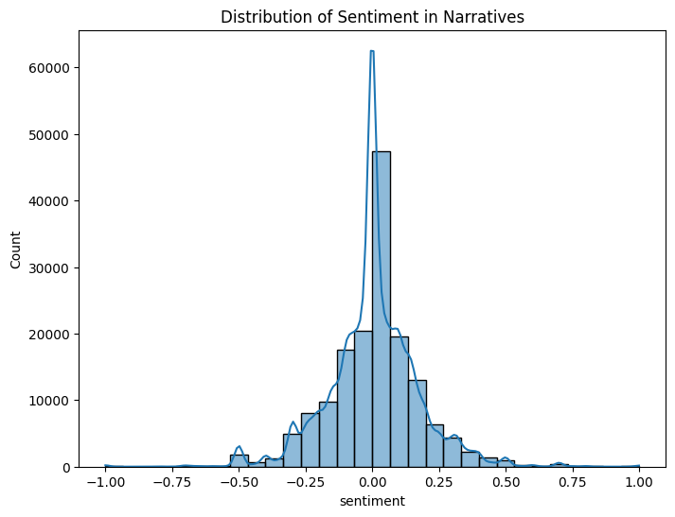
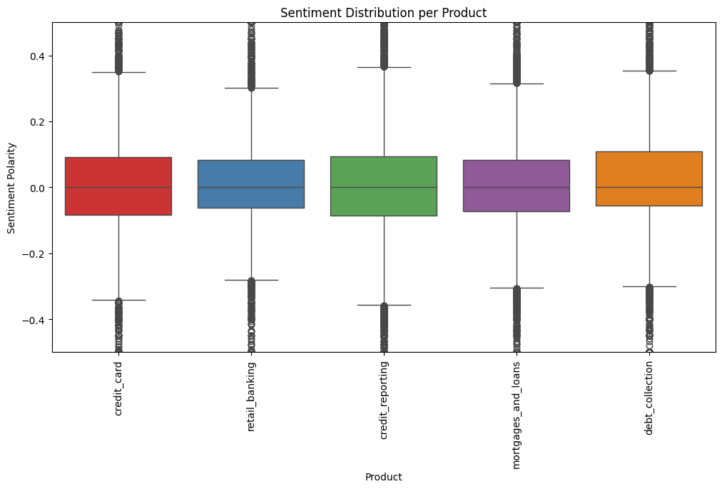
Sentiment Analysis

Slide 15
Methods
Undersampled Data
get smaller data set n=67.175
handle data imbalance 13.435 per product category
Evaluation of Models with different Embeddings
TF-IDF, Word2Vec
Different Models
Logistic Regression, Random Forest, XGBoost, Naive Bayes, SVM
Hyperparameter Tuning
Cross-Validation

Slide 16
Methods
Hyperparameter-Tuning for Word2Vec Embeddings
Logistic Regression, RF, XGBoost, NB, SVM
Advanced Models:
Multilayer NN
Recurrent NN
Convolutional NN
BI-LSTM

Slide 17
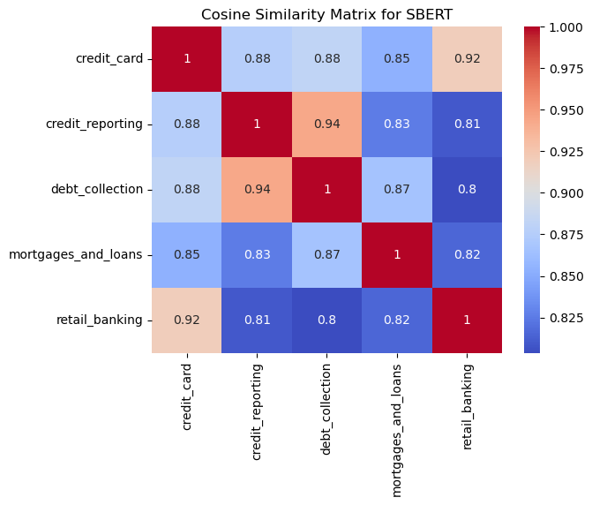
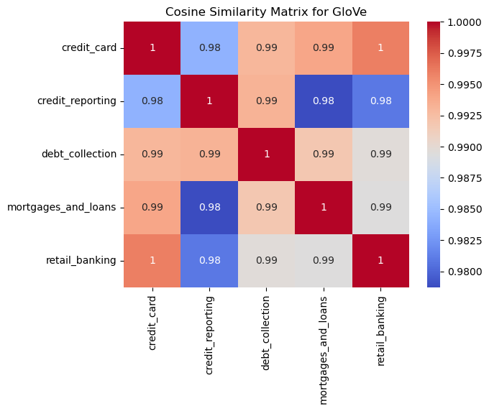
Tests on Small Data Set
Embeddings SBERT
Embeddings Glove
Text classification of Consumer Complaints | Jasia Alam, Michaela Hubweber, Kathrin Schumich, Florian Ye | 24.10.2024

Slide 18
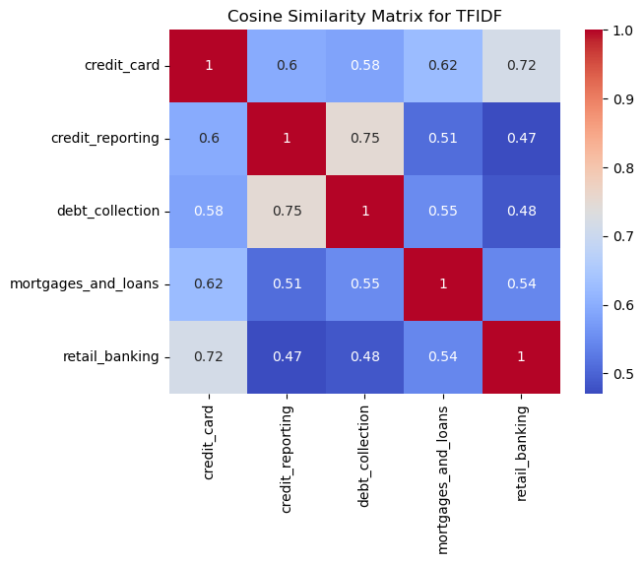
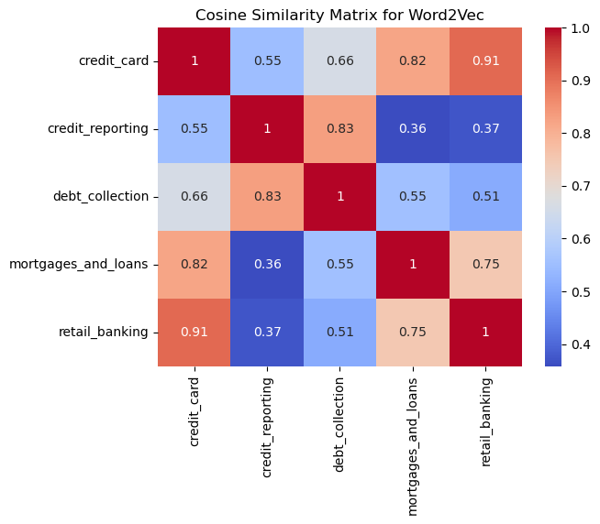
Tests on Small Data Set – Embeddigs best results
Embeddings TFIDF
Embeddings word2vec
Text classification of Consumer Complaints | Jasia Alam, Michaela Hubweber, Kathrin Schumich, Florian Ye | 24.10.2024

Slide 19
Comparison of Models with TFIDF
Complexity Handling: Logistic Regression and Naive Bayes are relatively simple models
may not capture complex non-linear patterns in data
Methods: Random Forest and XGBoost both leverage ensembles of decision trees
XGBoost uses a boosting technique to focus on misclassified examples
Independence Assumption: Naive Bayes assumes independence between features
might limit its effectiveness in this dataset, where word features are often interdependent
Non-Linear Interactions: Models like Random Forest, XGBoost, and SVM can better capture non-linear interactions within the data
improves their performance in handling more complex classification tasks
Text classification of Consumer Complaints | Jasia Alam, Michaela Hubweber, Kathrin Schumich, Florian Ye | 24.10.2024

Slide 20
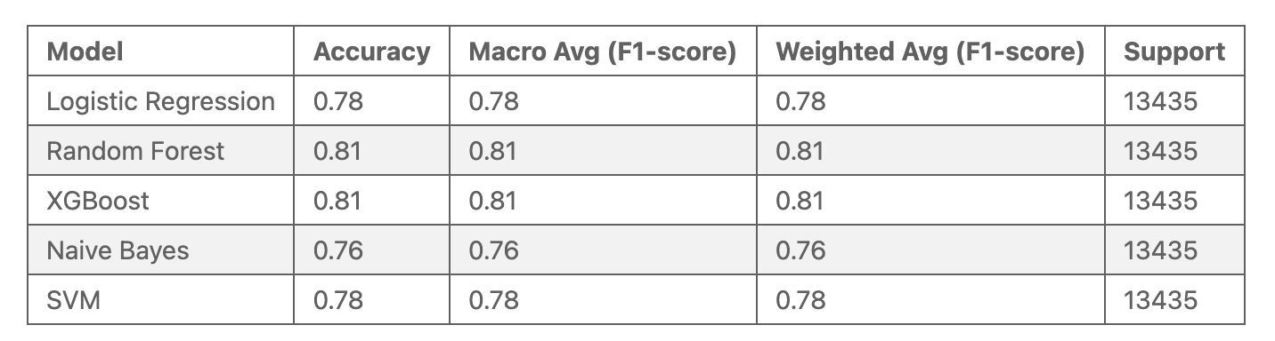
Comparison of Models with TFIDF
Performance of different models on test set
The best model based on accuracy and F1-Score is the RF –Model & XGBOOSt, which means it's better at handling imbalanced classes and predicting both major and minor categories.
SVM & Logistic regression is also competitive with a 78% accuracy and decent performance across all metrics.
* with TF-IDF Embeddings
Text classification of Consumer Complaints | Jasia Alam, Michaela Hubweber, Kathrin Schumich, Florian Ye | 24.10.2024

Slide 21
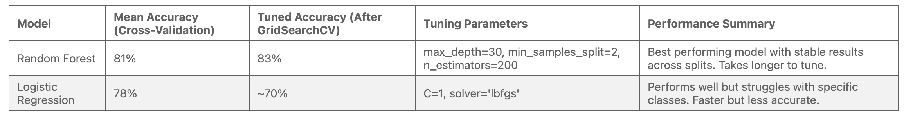
Cross-Validation and Tuning Parameters with TFIDF
Random Forest achieved higher mean accuracy 81% and tuned accuracy 83% with more complex tuning parameters, making it the best performer but slower to tune.
Logistic Regression, with a mean accuracy of 78% and an estimated tuned accuracy of 70%, is faster but struggles with class-specific performance.
* with TF-IDF Embeddings
Text classification of Consumer Complaints | Jasia Alam, Michaela Hubweber, Kathrin Schumich, Florian Ye | 24.10.2024

Slide 22
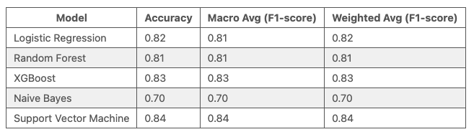
Comparison of Models with Word2Vec
The best model based on accuracy and F1-Score is Support Vector Machine model, which means it's better at handling imbalanced classes and predicting both major and minor categories.

Slide 23
Comparison of Models with Neural Networks
MLP treats the text as a simple feature set without considering word order
decent performance but rather bad in sequential understanding
CNN detects local word patterns well
may miss out on capturing the full context of longer sequences in customer complaints
RNN captures sequential data better than MLP and CNN
favor through understanding the order of words
Bi-LSTM is good in capturing both the past and future context of words in a sequence
helpful in understanding complaints in more detail destictions

Slide 24
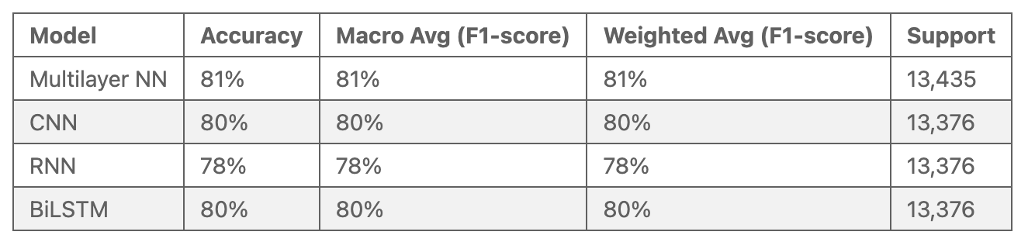
Comparison of Models with Neural Networks (TF-IDF)
The best model based on accuracy are Multilayer Neural network and CNN.
* with TF-IDF Embeddings

Slide 25
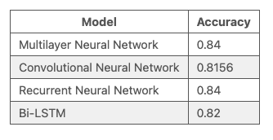
Comparison of Models with Neural Networks (Word2vec)
The best model based on accuracy are Recurrent Neural Network and Multilayer Neural network.

Slide 26
Results
Comparison of all models
Focus on three main models

Slide 27
Results
Focused on Logistic Regression, SVM & Random Forest with Word2Vec
Evaluated model performance using accuracy scores and classification reports.
TF-IDF Features:
Classical models and neural network models achieved around 78-81 % accuracy.
Word2Vec Features:
Classical models achieved around 80-85% accuracy.
Neural network models also achieved 80-85% accuracy.

Slide 28
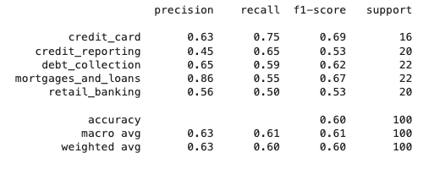
Manuel Labeling
Manual labeling of random 100 complaints
Text classification of Consumer Complaints | Jasia Alam, Michaela Hubweber, Kathrin Schumich, Florian Ye | 24.10.2024

Slide 29
Limitations
Open Issues/Future Work?
Comparison with other embeddings
Tests on other data sets that are not as highly pre-processed
Compare different dimensionalities of embeddings
Explore different network architectures (or deeper neural nets)

Slide 30
References
Vinayak, V., & C., J. (2023). Consumer Complaints Classification using Deep Learning & Word Embedding Models. 2023 14th International Conference on Computing Communication and Networking Technologies (ICCCNT), 1-5.
Kohler, M., Sondermann, L., Forero, L., & Pacheco, M.A. (2018). Classifying and Grouping Narratives with Convolutional Neural Networks, PCA and t-SNE. International Conference on Health Information Science.
Research, M., & Rafiee, D.M. (2020). Analysis of Customer Complaint Data of Consumer Financial Protection Bureau Using Different Text Classification Methods.
Correa, N., & Correa, A. (2022). Neural Text Classification for Digital Transformation in the Financial Regulatory Domain. 2022 IEEE ANDESCON, 1-6.
Text classification of Consumer Complaints | Jasia Alam, Michaela Hubweber, Kathrin Schumich, Florian Ye | 24.10.2024

Slide 31
Any questions?

