Slide 1
Text classification of Consumer Complaints
Jasia Alam, Michaela Hubweber, Kathrin Schumich, Florian Ye

Slide 2
Updates since last week
State of the Art / Related Work
Undersampled Data
get smaller data set n=67.175
handle data imbalance 13.435 per product category
Tested several embeddings with cosine similarity
Tested Logistic Regression Model with TFIDF

Slide 3
State of the Art / Related work
What has been researched so far?
Classifying customer complaints into predefined categories using advanced NLP techniques
Various machine learning and deep learning techniques
Word embeddings to capture semantic relationships in complaint texts
Studies show high accuracy in categorizing consumer complaints based on text
Some approaches also use dimensionality reduction for better data visualization and grouping
What are common approaches/models?
Traditional Methods: Naïve Bayes, Decision Trees, Support Vector Machines, Generalized Linear Model
More advanced approaches: LSTM, GRU, and CNN
Word Embeddings (Word2Vec, BERT)
Transformer Models (DistilBERT and FinBERT)
Sentiment analysis to identify trends
Similar work and differences from ours? Existing research has explored the categorization of customer complaints, particularly through the use of NLP techniques to analyze text. However, our work……

Slide 4
References
Vinayak, V., & C., J. (2023). Consumer Complaints Classification using Deep Learning & Word Embedding Models. 2023 14th International Conference on Computing Communication and Networking Technologies (ICCCNT), 1-5.
Kohler, M., Sondermann, L., Forero, L., & Pacheco, M.A. (2018). Classifying and Grouping Narratives with Convolutional Neural Networks, PCA and t-SNE. International Conference on Health Information Science.
Research, M., & Rafiee, D.M. (2020). Analysis of Customer Complaint Data of Consumer Financial Protection Bureau Using Different Text Classification Methods.
Correa, N., & Correa, A. (2022). Neural Text Classification for Digital Transformation in the Financial Regulatory Domain. 2022 IEEE ANDESCON, 1-6.
Text classification of Consumer Complaints | Jasia Alam, Michaela Hubweber, Kathrin Schumich, Florian Ye | 03.10.2024

Slide 5
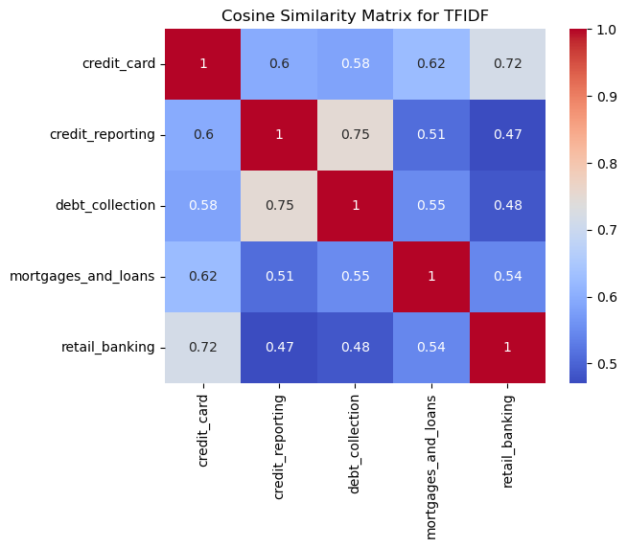
Tests on Small Data Set – Embeddings TFIDF

Slide 6
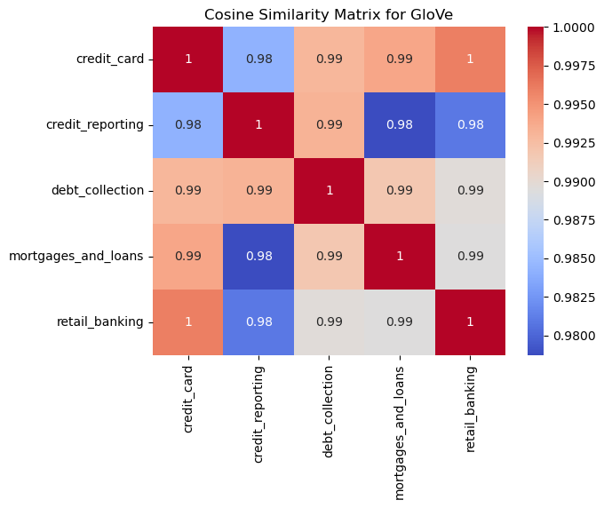
Tests on Small Data Set – Embeddings Glove

Slide 7
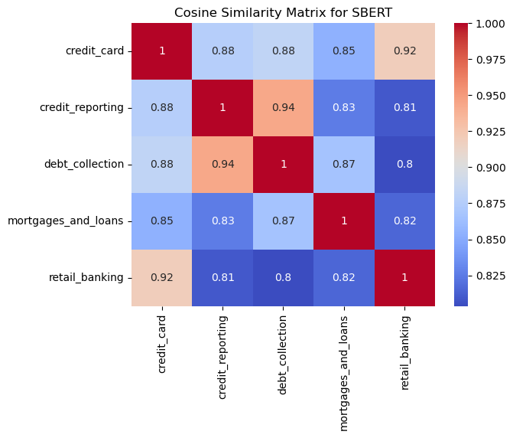
Tests on Small Data Set – Embeddings SBERT

Slide 8
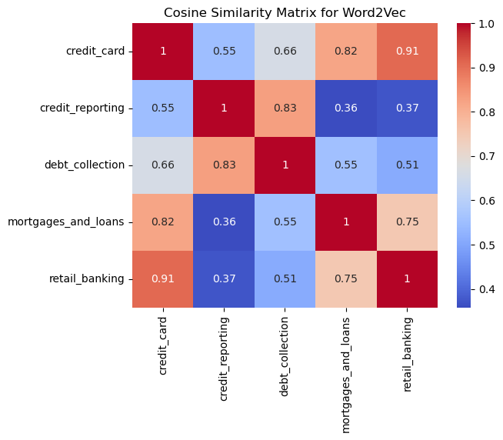
Tests on Small Data Set – Embeddings w2vec

Slide 9
Tests on Small Data Set – Embeddigs best results

Slide 10
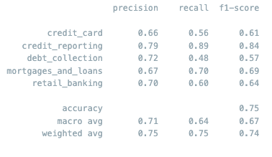
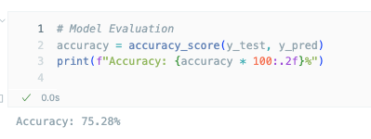
Classification Test Run: Logistic Regression/TFIDF
This has not been tuned yet, we will also try out other combinations.

