Slide 1
Netflix, Poverty, Race, and Tone Preliminary Findings 2 30 movies & TV shows 26,950 productino/cast/crew names
Jordan Schaer

Slide 2
Item Analysis and Scoring
Racial composition of producers/cast/crew from US Census
% white (total, cast, crew)
% Black (total, cast, crew)
% hispanic (total, cast, crew)
% Asian (total, cast, crew)
% other (total, cast, crew)
Words related to poverty in synopsis
% total
% distinct words
Synopsis tone composition from IBM Watson
anger
disgust
fear
joy
sadness

Slide 3
Item Scoring, modified
Racial composition of producers/cast/crew from US Census, ranked
% white (total, cast, crew), ranked
% Black (total, cast, crew), ranked
% hispanic (total, cast, crew), ranked
% Asian (total, cast, crew), ranked
% other (total, cast, crew) , ranked
Words related to poverty in synopsis, ranked
% total, ranked
% distinct words, ranked
Synopsis tone composition of synopsis from IBM Watson, normalized
% anger
% disgust
% fear
% joy
% sadness

Slide 4
Tone of poverty
In which my poverty analysis and Watson Tone Analysis confirm each other.

Slide 5
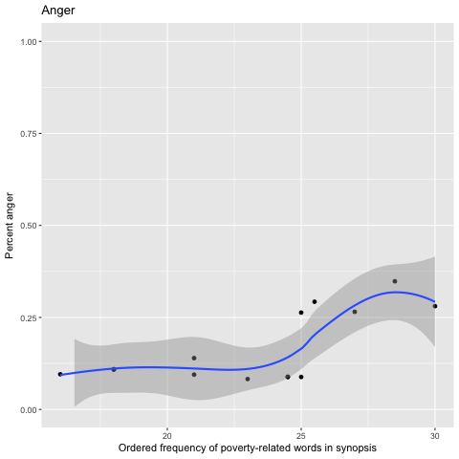
Higher poverty relevance, more anger

Slide 6
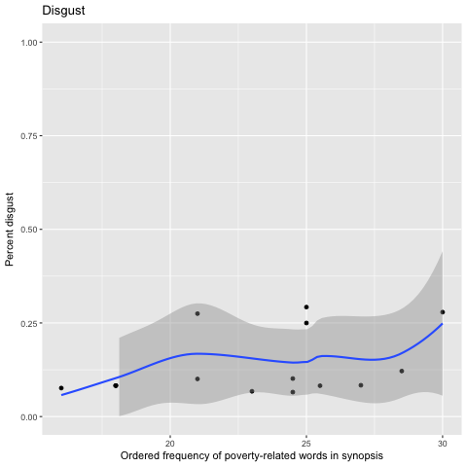
Higher poverty relevance, more disgust

Slide 7
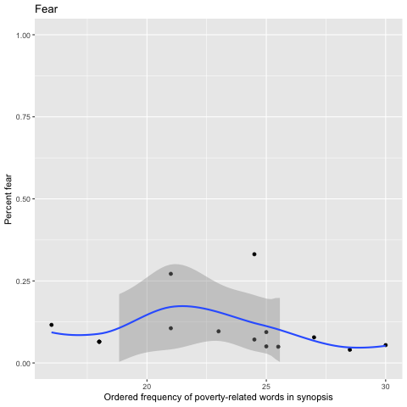

Slide 8
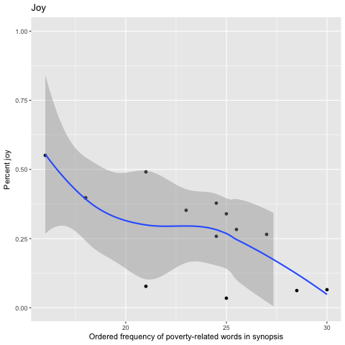
Higher poverty relevance, less joy

Slide 9
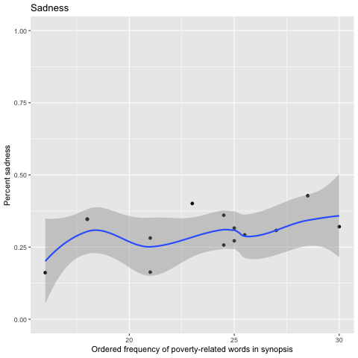
Higher poverty relevance, more sadness

Slide 10
Color of tone

Slide 11
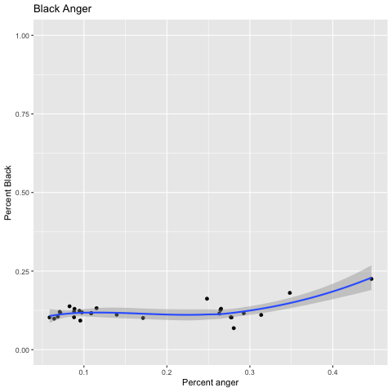
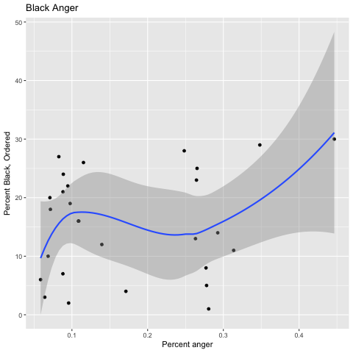
Angrier the story, more Black people

Slide 12
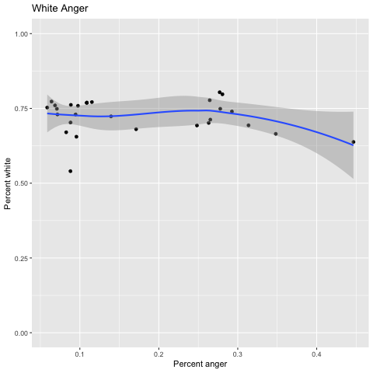
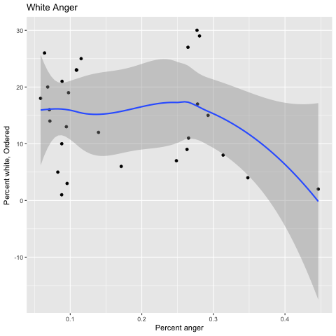
Angrier the story, fewer white people

Slide 13
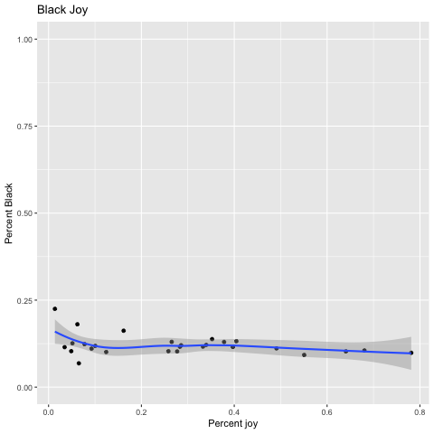
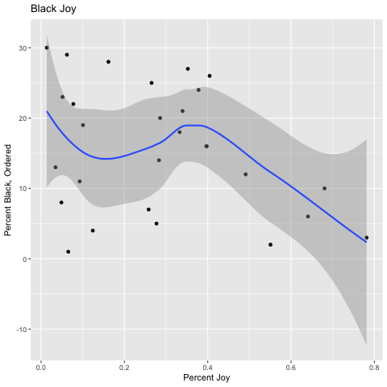
More joy, less Black

Slide 14
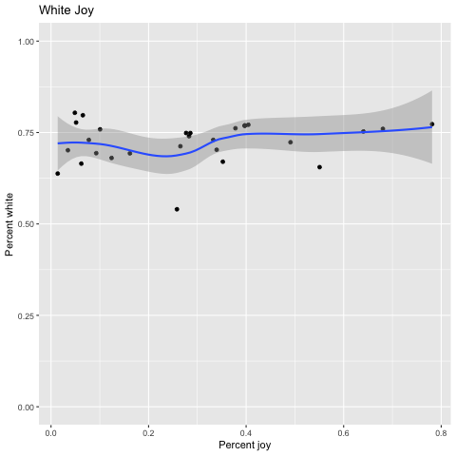
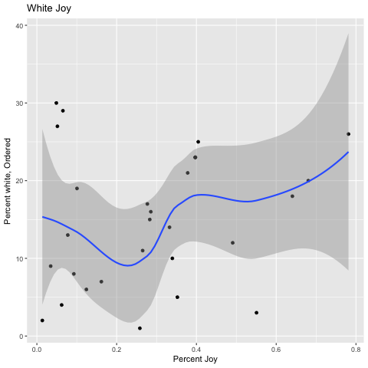
More joy, more white

Slide 15
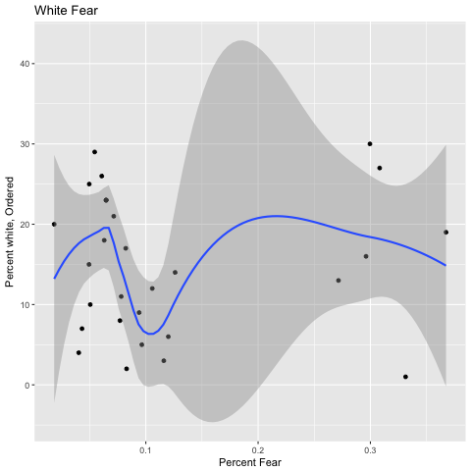
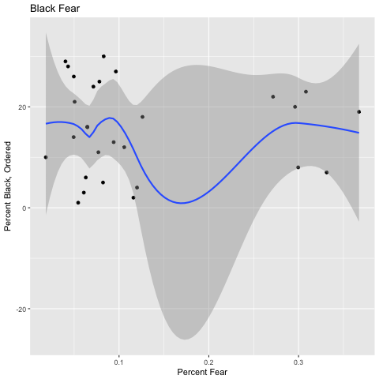
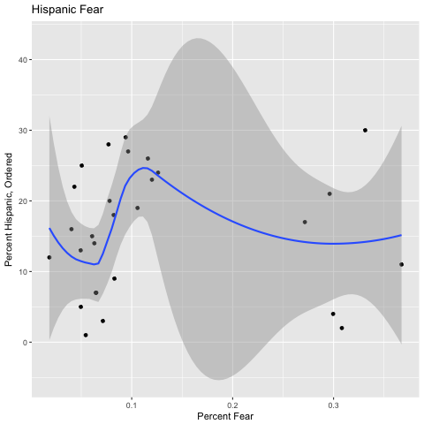
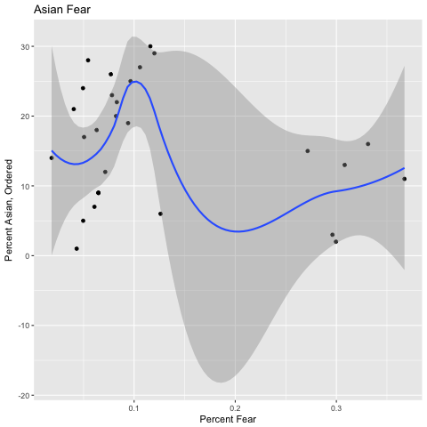
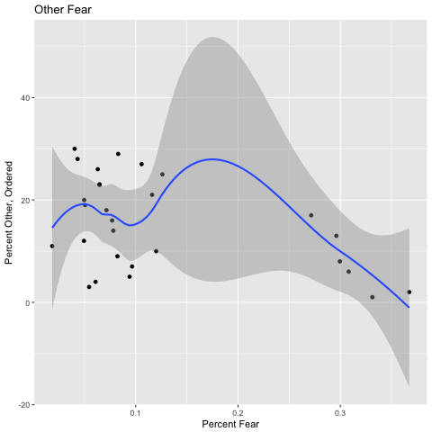
Fear, ranked

Slide 16
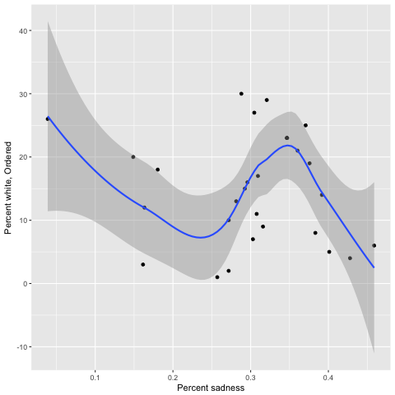
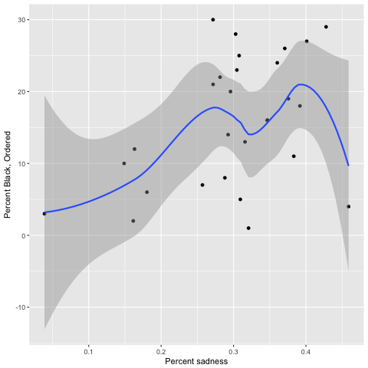
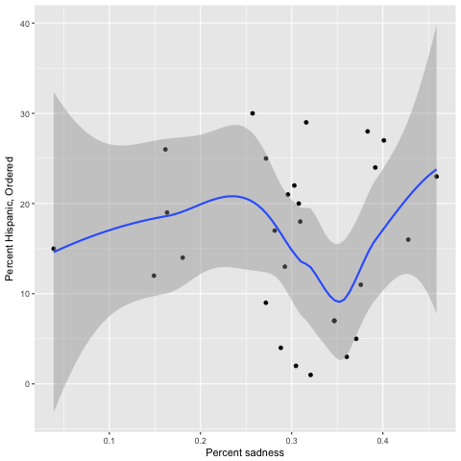
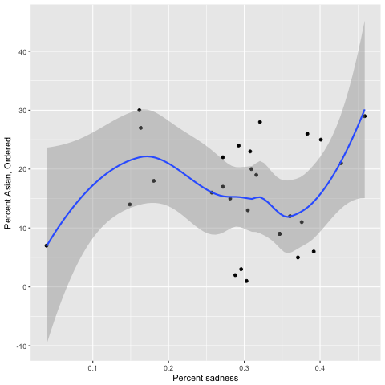
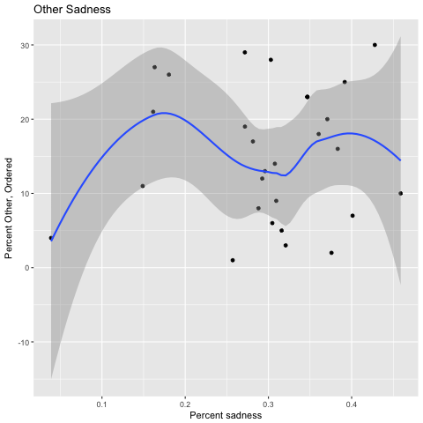
Sadness, ranked

Slide 17
Color of poverty

Slide 18
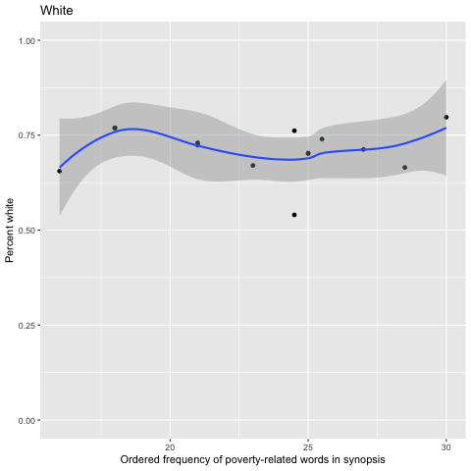
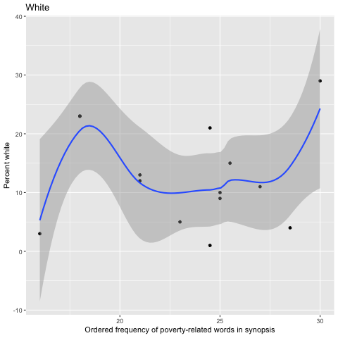
Poverty ~ white

Slide 19
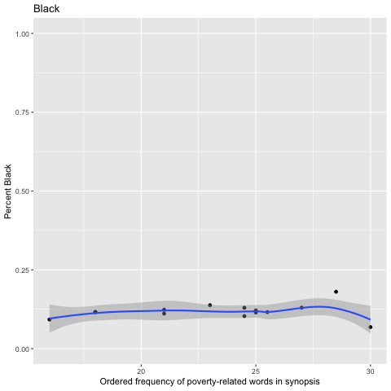
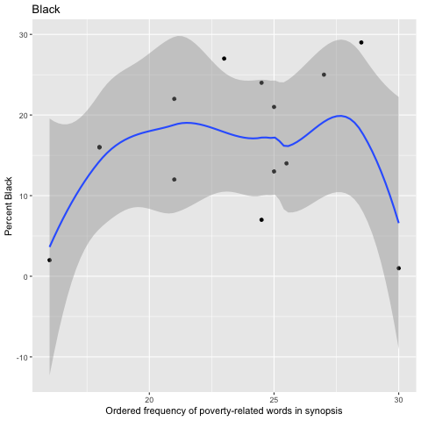
Poverty ~ Black

Slide 20
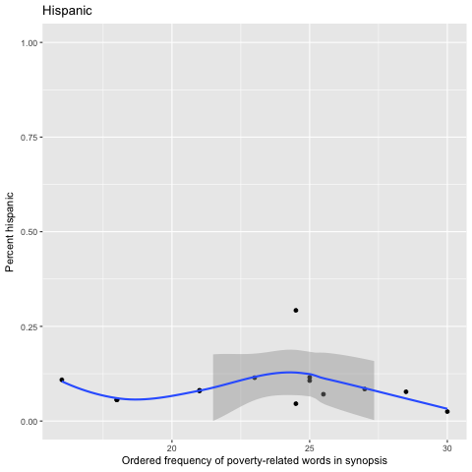
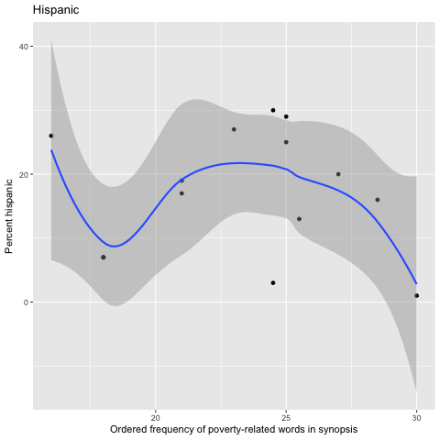
Poverty ~ Hispanic

Slide 21
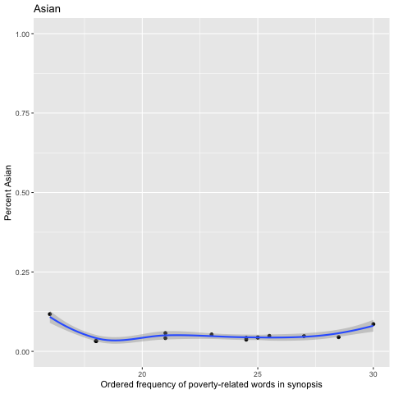
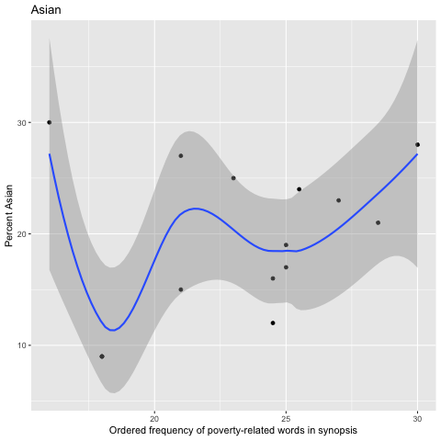
Poverty ~ Asian

Slide 22
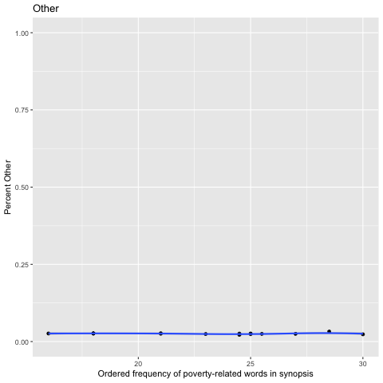
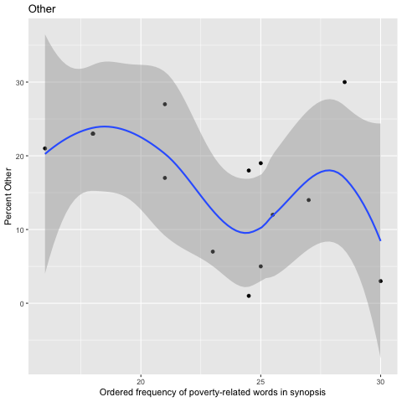
Poverty ~ other

Slide 23
Methodology explanations
Ranking allows us to ask questions comparing the observations to each other, i.e. which is poorer? Which has a more Black cast?
Because my estimators are not perfect, but their errors are (hopefully) distributed uniformly, rather than comparing true values, I want to look at items that are more or less than a given item, so the errors cancel out.
I look at both percent and ranked percent for racial composition to observe population and subgroup trends.

Slide 24
Some synopses came back with high scores across every category, and some stories came back much lower. Normalizing allows comparison without punishing the stories that didn’t score as high overall. Black people are minority, even in a majority-Black cast could still appear a minority—my racial approximation algorithm is better at determining which stories include more Black people compared to others, rather than the precise percentage of Black people included.

Slide 25
I rank the percentages, and can trust that, say for Black people, the higher-ranked items do indeed feature more Black people than the lower-ranked items. The trends do not change, but they do become more readily observable. In analyzing stories with respect to poverty relevance, I removed the stories that scored lowest. This is because these stories are approximately irrelevant to poverty and are distributed uniformly across race and tone composition. As the relevant stories become more so, what happens?

