Slide 1
SUPPLY CHAIN ANALYTICS • POWER BI
Supply Chain Visibility System With Optimization Analytics
Data Visualization Project
INFOSYS SPRINGBOARD

Slide 2


Problem Statement
Major Challenges
Proposed Solution
Modern supply chains generate large volumes of operational data, making it difficult to monitor overall performance using traditional reports. The major challenges include:
Develop an interactive Power BI dashboard that integrates supply chain data into a single platform, enabling users to:
Difficulty in tracking inventory levels across warehouses.
Limited visibility into delivery performance and late deliveries.
Challenges in evaluating supplier quality, reliability, and lead time.
Lack of insights into transportation costs and shipping efficiency.
Difficulty in monitoring warehouse utilization and capacity.
Scattered data, making decision-making slow and less effective.
Monitor key performance indicators (KPIs).
Analyze inventory, delivery, supplier, transportation, and warehouse performance.
Identify operational bottlenecks.
Support faster and data-driven business decisions.
INFOSYS SPRINGBOARD
Problem Statement
02

Slide 3






Objectives
The main objectives of this project are:
Develop an interactive Power BI dashboard for supply chain analysis.
Monitor Inventory, Delivery, Supplier, Transportation, and Warehouse performance.
Track important Key Performance Indicators (KPIs) using DAX measures.
Analyze inventory movement, stock levels, delivery efficiency, and supplier performance.
Identify operational issues such as late deliveries, slow-moving inventory, and warehouse utilization.
Enable interactive data analysis using filters and slicers.
Support data-driven decision-making through meaningful visualizations and insights.
INFOSYS SPRINGBOARD
Objectives
03

Slide 4
Project Overview
WHAT WE BUILT
TOOLS USED
Developed an interactive Business Intelligence solution using Power BI.
Analyzed different stages of the supply chain, including Inventory, Delivery, Supplier, Transportation, and Warehouse Performance.
Created interactive dashboards using DAX measures, KPIs, and visualizations.
Built a star schema data model to improve reporting and analysis.
Enabled users to monitor operational performance and support data-driven decision-making.
Implemented filters and slicers for interactive analysis across multiple business areas.
Tool | Purpose
Power BI Desktop | Dashboard Development
Power Query | Data Cleaning & Transformation
DAX | KPI & Measure Calculations
Data Modeling | Star Schema & Relationships
GitHub | Project Documentation & Version Control
DATASET SOURCE & OVERVIEW
DATA PREPARATION & PROCESSING
Dataset: DataCo Global Supply Chain Dataset
Source: Kaggle
Database: Imported into PostgreSQL and connected to Power BI
Covers: Customer, Product & Order details
Inventory & Warehouse information
Supplier & Shipping data
Sales, Profit & Discount details
Delivery status & Regional information
Cleaned and transformed the data using Power Query.
Removed duplicate records and unnecessary columns.
Renamed columns and corrected data types wherever required.
Created a Star Schema by separating fact and dimension tables.
Established relationships between tables for efficient data analysis.
Added calculated columns, DAX measures, and KPIs required for dashboard development.
INFOSYS SPRINGBOARD
Project Overview & Dataset
04

Slide 5

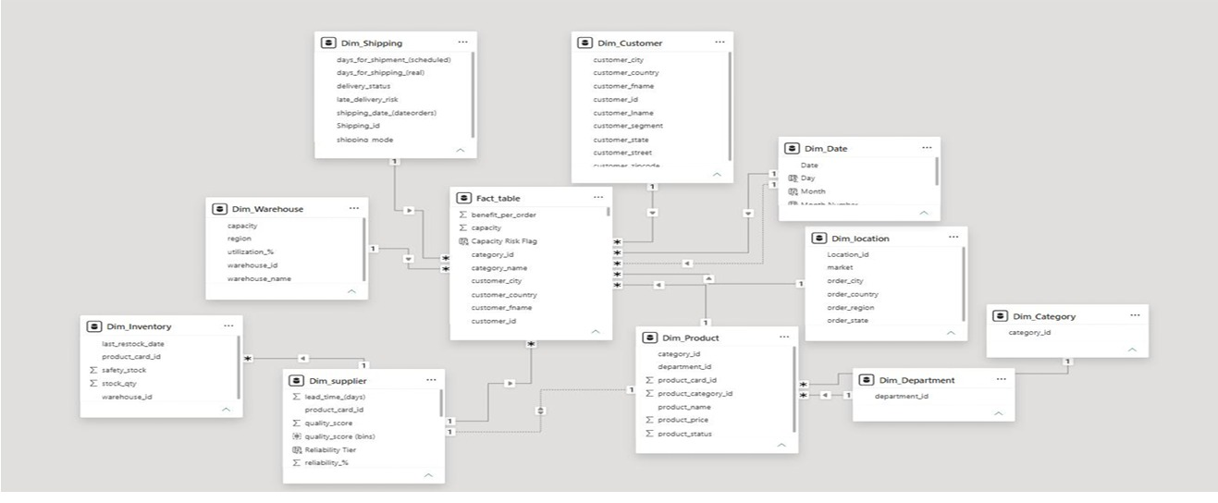
Data Model
DATA MODEL OVERVIEW
Designed a Star Schema to organize the dataset for efficient reporting and analysis.
Created one Fact Table containing transactional order data and multiple Dimension Tables for Customers, Products, Suppliers, Warehouses, Shipping, Date, and Locations.
Established one-to-many relationships between the Fact Table and Dimension Tables.
Star Schema Data Model — Power BI
INFOSYS SPRINGBOARD
Data Model
05

Slide 6


Dashboard Development & Key Features
ARCHITECTURE FLOW
KEY DASHBOARD FEATURES
Kaggle Dataset
Enabled drill-through reports for detailed transaction-level data exploration.
Created custom hierarchies for seamless drill-down and roll-up analysis.
Added interactive slicers for dynamic filtering across dashboards.
Implemented trend analysis and forecasting with confidence intervals.
Applied conditional formatting and KPI targets to highlight key performance indicators.
Added narrative visuals to generate data-driven business insights.
↓
PostgreSQL
↓
Power Query (Cleaning & Transformation)
↓
Star Schema Data Model
↓
DAX Measures & KPIs
↓
Interactive Dashboards
↓
Business Insights
INFOSYS SPRINGBOARD
Dashboard Architecture
06

Slide 7
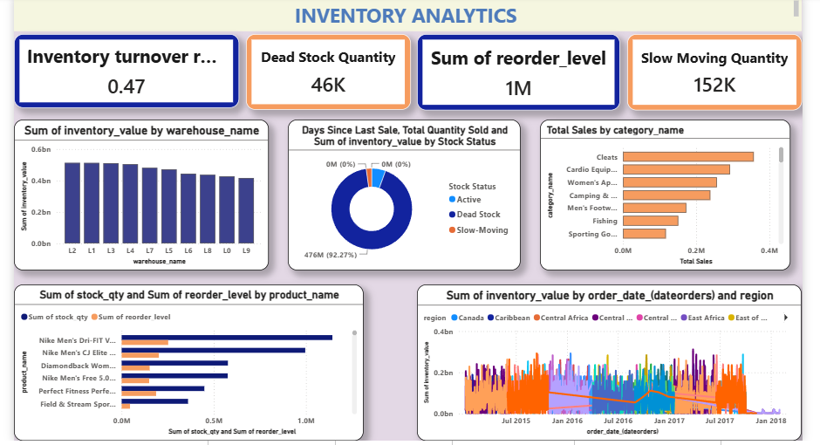
Inventory Analytics
38.56
6M
152K
10
Inventory Turnover Ratio
Dead Stock Quantity
Slow Moving Qty
Warehouses
KEY HIGHLIGHTS
Inventory Turnover Ratio: 38.56, indicating the efficiency of inventory movement.
The dashboard identified 6M Dead Stock Quantity and 152K Slow Moving Quantity, helping identify products requiring attention.
The total reorder level is 1M, supporting timely inventory replenishment.
Inventory value is analyzed across 10 warehouses to compare stock distribution and warehouse performance.
Products are classified into Active, Dead Stock, and Slow-Moving categories using Days Since Last Sale and Stock Quantity.
Inventory performance is analyzed by warehouse, product category, region, and time, enabling better inventory planning.
KEY DAX MEASURES
Inventory Turnover Ratio
Stock Status
Reorder Flag
Dead Stock Quantity
Slow Moving Quantity
INFOSYS SPRINGBOARD
Inventory Analytics
07

Slide 8

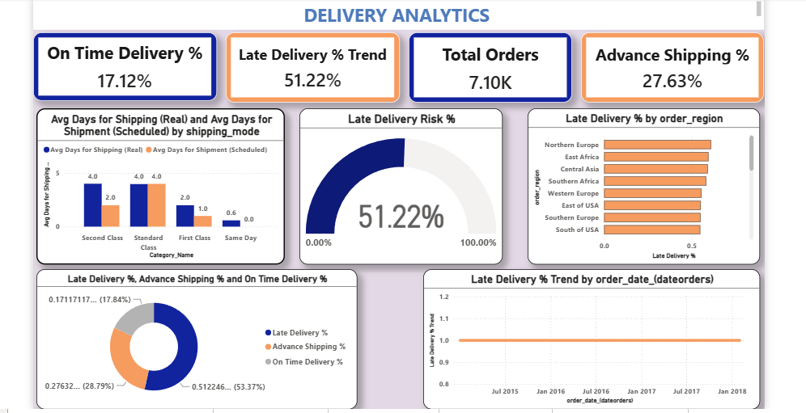
Delivery Performance
17.12%
51.22%
7.10K
27.63%
On-Time Delivery Rate
Late Delivery Rate
Orders Analyzed
Advance Shipping
KEY HIGHLIGHTS
The dashboard shows an On-Time Delivery Rate of 17.12% and a Late Delivery Rate of 51.22%.
A total of 7.10K orders were analyzed, with 27.63% Advance Shipping.
Late Delivery Risk is monitored using a gauge chart, helping identify the percentage of high-risk orders.
Shipping performance is compared across different shipping modes using actual and scheduled shipping days.
Regional analysis highlights the Late Delivery % across different order regions to identify areas with frequent delays.
Delivery trends over time help monitor overall shipping performance and support operational improvements.
KEY DAX MEASURES
On-Time Delivery %
Late Delivery %
Lead Time Variance
Late Delivery Risk %
Fulfillment Rate
INFOSYS SPRINGBOARD
Delivery Performance
08

Slide 9

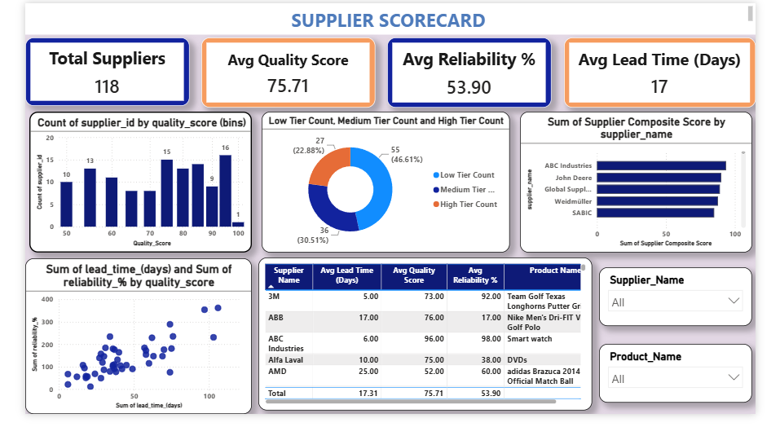
Supplier Performance
118
75.71
53.90%
17 days
Suppliers
Avg Quality Score
Avg Reliability
Avg Lead Time
KEY HIGHLIGHTS
The dashboard evaluates supplier performance using Quality Score, Reliability %, and Lead Time.
The dataset contains 118 suppliers with an Average Quality Score of 75.71 and an Average Reliability of 53.90%.
The Average Lead Time across all suppliers is 17 days, helping measure supplier responsiveness.
Suppliers are classified into Low, Medium, and High Reliability Tiers, making it easier to identify reliable suppliers.
A Supplier Composite Score is calculated to rank and benchmark suppliers based on overall performance.
The scatter plot analyzes the relationship between Lead Time, Reliability, and Quality Score, supporting supplier performance evaluation.
KEY DAX MEASURES
Supplier Composite Score
Supplier Rank
Reliability Tier
Avg Quality Score
Avg Reliability %
INFOSYS SPRINGBOARD
Supplier Performance
09

Slide 10

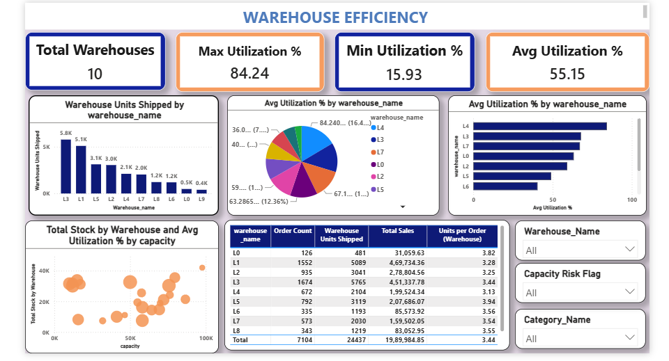
Warehouse Efficiency
84.24%
15.93%
55.15%
10
Max Utilization
Min Utilization
Avg Utilization
Warehouses
KEY HIGHLIGHTS
The dashboard provides an overview of warehouse performance by analyzing capacity utilization, stock movement, and operational efficiency across 10 warehouses.
The Maximum Warehouse Utilization is 84.24%, while the Minimum Utilization is 15.93%.
The Average Warehouse Utilization is 55.15%, providing an overall view of warehouse capacity usage.
Warehouse performance is compared using Units Shipped, Total Stock, Total Sales, and Utilization Percentage.
A scatter plot analyzes the relationship between Warehouse Capacity, Total Stock, and Utilization, helping identify capacity utilization patterns.
Interactive slicers allow warehouse performance to be filtered by Warehouse Name, Capacity Risk Flag, and Product Category.
KEY DAX MEASURES
Avg Warehouse Utilization %
Capacity Risk Flag
Warehouse Utilization %
Total Units Shipped
Avg Capacity
INFOSYS SPRINGBOARD
Warehouse Efficiency
10

Slide 11

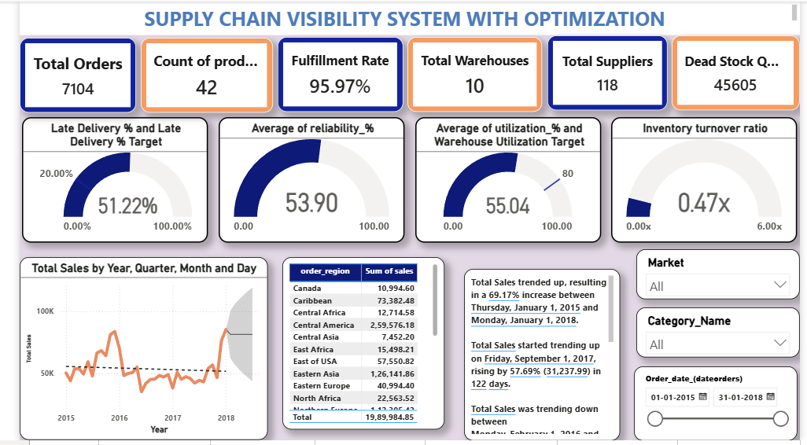
Glimpse of Dashboards
Supply Chain Overview
Supplier Performance
INFOSYS SPRINGBOARD
Glimpse of Dashboards
11

Slide 12

Key Insights
INSIGHT SUMMARY BY AREA
BUSINESS INSIGHTS
Inventory: Inventory Turnover Ratio of 38.56, with 6M units of dead stock and 152K units slow-moving — a large volume of stock sitting idle across our 10 warehouses, tying up capital and signaling an urgent need for reorder planning.
Delivery Performance: On-Time Delivery Rate of just 17.12% against a Late Delivery Rate of 51.22% across 7.10K orders — meaning more than half of all orders are arriving late, a critical bottleneck directly affecting customer satisfaction.
Supplier Performance: Across 118 suppliers, average Quality Score is 75.71 but Reliability is only 53.90%, with a 17-day average lead time — showing that while quality holds up, delivery commitments are missed nearly half the time.
Warehouse Efficiency: Utilization ranges from 15.93% to 84.24%, averaging 55.15% across 10 warehouses — a 68-point gap between the least and most utilized site, showing capacity is unevenly distributed.
Overall Impact: With 7,104 total orders, 87 suppliers, and a 95.97% fulfillment rate — strong fulfillment numbers mask real inefficiencies underneath, proving that "orders completed" isn't the same as "orders completed well."
Inventory
Identified dead stock and reorder requirements
Delivery
Late deliveries were higher than on-time deliveries
Supplier
Supplier benchmarking improved performance evaluation
Transportation
Compared shipping costs and shipping modes
Warehouse
Analyzed warehouse utilization and capacity
Overall
Interactive dashboards support better decision-making
INFOSYS SPRINGBOARD
Key Insights
12

Slide 13


Conclusion & Future Scope
CONCLUSION
FUTURE SCOPE
Developed an interactive Power BI solution to analyze different areas of the supply chain.
Built six dashboards covering Supply Chain Overview, Inventory, Delivery, Supplier, Transportation, and Warehouse analytics.
Used Power Query, DAX measures, and Star Schema to transform raw data into meaningful insights.
The dashboards provide clear visibility into inventory, supplier performance, delivery efficiency, transportation, and warehouse operations.
The project transforms supply chain data into meaningful insights, enabling faster and better business decisions.
Integrate real-time supply chain data for live monitoring.
Add forecasting models to predict inventory demand and future sales.
Include AI/ML-based analytics for demand forecasting and risk prediction.
Develop automated alerts for low stock, delayed deliveries, and warehouse capacity.
Publish dashboards on the Power BI Service for organization-wide access and collaboration.
→
→
→
→
Raw Data
Analysis
Interactive Dashboards
Business Insights
Better Decisions
INFOSYS SPRINGBOARD
Conclusion & Future Scope
13

Slide 14


Team Members & Roles
Anchal
Mehak Grover
Abbireddy Mohana Amitha
Sakshi Bhabad
P. Akshaya Reddy
Inventory Analytics Dashboard
Warehouse Efficiency Dashboard
Delivery Performance Dashboard
Transportation Analytics Dashboard
Supplier Performance Dashboard
INFOSYS SPRINGBOARD
Team Members & Roles
14

Slide 15


