Slide 1

SUPPLY CHAIN ANALYTICS • POWER BI
Supply Chain Visibility System With Optimization Analytics
Data Visualization Project

Slide 2


Problem Statement
Major Challenges
Proposed Solution
Modern supply chains generate large volumes of operational data, making it difficult to monitor overall performance using traditional reports. The major challenges include:
Develop an interactive Power BI dashboard that integrates supply chain data into a single platform, enabling users to:
Difficulty in tracking inventory levels across warehouses.
Limited visibility into delivery performance and late deliveries.
Challenges in evaluating supplier quality, reliability, and lead time.
Lack of insights into transportation costs and shipping efficiency.
Difficulty in monitoring warehouse utilization and capacity.
Scattered data, making decision-making slow and less effective.
Monitor key performance indicators (KPIs).
Analyze inventory, delivery, supplier, transportation, and warehouse performance.
Identify operational bottlenecks.
Support faster and data-driven business decisions.
Problem Statement
02

Slide 3






Objectives
The main objectives of this project are:
Develop an interactive Power BI dashboard for supply chain analysis.
Monitor Inventory, Delivery, Supplier, Transportation, and Warehouse performance.
Track important Key Performance Indicators (KPIs) using DAX measures.
Analyze inventory movement, stock levels, delivery efficiency, and supplier performance.
Identify operational issues such as late deliveries, slow-moving inventory, and warehouse utilization.
Enable interactive data analysis using filters and slicers.
Support data-driven decision-making through meaningful visualizations and insights.
Objectives
03

Slide 4
Dataset Overview
180,519
53
Kaggle
PostgreSQL → Power BI
Rows
Columns
Source
Data flow
Original Kaggle dataset
Original dataset fields
DataCo Global Supply Chain
Database to BI model
DATA DESCRIPTION
TABLES INCLUDED IN THE MODEL
The DataCo Global Supply Chain Dataset contains transactional and operational information covering customers, products, orders, inventory, shipping, suppliers, warehouses, sales, profit, delivery and regional data.
Fact Table Dim_Customer Dim_Product Dim_Category Dim_Department Dim_Shipping
Dim_Location Dim_Date Dim_Supplier Dim_Warehouse Dim_Inventory
TECHNOLOGY STACK
Power BI Desktop
Power Query
DAX
PostgreSQL
Github
Dataset
04

Slide 5

Data Preparation
CHANGING DATA TYPES
CHOOSING DIMENSION COLUMNS
DATA CLEANING
Removed unnecessary columns, duplicate records, and checked missing values before analysis.
Converted dates, numeric fields, and categorical columns to the correct data types for reliable calculations.
Selected only the necessary columns for Customer, Product, Shipping, Location, Date and other dimensions.
FACT & DIMENSION SEPARATION
RELATIONSHIP SETUP
DAX & KPI PREPARATION
Established one-to-many relationships between the Fact Table and Dimension Tables.
Created reusable measures and KPIs required for dashboard analysis.
Kept transactional order data in the Fact Table and descriptive attributes in Dimension Tables.
TRANSFORMATION FLOW
Raw Data
→
Power Query
→
Fact + Dimensions
→
Relationships
→
DAX & KPIs
Data Preparation
05

Slide 6
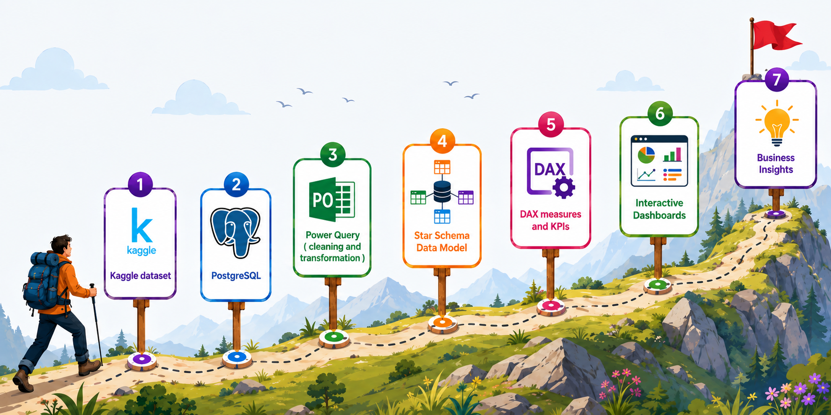
Architecture Flow
Architecture Flow
06

Slide 7

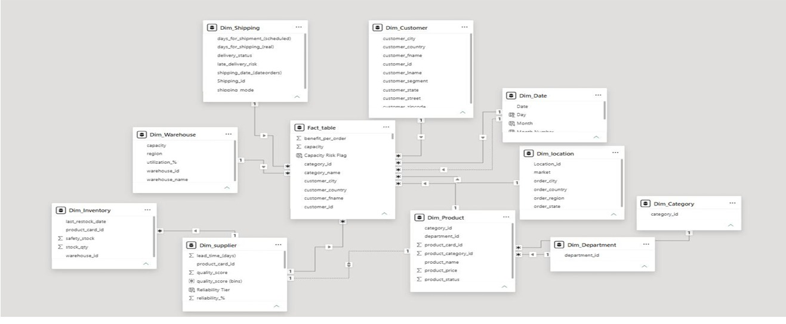
Data Model
DATA MODEL OVERVIEW
Designed a Star Schema to organize the dataset for efficient reporting and analysis.
Created one Fact Table containing transactional order data and multiple Dimension Tables for Customers, Products, Suppliers, Warehouses, Shipping, Date, and Locations.
Established one-to-many relationships between the Fact Table and Dimension Tables.
Star Schema Data Model — Power BI
Data Model
07

Slide 8
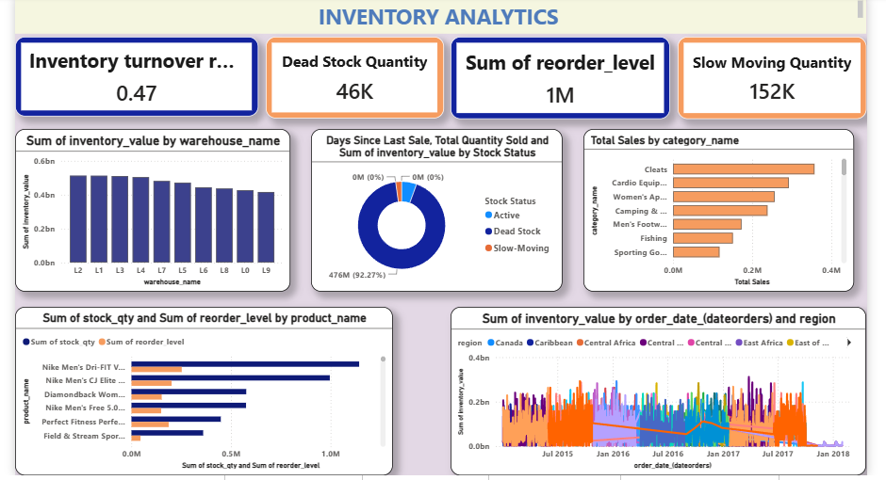
Inventory Analytics
0.47
46K
152K
10
Inventory Turnover Ratio
Dead Stock Quantity
Slow Moving Qty
Warehouses
KEY HIGHLIGHTS
Inventory Turnover Ratio: 0.47, indicating the efficiency of inventory movement.
The dashboard identified 46K Dead Stock Quantity and 152K Slow Moving Quantity, helping identify products requiring attention.
The total reorder level is 1M, supporting timely inventory replenishment.
Inventory value is analyzed across 10 warehouses to compare stock distribution and warehouse performance.
Products are classified into Active, Dead Stock, and Slow-Moving categories using Days Since Last Sale and Stock Quantity.
Inventory performance is analyzed by warehouse, product category, region, and time, enabling better inventory planning.
KEY DAX MEASURES
Inventory Turnover Ratio
Stock Status
Reorder Flag
Dead Stock Quantity
Slow Moving Quantity
Inventory Analytics
08

Slide 9

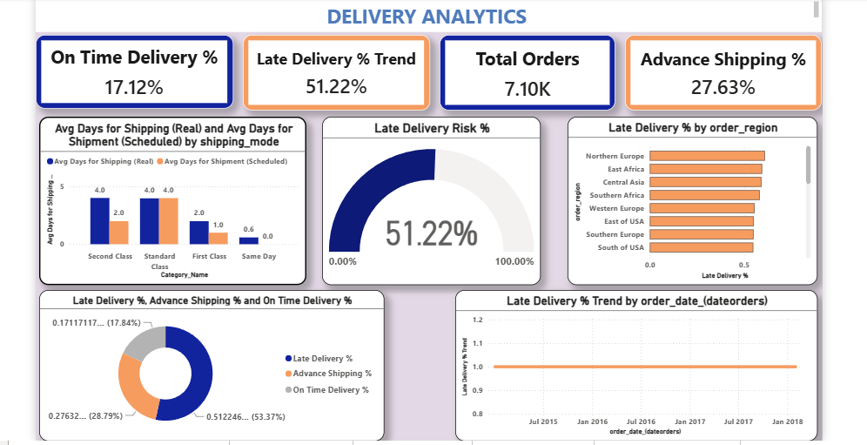
Delivery Performance
17.12%
51.22%
7104
27.63%
On-Time Delivery Rate
Late Delivery Rate
Orders Analyzed
Advance Shipping
KEY HIGHLIGHTS
The dashboard shows an On-Time Delivery Rate of 17.12% and a Late Delivery Rate of 51.22%.
A total of 7104 orders were analyzed, with 27.63% Advance Shipping.
Late Delivery Risk is monitored using a gauge chart, helping identify the percentage of high-risk orders.
Shipping performance is compared across different shipping modes using actual and scheduled shipping days.
Regional analysis highlights the Late Delivery % across different order regions to identify areas with frequent delays.
Delivery trends over time help monitor overall shipping performance and support operational improvements.
KEY DAX MEASURES
On-Time Delivery %
Late Delivery %
Lead Time Variance
Late Delivery Risk %
Fulfillment Rate
Delivery Performance
09

Slide 10

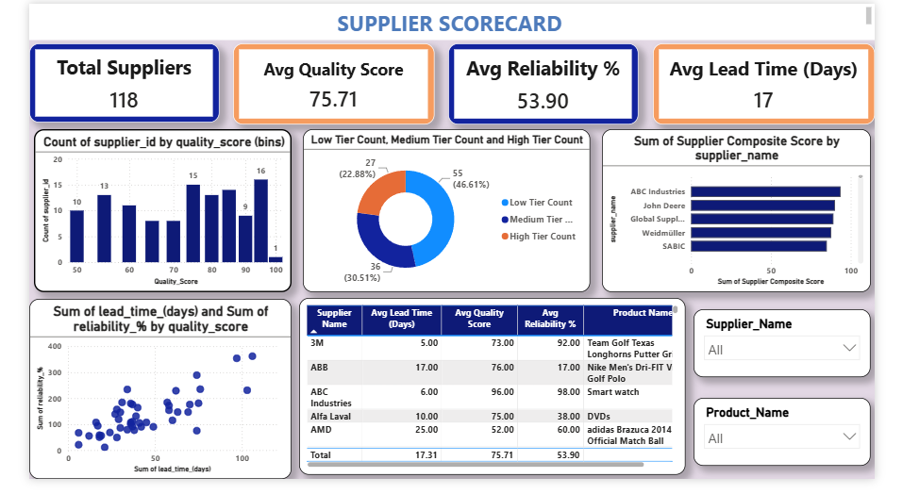
Supplier Performance
118
75.71
53.90%
17 days
Suppliers
Avg Quality Score
Avg Reliability
Avg Lead Time
KEY HIGHLIGHTS
The dashboard evaluates supplier performance using Quality Score, Reliability %, and Lead Time.
The dataset contains 118 suppliers with an Average Quality Score of 75.71 and an Average Reliability of 53.90%.
The Average Lead Time across all suppliers is 17 days, helping measure supplier responsiveness.
Suppliers are classified into Low, Medium, and High Reliability Tiers, making it easier to identify reliable suppliers.
A Supplier Composite Score is calculated to rank and benchmark suppliers based on overall performance.
The scatter plot analyzes the relationship between Lead Time, Reliability, and Quality Score, supporting supplier performance evaluation.
KEY DAX MEASURES
Supplier Composite Score
Supplier Rank
Reliability Tier
Avg Quality Score
Avg Reliability %
Supplier Performance
10

Slide 11

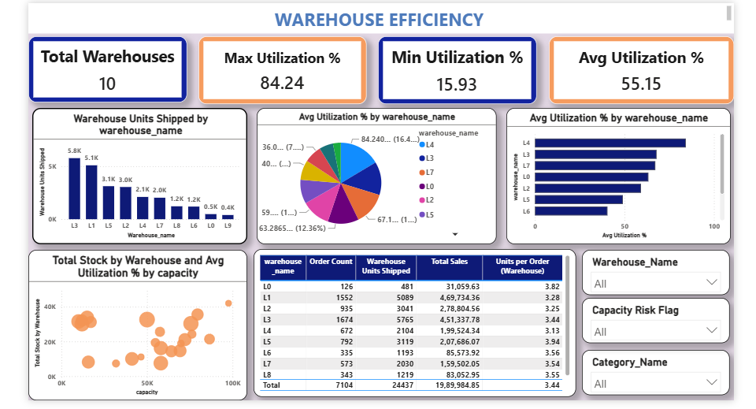
Warehouse Efficiency
84.24%
15.93%
55.15%
10
Max Utilization
Min Utilization
Avg Utilization
Warehouses
KEY HIGHLIGHTS
The dashboard provides an overview of warehouse performance by analyzing capacity utilization, stock movement, and operational efficiency across 10 warehouses.
The Maximum Warehouse Utilization is 84.24%, while the Minimum Utilization is 15.93%.
The Average Warehouse Utilization is 55.15%, providing an overall view of warehouse capacity usage.
Warehouse performance is compared using Units Shipped, Total Stock, Total Sales, and Utilization Percentage.
A scatter plot analyzes the relationship between Warehouse Capacity, Total Stock, and Utilization, helping identify capacity utilization patterns.
Interactive slicers allow warehouse performance to be filtered by Warehouse Name, Capacity Risk Flag, and Product Category.
KEY DAX MEASURES
Avg Warehouse Utilization %
Capacity Risk Flag
Warehouse Utilization %
Total Units Shipped
Avg Capacity
Warehouse Efficiency
11

Slide 12

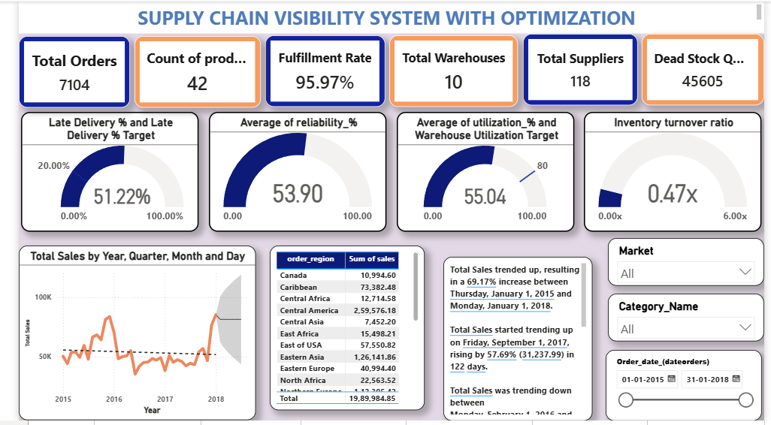
Dashboard Overview And Key Features
KEY FEATURES
Interactive Filters & Slicers
Filter by date, region, supplier and product category.
Drill-Down & Cross-Highlighting
Move from summary visuals to detailed analysis.
KPI Cards
Track sales, profit, delivery, inventory and other KPIs.
Trend Analysis
Monitor sales, orders and delivery trends over time.
Custom DAX Measures
Reusable measures for dead stock, lead time and utilization.
Multi-Dashboard Navigation
Six dashboards for overview, inventory, delivery, supplier, transportation and warehouse.
Supply Chain Overview
Key Features
Dashboard Overview And Key Features
12

Slide 13

Key Insights Discovered
17.12%
51.22%
118
On-Time Delivery
Late Delivery
Suppliers
Only 17.12% of orders were delivered on time, highlighting a logistics performance gap.
Late deliveries were significantly higher than on-time deliveries.
Supplier benchmarking across 118 suppliers supports performance evaluation.
15.93–84.24%
0.47x
95.97%
Warehouse Utilization
Inventory Turnover
Fulfillment Rate
Utilization varied widely, revealing uneven workload distribution.
Low turnover indicates inventory that needs better reorder and movement planning.
Strong fulfillment performance shows the value of consolidated dashboard monitoring.
Overall insight: the dashboards convert fragmented supply-chain data into clear, measurable insights for faster decisions.
Key Insights Discovered
13

Slide 14
Challenges Faced & Future Scope :
CHALLENGES FACED
FUTURE SCOPE
Data Quality — inconsistencies, missing values and duplicates required cleaning. Data Integration — combining the data into one Star Schema model was complex. DAX Complexity — KPI measures required repeated testing and validation. Relationship Modeling — correct relationships were essential for accurate results. Visualization Design — balancing detail with clarity required iteration.
Real-Time Data — integrate live supply-chain data for continuous monitoring. Forecasting — predict inventory demand and future sales. AI/ML Analytics — add demand forecasting and risk prediction models. Automated Alerts — notify users about low stock, delays and capacity risks. Power BI Service — publish dashboards for organization-wide access and collaboration.
Current Solution
→
Forecasting
→
AI / ML
→
Real-Time Alerts
→
Power BI Service
Challenges & Future Scope
14

Slide 15



Team Members & Roles
Anchal
Mehak Grover
Abbireddy Mohana Amitha
Sakshi Bhabad
P. Akshaya Reddy
Inventory Analytics Dashboard
Warehouse Efficiency Dashboard
Delivery Performance Dashboard
Transportation Analytics Dashboard
Supplier Performance Dashboard
Team Members & Roles
15

Slide 16


