Slide 1
How to Build A Computer?
By Abisek Saththiyasiritharan

Slide 2
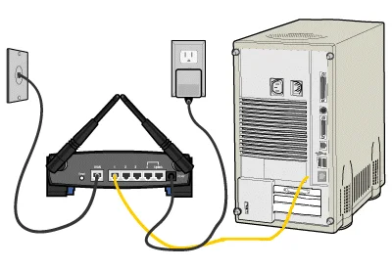
What is a Computer?
- General-purpose computers are devices that are capable of performing various tasks by executing instruction given to it in the form of programs and software. It is able to process data according to instructions. Computers come in various forms, from desktops and laptops to smartphones, tablet and even servers. A Computer also has hardware that can consist of RAM, Central processing unit, storage devise and even networking components.

Slide 3


Purpose of Computer?
The purpose of a computer is to process and manipulate data in order to perform various task’s efficiently and accurately. Computers are designed to execute instructions provided by users or pre-programmed software, which allows them to..
1.Process Information
2.store and retrieve data
3.communicate.
4.create/edit media
5.provide entertainment

Slide 4
Hardware
-Hardware forms the physical foundation of a computer system. There are many aspects to this such as the central processing unit commonly known as the CPU, the memory/RAM, storage receives like hard drives and SSDs, Input/Output devices like keyboards, mice, monitors, speakers, and much more, and also networking equipment. The hardware processing power is also important because if the computer has outdated parts, it will not perform at a high level but rather it will be slow, and cause a lot of buffering issues when trying to use the system.

Slide 5
Computer Hardware Basics
CPU. This component is the brain of the computer and it is responsible for executing instructions and performing a lot of complicated calculations.
RAM. The RAM temporarily stores data and instructions that the CPU needs to access quickly, allowing for faster processing levels.
The HDDS and the SSDs store data and programs permanently for faster access times.
Motherboard, this component is the main circuit board that connects and allows communication between all computer components, including the CPU, RAM, and inputs
Graphics card, which is also known as the Graphics Processing Unit(GPU). The GPU handles graphical computations, rendering images and video for display on the monitor
Power Supply Unit, in short, it is the PSU and it converts electrical power from an outlet into the computer components, providing consistent and reliable power.
Input Devices, this is simple because it’s your keyboard, and mouse,
output devices like monitors, printer displays
Cooling System, The cooling system includes fans and heatsinks that regulate the temperature of computer components to prevent overheating
Expansion card, these cards are network interface cards and sound cards that add functionality or connectivity to the computer system through expansion slots on the motherboard.

Slide 6
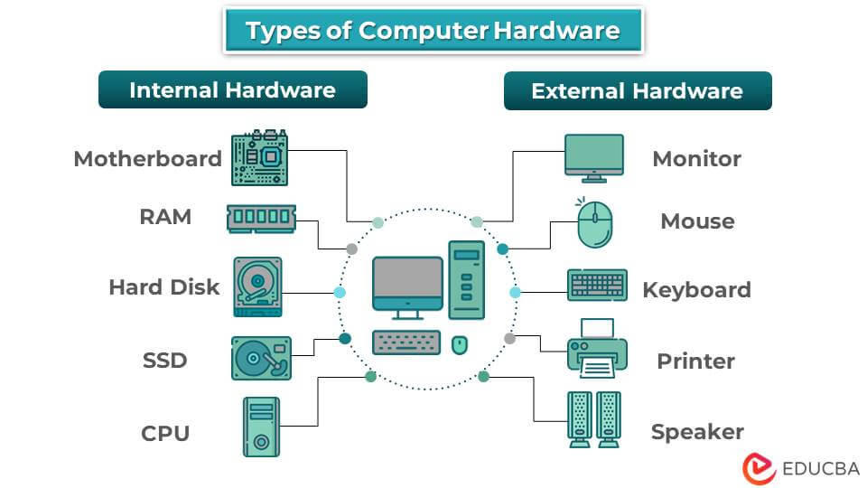
Computer Hardware Basics

Slide 7
Software
- The software is the brains of the hardware. Software makes up programs, applications, and operating systems that provide instructions to hardware components. Another, important thing software applications do is that it enable the user to do a lot of different tasks at once, such as web browsing, playing games, and even editing. In the end, software drives innovation and advancement by producing new features and capabilities, and due to these great advancements, lead to better performance, efficiency, and user experiences.

Slide 8
Examples:
Software:
1.Operating System: Windows 10/11, macOS, Linux
2.Microsoft Office
3.Web Browser: Google Chrome, Mozilla Firefox, Microsoft Edge
4.Creative Software: Adobe Creative cloud
5, Media Player: Spotify, iTunes(for Apples devices)
6.Communication: Gmail, Zoom, Discord

Slide 9
Why you should build a computer
-Building a computer offers customization, cost-effectiveness, and performance optimization advantages. By selecting specific components tailored to individual needs and budgets, builders can create systems that outperform pre-built alternatives at a comparable or lower cost. Additionally, the process provides valuable hands-on experience and insights into technology while fostering a sense of satisfaction and ownership. Custom-built computers also offer greater upgradeability and quality control, allowing users to extend their lifespan and adapt to changing requirements. Finally, the aesthetic appeal of custom-built systems can be personalized to reflect individual style preferences, making them not just functional tools but also expressions of creativity and identity.

Slide 10

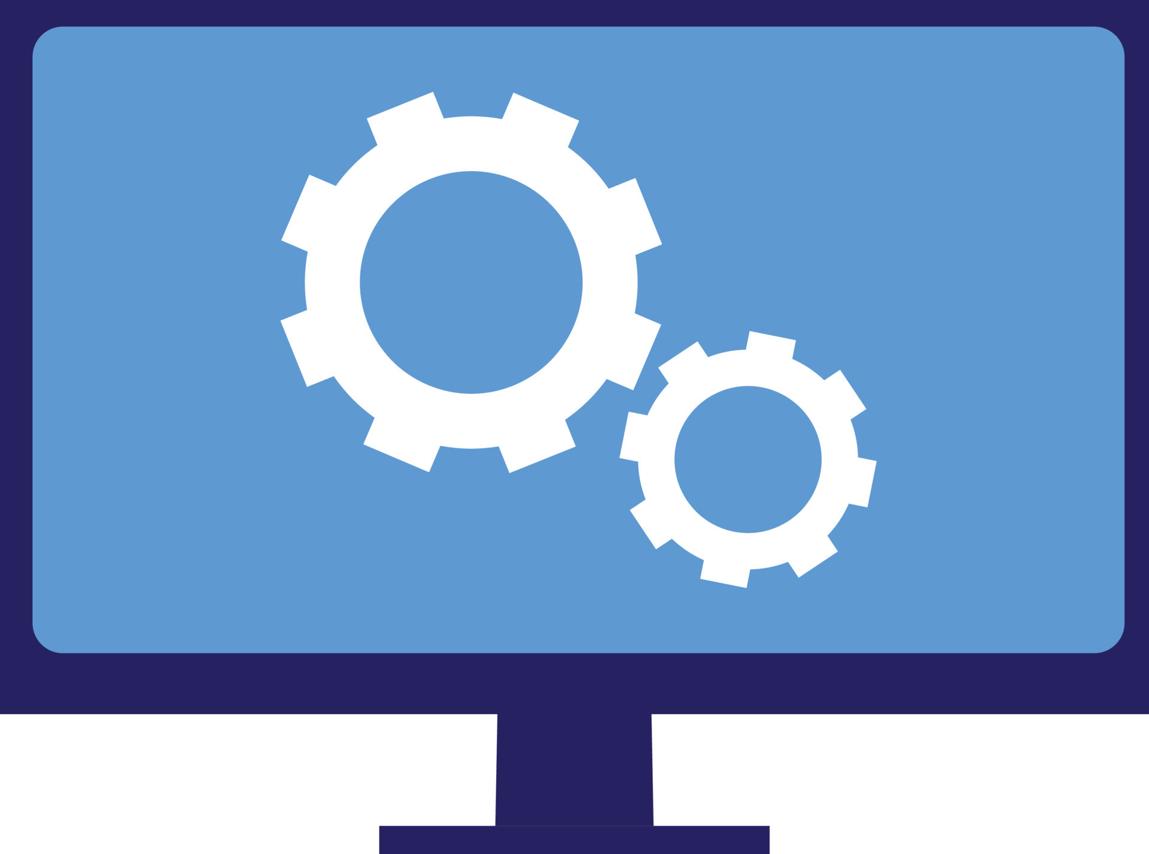
Why you should build a computer
1.Customization
2.Cost-Effectiveness
3.Performance Optimization
4.Learning Experience
5.Quality Control
6. Satisfaction of Ownership

Slide 11
Building a computer
-Building a computer involves several steps, and it is essential that you approach the process carefully in order to be successful.
Step-by Step:
1. To start off building your computer make sure you have all the necessary components for the build, which include the CPU, Motherboard, Storage drives like HDD/SDD, Graphics card, Power Supply Unit, Desktop Case, Cooling Systems, and Peripherals as well.
2. make sure you inspect all your hardware to ensure nothing is damaged.
3. install the CPU, CPU cooler, and RAM onto the motherboard according to the manufacturer's instructions.
4. place the motherboard on the motherboard tray within the case, aligning the mounting holes with standoffs
5. install the Power Supply Unity (PSU) into its designated spot in the case and make sure you connect the necessary power cables to the motherboard, storage drives, and other components, if you are unsure what wires you have you can always look them up and see where each one goes but it should be straightforward.
6. Mount HDDS or your SSDs onto drive bays (Slots in the computer case)
7. Install the GPU into its correct PCIe slot gently on the motherboard and secure it with screws and then connect the PCIe power cables from the PSU to the graphics cards.
8. Now connect the front panel cables from the case to the corresponding headers on the motherboard, this part has your audio jacks and USB Ports so it should be easy to find. From this point, you can plug in your additional expansion cards such as Wi-Fi and sound cards into PCIe slots.

Slide 12
Continuation:
9. You should also make sure to organize all the wires so it doesn't look messy, which also makes it hard for you to upgrade any hardware in the future
10 Now you should install the cooling system such as the case fans and CPU cooler according to the manufacturer's instructions,
11. . After all that make sure to double-check that everything is in its proper place and secure well and then you should power the computer on by connecting the power cable to the PSU and plugging it into the power outlet
12. make sure all your input and outputs are connected so you can see if everything works
13. go ahead and set up the Operating system and then install your drivers and updates

Slide 13
Reference
1. https://www.wired.com/story/how-to-build-a-pc/
2. https://edu.gcfglobal.org/en/computerbasics/what-is-a-computer/1/
3.https://www.lenovo.com/us/en/glossary/general-purpose-computer/?orgRef=https%253A%252F%252Fwww.google.com%252F
4.https://www.tomshardware.com/news/building-your-own-pc-smart-move
5.https://openlab.citytech.cuny.edu/com-basics/hardware-guide/
6.https://dayaxmo.medium.com/why-hardware-and-software-are-important-in-computer-system-85cd69e3f58a#:~:text=Hardware%20is%20important%20because%20it,the%20performance%20of%20a%20computer.

