Slide 1
Swag: A Large-Scale Adversarial Dataset for Grounded Commonsense Inference
Rowan Zellers♠ Yonatan Bisk♠ Roy Schwartz♠♥ Yejin Choi♠♥
♠Paul G. Allen School of Computer Science & Engineering, University of Washington ♥Allen Institute for Artificial Intelligence
Presenter: Fan Luo

Slide 2
Introduction
Grounded Commonsense Inference
- natural language inference (NLI)
- commonsense reasoning
For example:
On stage, a woman takes a seat at the piano. She ...
nervously sets her fingers on the keys.
Notes:
When we read a story, we bring to it a large body of implicit knowledge about the physical world.
on stage, a woman takes a seat at the piano
we can easily infer what the situation might look like: a woman is giving a piano performance, with a crowd watching her. We can furthermore infer her likely next action: she will most likely set her fingers on the piano keys and start playing.

Slide 3
NLI
Prior work : linguistic entailment
whether two sentences describe the same set of possible worlds
This work: anticipate future from the described situation,
even when it is not strictly entailed.
Our task is to predict which event is most likely to occur next in a video, , given the caption of previous scene.
Notes:
even when it is not strictly entailed: such inference necessitates a rich understanding about everyday physical situations

Slide 4
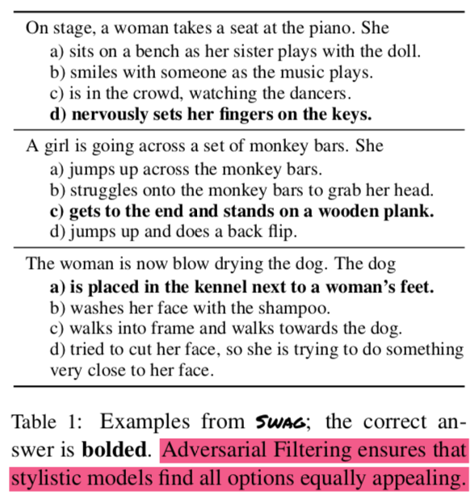


Slide 5
Grounded Commonsense Inference Task
Given an example triple (s, n, vi)
a complete sentence s: On stage, a woman takes a seat at the piano.
a noun phrase n that begins a second sentence: She
a list of possible verb phrase sentence endings V ={v1,...,v4}
a) sits on a bench as her sister plays with the doll.
b) smiles with someone as the music plays.
c) is in the crowd, watching the dancers.
d) nervously sets her fingers on the keys.
model select the most appropriate verb phrase v ∈ V
nervously sets her fingers on the keys.

Slide 6
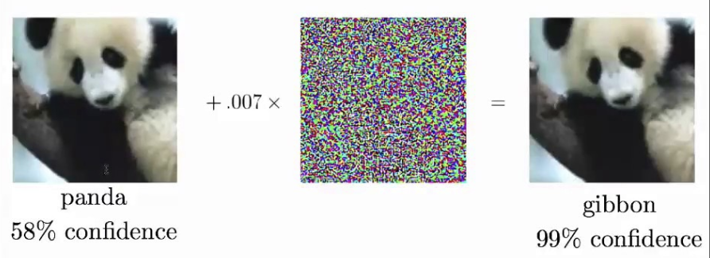
Dataset
Existing dataset:
- annotation artifacts and human biases, give clues for gold label
- models over-estimating the actual performance
- models are vulnerable to adversarial or out-of-domain examples
SWAG (Situations With Adversarial Generations ):
Adversarial Filtering (AF): construct a de-biased dataset
- iteratively training an ensemble of stylistic classifiers
- using these classifiers to filter the data
- ensure that stylistic models find all options equally appealing
Notes:
annotation artifacts and human biases： unintended stylistic patterns that give out clues for the gold labels

Slide 7
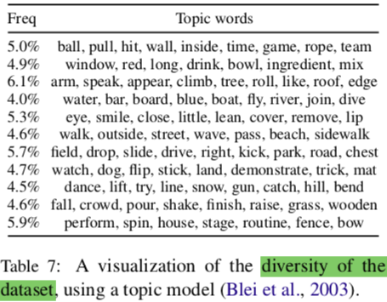
Dataset
Swag, an adversarial dataset
113k multiple choice questions
73k training, 20k validation, 20k test
a rich spectrum of grounded situations

Slide 8
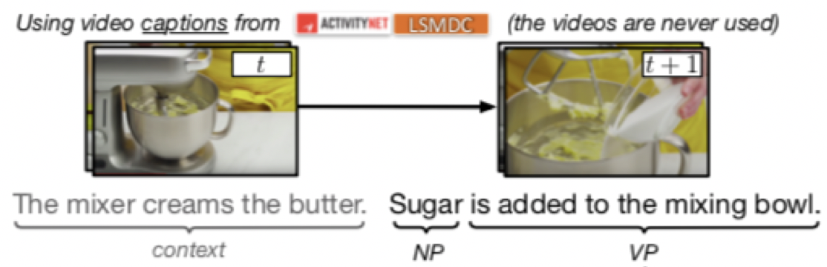
Data collection
Step1: Dataset contains pairs of temporally adjacent video captions
(follow-up event that is physically possible)
Step2: Use a constituency parser to split the second sentence into noun and verb phrases (ending)
LSMDC: Large Scale Movie Description Challenge
Notes:
The two datasets are slightly different in nature and allow us to achieve broader coverage:
- ActivityNet contains 20k YouTube clips containing one of 203 activity types (e.g.: doing gymnastics or playing guitar);
- LSMDC consists of 128k movie captions

Slide 9
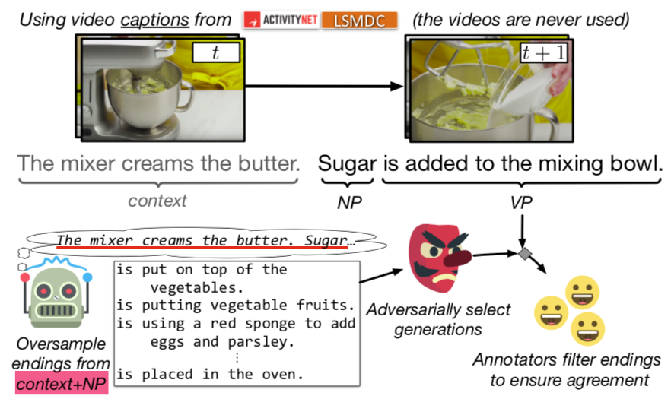
Data collection
Step3: Use language model to oversample counterfactuals
Step4: Filter candidates with a committee of trained models (AF)
Step5: Validate by crowd workers
Notes:
For a pair of sequential video captions, the second caption is split into noun and verb phrases.
A language model generates many negative endings, of which a difficult subset are human-annotated.

Slide 10
Generating candidate endings (step3)
LSTM language model (LM)
sample N- = 1023 unique endings (oversample)
Generated endings
tend to use topical words, but often make little sense physically, making them perfect for our task.
marked as “gibberish” by humans only 9.1% of the time, in that case the ending is filtered out.
Notes:
we greedily sample the endings, since beam search decoding biases the generated endings to be of lower perplexity (and thus easily distinguishable from found endings).

Slide 11
Annotation artifacts (why step4)
Stylistic patterns
such as: length and word-preference biases
Shallow models obtain artificially high performance
e.g.: bag-of-words

Slide 12
A solution to annotation artifacts : AF (step4)
Adversarial Filtering (AF)
Iteratively refine of a set of negative assignments to increase the entropy under a chosen model family.
Adversarial dataset
A dataset is adversarial with respect to f, if we expect high empirical error I over all leave-one-out train/test splits.
Intuition: stylistic model should not generalize on test.

Slide 13
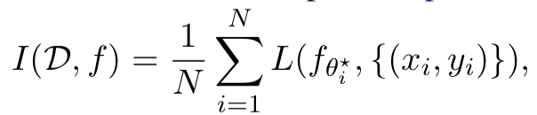

Adversarial filtering
Train an ensemble of four stylistic models:
1. A multilayer perceptron (MLP) given LM perplexity features and context/ending lengths.
2. A bag-of-words model that averages the word embeddings of the second sentence as features.
3. A one-layer CNN, with filter sizes ranging from 2-5, over the second sentence.
4. A bidirectional LSTM over the 100 most common words in the second sentence;
uncommon words are replaced by their POS tags.
Concatenate their final representations and passing it through an MLP
Maximize empirical error I over all leave-one-out train/test splits
Notes:
a model family to pick up on low-level stylistic:
low-level stylistic features: should not be predictive of whether an event happens
lower perplexity：easily distinguishable from found endings
We extract perplexities for the context by itself (going forward), the ending given the context (going forward), the context given the ending (going backward), and the ending by itself (go- ing backward).
aim to ensure it cannot generalize to the held-out set.
reduce the generalization ability of the model family f over arbitrary train/test splits.

Slide 14
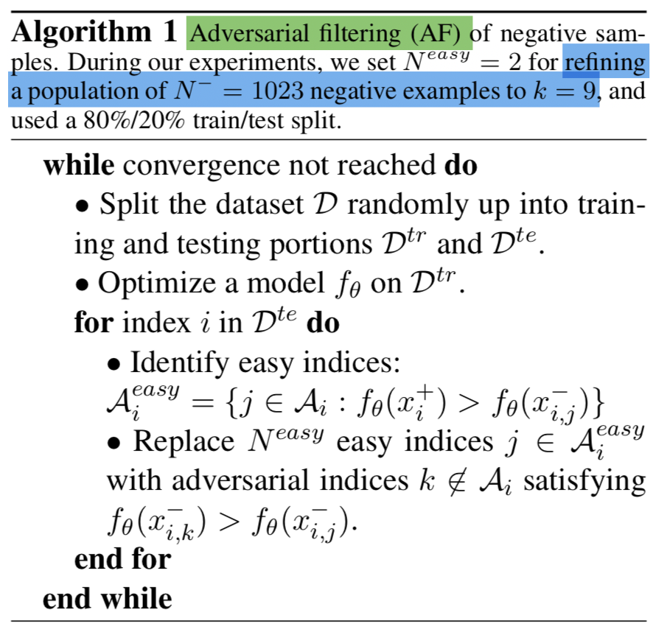
Generating an adversarial dataset
Notes:
On each iteration, we split the data into ‘train’ and ‘test’ splits.
We train a model f on the training portion and obtain parameters θ, then use the remaining test portion to reassign the indices of A.
For each entry in test, we replace N^{easy} negatives in A that the model classifies correctly with ‘adversarial’ negatives outside of A that the model misclassifies.

Slide 15
Adversarial dataset
input space X
label space Y
dataset of size N: D = {(x_{i} , y_{i})}_{1≤i≤N}
- a single positive ending (x_{i}⁺ , 1) ∈ X × Y
- a large population of negative ending (x_{i,j}⁻ ,0)∈X ×Y (1≤j≤N ⁻)
For each instance, AF return a k-subset assignment A_{i} = [1 . . . N⁻]^{k}
N⁻ = 1023
k = 9
Notes:
we aim to ensure a model cannot generalize to the held-out set.
We repeat this for several iterations to reduce the generalization ability of the model family f over arbitrary train/test splits.

Slide 16
Human verification (step5)
Workers on Amazon Mechanical Turk
Given the caption context, and 6 candidate endings:
1 found ending
5 adversarially-sampled endings
The task was twofold:
rank the endings: likely, unlikely, or gibberish
select the best and second best endings

Slide 17
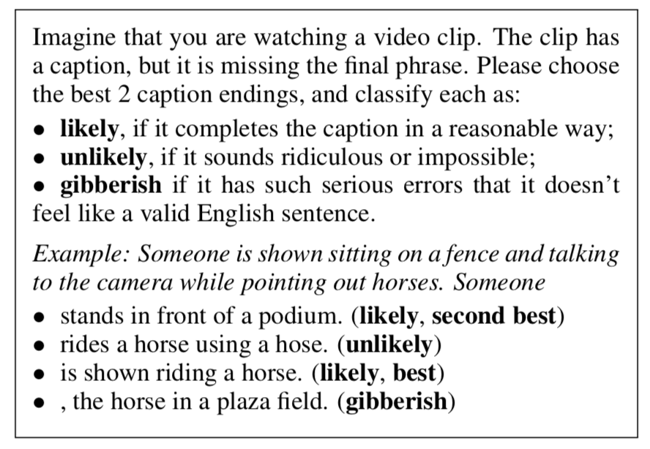
Human verification (step5)
Mechanical Turk instructions (abridged)

Slide 18
Human verification (step5)
If the found ending is ranked as either best or second best (73.7% of the time)
then: the found ending -> gold
not labelled best or gibberish -> negatives
If a generated ending is ranked as best, and the found ending as second best
then: add an additional training example
- the generated best ending -> gold
- remaining generations -> negatives

Slide 19
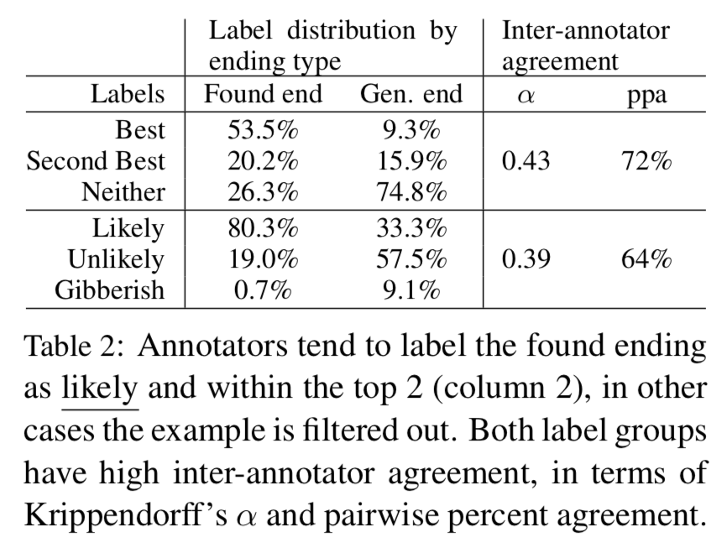
Human verification (step5)
Notes:
Annotators tend to label the found ending as likely and within the top 2
Both label groups have high inter-annotator agreement,
in terms of Krippendorff’s α and pairwise percent agreement.

Slide 20
Experiments
Evaluate various NLI models on Swag
Given an example triple (s, n, v_{i})
a context c = (s, n):
a complete sentence s
a noun phrase n that begins a second sentence
a list of possible verb phrase sentence endings V ={v₁,...,v₄}
model must then select the verb phrase v ∈ V, that hopefully matches ’gold’
Notes:
To study the amount of bias in our dataset,
we also consider models that take as input just the ending verb phrase vi, or the entire second sentence (n, vi ).

Slide 21
Unary models
Predict labels from a single span of text:
ending OR second sentence OR full passage
fastText :
bag of n-grams
Pretrained RNN sentence encoders
SkipThoughts; InferSent
LSTM sentence encoder
a two-layer BiLSTM

Slide 22
Binary models
Predict labels from two spans of text:
1. noun phrase n
2. ending v_{i}
_{or}
1. complete sentence s
2. n + v_{i}

Slide 23
Binary models
Dual Bag-of-Words
Dual pretrained sentence encoders
SkipThoughts or InferSent
+
MLP or Bilinear
SNLI inference (pretrained)
Decomposable Attention or ESIM
+
log-linear
SNLI models (retrained)
retrain Decomposable Attention or ESIM on SWAG
SNLI: Stanford Natural Language Inference corpora

Slide 24
Other models
Length
always choose the shortest ending
to verify that human validation didn’t reintroduce a length bias
ConceptNet
spaCy dependency parser to extract the head verb and its dependent object
the ending score is given by the number of ConceptNet causal relations
between synonyms of the verb and synonyms of the object
Human performance
five Mechanical Turk workers were asked to answer 100 dataset questions
predictions were combined using a majority vote

Slide 25
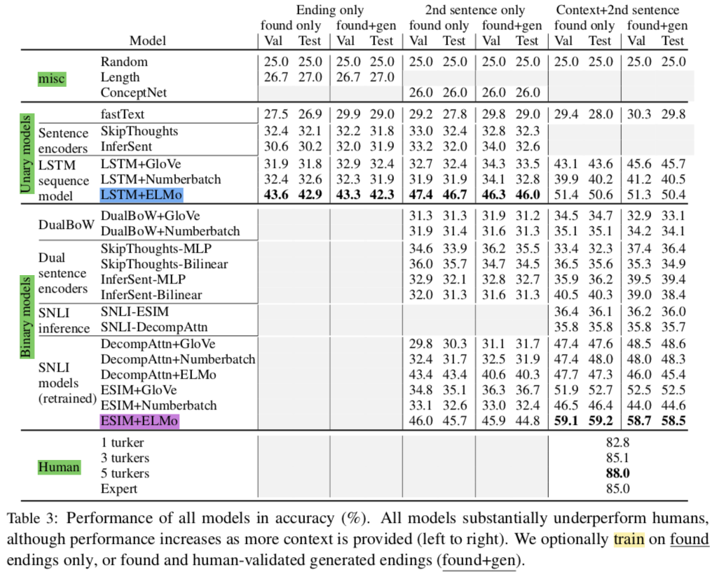
+ n
+ (s, n)
Notes:
SNLI inference is pretrained, so no 2nd sentence only

Slide 26
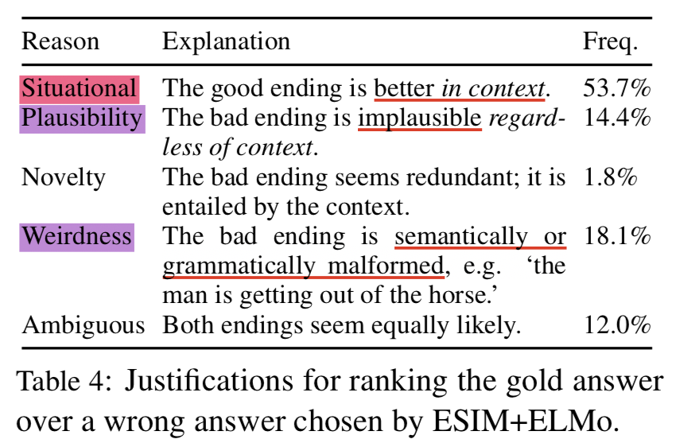
Error analysis
100 validation questions, ESIM+ELMo answered incorrectly
gold ending VS. model’s preferred ending
5 Amazon Mechanical Turk workers select and explain
Notes:
94% of the time select gold
situational (52.3% of the time): the main bottleneck being grounded physical understand- ing.
weirdness (17.5%) and plausibility (14.4%). This suggests that ESIM+ELMo already does a good job at filtering out weird and implausible answers

Slide 27
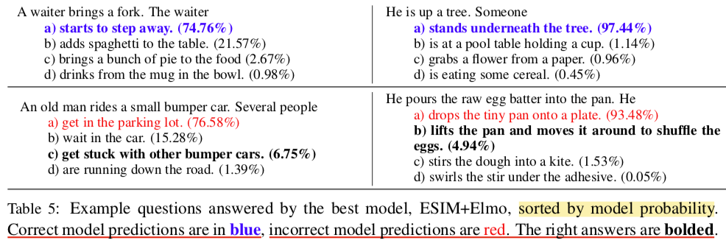
Qualitative examples
Qualitative examples
Notes:
several qualitative examples
identify complex alignment patterns between the two sentences
(e.g. being “up a tree” implies that “tree” is the end phrase)
insufficient: requires knowledge about bumper cars and how they differ from regular cars
this knowledge is difficult to ex- tract from existing corpora. ConceptNet entry for Bumper Car has only a single relation: bumper cars are a type of vehicle
require intuitive physical reasoning: what happens next in making an omelet.

Slide 28
Discussion
Swag is a challenging testbed for NLI models.
The large gap between machine and human performance suggests that more is required to solve the dataset.
The adversarial models used to filter the dataset are purely stylistic and focus on the second sentence.
Thus, subtle artifacts still likely remain in our dataset.
AF can be used again to create a more adversarial version of Swag using better language models and AF models.

Slide 29
Conclusion
Propose a new challenge of physically situated commonsense inference.
Create a large-scale dataset Swag with 113k multiple-choice questions.
Swag is constructed using Adversarial Filtering (AF)
- reduce annotation artifacts that can be easily detected
- allow potential applications to other QA datasets
Notes:
Adversarial Filtering allows datasets to be constructed at scale while automatically reducing annotation artifacts that can be easily detected by a committee of strong baseline models.

Slide 30
Recap

Slide 31
Adversarial filtering
Train an ensemble of four stylistic models:
1. A multilayer perceptron (MLP) given LM perplexity features and context/ending lengths.
2. A bag-of-words model that averages the word embeddings of the second sentence as features.
3. A one-layer CNN, with filter sizes ranging from 2-5, over the second sentence.
4. A bidirectional LSTM over the 100 most common words in the second sentence;
uncommon words are replaced by their POS tags.
Concatenate their final representations and passing it through an MLP
Maximize empirical error I over all leave-one-out train/test splits
Notes:
a model family to pick up on low-level stylistic:
low-level stylistic features: should not be predictive of whether an event happens
lower perplexity：easily distinguishable from found endings
We extract perplexities for the context by itself (going forward), the ending given the context (going forward), the context given the ending (going backward), and the ending by itself (go- ing backward).
aim to ensure it cannot generalize to the held-out set.
reduce the generalization ability of the model family f over arbitrary train/test splits.

Slide 32
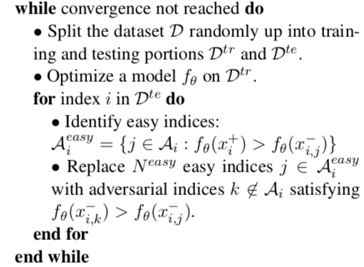
Generating an adversarial dataset
Notes:
On each iteration, we split the data into ‘train’ and ‘test’ splits.
We train a model f on the training portion and obtain parameters θ, then use the remaining test portion to reassign the indices of A.
For each entry in test, we replace N^{easy} negatives in A that the model classifies correctly with ‘adversarial’ negatives outside of A that the model misclassifies.

Slide 33
Thank you !

