Slide 1
Sharp Nearby, Fuzzy Far Away: How Neural Language Models Use Context
Urvashi Khandelwal, He He, Peng Qi, Dan Jurafsky

Slide 2
Question: How does LSTM language model uses context?
Methods
Data
(not manipulated)
LSTM language model
train
(Three-layered LSTM with no attention/cache)
Data
(manipulated, with special context)
LSTM language model
See how LSTM behaves
test

Slide 3
LSTM uses context with size of about 200 tokens
How much context does LSTM use?
This length is independent of hyper parameters
Infrequent words use more contexts
This length is dependent on the type of target word
Content words use more contexts
Word order
The order of nearby word matters
Word order and word type in context
Word type
Content word is more important
Without cache
LSTM can regenerate nearby words
Cache/attention
With cache
Cache can help LSTM to copy long-range words

Slide 4
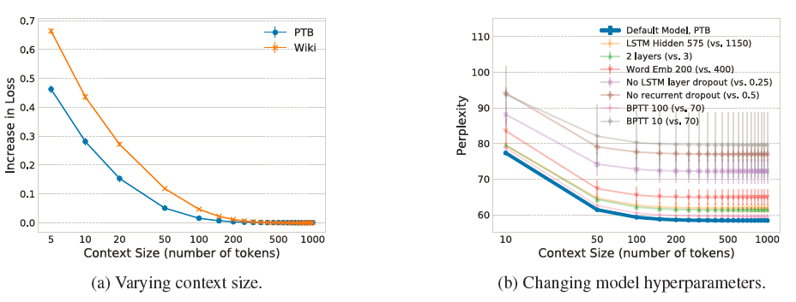
How much context does LSTM use?
The effective size of LSTM language model is about 150 to 250 (depending on the dataset). The effective size is independent of the hyper-parameters of the model.
1000
Target word

Slide 5
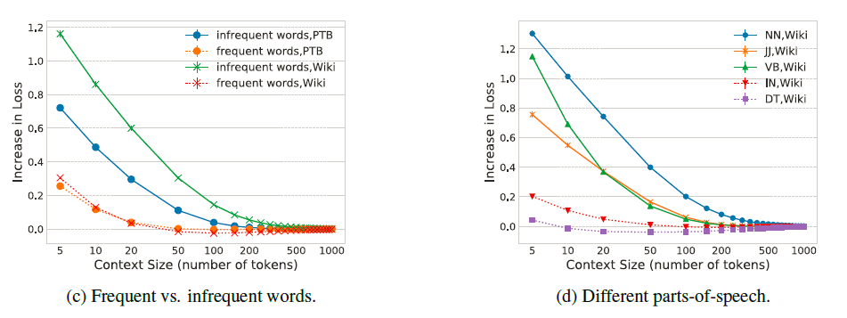
How much context does LSTM use: the type of the target word
1000
Target word
Infrequent words: occurrence is less than 800 in the training set.
Infrequent words uses more context.
Content words (noun, adjective, verb) uses more context than function words (preposition, determiner).

Slide 6
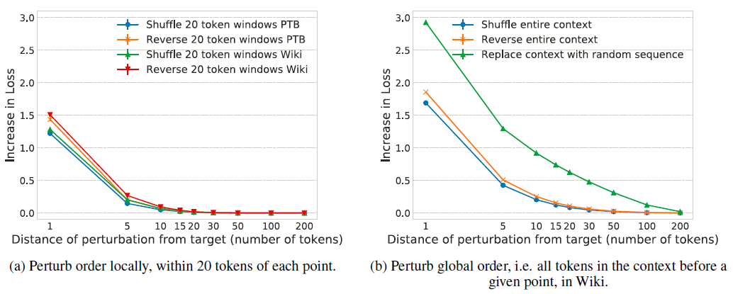
Nearby context vs long range context
300
Target word
The order of tokens in the nearby 20-token context is extremely important.
300
Target word
The order of tokens in the far context is not important. But the show up of tokens is important.
Target word
Target word
Target word
Target word

Slide 7
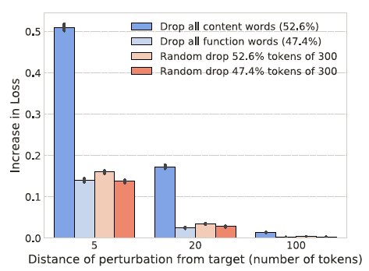
Nearby context vs long range context
300
Target word
Target word
Target word
Target word
Content words are more important than function words in language model.

Slide 8
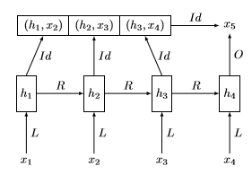


LSTM and Cache
Before we proceed, what is attention model and what is cache model?
Neural language model
Neural language model with attention
Neural language model with cache
The idea of cache is very similar to attention mechanism, but the formula are different.
1
2
*Image from: IMPROVING NEURAL LANGUAGE MODELS WITH A CONTINUOUS CACHE
By Edouard Grave, Armand Joulin, Nicolas Usunier

Slide 9
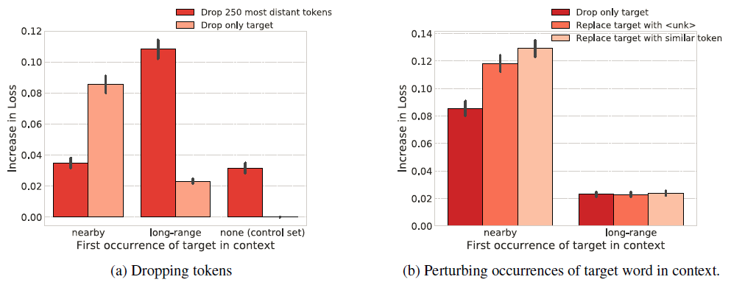
LSTM and Cache
First occurrence of target
Nearby
300
50
Target word
First occurrence
Long-range
300
50
First occurrence
None
300
50
Dropping option
LSTM language model generate words by copying from nearby context. Whereas for long-range context, it only forms a rough semantic representation
The result is not because of the change of grammaticality.
300
50
Drop only target
Target word
Drop most distant 250

Slide 10
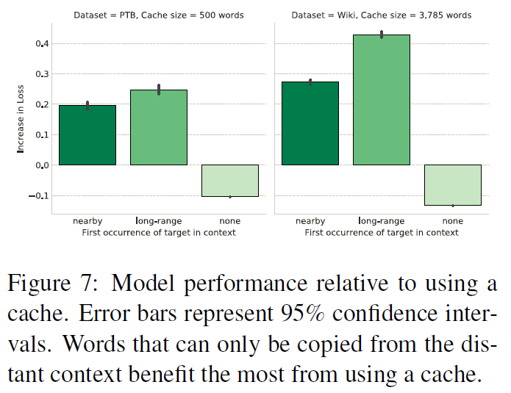
LSTM and Cache
First occurrence of target
Nearby
300
50
Target word
First occurrence
Long-range
300
50
First occurrence
If target word does not show up in the context, then cache harms the performance (in other words, no cache reduces perplexity).
None
300
50

Slide 11

A ruler of LSTM LM
Context before 20: order of tokens are important (shuffling causes huge loss). (Section 5.1)
Context before 50: LSTM without cache may copy word from such context to generate target. (Section and 6.1)
Context from 20 to 200: order of tokens is not important, but the show up of relevant words is important. (Section 5.1)
Context before ~200: effective size of LSTM language model without cache. (Section 4)
Context from 50 to 300: only a rough semantic context is maintained. (Section 6.1)
Context between 200~3750: cache can help LSTM language model to retrieve information from the history. (Section 6.2)

