Slide 1
Text-GCN
CIL Sentiment Classification Project 2022

Slide 2
Text GCN
Text GCN, by Yao et al. in 2018*, is a Graph Convolutional Network for Text Classification
Only well known GCN based Text Classifier (as far as I know)
Good results at the time, but underwhelming for sentiment classification
*https://arxiv.org/abs/1809.05679

Slide 3
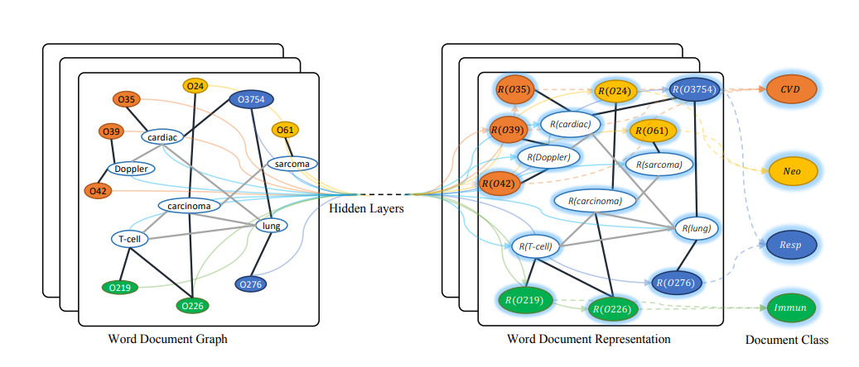
Text GCN
Graph consists of nodes for documents (tweets) and words in the vocabulary with weighted edges between each other
With GCN layers, learn embeddings of documents and words based on their neighborhood in the graph

Slide 4
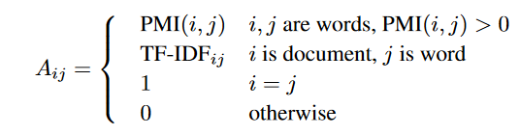

Text GCN
Output of the network: $Z = softmax\left(A ReLU\left(AXW_{0}\right)W_{1}\right)$
$X$: Feature Matrix, $W_{0},W_{1}$: Weights Learned with Gradient Descent, $A$: Adjacency Matrix
A determines the edges between nodes in the graph and is the main driver of the model
Elements in A:

Slide 5
Why Text GCN?
Code is entirely available on Github! Easy to extend and modify!
Text GCN is not too commonly used, potential for novelty.
Decent performance for small twitter dataset: 80-81% Accuracy on 90/10 train test split
Many weaknesses that give potential for improvement:
No pre trained word embeddings used, could potentially yield many percentage points of improvement, only word co-occurrence used for now
Adjust word-to-doc edges and doc-to-doc edges
Change architecture of the model
Further optimization when training the model

Slide 6
Next Steps
Reading Paper + Understanding Code Base ✓
Preliminary Tests with small twitter dataset and some preprocessing ✓
Adjusting the Adjacency Matrix: Edges between nodes
Further changes in model architecture
If decent performance achieved on small dataset, train on larger dataset and submit results
Effective pre-processing for Text GCN

